Slide 1
It’s Never Too Late to Change

Slide 2
TIMELIST GROUP,INC
501(c) (3) Non-profit Organization
- Highlights
Jail/Prison Rehabilitation Program - Curriculum
Supporting Integration of Released Inmates into the community – Housing
Prevention and Intervention for Juveniles/Youth
Workforce Program – Gardening Service

Slide 3
Mission
Serving families and communities impacted by incarceration by providing pre and post release educational programs, reentry housing, mentoring and intervention services.

Slide 4
Timelist Background
Originally Created and Founded in 2007 by Andre L. Wiley, former lifer prisoner
Developed Reformative Programs within the Prison System to Help Violent Criminals and Gang Members become ready to Re-enter Society
- More than 600 Inmates benefited from these programs
- Reformed More than 48 life-timers and enabled their release
- Developed Timelist Intervention and Rehabilitation courses
- Proven Curriculum that reformed hardened prisoners
Founder’s Proven Record and Success of the Programs gives them the experience for Youth Intervention and Inmate Integration Programs

Slide 5
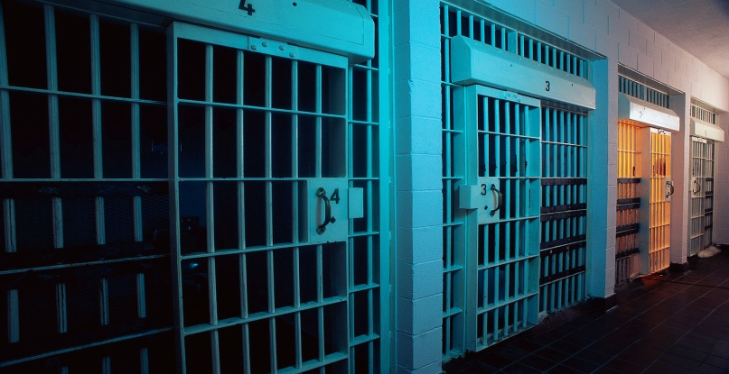
Received 501(c)(3) Status in 2013
INCARCERATION
INTERVENTION &
MENTORING
PROGRAMS
S.T.O.P.
- R.D.I.P
G.R.P
- S.G.R
REHABILITATION &
MENTORING
PROGRAMS
S.E.R.I.O.U.S
S.A.F.E
- S.P.M.D
- Pahtway4home
RELEASED INMATES
AT-RISK YOUTH

Slide 6
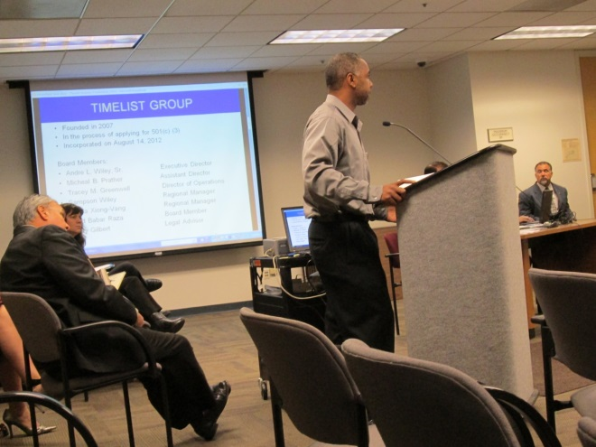
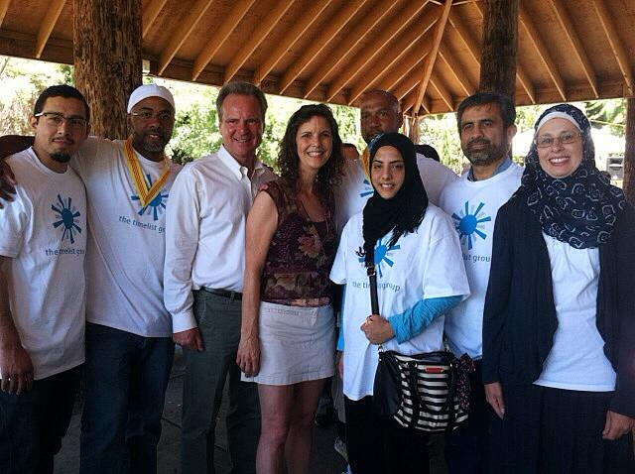
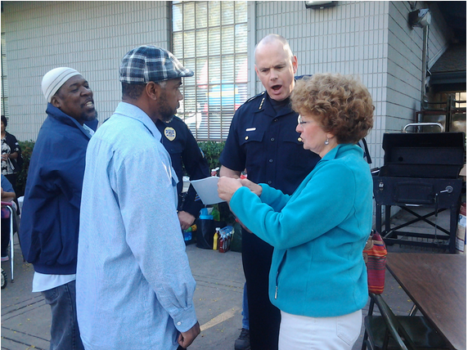
2013-16 Accomplishments
OUR ENGAGEMENT
Timelist Presentation
Parole Board of the State of California
Timelist with San Jose BOS Dave Cortese and his wife
Timelist Team with
Union City Mayor and Police Chief
OTHER ENGAGEMENTS
Patricia Abedesco (Union City Programs Manager), Darl Michael (UC Outreach Worker) and Pastor Jerome Brown has helped us to acquire the space to start our program
Have received clients through Eduard Quinones, June Antonio (Alameda County Probation Officers) for juveniles that are on probation and Michelle Keller for Adult clients

Slide 7
2016-2017 Accomplishments
Partnerships and Collaborations:
Roots Community Health Center, Oakland
Onlone College One-Stop Program, Newark
New Haven Adult School Union City
Root & Rebound, Oakland
Ten Toes In, LA
Pathway4home reentry housing facility, LA
Member of Blue Ribbon Commission, City of LA
South Bay One Stop – Inglewood CA

Slide 8
Curriculum
At: CDCR Institutions: Avenal, VSP, CMC-West, DVI, CCC and others
S.T.O.P. (Straight Talk On Point)
G.R.P. (Gang Rehabilitation and Prevention)
S.G.R. (Nine Steps to Street Gang Recovery)
Anger Management & Conflict Resolution
Substance Abuse Intervention & Prevention
R.D.I.P. (Resume Development and Interview Preparation)
S.A.F.E. (Staying Out of Prison, Addressing Addiction, Family in Crisis, Earning a Legitimate Livelihood)
G.R.P. (Gang Rehabilitation and Prevention)
Cisco Networking Academy (Housing Program ONLY)
S.P.M.D. (Street and Prison Mindset Detoxification)
Re-entry: Resources for Parolees and Ex-Offenders
Pathway4home, Plenitude: (Housing Program ONLY)

Slide 9
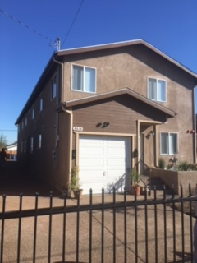
Location Los Angeles, SF Bay Area
Pathway4home - Housing Facility, LA
Plenitude Independence - Residential Treatment Facility, LA

Slide 10
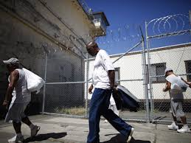
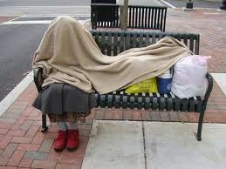
Investing in People
Too often individuals are returning to the community without the proper support and resources and end up back in jail, prison or even homeless

Slide 11
Direct Services
Sober Living Housing Environment
Drug & Alcohol Counseling
Relapse Prevention Planning
Pre-releasing Self-Help programming
Life Skills Training
Job Prep Orientation
Job Placement Workforce– Landscaping Services
Peer Mentoring
Financial Management
One on One Counseling

Slide 12
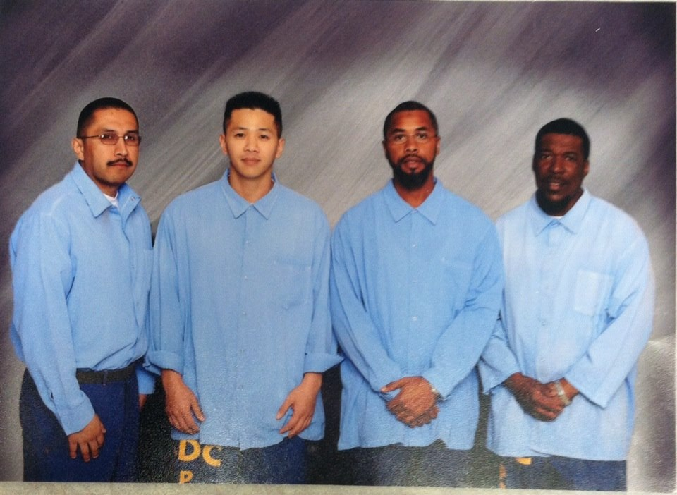
Founders
L/R: Ruben Sanchez, Hai Nguyen, Yusef-Andre Wiley and Micheal Taahir Prather
Warden Approved Photo from 2009
Where are they today?

Slide 13
Change is Real

Slide 14
Our 2018 Goals
Additional Office and Program space in Los Angeles, Antelope Valley and the SF Bay Area
Additional properties for housing in Los Angeles and Lancaster
Increase staffing to perform street outreach work and jail/prison in-reach
Youth Mentoring, Leadership and Advocacy services
Timelist Group, Inc
3894 Crenshaw Blvd., Ste #8824
Los Angeles, CA 90008 | Tel: 323.389.8664
info@timelistgroup.org| www.timelistgroup.org

