Slide 1
YBA Guest
Idan Shpizear

Slide 2
INTRODUCTION
My name is Idan Shpizear and I am 36 years old.
Married for 8 years and I have 3 kids
Im The founder of 3 companies
911 Restoration – water, fire and mold damage restoration with 56 location
Milestone SEO – Marketing Company
Gazingle.com – Sales people toolbox

Slide 3
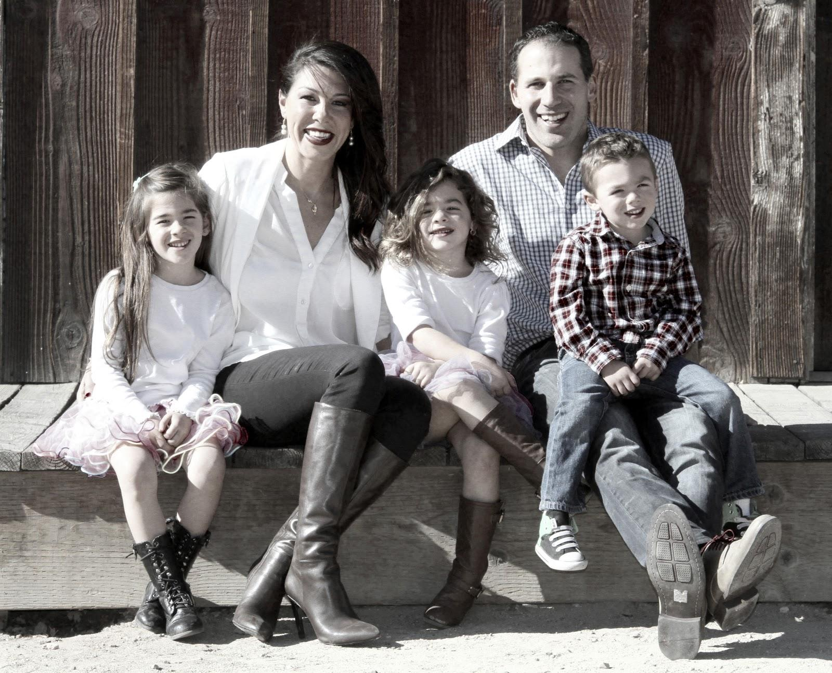
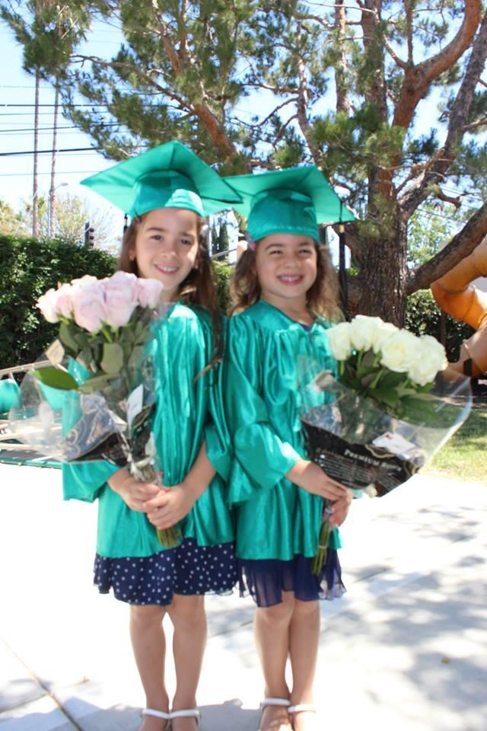
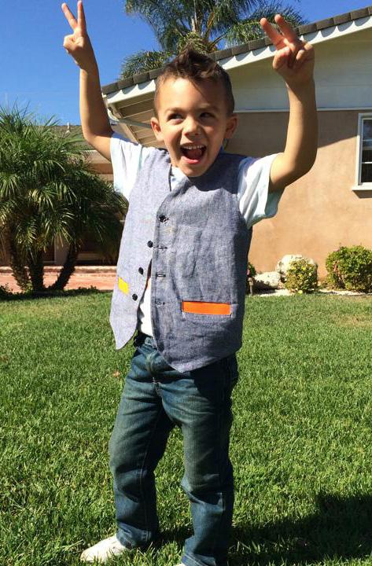
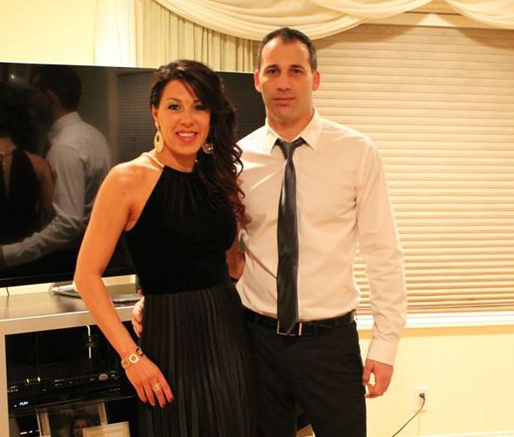
My Family

Slide 4
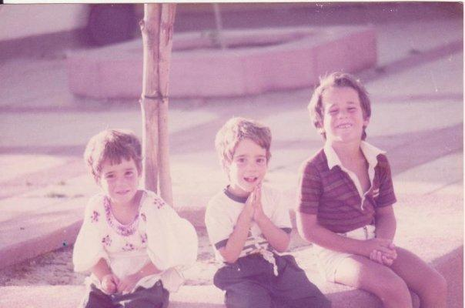
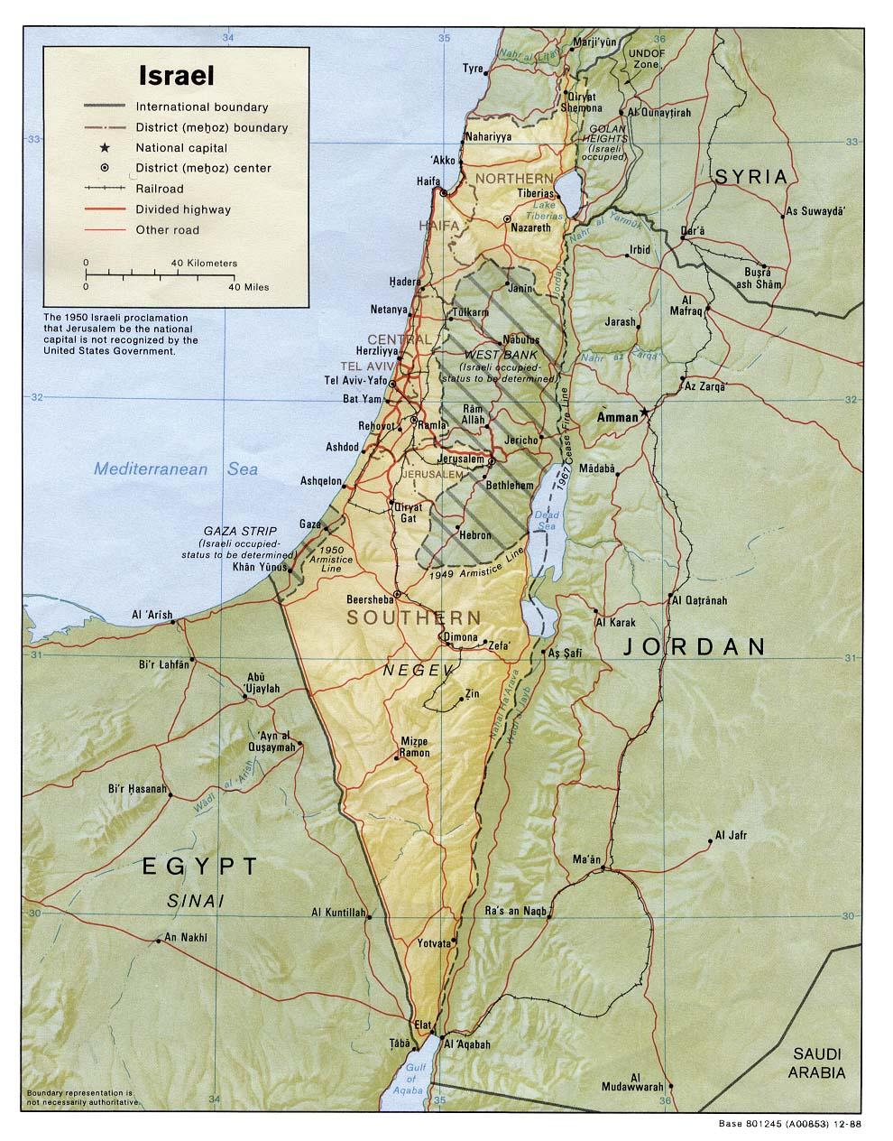
The Early Years…
I was born in Israel and raised in Mushav Dekel

Slide 5
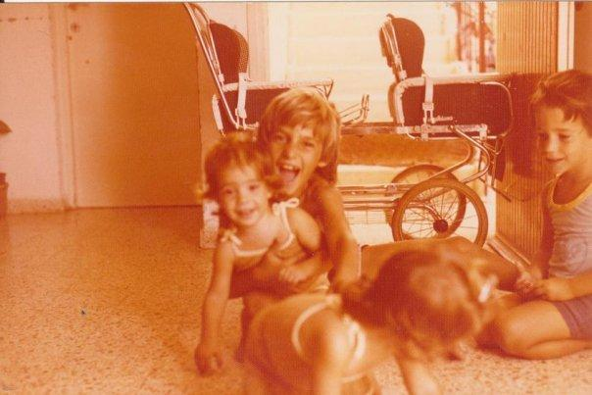
More Early Years…
A little about
my family…

Slide 6
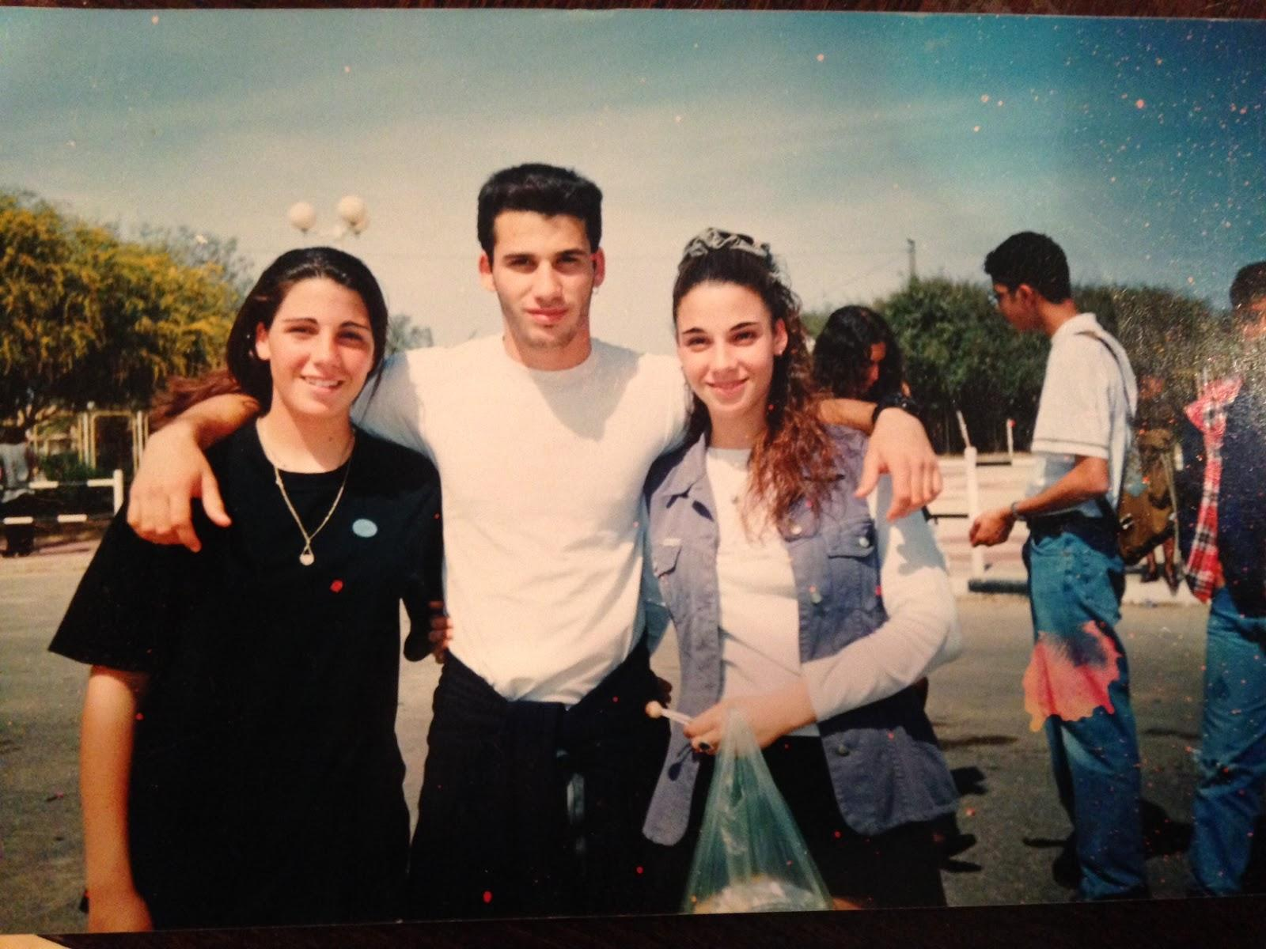
HIGH SCHOOL
I attended Abshor
School in the South
part of Israel

Slide 7
HIGH SCHOOL
As a student I was involved in all types of sports, swimming, running & basketball.
I was - shy and very challenged academically…. School wasn’t a good experience for me.

Slide 8
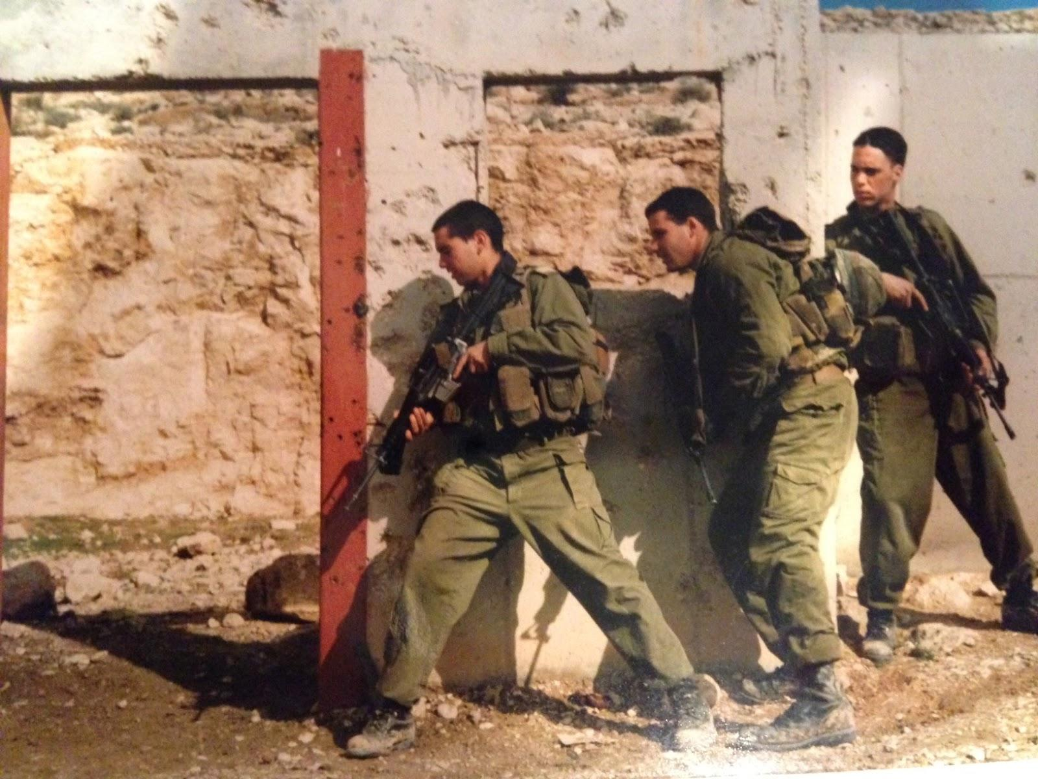
I joined the Israeli Army

Slide 9
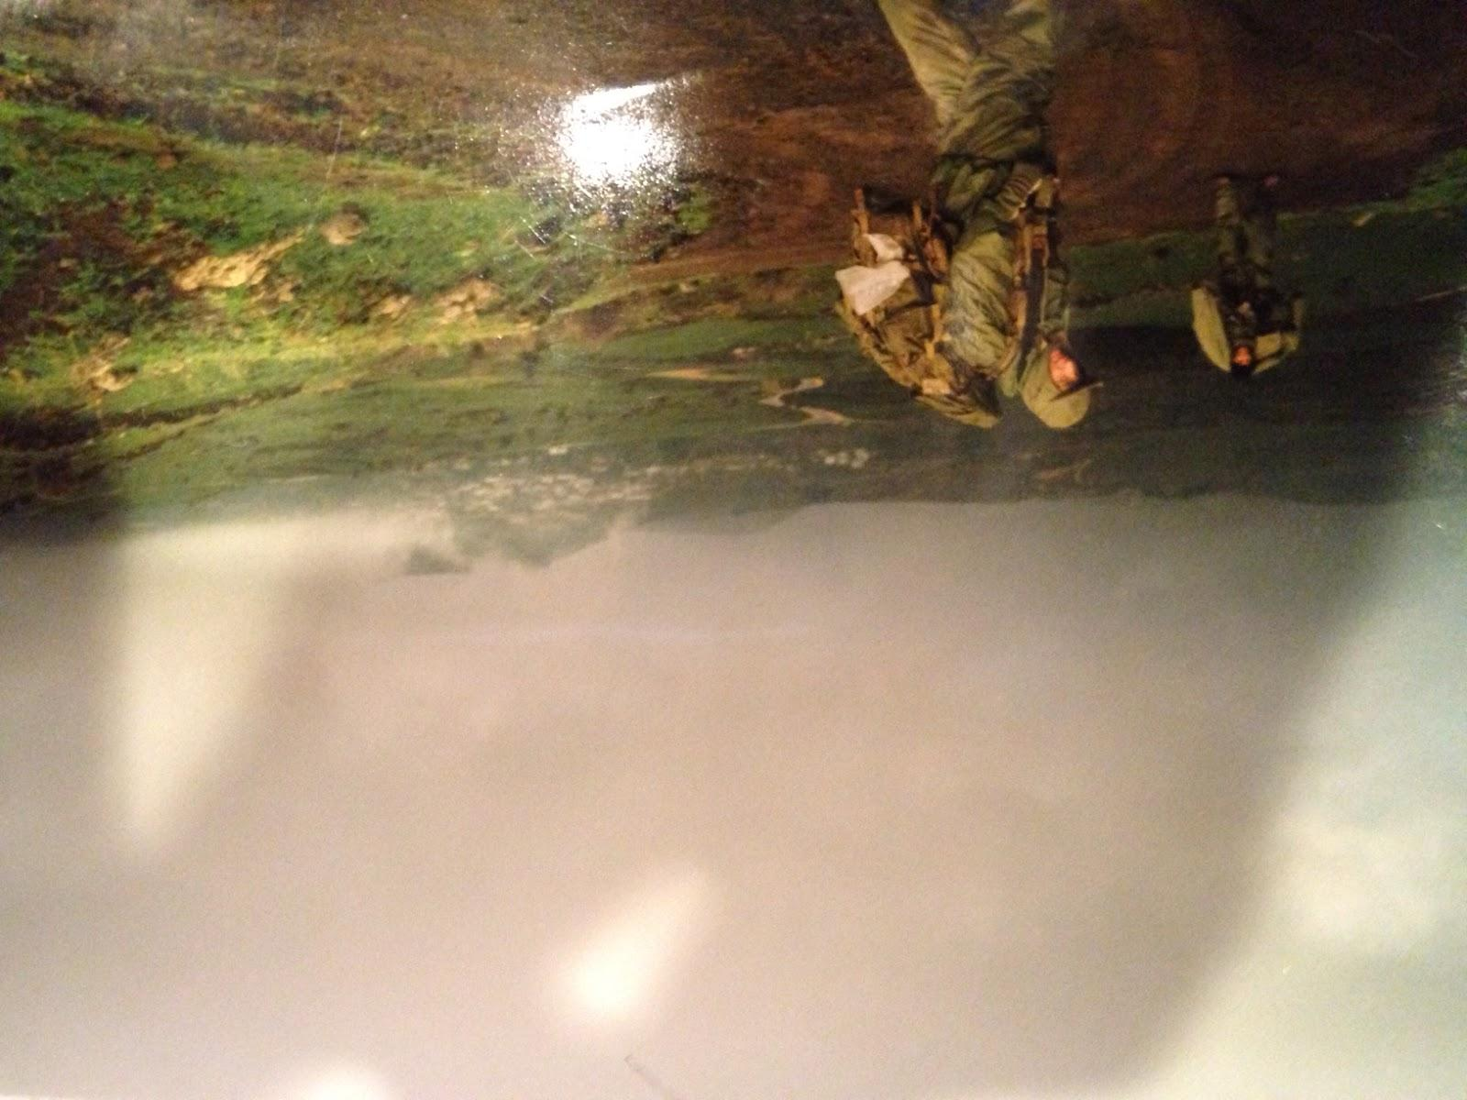
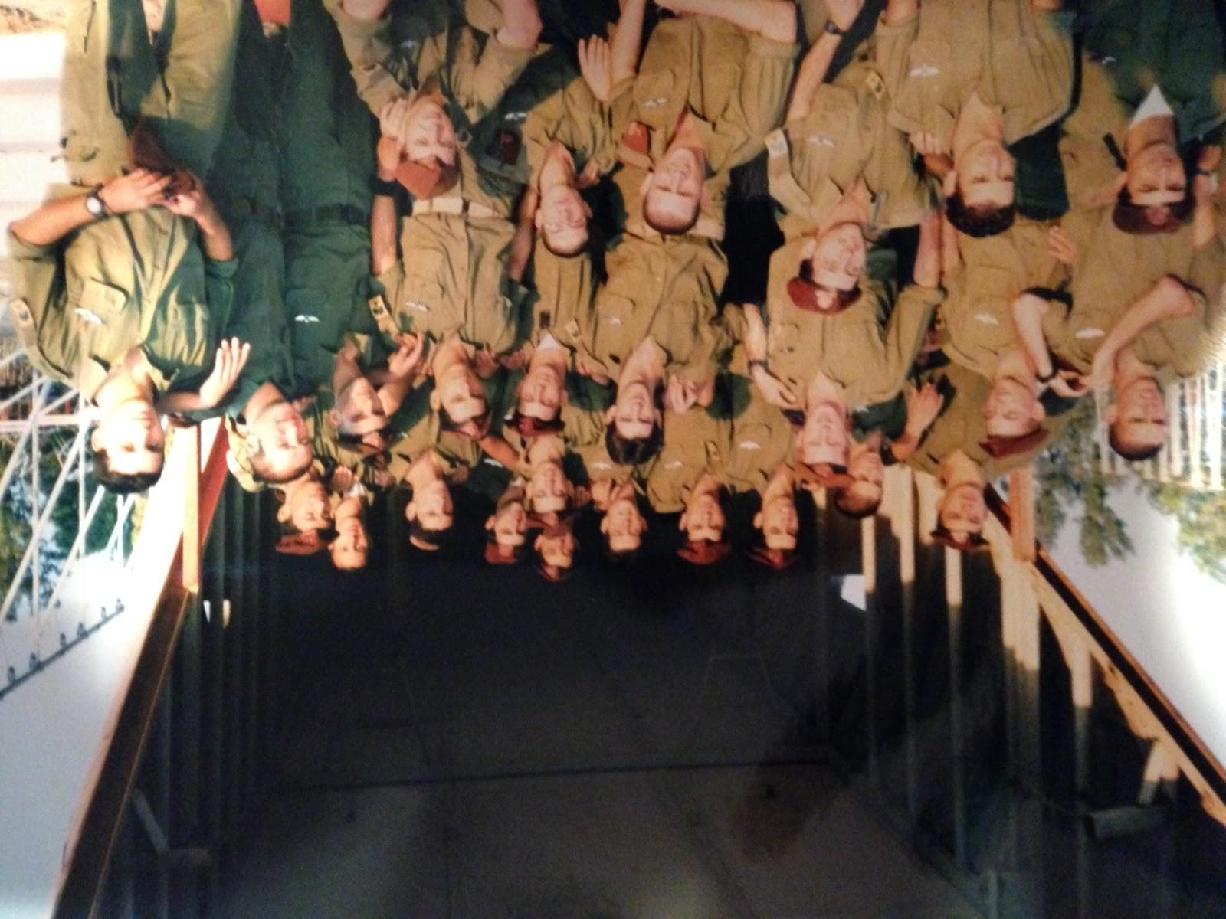
More Army

Slide 10
What did I learn from the Army
You have to trust people
Its all in our head
When you think you can’t go any more …. Yes you can!

Slide 11
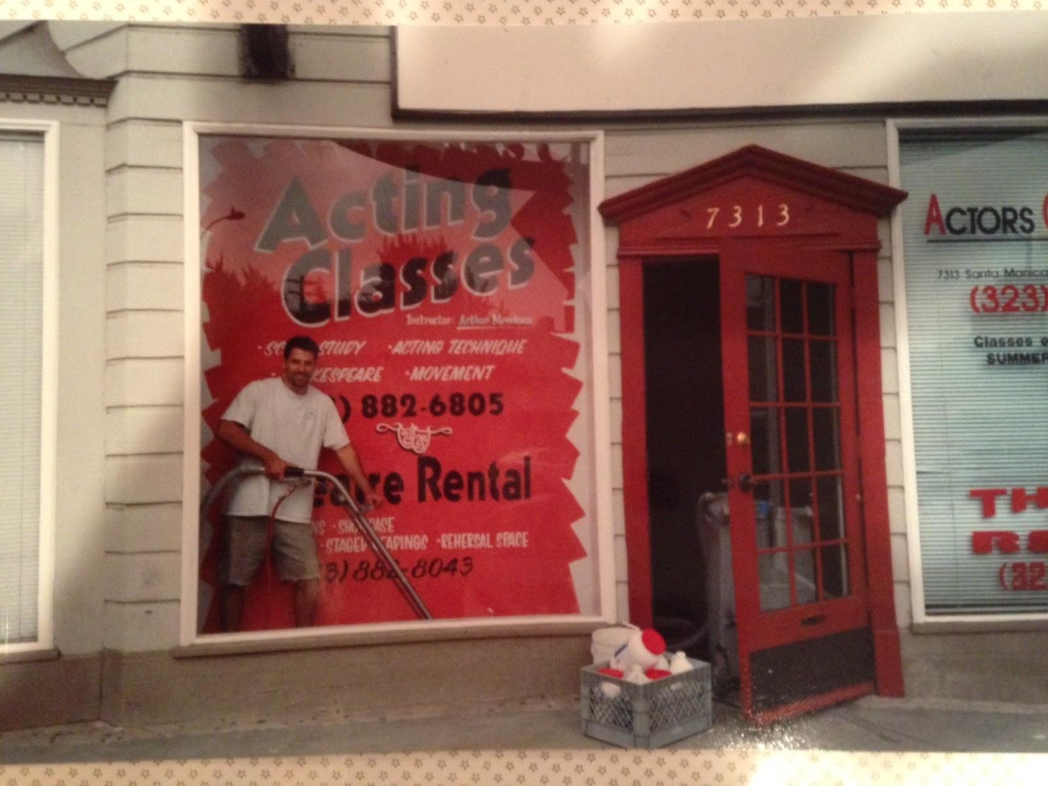
Moving to Los Angeles CA
Money grows
on trees ….
Not Really

Slide 12
Challenges and opportunity
Learning english New people
Finding our way Size of the market
Getting by New opportunities
Renting an apartment
Finding a job

Slide 13
My career paths…..
12 Years old - 2 acres of zucchini
13 years old - sold Falafel & sold shows
always worked in between ….
17 years old - I drove workers from the border to the field
23 years old - started 911 Restoration (America)

Slide 14
Where I am today.

Slide 15
My 2 cents ….
You have to get up and do it
Giving up its only a matter of choice and we always have a choice
Before you are trying to understand the world understand your self
Everything happens Inside of you
Never ever stop developing yourself
You have to love what you do
If you can’t explain it in a few words you don't understand it

Slide 16
True Statements
Each one of us have greatness in ourselves.
We all have a choice.

Slide 17
Most Important
Our Mindset

Slide 18
TO DO ….
I want each one of you to have a vision of who you want to become.

