Slide 1
hello neuwirth leadership academy! my name is tiffany

Slide 2
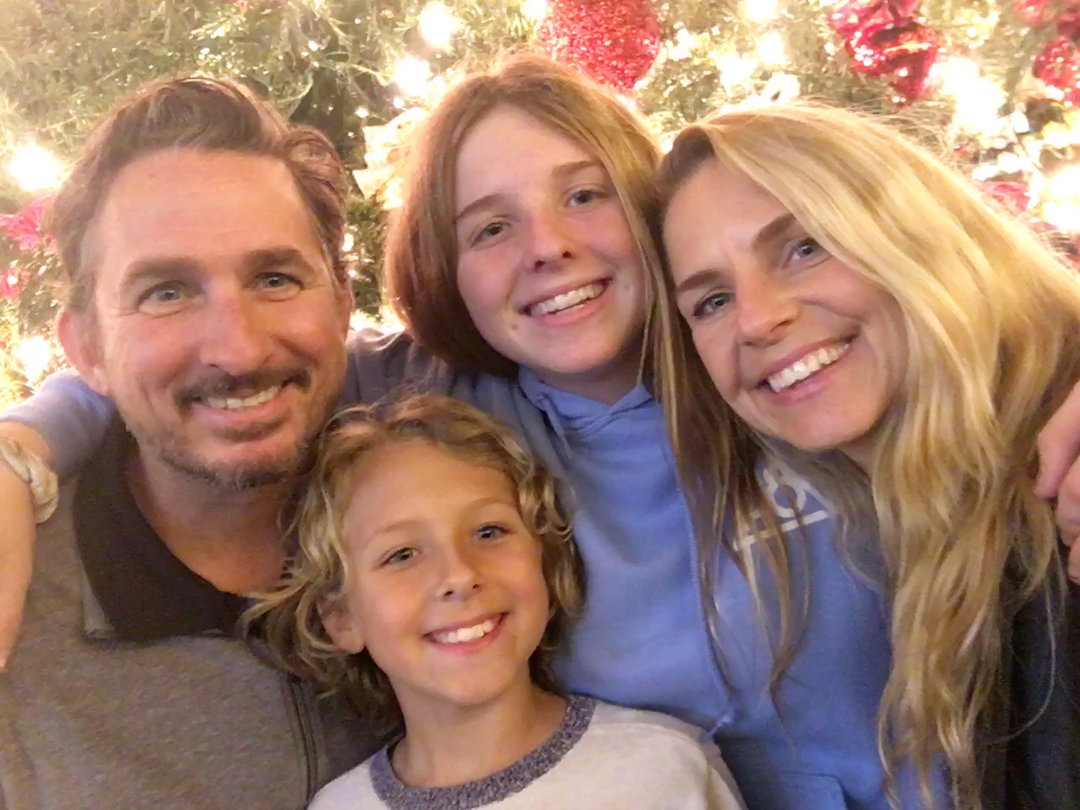

Slide 3
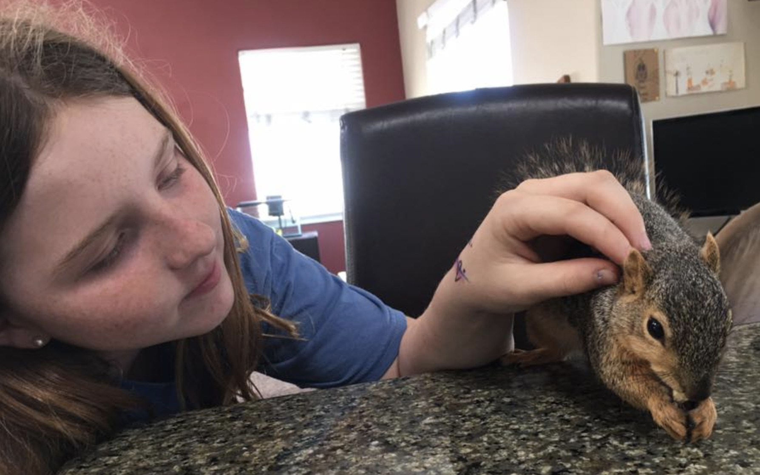

Slide 4
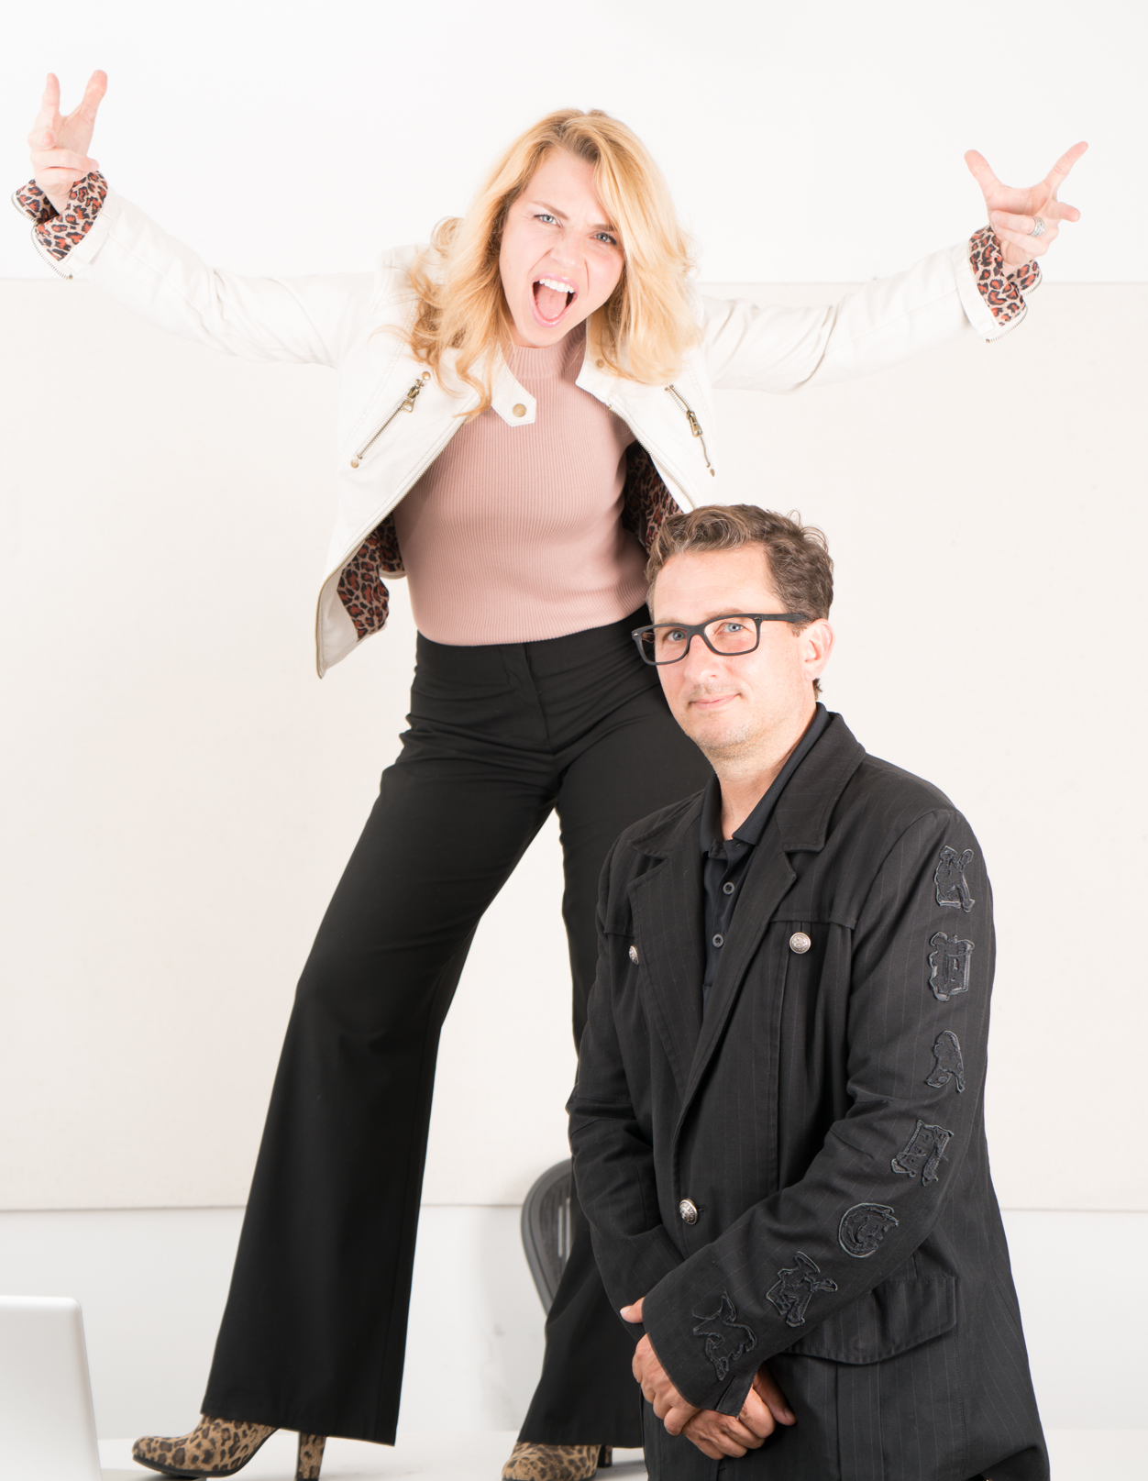

Slide 5
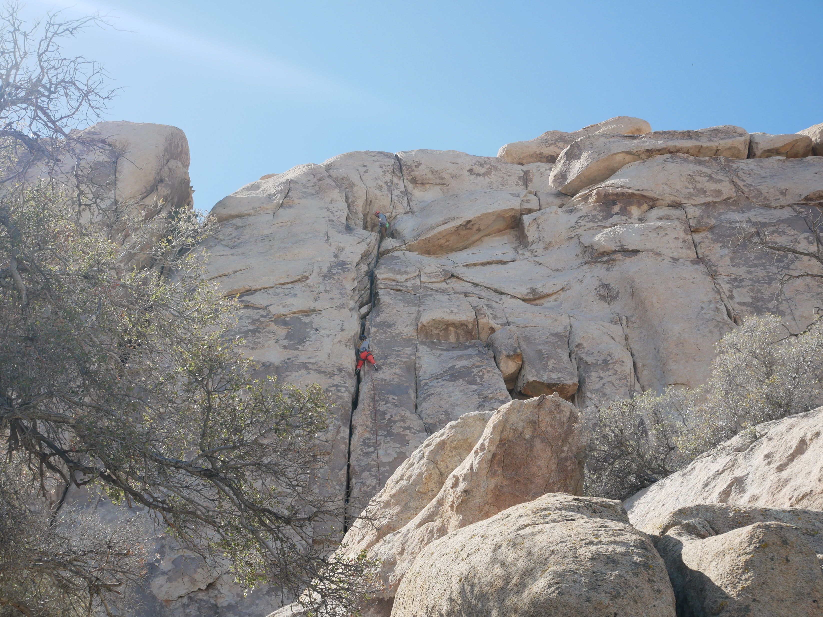

Slide 6
Notes:
Rise & Climb!

Slide 8
universal life principles
Notes:
Open vs close.
Energy flowing
Don’t close – you give up joy and happiness
Acceptance and surrender. Do NOT let the outside world close me. Spiritual work.
Learn how NOT to close. Also known as triggering. Don’t let outside people or circumstances trigger you.
Don’t let your mind trigger you and then close you. Learn to accept honor accept and appreciate the experiences that unfold in front of you. Let the energy flow and be open. Practice not closing – the light in you will shine all the time, just like the blinds in your house. If you close the blinds, you block the light.

Slide 9
number one:
i am
Notes:
We are not human doings We are human beings
When we’re little kiddos, people ask us, ”what do you want to BE?” Then it starts to change, or twisted into, “What do you want to DO, or worse…what are you going to DO?” This question feels kind of panicky…like, I dunno, and then stress begins to enter our consciousness…everyone else is doing something…ack, now I must DO something?
Focus on who you want to be, not what you want to do. When you focus on who you want to be, what you do unfolds from that. It is not your job to get a job.
What are you being when you feel totally fulfilled and complete and whole, is who you are…are being heroic, healing, humorous?

Slide 10
number two:
your feelings are your compass
Notes:
The second most powerful statement you can make in your life is “I don’t feel like it, or that doesn’t feel right to me.” The way you feel about a person, a place, a thing, an event…anything is ALWAYS more important than what you THINK about it. Your brain is a computer program with one primary job…keep you alive. When we were cavemen, it served us well and kept our species alive. Now, we don’t have those threats…there’s not a saber tooth tiger around the corner waiting to devour you. Your brain does not like what is unknown or unfamiliar to you and it will check EVERY SINGLE BOX about why you shouldn't do something if it is new. Your heart will definitely tug at you and guide you and your brain/thoughts will constantly battle it.
Girl going down into a basement.
How to get in touch with how you feel? Take a breath, slow down for just a few moments. There’s a saying, “those who don’t go within, go without.”
Listen with the ear behind the ear, see with the eye behind the eye and feel with the heart behind the heart.
Ask yourself when making a decision, “Does this come natural to me? Does this feel authentic and genuine to me? Do you feel at home engaging with this person, activity or being in this place?”

Slide 11
number three:
your thoughts are energy
Notes:
Your thoughts are a mental unit of energy. Very very powerful energy. “What you think about, you bring about.” Let your thoughts make you strong.
Create thoughts that empower you not disempower. Neutrality and love.
Your mind is receptive…think of a row boat, think of a sailboat, think of a yacht, think of a cruise ship.
You CAN change your mind.
What you think about expands.
Change your thoughts change your life.
Freedom of speech comes second. You cannot speak anything that you don’t think first. What you think about yourself is so much for important than what other people think about you.
Take a piece of paper a write something hurtful or mean or rude that someone has said to you. Now fold it up. I am going to try to give it to you, don’t accept it. Now, the person holding it is the one stuck with it. What’s more important than that is the person holding this piece of paper feels exactly like what is written on this paper. The way they get rid of this feeling is to drop the paper.
Write who you really are on a piece of paper, fold it up and carry it in your pocket…write as many times as you can.

Slide 12
bonus:
a life lived in fear is a life half lived

Slide 13
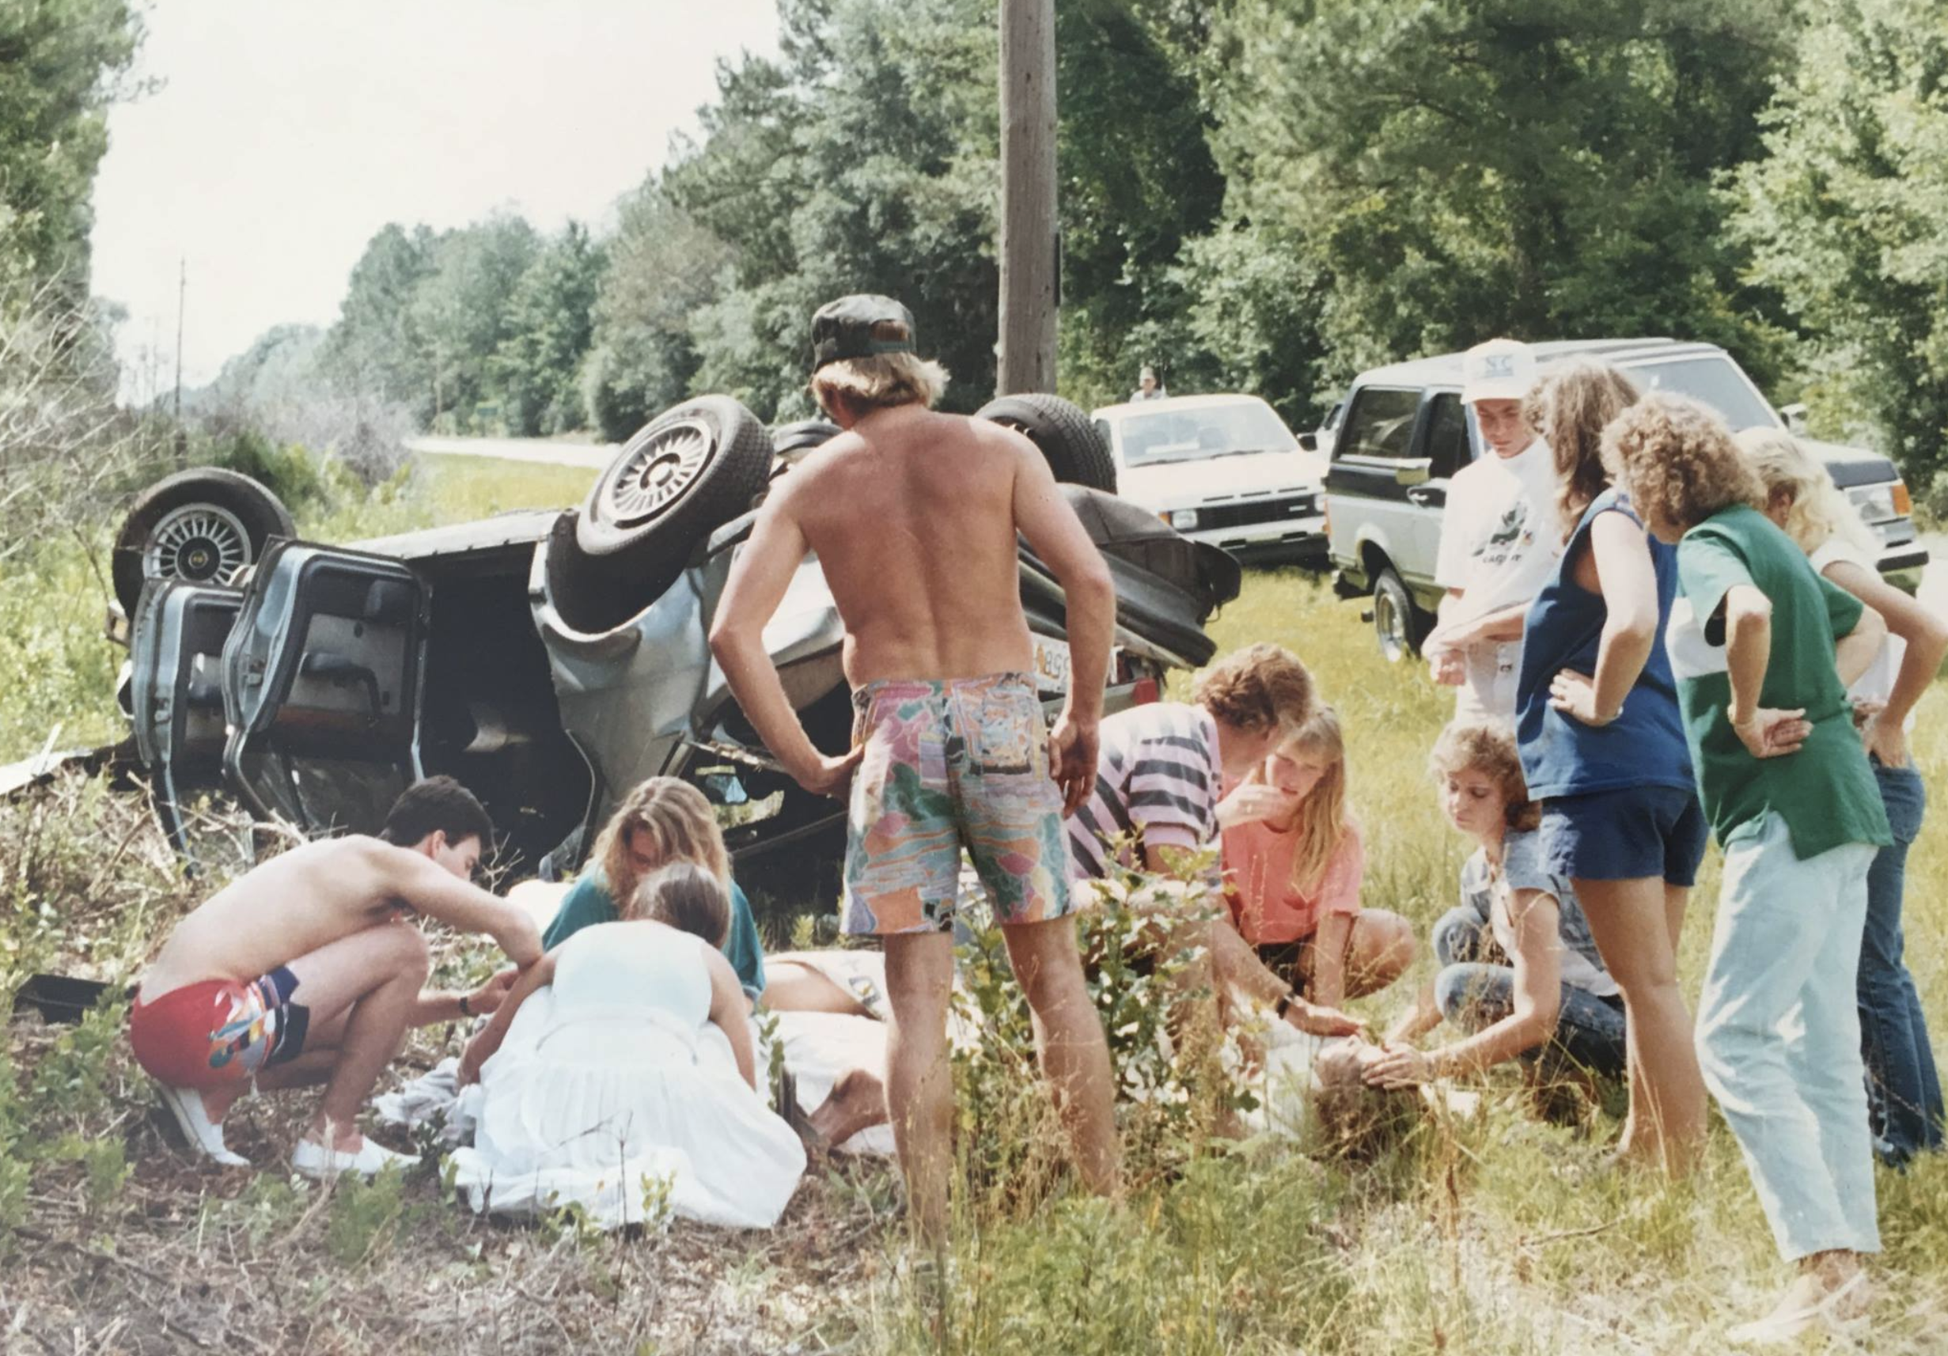

Slide 14
bonus:
a life lived in fear is a life half lived

Slide 15
number three:
what you believe is what you see
Notes:
Heard the saying, “seeing is believing?” It’s not true. Know that in life, what you believe you will experience is exactly what you will experience.

Slide 16
another bonus:
confidence
Notes:
We are not human doings We are human beings
When we’re little kiddos, people ask us, ”what do you want to BE?” Then it starts to change, or twisted into, “What do you want to DO, or worse…what are you going to DO?” This question feels kind of panicky…like, I dunno, and then stress begins to enter our consciousness…everyone else is doing something…ack, now I must DO something?
Focus on who you want to be, not what you want to do. When you focus on who you want to be, what you do unfolds from that.

Slide 17
another bonus:
money
Notes:
We are not human doings We are human beings
When we’re little kiddos, people ask us, ”what do you want to BE?” Then it starts to change, or twisted into, “What do you want to DO, or worse…what are you going to DO?” This question feels kind of panicky…like, I dunno, and then stress begins to enter our consciousness…everyone else is doing something…ack, now I must DO something?
Focus on who you want to be, not what you want to do. When you focus on who you want to be, what you do unfolds from that.

Slide 18
Have a mind that is open to everything and attached to nothing.
No one knows enough to be a pessimist about anything.
When we close our mind, we close off our own genius.
Progress is impossible is you always do things the way you’ve always done things.
I can make my life happy by keeping my mind open.
Notes:
2000 year old teaching.
Having an open mind means opening a mind means finding with ourselves to get rid of complaining and blaming. It’s the victim state of consciousness. Being offended is also being a victim – if you become offended by what people say, do and
I’m never looking to be offended. Anything that people do or say, you respond with, “that’s an interesting perspective. That’s different.”

Slide 19
What do you want?
Your job is not to get a job.
Notes:
Open vs close.
Energy flowing
Don’t close – you give up joy and happiness
Acceptance and surrender. Do NOT let the outside world close me. Spiritual work.
Learn how NOT to close. Also known as triggering. Don’t let outside people or circumstances trigger you.
Don’t let your mind trigger you and then close you. Learn to accept honor accept and appreciate the experiences that unfold in front of you. Let the energy flow and be open. Practice not closing – the light in you will shine all the time, just like the blinds in your house. If you close the blinds, you block the light.

Slide 20
A question opens the mind.
Imagination is more important than knowledge. Knowledge informs imagination.
Notes:
Open vs close.
Energy flowing
Don’t close – you give up joy and happiness
Acceptance and surrender. Do NOT let the outside world close me. Spiritual work.
Learn how NOT to close. Also known as triggering. Don’t let outside people or circumstances trigger you.
Don’t let your mind trigger you and then close you. Learn to accept honor accept and appreciate the experiences that unfold in front of you. Let the energy flow and be open. Practice not closing – the light in you will shine all the time, just like the blinds in your house. If you close the blinds, you block the light.

Slide 21
I’m not hear to talk you out of life…
I’m here to talk you into it. To design it.

Slide 22
You are your own master.
I’m the Boss and I have a mind and I can do better with it. I will do better with it.
How?
If you met someone new in high school and she came up to you and said…”you’re thighs are way too big. You need to diet. Do you want to be friends?” now what do you say to yourself in your mind when you look in the mirror?”
Notes:
You are the master of your mind and your body. Use it wisely.
You are not your body…you tell your body what to do. Pay attention to your body.
You are not your mind…you tell your mind what to do. Pay attention to your mind. What is it doing? Actively use your mind right now…let me ask you…visualize in your mind a row boat, now make it sailboat, now make it yacht, now make it cruise ship. You are making your
You are the light that resides inside…your soul…

Slide 23
2. You can’t give away what you don’t have.
Very simple.
People who are not good at giving away love, can’t give it away because they don’t have it to give away. You can give away love to someone else if what you carry with you is resentment and anger and frustration and
You get back what it is you put out there. If you put out there in the world that you’re not enough, the Universe will continue mirror that to you.
Take an inventory of what you do have…kindness, joy, love, support. It will come back to you.
Notes:
Very simple.
People who are not good at giving away love, can’t give it away because they don’t have it to give away. You can give away love to someone else if what you carry with you is resentment and anger and frustration and
You get back what it is you put out there. If you put out there in the world that you’re not enough, the Universe will continue mirror that to you.
All that I have is thine. If you believe what you can have is limited, your life will be limited.
If your message to the universe is gimme gimme gimme. You think you’re here to get something? Is that what you think this is?
You will never be in a state of arriving, but always in a state of striving. If you shift that and say to the universe, how may I serve? The Universe will respond back to you the same. When you take your energy and attention off what you demand from the world and focus on what you can give the world, the most amazing gifts will occur in every way.

Slide 24
3. There are NO justified resentments.
No matter how much hate is flowing through your life…if you carry around resentment in your heart…the person who owes you money, the person who hurt you,
All those things, that you feel you have the right to be resentful about, those resentments HURT YOU and create a sense of despair in YOU.
If you try to grab some fire, hold onto it with the intent to throw it on someone else to burn them, who is holding the fire? YOU ARE. So who is getting burned? YOU ARE.
Always send love in response to anything or everything.
Notes:
Blame has to go. Your life cannot be blamed on anyone else. NO BLAME. The grades you have right now, are on you, not your teachers, and not your counselors, and it’s not your friends fault. Assign responsibility to yourself. You can’t change other people. You can change YOU, you can change by letting it go. Send love in response to hate.
Tree in front of my house was cut down.

Slide 25
4. Don’t die with your music inside you.
All of you have a heroic mission.
There are no accidents. You come here with a purpose and all of us are connected to it and too many of us are afraid to listen to it and march to it.
Notes:
Look at what you love to do for the past 5 years of your life. We all feel something and want to do something. Listen to your heart to hear your music. I know what my music is. It’s being here with YOU right now. Even if the music you hear is weird or sounds unfamiliar, or if other people can’t hear it or those in your life question your music…honor it.

Slide 26
5. Embrace Silence.
You can’t hear your song, you can’t hear your music if you listen to the rhetoric and noise.
You will feel more connected to energy, to love, to you.
Notes:
Meditate. Go deep inside. That’s where your song is. What I know most about getting quiet and peaceful. Here’s what I know…there is one universal power and energy…it flows through everything and it is indivisible and everything in your life is given a division…good bad, up down, young old, birthing dying…anybody who can come to this class and bring with them a magnet that only has a north pole, the physical world is full of dichotmoies and blend it – you need the silence. It’s the space between the bars that hold the it’s the silence between the notes that make the music. It’s the
Go to the place within you that you cannot divide – you cannot divide energy. When you go within and practice maditate and embrace the silence is where you will hear your music. See the eye behind the eye, hear with the ear behind the ear, feel with the heart behind the heart. Look at nature….

Slide 27
6. You are not your past.
You are not the baggage and wounds of your past.
You don’t have to identify with it.
Notes:
Give up your history. Be with the presence. You are not yesterday. Pick up your past, embrace it, accept it, and honor that you went through what you went through and then you toss it. Come into the now.
The wake is not what drives the boat, it is only the trail that is left behind. It is an illusion to believe that it is the cause of your struggling today.

Slide 28
7. You can’t solve a problem with the same mind that created it.
Admitting you’re wrong is nothing more than saying I have been making choices in my mind that are creating my life that aren’t working. So change your mind, change your life.
Notes:
Give up your history. Be with the presence. You are not yesterday. Pick up your past, embrace it, accept it, and honor that you went through what you went through and then you toss it. Come into the now.
The wake is not what drives the boat, it is only the trail that is left behind. It is an illusion to believe that it is the cause of your struggling today.

Slide 29
8. Treasure your divinity
Trust the source.
There are no accidents.
Trust your heart more than the fodder.
See it in nature.
See it in your body.
Notes:
Give up your history. Be with the presence. You are not yesterday. Pick up your past, embrace it, accept it, and honor that you went through what you went through and then you toss it. Come into the now.
The wake is not what drives the boat, it is only the trail that is left behind. It is an illusion to believe that it is the cause of your struggling today.

Slide 30
9. Every thought is energy
Let your thoughts make you strong.
Create thoughts of empowering not disempower. Neutrality and love.
What you think about expands.
Change your thoughts change your life.
Freedom of speech comes second. You cannot speak anything that you don’t think first.
Notes:
If you can’t be positive be neutral.

Slide 31
10. Limiting Beliefs
You are programmed. Parents, teachers, counselors.
You do you which is what is natural.
It comes natural to me.

