Slide 2
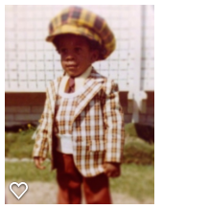
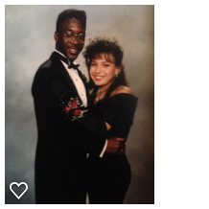
Allow me to introduce myself
70’s
90’s
2000’s

Slide 3
My Family
Mr. & Mrs. Jones
Zoe
Henry
Teddy

Slide 4
The High School Years

Slide 5
The High School Years
Things I Liked
Things I Struggled With
Sports
Theater
English
Friendships/Support
Insight/Perspective
Cliques
Math
Popularity
Leading
Path to Success

Slide 6
High School Jobs
THD Janitorial Services
Family business
Accommodating schedule
Pay was inconsistent

Slide 7
Life After High School
Moved to Atlanta
Worked at a pharmacy
Moved back to Los Angeles
Auditioned for New York Film Academy
Worked as a songwriter
Worked for Strange Fruit Films
Began managing artist

Slide 8
Boys Became Men

Slide 9
Life Defining Moment

Slide 10
My Career Path
Profound Entertainment
Subtle Insight Entertainment
Storyboard Entertainment

Slide 11
Subtle Insight Entertainment
Entertainment company specializing in
Feature/Short Films
Stage Plays
Commercials
Scriptwriting
Artist Management

Slide 12
My Career Path
Challenges
Successes
Emerging from my cousin’s shadow
Proving my talent to non believers
Pride of wanting to do things on my own
Procrastination
Learned to
Trust in my talent
Be patient
Be true to myself
Trust in the process
Ask for help

Slide 13
My First Solo Project

Slide 14
More Than Just Work
I am a family man
Los Angeles Rams season ticket holder
Leadership/Mentorship
Giving back to others
Traveling

Slide 15
Do It All Over Again?
If I could go back and talk to my high school self, I would say?
Give maximum effort in everything you do, because work ethic is learned not inherited
Treat everyone with respect because the person you look down upon may be the same person you ask to help you up when you fall
Don’t just sit in class, be present
Understand that most people want the best for you, and those who don’t will tell you by their actions, not their words
Humility goes a long way

Slide 16
What Are You

