Slide 1
Publishing for Profit to Prosperity for PEACE

Slide 2
INTRODUCTION
My name is Jeanette JOY Fisher and I am 70 years old.
I work for myself.
My company publishes books and online content.
We also teach internet marketing skills.
My role at JOY PUBLICATIONS is LEADER, TEACHER,
WEBSITE CREATOR, CONTENT WRITER, &
SOCIAL MEDIA BROADCASTER
  Every day I write, create content, answer client questions, teach,
  read trade articles and books to learn new skills, build websites, and connect with prospective clients on social media.

Slide 3
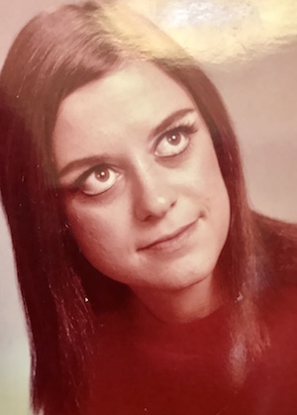
My childhood
I was born in LOS ANGELES and raised in ANAHEIM.

Slide 4
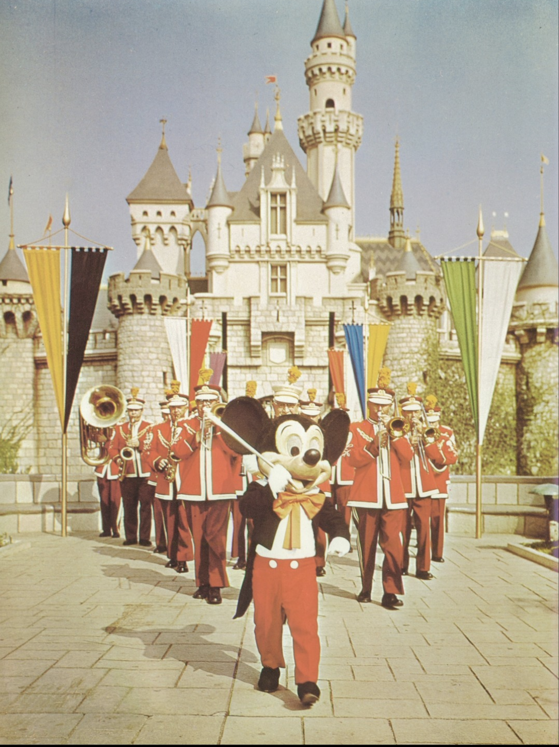
MY HIGH SCHOOL
I Attended SAVANNA HS in ANAHEIM

Slide 5
This is a savanna

Slide 6
REBELS?
As a HS student I was shy and a good student.
I didn’t know what I wanted to be as an adult.
I didn’t have any direction and guidance.

Slide 7
Getting in to College
The top few things I did to ensure I got into college were:
All A’s and One C
Clubs
Athletic Swim Team Score Keeper
Lived Near Cal State Fullerton

Slide 8
College
I Attended Cal State University at Fullerton
Got Married
Attended OCC
Interior Design
St Johns River College, Palatka Florida
Computer Science

Slide 9
College
Bethune Cookman University
English, Education, Marketing

Slide 10
College
Bethune Cookman University
English, Education, Marketing

Slide 11
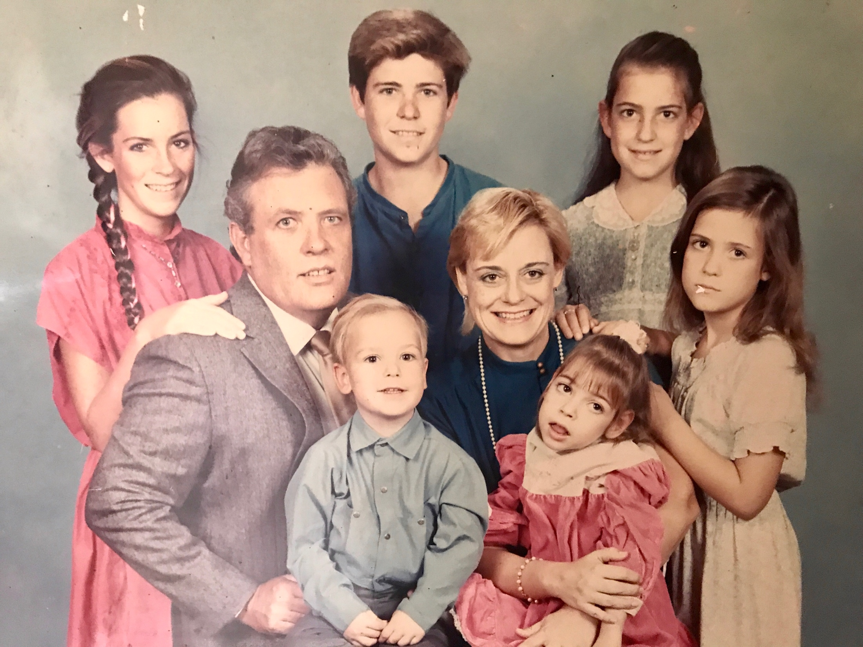
My family

Slide 12
College
Things I enjoyed in College
Things I didn’t enjoy in College
Learning
My Professors
Students

Slide 13
College
Favorite classes
Least favorite classes
English
Thanatology
Interior Design
Algebra
Marketing Psychology
Computer Science
Algebra

Slide 14
College
Things that felt difficult or challenging for me while I was in College were:
  Child Care
  Housekeeping

Slide 15
Getting a job after College
I never had a job after I graduated college.
I am an ENTREPRENEUR.

Slide 16

This is My Company

Slide 17

This is My Company
Insert company picture

Slide 18


Slide 19
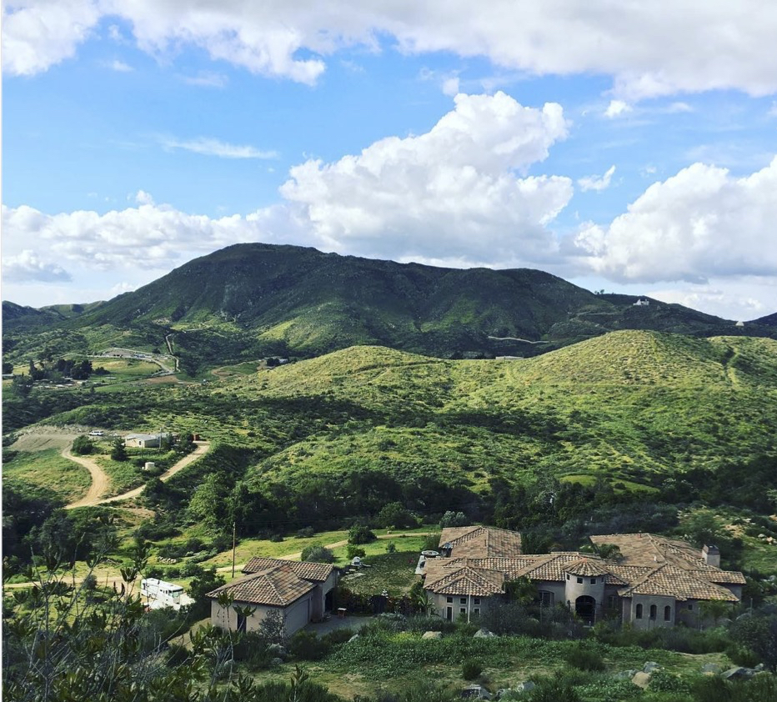
THIS IS MY OFFICE

Slide 20
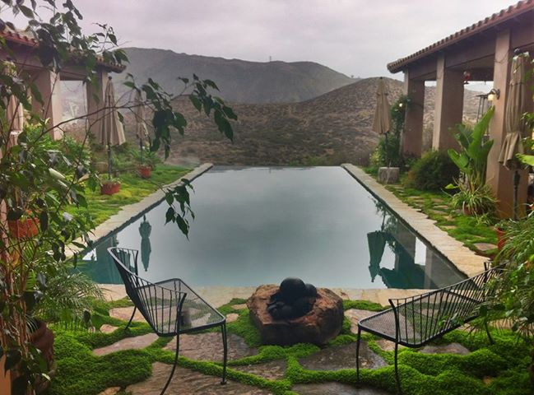
THIS IS MY VIEW

Slide 21
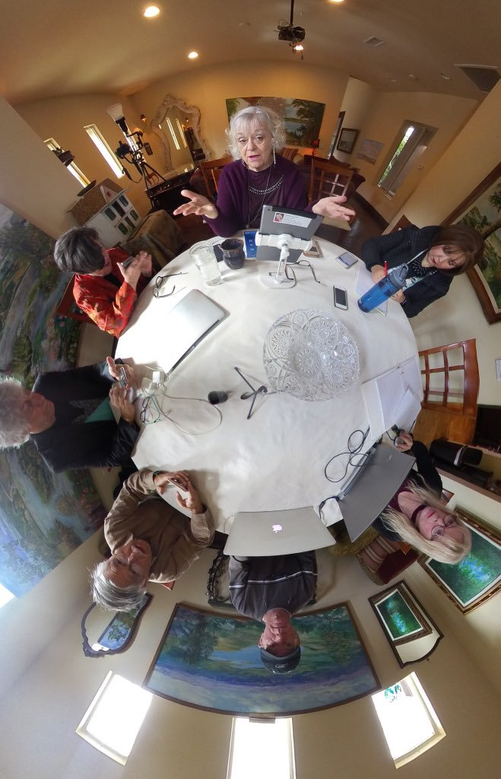

Slide 22
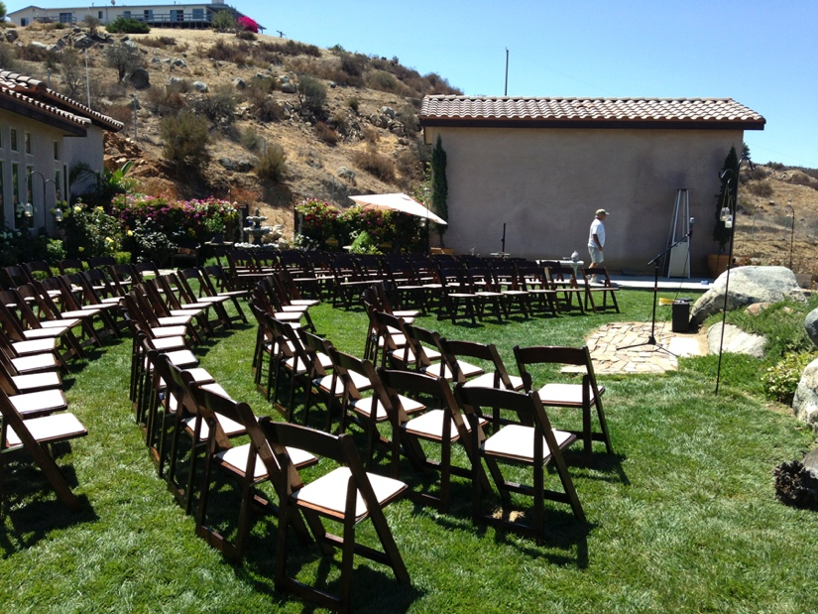

Slide 32
More than just work
When I am not at work I like to:
  Spend Time with Family & Friends
  Read
  Write
  Watch TV
  Host Parties
  Go to Events
  Host Events
  Teach
  PUBLICITY for PROFITS to PROSPERITY for PHILANTHROPY for PEACE

Slide 33
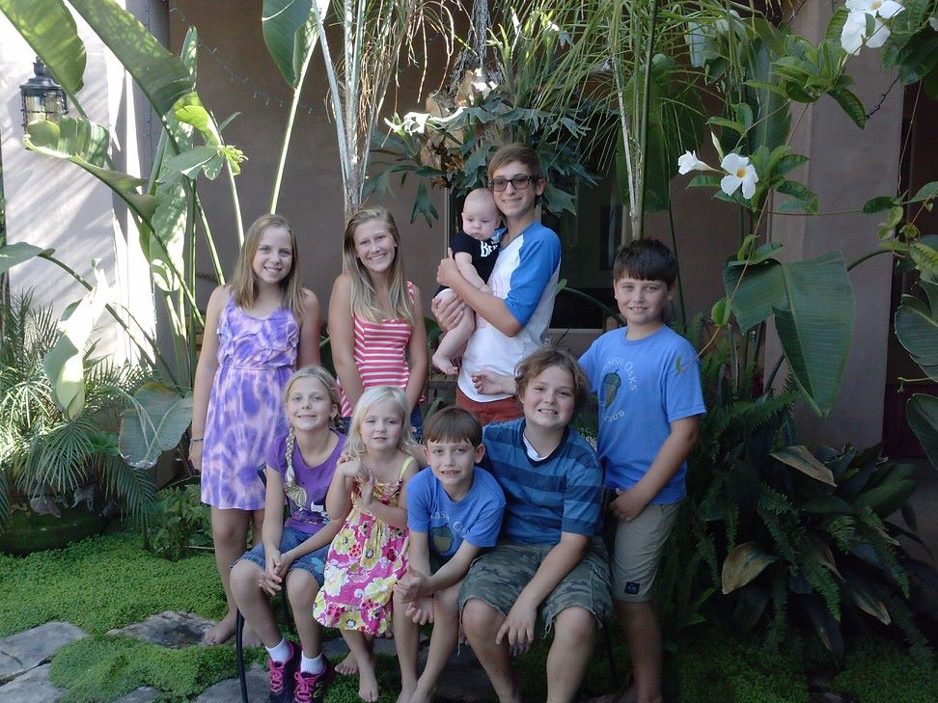
WHY?

Slide 34
Do it all over again?
If I could talk to my high school self, what would I say?
  Don’t worry. Be happy.
  Pay more attention to your family.

Slide 35
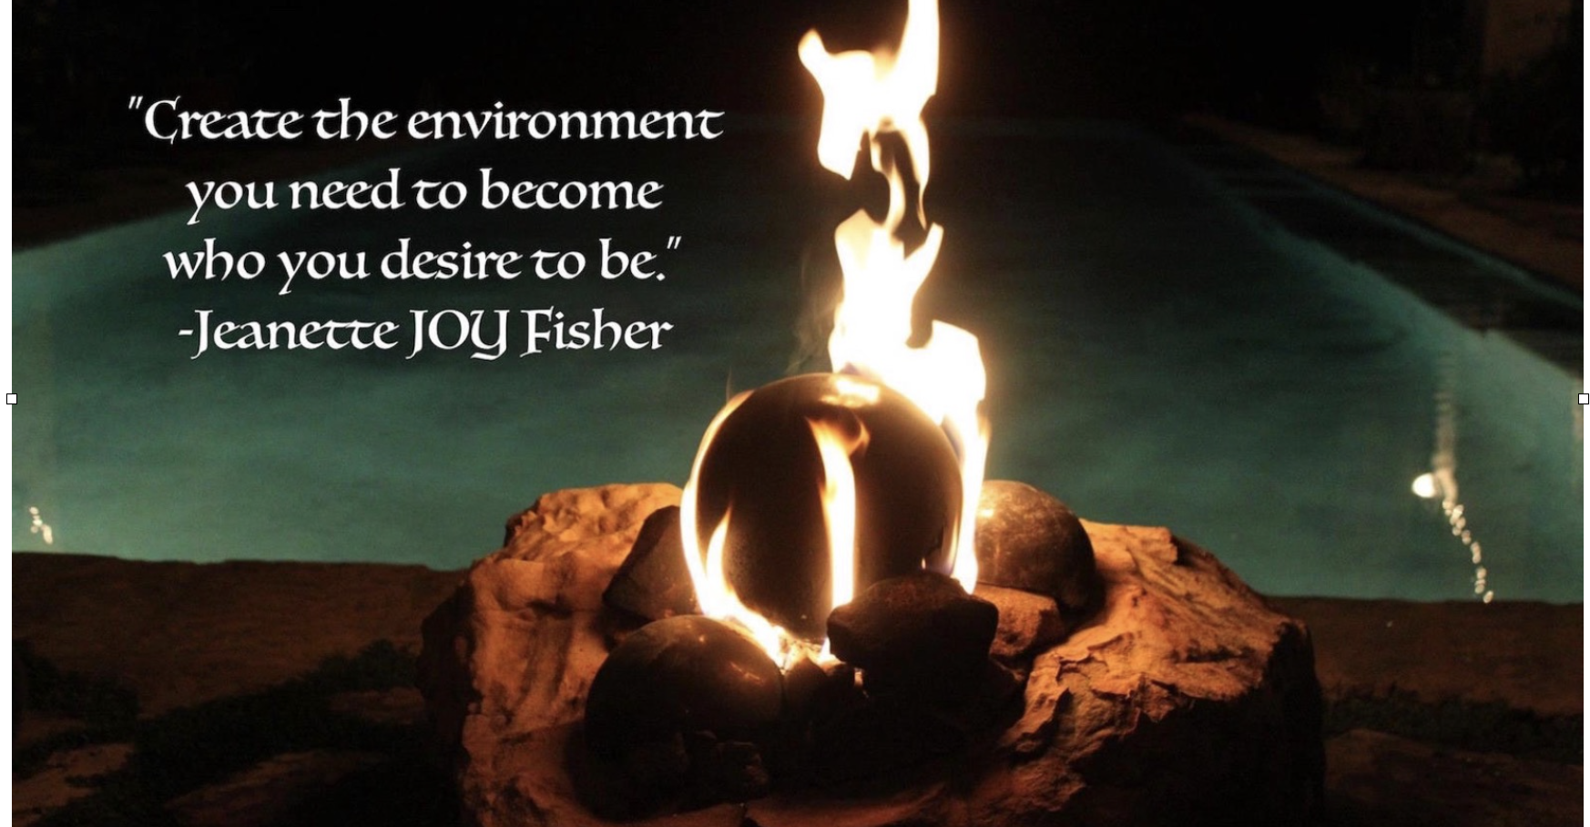

Slide 36


Slide 37
YOU?
Are you interested in learning entrepreneurial skills?
How to Design Websites & Keep them Updated
Write Content for Websites & Magazines to Become a Published Author
Write a Book

Slide 38
Free Online WebinarS
Free for Students
Join paying entrepreneurs and learn.
Become an Intern.
Gain experience and get paid for writing.
Writing online content is not the same as writing essays.

Slide 39

QUESTION AND ANSWER

