Slide 1

Being a Leader
Michael Vargas

Slide 2
Agenda
Introduction
Concept Introduction
Leadership
Questions and Answers

Slide 3

Michael Vargas
ROLES
Principal of Atlas Project Support
Adjunct Professor, Saint Leo University
Adjunct Professor, San Diego State University
Instructor for Everblue
Instructor for Murrieta Valley Adult School
EDUCATION
Doctor of Education, Organizational Leadership, Creighton University
Master of Business Administration, Keller Graduate School of Management
Master of Project Management, Keller Graduate School of Management
Graduate Certificate in Financial Analysis, Keller Graduate School of Management
Bachelor of Science in Business Administration in Management, San Diego State
PROFESSIONAL DEVELOPMENT
Certified Business Energy Professional - Association of Energy Engineers
Certified Energy Auditor- Association of Energy Engineers
Certified Energy Plans Examiner- California Association Building Energy Consultants
Certified Cost Professional- Association for the Advancement of Cost Engineering
NAVFAC Certified Contractor Quality Manager

Slide 4
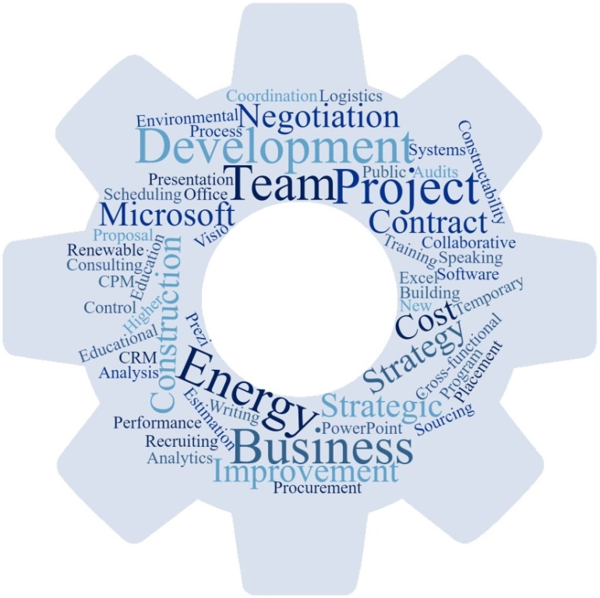

The Envelope Please…
Michael Vargas Named to the Top 75 Executives in Energy Management
Torrance, CA – May 1, 2018 Michael Vargas, has been named to the prestigious list of the top 75 executives in energy management as selected by the Editorial and Management team at Business Sector Media.

Slide 5
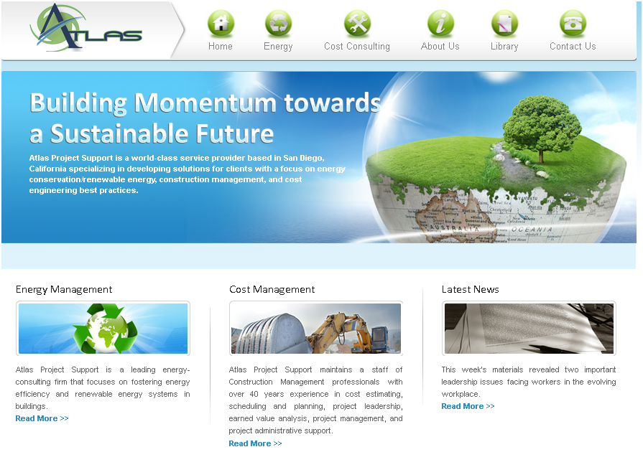
Atlas Project Support

Slide 6
My Story
Born in Mayaguez, Puerto Rico
Grew up in Merced, CA
Family
Why I want to speak to you…

Slide 7
Value System
Magis: Meaning “more.” This is the challenge to strive for excellence.
Cura Personalis: “Care for the individual person.” Respecting each person as a child of God and all of God’s creations.
Unity of Heart, Mind, & Soul: Developing the whole person and integrating all aspects of our lives.
Ad Majorem Dei Gloriam (AMDG): For the Greater Glory of God
Forming & Educating Agents of Change: Teaching behaviors that reflect critical thought and responsible action on moral and ethical issues.
Women & Men for and with Others: Sharing gifts, pursuing justice, and having concern for the poor and marginalized.

Slide 8

What is Leadership?

Slide 9
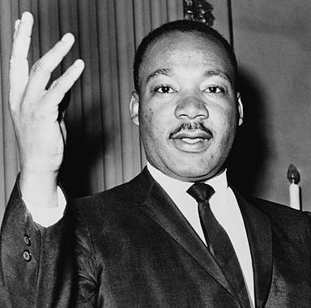
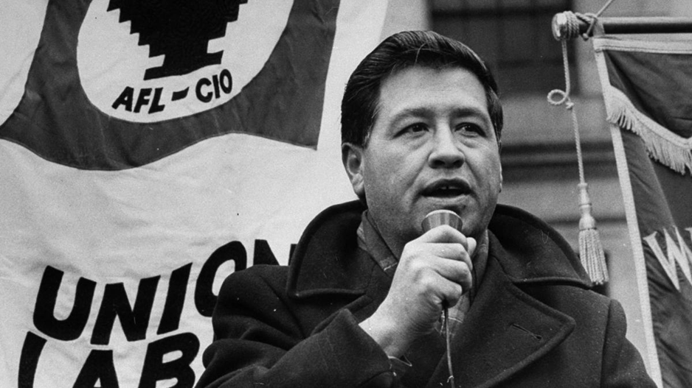
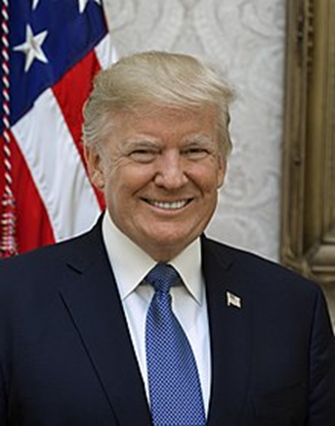

What is Leadership?

Slide 10
Is Leadership…
Leadership Theories Over time, a number of theories of leadership have been proposed. Here are some of the main ideas. Great Man Theory Trait Theory Behavioral Theories Role Theory The Managerial Grid Participative Leadership Lewin's leadership styles Likert's leadership styles Situational Leadership Hersey and Blanchard's Situational Leadership Vroom and Yetton's Normative Model House's Path-Goal Theory of Leadership Contingency Theories Fiedler's Least Preferred Co-worker (LPC) Theory Cognitive Resource Theory Strategic Contingencies Theory Transactional Leadership Leader-Member Exchange (LMX) Theory Transformational Leadership Bass' Transformational Leadership Theory Burns' Transformational Leadership Theory Kouzes and Posner's Leadership Participation Inventory
Notes:
LEED and the related logo is a trademark owned by the U.S. Green Building Council and is used with permission

Slide 11
What is Leadership?
Merriam-Webster: Definition of leadership
The office or position of a leader
Capacity to lead
The act or an instance of leading

Slide 12
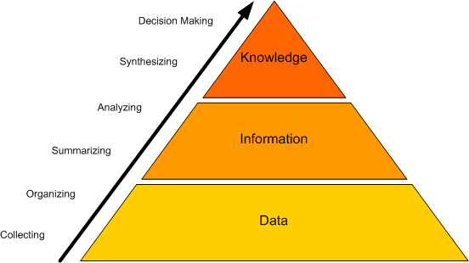
What is Leadership?
Notes:
LEED and the related logo is a trademark owned by the U.S. Green Building Council and is used with permission

Slide 13
Discuss Framework
Can Leadership be taught?
Is there things we can do starting tonight to be better Leaders?

Slide 14
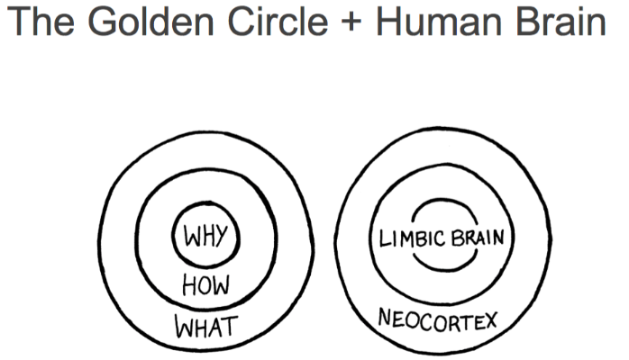
Golden Circle
Paleocortex
Archicortex
Language

Slide 15
Limbic System Functionality
Integration of olfactory, visceral, and somatic impulses
Control of activities necessary for survival
Emotional behavior
Retention of recent memory

Slide 16
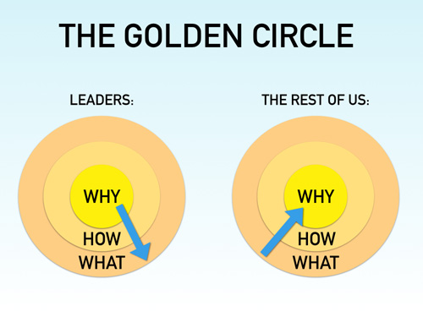
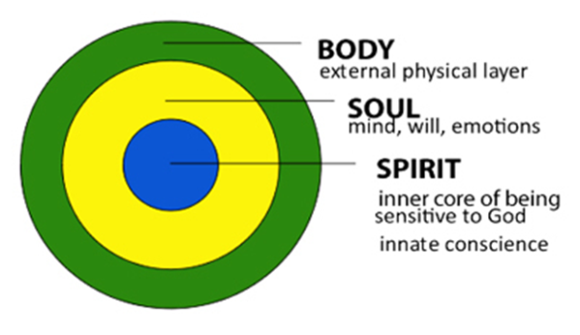
Golden Circle
Look Famaliar?

Slide 17





Golden Circle

Slide 18
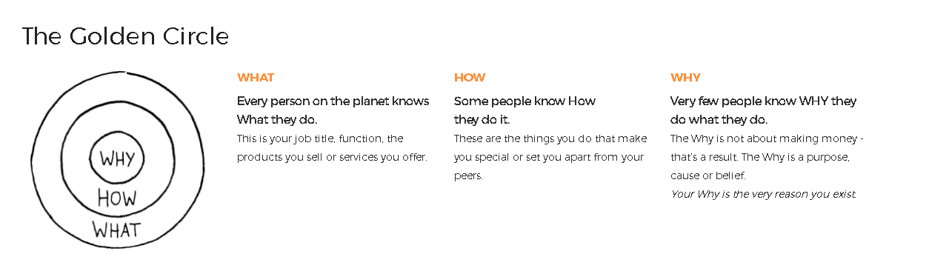
Notes:
Very few people and very few organizations can clearly articulate Why they do what they do. Why is a purpose, a cause or a belief. It provides a clear answer to the questions, “Why do you get out of bed every morning?” “Why does your organization exist?” and “Why should that matter to anyone else?”
Making money is NOT a Why. Revenues, profits, salaries and other monetary measurements are simply results of what we do.
The Why is about our contribution to impact and serve others. The Why inspires us.

Slide 19

Mental Models
Visualizing complex systems for better clarity and understanding, without sacrificing unique and important attributes

Slide 20
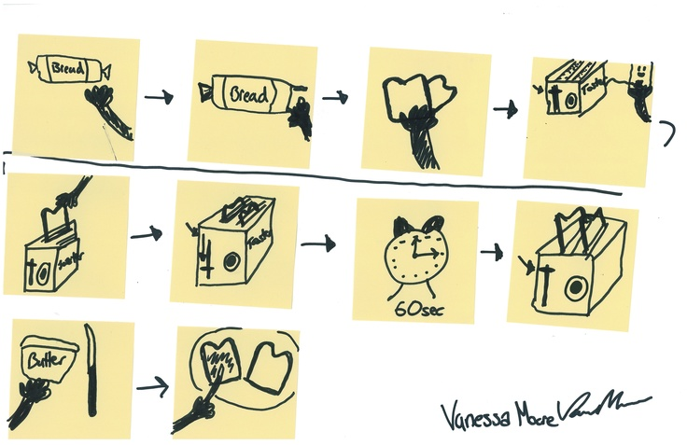
Mental Models
DRAW HOW TO MAKE TOAST
In just 1 minute, each person sketch a diagram of how to make toast.

Slide 21
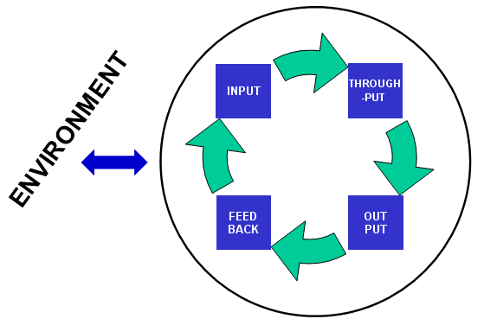
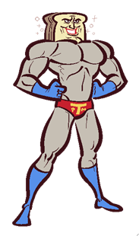
Mental Models
Node
Link

Slide 22
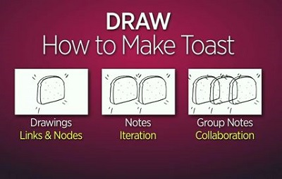
Mental Models

Slide 23
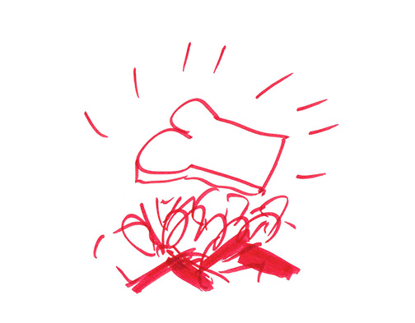
Mental Models

Slide 24
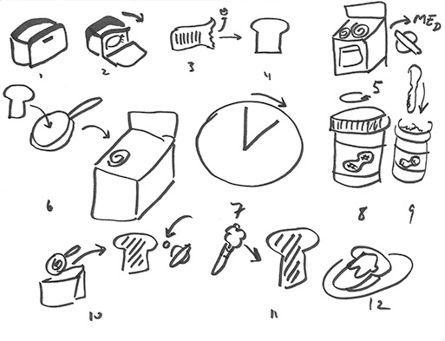
Mental Models

Slide 25
Mental Models
Good: Links & Nodes
Better: Iteration
Best: Synthesis

Slide 26
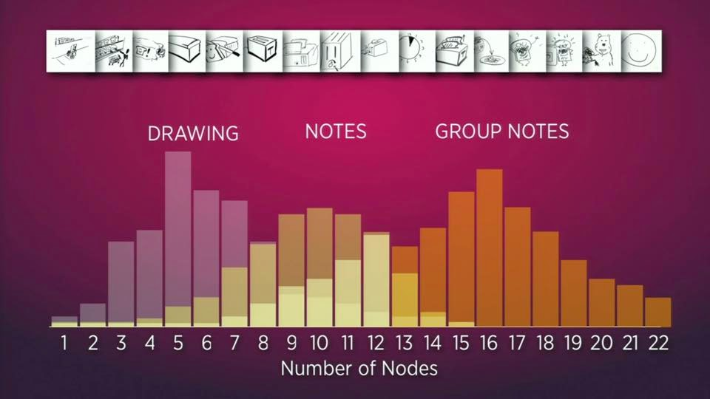
Mental Models

Slide 27
Mental Models
Key Takeaways
Everything has Nodes and Links
Between 5 and 13 node is the sweet spot for individuals
Between 11 and 19 nodes is the sweet spot for groups (Because it’s participatory it avoids “map shock”)
People are intuitive know how to break complex things down in simplified tasks (nodes)

Slide 28
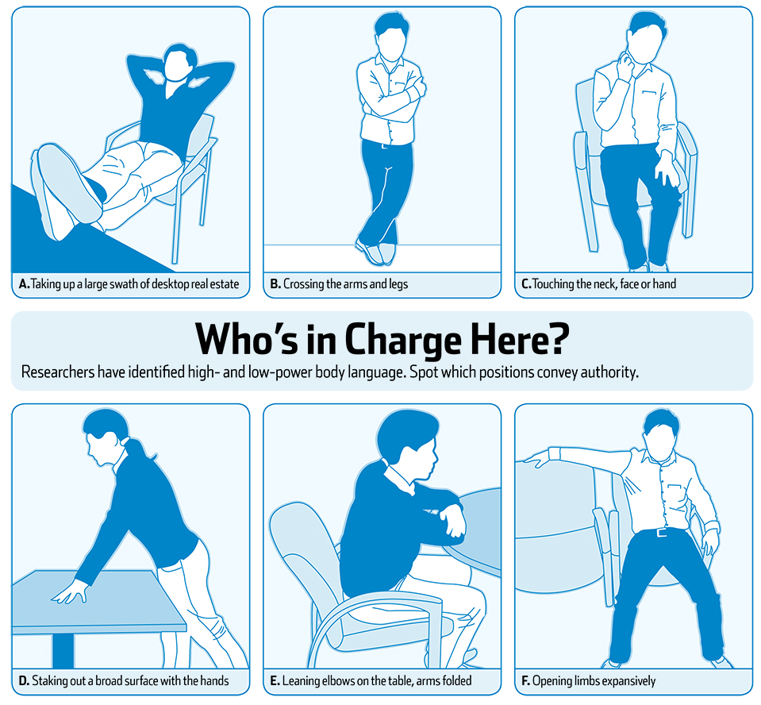
Power Posing

Slide 29
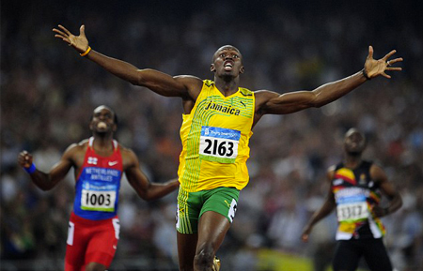
Power Posing

Slide 30
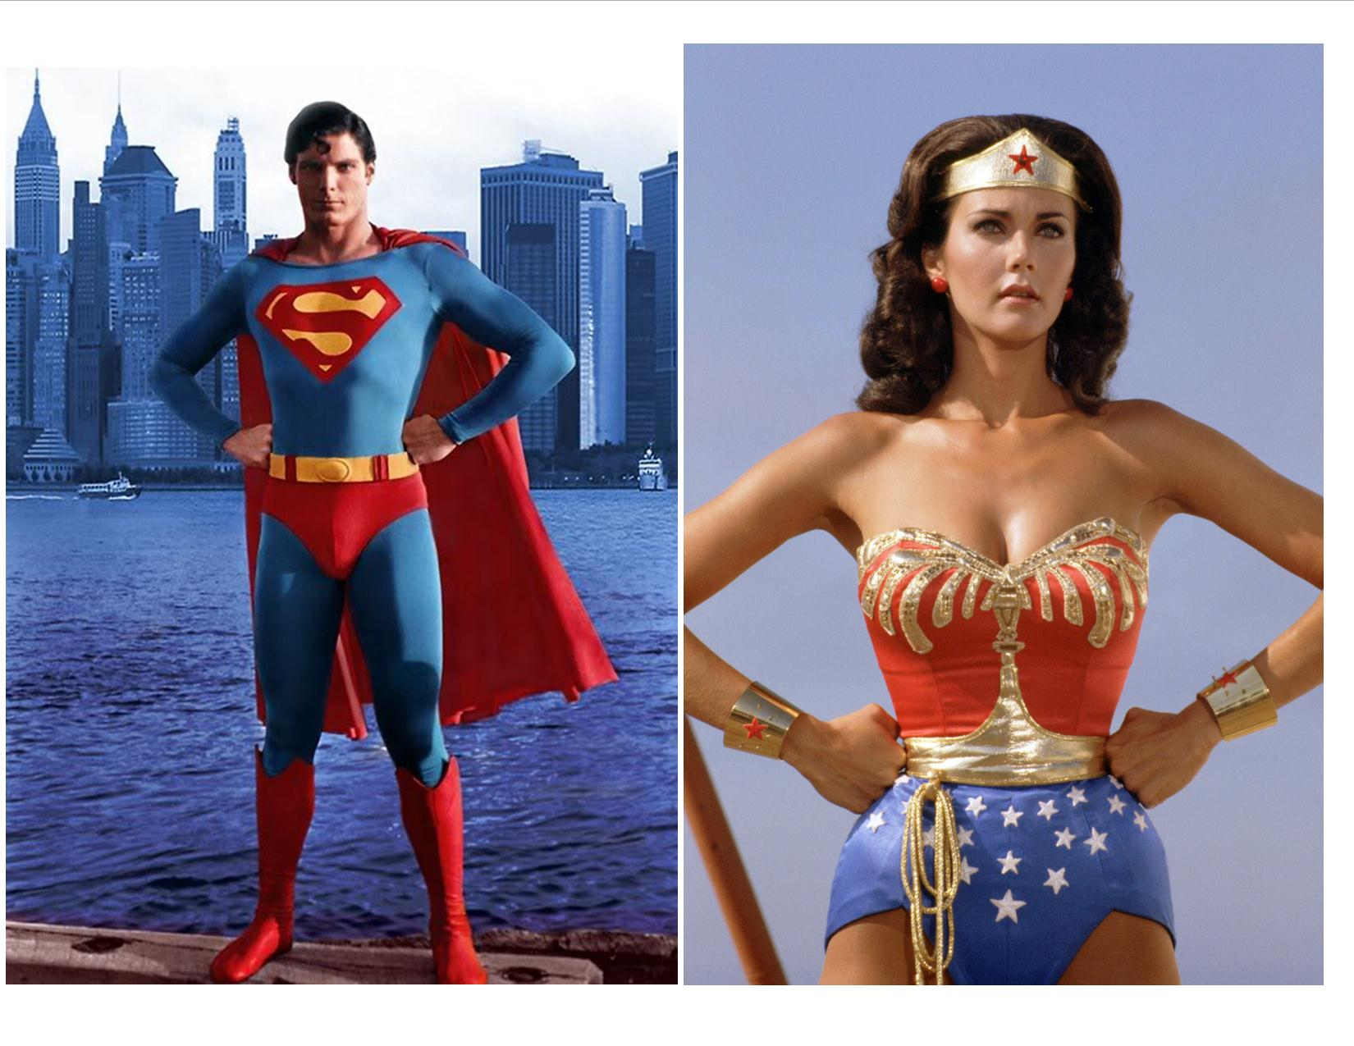
Power Posing

Slide 31
Power Posing
Here’s how the study went down…
First, a saliva sample was taken from each subject and their testosterone and cortisol levels were measured.
Second, the subject was asked to sit in either a high power pose or a low power pose for two minutes.
Third, a second sample of saliva was taken from each subject and their testosterone and cortisol levels were measured again.
When the researchers looked at the results, they were stunned by the impact that body language had on the hormones within the body.
High power poses increased testosterone by 20 percent and decreased cortisol levels by 25 percent.

Slide 32
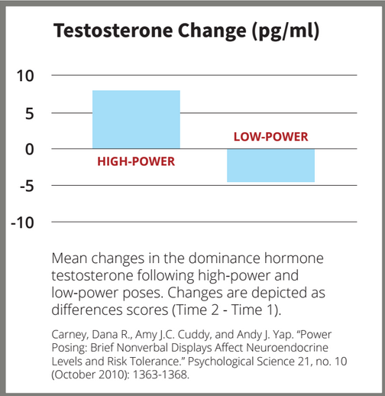
Power Posing

Slide 33
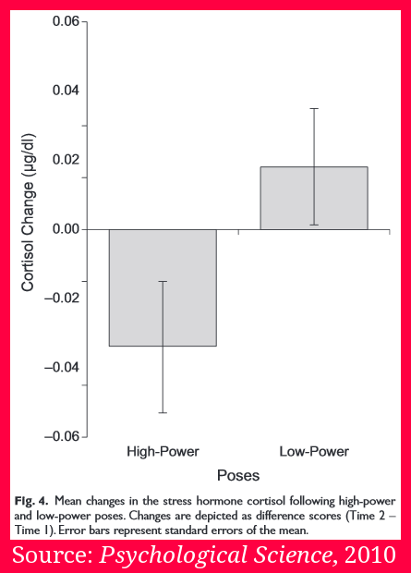
Power Posing

Slide 34
Summary
Leadership
Tangible
Skills
Golden Circle
Models
Body Language
Physical

Slide 35

Discussion

