Slide 1
About ME
My name is Laura Lull and I am 49 years old.
I am the Executive Director of the META Foundation.
META is a college access organization that provides scholarships and mentorship to Latinx youth from Southern California who attend colleges and universities locally and throughout the country.
As the Executive Director and only staff member for META, every day is different for me in terms of my daily responsibilities.

Slide 2
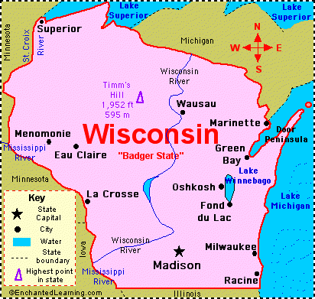

Slide 3
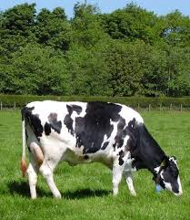
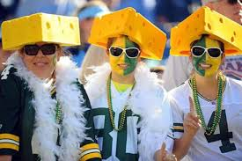

Slide 4
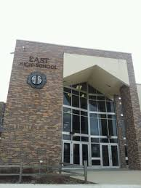

Slide 5
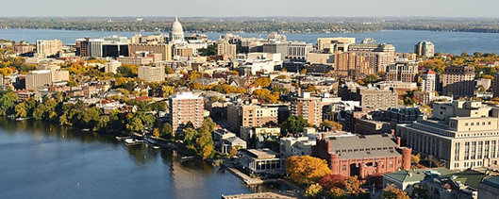

Slide 7
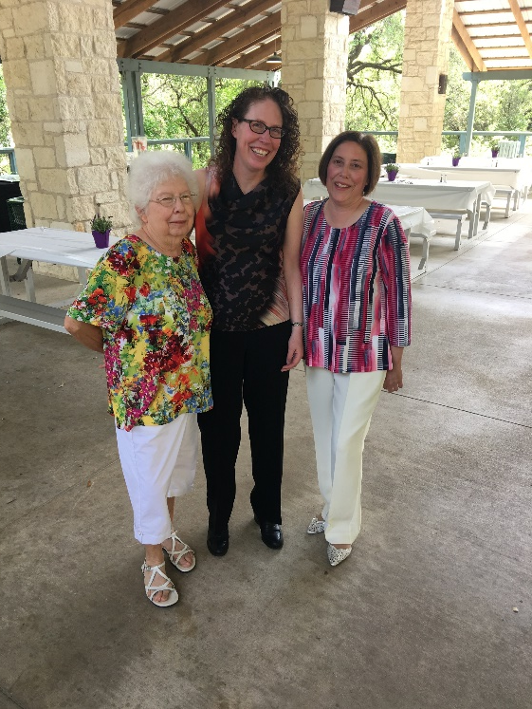
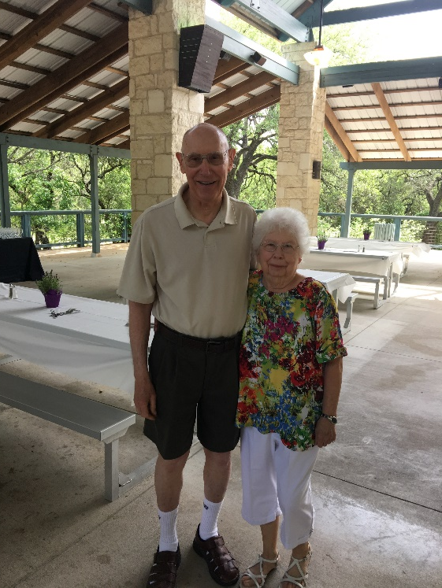
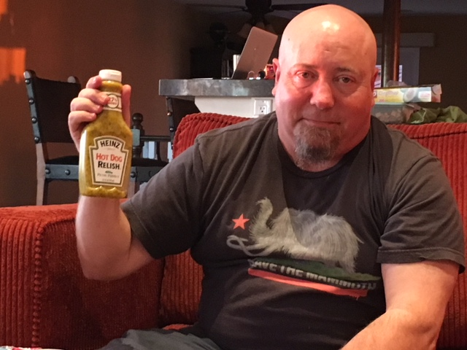

Slide 8
Everyday at my organization is different!
My roles:
Strategic Planner
Board of Directors Liaison
Accountant
Marketing Manager
Scholarship Program Manager
Fundraiser
Administrative Assistant

Slide 9
My Career Path
Nonprofit organizations; MBA
Middle school and high school Spanish teacher
Now Executive Director of META
Notes:
You may use this chart to describe your journey to the current career

Slide 10
My Career
The first job I had after college was:
Teaching middle school Spanish just outside of Washington D.C.
The craziest job I have ever had was:
After senior year of high school…school janitor.

Slide 11
My Career
Challenges I have had to overcome throughout my career are:
Learning how to say “no”
Learning how to survive as an introvert in an extroverted world
Being underestimated
Using my resume and cover letter as strong marketing tools

Slide 12
More than just work
When I am not at work I like to:
Read mysteries
Have adventures with our dog
Relax with family and friends
Watch sitcoms on TV
Watch cheesy movies over and over again

Slide 13
Do it all over again?
If I could talk to my high school self, what would I say?
Listen to your gut!
Be brave!
Live life to the fullest!
Surround yourself with people who love you for who you are!
Find your core values and stick with them!

Slide 14
QUESTION AND ANSWERS

