Slide 1

Suzanne baran
CEO & Founder

Slide 2
INTRODUCTION
I’m Suzanne Baran and I’m 42 years of age.
I created my own freelancing agency.
My company:
helps businesses optimize their digital marketing strategy and processes; provides content creation; brand & content strategy, and copywriting services.
My role at Content Empress is Founder & CEO
  Every day I help brands become better marketers and publishers.

Slide 3
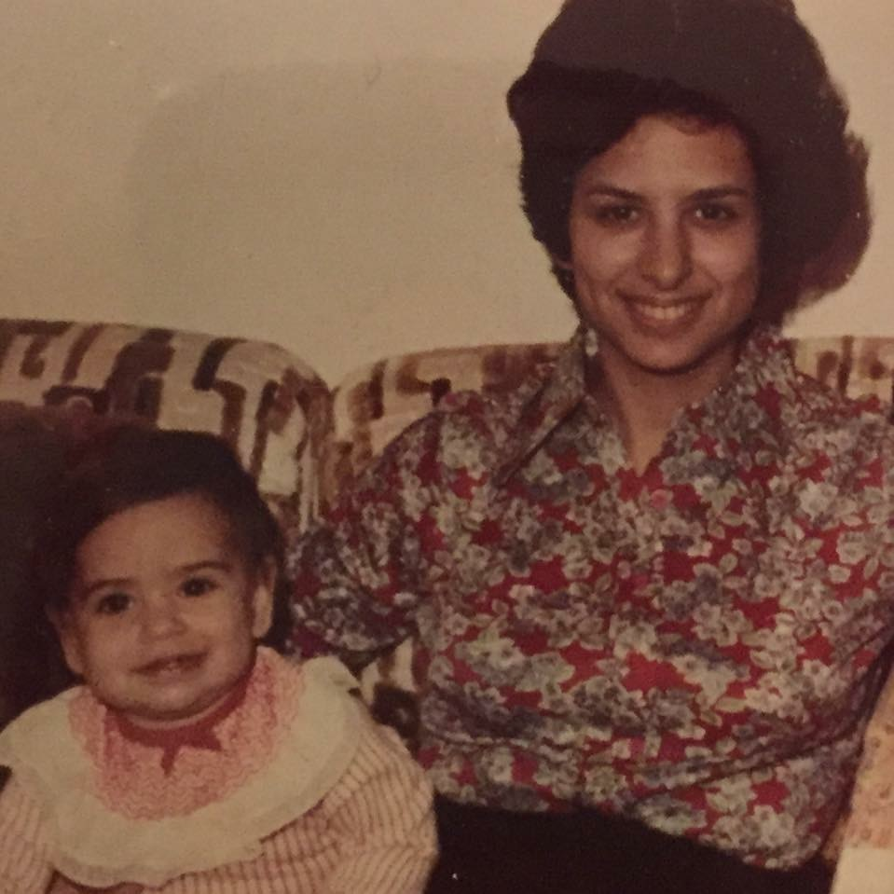
My childhood
I was born in Morristown, NJ and raised in Succasunna, NJ.
This is a picture of me at (BLANK) age

Slide 4
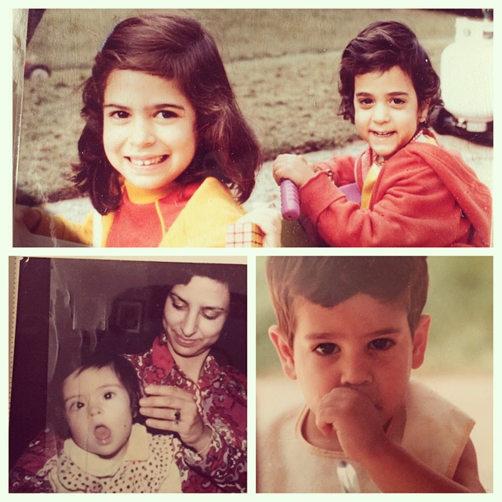
My family
Lower middle class Jewish family. 30 relatives killed in the Holocaust. Hard working household. Lots of chores. My siblings passed.
This me and my sister Laura, my mom, my sister Rochelle, and brother Jeff

Slide 5
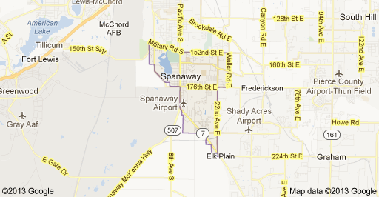
MY HIGH SCHOOL
I attended BRURIAH HS for girls in Elizabeth, NJ
(Insert map or image of high school or mascot etc. here)

Slide 6
High School
As a HS student I was pretty studious, fun, into poetry and music, and worked very hard and did not have much time for partying. ……………………………………………………………….
After graduation Bruriah students go on to top seminaries, colleges and universities. Prepared for the world’s challenges, Bruriah graduates excel in any environment they choose. They are consistently at the top of their seminary classes, earn admission to leading college programs, and achieve valedictory honors upon graduation from university.

Slide 7
High School
Things that I really liked in High School were:
  Alternative rock bands
  Metal bands like Metallica
  Writing poetry
  French class
  Writing for the school paper
  Reading mysteries and Stephen King novels
  Wearing grunge outfits when not in school
  Playing harmless pranks
  Driving my friend’s Thunderbird
  Learning about literature, Jewish liturgy, and marketing

Slide 8
High School
Things that felt difficult or challenging for me while I was in High School were:
  My classes were intense and some were given in Hebrew
  Prophets class was tough
  Hebrew language classes were rough
  I really hated Trigonometry and loved Geometry
  Fitting in sometimes with wealthier girls
  Having my own sense of identity
  Fitting in time for fun

Slide 9




High School
Jobs I worked while I was in High School were:
  At 15 a counselor at a camp in Canada
  At 16 a counselor at a camp in upstate NY
  At 17 - office assistant for a computer sales company
  At 18 I became an assistant office manager for a computer semi-conductor chip company and did light bookkeeping and data entry of part numbers
  At the same time, I interned for a family attorney as a legal assistant and conducted research on supervised visitation

Slide 10
Getting in to College
The top few things I did to ensure I got into college were:
  Having a tutor for the math portion of the SATs.
  Taking summer school classes in Chemistry
  Writing lots of personal essay statements
  Studying, studying, and more studying

Slide 11
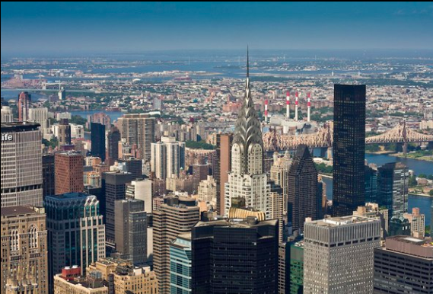
College
I attended college and (some grad school) in New York, NY
Insert map shot here

Slide 12


College
Things I enjoyed in College
Things I didn’t enjoy
Fencing, Literature classes, Philosophy classes, Assistant Cultural Arts Editor for school paper
Logic class
Some Hebrew courses – Economics in Hebrew
Working 2 jobs

Slide 13
College
Favorite classes
Least favorite classes
Literature and Art
Media Studies
Journalism
Creative Writing
Comparison Literature
Broadcast Journalism
Economics
Biblical studies
Logic
Sephardic Jewish Customs
Rabbinic Law

Slide 14
College
Jobs I worked while I was in College were:
  Hebrew school tutor for junior high kids
  Legal clerk for corporate attorneys
  Intern at Fox 5 local TV station – WNYW – awesome
  Data entry at Cherry Stix clothing company
  Intern and then full-time employee at a financial publishing company in Wall Street
  Editorial assistant at Churchill Livingstone Publishing company
  Club promoter, Systems downtown

Slide 15
College
Things that felt difficult or challenging for me while I was in College were:
  Keeping up my grades and working two jobs
  Living in NYC during the summer and supporting myself
  Supplementing classes at F.I.T for my major
  Not feeling prepared enough for my major
  Learning finance to be good at my job
  Dealing with nasty lawyers at my job

Slide 16
Getting a job after College
The top few things I did to ensure I got a good job after college were:
  Interning at a financial publishing company where I was hired and promoted through the ranks to Staff Writer
  Learning to manage difficult personalities
  Learning to prioritize and manage my time
  Not dating too much, staying focused
  Learning from others as much as possible

Slide 17
This is My Company
Every day at my company:
  2010 became a freelancer for the top agencies and brands in the world. Social media strategy, content strategy, copywriting, user experience inputs, content management system and software expertise; SEO and brand-building.

Slide 18





BRANDING + DESIGN + CONTENT PROCESS
Content Strategy involvement will be integrated throughout our process.
Discovery
Planning
Design
Content Review
Site Integration

Slide 19








CONTENT STRATEGY
Suzanne Baran
Content Strategy & Content Marketing Services based in Los Angeles, CA
19 years in digital marketing working with the world’s most celebrated brands: Intel, MGM Grand, Toyota, AT&T, Yahoo!, Fiji Water, Sony, Skype.

Slide 20
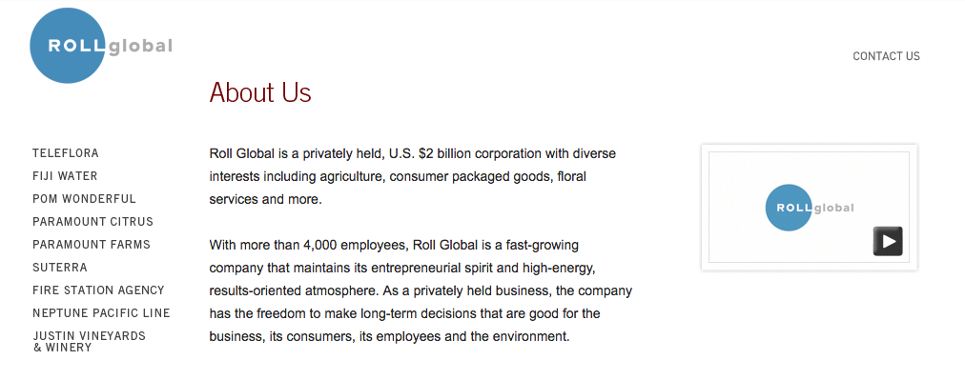
SUZANNE’S DIGITAL BRANDING WORK
Brand Refresh:
Roll Global
Roll Global, the parent company for Fiji Water, POM Wonderful and a suite of CPG brands suffered from an identity crisis.

Slide 21
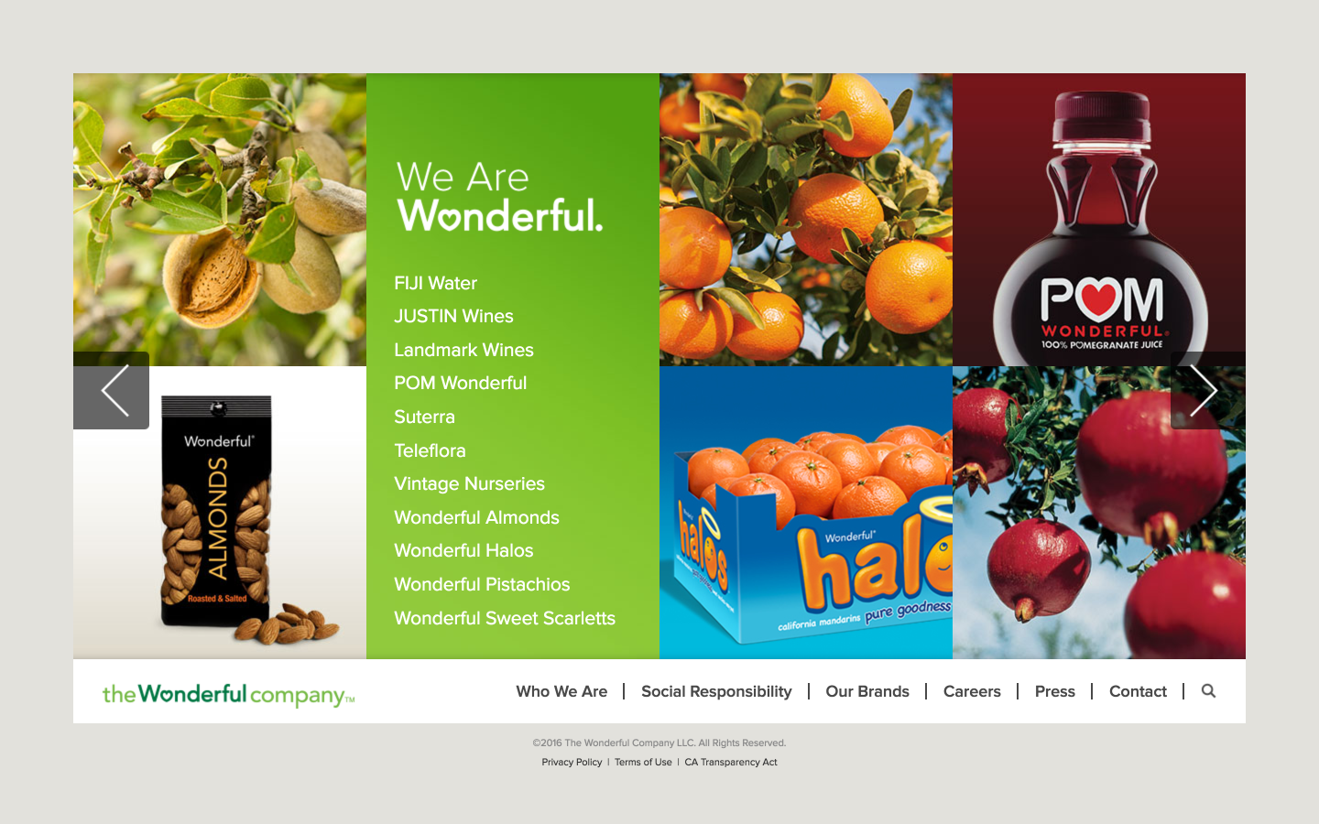
SUZANNE’S DIGITAL BRANDING WORK
Wonderful.com
The Wonderful Company’s diverse holdings make it the world’s largest grower of tree nuts, America’s largest citrus grower, and the world’s largest flower delivery service with the Teleflora network of florists.
Marketing Copy
Product Descriptions
SEO strategy
Omnichannel strategy (social, email platforms)
Content creation and management
Workflows and governance
Persuasive Landing Page design and strategy
Brand storytelling
Brand strategy: identity and positioning
Message maps
Style guides

Slide 22
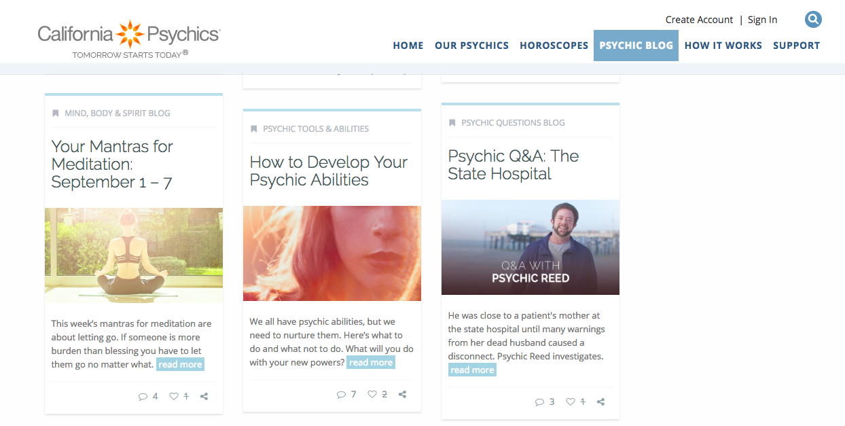
SUZANNE’S DIGITAL BRANDING WORK
Digital Property Redesign:
California Psychics
Product roadmap creation
KPI research and measurement
Campaign integration
CRM integration
Content Management System migration
Governance and workflow
Content creation, planning and management
Omnichannel strategy
Email template redesign
Site redesign
Publishing process overhaul
Landing page copy
Analytics dashboards
WordPress training
WordPress blog creation
Newsletter production
Audience Segmentation
Email KPIs
Direct mail catalog creation
KPIs:
Quadrupled blog traffic: 80K/month to 500K PVs/month
in 9 months
Increased new customer referrals from 85K to 400K in 6 months
Increased newsletter open and click through to highest rates (opens 7-8% of 3.5 mil subscribers, CTR: 74-95%)

Slide 23
KEY AREAS
Content Strategy
Storytelling Experience
Less utility-driven, reflect real scenes of life at home
Show how will the consumer’s life be changed by the product
Appeal to users by relating to their lifestyle
Intelligent Content
Ensure consistent messaging, branding, storytelling and
content delivery methods across the production life cycle.
Localization | Globalization best practices
Thematic, useful and reusable content production
within intelligent structures will cull down on translation efforts to create
a content pattern library across properties.
Key Areas

Slide 24
KEY AREAS
SEO
Increase Effectiveness of UX
Help users find solutions themselves
Decrease call volume
Search Engine Results
Build strawman taxonomies to facilitate faceted search. Determine top terms, page levels to crawl/index, create domain structure for multi-lingual SEO best practices.
Tactical Fixes
Identify duplicate content, outdated content and lower-performing pages for redirect strategy and landing page aggregation.
Best Practices
Consolidate all support information relating to a specific product on one comprehensive page - no searching support types in multiple locations
Key Areas

Slide 25
My Career Path
I was promoted to Staff Writer after 2 years.
I started as an intern.
2002-2005
DirecTV and Hollywood Reporter
2005-2007
Yahoo!
2007-2010
Celebuzz, CA Psychics, Rosetta
2010-2016
Built my consulting business
2016- now
Full-time consultant
Part time grad student
Laid off in 2000. Lost my brother. Hired again and worked one year before 9/11 in 2001.
2002
Moved to LA.
Notes:
You may use this chart to describe your journey to the current career

Slide 26
My Career
The first job I had after college was:
  Editorial Assistant at Ticker Magazine – from internship
The worst job I have ever had was:
  Office assistant when I moved to LA – cleaning up after models

Slide 27
My Career
Challenges I have had to overcome throughout my career are:
  Not having a huge network in LA
  Having to learn on the job
  Learning software systems or new SEO updates and algorithms on the job
  Being taken advance of
  Working hard at times, not smart
  Dealing with workplace harassment

Slide 28
My role within organization
CEO (ME)
MANAGEMENT
PROJECTS
PROJECTS
PROJECTS
Notes:
Use this graph to give more description of your role specifically (responsibilities, typical work week, direct reports, etc.)

Slide 29
More than just work
When I am not at work I like to:
  Study and complete my graduate school courses
  Spend time with my husband, a Navy veteran, in grad school
  Volunteering at a lay Buddhist peace keeping organization
  Lift weights and bodybuilding (competed in 2016)
  Playing with my Goldendoodle, Clovis
  Listening to music
  Inspiring people at Buddhist discussion meetings
  Boogie boarding
  Reading on the beach
  Blogging

Slide 30
Do it all over again?
If I could talk to my high school self, what would I say?
  You’re working so hard, do not be hard on yourself
  Have more fun

Slide 31

QUESTION AND ANSWER

