Slide 1
Steve Parkford
“Picture the Outcome”

Slide 2
INTRODUCTION
My name is Steve Parkford and I am 66 years old.
I work for Parkford & Associates, Inc.
My company does:
Executive recruiting in automotive industry
My role at P&A is President
Every day I research on the internet for potential candidates who might fit job positions I am contracted to fill

Slide 3
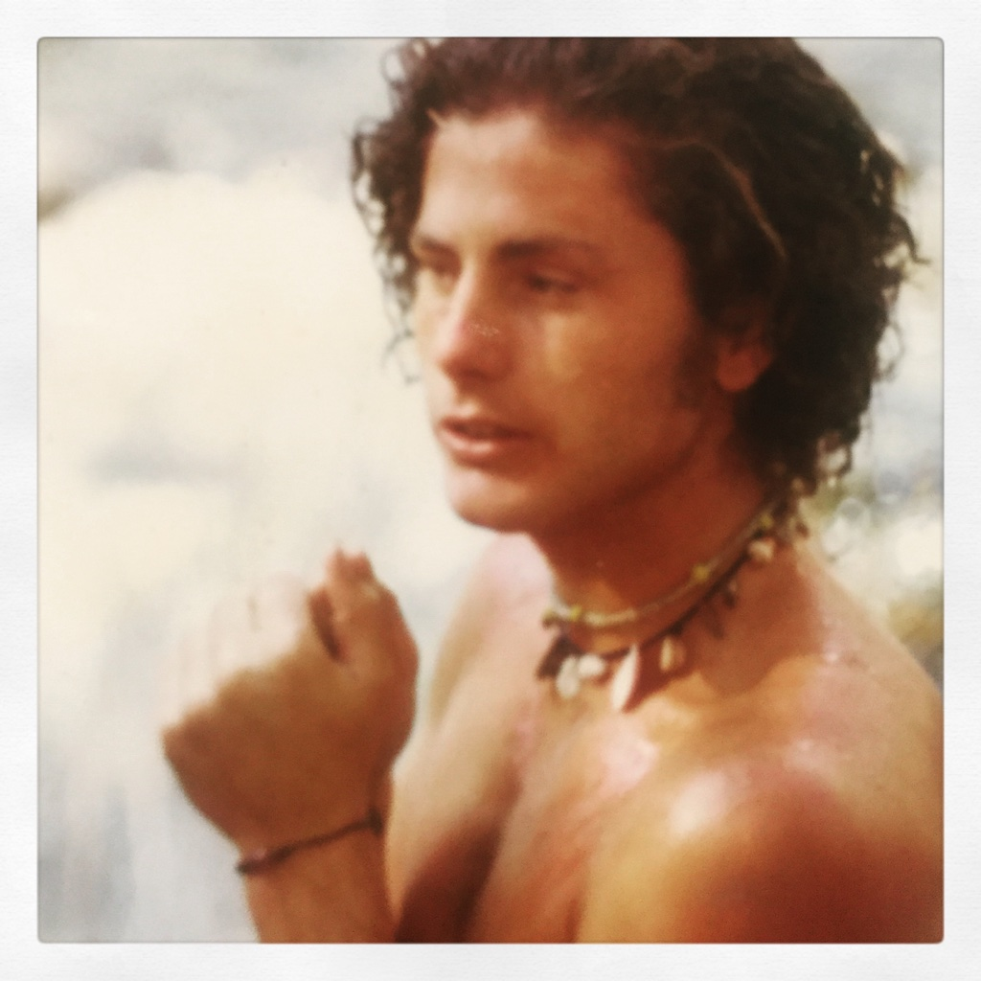
My childhood
I was born in Oceanside and raised in Newport Beach
This is a picture of me at 18 age right after high school

Slide 4
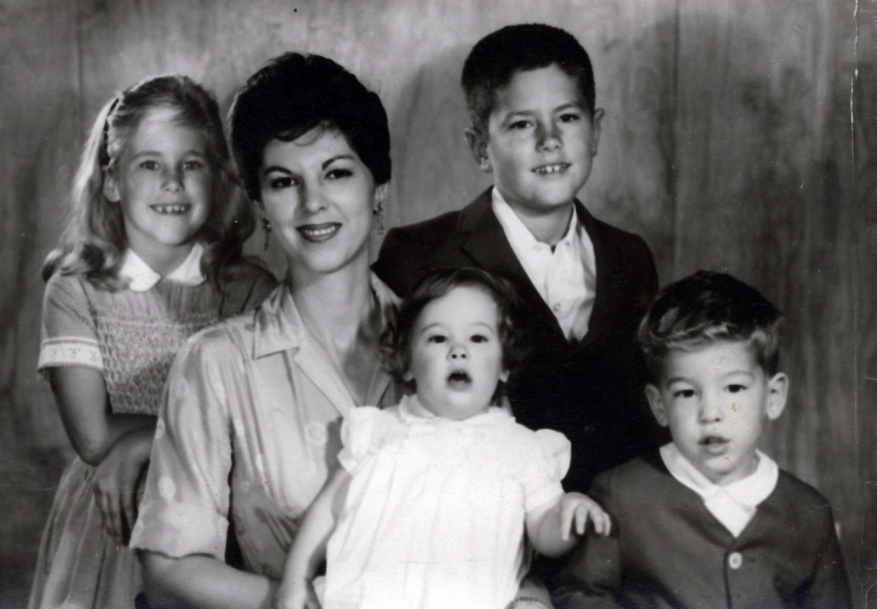
My family
A little about my family
Grew up in Socal – parents divorced when I was 12
High school in Newport but sent off to “boarding school” for 11th & 12th grade – changed my life
This is a picture of my mom, me, my sister Linda, little brother Ken and little sister Heather

Slide 5
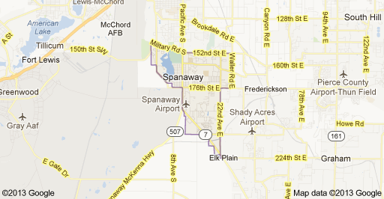
MY HIGH SCHOOL
I attended Cate School in Carpinteria, CA

Slide 6
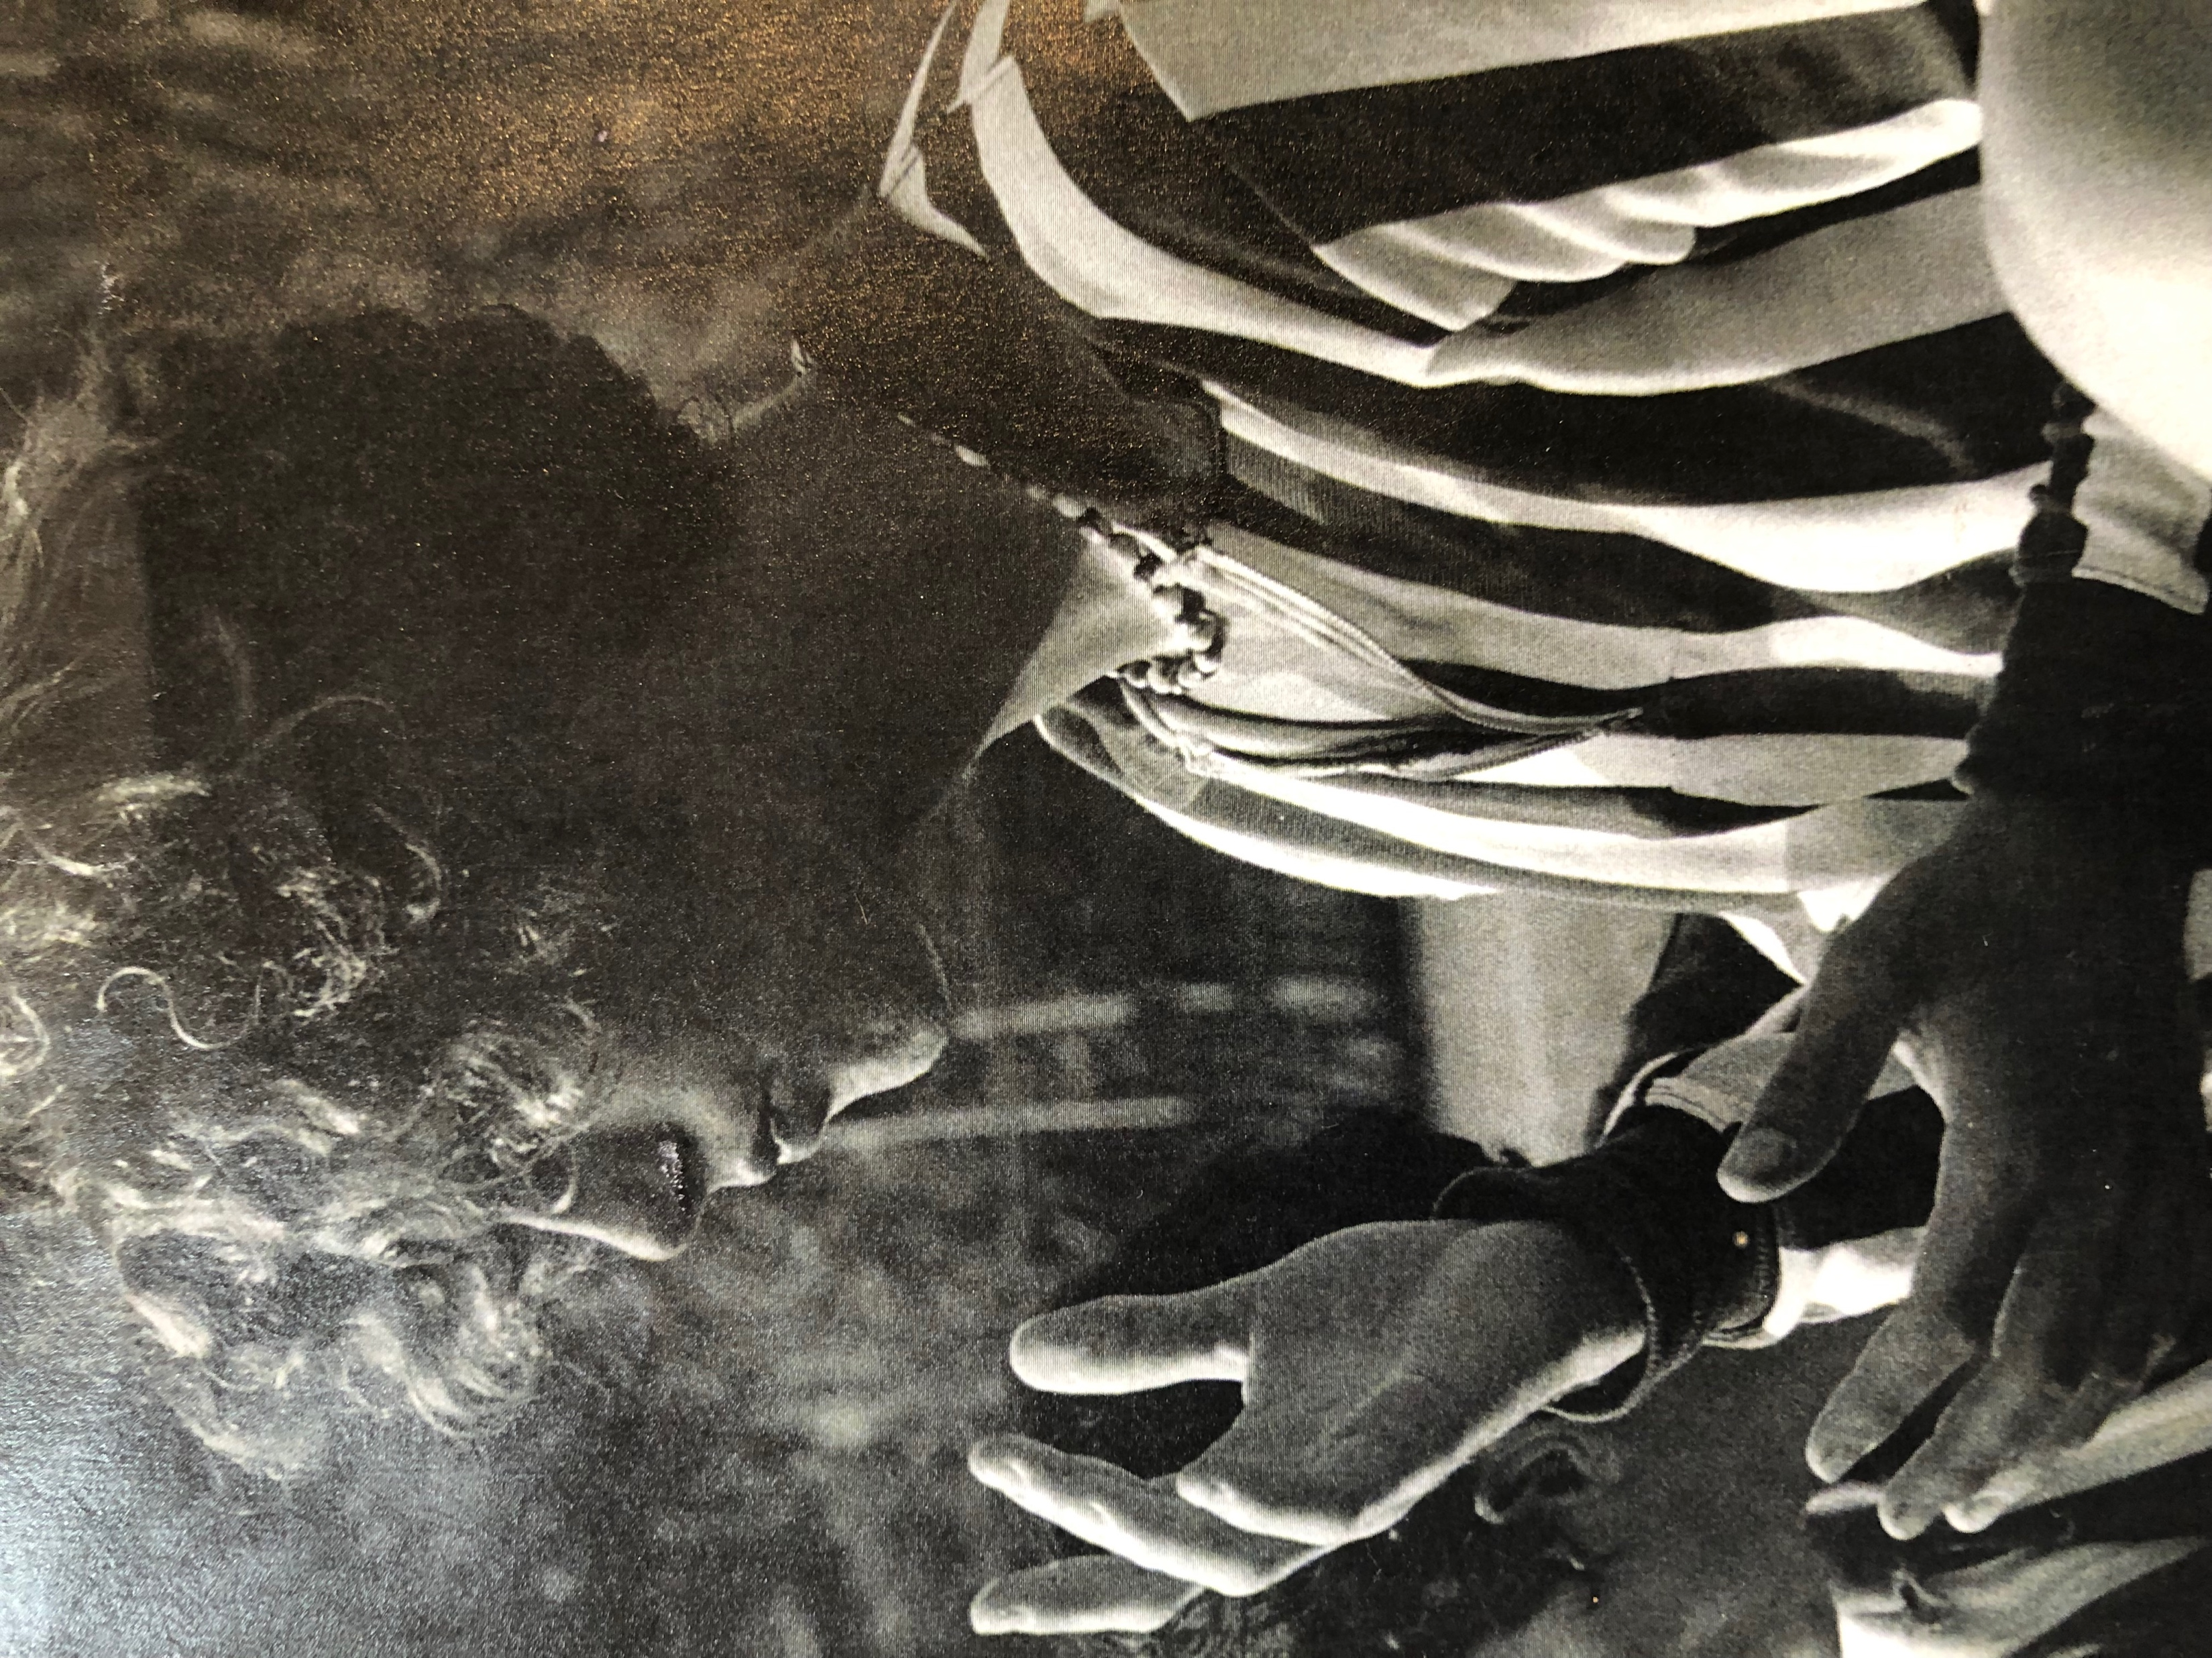
High School
As a HS student I was lazy, athletic, super curious, social and very shy of girls (unfortunately!).
Here is a picture of me in HS

Slide 7
High School
Things that I really liked in High School were:
Water polo, Lacrosse, Soccer
Philosophy
Math
English – reading classics !
Hanging out and talking about our studies
Books
Philosophy – Plato to Camus
Politics of Viet Nam War
Goofing around between classes

Slide 8
High School
Things that felt difficult or challenging for me while I was in High School were:
Creative writing – getting my ideas across to others
Spanish – remembering the language rules
Physics – formulas
Chemistry –
GIRLS !

Slide 9
High School
Jobs I worked while I was in High School were:
Busboy
Dishwasher
Window cleaner
Paper boy
Leather “stamper” for belt company
Ranch Hand – feed horses, cleaned stalls (ugh)
Fisherman (with my dad who was a commercial fisherman)

Slide 10
Getting in to College
The top few things I did to ensure I got into college were:
Private Boarding School gave me an extra advantage
If I stayed at Harbor High would not have gone to college

Slide 11
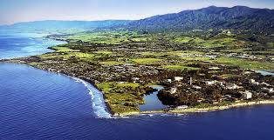
College
I attended college in Portland, Oregon,
Humboldt, CA and
UCSB
Insert map shot here

Slide 12
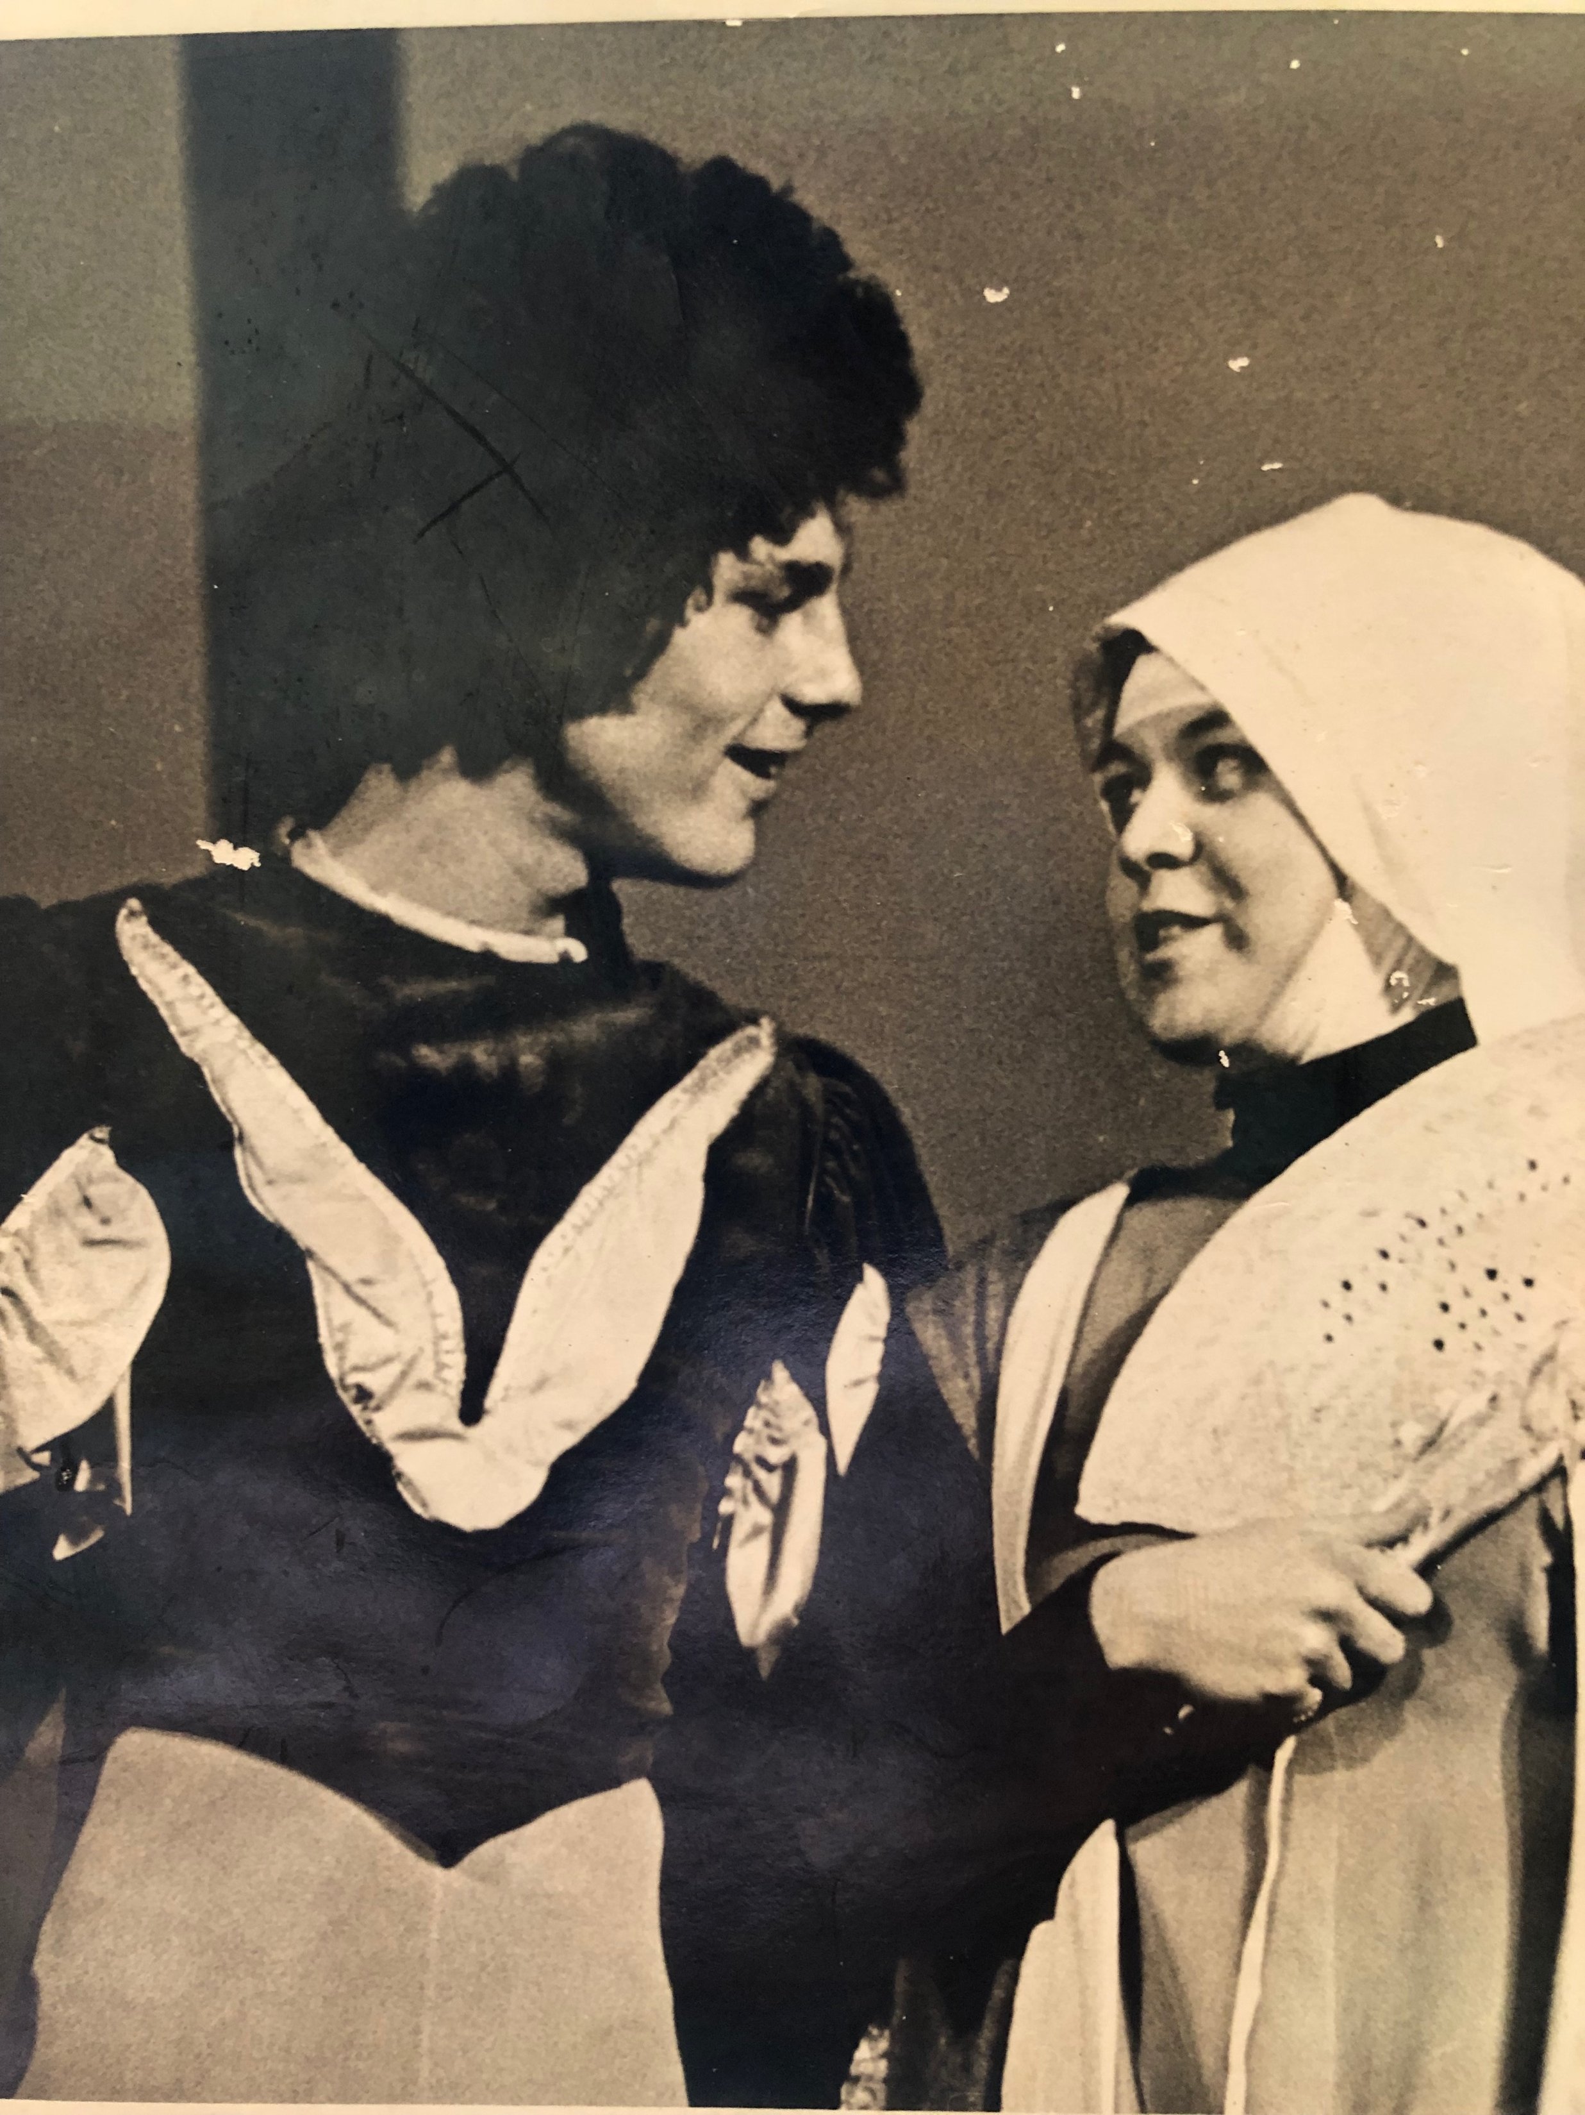
College
Things I enjoyed in College
Things I didn’t enjoy in College
Film Studies
Filmmaking
Putting on films for $
Acting in plays
Pressure to write papers
Reading
Too much free time

Slide 13
College
Favorite classes
Least favorite classes
Aesthetics of Cinema
History of Film
Anthropology
Art History
Electronics
Spanish

Slide 14
College
Jobs I worked while I was in College were:
Waiter – worked 8 different restaurants
Pizza Parlor – cook

Slide 15
College
Things that felt difficult or challenging for me while I was in College were:
Surviving on $15 a week for food
Using food stamps to eat
Having a crappy car (Ford Falcon)

Slide 16
Getting a job after College
The top few things I did to ensure I got a good job after college were:
Have a realistic resume
Looked presentable
Smiled a lot
Picked an industry – Advertising – and keep applying and learning about what entry level jobs there are to have

Slide 17
This is My Company
Sales – get clients – create trust
Recruit – research for candidates – entice employed
Select and Present – top 4-6 candidates
Started 2007
11,500 Linkedin connections
Placed: VP, Sales, Service, Parts, Marketing,
Estimate150 automotive jobs filled
Fees are based on base salary 20-30% of annual salary

Slide 18
My Career Path
Advertising – “traffic manager”
Advertising – TV & Radio Producer
Sales of company films/slide shows and events”
VP General Manager of production company
Junior Recruiting Mgr.
Notes:
You may use this chart to describe your journey to the current career

Slide 19
My Career
The first job I had after college was:
Waiter
Print Traffic Manager for Advertising Agency
The worst job I have ever had was:
None – all good learning jobs

Slide 20
My Career
Challenges I have had to overcome throughout my career are:
Being the boss is lonely
Going my own way was lonely
Resisting peer pressure to be and act a certain way
Going bankrupt twice
Being fired from a job

Slide 21
My role within organization
President
Assistant
Researcher
Recruiters
Data Base Mrg
Notes:
Use this graph to give more description of your role specifically (responsibilities, typical work week, direct reports, etc.)

Slide 22
Compensation in Recruiting industry
Banking/Lawyers/CEOs
($350K- 750K)
Management
($100-250K)
Middle Manager
($75-100K)
IT/ Accounting
40-75k
Notes:
Use this graph to show general compensation ranges for people in various roles in your company

Slide 23
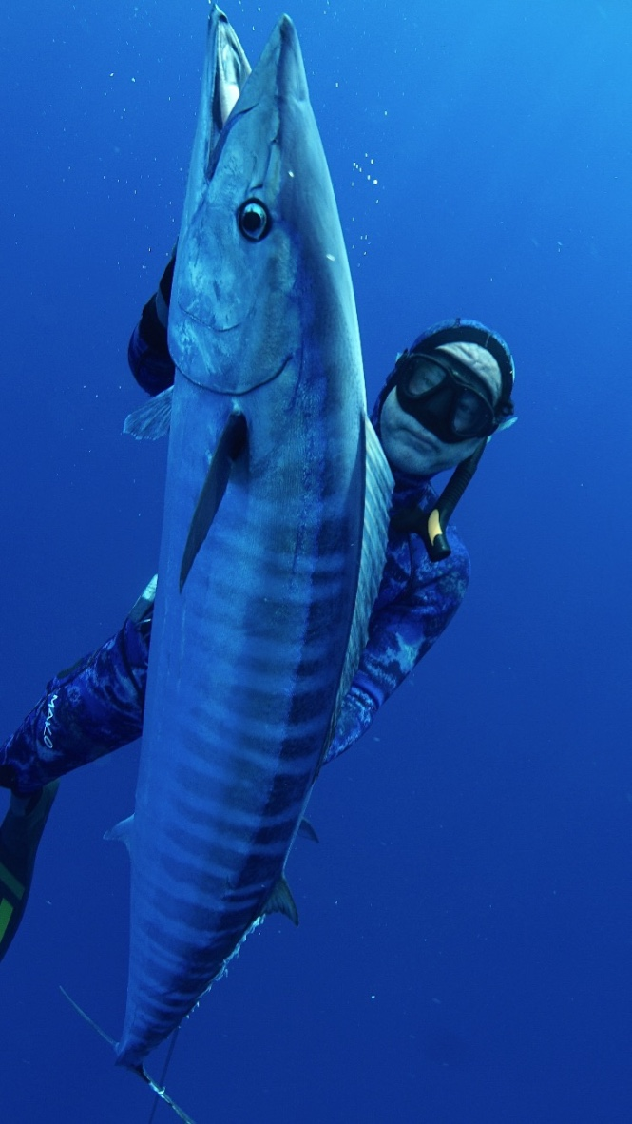
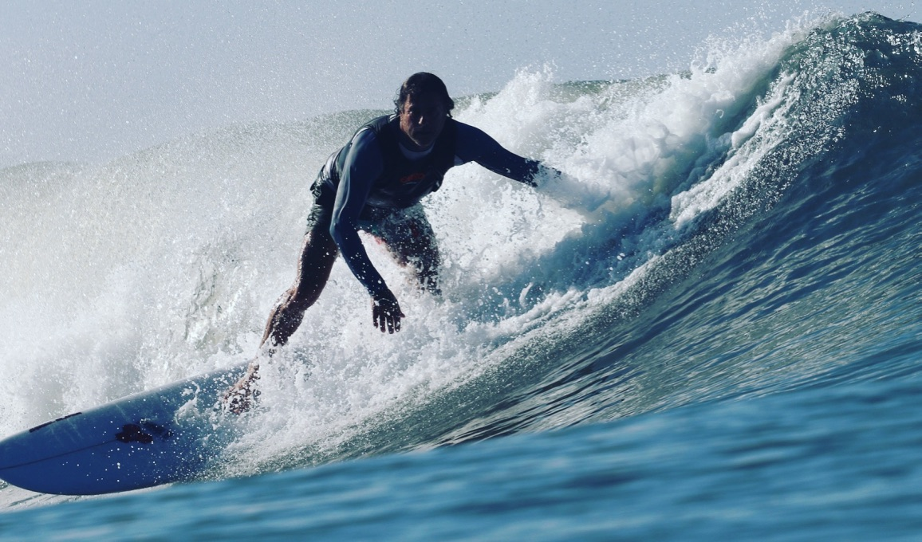
More than just work
When I am not at work I like to:
Spearfish
Surf

Slide 24
Do it all over again?
If I could talk to my high school self, what would I say?
Move to the city where your dreams can come true
Constantly make connections
Say ”yes” to every opportunity
Don’t waste time, wasting time
Don’t chase “the party”
Picture the ultimate outcome
Refine that image
Make little steps toward that goal
Recognize everything as progress

Slide 25
QUESTION AND ANSWER

