Slide 1
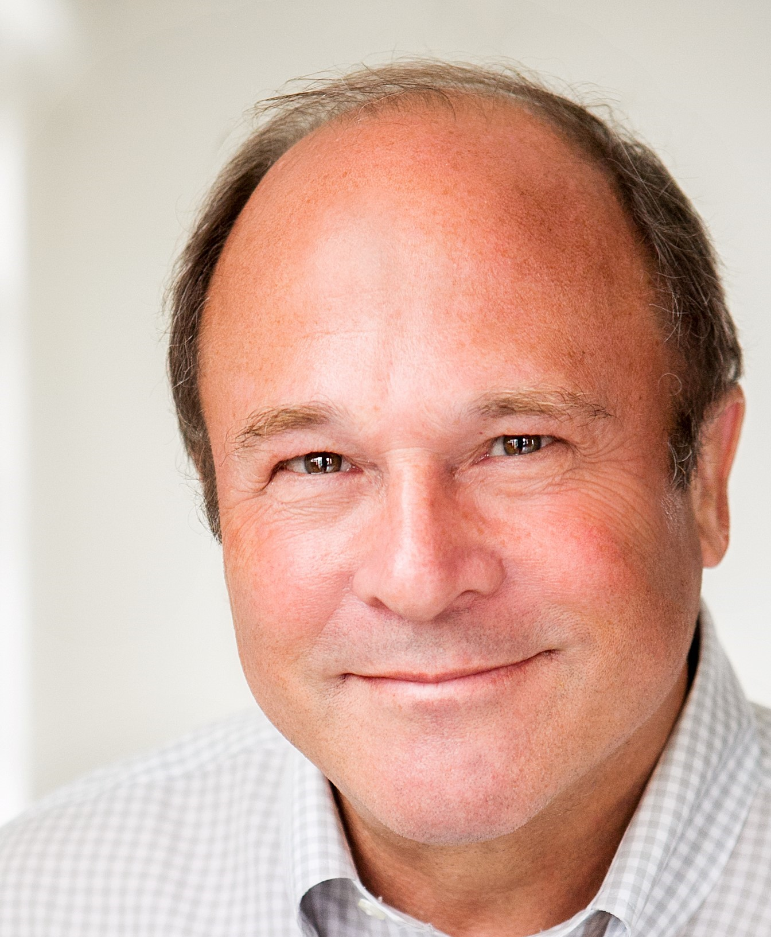
Howard donaldson
Business Executive & Consultant
My Life Journey
Santa Monica, CA
June 2018

Slide 2
agenda
Where will your Journey take you
Today
Key Learnings and Decisions
Personal Story – What I learned growing up
Career/Business – Fascinating Journey
Classroom Project – 3 Relevant Activities
Q&A

Slide 3
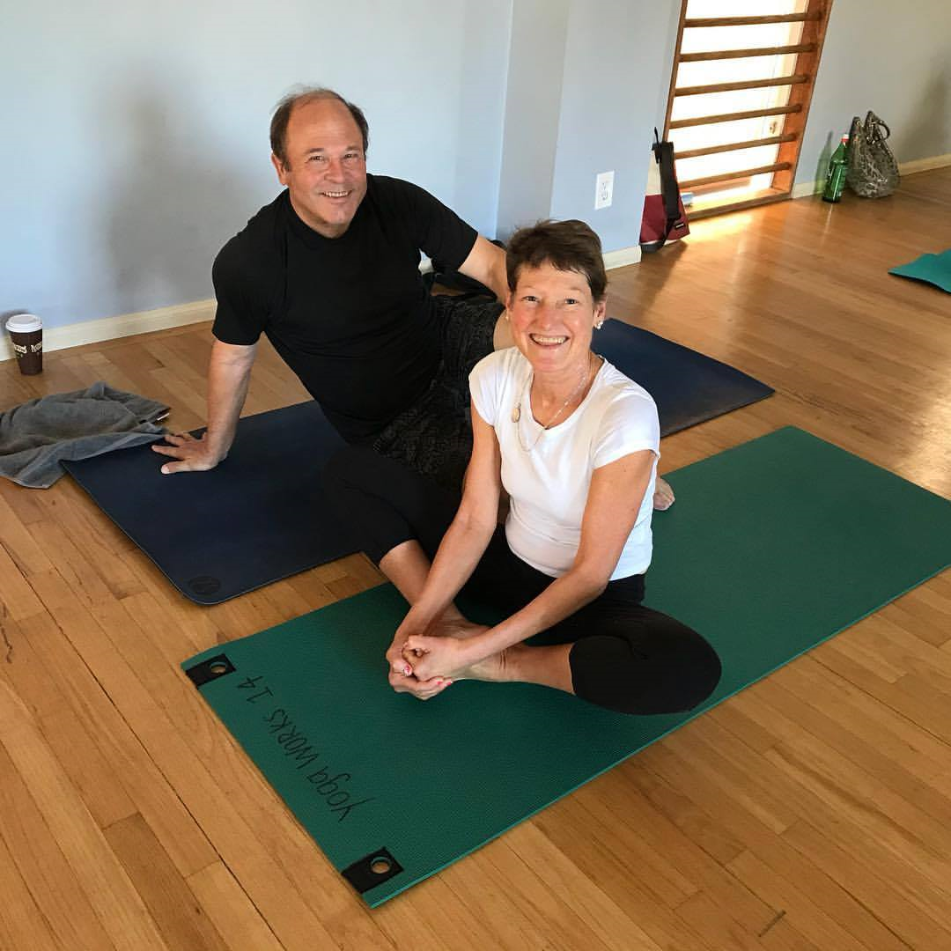
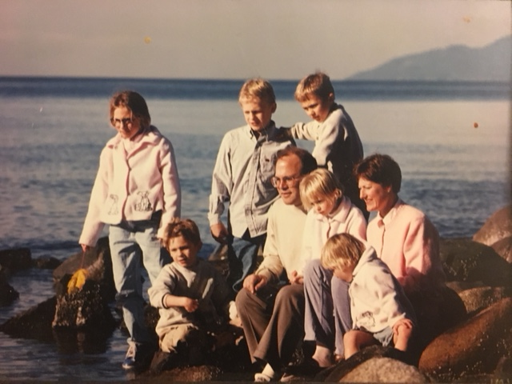
today
We Help Your Dreams Become Your Reality
Married with 6 Children
Children are older and all working
Twin daughters University Athletes on scholarship
Stay active - Yoga, running, Hiking, Golf, Skiing, travel
CEO – Lunar Owl Consulting
Advise tech, video game and entertainment companies
Business consulting, M&A and entertainment deals
Work with My oldest son who is game agent
many clients and achievements

Slide 4
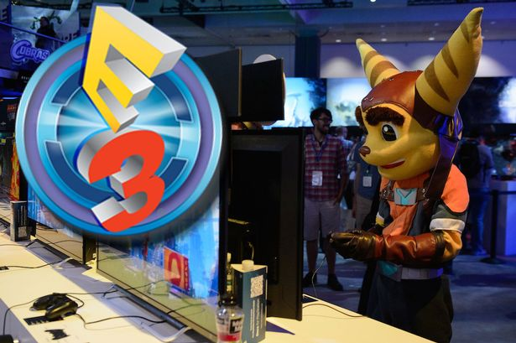
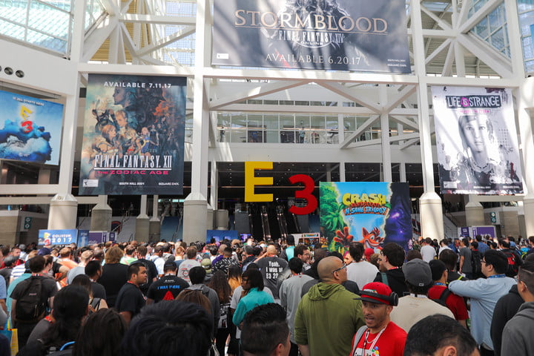
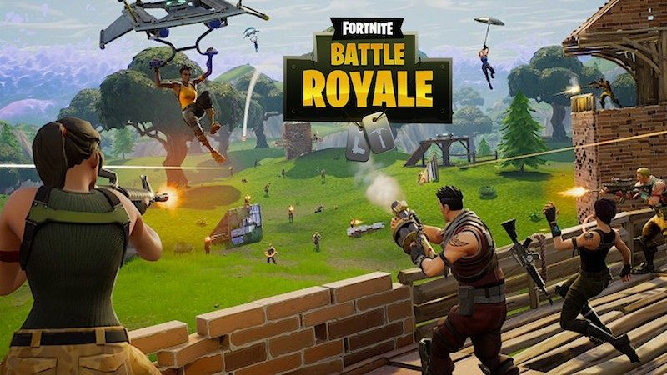
Attending next week in LA

Slide 5
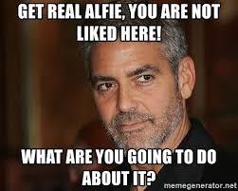
This is my favorite quote
It’s not what situation you find your self in or what happens to you that matters:
It’s what you do about it

Slide 6
We are all on a different journey; There is no one right way to get there
Example:
LA Freeway and Major Highway System
Find the best way to get from point A to point B

Slide 7
The Beginning
Born in Grand Rapids, MI as identical twin and 5 brothers
My father was a factory foreman; my mother raised dahlias and won numerous awards
She managed the family and the budget
We went to church every Sunday without fail
We were expected to study hard, play sports and a musical instrument
My parents were strict and had a negative outlook on life
They experienced the great depression and their families lost all their money

Slide 8
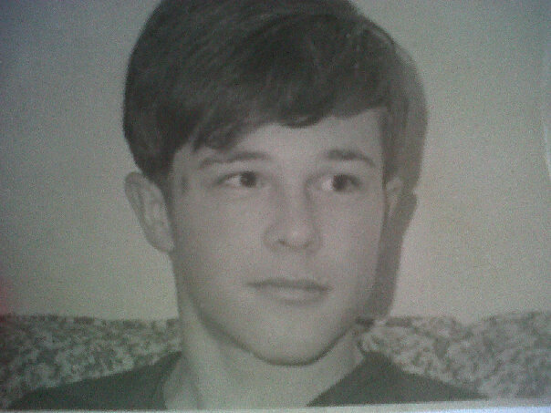
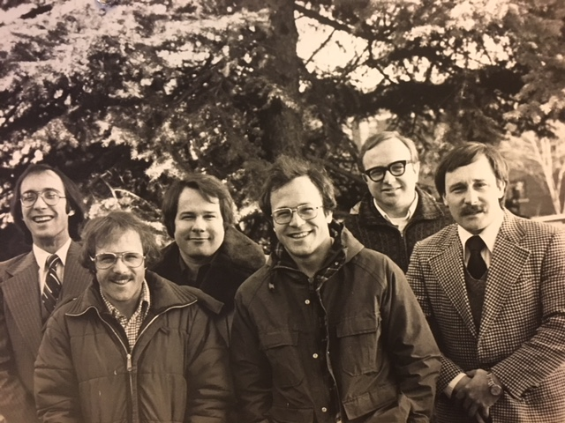
My Early Life
In elementary and middle school I was an average child
In High School, I changed
I studied hard and excelled academically
I played football and Wrestling as expected but quit both
I found my calling as captain of the tennis team and ranked regionally
I played trumpet in the Orchestra

Slide 9
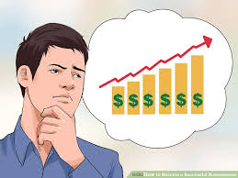
My Early Decisions
I felt ashamed of my family and could not tolerate the negativity
We had many conversations but they went nowhere
I lacked confidence
I decided I wanted to be a successful businessman but had no idea what it meant
I felt I needed to find a way out of my current situation
I decided to focus on academics; I was very good at math and analysis
My goal was to attend a major university
huge problem: My parents had no money; Neither did I

Slide 10
Early Learning
Set a big hairy ass goal and don’t worry about how you will get there. You will subconsciously figure out a way if you commit, are determined and persistent
It’s okay to get advice and support but you need to make the final decision and own it. Commit without judgement until you reach competency at a high level (5 – 10yrs)

Slide 11
Our life is integrated: each aspect of our life affects another aspect whether we like it or not

Slide 12
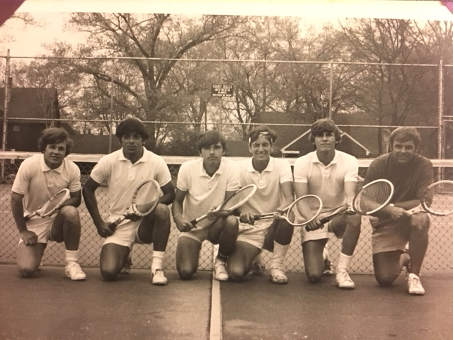
Entered Business School with co-op Program
Interned at Comerica Bank and Ernst & Young
Focus on Finance and Accounting
Aced Calculus: But never used it in my life
1st two yrs at Grand Rapids Junior College – Top Scholastic Athlete
Three jobs: Auto Parts Factory; Taught Tennis; Academic Tudor
Graduated with honors and no debt

Slide 13
Detroit Office
My 1st real professional job
I had 5 offers before I graduated; I was one of a few who received offers
I was on the Audit Team and progressed to Audit Director
Learned a lot about how businesses operate
Each 1 yr is worth 2 yrs in business
Key Learning: Do not automatically accept what people tell you; be skeptical and do your own homework
Key Decision: I did not want to be an accountant

Slide 14
Global Mainframe Company
Manager – International Accounting
Became expert in foreign currency Transactions and Management Reporting
Several published articles
MBA – University of Detroit
Adjunct Professor – International Economics and Finance
Promoted to Manager Mergers & Acquisitions
Recognized for computer model I built – Determined what companies to buy and impact in 1 day
Key Learning: Exec VP taught me - Nothing is Impossible
Key Decision: Time to leave; Unisys was not good managing acquisitions
and I needed operating experience

Slide 15
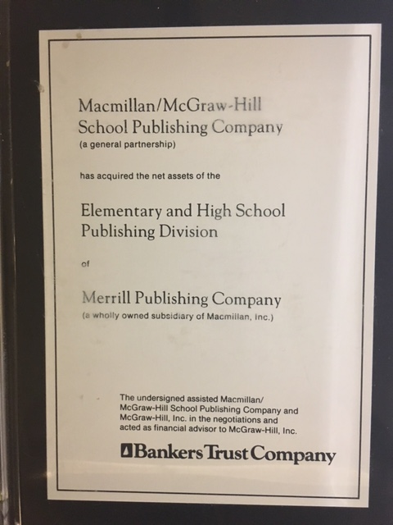
MERRill Publishing High School/Post Secondary Education Materials
Accepted offer - CFO of Merrill Publishing
$100 mil Revenue and excellent profits
Requested by Bell & Howell to Sell Company
Sold Company in 8 months for $300 Mil
Worked with Bankers Trust
Received a substantial bonus
Key Learning: How to sell a Company

Slide 16
Macmillan McGraw-Hill School Publishing Joint Venture
Joined executive team as Sr Vice President - Finance
formed as spin out of 11 losing companies including profitable Merrill Publishing
JV required to fund its own operation – Major reorganization and 50% of staff terminated
Employee morale reached an all time low for several months
JV became profitable and largest educational publishing company
Major management shakeup and executive exchange with Harcourt Brace Jovanovich
JV sold back to McGraw-Hill for $2 Billion
Key Learning: How to turn around a business successfully

Slide 17
VP/CFO – Disney Interactive Education
Developed a long term strategy and operating plan
Created online world embedded with learning called - Curio
Presented to Disney CEO - Michael Eisner
Executives required to Retrace Walt Disney’s Steps
Promoted to VP – Finance & Admin – Disney Interactive
KEY LEARNING: Walt only wanted your biggest idea
KEY DECISION: Many companies wanted people with Disney Experience. I received multiple offers

Slide 18
We can learn a lot from others: especially people who have achieved great success

Slide 19
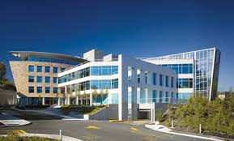
VP/CFO – Largest EA Game Studio
Responsible for quarterly meetings with EA Worldwide Executive Team
Directed 1st Strategic plan
Achieved 30% + annual growth to $1 Bil in Revenue
Developed green light process to approving new game projects
Oversaw design and construction of 600,000 sq ft studio facility
Top titles: FIFA, NFS Underground, SSX, DefJam, NBA Live, Fight Night
Key Learning: How to scale a large company. I love working in video games

Slide 20
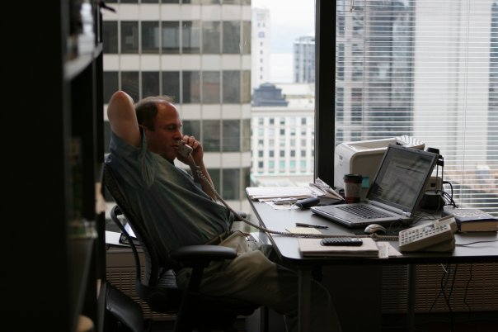
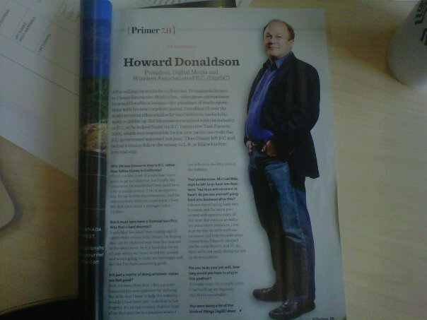
Co-Founder and COO – New Game Studio in Vancouver
Negotiated contract with Disney in one meeting
Developed and released Turok and Tron Evolution
Negotiated sale to Disney and grew studio to over 200 development staff
Recognized widely in Canadian Media
Key Learning: Choose your co-founders carefully. It’s fun starting a new company

Slide 21
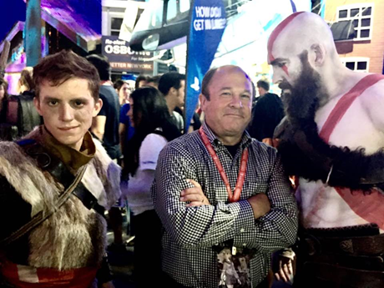
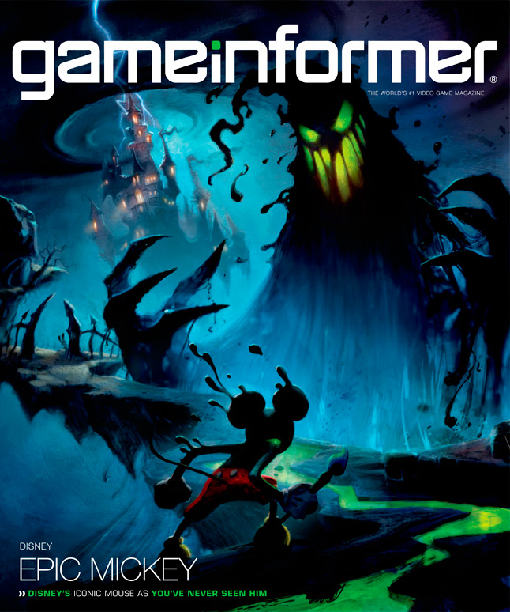
again
Promoted to VP Studio Operations for Disney Interactive
Directed strategic plans for all interactive Studios
Set up new Studios in Austin, TX, Shanghai, China and Chicago, IL
Participated in redesign of mickey Mouse and new Epic Mickey game
Key Learning: Greenlighting games decision is critical to success

Slide 22
Partner and CFO for Fund – 3 Partners
Venture Capital Fund in Vancouver – Raised $136 Mil 1st Fund/ $160 Mil in 2nd fund
Invested in Technology, Digital Media and Video Game Companies
Directed Turnaround from Negative IRR of (-84%) to positive 19%
6 successful exits and positive traction on other investments
Developed real time IRR model for managing performance by portfolio company
Developed plans to scale startup companies
Key Learning: Venture capital and how to scale companies

Slide 23
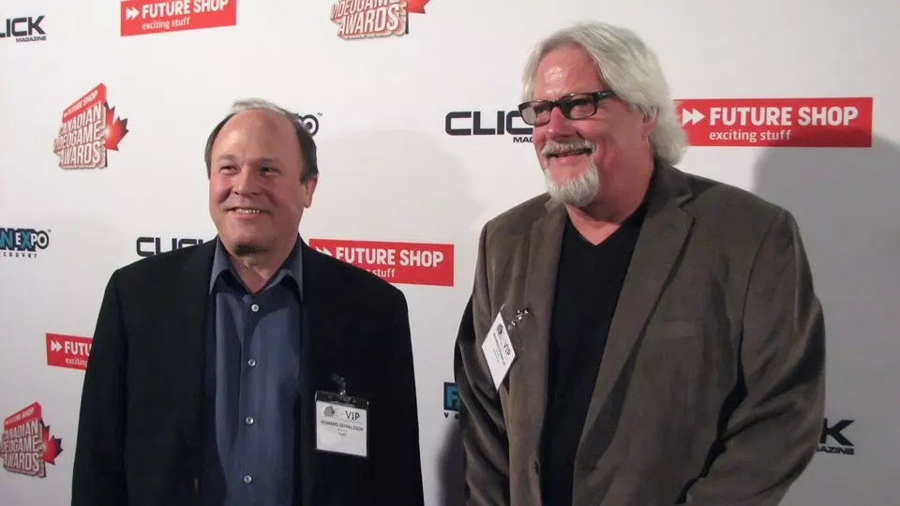
Chairman/President – Digital Media Association of British Columbia
Organized Games Conference and Awards Show
Created NEXTBC – Recognized Top Innovative Companies in BC
Directed 1st Digital Media Tax Credit in BC for Game Companies
Key Learning: How to work with and influence government

Slide 24
Classroom Activity #1 – Should I invest in this Company?
Founded 1985 as natural gas pipeline
Transformed into largest energy trading company and 7th largest company in US
Exploited deregulation of natural gas and electricity prices
Further diversified in paper, water and broadband services
Became darling of Wall Street
Should you invest at the end of 2000?
What questions are important?
$ in Mil | 1996 | 1997 | 1998 | 1999 | 2000
Revenue | 13,289 | 20,273 | 31,260 | 40,112 | 100,789
Net Income | 584 | 105 | 703 | 893 | 979
EPS | 1.08 | 0.16 | 1.01 | 1.10 | 1.12
Dividends /Share | 0.43 | 0.46 | 0.48 | 0.50 | 0.50
Cash Flow | 742 | 276 | 1,873 | 2,228 | 3,010
NYSE Price
- High | 23 | 22 | 29 | 44 | 90
- Low | 17 | 17 | 19 | 28 | 41
- Close | 21 | 20 | 28 | 44 | 83

Slide 25
Classroom Activity #2 – Should I invest in this Company?
Two founders began experimenting with a plant based mozzarella and cheddar cheese alternative that was dairy, gluten and soy free in 2005
Brought on Food Scientist in 2008 to scale and refine their invention
They decide to raise $4 million from local angel community in 2008
You taste the cheese and it is delicious and similar in many respects
They promise to focus on profitability from day 1 and not expand too fast
Local companies and restaurants are already pre-ordering the product
The funding round is filling up fast with experienced and wealthy investors
The Company does not plan to raise a 2nd round
Your investment company and others tell you not to invest because it is too risky
What should you do?

Slide 26
Classroom Activity #3 – Should Your State implement a Digital Media Tax credit to encourage high paying software technology jobs primarily in Video Games?
You work in business development for the state of Michigan
You have noticed video games industry is fastest growing entertainment sector
The industry creates jobs that pay average of 2x the average wage
The workers are young, educated and highly marketable around the world
The game studios hire full time employees rather than short term contractors
Government programs are highly competitive to attract the best talent
You are worried about backlash from other industries and local community
You are also worried if the cost/benefit relationship will be favorable
What are the important factors to consider?

Slide 27
Final thoughts
Be Grateful for who you are, what you have to offer and what you have in your life
Have gratitude for your parents, family, friends, work colleagues and other people who enter your life

Slide 28
Q&A
Feel free to ask any questions
All questions and comments are welcome
Thank you for allowing me to share my life story
I hope you are all happy with your future life story!

