Slide 1
My name is Denis Faye. I’m 48-years-old.
I’m the Executive Director of Nutrition at Beachbody LLC, an in-home fitness and nutrition company.

Slide 2
What obstacles do you face in going where you want to go in life?

Slide 3
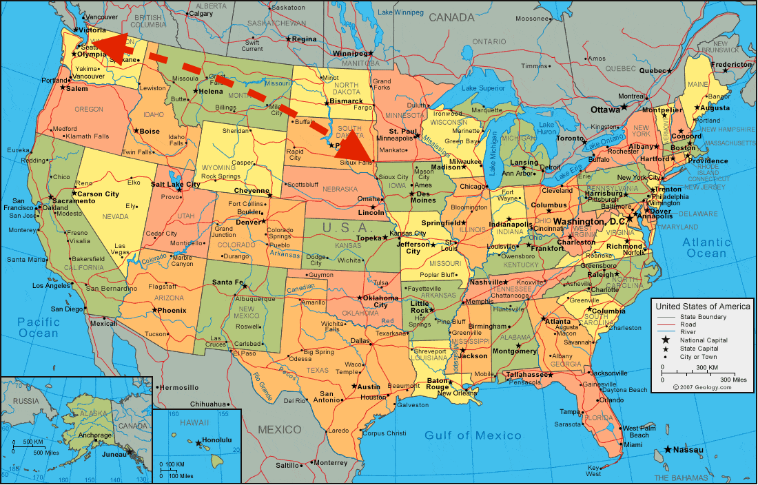
I moved around a bunch as a kid. In Sioux Falls, I switched grade schools between third and fourth grade.
Then, after sixth grade, my family moved from Sioux Falls, SD to Edmonds, WA.

Slide 4
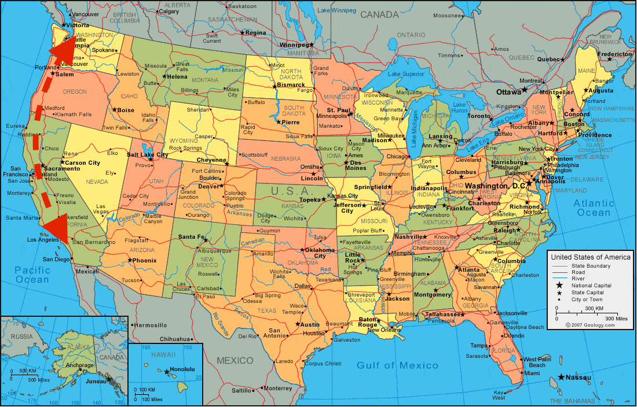
After tenth grade, we moved from Edmonds to Laguna Hills, CA.

Slide 5
It was challenging at the time, but it taught me how to adapt to new situations and make friends quickly.

Slide 6
What do you want to do after graduating and how are you making that happen?

Slide 7
In high school, I had no idea what I wanted to be, but I knew it was important to keep my options open.
Maintained a decent grade average.
Involved myself in a meaningful way in activities like sports, drama, and student government.
Tried hard not to be a jerk.

Slide 8
After high school, I still wasn’t sure what I wanted to be. To make matters worse, my family was completely broke.
But I’d kept my options open and worked hard, so…

Slide 10
How I paid for it
Pell Grants
Academic Scholarships
Student Loans
Jobs:
Working in two video stores
Writing/editing for the student newspaper
Writing for two other newspapers
Construction clean-up
Chauffeuring new students
Working in the cafeteria
Several other jobs I’ve deleted from my memory

Slide 11
By sophomore year, I was still undecided. I just knew I loved writing. An advisor told me to get a degree in something I would want to write about, so I chose Film Studies.

Slide 12
After college, I decided I wanted to be a journalist, but took some bad advice and ended up working in advertising.

Slide 13
Make the best of what you have…

Slide 14
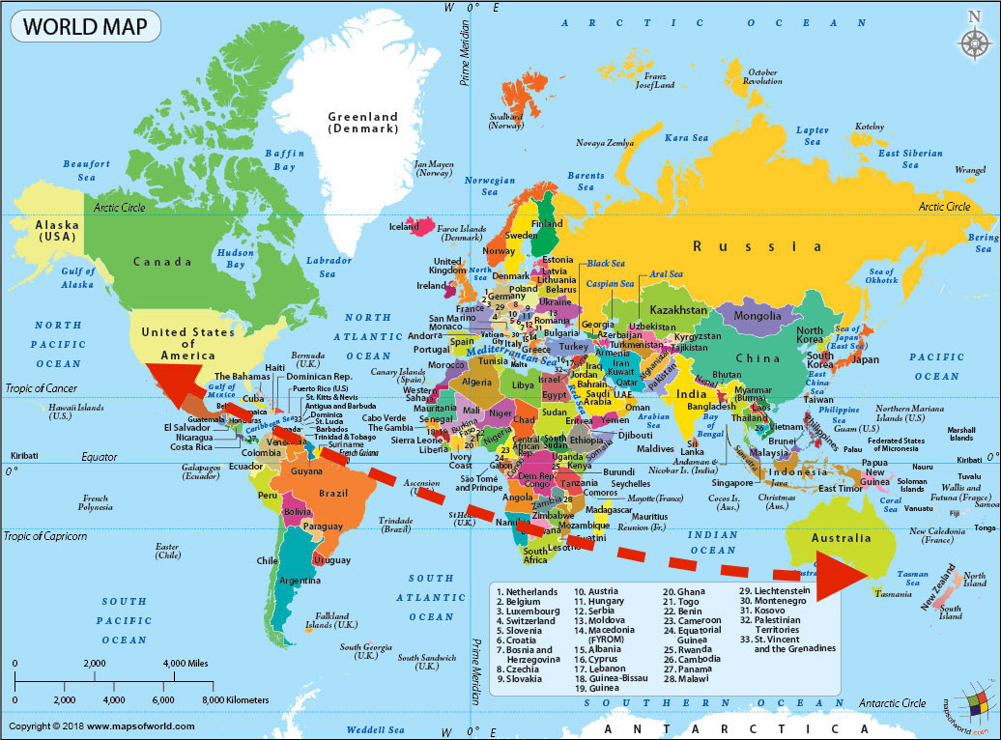
I hadn’t travelled much, so I talked my advertising firm into transferred me to Melbourne, Australia.

Slide 15
Don’t be afraid to reboot.

Slide 16
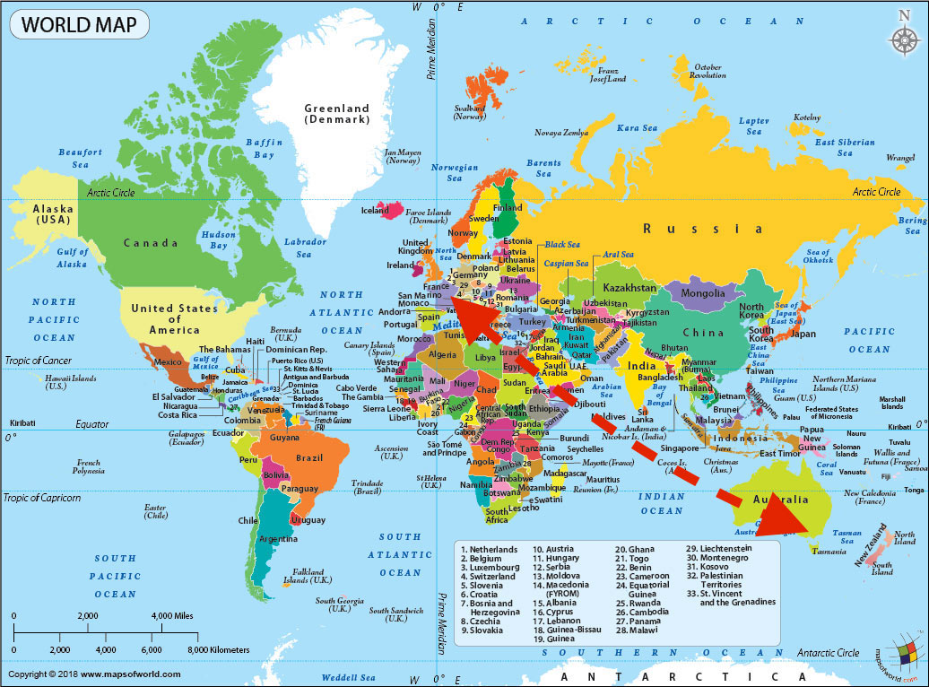
I quit advertising, went back to journalism, saved my money, and moved to France for a year.

Slide 17
What’s your big, crazy dream?

Slide 18
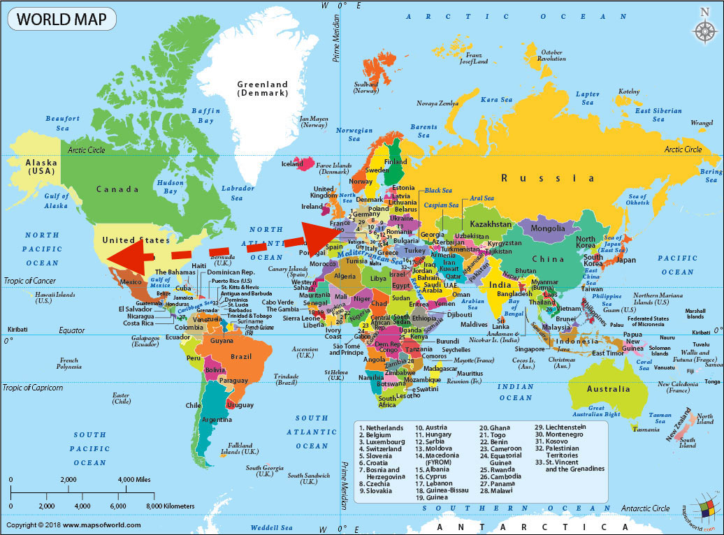
I decided to return to the US and be a screenwriter in Hollywood.

Slide 19
I spent twelve years as a screenwriter with some success but little money, so I took side jobs to help support my family.
One day, I woke up and realized one of those side jobs had replaced screenwriting as my passion.

Slide 21
I got this gig from my boss at a video shop in college. (Lucky I wasn’t a jerk!)
I went back to school to earn a Masters so I’d be more qualified and easily promotable.

Slide 23
I have a Masters in Holistic Nutrition and I oversee a staff that reviews or creates all nutrition content, including nutrition guides, videos, blog articles, and marketing content to make sure it’s accurate and useful to our customers.
In other words, I get paid to help people.

Slide 24
My Career Path
Moved to writing nutrition guides.
Started out freelance, writing articles.
Oversee a staff and report directly to the CEO.
Notes:
You may use this chart to describe your journey to the current career

Slide 25
If you have a path, go for it. If you don’t, stay flexible by working hard and not being a jerk.
Go for your dreams now. You’ll have time to change course later. And if you don’t have dreams, keep your options open and maybe your dream will find you.

Slide 26
QUESTION AND ANSWER

