Slide 1
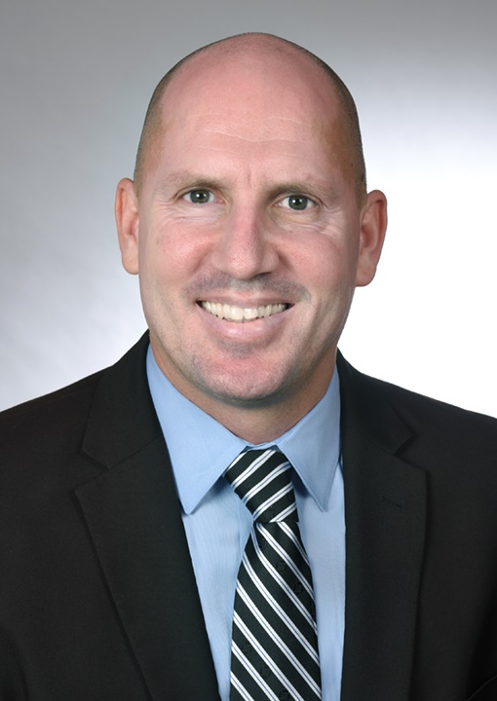
INTRODUCTION
My name is Ken Stovall and I am 43 years old.
I work for Citizens Business Bank (CBB) in Burbank, CA.
CBB is the largest financial institution headquartered in the Inland Empire region of California. The Bank has $12 billion in assets and 65 branches throughout the state.
My role at Citizens Business Bank is Vice President, Relationship Manager.
I develop and manage a portfolio of commercial clients up to $200 million in revenue by offering a full suite of banking services including conventional owner-occupied and non-owner commercial real estate loans, multi-family properties, SBA loans, lines of credit, and equipment finance.

Slide 2
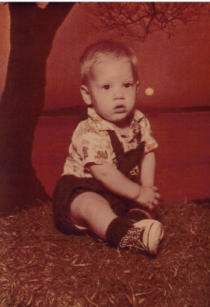
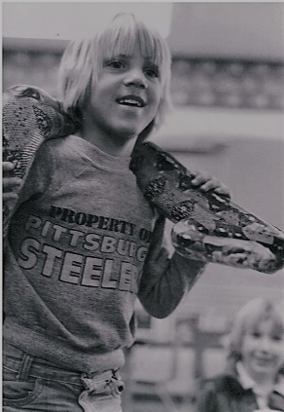
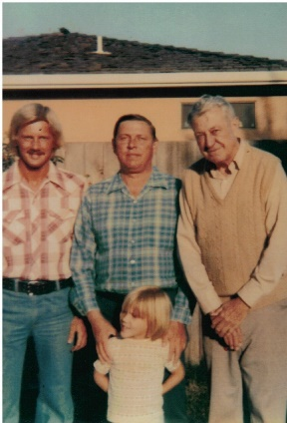
MY CHILDHOOD
I was born on Eglin Airforce Base in Florida in 1974 and grew up in Santa Cruz, California with my three sisters.
My childhood was often tough, for I lived in a very dysfunctional and economically disadvantaged family. I was often made fun of for my appearance.
I was a very sensitive, opinionated, moody and adventurous/hyper-active kid (with several trips to the ER with broken bones and stitches).

Slide 3
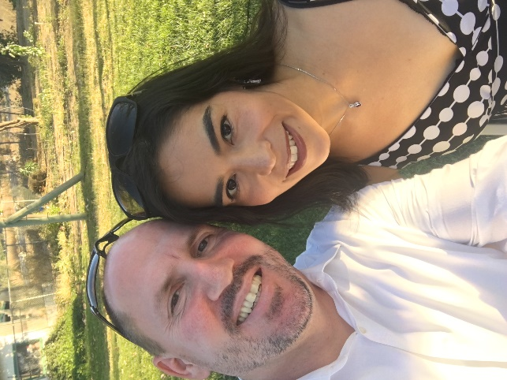
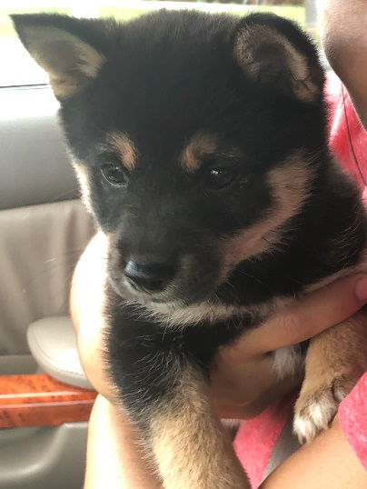
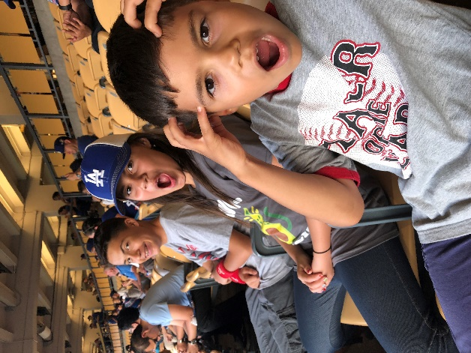
MY FAMILY
I met my wife in College at Cal State Northridge in 1999 and we’ve been married 14 years.
We have three beautiful children: Kenny (13), Fianna (10), and Joseph (8).
We recently included a new member to our family, our Shiba Inu, Yuki (means “snow” in Japanese).
I live in Chatsworth, CA

Slide 4
EDUCATION
I attended and graduated from the following schools:

Slide 5
HIGH SCHOOL
Things I really liked in high school were:
Classes: Sociology, P.E., History and Video Production.
Competing in Cross Country, Wrestling and Track & Field. Sports were my escape from stress and allowed me to channel my frustrations into a more positive outlet. Sports made me tougher and taught me the value of hard work, goal setting, teamwork and overcoming adversity.
Despite being an average performing student, I loved teachers who challenged my logic, encouraged me to express my thoughts and consider the viewpoints of others.
Gorging myself on 29 cent tacos at Taco Bell about a block from school.
Making friends with people from all walks of life.

Slide 6
HIGH SCHOOL
Things that were difficult or challenging for me while I was in high school:
Classes: Biology, geometry and chemistry.
Focusing and completing homework. My family was homeless my freshman year (we lived in a van). I was embarrassed and stressed all the time and it affected my concentration and motivation.
Staying out of trouble my first two years in high school. I carried a huge chip on my shoulder due to my treatment for being poor and being physically smaller than the majority of my classmates. I was also very opinionated and angry which lead to several fights and trips to the dean’s office for verbal confrontations with teachers and administrators.

Slide 7
HIGH SCHOOL
Shortly after my parents divorced during sophomore year, my high school put me into a program called “Transitions.” This is where they put the most troubled kids and it effectively acted as an on campus continuation school. The vast majority of students here were gang members and drug abusers. Despite, getting into trouble for being disrespectful and fighting I knew I didn’t belong there.
I made a conscious choice to change my approach and try to let the true me shine through. In order for a fresh start, I transferred to Santa Cruz High School.
By my senior year, I was living on my own at the age of sixteen and bounced around from friend’s house to friend’s house carrying all my possessions in a cardboard box. There were several nights where I had no place to stay and slept inside a covered slide at a local park.

Slide 8
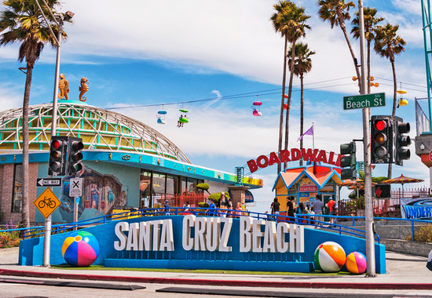
HIGH SCHOOL
Jobs in high school:
I worked at the Santa Cruz Beach Boardwalk from age of 13 to 17 on weekends during school and summers. During those years I worked as game attendant at the Ski-Ball, sweeping trash on the walkway, a ticket booth cashier, in food service selling frozen yogurt and a ride operator. I earned anywhere from $4.25/hr. to $5.50/hr.

Slide 9
GETTING IN TO COLLEGE
The top few things I did to continue my education:
After high school I took a job with Longs Drug Store in Capitola, CA as a stock boy and worked my way up to supervisor. After five years, I decided I needed something more and moved to Fresno, CA where my best friend was attending Fresno State.
I enrolled at Fresno City College (FCC) and earned an Associate of Arts degree in General Studies.
I met with my academic advisor at FCC on a regular basis to ensure I was on pace to transfer to a four year institution.
I was accepted to Cal State University Northridge (CSUN) on a partial track and field scholarship and majored in Broadcast Journalism.
I attended CSUN for three years and left the school when I got a job in television and eventually completed my undergrad at Azusa Pacific University (APU) earning a Bachelors of Arts in Applied Studies.

Slide 10
COLLEGE
Things I enjoyed
in College
Things I didn’t enjoy in College
I loved reporting the sports news for CSUN’s Valley View News and KCSN radio.
Meeting my wife.
Traveling with my teammates for meets.
The diversity on campus.
Research papers.
Student Loans.
Lack of sleep from balancing school, athletics and work.

Slide 11
COLLEGE
Favorite classes
Least favorite classes
Television Broadcast News.
Latin American History.
Statistics.
English.
Accounting (very helpful for my profession, but quite tedious).

Slide 12
COLLEGE
Jobs I worked while I was in College:
I continued to work for Longs Drug Store in Fresno and Granada Hills between 20 and 30 hours per week as an assistant manager. I earned about $11/hr.

Slide 13
COLLEGE
Things that felt difficult or challenging for me while I was in College:
Time management was the most difficult aspect of college. Attending class, competing in athletics, working 5 days per week and still needing time for homework left little room for rest or proper nutrition.
Finances were tight despite a receiving a partial scholarship (books only), student loans and part time work hours. The cost of living in Los Angeles County made it difficult feel financially secure.

Slide 14
CAREER CHOICES
The top few things I did to ensure I got a good job after college were:
Completing an internship was instrumental in my first post college job in television. I was able to make professional contacts and it allowed me to prove to them I had the work ethic, acumen and ability to handle the job. I was hired by the company 3 months after my internship ended.
I made sure to always show up on time and maintain a professional appearance.
I talked to my professors about any companies they would consider recommending me to.

Slide 15
MY COMPANY
Every day at my company:
Citizens Business Bank was founded in August 1974 with one branch in Chino, CA. Along the way, and after many years of success and progress, the Bank changed their name from Chino Valley Bank to Citizens Business Bank. Currently, the Bank employs over 800 individuals and is headquartered in Ontario, CA.
Today, CBB is a $12BN commercial business bank serving business clients that have annual revenues of up to $200MM throughout the State of California.
I work with many Business Owners and local community groups to ensure we offer, educate and expand our Banking Services and relationships in communities we serve. In addition, my job is to provide new product solutions, deposits and loans to Business Owners within the state of California and build new relationships for our bank.

Slide 16
MY COMPANY
Every day at my company:
Some of the key areas of activity in my position consist of; customer calls, scheduling visits with prospects, mailing or emailing info to existing business owners, developing new opportunities through my existing customer base and relationships with CPA’s and loan brokers, as well as industry networking groups. We provide services that businesses may need to grow or improve.
There is also a focus on risk management and loan portfolio performance by reviewing a client’s financial condition on an annual basis.

Slide 17
MY CAREER PATH
Assistant Vice President, Relationship Manager for Chase Business Banking.
Assistant Vice President, Premier Banker/Brokerage Associate for Wells Fargo Bank
Today, Vice President, Relationship Manager for CBB
Notes:
You may use this chart to describe your journey to the current career

Slide 18
MY CAREER
Challenges I have had to overcome throughout my career:
Finding a way to stand out amongst a pool of talented and high producing individuals. There is a fine line between shameless self-promotion and highlighting your achievements.
Finding a work/life balance. It can be hard for me to get work off my mind well into the night.

Slide 19
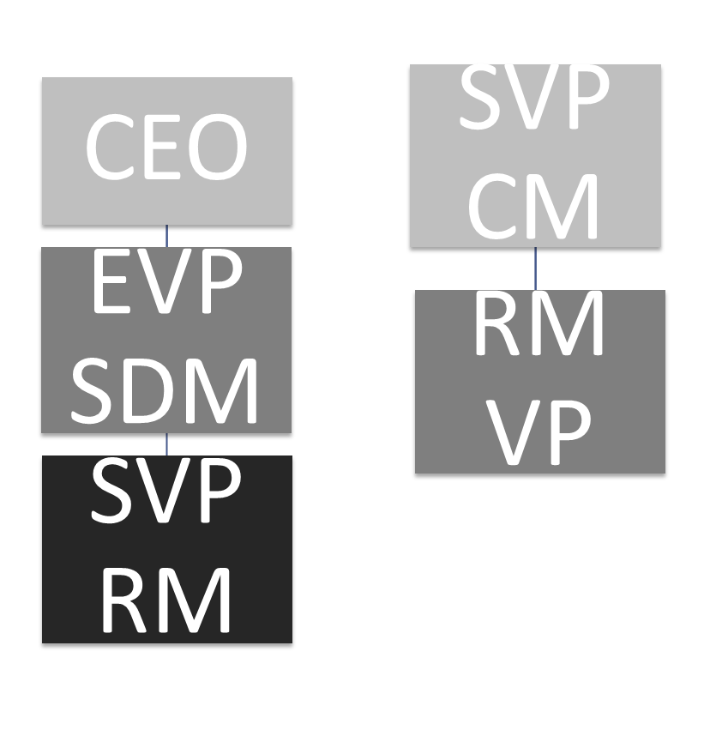
MY ROLE WITHIN
THE ORGANIZATION
Notes:
Use this graph to give more description of your role specifically (responsibilities, typical work week, direct reports, etc.)

Slide 20
COMPENSATION AT MY COMPANY
President and Executive Vice Presidents
($500K - $1M)
Senior Vice Presidents
($175K - $400K)
AVP & Vice Presidents
($100K - $175K)
Entry Level to Non-Officer Positions
($40K - $75K)
Notes:
Use this graph to show general compensation ranges for people in various roles in your company

Slide 21
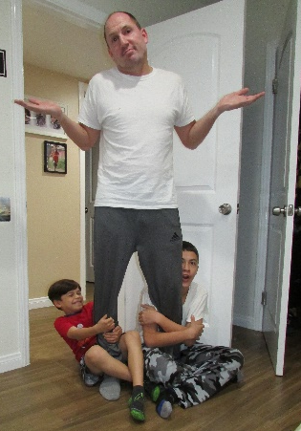
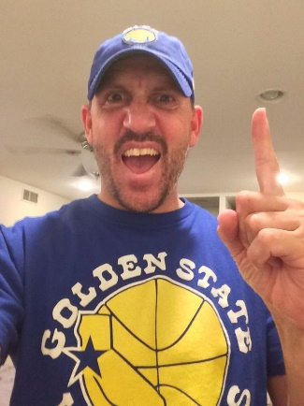
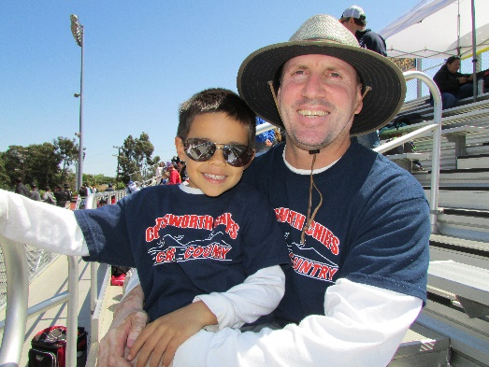
MORE THAN JUST WORK
When I’m not at work, I like:
Watching Professional Sports.
Spending weekends at kids’
Cross Country and Track meets.
Goofing around at home.
Pigging out on gummy bears.

Slide 22
DO IT ALL OVER AGAIN?
If I could talk to my high school self, what would I say?
Try to have more fun, everything will turn out great.
Do your homework.
You don’t have to win every argument.
Be proud of yourself.
Eat more tacos!

Slide 23
QUESTIONS AND FEEDBACK

