Slide 1
Musician / Media composer
Rogerio Maudonnet

Slide 2
I Was Born in São Paulo, Brazil in 1970.
13 years old - I started playing classical guitar
15 years old – I switched to eletric guitar
20 years old - playing in several bands and doing a lot of gigs while I was studying Civil Engineering at the University of Sao Paulo
⇱
Civil Engineering. WHY???

Slide 3
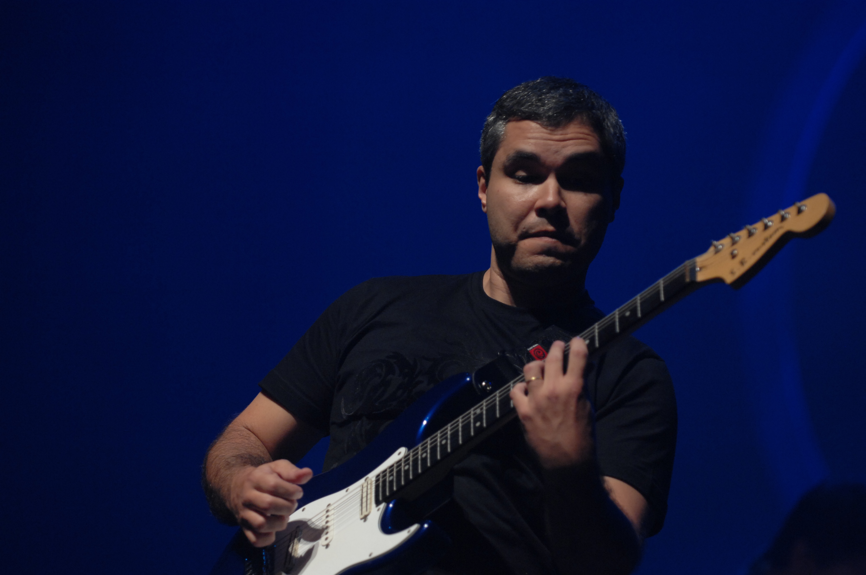
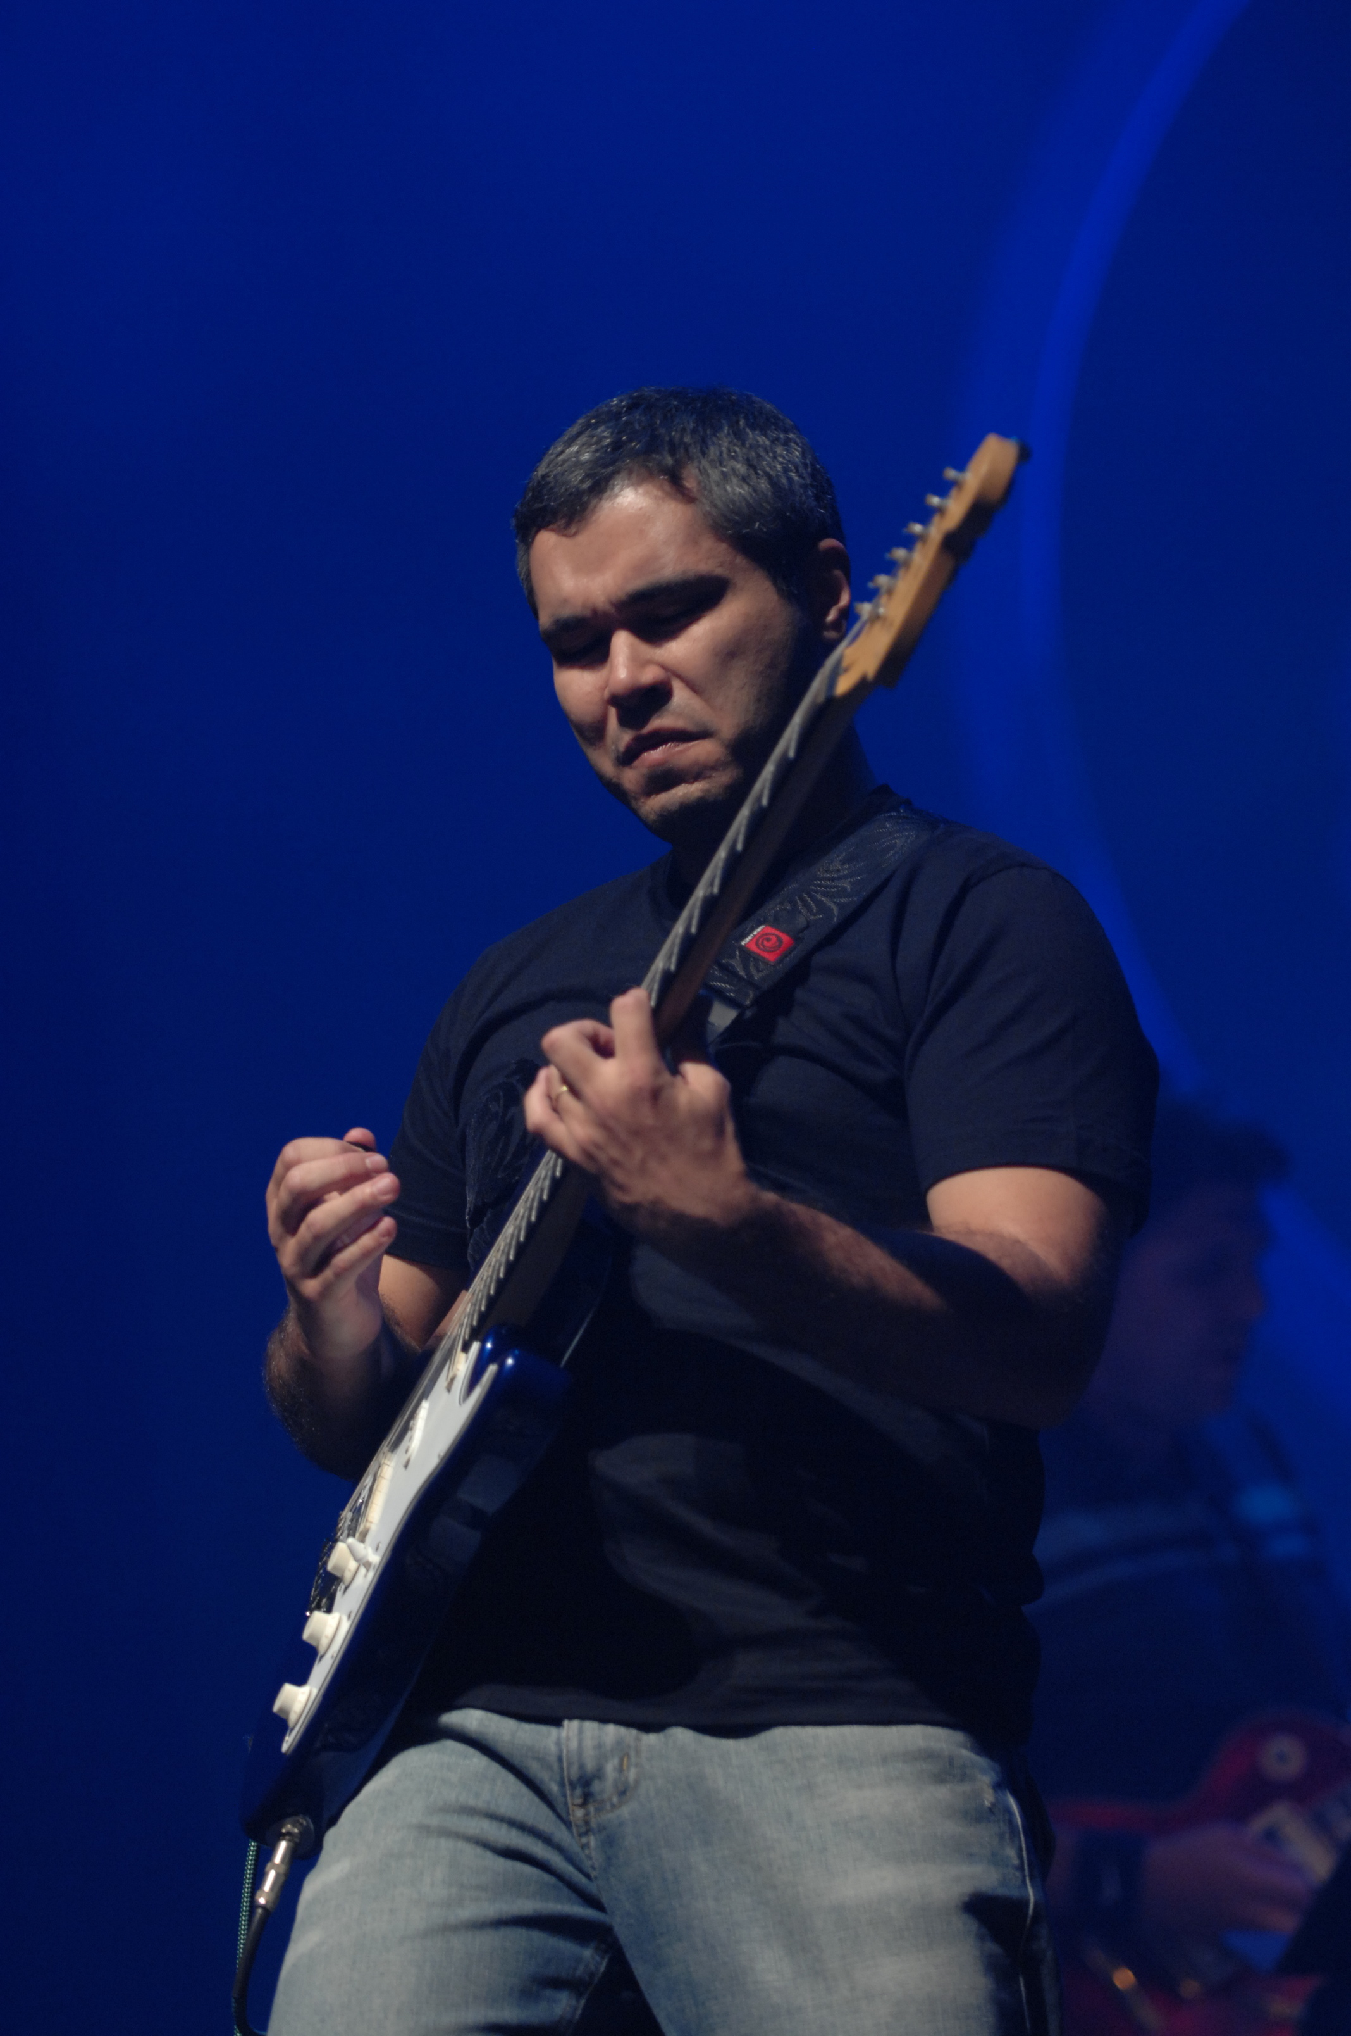

Slide 4
CarEer Paths
Internship in a Music House
Composer Assistant
In-house composer
My own studio/ company Sustains Studios

Slide 5
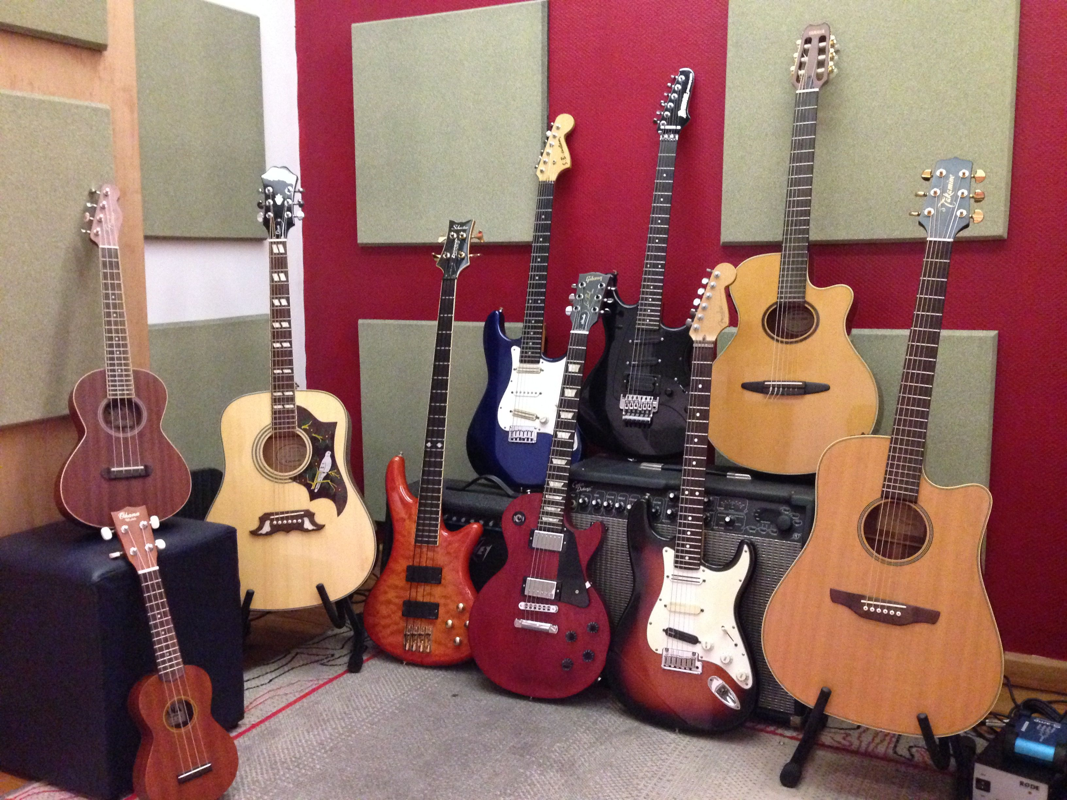
Custom Music: what is it?
To be able to write music on demand following a briefing
A game developer asks for a “pirate” theme for their indie game.
An ad agency asks for hard rock tune for their new campaign.
- Another ad agency wants you to produce a cover song.

Slide 6
“pirate” theme for video game

Slide 7
hard rock tune for a commercial

Slide 8
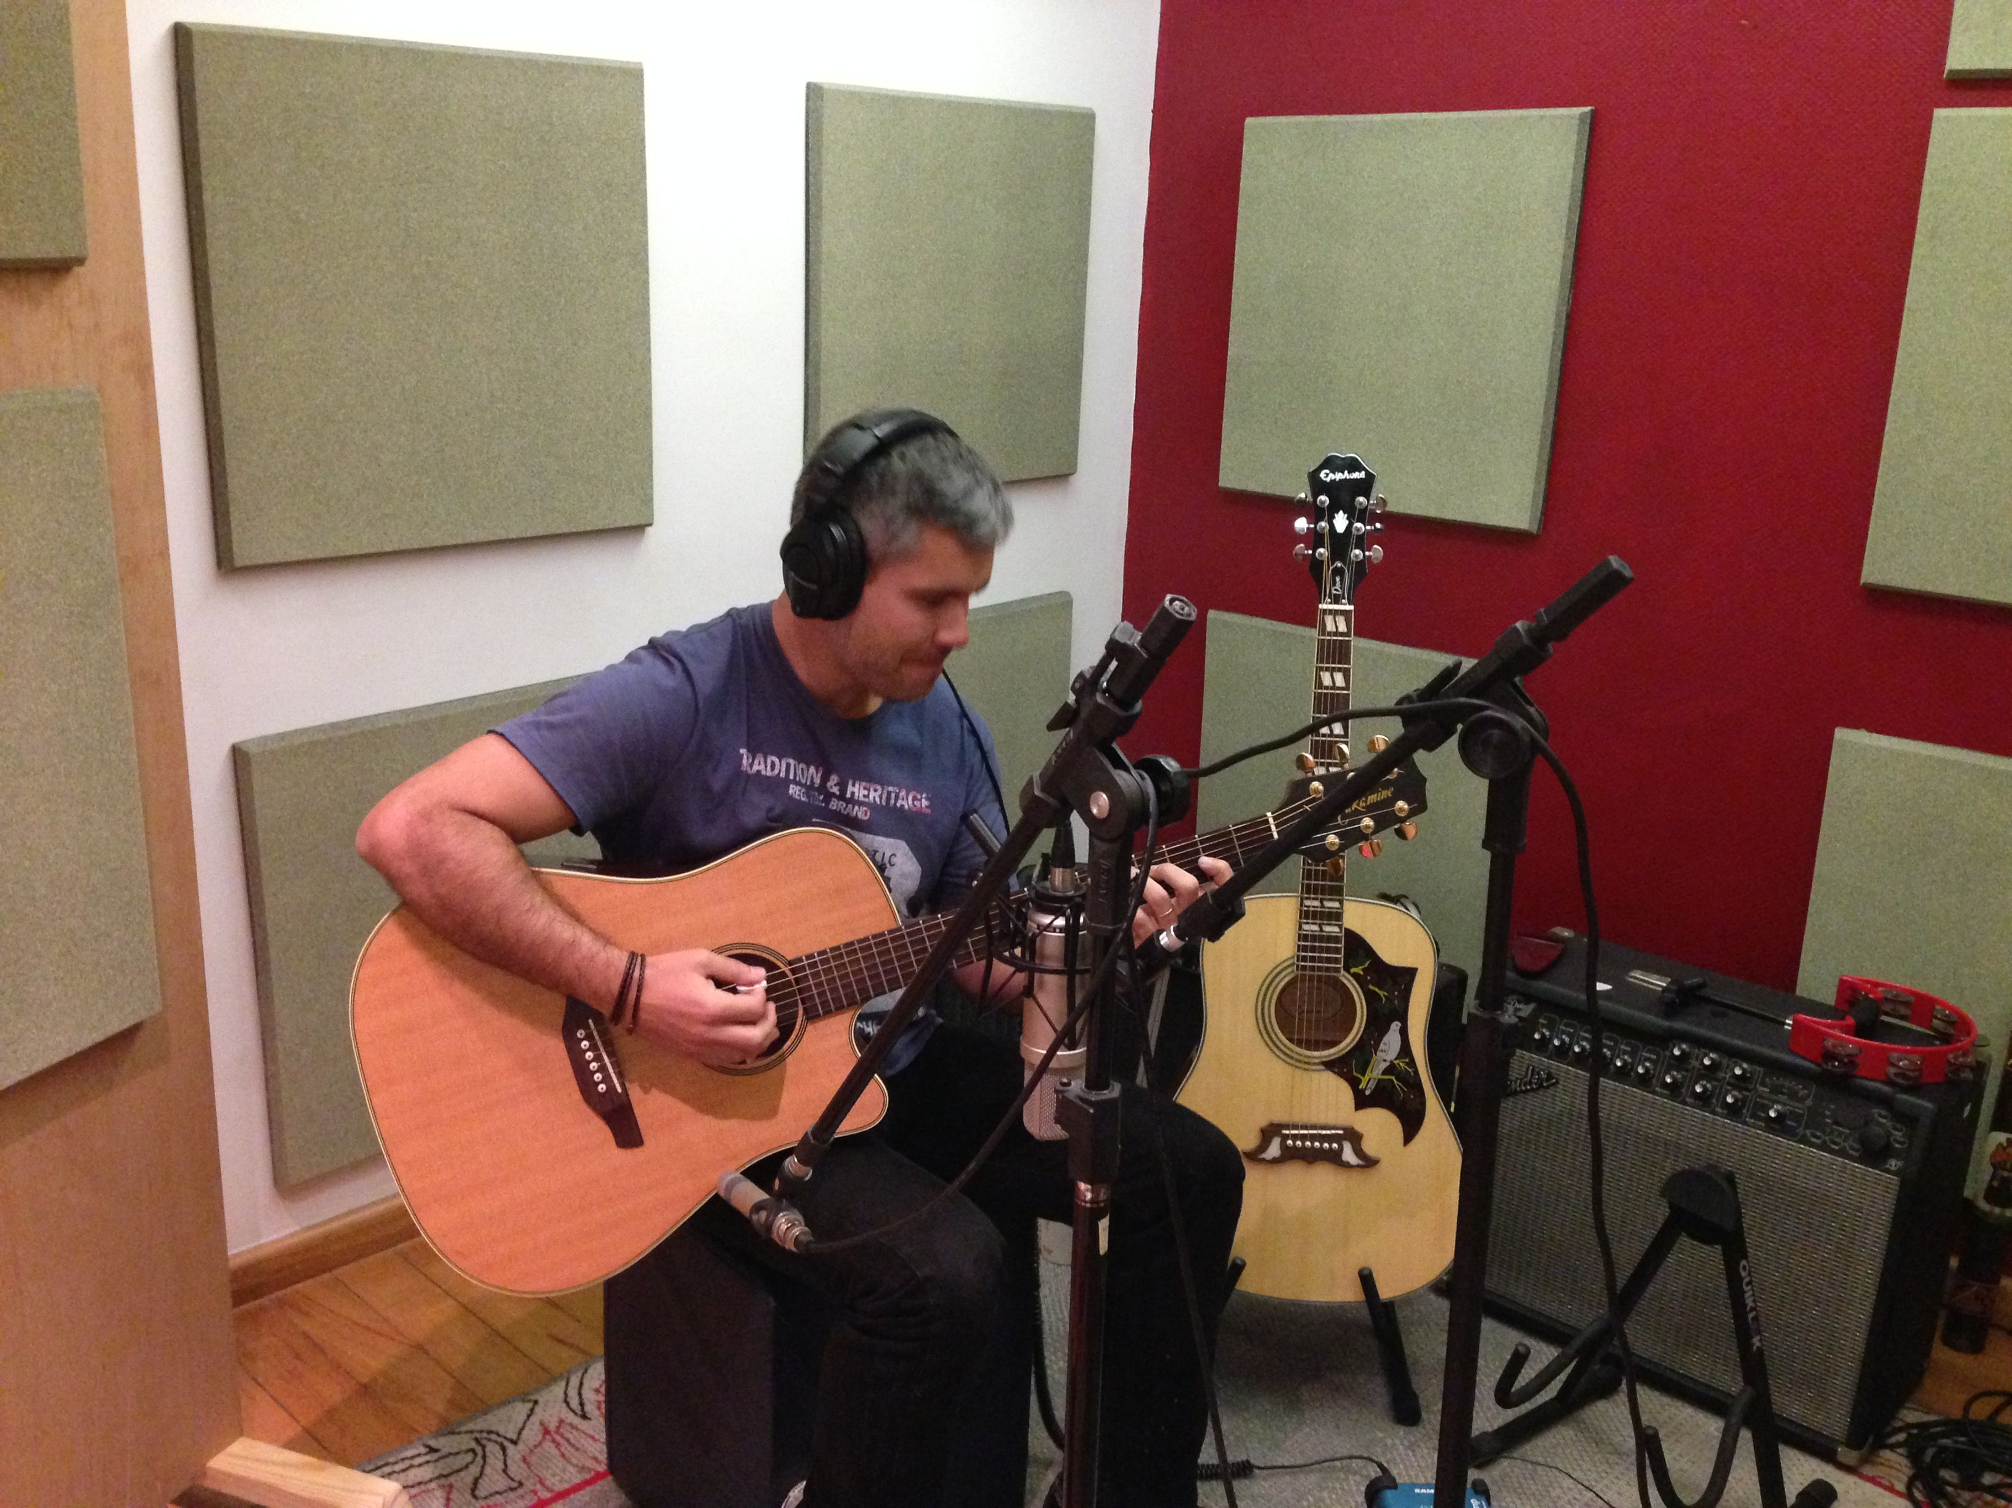
Typical day in my job
Each day is different
Go to meetings (directors, ad agencies, developers)
Do your work: compose, record, hire other musicians, mix or send your music to someone else to mix it
Networking – look for another project/job

Slide 9
SKILLS
Know different music styles – Open your mind!!!
Understand that people who will hire you don’t know musical terms.
Be creative with a briefing!
Listen to a lot of music and understand how they are produced.

Slide 10
Film without music

Slide 11
Film Score

Slide 12
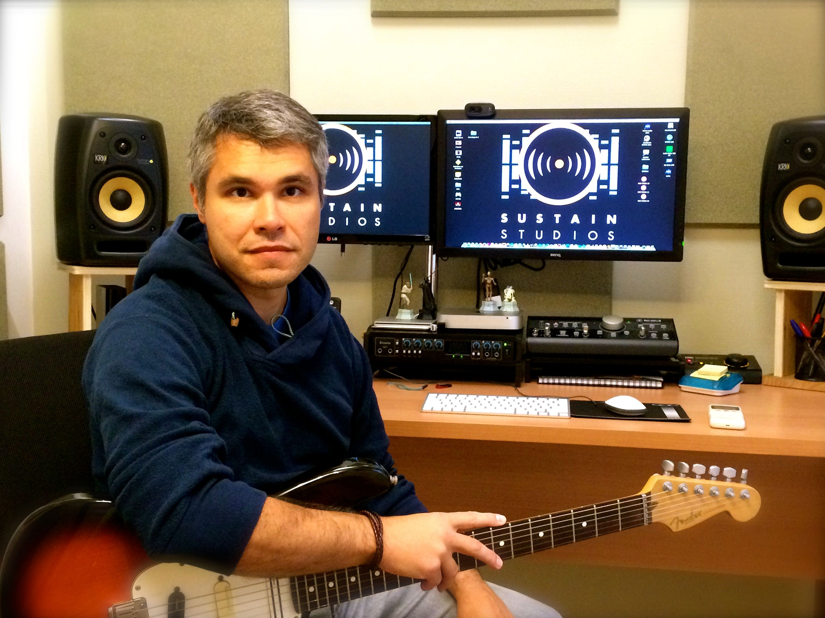
TIPS
Do the research on what do you want to do. Talk to people, ask them how are their jobs: is there a routine? What makes you improve on your work?
Every job has good and bad things.
I wish someone told me that it was possible to make a living making music.

Slide 13
Questions?

Slide 14
Thank you!
maudonnet@gmail.com

