Slide 1
YBA Presentation
Steam Legacy High School
October 19, 2018
Richard Finkelman

Slide 2
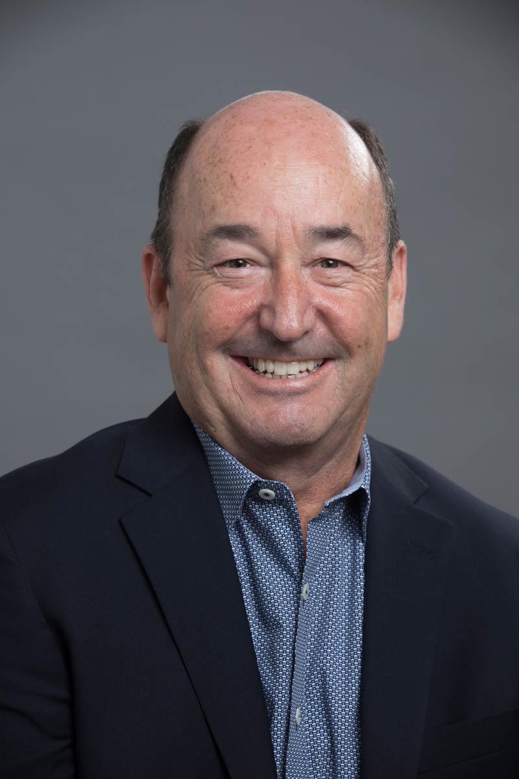
Introduction
My Name is Richard Finkelman
I am happy to be here today and to share some of my life with you
I commend you for your accomplishments and I thank you in advance for you giving me your time
Participation is encouraged
Volunteering is totally on you

Slide 3
INTRODUCTION
I am 58 years old
I was born in Palo Alto, California
I grew up in Redondo Beach, California
I Went to High School in Ridgewood, New Jersey
I Went to College in Evanston, Illinois

Slide 4
INTRODUCTION
I worked in 2 Industries during my career
I worked at 12 companies during my career
I am Father and I was a Husband (2x)
I am grateful for the challenges life has given me, I have found more happiness in overcoming life’s challenges than pursuing life’s happinesses

Slide 5
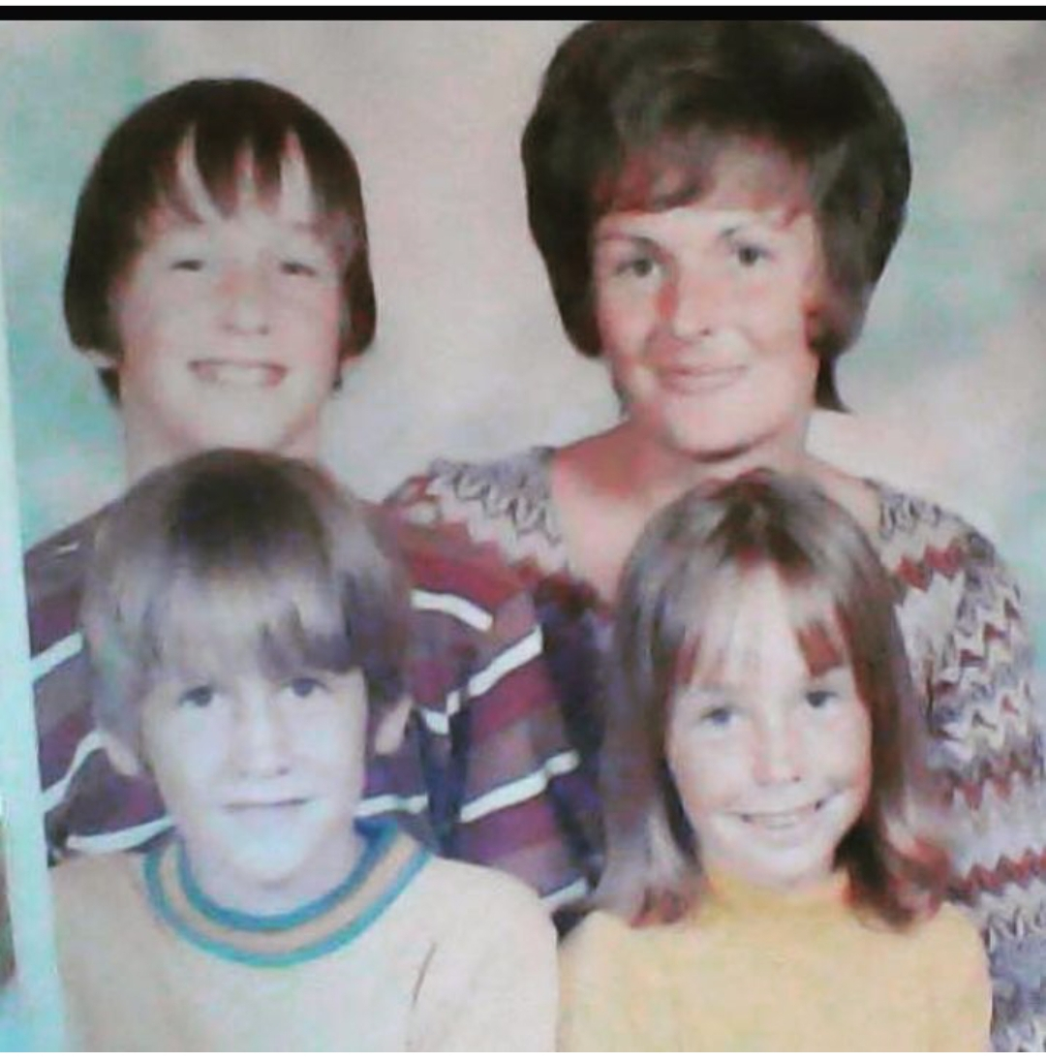
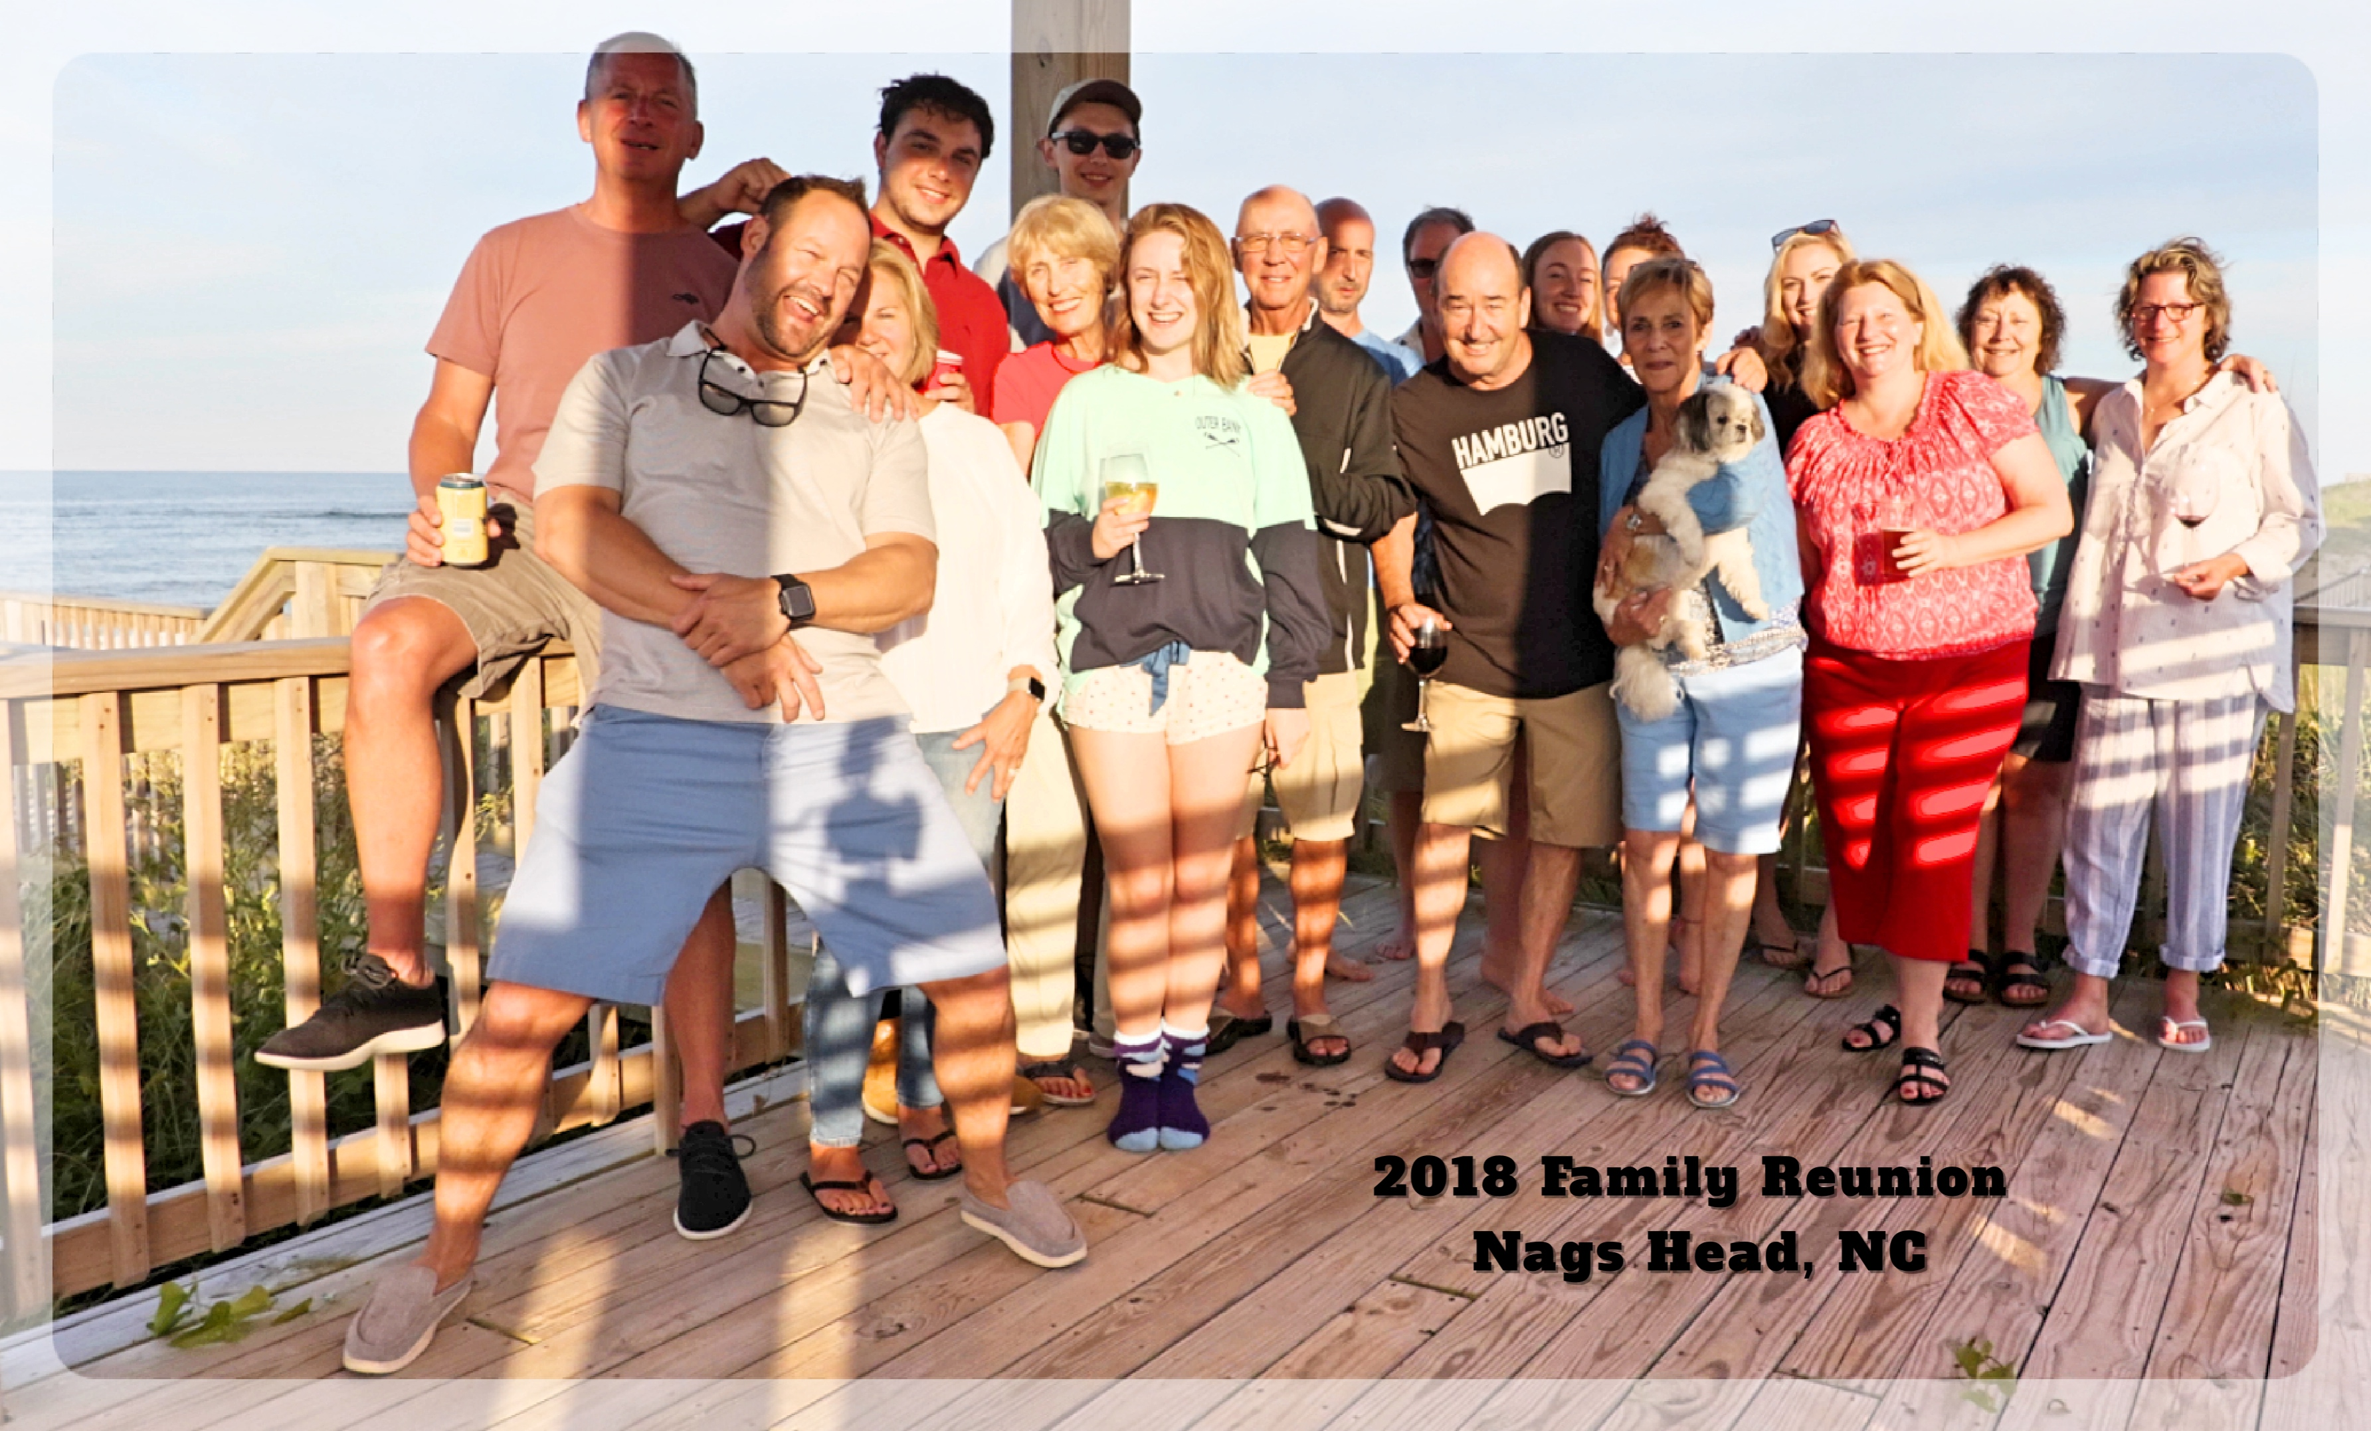
My family
I am a Baby Boomer, my generation has lots of siblings and lots of cousins…

Slide 6
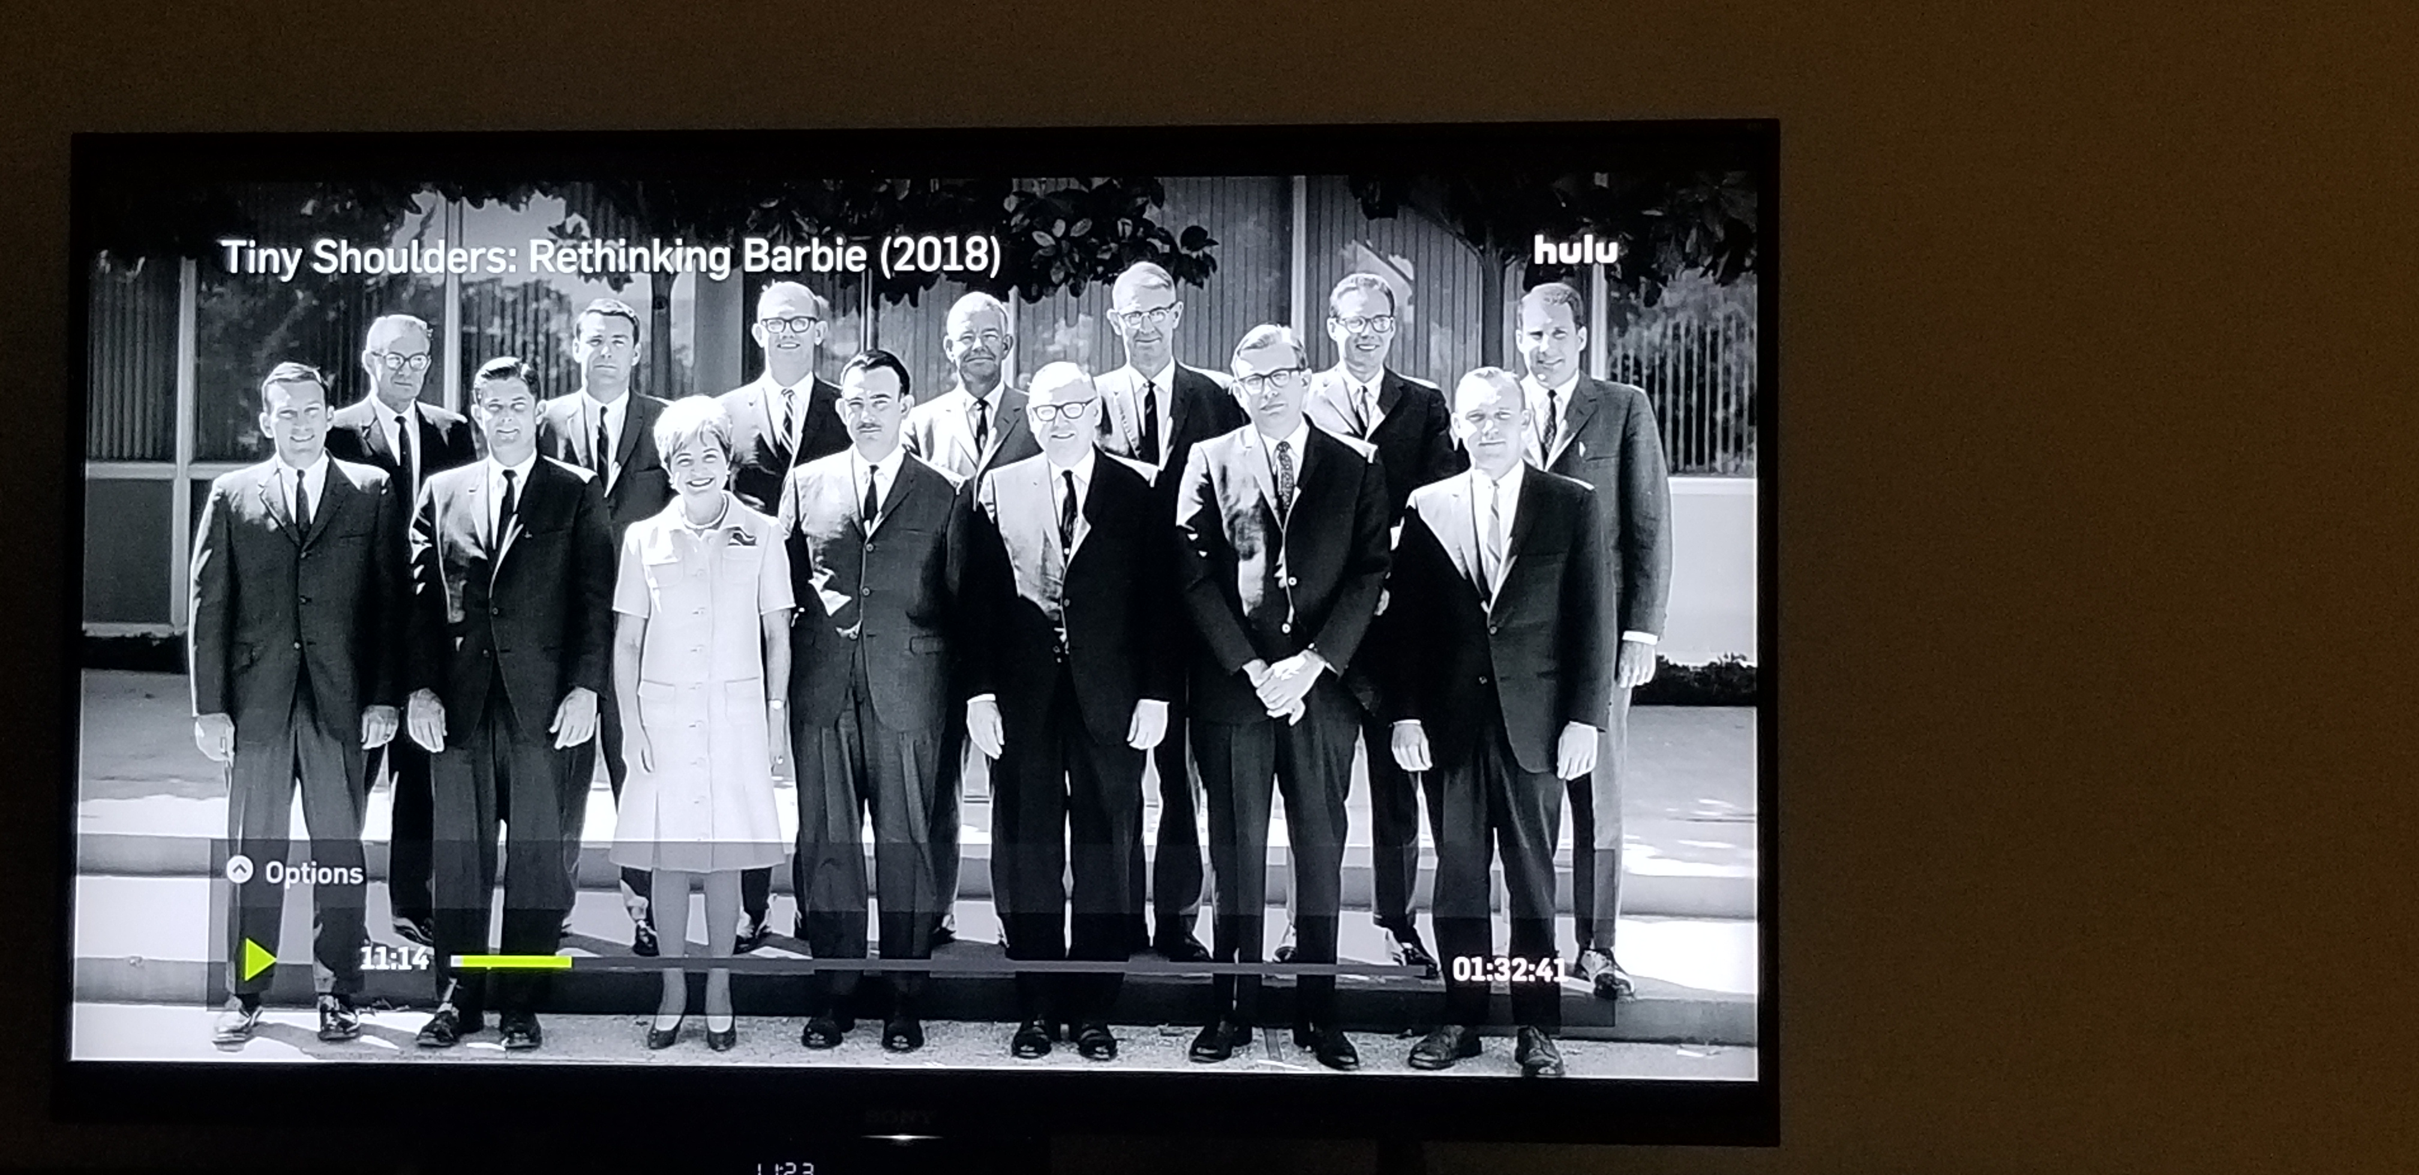
Greatest childhood ever
Mattel Toys
My Father worked for Mattel Toys when I was a kid

Slide 7
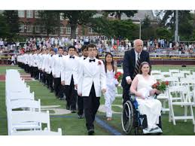
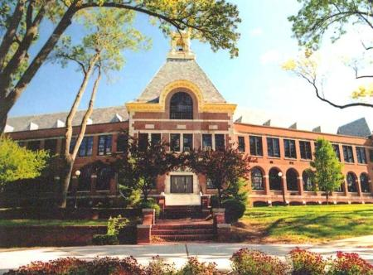
HIGH SCHOOL
I attended South High in Torrance and Ridgewood High School in Ridgewood, New Jersey

Slide 8
HIGH SCHOOL
Challenges I Faced in HS
Education
Schoolwork
College Prep
Adult
Guidance
Family
Expectations
Siblings
Adult
Guidance
Friends
Best Friends
Worst Friends
Adult
Guidance

Slide 9
HIGH SCHOOL
Challenges I Did Not Face in HS
Education
Teacher Access
Technology
Less Adult
Guidance
Family
Empty Nest
No Siblings
Helicopter Parents
Friends
My Story
Texting
FortNite

Slide 10
Getting in to College
Keep Doing Everything You Are Doing
Attend college nights, met alumni from different colleges
Essays and Recommendation letters
Campus visits
Admission interviews

Slide 11
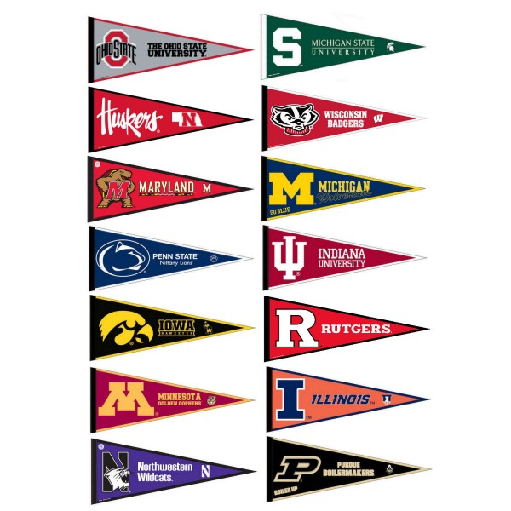
College
I attended Northwestern University in Evanston Illinois
I received a Bachelors of Arts in History

Slide 12
College
Favorite Classes
Least Favorite Classes
History
Statistics
Film Studies
Semester Abroad
Economics
Science(s)
Computer Programming

Slide 13
College
What I would do now if I was in College is:
Sit closer
Do my research earlier
Fund my own social life
Learn to Learn

Slide 14
My Career
The first job I had after college was:
Triad Systems Corporation
I sold Computer Systems for Auto Parts stores
Learned how to Sell
Promoted to the best territory in the Country
South Central LA
Earned multiple Sales Awards (Hawaii)
The best and worst job I have ever had was:
Arthur Andersen
The Good – Fantastic Training and Alumni Program
The Bad – Arrogance and Cockiness

Slide 15
My Career
Challenges I have had to overcome throughout my career are:
Ambition
Knowledge
Communication
Adaptability
Patience
Prejudice

Slide 16
Do it all over again?
If I could talk to my high school self, what would I say?
Breathe
Practice Velocity
Get Up
Find the Humor

Slide 17
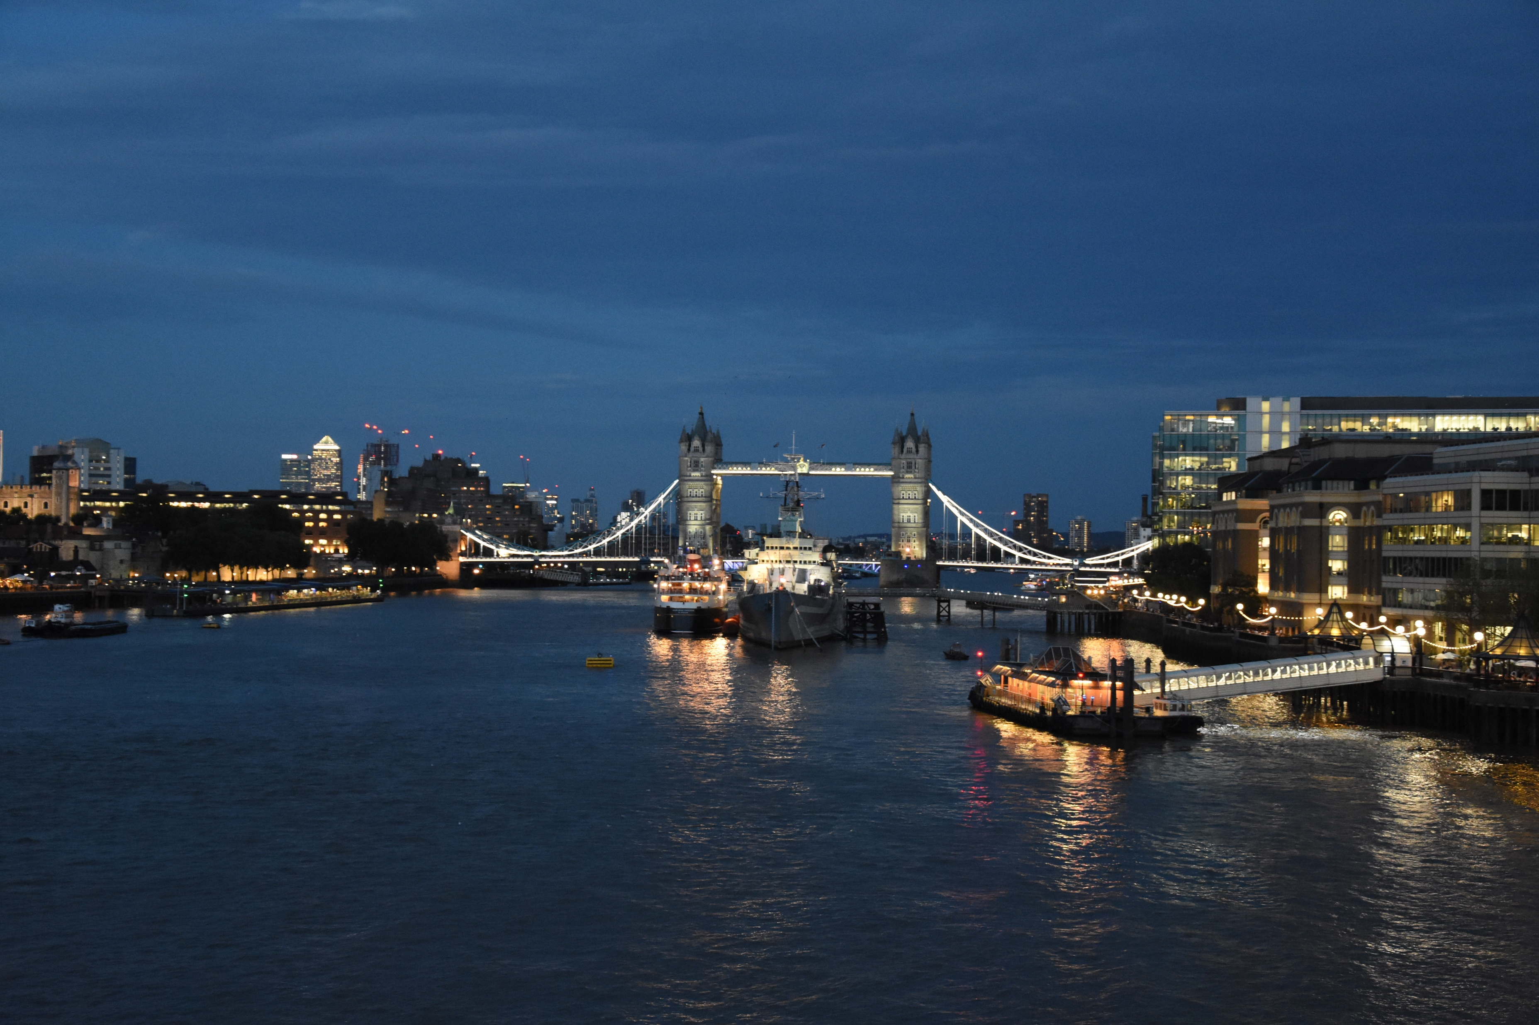
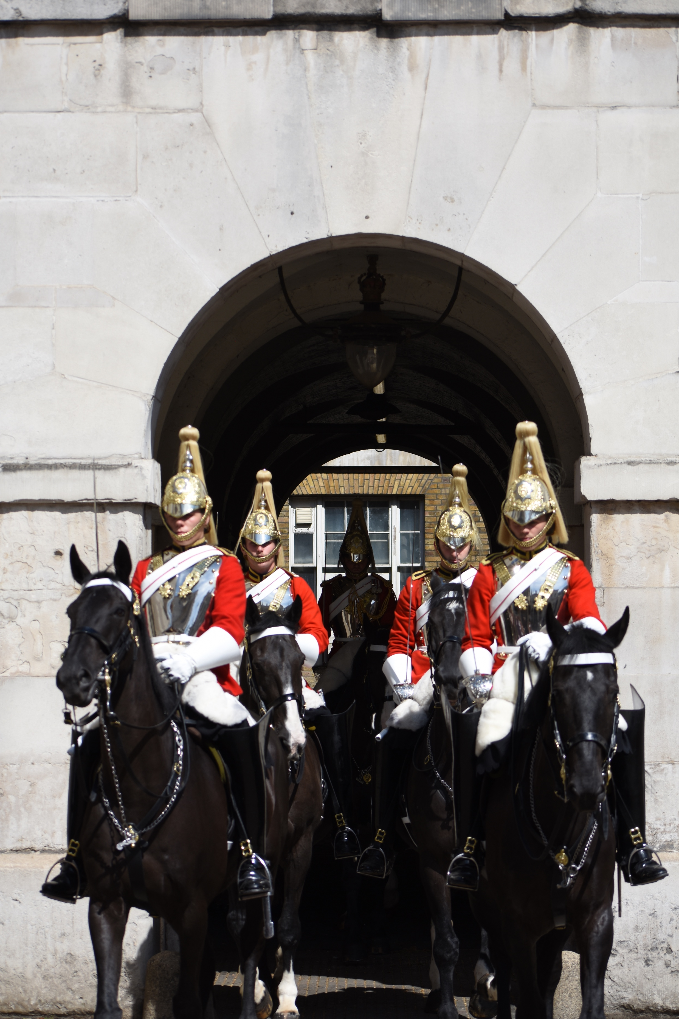
More than just work
When I am not at work I like to:
Photography

Slide 18
My best Advice
Move Toward The Star You See
You
You will spend more time in your life than you will with anyone else,
be good to yourself
Family
You stand on the shoulders of those who came before you
Community
You represent your community,
participate, commentary without participation doesn’t count

Slide 19
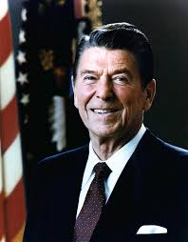
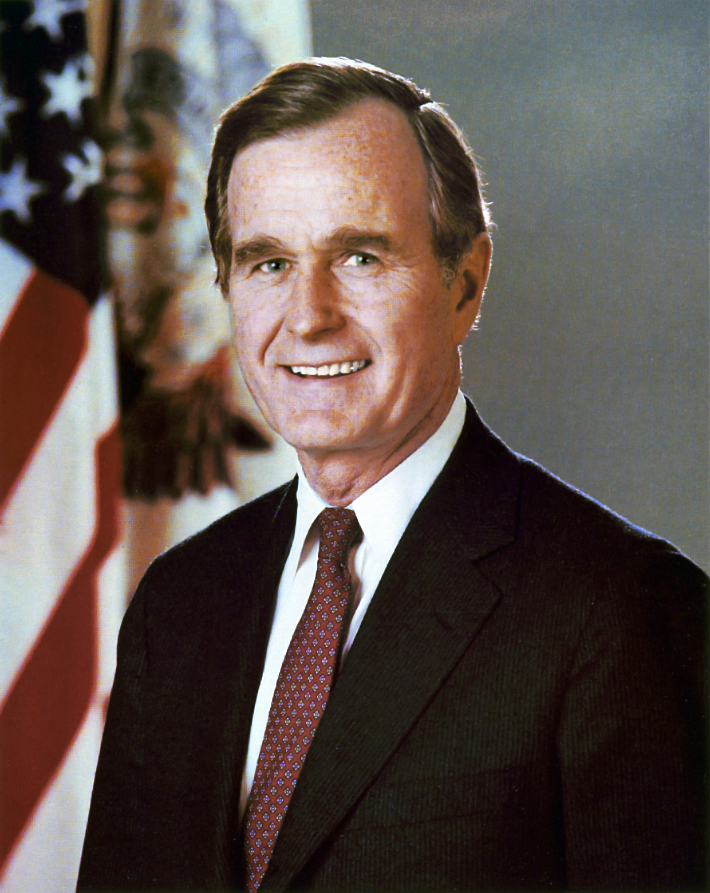
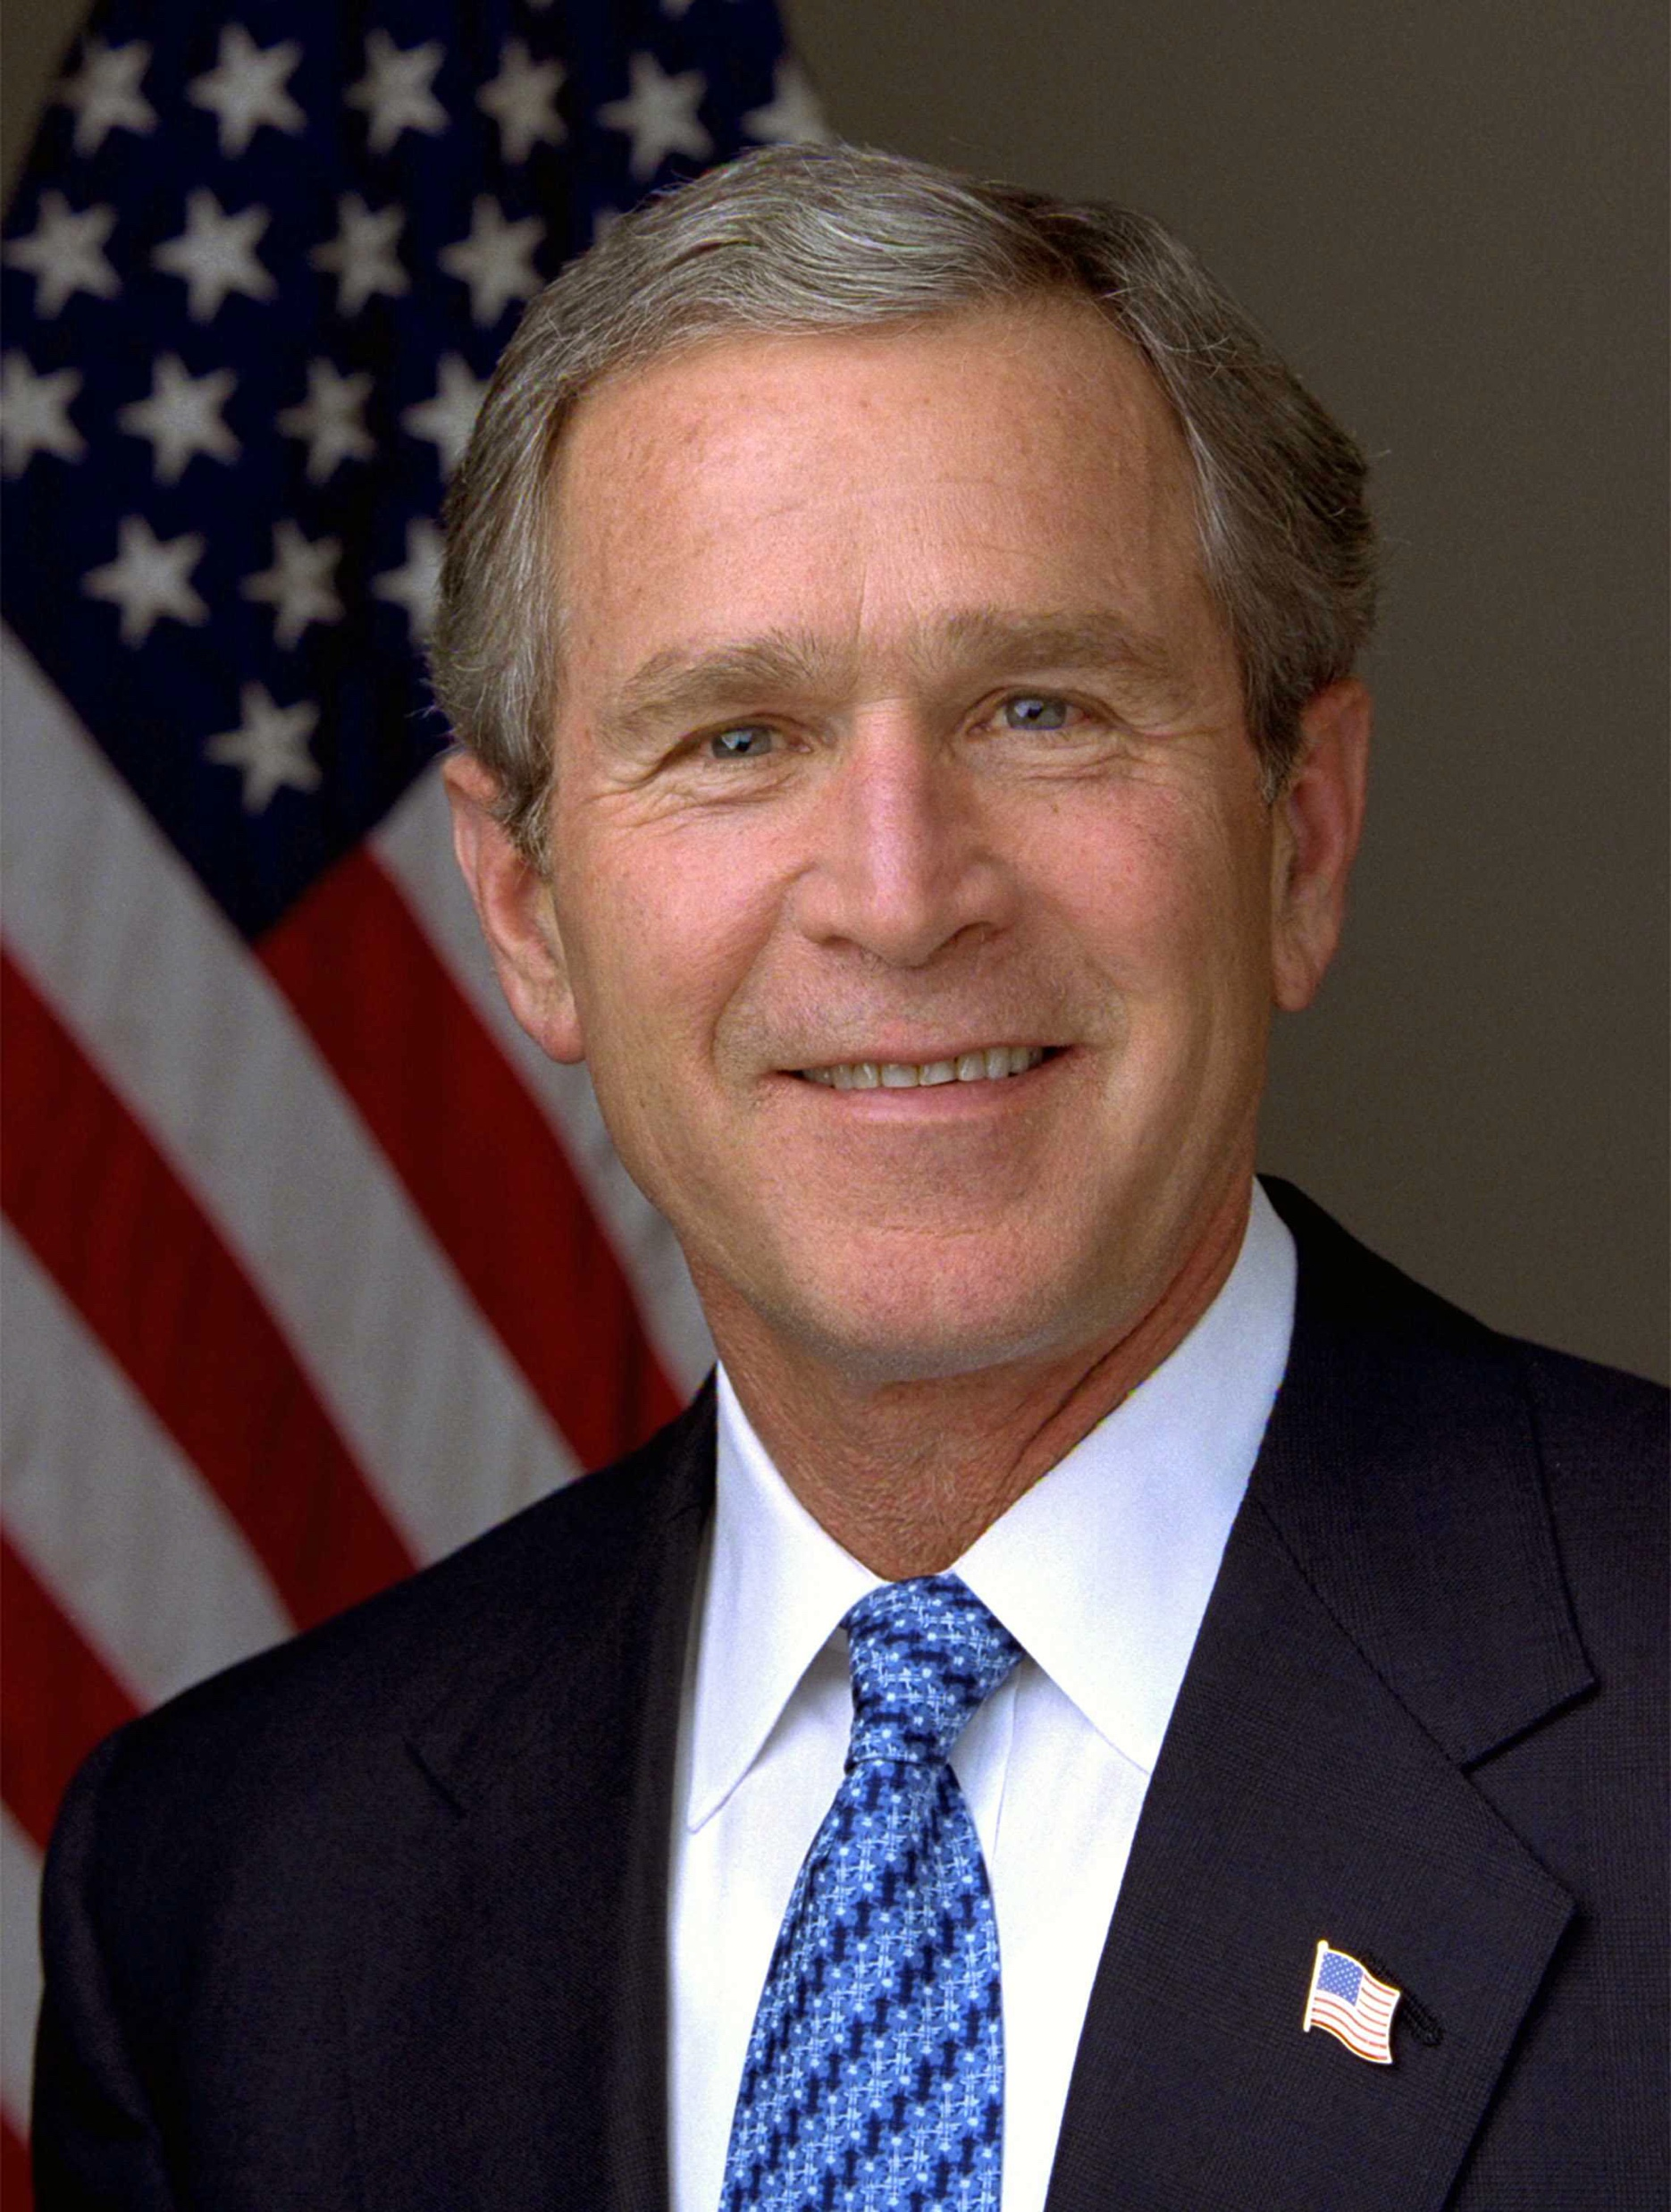
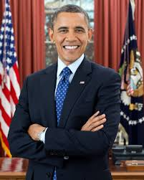
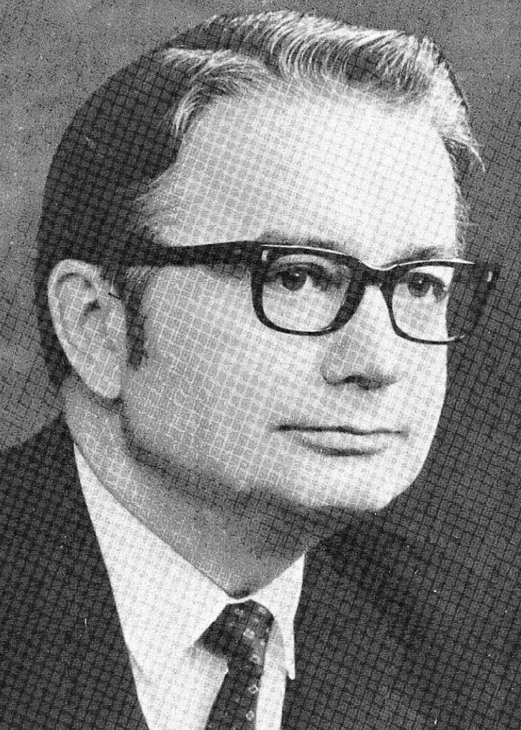
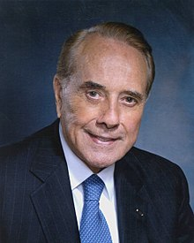
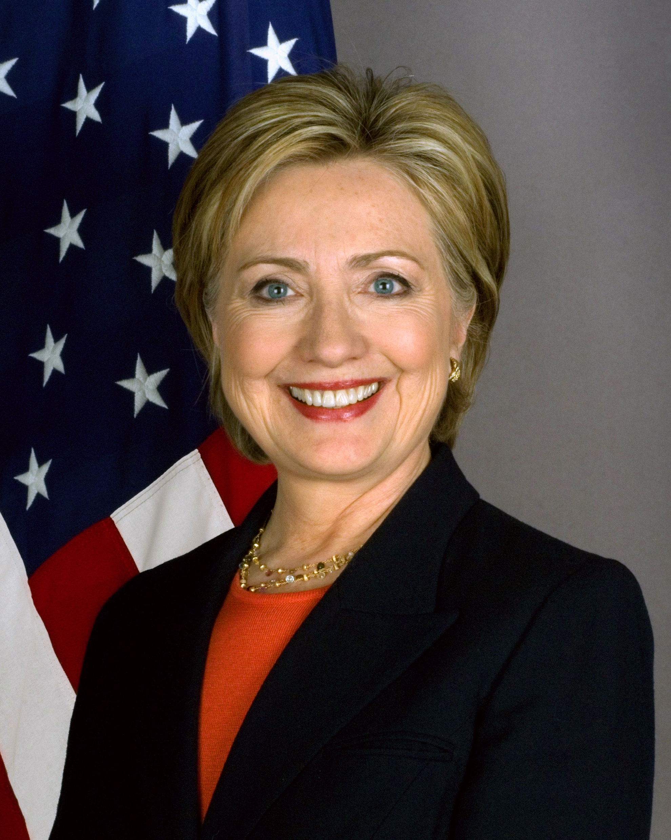
You will always Remember

Slide 20
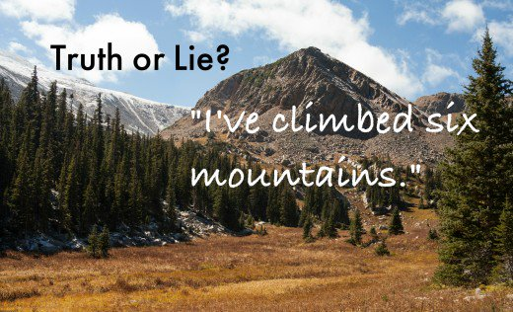
The Homie Game
2 Truths and 1 Lie

Slide 21
QUESTION AND ANSWER

