Slide 1
Youth Business Alliance
Steam Legacy High School
Luc Imberechts - Bakon USA Food Equipment

Slide 2
My Backstory
Born in Brussels, Belgium.
Grew up with my mother, my 2 sisters and my grandfather.
Eighties: great music, very high unemployment…No Future…
Business Degree from HEC Brussels and INSEAD France.
Certified Chocolatier.
Internship in India for US company.
Officer in Belgian Army (Mechanized Infantry).
Met my wife in Los Angeles playing beach volley.
We have 2 boys.
French, Flemish, English, Spanish, German

Slide 3
My Business Career
Student jobs and volunteering (life lesson from my grandfather)
Yearlong Internship in New Delhi (spice processing unit feasibility study)
Worked in Market Research before military service
Joined an International Belgian Food Ingredient Company
Worked in Asia, Middle East and Africa before being transferred to the US (1996).
In 2004, invested in Bakon USA Food Equipment

Slide 4
Typical Work Day
My boss: our customers
My focus: Team building and management
My source of inspiration: our customers and their passion
Importance of Mentors and Peers
Importance of Languages
OSMEALQ

Slide 5
Major Professional Challenges
“Impossible is not a fact. It is an opinion.
Impossible is not a declaration. It is a dare.
Impossible is potential. Impossible is temporary.
Impossible is nothing.”
Muhammad Ali

Slide 6
Tips and Values
Koshima Monkeys

Slide 7
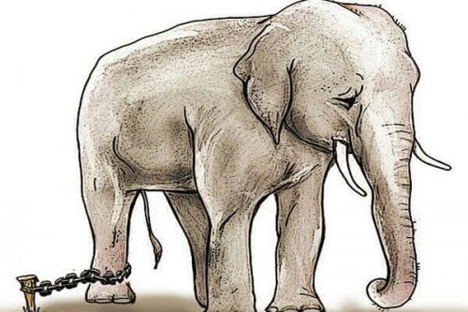
Tips and Values
Baby Elephant

Slide 8
Tips and Values
Financial Literacy: BS, IS, CF

Slide 9
Tips and Values
We are all in sales
We are all in finance and accounting
We are all in strategy and marketing
Business 101

Slide 10
Questions

Slide 11
Thank you!

