Slide 1
Improvise
Adapt overcome
“Semper Gumby”

Slide 2
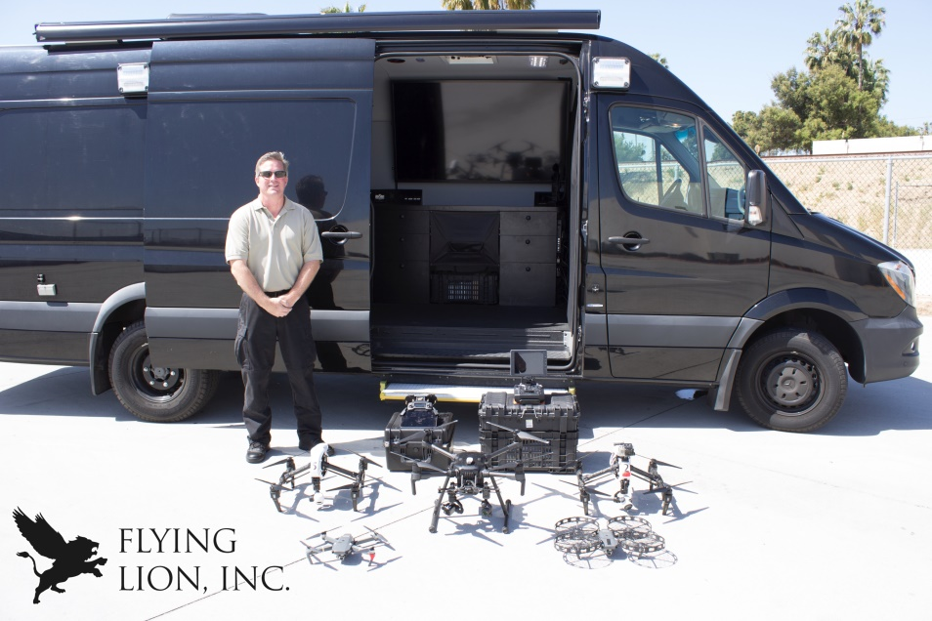
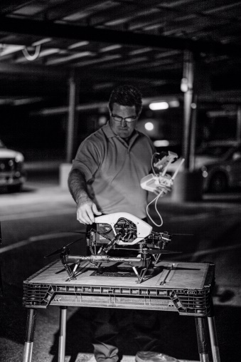
INTRODUCTION
Barry Brennan, Founder and CEO of Flying Lion, Inc.
Flying Lion provides On-demand drone Air Support, training, and equipment for Public Safety Agencies.
video

Slide 3
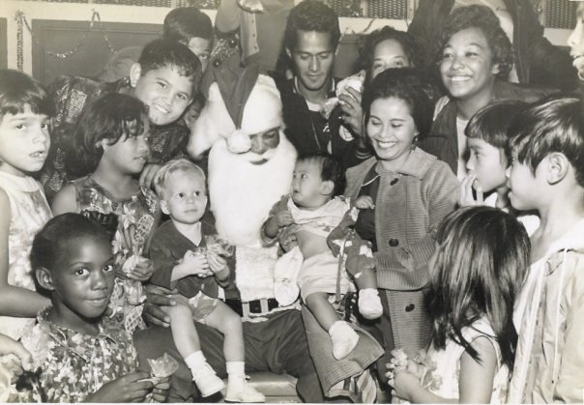
My childhood
Born and raised in Honolulu, Hawaii

Slide 4
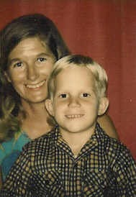
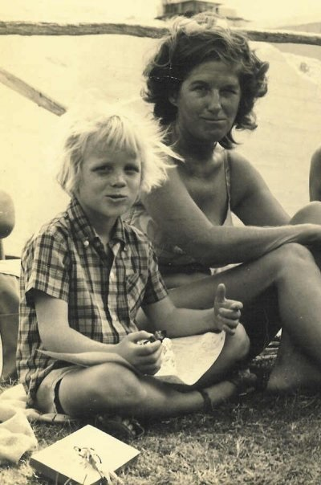
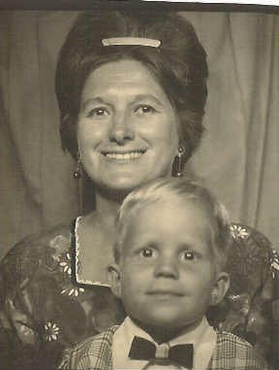
My family
Raised by mom, a single parent. I never met my Dad. My Mom unfortunately was a “Jerk Magnet”, so most men in my life were not positive role models.

Slide 5


My up Bringing
We moved around a lot. I went to six schools by the time I went to High School. So I’ve been a Surfer, a Hawk, a Surfer again, a Star of the Sea, a Crusader and a Pioneer…
If that wasn’t bad enough at the age of 15 my Mom Married a Canadian Tourist. So at 15 I moved to Canada. From a Tropical Paradise to the artic tundra. Now I was a Saint, how horribly ironic!!

Slide 6
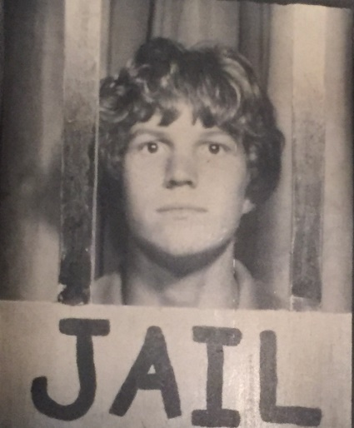
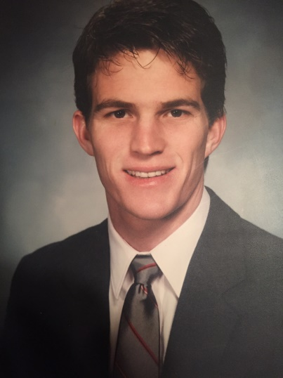
My up Bringing
In Hawaii, being a “latchkey” kid and a parent with poor parenting skills, I was a wild child. Getting involved in all kinds of age inappropriate things. Needless to say, I was quickly on my way to prison.
Canada as much as I hated it in the beginning was a great opportunity to re-invent myself. I went from a little “dirt bag” to ‘Boy Scout”

Slide 7
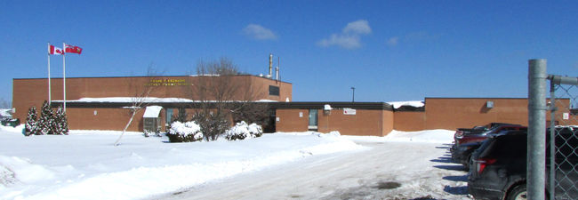
MY HIGH SCHOOL
New Liskeard Secondary School in Northern Ontario, Canada

Slide 8
High School
Moving to Canada was rough but a great opportunity to re-invent myself.
Grade 10, I was super popular because I came from Hawaii. Popularity has its own challenges.
Grade 11, started to focus on sports ( Soccer, X-Country, Basketball, Indoor and Regular Track and Field).
Grade12 , friends with all the cliques
However, while being naturally smart, I never applied myself so I was a high D or Low C student.

Slide 9


High School
Things that I really liked in High School were:
  Sports
  History
  Science
  Hanging with Friends – Parties
  Learning to hate winter sports

Slide 10
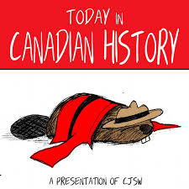
High School
Things that felt difficult or challenging for me while I was in High School were:
  Canadian History
  French
  Homework
  Studying

Slide 11

High School
Jobs I worked while I was in High School were:
  I was in Canada on a Student Visa – can’t legally work
  Had to do jobs that Canadian Teenagers wouldn’t do
    Digging ditches
      Worst job ever… three weeks digging for 8 hours a day
    Digging out cellars for rich cottage owners
    Clearing brush
  Had to come back to Northern California to get a decent Summer Job

Slide 12

Getting in to College
I had no clue what I wanted to do after high school.
  Not going to Canadian College or University
  No direction. Didn’t take any technical classes.
  Graduated and moved to Northern California
  Took jobs with a temp agency to see what careers I might be interested in pursuing.
  Took the ASVAB with the Air Force Recruiter
    Was offered a Military Police role
      But needed to serve for 8 years…
  Decided to go to community college for a semester

Slide 13

College
Attended Diablo Valley College in Pleasant Hill, CA

Slide 14
College
Things I enjoyed in College
Things I didn’t enjoy in College
Subject Changed every four months
Huge amount of electives
Student Diversity
Being Treated like an adult
Too many required classes
Homework
Finding parking
Being Treated like an adult

Slide 15
College
Favorite classes
Least favorite classes

Slide 16
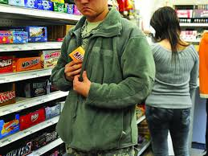
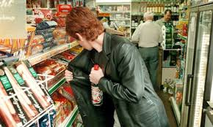

College
To put myself through college I worked in Retail
  Started out in Men’s Furnishings
  Quickly move into Security
    Became an undercover shoplift detective

Slide 17

College
Things that felt difficult or challenging for me while I was in College were finding the balance:
  Studying and Homework
  Working
  Social Life

Slide 18





University
Attempted to transfer to four year Universities
DENIED
DENIED
ACCECPTED
ACCECPTED
ACCECPTED

Slide 19
University
Things I enjoyed at CAL
Things I didn’t enjoy
History
Professors wrote the book
Student Diversity
Campus Life
Football
Intensity
So Expensive
Classes were huge
  TAs
Homework, Homework, Homework
Size of Campus

Slide 20
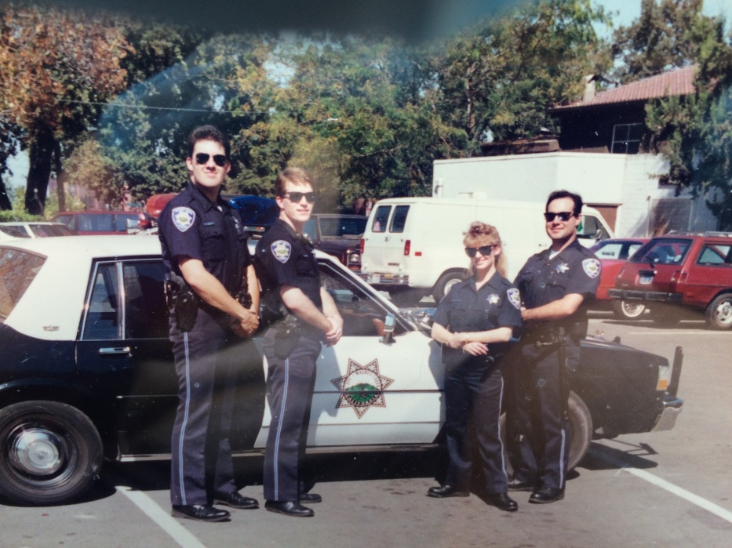
Volunteerism
At CAL I began to Give Back
Student Disciplinary Review Board
Reserve Police Officer – Walnut Creek Police Department
I became a volunteeraholic
PAY IT FORWARD
BECOME THE CHANGE YOU WANT TO SEE IN THE WORLD

Slide 21

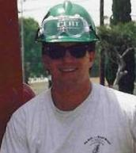
COMMUNITY EMERGENCY RESPONSE TEAM

Slide 22

CITIZENS’ POLICE ACADEMY

Slide 23
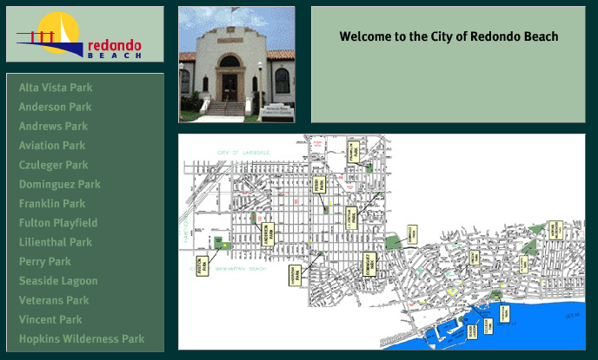
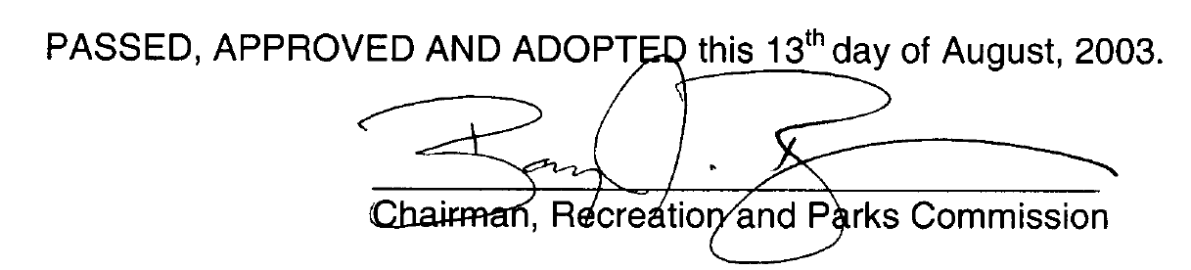
RECREATION AND PARKS COMMISSION –

Slide 24
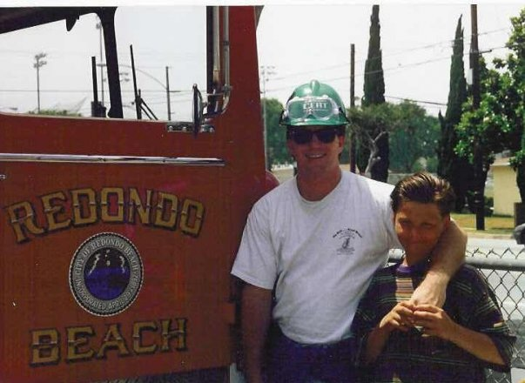
BIG BROTHER – Vernon 6 years

Slide 25

BOARD MEMBER Redondo Beach Library Foundation

Slide 26
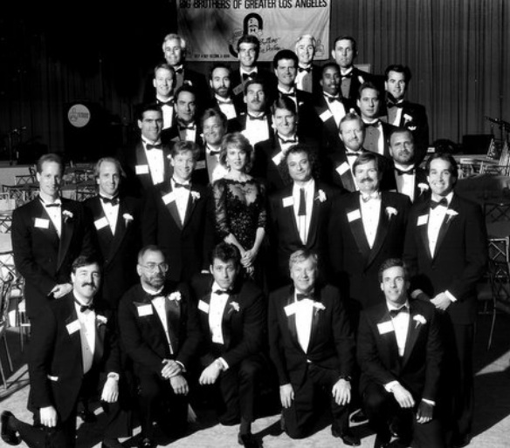
BIG BROTHER BACHELOR AUCTION
TWICE

Slide 27
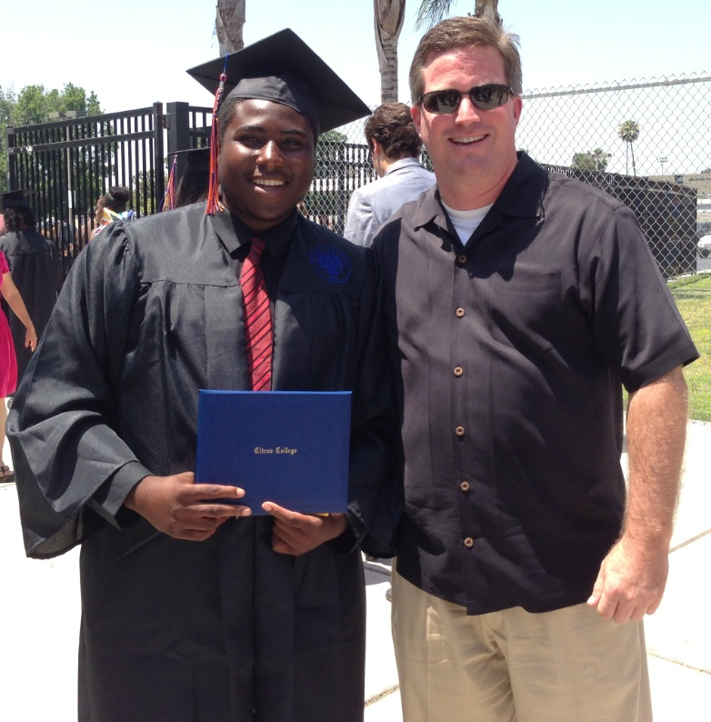
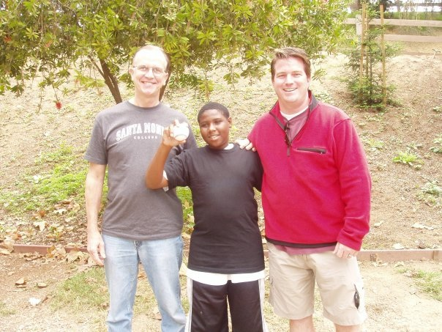
BIG BROTHER – Reggie 7 years

Slide 28
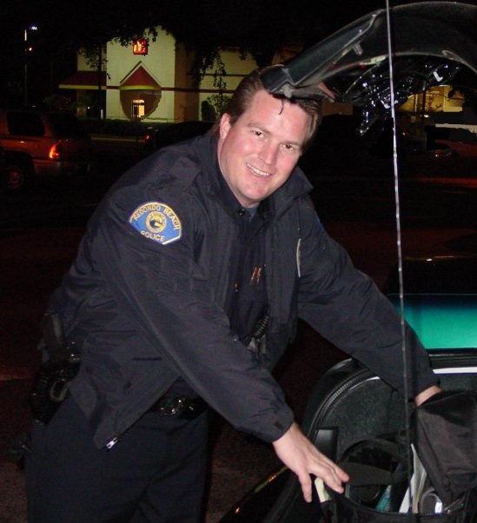
RESERVE POLICE OFFICER — Redondo Beach

Slide 29
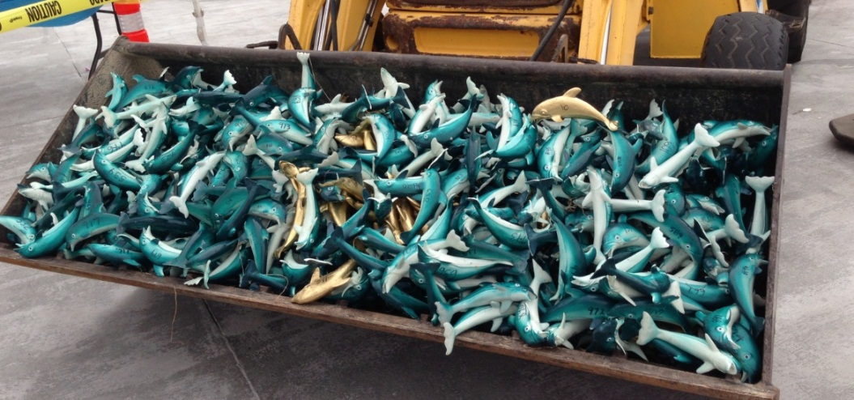
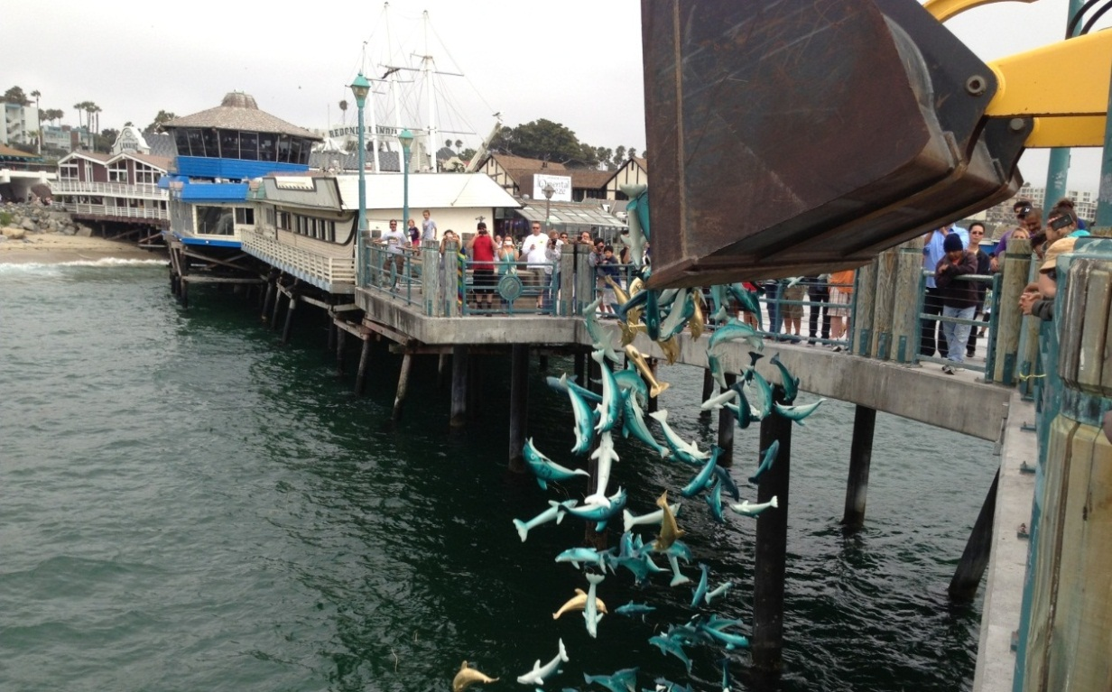
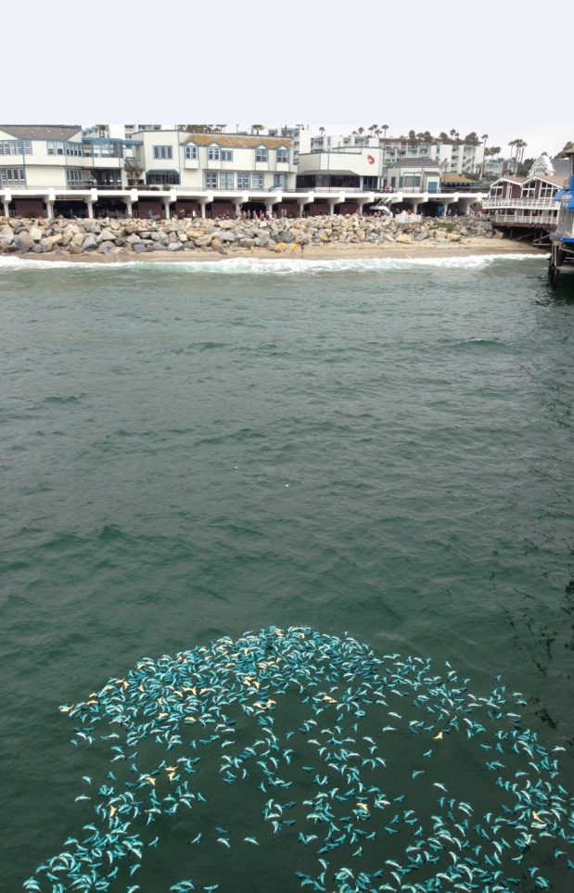
DOLPHIN DASH WRANGLER

Slide 30
Getting a job after University
The top few things I did to ensure I got a good job after college were:
  Volunteer
  Worked harder than my peers
  Asked for challenging assignments
  Talked to Managers about their career path
  Told everyone what I wanted to do
  Dressed not for my job but the job I wanted

Slide 31

This is My Company
Every day at my company:
  Being a start-up every day is a challenge and an adventure
    It keeps it very exciting and fresh
Insert company picture

Slide 32





My Career Path
Executive
MBA
Director
Manager
Law School
Supervisor
Entry Level
Notes:
You may use this chart to describe your journey to the current career

Slide 33
My Career
The first job I had after college was:
  Nordstrom
  Then went to Law School – Got asked to leave
  Circuit City
  Expeditors International
  Custom Goods
The worst job I have ever had was:
  Digging ditches and construction.
  However, I look at the fact that I learned the most from my worst Managers. I learned what I would never do…

Slide 34
My Career
Challenges I have had to overcome throughout my career are:
  I get bored easily so I need continuous challenges. Helps the career but can be frustrating for supervisors, peers and subordinates. However, I became a change agent. Great for the Career but bad for your social life.

Slide 35

My role within organization
CEO
Me
MANAGEMENT
RPIC
IT
TECHNICIAN
Notes:
Use this graph to give more description of your role specifically (responsibilities, typical work week, direct reports, etc.)

Slide 36
Compensation at my company
C-Suite
($200K)
Senior Management
($150K)
Manager
($90K)
Entry Level
($40K)
Notes:
Use this graph to show general compensation ranges for people in various roles in your company

Slide 37
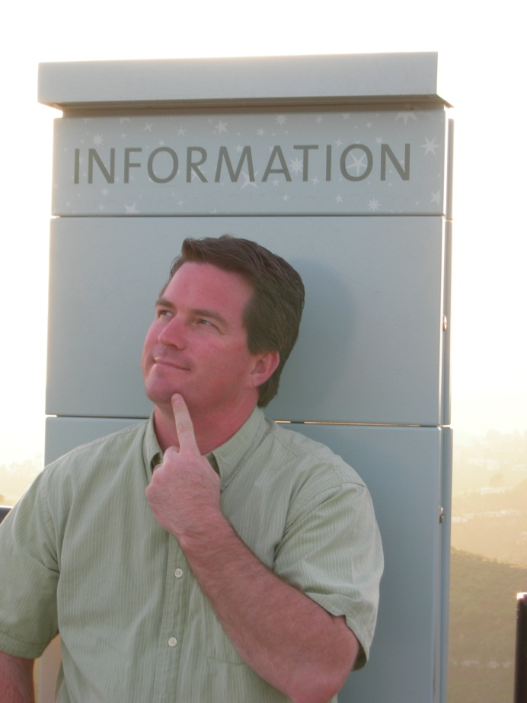
What Motivates Me
Making my business:
The best, more efficient, and profitable
Continuous Improvement
Paying it Forward

Slide 38
More than just work
When I am not at work I like to:
  Spending as much time with my Daughters as possible
  Traveling
  Learning
  Volunteering

Slide 39
Do it all over again?
If I could talk to my high school self, what would I say?
  Buy Apple and Amazon Stock

Slide 40

QUESTION AND ANSWER

