Slide 2
Who am I?
My name is Bree Beltran
I work for Study Smart Tutors
Our mission is to help students realize their college dreams by building their confidence and developing their test-taking skills.
We offer an array of college access courses at no cost to our students or their families. We accomplish this by partnering with schools, outreach programs, and other college access organizations to provide efficient and effective college access programming and classroom-based test preparation.
My role at Study Smart Tutors is Director of Operations

Slide 3
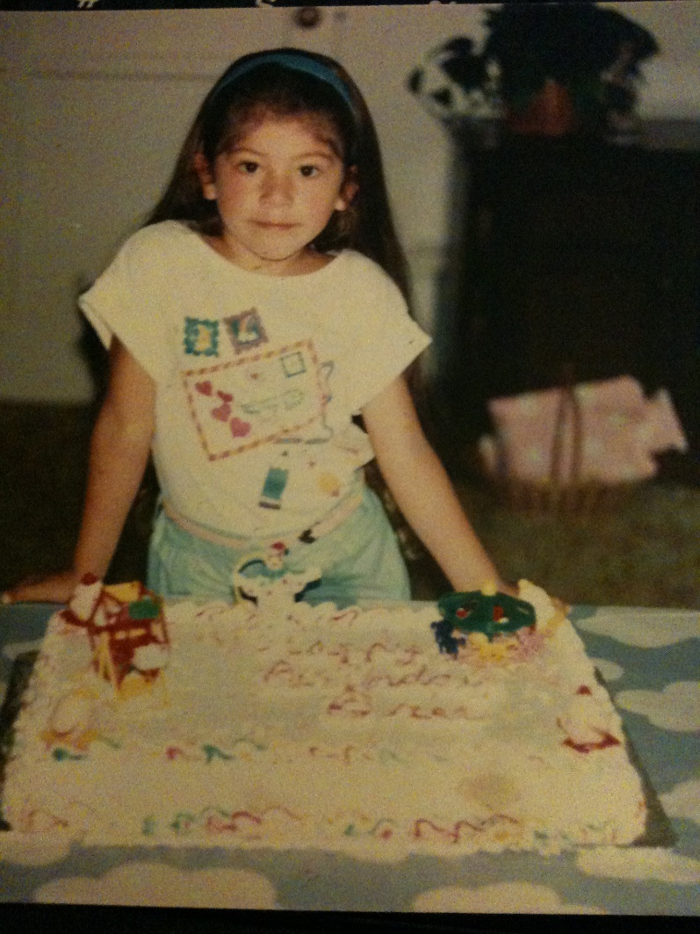
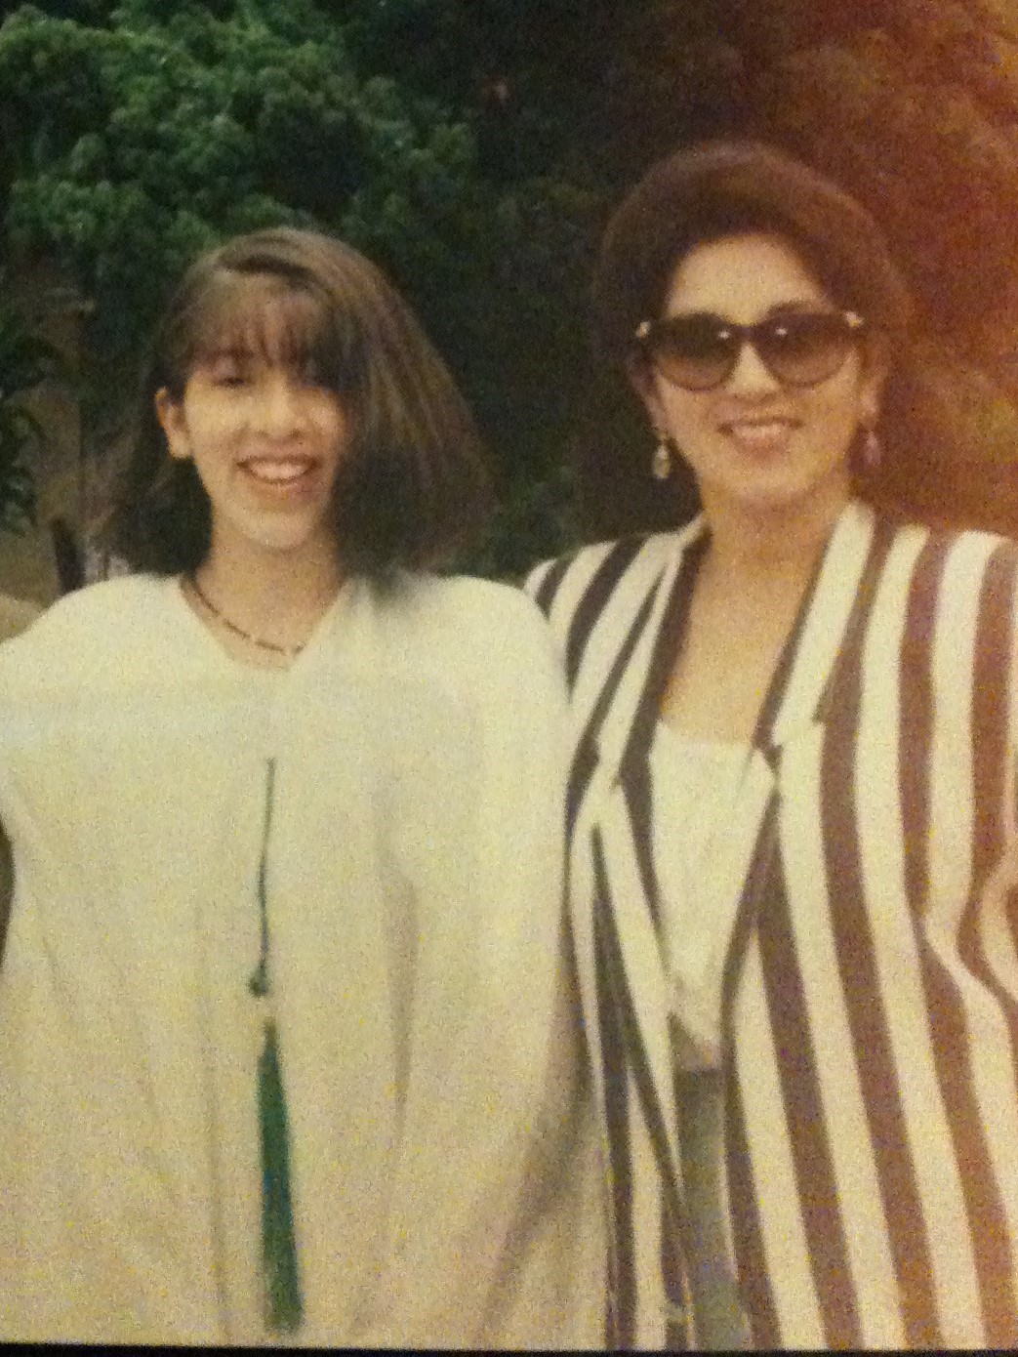
My 2 childhoods
I was born in Port Hueneme, Ca and raised in Ventura County.
I am the 3rd of 5 children
I attended a private elementary school
I attended a public middle school

Slide 4
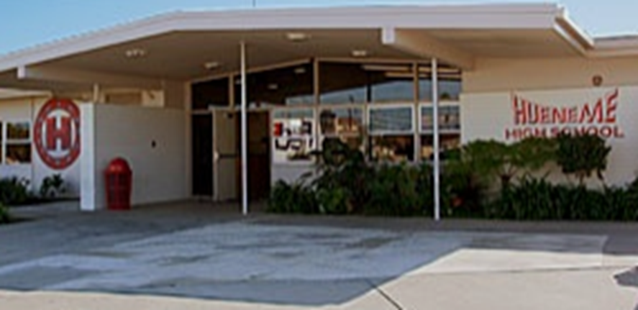
MY HIGH SCHOOL

Slide 5
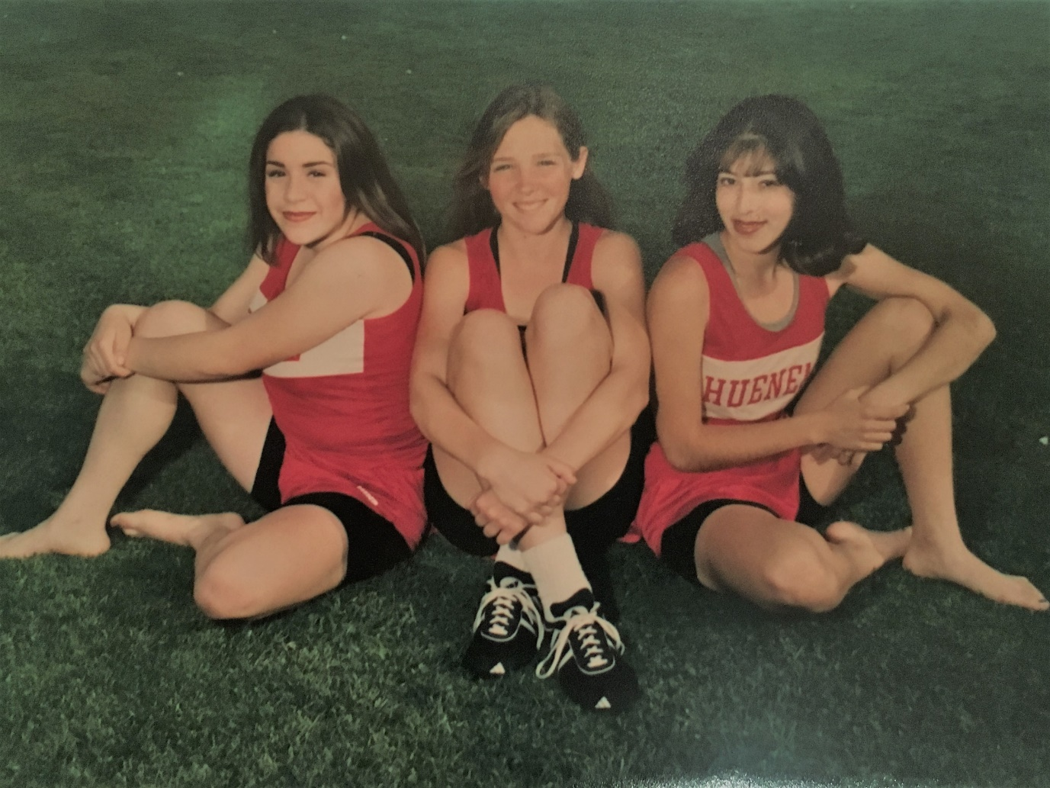
Hueneme High School

Slide 6
High School Graduation

Slide 7
Associate of Arts Oxnard Community College

Slide 8
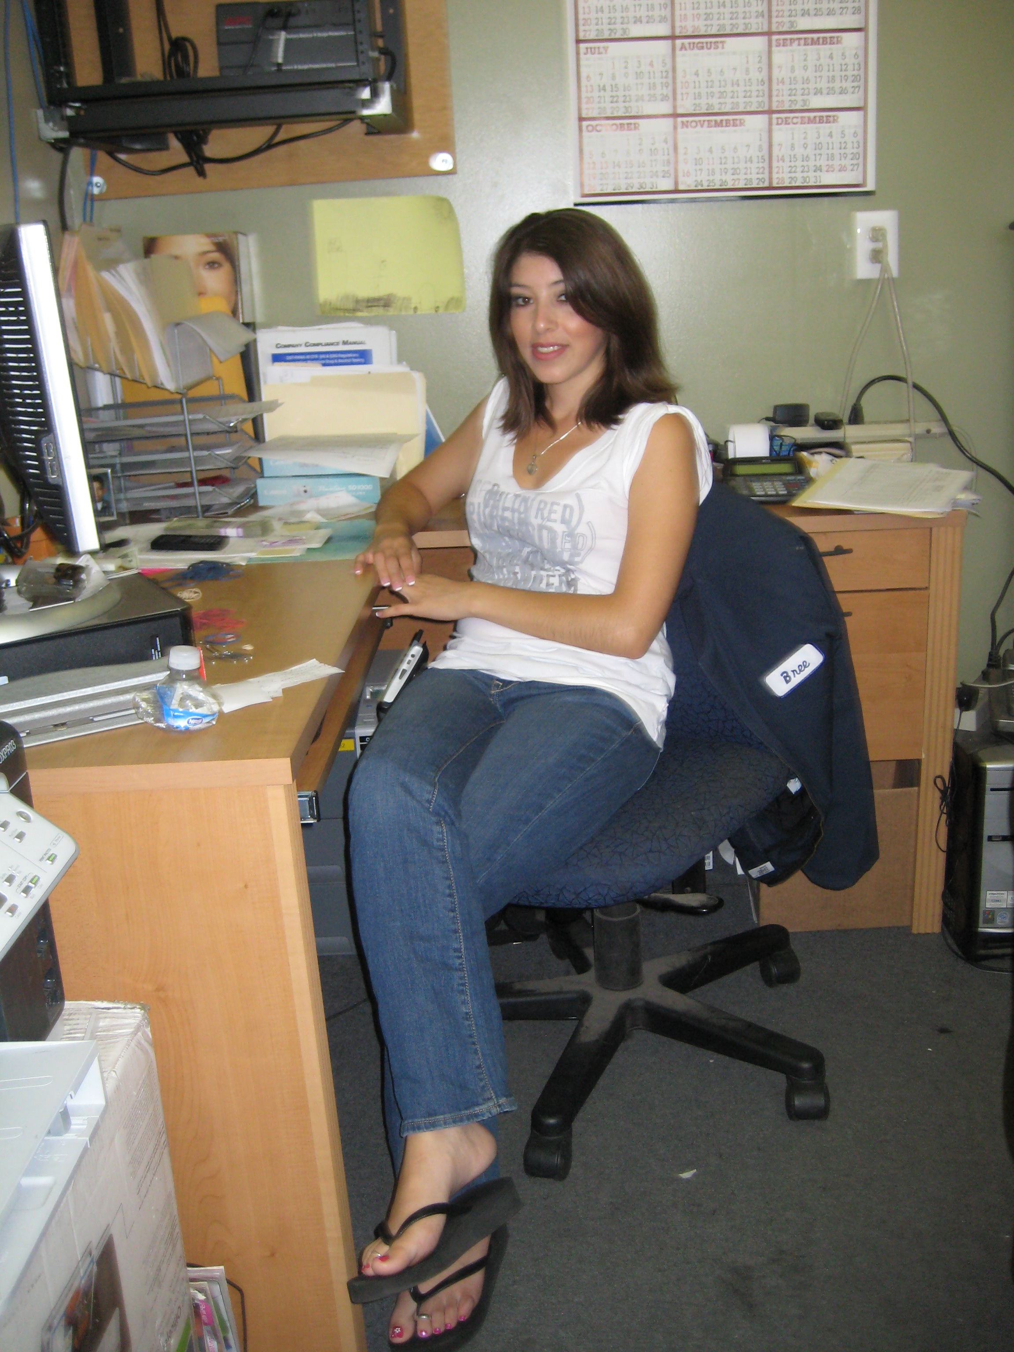
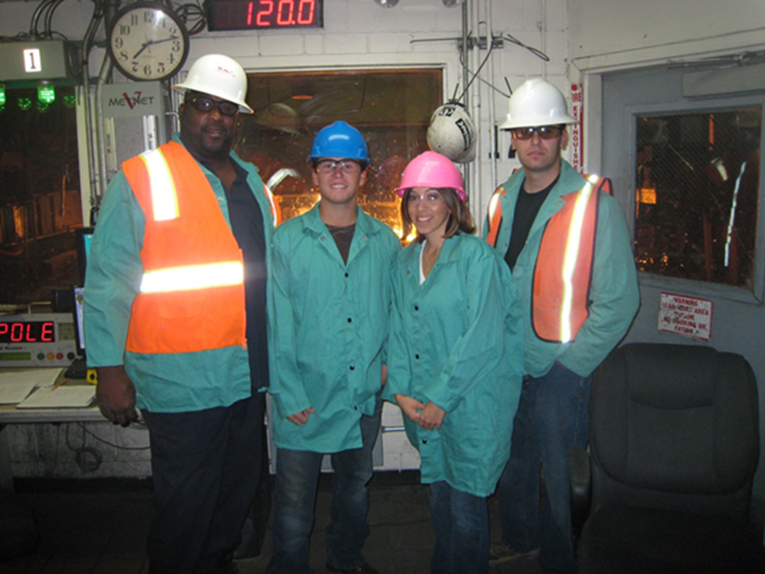
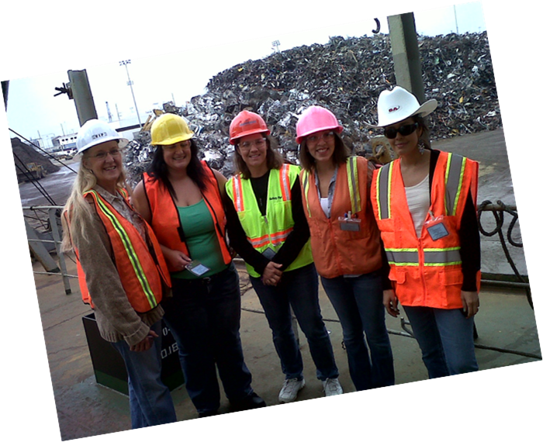

Slide 9
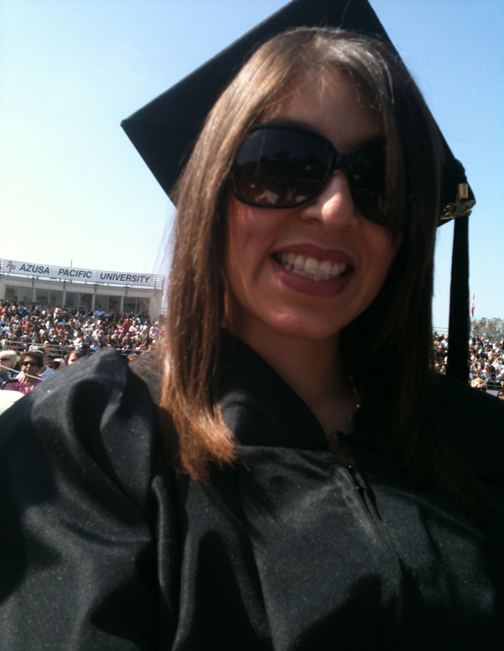
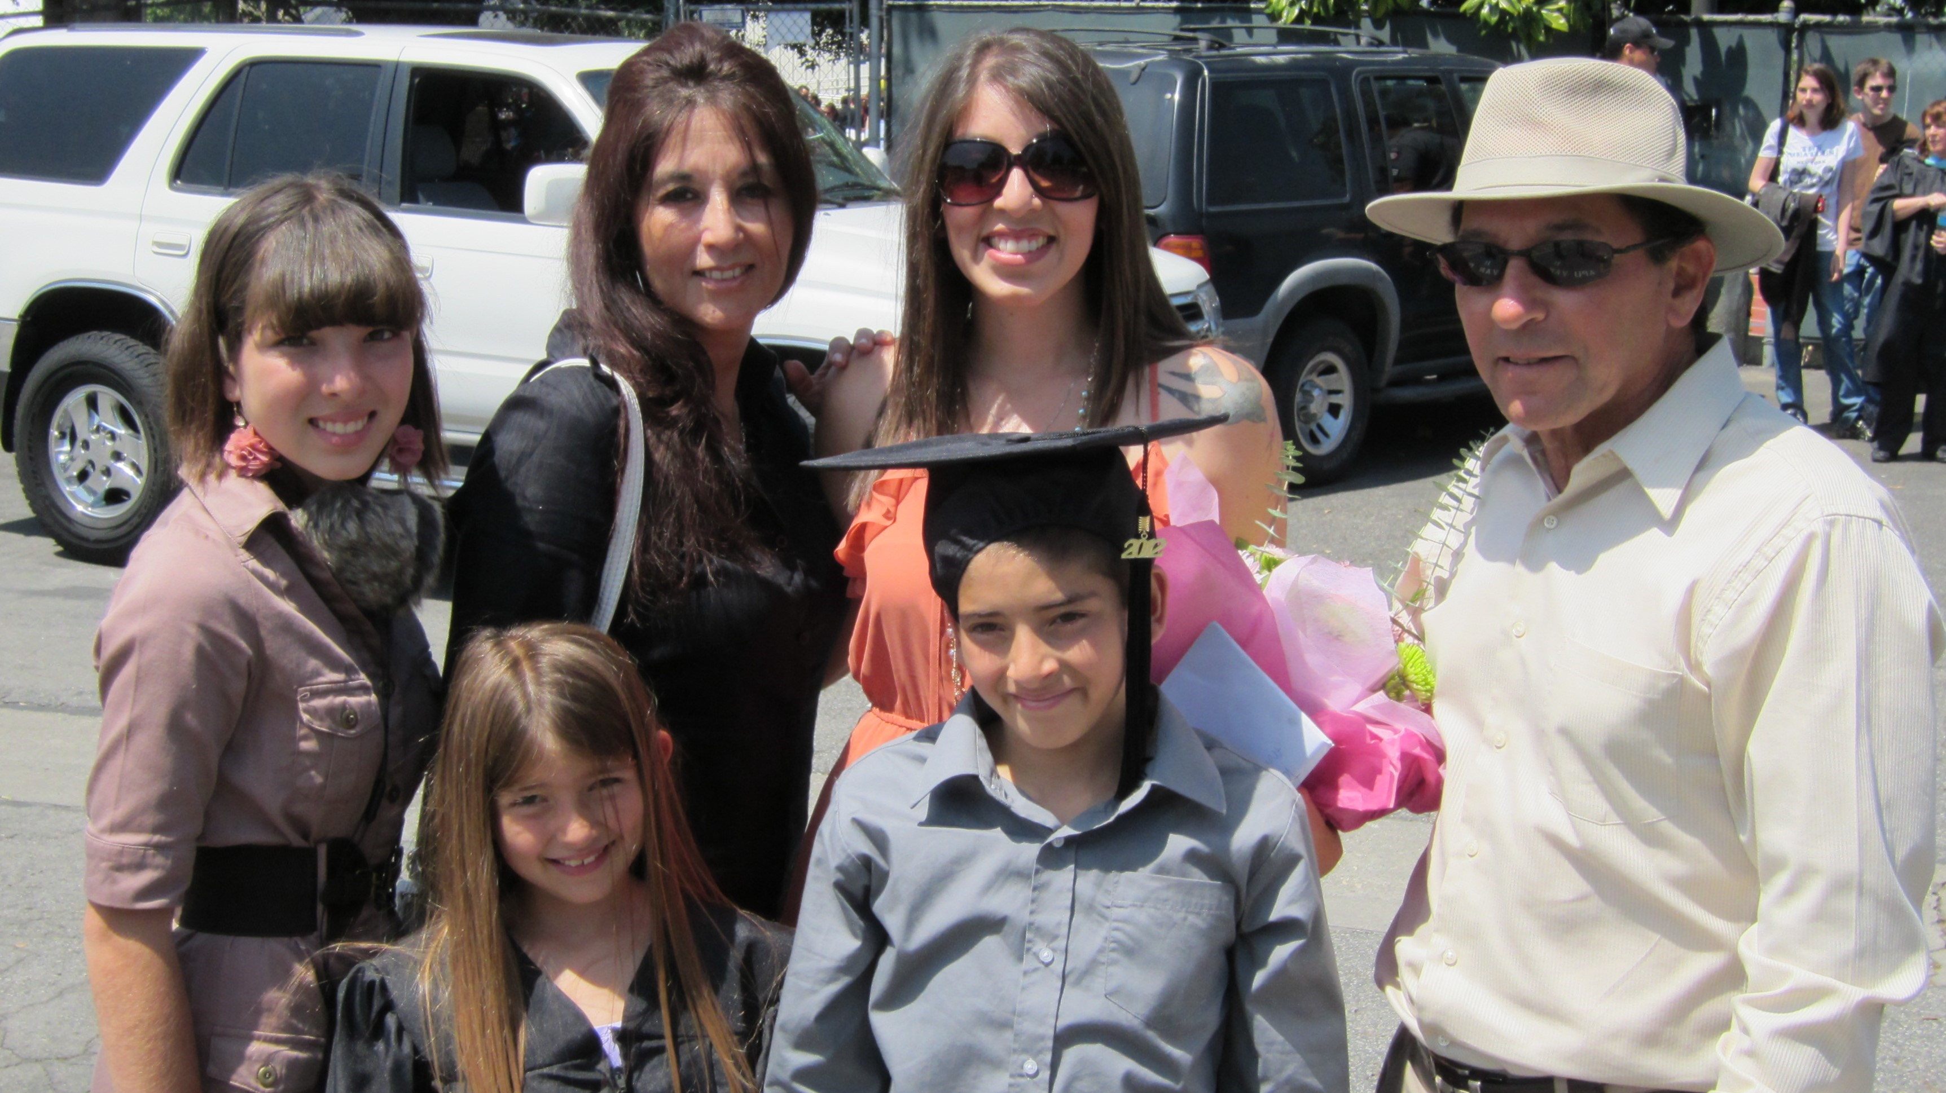
Bachelor of Science Azusa Pacific University

Slide 10
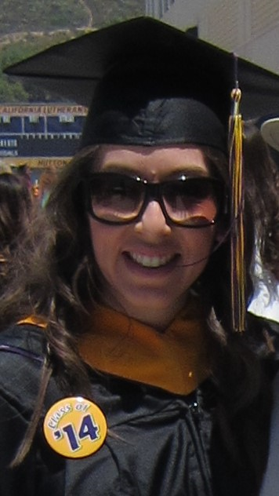
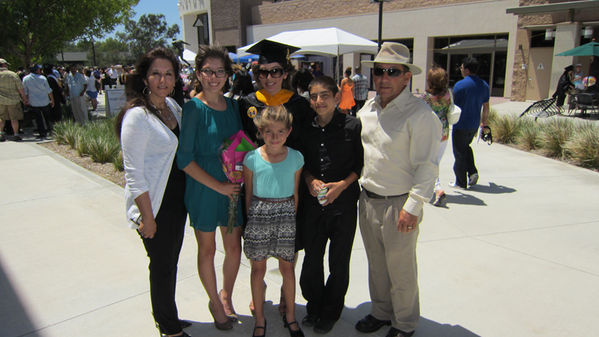
Master of Science California Lutheran University

Slide 11
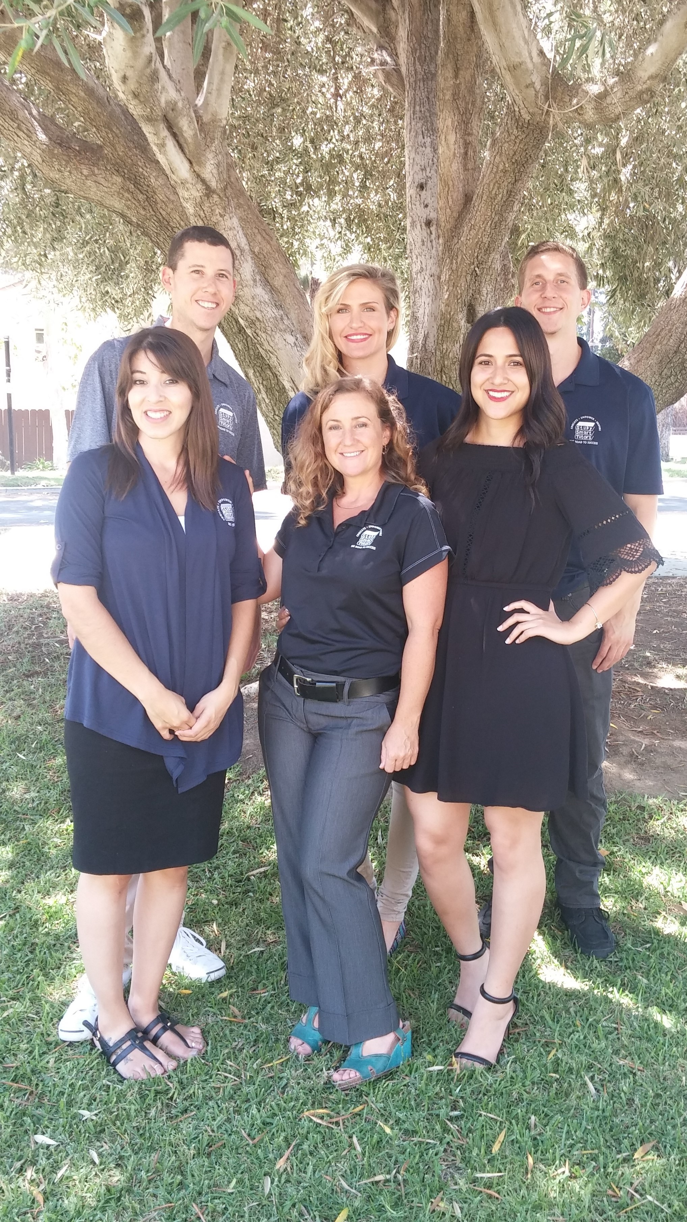
Study Smart Tutors Inc.
Coordinating of Services
Human Resources
Payroll
Policies & Procedures
Recruitment
Scheduling
Strategic Growth
Special Projects
Support
Vendors

Slide 12
Director of Operations
The goal of operations is to maximize efficiency while producing goods and services that effectively fulfill customer needs
Operations oversees planning, organizing and supervising of all departments
Operational decisions include decisions that are strategic in nature, meaning that they have long-term consequences and often involve a great deal of expense and resource commitments

Slide 13
Organizational Structure
Founder
Director of Education
Associate Director of Curriculum
Associate Director of Education
Director of Operations
Accounts Coordinator
Director of Partnerships
Administrative Coordinator
Education Services Coordinator
Program Manager – Northern California
Program Manager- Southern California
Program Outreach Coordinator
Curriculum Coordinator

Slide 14
Coordinating of Services
Services Sold
Scheduling of Classes
Instructor & Program Support
Finish Course
Follow up with Program
Schedule Instructor
Coordinate Materials
Begin Course

Slide 15
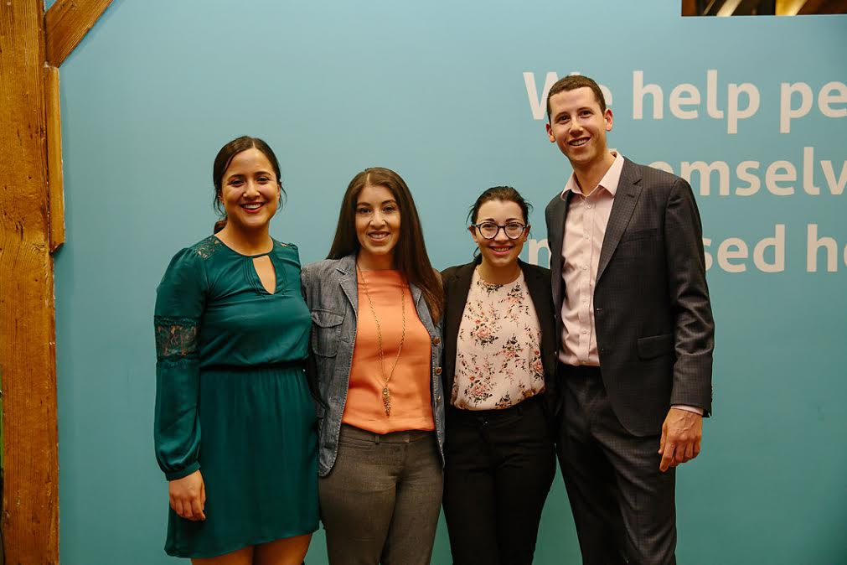
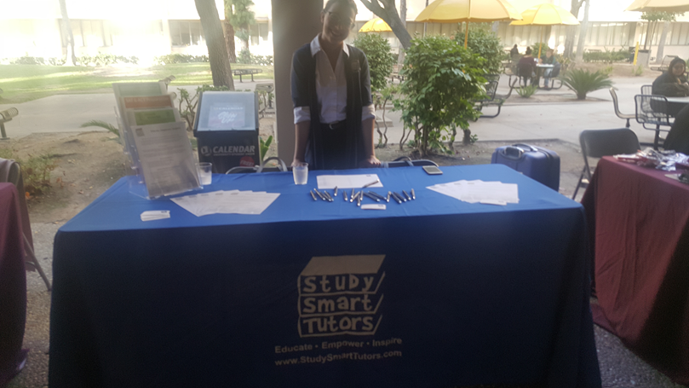

Slide 16
Scenario 1
Let’s order a pizza!

Slide 17
Scenario 2
Please brush your teeth.

Slide 18
Scenario 3
Let’s do some laundry!

