Slide 1
Youth Biz alliance John Hansbrough
Thursday, May 31st 2018
Steam Legacy High School

Slide 2
INTRODUCTION
My name is John Hansbrough and I’m 28 years old.
I have an independent insurance practice called Hansbrough Financial & Insurance Services.
I work with families and businesses.
I take care of their insurance and financial needs.
I’m the boss
That makes every day both fun and stressful

Slide 3
My childhood
I was born in San Diego and lived there until I went to college
This is a picture of me at 4 years old

Slide 4
My family
A little about my family
I have a younger sister
My dad passed away when I was ten years old
Dad, Mom, Elizabeth, John

Slide 5
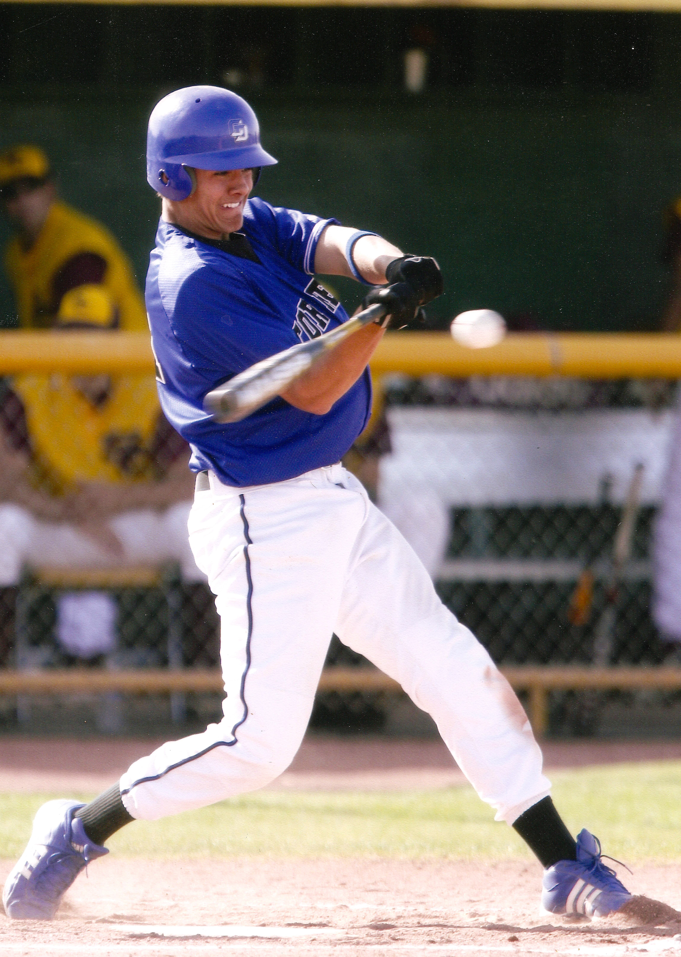
MY HIGH SCHOOL
I attended La Jolla Country Day HS in San Diego
Playing baseball

Slide 6
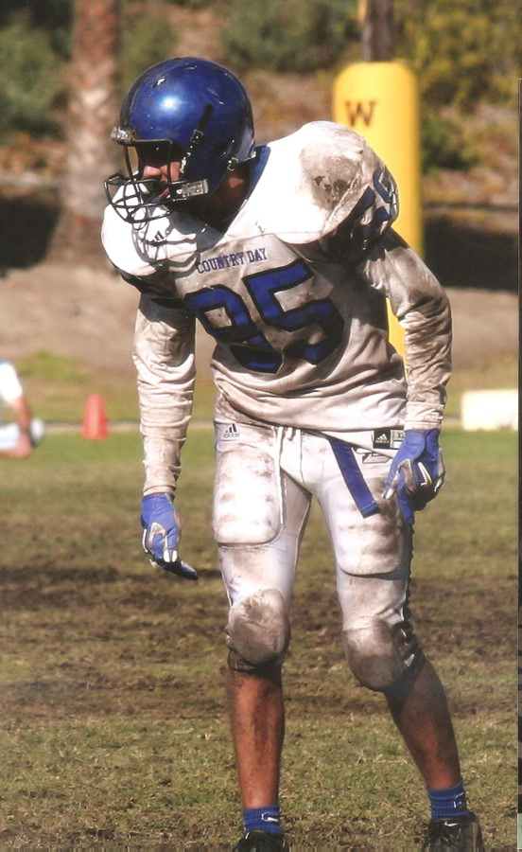
High School
As a HS student I was:
Introverted
Athletic
Somewhat academic
HS Football

Slide 7
High School
Here’s what I liked about high school
Tight group of friends
Habits and routines
School wasn’t too hard

Slide 8
High School
Here’s what I didn’t like about high school:
Didn’t explore opportunities
Too focused on athletics
Didn’t push myself academically

Slide 9
High School
Jobs I worked while I was in High School were:
Line prep at Quiznos
Smile and eat it
Not everyone is a team player
Dream of more

Slide 10
Getting in to Oxy
I got into my top pick for college because:
Offset grades with test scores
Leadership via sports
Sell myself

Slide 11
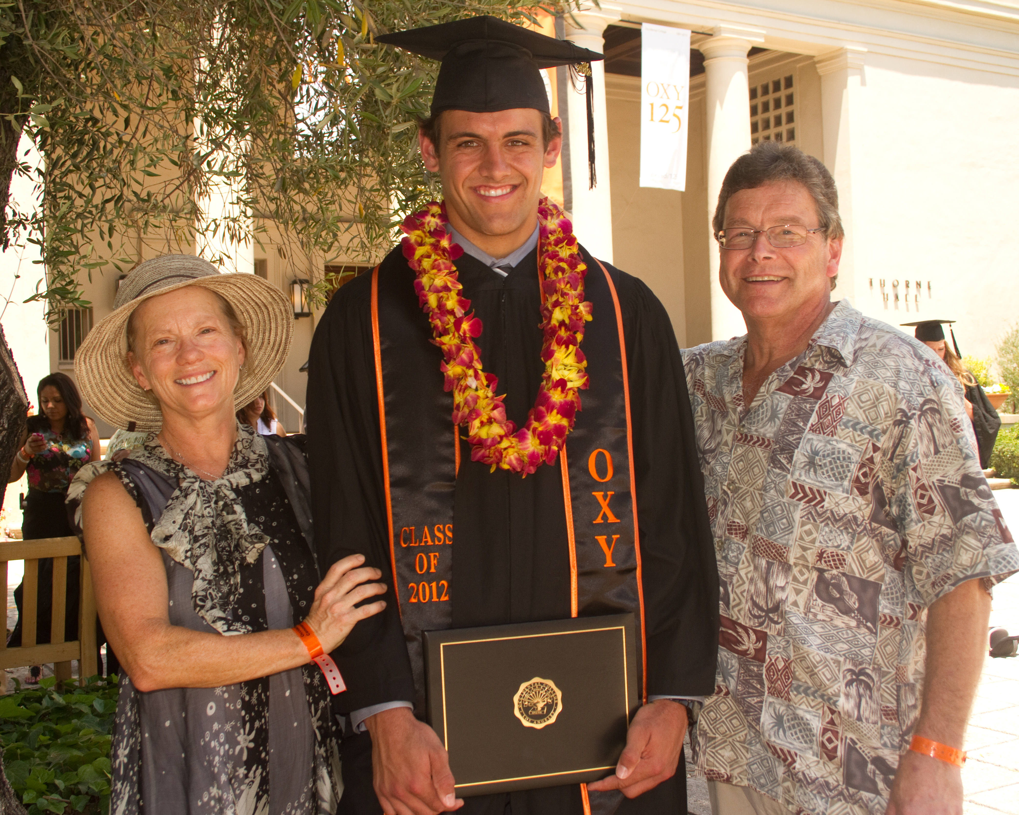
College
I attended Occidental College in Eagle Rock, CA
Graduation with uncle and aunt

Slide 12
College
Things I enjoyed in College
Things I didn’t enjoy in College
Sports
Socializing
Classes
Sports
Socializing
Classes

Slide 13
College
Favorite classes
Least favorite classes
Game Theory
Sports and Business
Multivariable Calculus
Geology
History
Linear Algebra
Russian literature

Slide 14
College
Jobs I worked while I was in College were:
Trainer at my high school
Intern for financial advisors

Slide 15
College
Things that felt difficult or challenging for me while I was in College were:
Balancing school, sports, and socializing
Hard to say no

Slide 16
Getting a job after College
The top few things I did to ensure I got a good job after college were:
Sell myself. Always tell a story.

Slide 17
This is My Company
Every day at my company, I am:
The boss
The sales team
The client service team
The financial team

Slide 18
My Career Path
Notes:
You may use this chart to describe your journey to the current career

Slide 19
My Career
The first job I had after college was:
Working for a team of advisors
The worst job I have ever had was:
Being in the middle of a bad business break up

Slide 20
My Career
Challenges I have had to overcome throughout my career are:
Lack of professional mentor
Changing industry

Slide 21
My role within organization
CEO
Me
MANAGEMENT
Me
Me
Me
Me
Notes:
Use this graph to give more description of your role specifically (responsibilities, typical work week, direct reports, etc.)

Slide 22
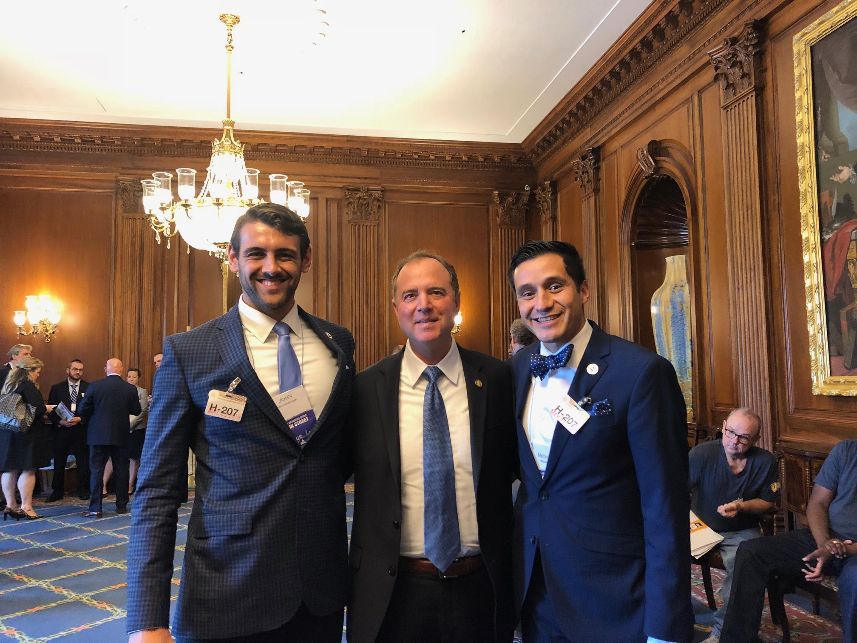
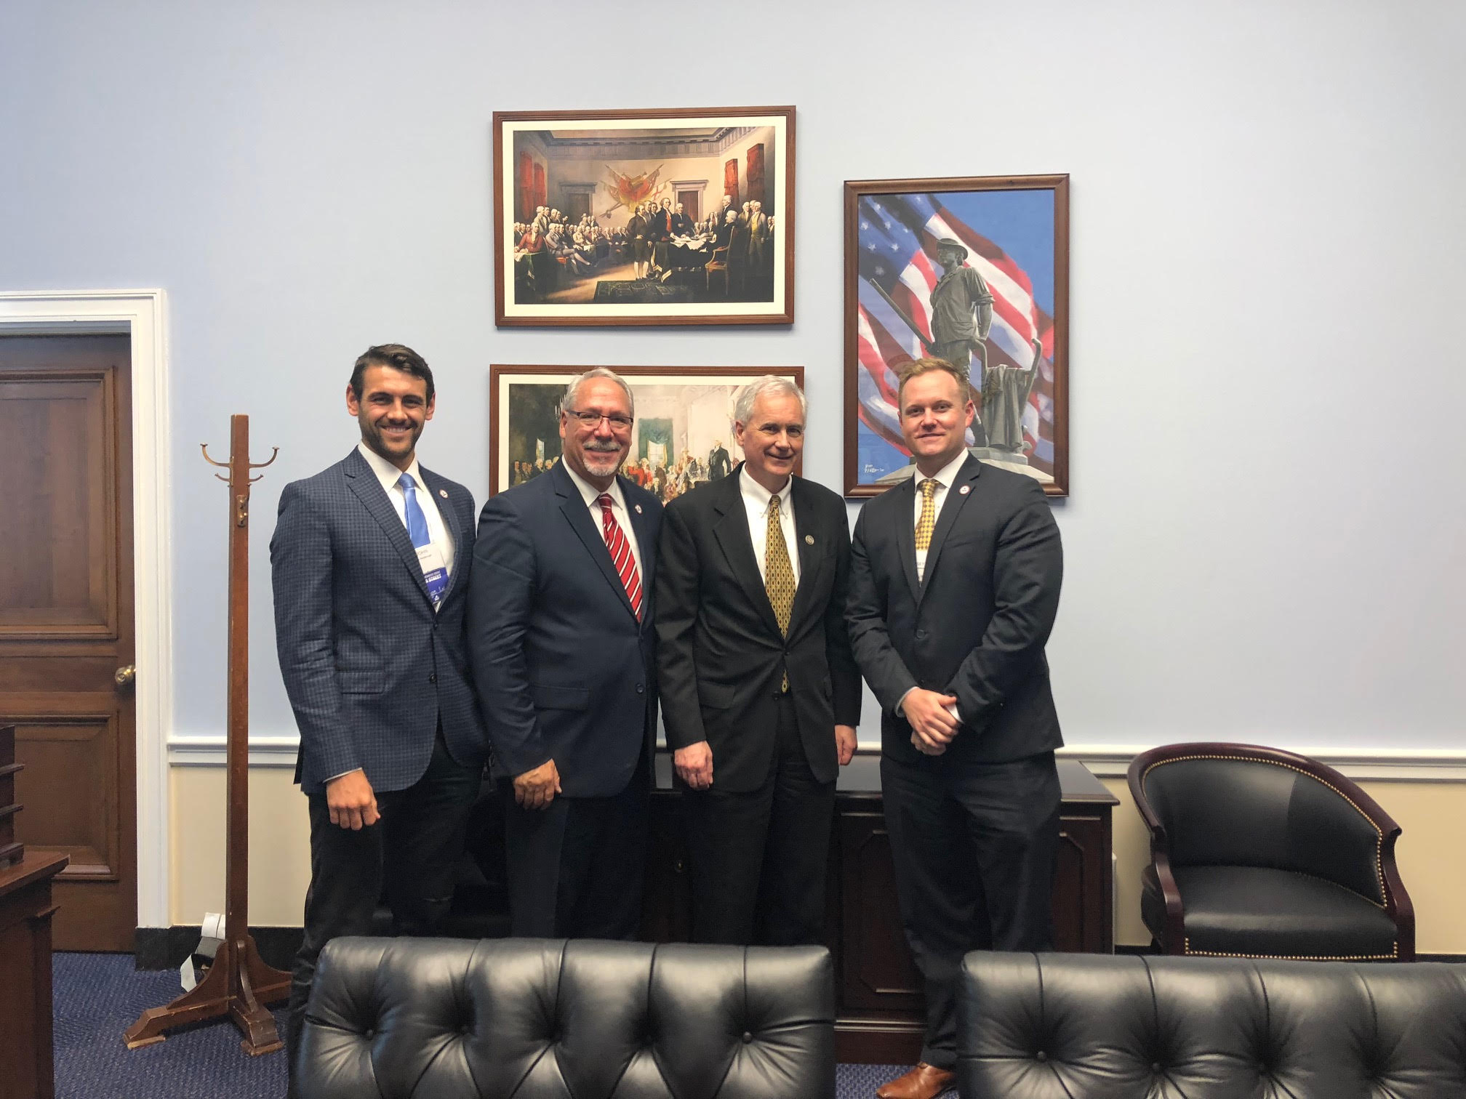
Cool opportunities
Tom McClintock, CA-4
Adam Schiff, CA-28
Notes:
Use this graph to show general compensation ranges for people in various roles in your company

Slide 23
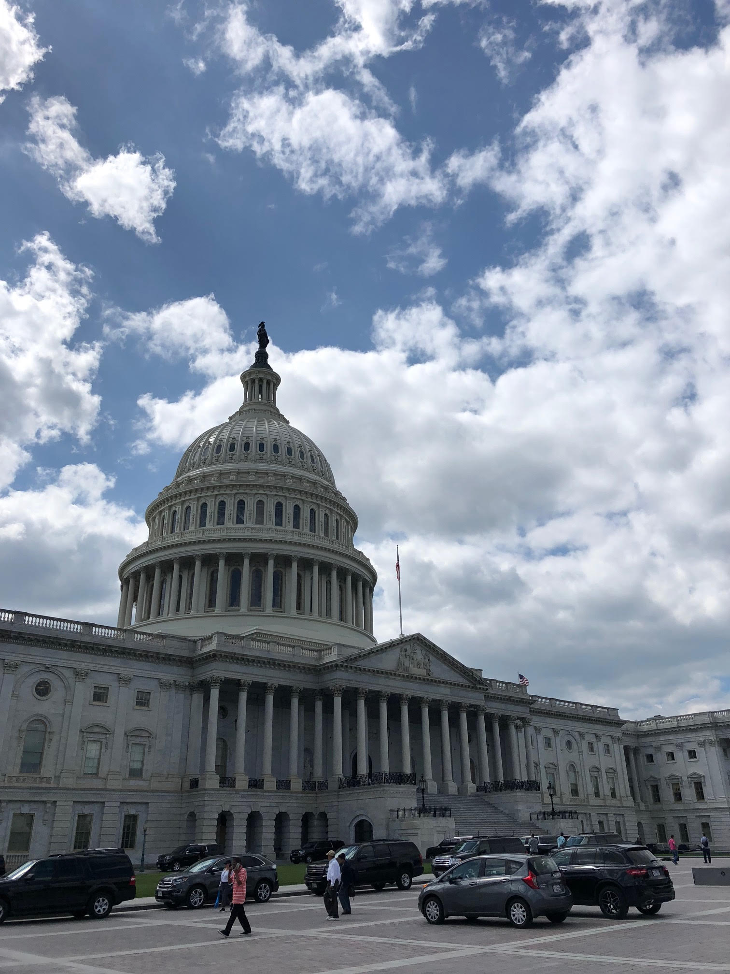
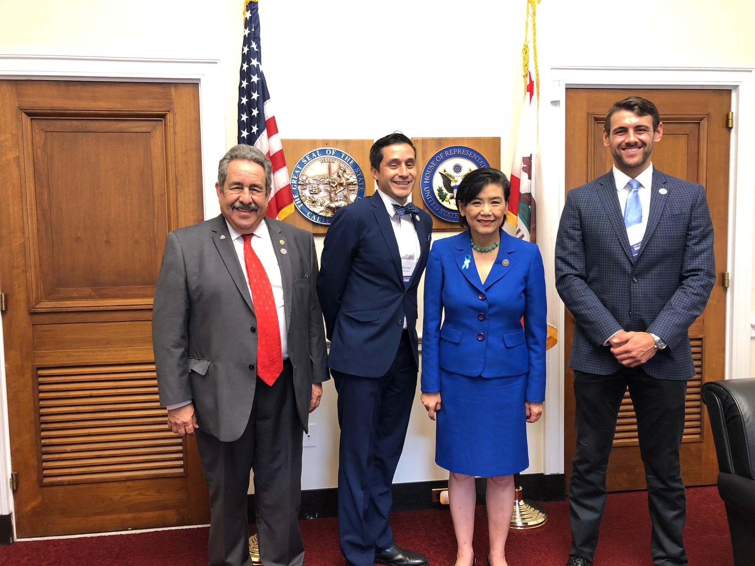
Cool opportunities
Capitol Building, (Right)
Judy Chu, CA-27 (Below)
Notes:
Use this graph to show general compensation ranges for people in various roles in your company

Slide 24
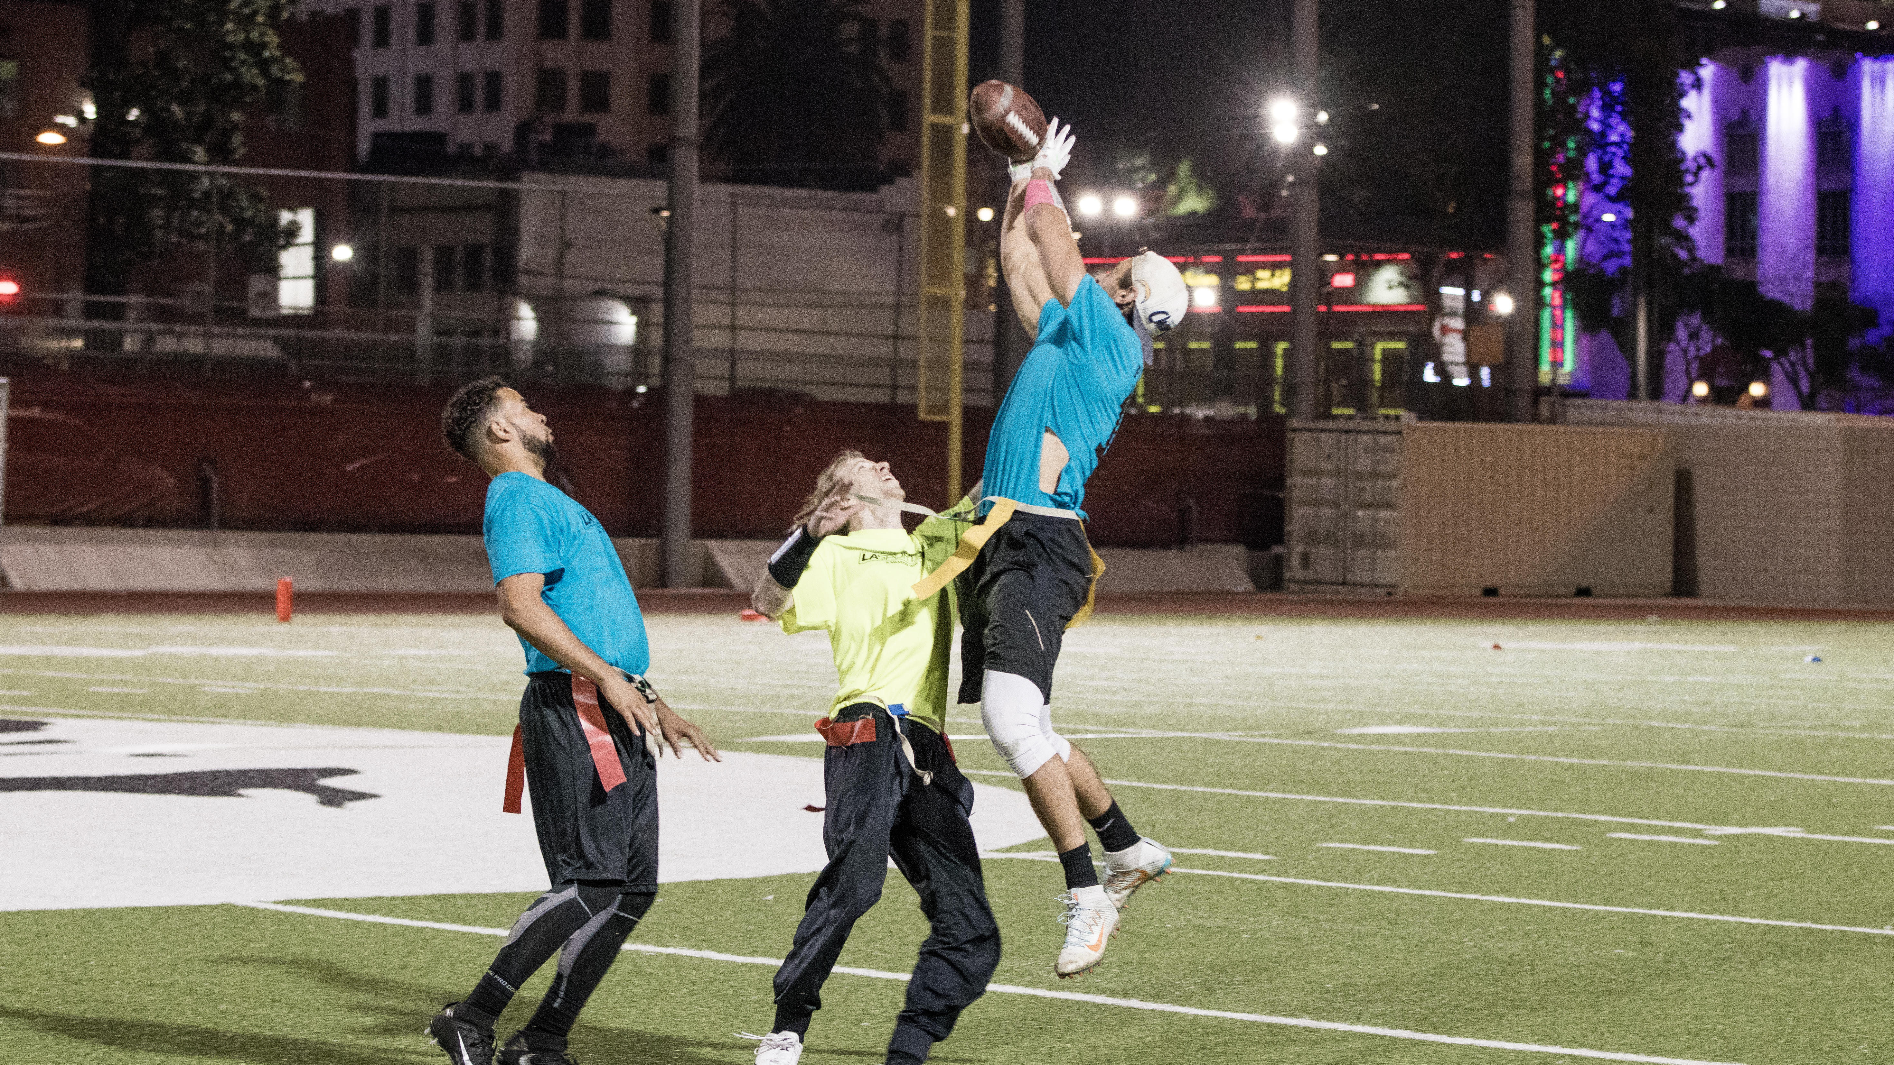
More than just work
When I am not at work I like to:
Play sports
Spend time with fiancée

Slide 25
Do it all over again?
If I could talk to my high school self, what would I say?
Personal
Be kinder to myself
Business
Learn to sell

Slide 26
QUESTION AND ANSWER

Slide 27
Activity
Value in goal setting
Steven Covey & 7 Habits of Highly Effective People
Begin with the end in mind

Slide 28
Activity
Vision and Guiding Principles
25 Year Plan
90 Day Increments
What is a BHAG?
“Moon Shot”

Slide 29
Activity
Get in groups of three
What is your BHAG? ( 12 minutes )
Guiding Questions
If everything goes right, what are you doing in 25 years?
Share ( if you want ☺ ) (8 minutes)

