Slide 1
Enrique Lopez
Youth business alliance presentation – may 2018

Slide 2
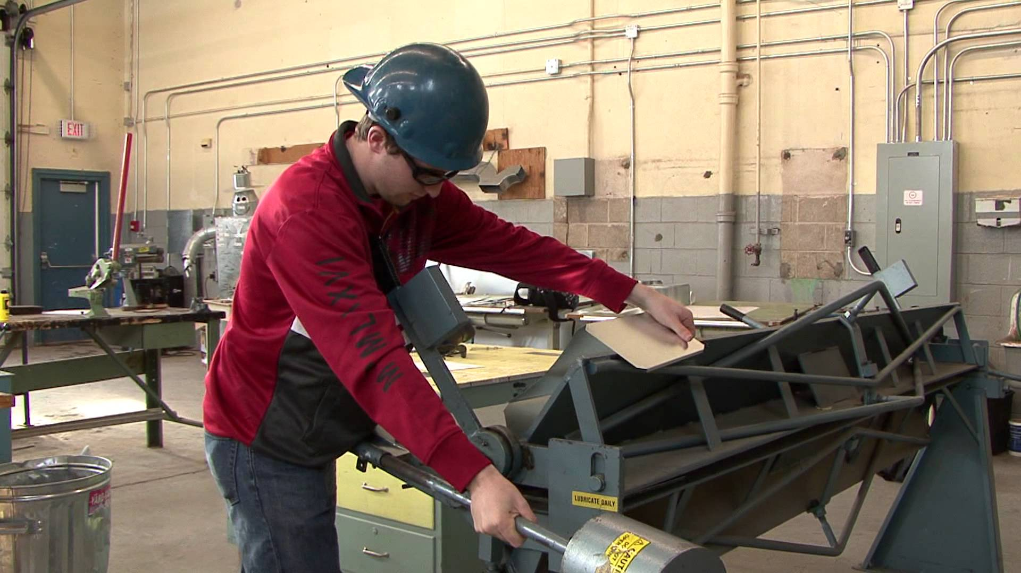
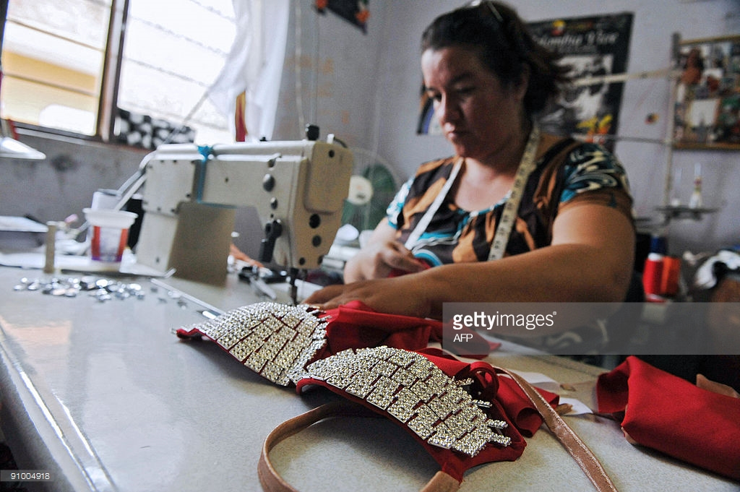
parents immigrated from nicaragua
Father – worked as sheet metal worker
Mother – worked as seamstress

Slide 3
Born in boyle heights at la county usc hospital

Slide 4
Youngest of 4 children – 2 boys – 2 girls. Raised in sun valley – northeast sfv
Not So Good
Experienced the growth of drug trade and gang violence. Friends in gangs and drug addicted.
Learned what neighborhoods not to cross and how to respond to rival gangs
Never met someone who attended college!
Good
No cell phones
Bike riding around neighborhood
Playing streetball
DJ crew
Breakdance crew (not really good)

Slide 5
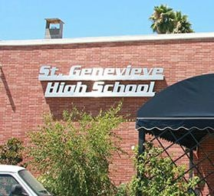
Attended catholic elementary school and high school through 11th grade
Experience:
Outsider – was one of few Latinos in school.
Bullied in elementary school
Felt like I was living in two worlds – one at home with my neighborhood friends – Latino lower income and school classmates middle/higher income

Slide 6
Overcoming challenges
Strong positive values at home:
POSITIVE THINKING - My father had a passion for reading books on positive thinking. “Power of Positive Thinking”, “The Power of Making Friends and Influencing People”, Anthony Robbins.
VISUALIZATION - My mother gave me the confidence to pursue my dreams. She would help me visualize myself in a professional role in the future. Key mom saying “Tell me who your friends are and I will tell you who you are”
Academics Focus:
- I was not athletic so I turned to excelling in academics to boost my self-esteem and confidence. Because of language issues, I struggled initially through 5th grade but began to excel starting in 7th grade.

Slide 7
Life is not a straight line!
In 11th grade – I convinced my mother to allow me to transfer in 12th grade from Catholic HS to my local public high school.
Result = Grades dropped being an Honors student to a C student. Skipped school and associated with “wrong” crowd.
Fortunately, I saw a lot of bad things that half way through 12th grade that I decided to break away from bad influences.
Studied and passed the GED examination.
My new journey was about to begin!

Slide 8
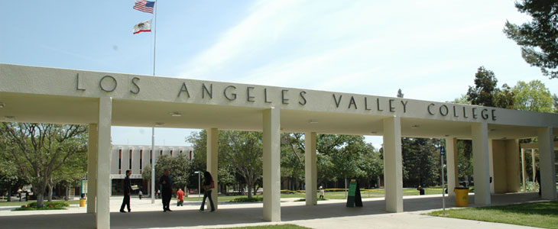
New journey - college
After high school – I was determined to succeed in college. I met with a college counselor and developed an academic plan for classes. Decided on accounting given interest in business.
Establish a
Game Plan

Slide 9
New journey - college
Transferred to CSUN – affordable but highly ranked for my major in Accounting. Focused on achieving high grades and securing a job with top accounting firm
Establish Goals
Dream Big!

Slide 10
New journey – graduate school
Set a goal to attend Stanford – most selective business school to be accepted. With help of mentors and UCLA Riordan Fellows Program was accepted!
Learn From Mentors
Be Persistent

Slide 11
Career journey – some turns but seeking always learning opportunities

Slide 12
Career journey – some turns but always seeking learning opportunities
Accountant
Restaurant Leader
Finance

Slide 13
Current career/Future aspiration
Last year I started my own company – Elo Restaurant Advisors
I help restaurant companies improve their business by analyzing their performance and finding opportunities. I work with smaller to medium size restaurant companies in the Los Angeles area.
I enjoy having the flexibility of schedule and working on projects and clients that I chose. I plan to at some point seek a college teaching position where I can teach a business subject matter.

Slide 14
Lessons from career
Follow YOUR Passion not $$$
Develop a Game Plan
Be Disciplined
Be Persistent
“Tell me who your friends are and I will tell you who you are”
“How you do anything is how do everything”
Be Humble
Always Seek To Grow and Learn

Slide 15
Questions?

