Slide 1
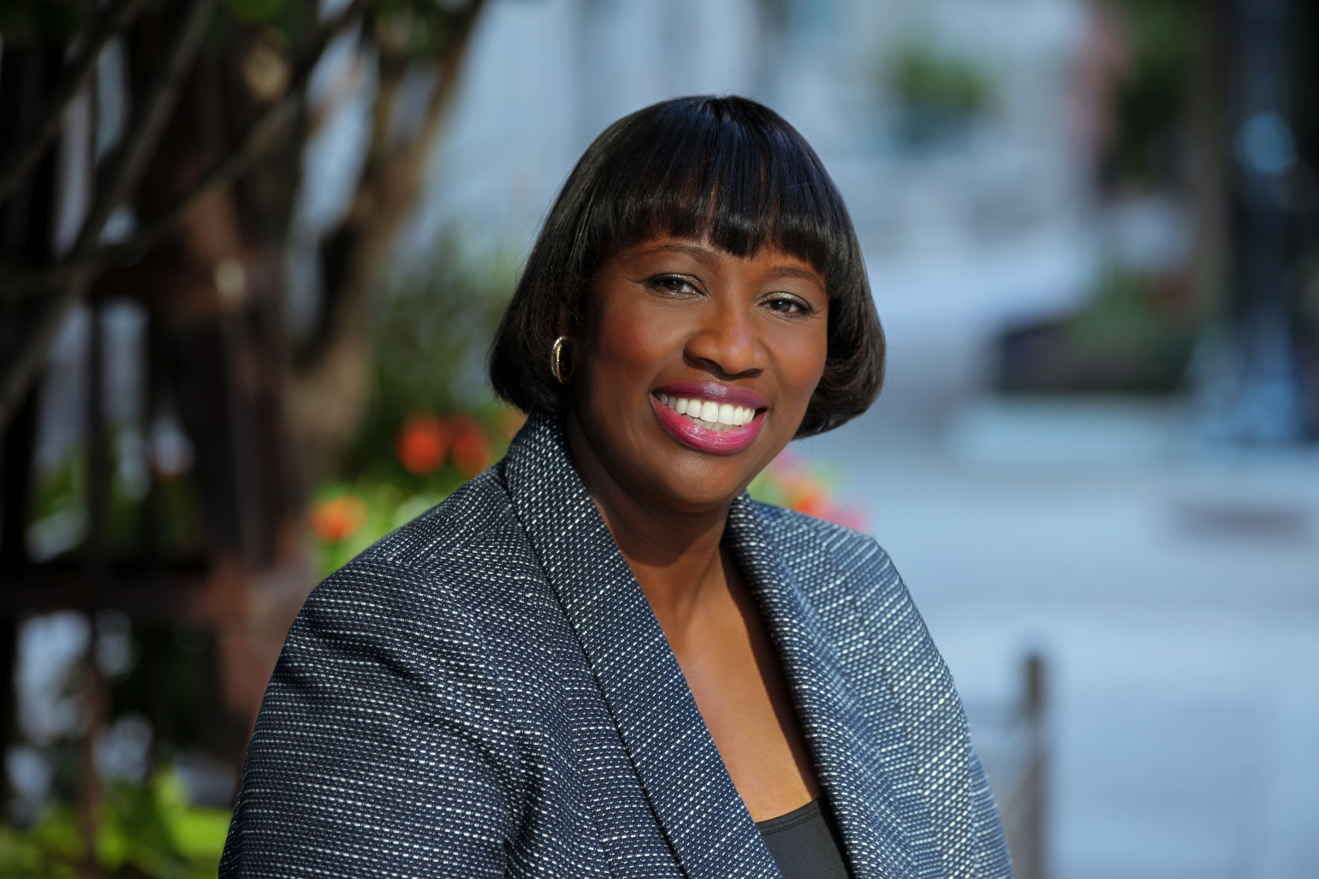
Barbara Oliver
President of Enterprise Publishing Inc.

Slide 2




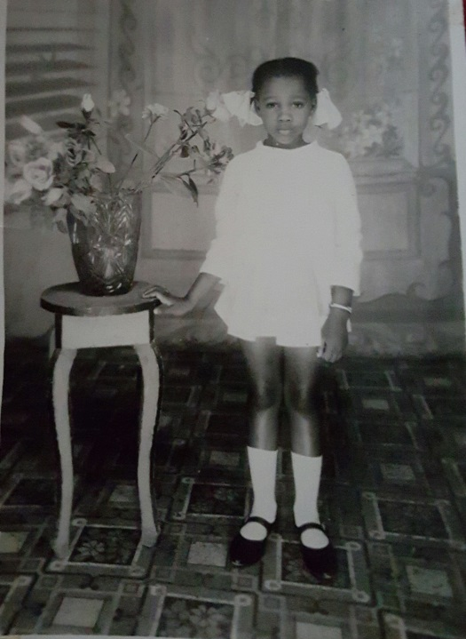

Slide 3
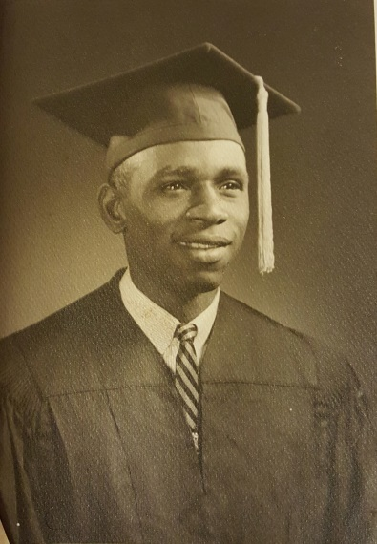
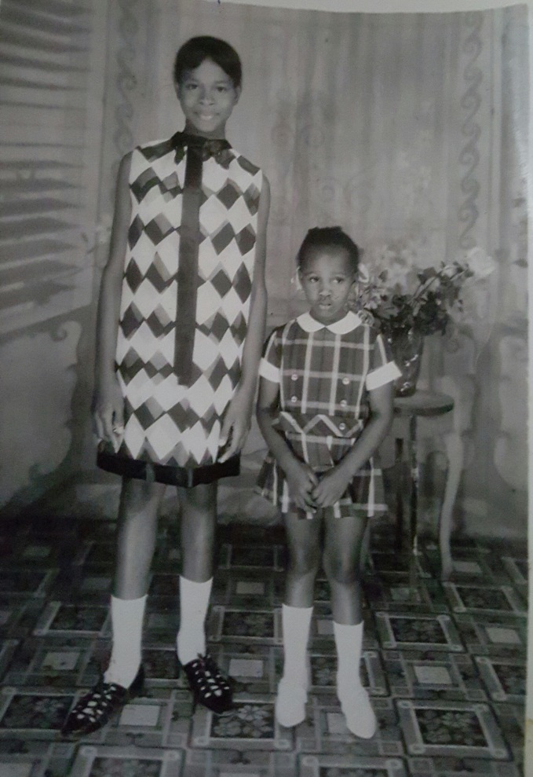
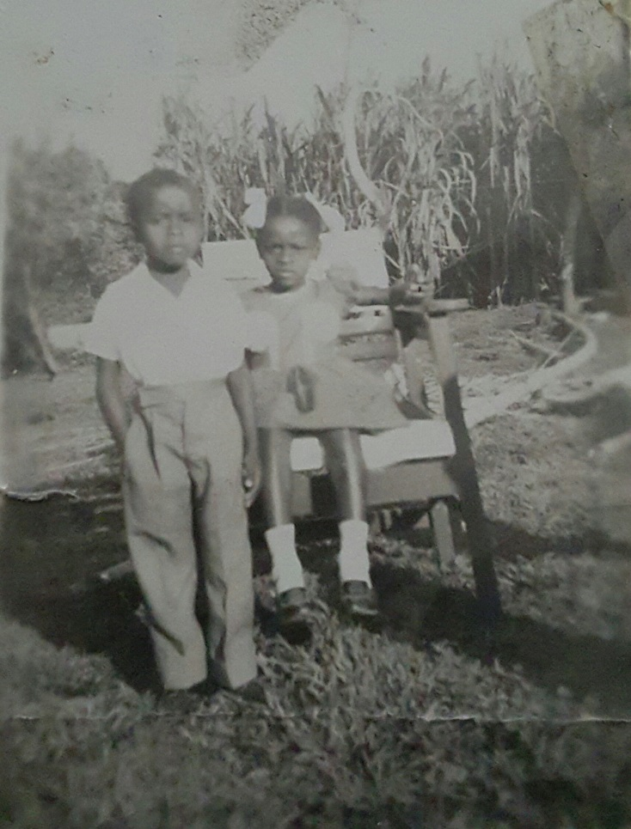
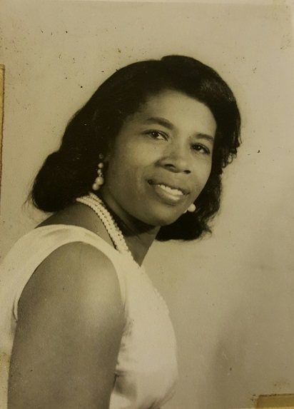
Growing UP
A little about my family

Slide 4




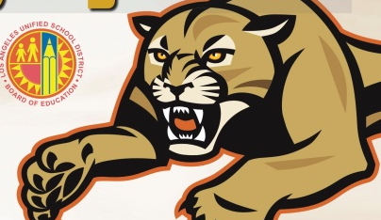
MY HIGH SCHOOL
Wolmers Girl School, Kingston, Jamaica
Hawthorne HS in Hawthrone, CA and John F Kennedy HS in Granada Hills, CA

Slide 5




High School
  I was very active when I was in Jamaica
  None of my friends were in my class at JFK

Slide 6
High School
Things that I really liked in High School were:
  Hanging with friends
  French
  Math
  Chemistry (lab)
  Singing
  Badmington
  Tennis

Slide 7
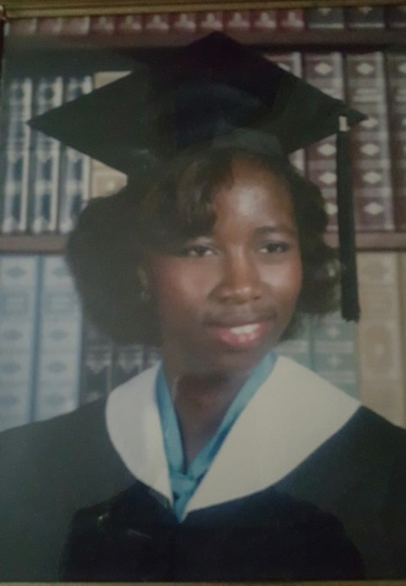
High School
Things that felt difficult or challenging for me while I was in High School were:
  The move to JFK
  I almost did not get my diploma…ask me why

Slide 8

High School
Jobs I worked while I was in High School were:
  My first (and only) job…

Slide 9
Getting in to College
The top few things I did to ensure I got into college were:
  Grades
  High SAT scores in Math
  Financial Aid, scholarships

Slide 10
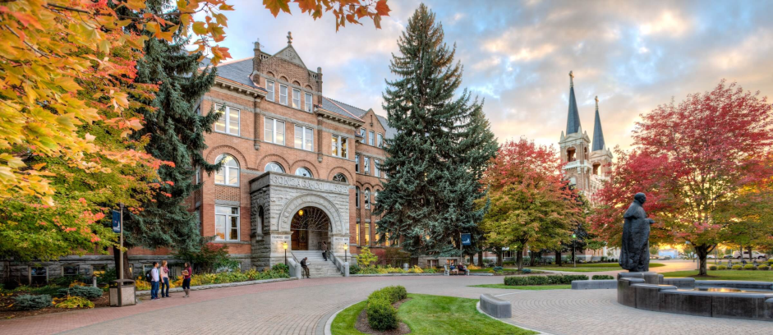
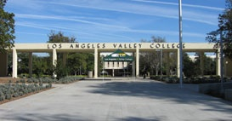
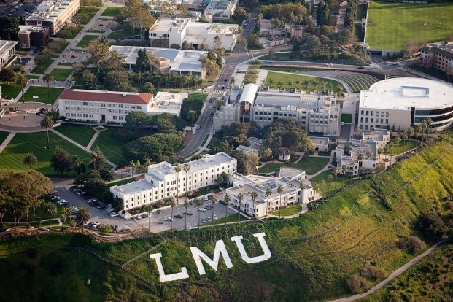
College
Gonzaga University
Los Angeles Valley College
Loyola Marymount University

Slide 11
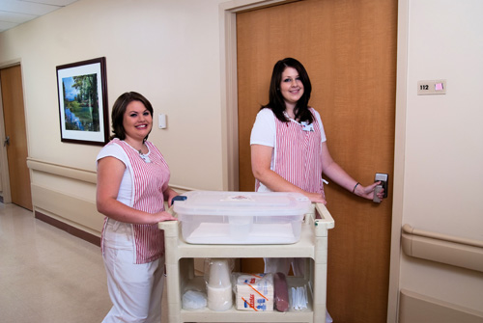



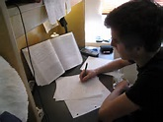
College
Things I enjoyed in College
Things I didn’t enjoy in College

Slide 12
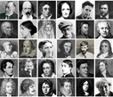

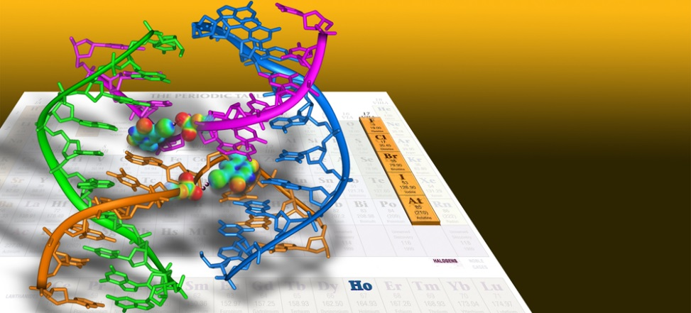

College
Favorite classes
Least favorite classes

Slide 13

College
Jobs I worked while I was in College were:
Weyerhaeuser Mortgage – Reseda, CA
Work-study - library

Slide 14
College
Things that felt difficult or challenging for me while I was in College were:
  Herniated disc
  BioChemistry
  Changing my major

Slide 15
Getting a job after College
The top few things I did to ensure I got a good job after college were:
  Apple One Employment Agency

Slide 16

This is My Company

Slide 17
My Career Path
I started Assistant to the Publisher; Went to Univ. of Phoenix for MBA
Worked for healthcare organization for 1 year
I am now the President and Publisher of Epi/MBE magazine
Notes:
You may use this chart to describe your journey to the current career

Slide 18

My Career
The first job I had after college was:
  PPO Secretary

Slide 19

My Career
Challenges I have had to overcome throughout my career are:
  Shyness
  To be outgoing and comfortable meeting new people

Slide 20
My role within organization
ME
Editorial
Advertising
Production
Notes:
Use this graph to give more description of your role specifically (responsibilities, typical work week, direct reports, etc.)

Slide 21
Compensation at my company
C-Suite
($70-90K)
Management
($50-60K)
Middle Manager
($35-40K)
Entry Level
($20-25K)

Slide 22
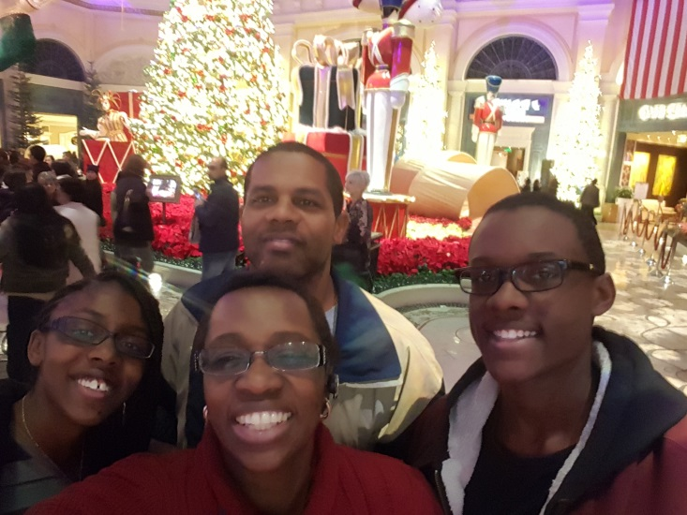
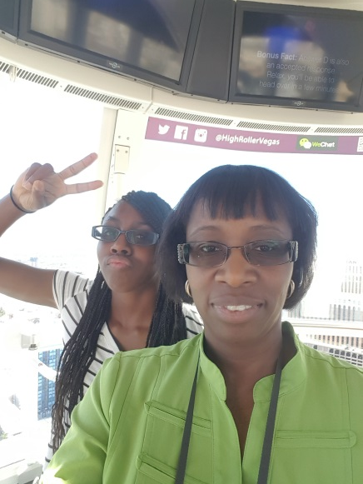
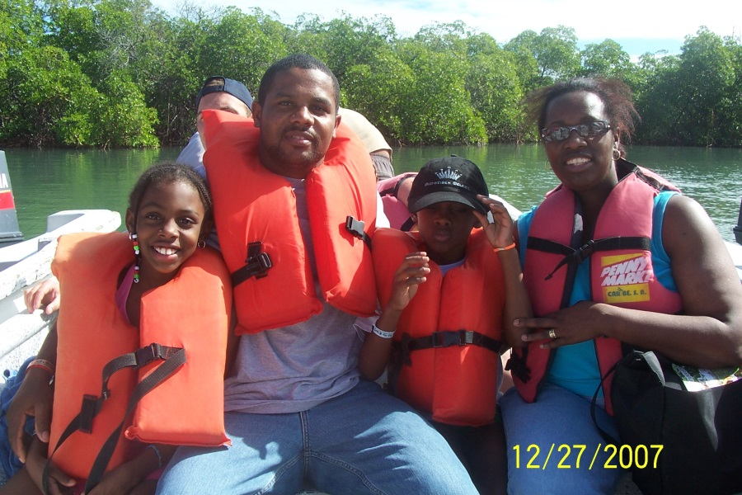
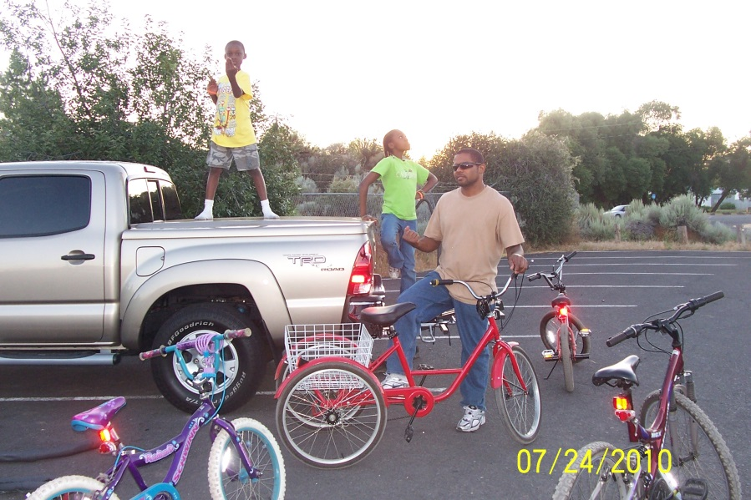
More than just work

Slide 23
Do it all over again?
If I could talk to my high school self, what would I say?
  Follow your passion
  Talk to people in the industry you like
  Volunteer in that industry
  Learn how to manage finances/money
  Don’t give up

Slide 24

QUESTION AND ANSWER

