Slide 1
How to Spend Your Way to Wealth & Abundance Why Budgets Suck & What to Do Instead
With Rennie Gabriel CLU, CFP®, BFD

Slide 2
Thank You
I no longer work for a living. Now I donate 100% of my book,
coaching and online program profits to
www.ShelterToSoldier.org

Slide 3
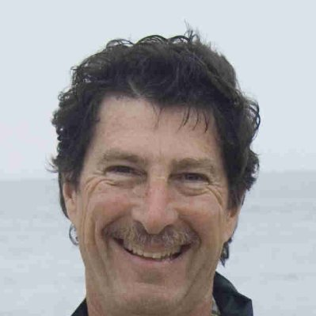
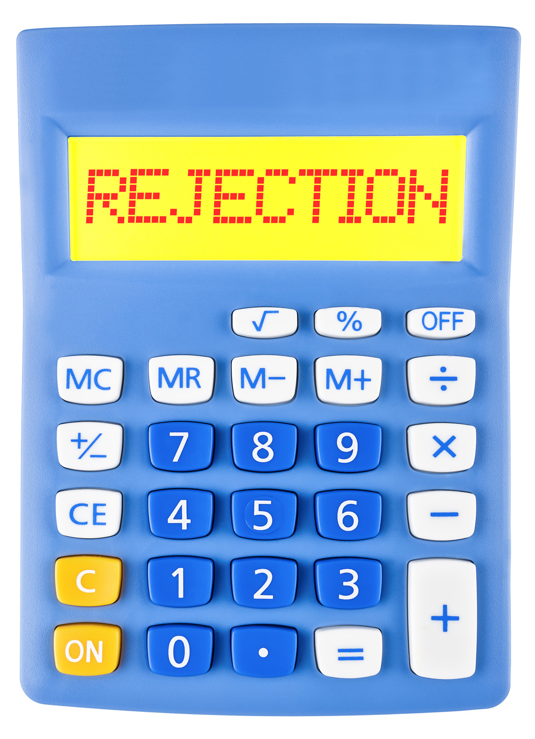
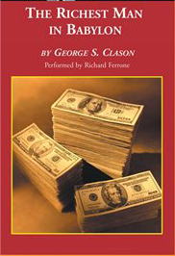
My Journey...
I failed high school math and then…
Notes:
High – Life is good now. I am a multi-millionaire with a multiple six figure passive income, get to do what I love, educating and working with people in wealth building .. I currently live in Encino California with my wife and 3 dogs about 2 blocks from where Michael Jackson lived. I am able to donate 100% of my profits from books, workshops and online courses to charity.
But, it wasn’t always that way …
LOW I failed high school math
I struggled my way, clawed up the ladder in business, learning insurance, investments, advisor, I worked hard for every dime. The true frustration was being a certified financial planner and not knowing how to do a personal budget .. And the more money I earned, the deeper in debt I got. All that stress made an impact personally, I went through 2 divorces, it was like I just couldn’t create prosperity, even though I had all the book learning and financial education, even way more than the average person …
Turning POINT –
One day, I read the book “The Richest Man in Babylon” … ‘Treat yourself like you deserve to own some of the money you’re earning. ‘ (only earning $3000/mo - 10 months later I had accumulated/saved $3000, by the end of the year, but owed $3000 in income taxes) – so hurt me and so devastated me that I didn’t pay myself first for another 8 years. It took that long to understand the missing piece. 8 years later, I re-read the book again with the right mindset this time, and it made all the difference in the world, I not only believe I deserved to own the money I’d worked so hard for, I had the right tools and the missing mindset piece to make it work for me…
Climb up HIGH - So, I turned it all around, I studied wealth building in a whole new way. Instead of just the book learning, details, I learned and absorbed mindset, I studied the wealthy, I build a business around it , and transformed my life so that I have the freedom to do what I value and love to do. One of the most rewarding things about my business and financial reality now, is that it is so attuned to my values I’m able to donate 100% of my business profits to ….
(PICTURE OF dogs/vets )
.. It has even moved beyond me into doing something healing and beautiful….
And that’s enough about me .. Let’s talk about you …

Slide 4
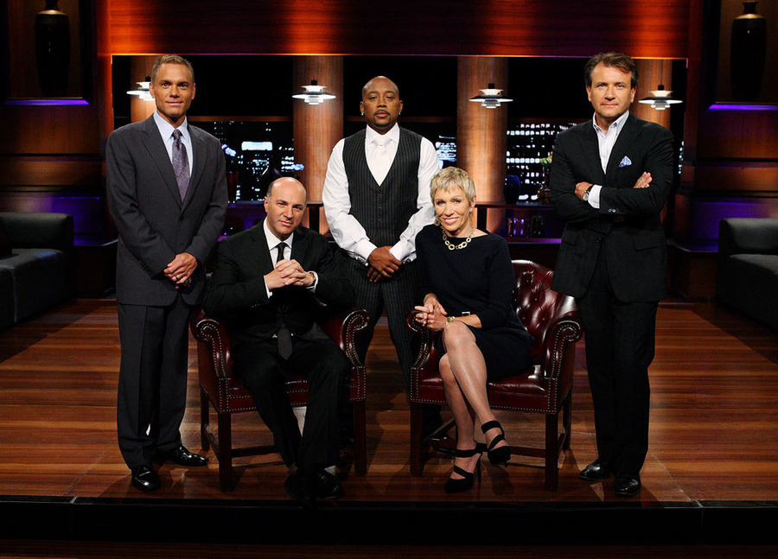
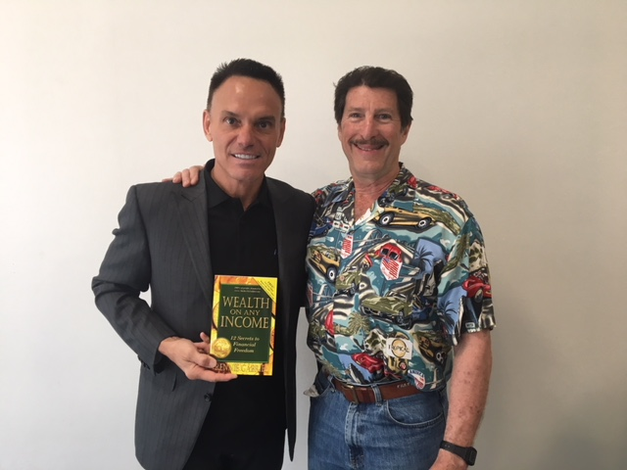
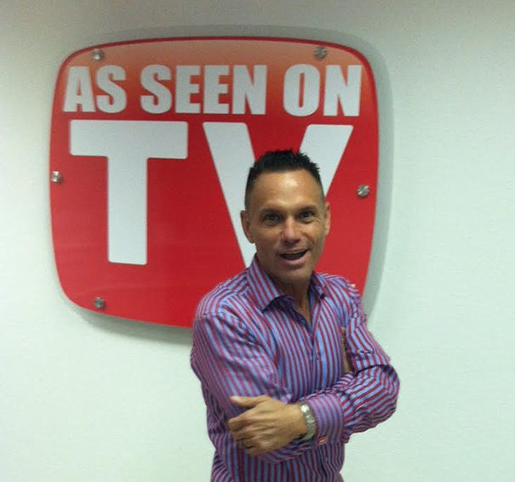
Kevin Harrington
Kevin Harrington is the inventor of the Infomercial, As Seen on TV, sold $5 billion of products and was the original shark on Shark Tank

Slide 5
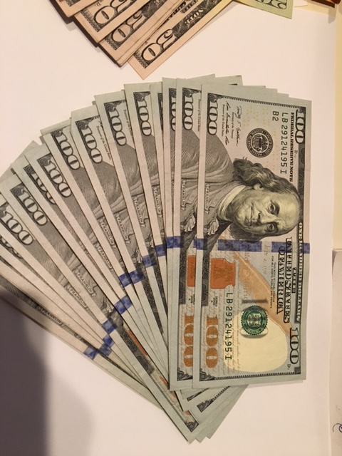
Busting Myth # 1
It Takes Money to Make Money
Creating wealth is a TEAM sport, not an individual sport
Notes:
The first myth is that lots of people think it takes money to make money
It’s just not true, and it may be holding you back.
So, even if you don’t have money to invest right now or even much money at all…. YOU are in the right place so stick around, this webinar is decidedly NOT just for the wealthy, it’s for regular people and business owners just like you …
I’m here to show you how to make money without having money to start with … Wealth creation is a team sport, not an individual game. At age 50 I had to start all over again, and I borrowed money from others and banks and went from flat broke to a multi-million dollar net worth in 8 years.

Slide 6
Quiz Question #1
Finish this sentence:
Creating wealth a
team sport
solo sport

Slide 7
Quiz Answer #1
If you checked “team sport” you are correct

Slide 8
Hollywood Perpetuates that Being Poor is Better Than Being Wealthy
Think about the movies:
Titanic - Leonardo DiCaprio vs. Billy Zane
It’s a Wonderful Life – James Stewart vs. Lionel Barrymore
Bonnie & Clyde vs. the banks
Butch Cassidy and the Sundance Kid vs. the trains

Slide 9
Philanthropy
You can be more effective in solving more world problems when you have more money.
The Philanthropic 50 from Forbes list was winnowed from a short list of 1,620 people; here are a few of the top givers from 2013:
Bill and Melinda Gates, Warren Buffett, George Soros, Mark Zuckerberg, the Walton Family, Eli and Edythe Broad, Michael Bloomberg, Paul Allen, Carl Ichan, David Koch, Sheldon and Dr. Miriam Adelson, Michael and Susan Dell, William B. Hilton, Sumner Redstone, Sergey Brin and Anne Wojcicki, Larry Ellison, David Geffin
But FIRST, YOU have to create wealth

Slide 10
Warren Buffett Quote
Of the billionaires I have known, money just brings out the basic traits in them. If they were jerks before they had money, they are simply jerks with a billion dollars. – Warren Buffett

Slide 11
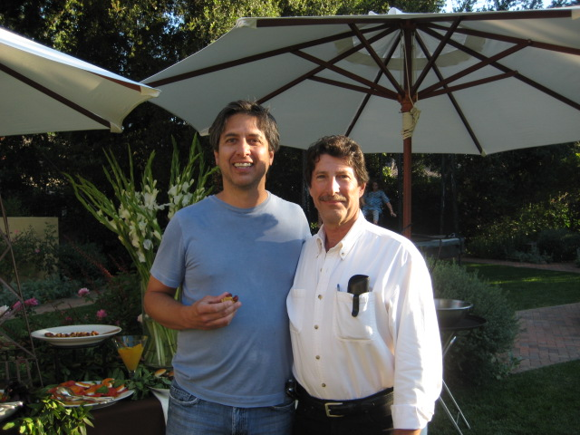
To Build Wealth, You Need 3 things
Attitudes (Mindset)
Forms
Investments
Notes:
Think like a rich person ..
Balance sheet, income/expense sheets, aware of, but don’t know what to look for
Investments – stocks, bonds, mutual funds, but that’s not how true wealth is built …
But, If I was going to teach all three of these, it would be an 8 hour webinar or more and frankly… unless you understand the attitude and nail that down, the forms and investments won’t work anyways …
The first way to spend your way to wealth and abundance is to have the right attitude, and we’ll focus on that first.
Attitudes, the mindsets – once you get this .. Then it’s easy to learn the rest.
So, let’s start with the importance of attitude and why I believe this

Slide 12
The Three Secrets of the Wealthy
A = Attitude
F = Forms
I = Investments
Notes:
But, If I was going to teach all three of these, it would be an 8 hour webinar or more and frankly… unless you understand the attitude and nail that down, the forms and investments won’t work anyways …
The first way to spend your way to wealth and abundance is to have the right attitude, and we’ll focus on that first.
Attitudes, the mindsets – once you get this .. Then it’s easy to learn the rest.
So, let’s start with the importance of attitude and why I believe this

Slide 13
Why is Thinking like a Wealthy Person so Important?
Without the right attitude, you aren’t getting anywhere!
The state of your life is nothing more than a reflection of your state of mind.
– Dr. Wayne Dyer
Notes:
Because it is the ONLY thing that will get you out of financial stress
Because to create wealth, the life you really want and deserve, it is 100% necessary. There is no other door to open = it is the way to get started on the path … .
If you don’t have a wealthy person’s mindset, it’s like trying to drive a car without a steering wheel. (this guy has his fancy suit, but do you think he’s really going to be getting anywhere?)
Trying to create wealth without the thought patterns of a wealthy person is the same thing .. You are not going to get anywhere.

Slide 14
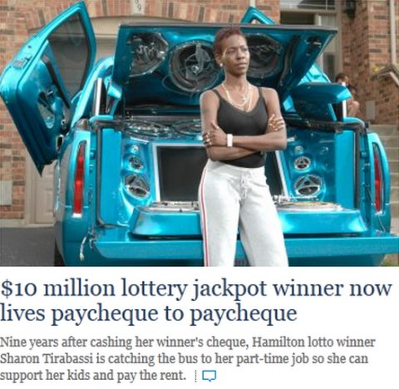
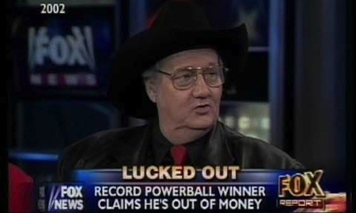
Why is Thinking like a Wealthy Person so Important?
70% of lottery winners are broke in 3 years!
Notes:
Why do you think 70% of lottery winners are broke in 3 years .. They didn’t have the mindset and they just kept driving around without a steering wheel, getting nowhere and blowing their winnings ..
Here’s a 10 million dollar lottery winner – now living paycheck to paycheck and taking the bus to a part time job
And a $315 million dollar powerball winner who claims he’s out of money.
More money doesn’t solve a problem of poor mindset and poor money management any more than more liquor will cure an alcoholic

Slide 15
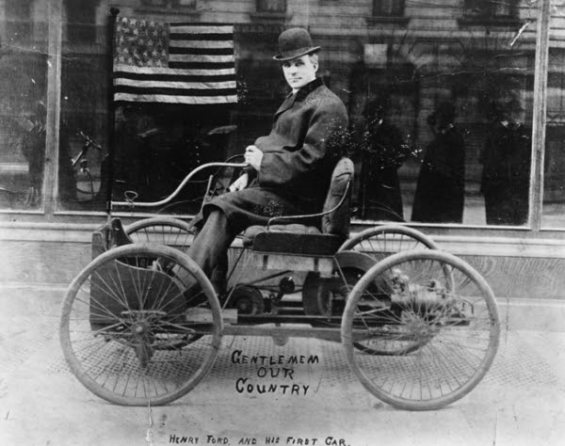
Thinking Like a Wealthy Person is What Makes Wealth Happen!!
"Whether you think you can or think you can’t, you’re right!” - Henry Ford
Notes:
The bottom line:
The Wealthy think differently. They are in control of their own mind and have belief and confidence in themselves. That is the place to start.
When I first start coaching people, I often have to deal first with what other people may have told them, and change their attitudes about what they are capable of in terms of building wealth.
So, they have to have that inner confidence, but what else do they have to have?
They need to Adopt the Attitudes that wealthy people have!!!!

Slide 16
Quiz Question #2
The wealthy have a different
attitude/mindset
automobile
than most people

Slide 17
Quiz Answer #2
If you answered “attitude/mindset” you are correct

Slide 18
Some Examples of How the Wealthy Think
#1 The three areas we all operate from:
Thoughts
Feelings and
Values

Slide 19
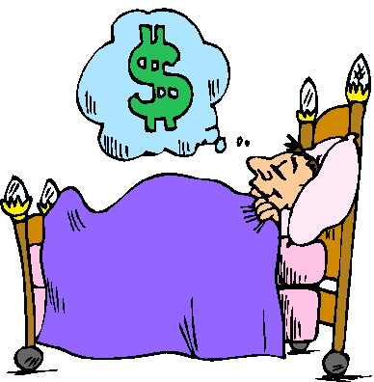
Thoughts, Feelings or Values
Thoughts
Feelings
Values

Slide 20
The Wealthy Operate from their Values!
Understand their values*
They use their values to overcome the feelings that could block their success
* You can request an exercise from me
Notes:
Identify the values – integrity – if you give them my word, I will do it .. Even if I don’t feel like it …
“I told someone I would do it” - therefore I go …
My going jogging with a neighbor … I don’t want to feel like I’ve broken my word . It’s that feeling that gets me out of my warm bed!!!
Then what is it we can lean on to move forward and achieve our goals …
So, what’s another thought of the wealthy ..

Slide 21
Example #2 – Wealthy Mindset/Attitude
Details
Big Picture

Slide 22
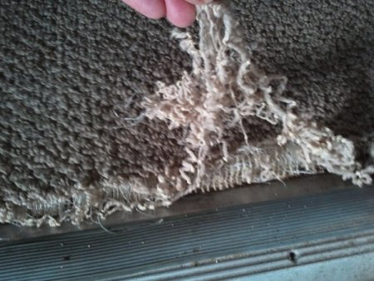
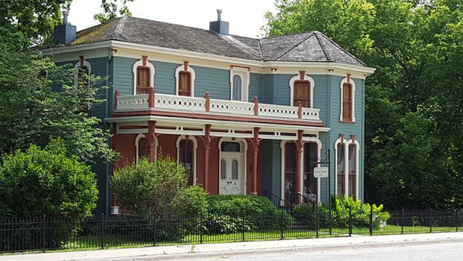
Details – Poor Mindset
Big Picture – Wealthy Attitude
vs..
Notes:
The Mindset of the Non-Wealthy is small thinking. They focus on the details.
For example, it’s what I call the “ship is sinking, let’s buy less staples” attitude .. the company’s finances and sales results are poor, and there’s always that one guy who runs around freaking out that you are spending too much on office supplies, like staples or coffee filters, when really, you need to focus on getting on the phone and getting more customers and growing the revenue.
An example is in real estate – where you have the opportunity to buy a house as an investment – paint peeling on the walls, faucet dripping, carpet is frayed- details are irrelevant , but it’s in a good neighborhood, priced right
A realtor friend said … “I can’t tell you how many times I take people to a house, and they completely miss the big pictures”
Everyone who’s built wealth has always been aware of and thinking big picture. The big picture first, the details second.

Slide 23
Quiz Question #3
The wealthy look first at the
details
big picture

Slide 24
Quiz Answer #3
If you answered “big picture” you are correct

Slide 25
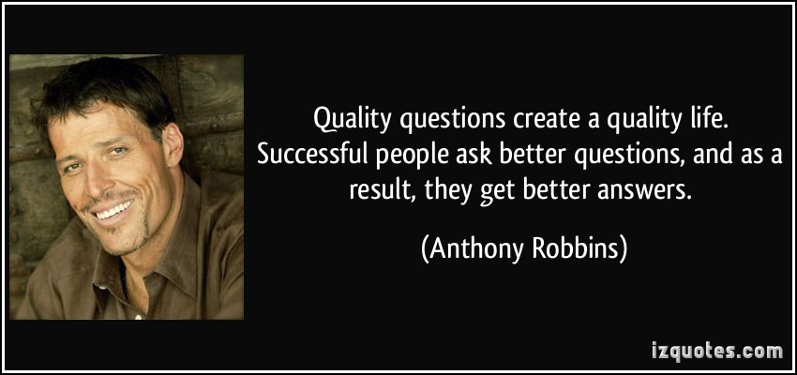
Example #3 – Statements vs Questions
.

Slide 26
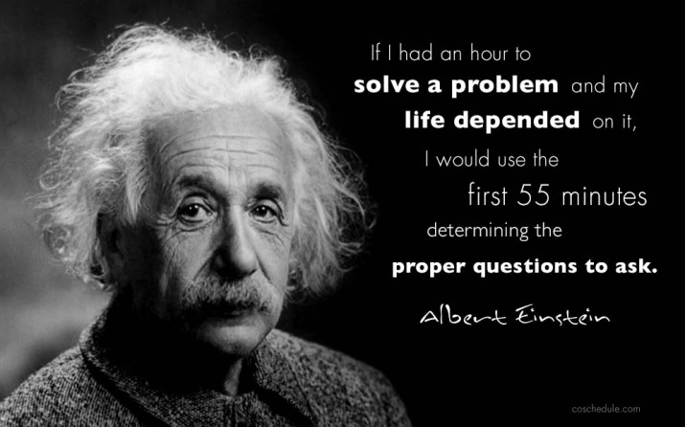
The Mindset of the Wealthy
Powerful Questions Start With:
How
What
Where
When &
Who
and NEVER Why
Notes:
Another mindset of the wealthy is they are always asking questions…
(READ the Quotes)
I am going to be covering some familiar information … make statements, heard it before, done it already, done it before .. Closing down the opportunity to create transformation.
In the morning I wake up I ponder questions.
How … how will I employ this?
Who … Who can support me in this?
When…When will I start or complete this?
Where… Where will it fit?
What … What do I need that I don’t have now?
The questioning mind is an open mind … If YOU want wealth to flow in, you want to open your mind.

Slide 27
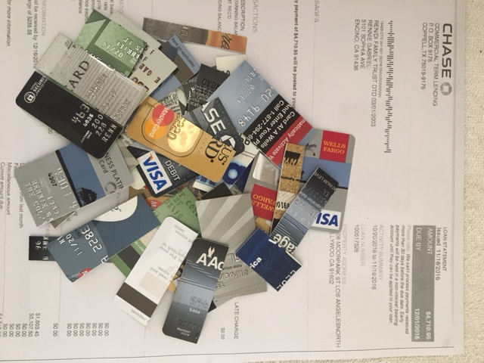
Busting Myth # 2
Being Debt-Free Creates Financial Freedom
Notes:
Let’s bust another myth …
But ... people believe that becoming debt free has something to do with financial freedom or becoming wealthy …
It’s completely wrong, it’s like people thinking if they diet, they can build muscles – but those are totally different!
Focusing on debt elimination is a HUGE mistake, it just eliminates debt, it doesn’t create wealth.

Slide 28
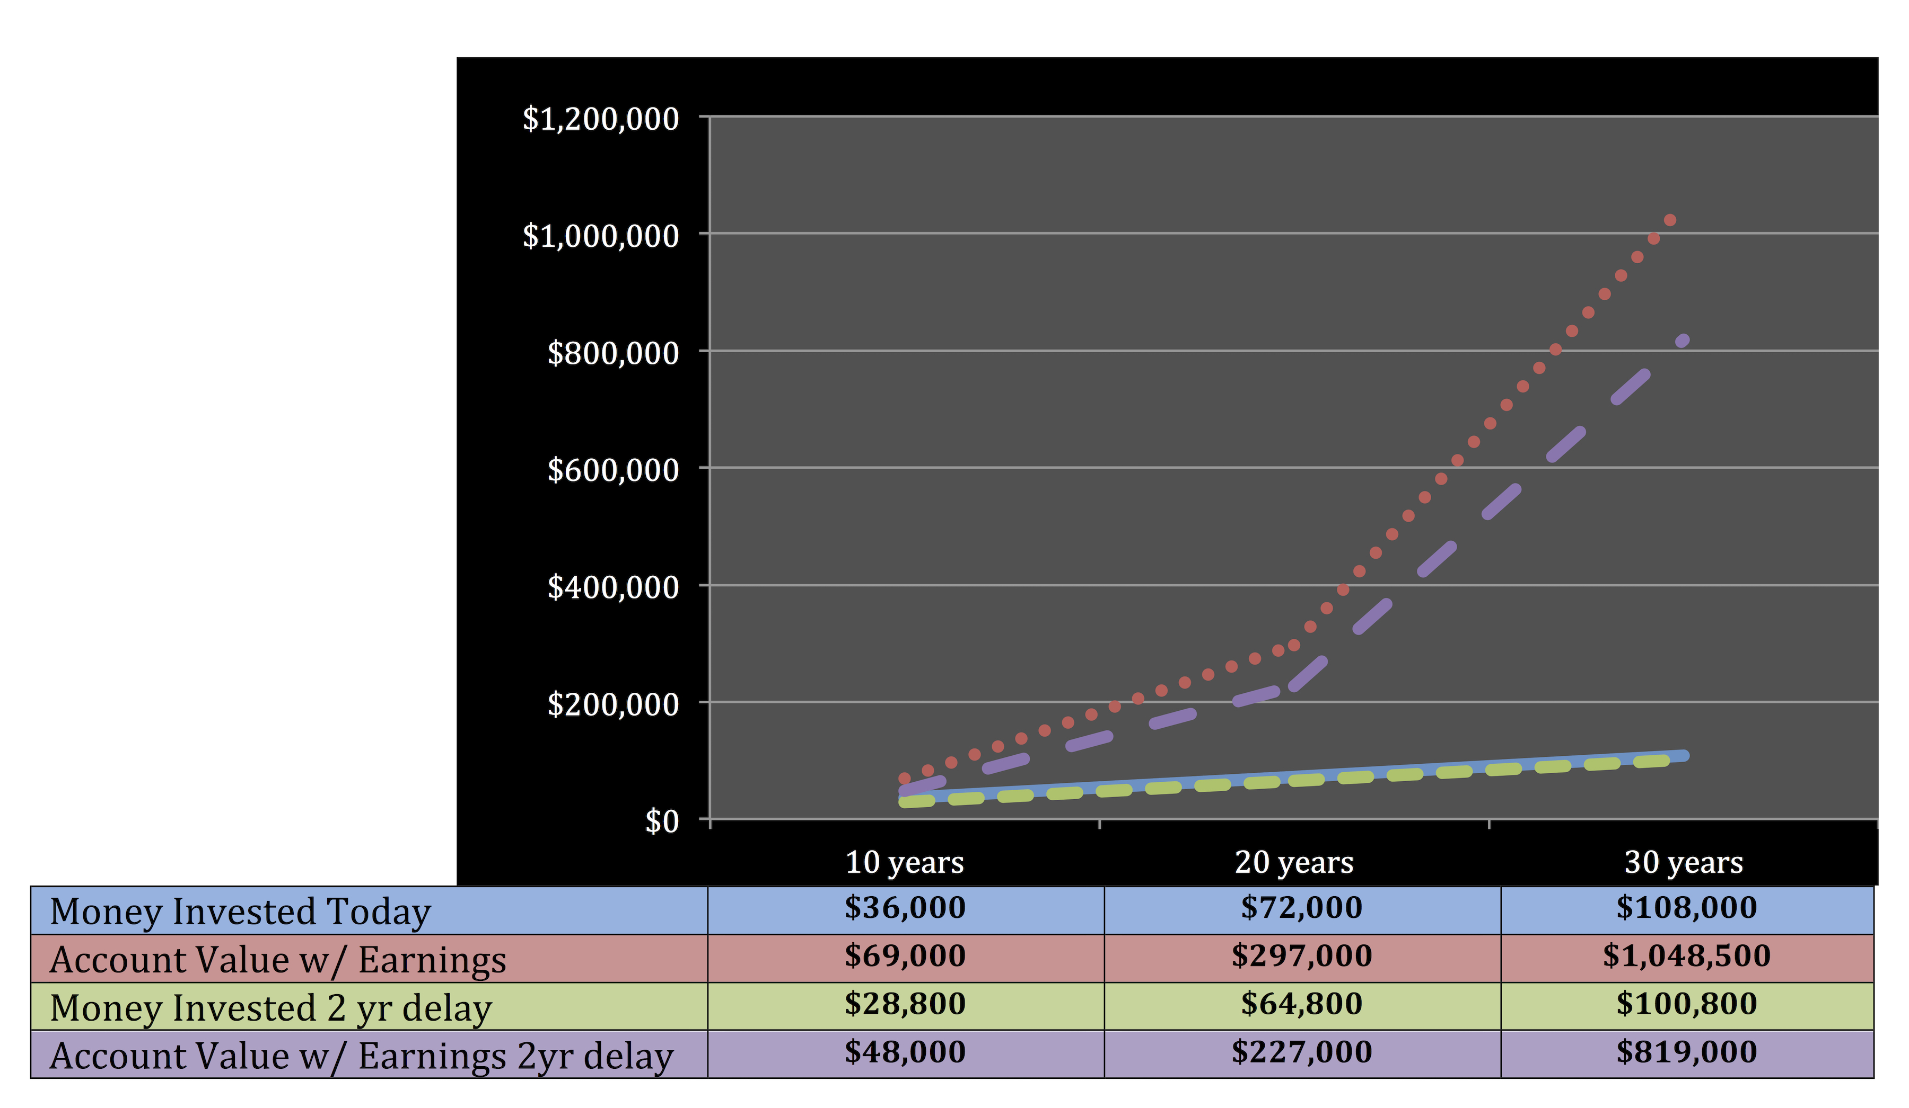
Do Not Pay Credit Cards First- Let Me Prove It to You
Notes:
$6000 in cc debt
Pay off $300/mo or invest $300/mo
Now, in 2 years, they can apply that to investments, they now set aside that $300 in an investments that earn 12% …
In 10 years, you are ahead … but let’s see what happens in 30 years …
Result in 30 years, that 2 year delay reduced their investment portfolio by $200,000 - had you carried that debt for 30 years, paid the interest on it you’d still be $170,000 ahead …
For those of you who think 30 years is a long time, you must be a lot younger than me!
Good on you if you’re here . … etc..
(but both tortoises and hares can play and win the wealth race – you can make significant changes quickly and I’ll teach you how).

Slide 29
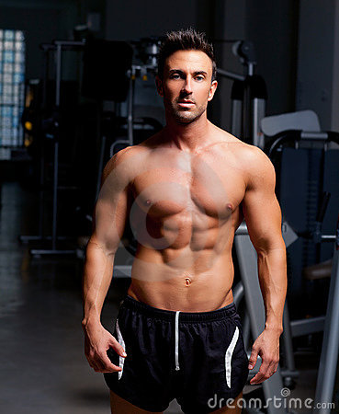
Dieting will not create muscles any more than focusing on paying off debt will create wealth
Notes:
Emotional stress:
An executive whose wife was in credit card debt and they were talking divorce over it – he couldn’t cope with it, they eventually did split.
I’ve seen this with my best friend, spouses hide it from each other, they feel shame about it, it’s the festering under-current in the marriage …
I’ve seen it over and over again, and it doesn’t have to be this way …

Slide 30
Why to Invest First
The income from your investments can pay the principal and interest on your debts.
Notes:
Frees up the Mind/Soul
If you’ve removed this stress and upset in the relationship – you’ve created the open space to move forward and create something better. It’s like I said earlier, it’s about mindset. The shame, worry, stress, guilt around debt is like trying to run a race with a ball and chain.
I just want to break the chains and move forward ..

Slide 31
How does a Wealthy Person Understand Debt?
Bad Debt vs. Good Debt

Slide 32
Quiz Question #4
The wealthy use
good debt
bad debt
to build wealth

Slide 33
Quiz Answer #4
If you answered “good debt” you are correct

Slide 34
Busting Myth # 3
Wasting small amounts of money is not important to creating wealth
Notes:
$10 per day (a coffee and muffin at Starbucks) can create a million dollar portfolio. Just look back at the chart on why you should not wait to pay off debt. That million dollars was created on $10 per day.

Slide 35
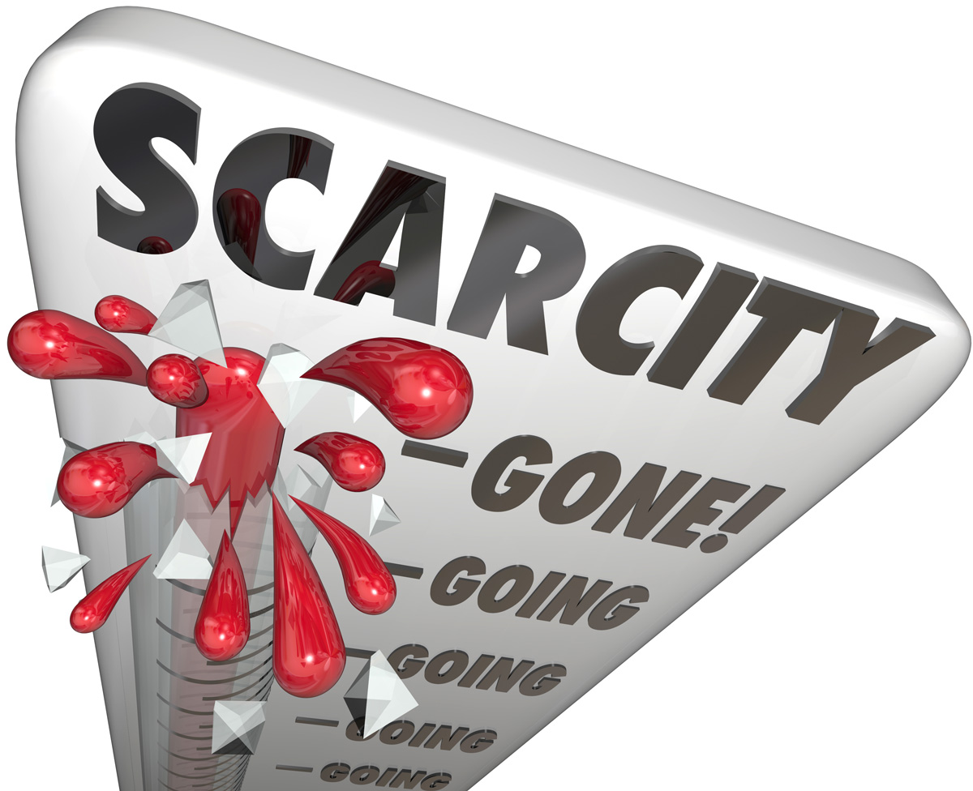
Don’t Budget…
Budgets create the feeling of sacrifice, scarcity and deprivation
Budgets require discipline and few people have it
Budgets have little to do with creating wealth

Slide 36
Spend Money Instead!
Create a Spending Plan based on your Values!
Determine your values
Notes:
Remember the attitudes of the wealthy? How they operate from their values?
Part of how they do this is they spend based on their values, not their feelings.
A friend of mine who had a minimum wage hourly job thought it was more important to spend $300 on a designer purse rather than set aside any money for emergencies.
Her feelings were all about feeling pretty, feeling that she would belong to the ‘in crowd’, she just feel accepted and better.
But, that is not how wealthy people spend.
If you would read the book “The millionaire next door” , you would see that the wealthy invest their money and spend based on their values, and it is hard to spot a wealthy person based on outward appearances.

Slide 37
Benefits of Spending Money
It aligns with what’s important to you &
It’s way more fun!!!
Notes:
Grocery Store versus Restaurant -
When I was looking at where I was spending my money and tracking it. I had a surplus in eating out, and less in buying groceries.
Bottom line – we aren’t sitting down and being with each other when we are making the meal at home
Restaurant – we are with each and able to communicate without running back and forth cooking the meal.
I value my wife and I communicating rather than saving a few dollars making our own food.

Slide 38
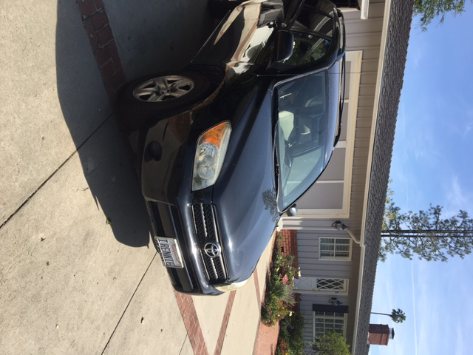
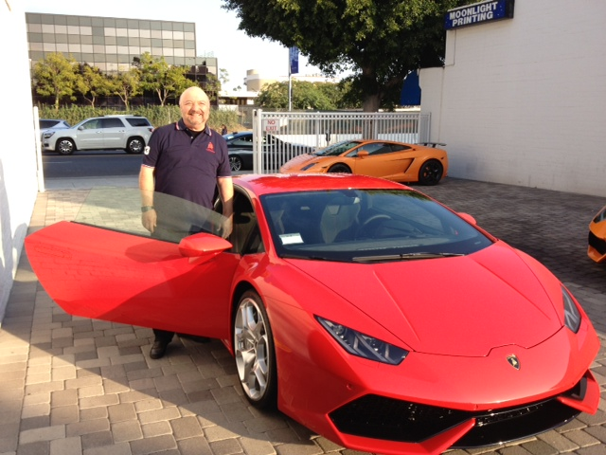
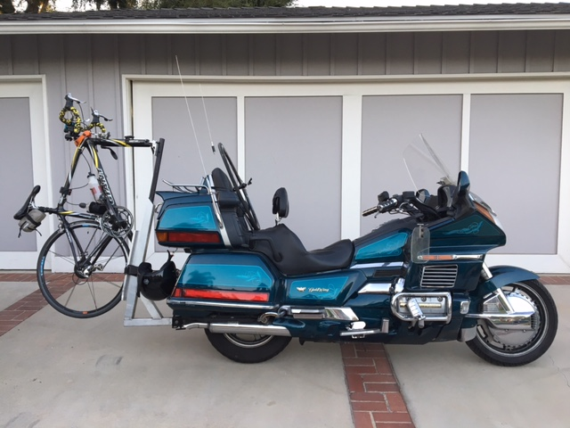
Spend Money Based on Your Values
VS.

Slide 39
Quiz Question #5
The wealthy spend money based on their
values
feelings

Slide 40
Quiz Answer #5
If you answered “values” you are correct.

Slide 41
“The universe doesn’t give you what you ask for with your thoughts - it gives you what you demand with your actions.”
– Steve Maraboli
“Your income will be the
average of the five people
you spend the most time with.” – Jim Rohn
“Wealth is a Team sport
not a Solo sport.”
-Rennie Gabriel

Slide 42
THANK YOU
FOR SHARING YOUR TIME
WITH ME!
Rennie Gabriel, CLU, CFP®, BFD
www.WealthOnAnyIncome.com

