Slide 1
Shirley Wiliani Entrepreneur

Slide 2
INTRODUCTION
My name is Shirley Wiliani and I am 43 years old.
I used to be an Accountant. Now I am an Entrepreneur.
That means I own my own business.
My company is A La Carte Solutions.
A La Carte Solutions provides accounting services to small businesses.
Every day I talk with other Entrepreneurs and help them with the accounting for their companies.

Slide 3
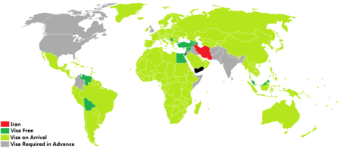
Personal Background
I was born in Tehran, Iran
This is me when I was 1 year old

Slide 4
My childhood / fAMILY
Entire ancestry is 100% Iranian Jews – parents, grandparents, great grandparents, etc.
My Family moved from Iran to Los Angeles when I was 5 years old
Went to a private, Jewish school K – 8
All of my friends were white and Jewish
I felt different from them.
I did not feel like I fit in and I didn’t want to.
I wanted to be different.

Slide 5
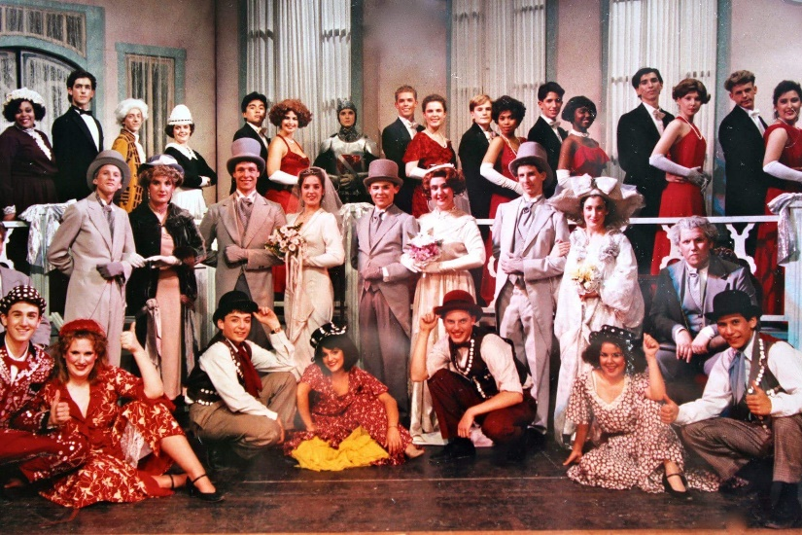
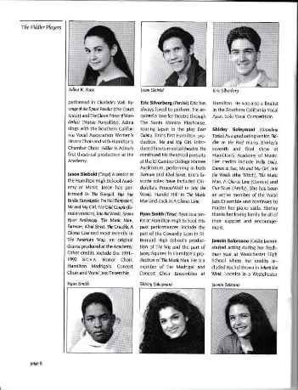
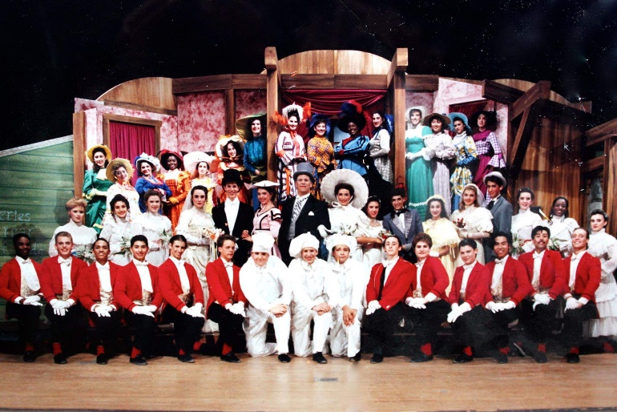
High School
Notes:
As a teenager, challenging the status quo got to be a little more serious than refusing to play with baby toys. When my parents moved us here from Iran, they tried hard not to assimilate into Western culture. I went to Hebrew School until 8th grade and graduated with 23 other Jewish, mostly Persian kids. As a Persian Jewish girl, I was expected to stay within the boundaries set for me. That meant only having Jewish friends, going to Beverly Hills High School, and becoming a part of the higher socio-economic community. Instead, I insisted on going to a public high school, majoring in musical theater, where I could prance around on stage, singing, dancing. I enjoyed be-friending gay people, black people or anyone not “my kind.” I lived somewhat of a double life during high-school. I was not the same person at home that I was at school. It was a confusing time. I felt guilty, free, happy, angry and sad all at the same time.

Slide 6
High School
Joys During my High School Years:
First-time being around anyone that wasn’t white and Jewish
Black people, Hispanic people, gay people, bisexual people – all new to me
I felt welcomed and free while at school. Everyone accepted me. It was awesome!
I loved music and performing
Everybody is Different. No one is the same!

Slide 7
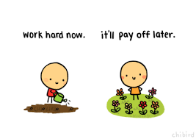
Getting in to College
The top few things I did to ensure I got into college were:
I tried to stand out from the crowd – be different, be unique be special
Took Advanced Placement classes while in High School (AP Calculus and AP Biology)
Studied Hard, Got Good Grades (mostly A’s, some B’s)
Took the SAT
Did Volunteer / Community Service

Slide 8
College, GRAD School, etc.
I attended Santa Monica Community College and earned my Bachelor’s Degree from the University of Southern California in Los Angeles. I later went back to school and got my Master’s Degree.

Slide 9
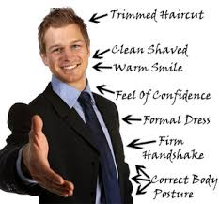
Getting a job after College

Slide 10
My Career Path
I worked for a 5 small companies as the leader of the Accounting Department
I started my career as a Staff Accountant in a public accounting firm
I now own my own company. I am an Entrepreneur. My company helps other companies with their accounting needs.
2010-Present
2000-2010
1997-2000
Notes:
You may use this chart to describe your journey to the current career

Slide 11
My Company
My company provides accounting services to small businesses.
Accounting is the language of business.
Without accounting, business owners would not know if their businesses are doing well, or if they are failing.
Accounting provides information about the health of a business so that decisions can be made to make the business even better.

Slide 12
My role
PRESIDENT (BOSS LADY)
Managers
Managers
Accountants
Accountants
Accountants
Notes:
Use this graph to give more description of your role specifically (responsibilities, typical work week, direct reports, etc.)

Slide 13
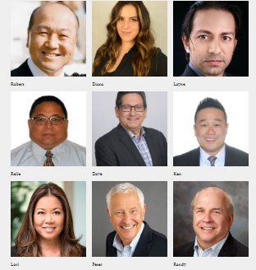
My TEAM

Slide 14
Compensation at my company
C-Suite
($200k++)
Management
($110k-$175k)
Middle Manager
($75K- $110k)
Staff Accountants
($50K – $75k)
Notes:
Use this graph to show general compensation ranges for people in various roles in your company

Slide 15
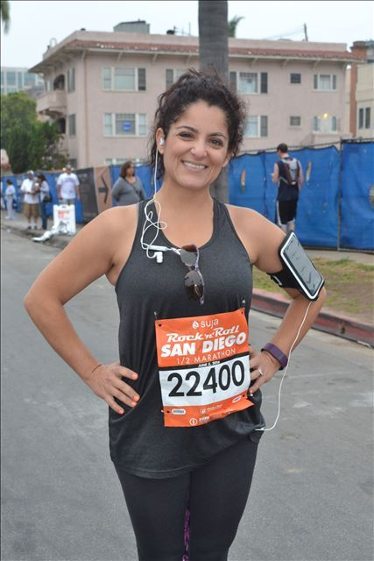
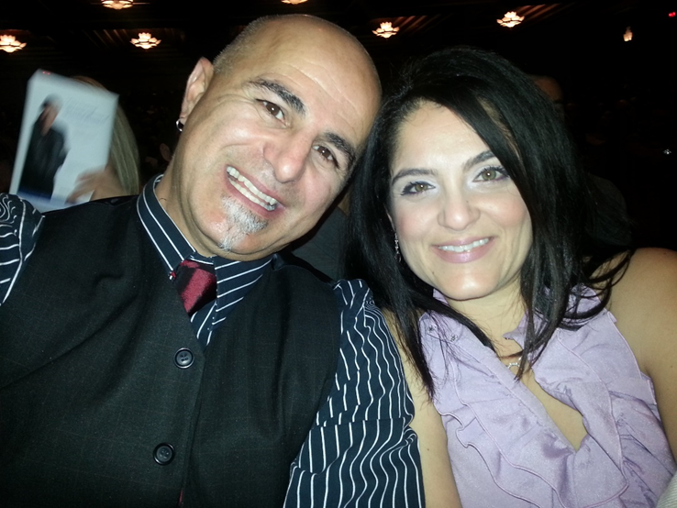
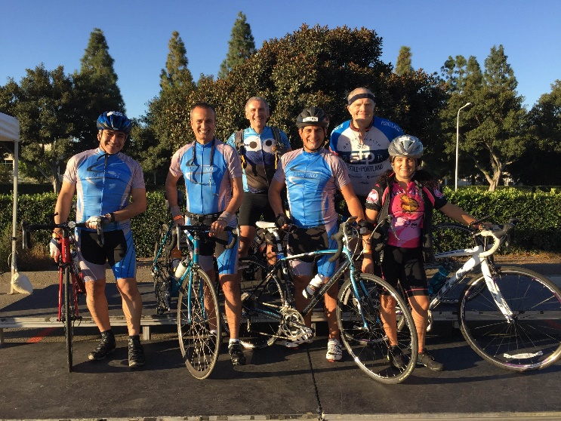
MY FUN

Slide 16
If I could talk to my high school self, what would I say?
Be Different.
Bet on yourself.
Work hard - give 100%
Be real, honest, humble, grateful.
Get better everyday.

Slide 17
Let’s Play monopoly!

Slide 18
instructions
3 groups: The Bean Counters, The Number Crunchers and Penny Processors (about 5 kids in each group)
1 person from each group will be the Business Owner (roll dice, move pieces, read cards out loud, etc.)
Remaining 4 people are Accountants:
2 Money Managers – spend and collect money; record transactions
2 Property Managers – provide information about properties; record transactions
Each group starts with 5 bills each of $500, $100, $50, $20, $10, $5, and $1
Each group owns the following properties:
The Bean Counters own browns, light blues, pinks, and oranges
The Number Crunchers own reds, yellows and both utilities
The Penny Processors own greens, blues and all 4 railroads

Slide 19
instructions
The 3 Volunteers are the Business Owners.
The Business Owners are in the real-estate business. They buy and sell property to make money.
Their goal is to make as much money as possible
The 3 groups are the Accountants for the Business Owners.
The Accountants’ job is to
Keep track of the Business Owner’s money
Give Business Owner information about the Business
Help Business Owner make decisions

Slide 20
instructions
Money Manager and Property Managers should each have a sheet of paper and pencil
Business Owner rolls the dice, and moves to appropriate space
If Business Owner lands on their own property, choose to:
Do nothing
Sell a property to another Business owner and negotiate value.
Buy houses or hotels on any property
Mortgage a property from the bank
If Business Owner lands on someone else’s property, pay the appropriate amount of rent shown on card
If Business Owner lands on Chance / Community Chest – do what the card says
If Business Owner passes GO, collect $200
If Business Owner lands in jail, stay there for 3 turns

Slide 21
The goal: Be able to answer these questions!
How much money do I have in total at the end of the game?
How much more money (or less money) do I have now than I did when I started?
How much money in total did I make from collecting rent?
How much money in total did I spend on paying rent?
How much money in total did I spend on buying properties?
Which of my properties made me the most money in rent?
What did I spend my money on (e.g., taxes, utilities, rent, buying properties, etc.)? How much did I spend on each?
What properties do I own and how much did each of them cost?
How did I earn my money (e.g. collecting rent, passing go, chance card, selling properties, etc). How much from each?

