Slide 1
Creating A Dream Life
or
“How I got happy in 44 steps, each one lasting a year.”

Slide 2
how would you introduce
the person you care about the most?

Slide 3
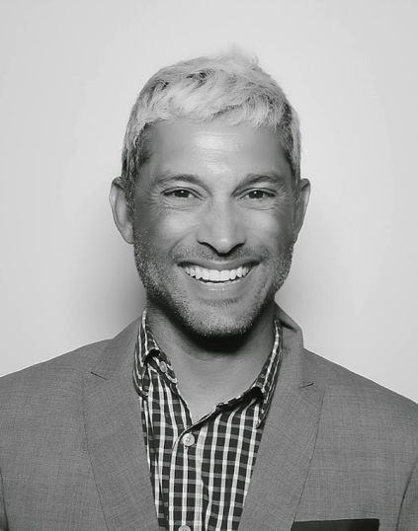
“This is my friend Konrad. He works in sales at Google”

Slide 4
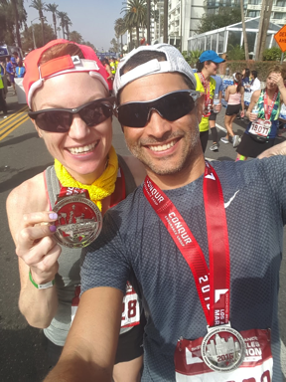
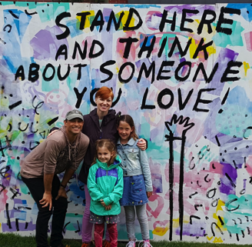
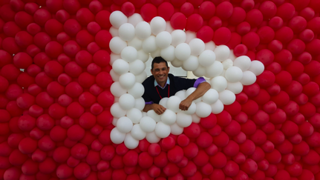
“This is Konrad, he’s a great dad, loves to run and he works at Google”

Slide 5
“Konrad has created a life of purpose. He tries to create a life where he doesn’t want to sleep because his waking life is better than his dreams. He spends time on things that matter with people who matter. He seeks truth, cares about humanity and tries hard to be kind.”
oh and also…
he loves his daughter, his wife and their daughters
he crushes it at work
and is always having fun
thank you.

Slide 6
Some things we’ll cover today
/ who I am
/ what I do
/ how I got here
/ and why any of that matters to you

Slide 7

My Job
to help my clients bring their stories to fans
[and help Google change the world]
Source: Nielsen Cross Media Homes Panel, August 2013,. YouTube’s reach is only on desktop and does not include mobile and tablet.
Notes:
1.1BB unique visitors monthly

Slide 8
what does that mean?
I sell ads that go on google, youtube, and the web

Slide 9
But what does that really mean?
I consult to the biggest studios in Hollywood and help them bring their marketing stories to life in digital

Slide 10
how I got here

Slide 11
“human beings are not born once and for all on the day their mothers give birth to them, but…life obliges them over and over again to give birth to themselves.”
- Gabriel García Márquez
Notes:
“Human beings are not born once and for all on the day their mothers give birth to them, but ... life obliges them over and over again to give birth to themselves.”
― Gabriel Garcí­a Márquez

Slide 12
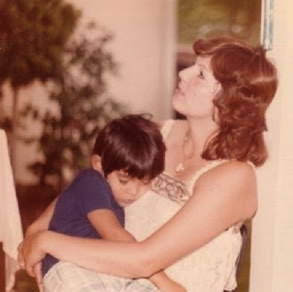
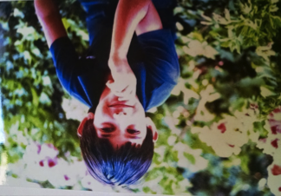
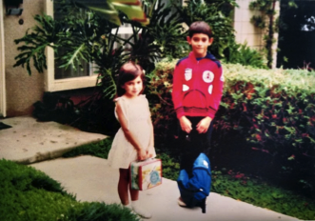
Spent the 70’s in Riverside

Slide 13
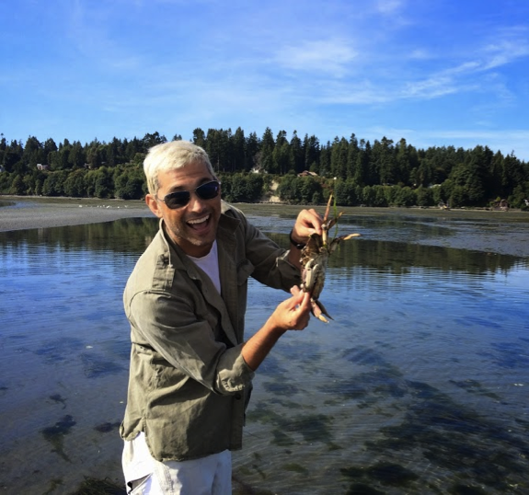
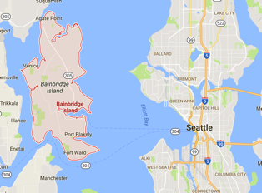
Moved to a rural island near Seattle

Slide 14
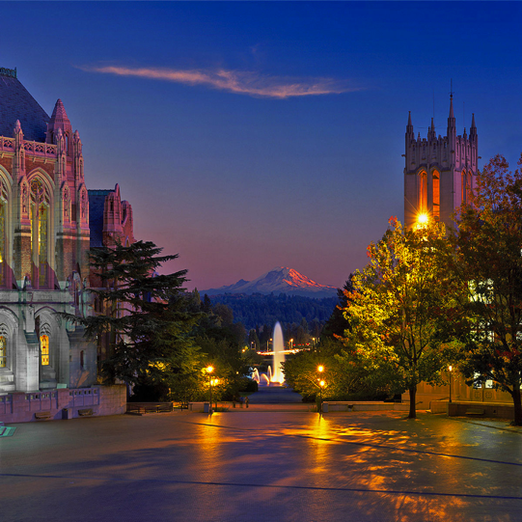

Spent 4 (ok, 6.5) years at Univ. of Washington

Slide 15
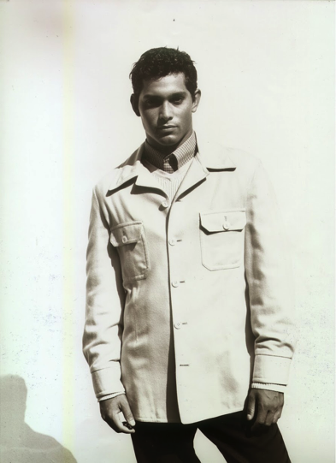
Then spent the better part of 8-years on my first career

Slide 16
But one day I realized…
…this isn’t taking me anywhere I want to be.

Slide 17
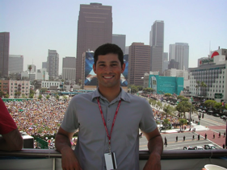
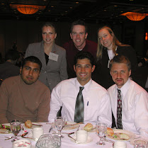
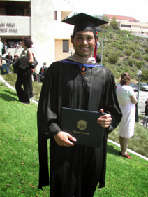
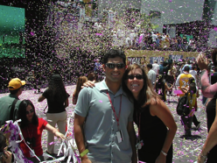
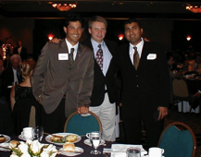
back to school, internships, and figuring out a new path

Slide 18
and what a ride it’s been…
Notes:
CTA overlays on all videos to drive direct action
Annotated endslates
InVideo Programming including new interactivity cards to drive sales from video content
Custom thumbnail branding

Slide 19










Four companies, three careers, a few false starts, no dead-ends, and a lot of learning

Slide 20

First job? Moving lawns
Worst job? Cleaned up the meat department at a grocery store.
Coolest job? Wrote for the school newspaper.
First corporate career? Management consulting.
Scariest career move? Going back to school.
Best lesson? It’s OK to make mistakes. In fact, it’s critical.
Happiest I’ve ever been at work? At Google/YouTube.
Notes:
First job? Moving lawns
Worst job? Cleaned up the meat department at a grocery store
Coolest job? Wrote for the school newspaper
First career? Modeling and commercial acting
Scariest career move? Going back to school
Best lesson? It’s OK to make mistakes. In fact, it’s critical
Happiest I’ve ever been at work? At Google/YouTube

Slide 21
A few thoughts
about what comes next

Slide 22

stay
calm
[seriously. don’t freak out.]

Slide 23
1
/ be present
Notes:
For you and everyone in your life.
Mute your phone/ Mute your laptop/ Sit by yourself for five or ten minutes a day.
Sit with someone you care for without touching your phone. Look them in the eye and just be with them.
The feeling will astound you.

Slide 24
2
/ be aware
Notes:
Here are some guides, which helped me along the way.
…of what’s going on around you. Look for those open doors.
Pay attention to the people in your orbit, no matter where they are. Don't burn bridges. Everyone matters.
You never know. You’d be surprised where people and opportunities can lead you.

Slide 25
3
/ be kind

Slide 26
4
/ be unreasonable
Notes:
Do not settle. When you are tempted to

Slide 27
5
/ don’t spend a lifetime raising pigs and then decide you want to be a ballerina
Notes:
Be authentically you.

Slide 28

Now MOVE!
Go DO something and BE great.

