Slide 1
Adam Gabay
May 8, 2018

Slide 2


Slide 3



Slide 4
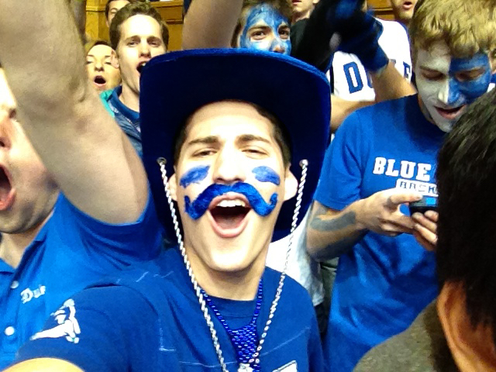

Slide 5



Slide 6
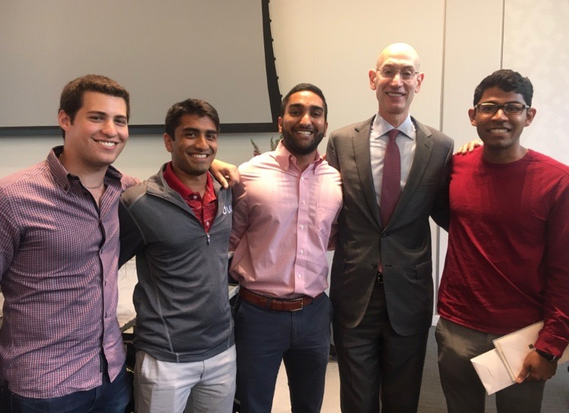
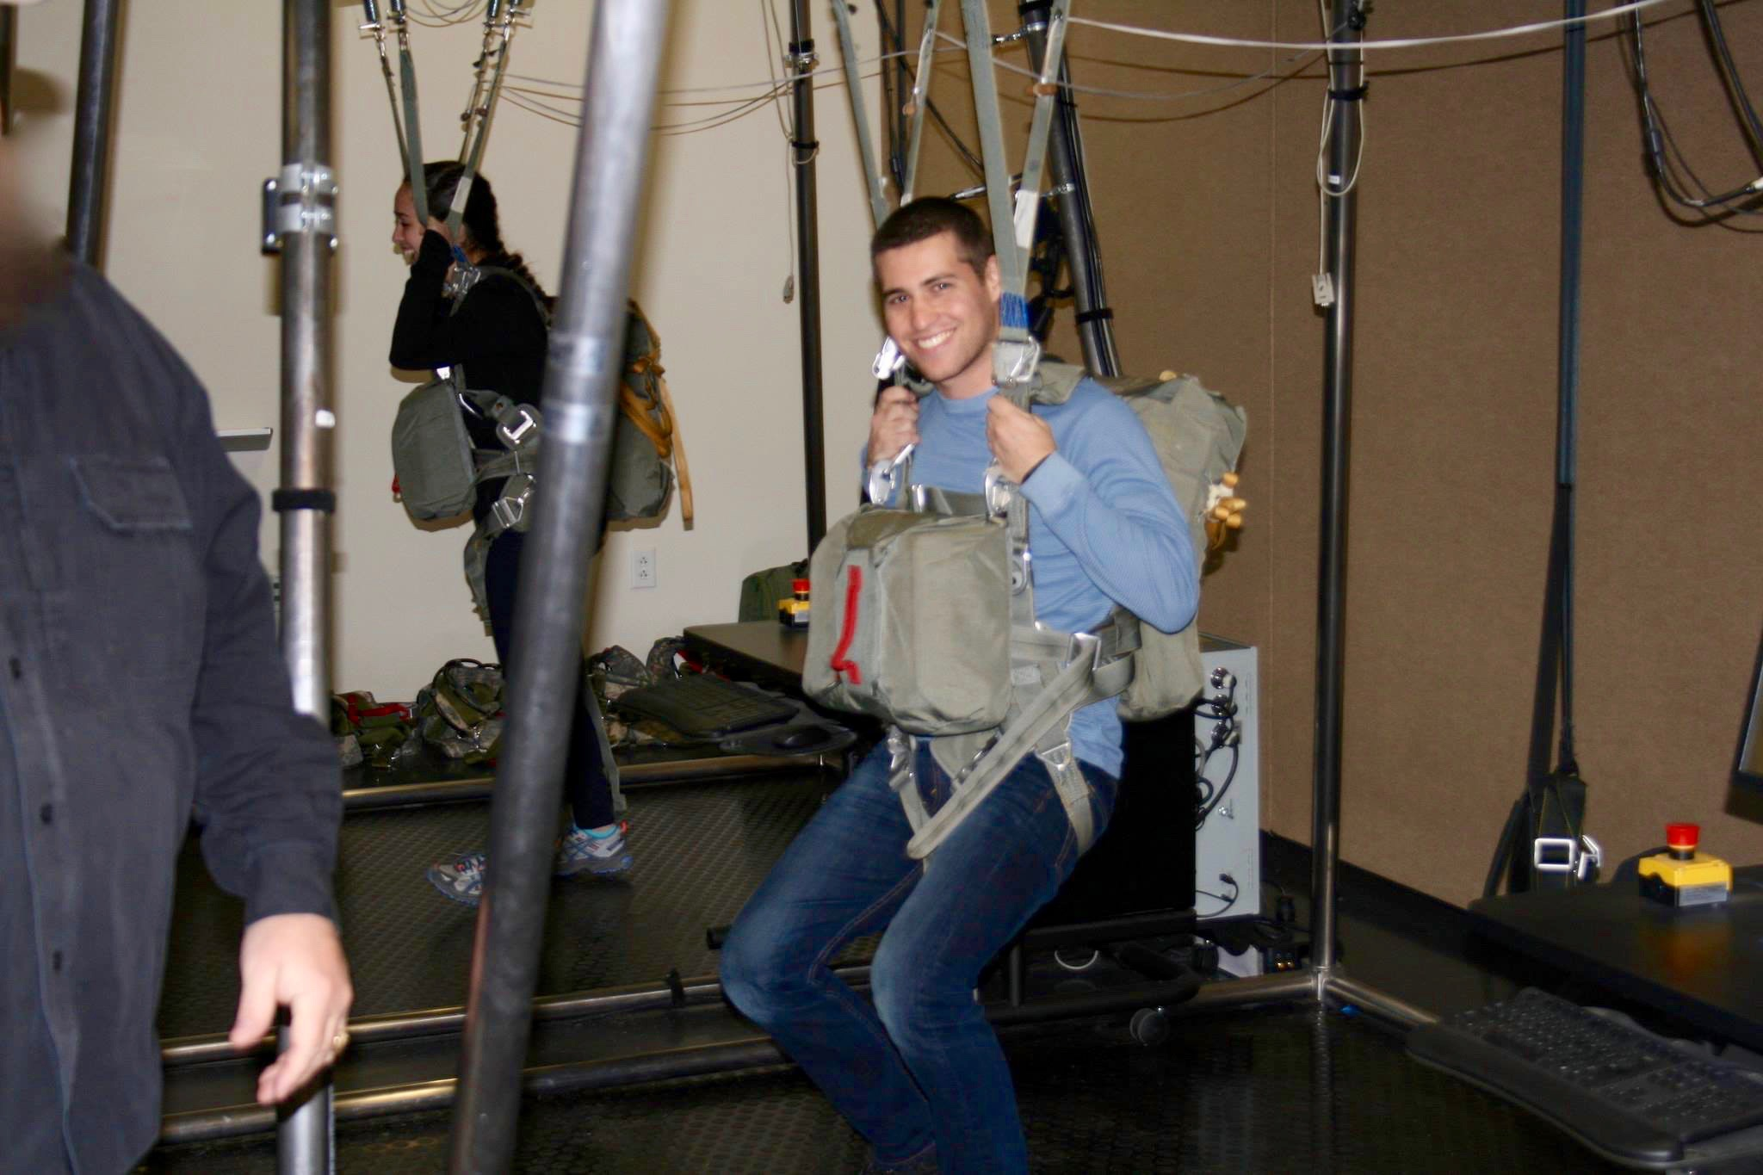
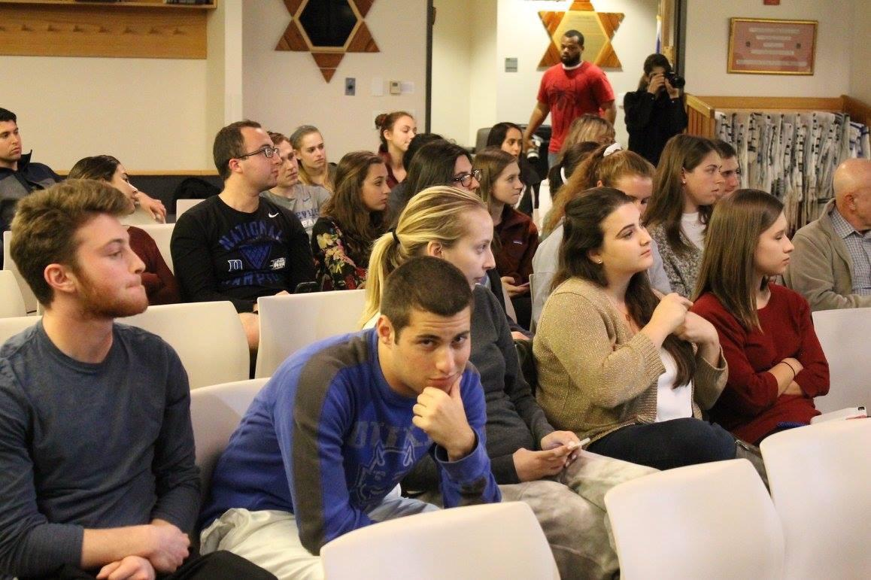

Slide 8


Slide 9


Slide 10

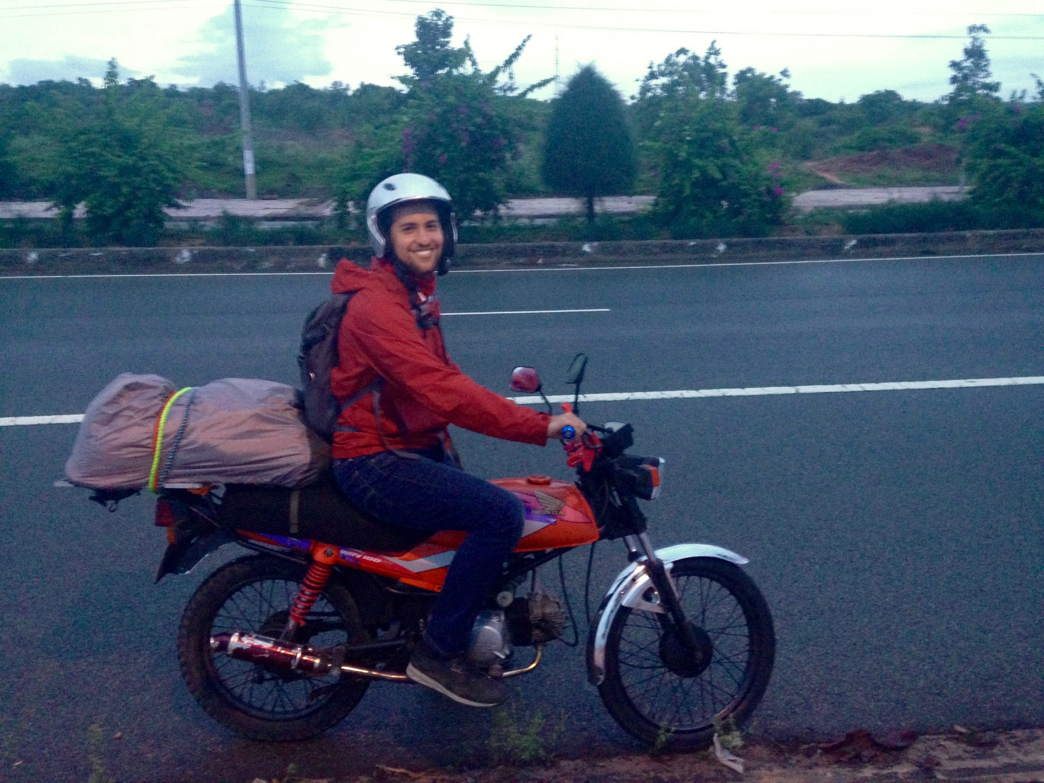

Slide 11


Slide 12



Slide 13
adamgabay514@gmail.com
Help with college applications, essays, resumes, or travels

