Slide 1
Maclin Motivation, LLC
Justin E. Maclin

Slide 2
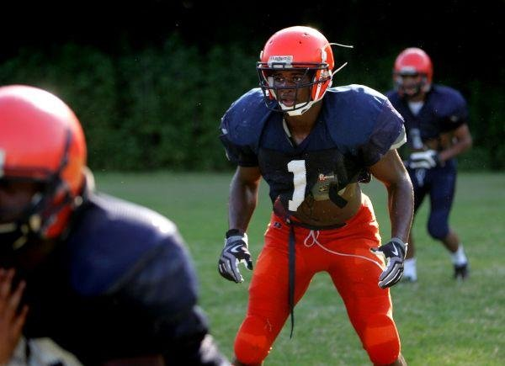
The Beginning
Whitehaven, Memphis, TN
Lisa Love
Faronia Square
Poverty
(625,000/1,500/100,000)
Ridgeway High School
Grades
Focus
Football & Basketball

Slide 3
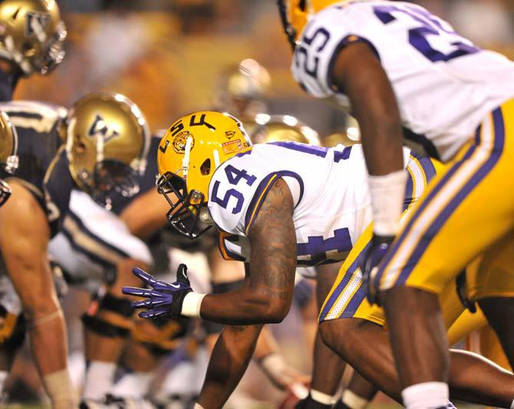
Baton Rouge
Second Home
Louisiana State University
The Experience
Travel
Exposure
Life Struggles
Depression
Injury

Slide 4
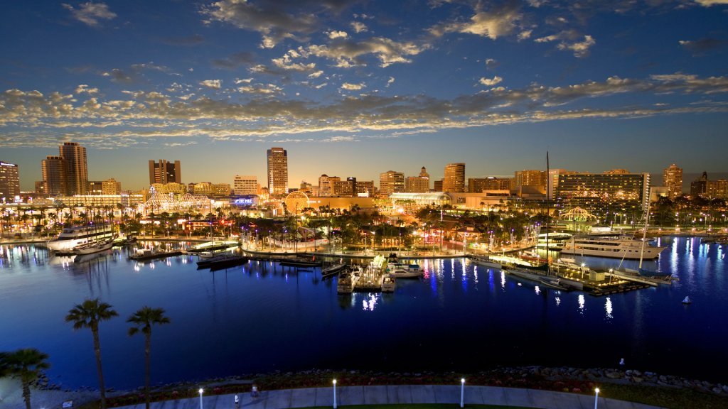
LonG Beach
The Move
Long Beach State University
Directory of the Beach Athletic Club
350 Student-Athletes
What to love about Long Beach?
Weather
Diversity
Opportunity to grow

Slide 5
Maclin motivation, llc
Hustle Pay The Price
Erin Hammond
Empower people to pursue and live their life goals with purpose and a sense of achievement
Services
Public & Motivational Enlightenment
Youth & Young Adult Transformation
Leadership Coaching
Speech and Communication Consulting

Slide 6
Thank You
Contact Me
Phone: 562-552-2372
Email: maclinmotivation@gmail.com
Website: www.maclinmotivationhptp.com
Facebook: @maclinmotivation
Twitter: @maclin_hptp

