Slide 1

YBA GUEST SPEAKER
October 23, 2014

Slide 2
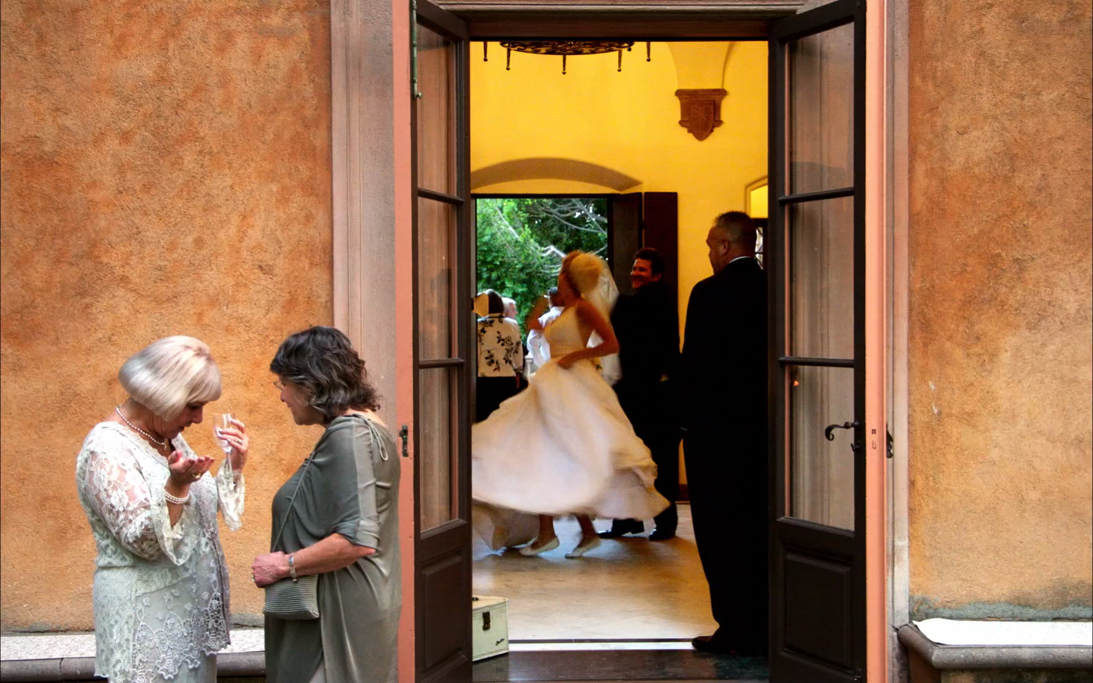

Slide 3
INTRODUCTION
My name is Maya Myers and I am 36 years old.
I am the lead photographer and owner of Maya Myers Photography
My company specializes in photographing weddings, private and corporate events and projects with non-profit organizations. The Majority of my business concentrates on luxury weddings.
As the lead photographer and owner I do everything from photographing to managing post production, client relations, administrative tasks, marketing and business management.

Slide 4
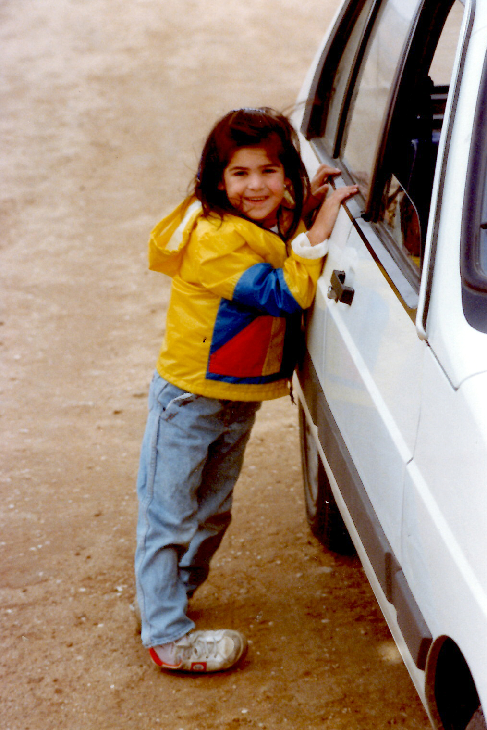
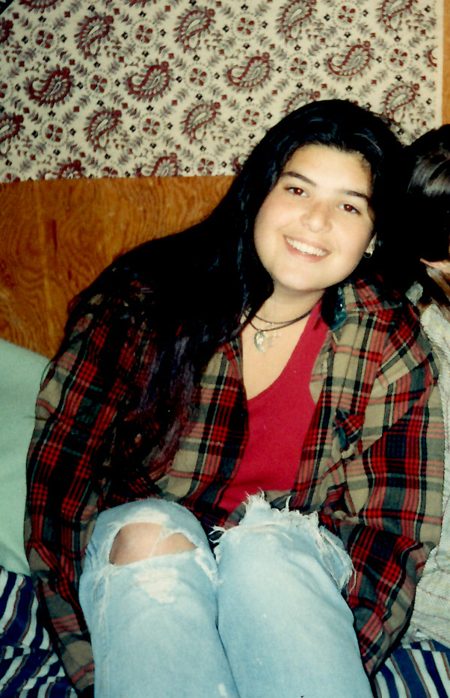
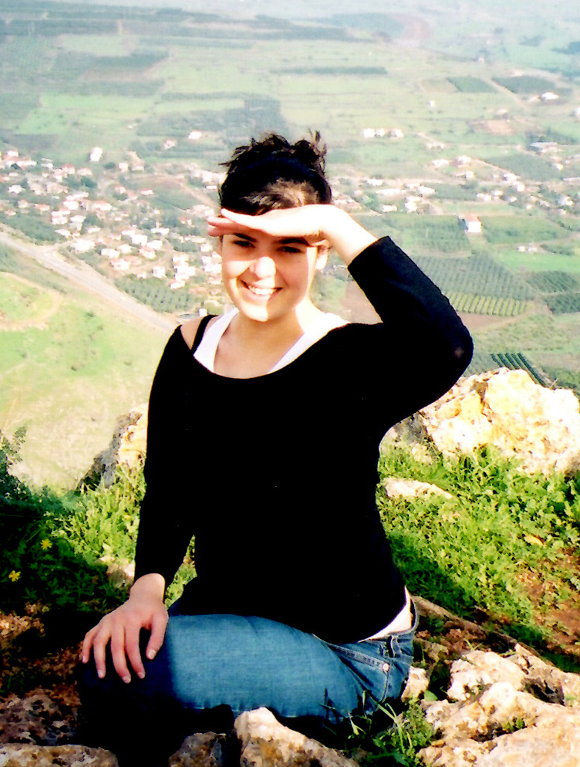
The Early Years…
I was born in Israel and raised in upstate New York
Age 5
Age 15
Age 25

Slide 5
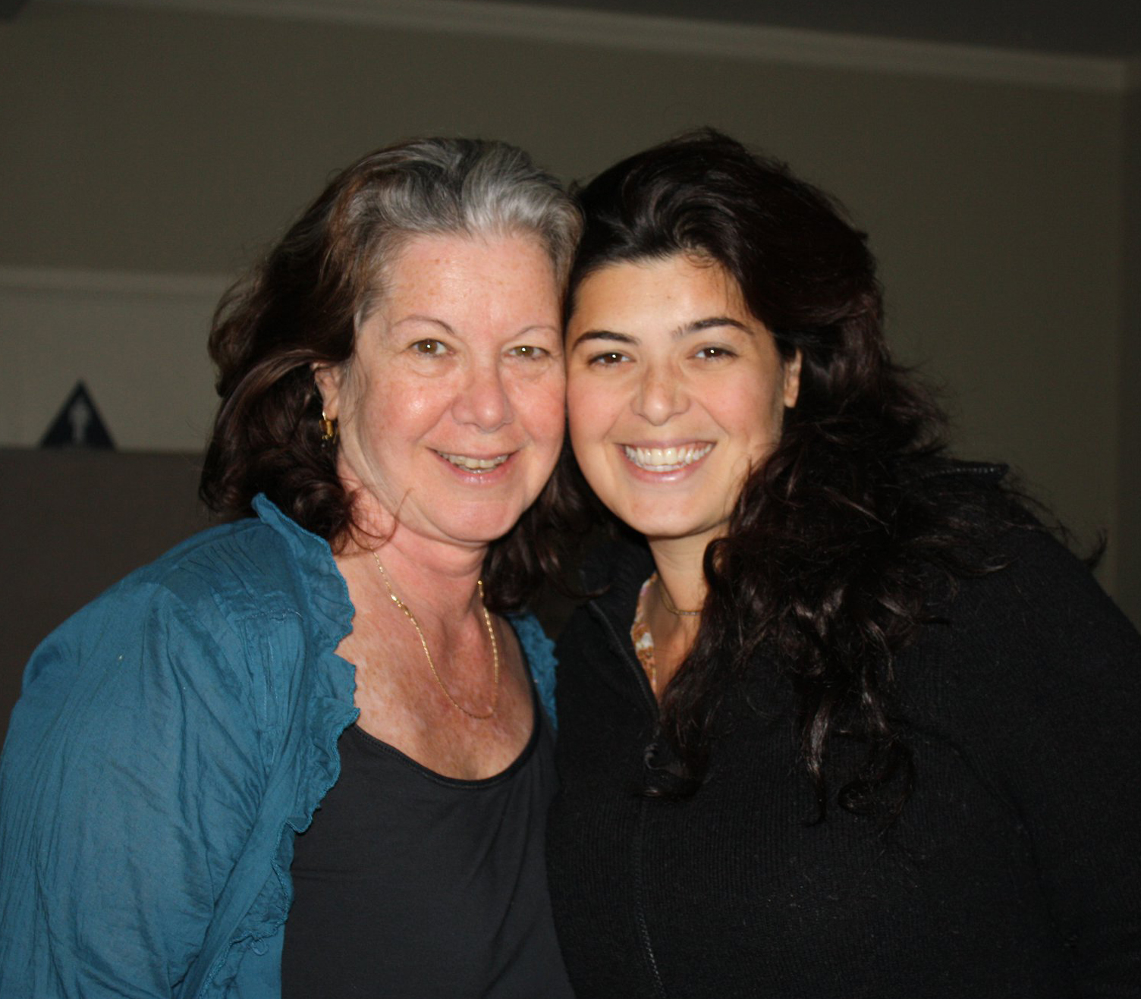
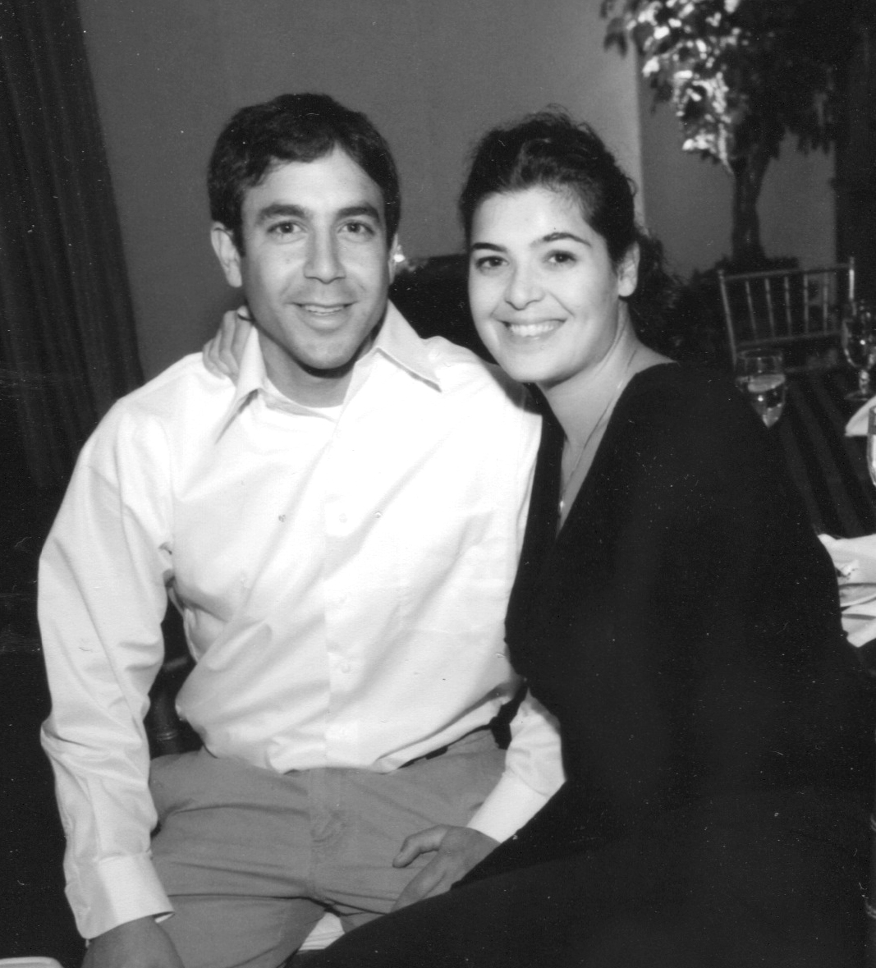
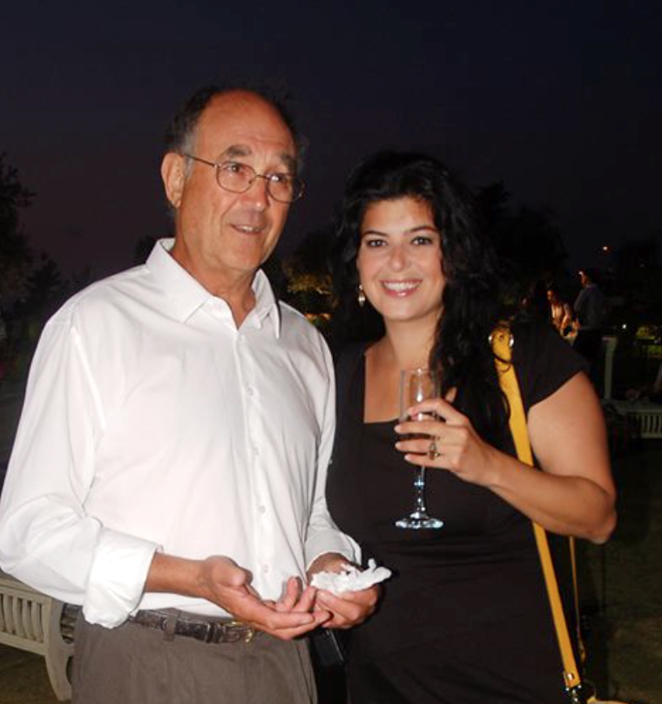
More Early Years…
A little about my family…
My brother sporting the
cleanest cut he’s ever had
Dad who refuses to look
at a camera, always
Mom after making me go to
a body detox center for a week (she owed me big time)

Slide 6
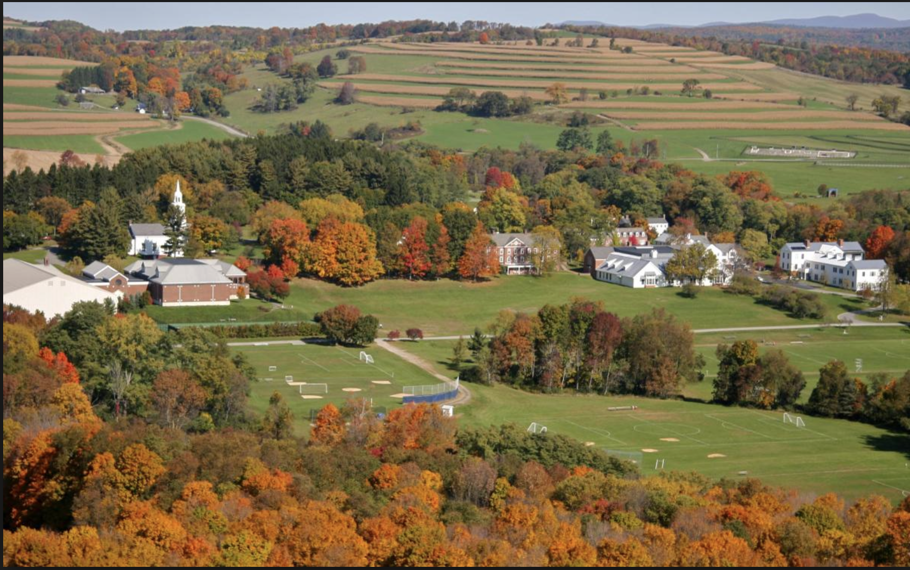
HIGH SCHOOL
I attended The Millbrook School in Upstate New York
Insert map shot here
\

Slide 7
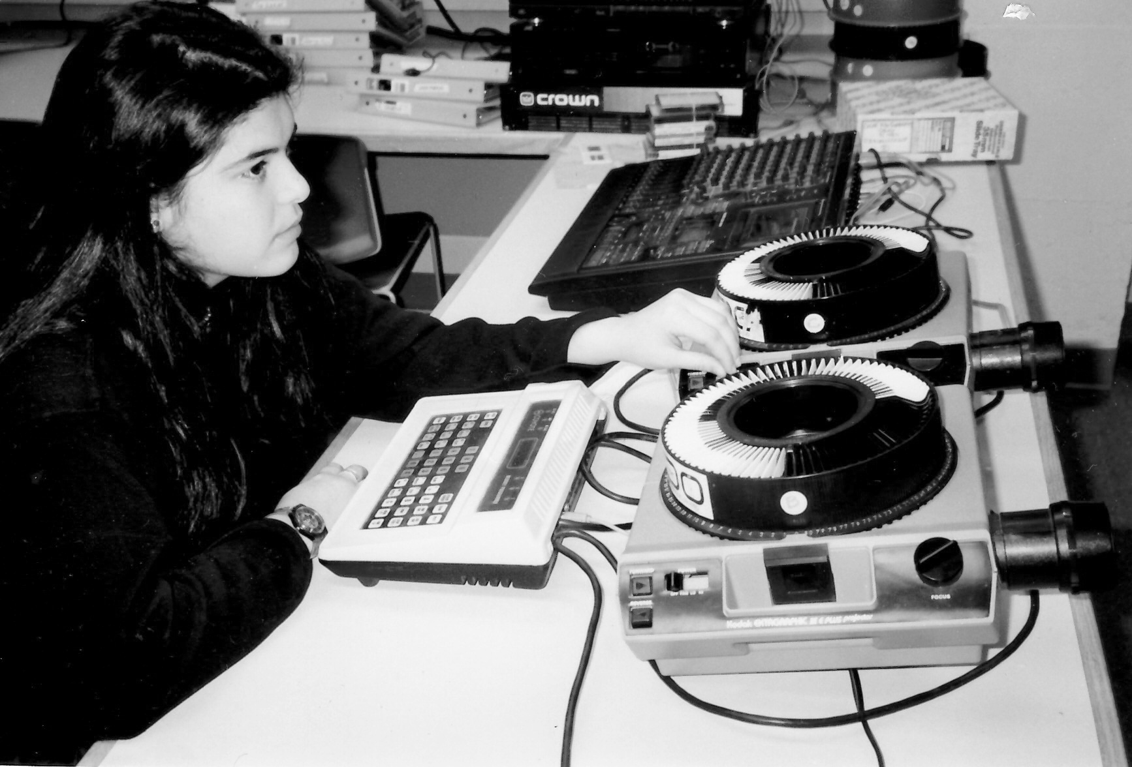
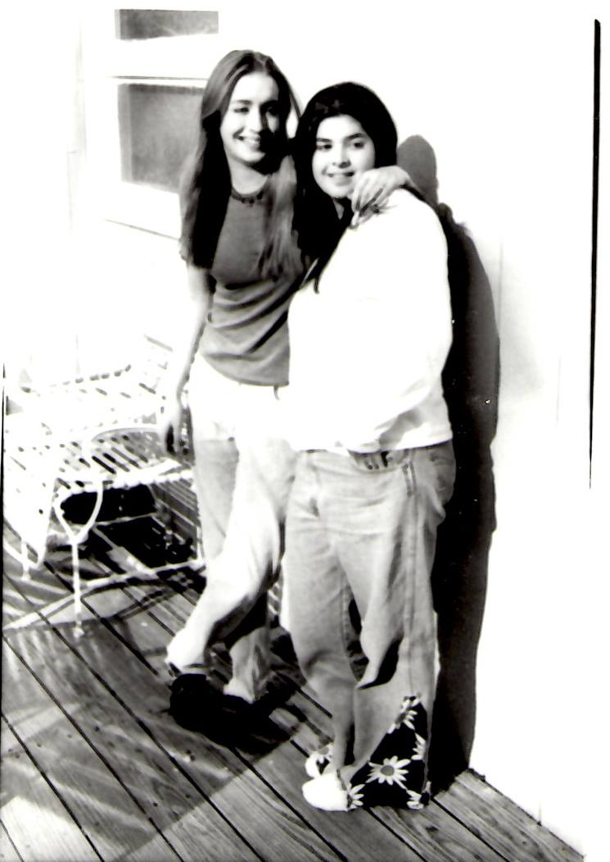
HIGH SCHOOL
As a HS student I was involved in the arts (painting, drawing, performing arts and of course photography. It’s where I discovered my love for telling a visual narrative through photography
I was very independent and marched to the beat of my own drum. I was known as the ‘artsy one’ with a strong voice. If anyone did something wrong I had no trouble letting them know.
I was friendly with my classmates and had a few close friends but for the most concentrated on my school work and spent time outside of school with my local friends.
Preparing a photography slideshow
Besties for 26 years!

Slide 8
HIGH SCHOOL
Things I enjoyed in HS
Things I did not enjoy in HS
Art class – painting an drawing
Singing and performing in talent nights and school productions
Photography
Hanging out with my hometown friends on the weekends
History Class
French
Team sports
Staying on campus on weekends

Slide 9
HIGH SCHOOL
Activities/Athletics in HS
Jobs I worked while in HS
Editor in Chief of the Yearbook
Dorm leader
Plays and Musicals
Photography
Cross country running and skiing in the winter
Great at becoming the ‘manager’ of every sports team I ‘played’ on.
Summer jobs as a nanny or au pair
During school – babysitter
Community Service in school – zoo keeper
The money I made during the summer had to be saved for the school year

Slide 10
HIGH SCHOOL
Fondest memories from HS
Obstacles/Adversity you had to overcome in HS
Hanging out with hometown friends on the weekends
Singing / performing
Discovering my love for photography
Sneaking off campus and ‘not getting caught’ ever!!
Difficult home life
Not fitting in with most of my class and school mates
Not having money like the rest of my peers had

Slide 11
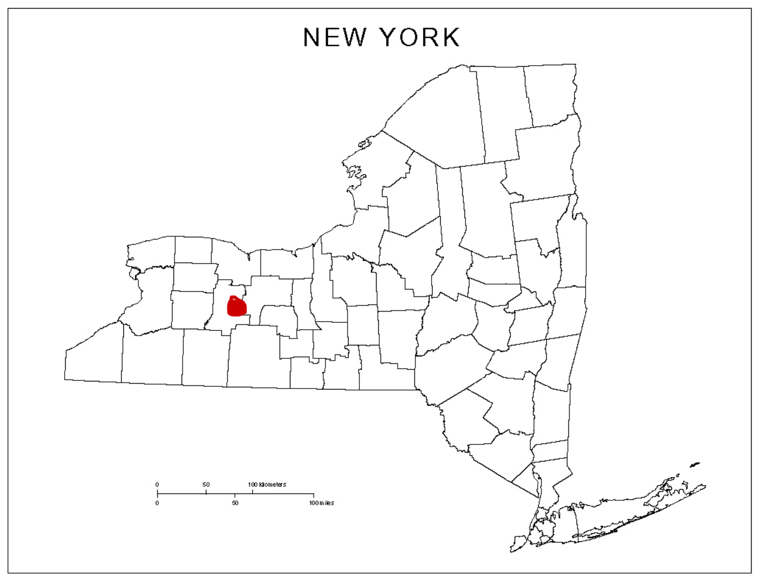
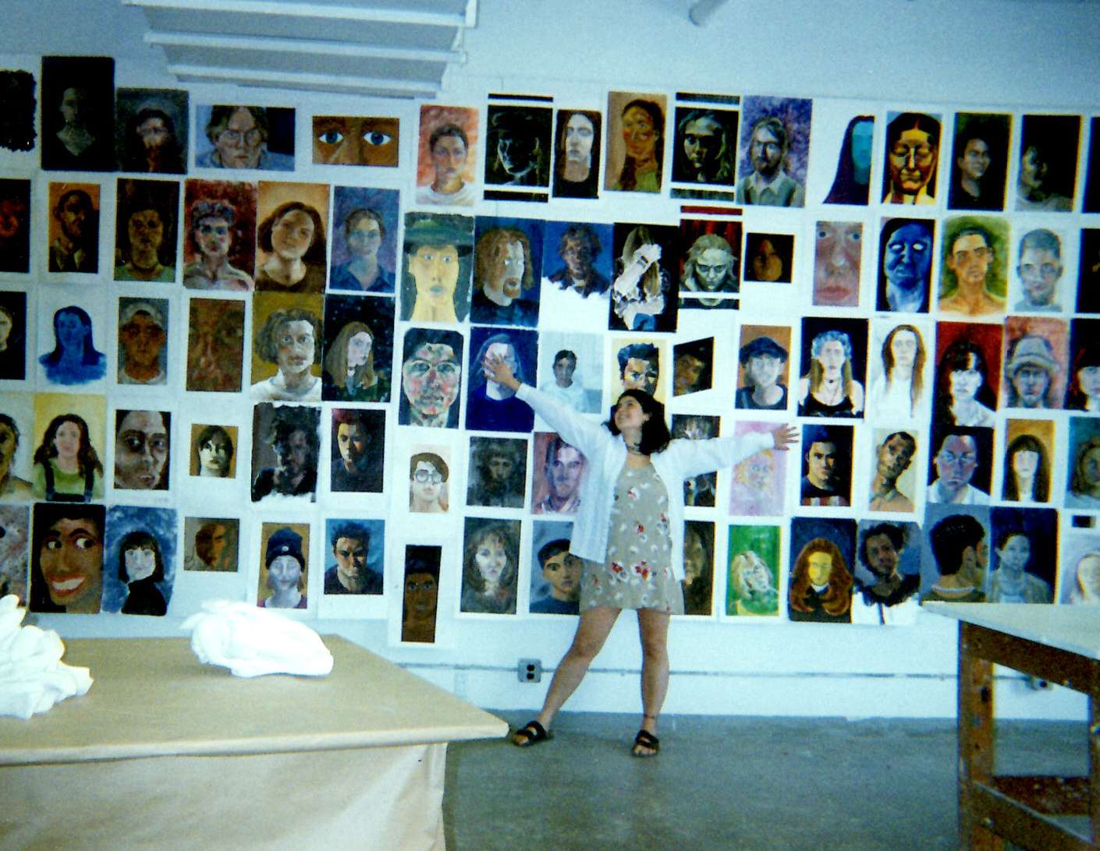
College
I attended college at Alfred University in Upstate New York
My 2nd year of college
\
Small art school in ‘ the middle of nowhere’ New York

Slide 12
College
Activities/Athletics in College
Jobs I worked while in College
Sang in the college Acapella group
Worked into the wee hours of the morning on a mountain of art assignments.
Served in the dining hall
Worked in the library
Modeled for drawing classes
Waitressed at a local restaurant
During the summers waitressed and worked at 9 West shoes

Slide 13
College
Favorite classes
Least favorite classes
Photography (the lab was my second home)
Foundry
Painting
Psychology
Art History
Graphic design
Anything that involved computers

Slide 14
College
Fondest memories
Obstacles or adversity that you had to overcome
Friends (in college you meet your people)
Learning about myself as an artist
The Parties!!
Having to work multiple work study and side jobs to support myself while managing the assigned project modes

Slide 15
Career Path
Notes:
You may use this chart to describe your journey to the current career

Slide 16
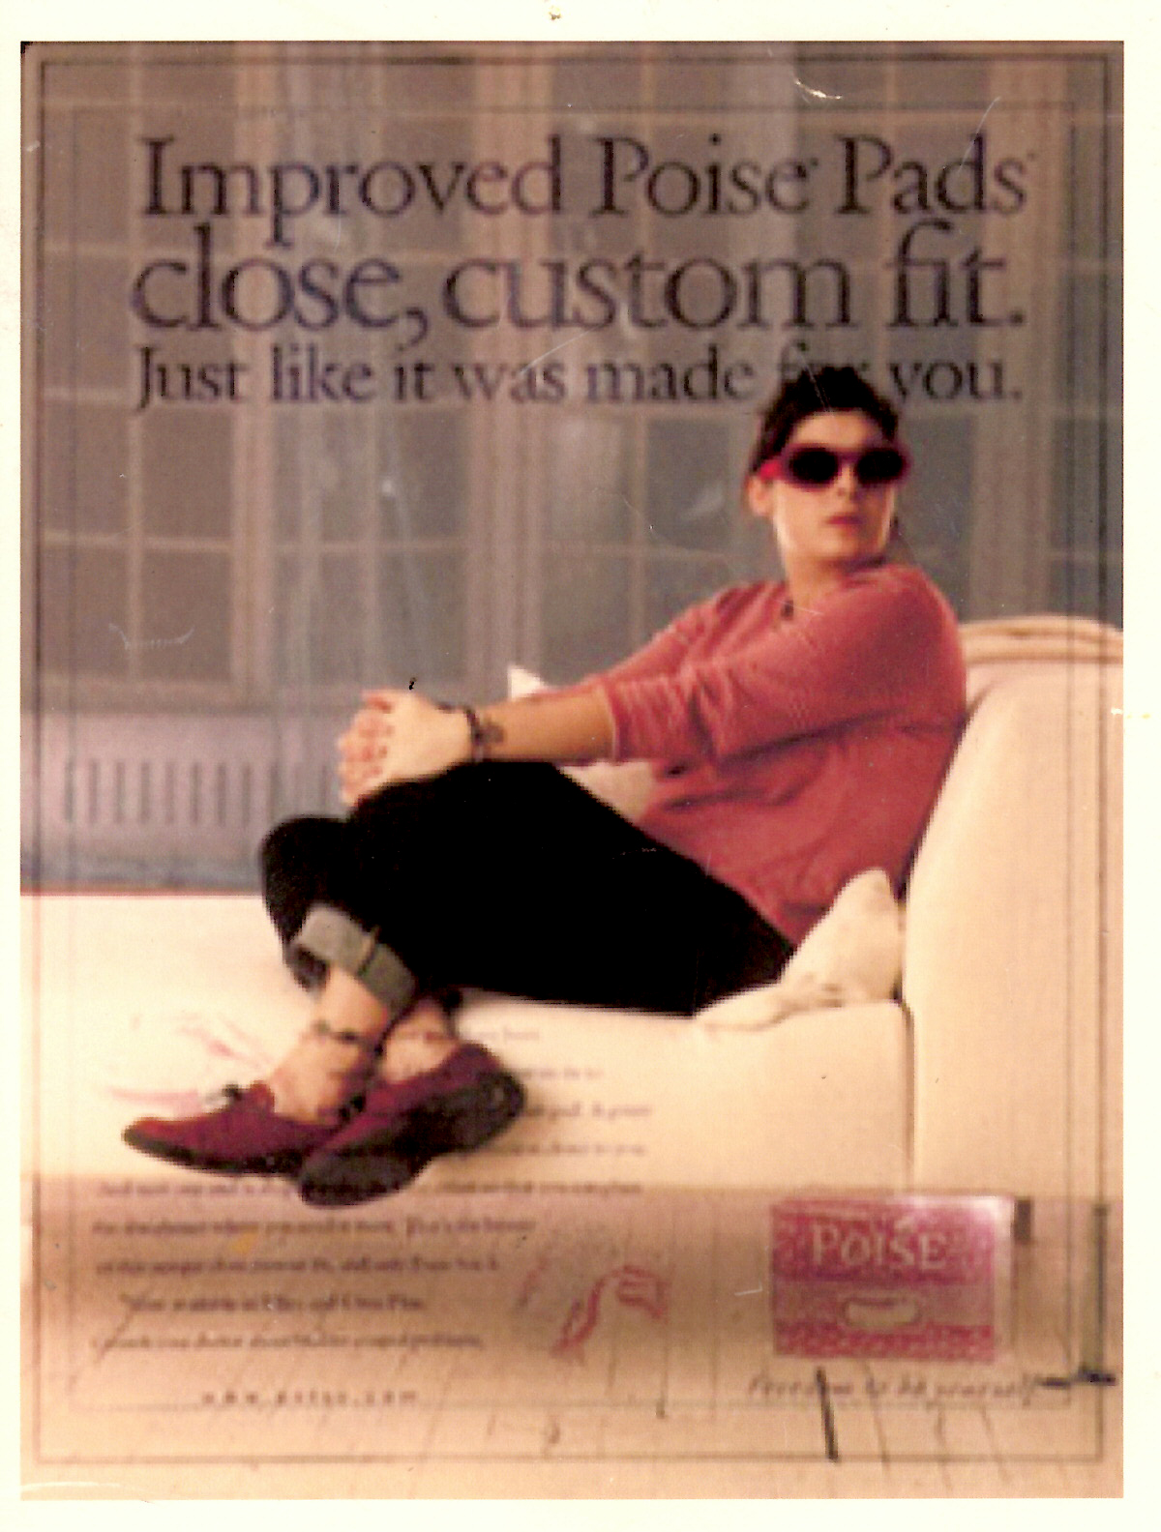
Career
My first Job
My first ‘real’ job out of college was working as an assistant to a commercial photographer (or at least that’s what he called himself)
My worst Job
My first ‘real’ job out of college … working as an assistant to a commercial photographer (or at least that’s what he called himself)

Slide 17
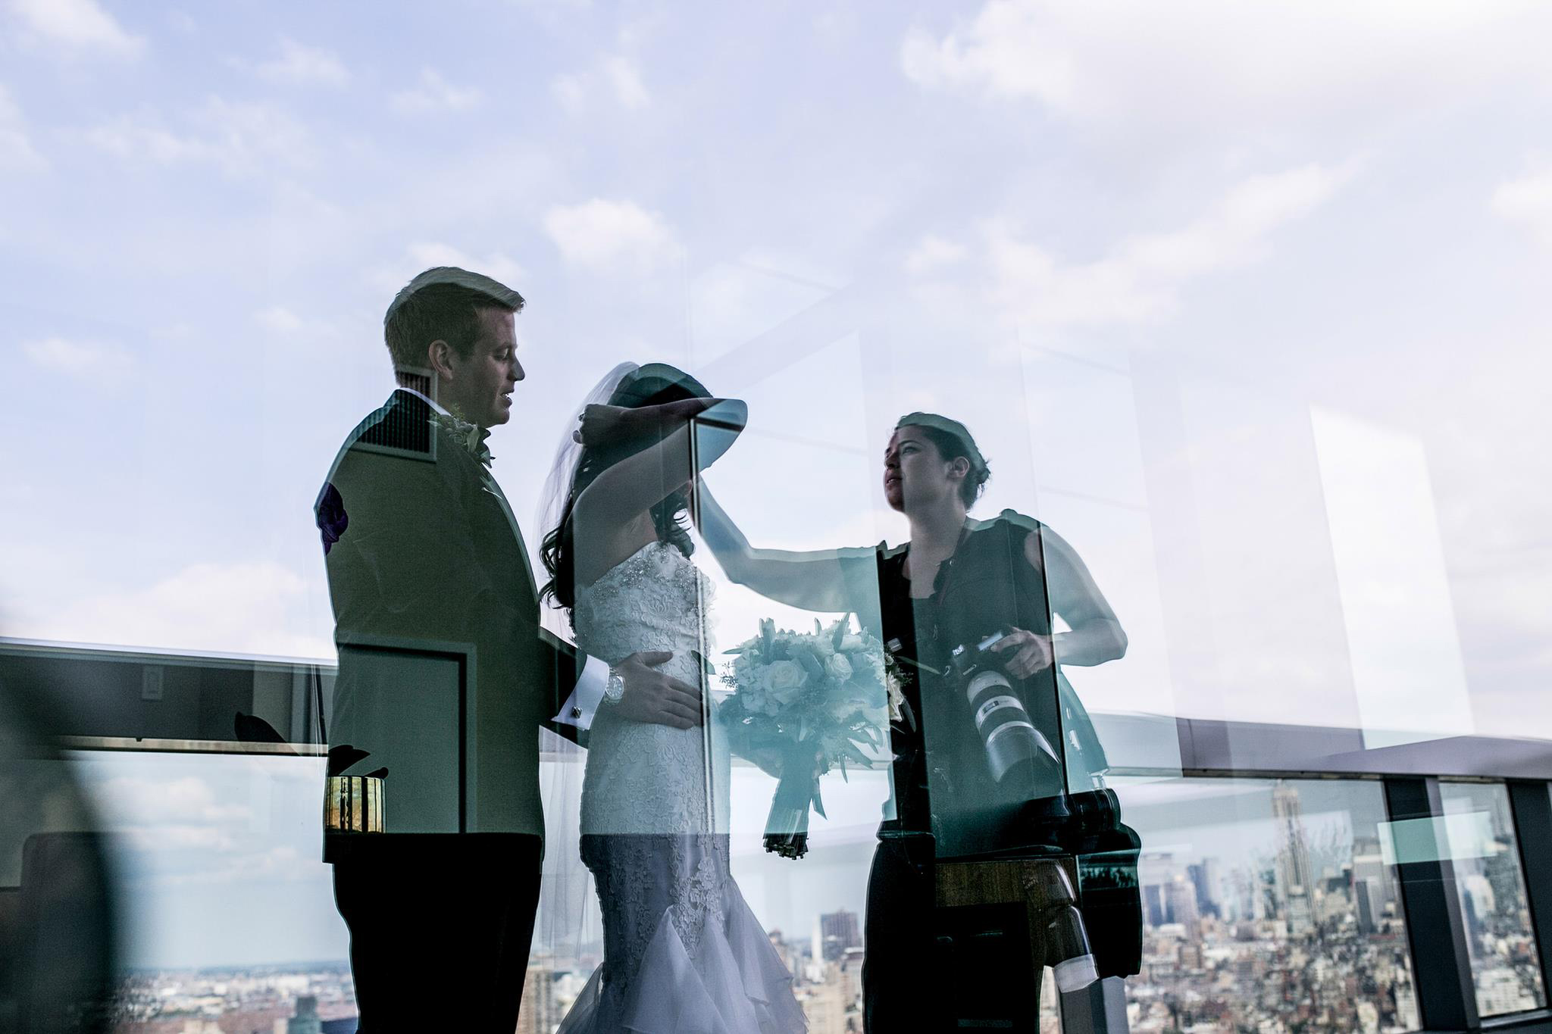
Career

Slide 18
Career
Some challenges I had to overcome in my career
Gaining confidence in my craft
Learning business skills
Learning business skills
LEARNING BUSINESS SKILLS!!

Slide 19
CURRENT ROLE
Notes:
Use this graph to give more description of your current company (history, size, location, products and services, etc.)

Slide 20
Current Role
Notes:
Use this graph to give more description of your role specifically (responsibilities, typical work week, direct reports, etc.)

Slide 21
Career (path) Compensation
Notes:
Use this graph to show general compensation ranges for people in various roles in your company

Slide 22
ADVISE FOR THE TEENAGE ART LOVER
Become an expert in your craft
Get a mentor
Create your own support system
Learn business
Love what you do to the point that you can’t imagine life without it, and remind yourself of this every time you want to quit.
Remember to build a life outside your craft
Have FUN!!
“There is no passion to be found playing small: In settling for life that is less than the one you are capable of living” - Nelson Mandela

Slide 23
ACADEMIC EXERCISE
We will now spend several minutes discussing the day’s academic module and how it is relevant in the ‘real world’

Slide 24
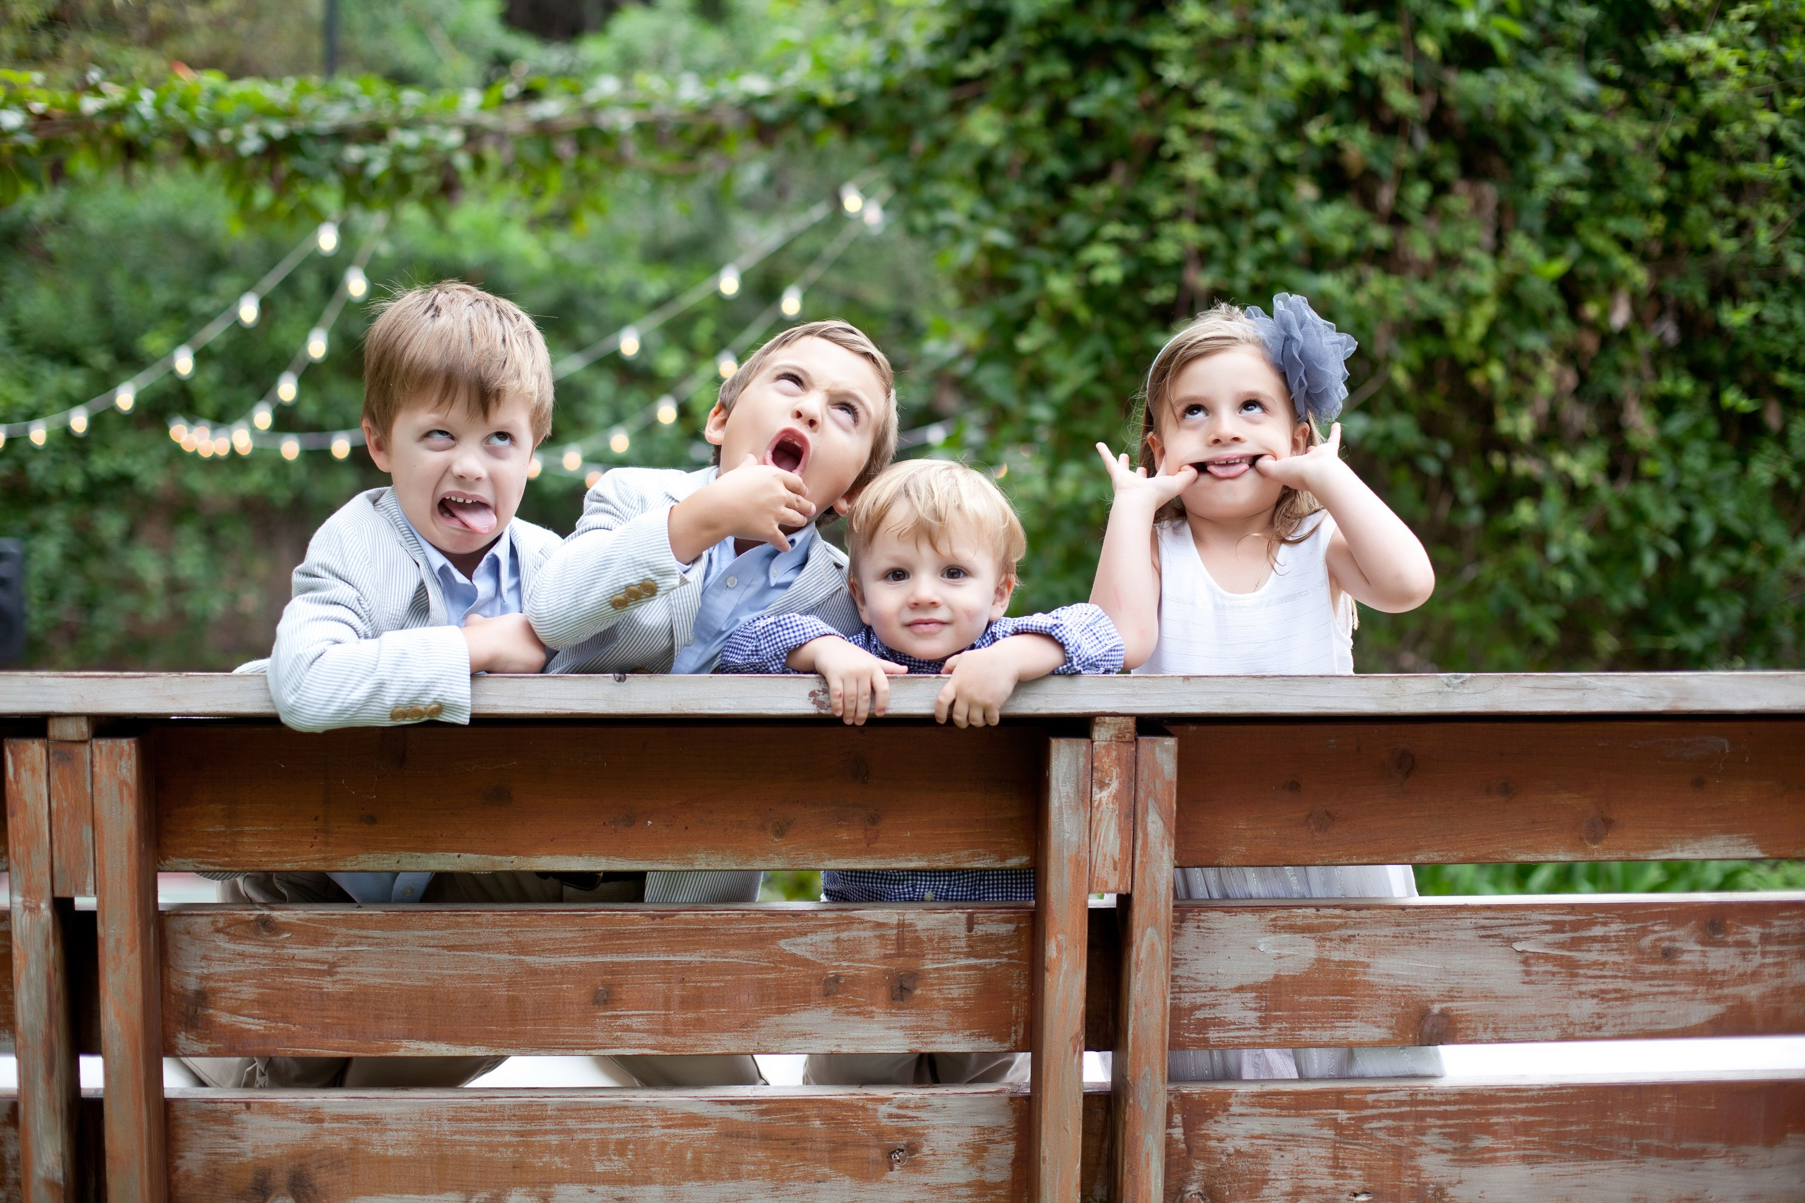
QUESTION AND ANSWER

