Slide 1
David Delepine
AA Security Systems LLC

Slide 2
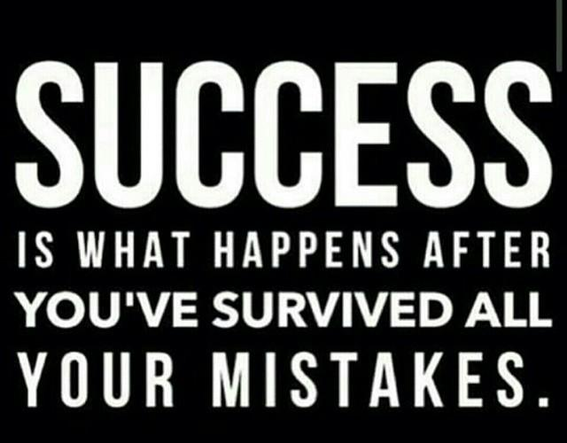

Slide 3
About Me
AA Security
Born In Torrance 1983
Married with 1 Baby Girl
Business Partner and Wife are both friends from High School!
Previous Jobs: Telemarketing, Sales, Construction, Customer Service, Fast Food, Fine Dining
Founded In March 2011
Company Size = 5 Employees
Dealer Partners/Subs > 10
Focus
AI/Machine Learning, Alarm Monitoring, Electronic Access Control, Surveillance Cameras

Slide 4
My Journey

Slide 5
Growing Up
Grew up in Orange County
Was an only child for the most part
Raised by father who worked from 3pm-12am (opposite schedules)
Often alone would play games and chat with people online
The friends I did have I was often not allowed to see (restriction/grounded)

Slide 6
High School
Went to Westminster High School, MERITS program (honors)
Nerdy kid for the first 3 years, then tried to become a “cool kid” senior year
Favorite activity in High School was performing in plays and videos (produced/starred in first student movie from WHS “Murder’s at Midnight High” and cofounded “WHS Campus News”)

Slide 7



Failures
1st High School Drop Out in Famiy
1 Arrest for Drugs
1 DUI
1 Wrecked Car
1 Divorce
3 Times Fired
3 Failed Business Startups

Slide 8
What is the difference between a “failure” and a person who fails?

Slide 9

Failures are the ones who have stopped trying...

Slide 10
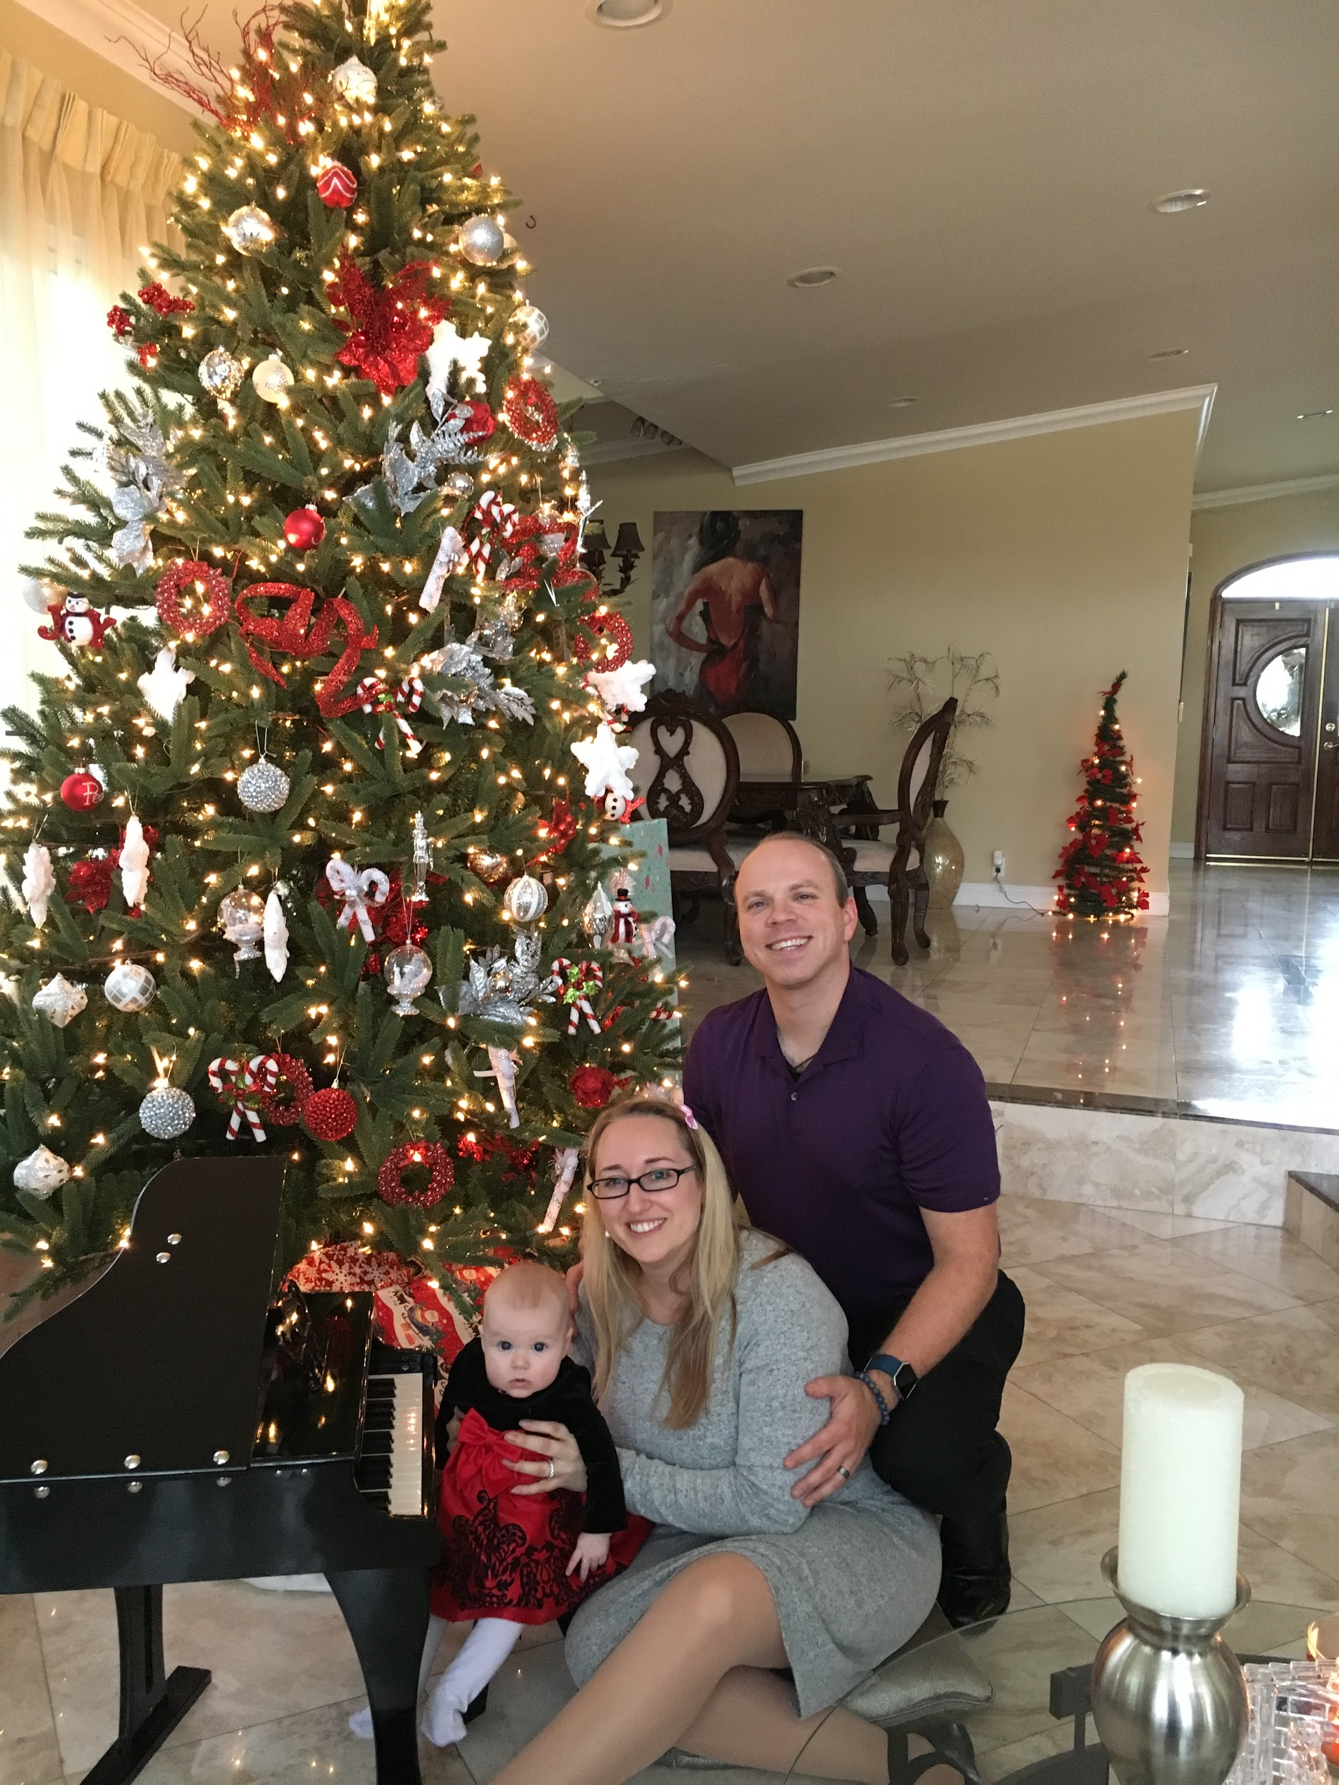
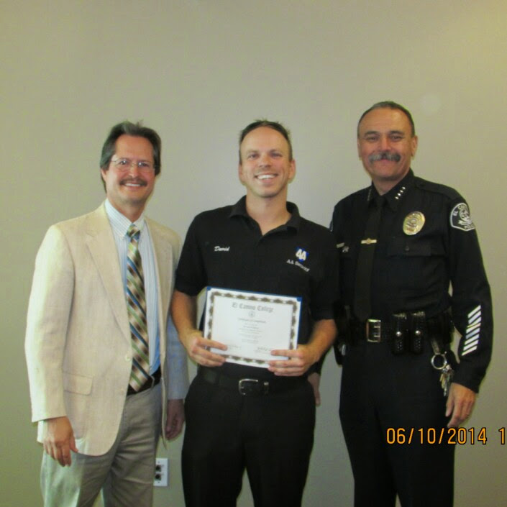
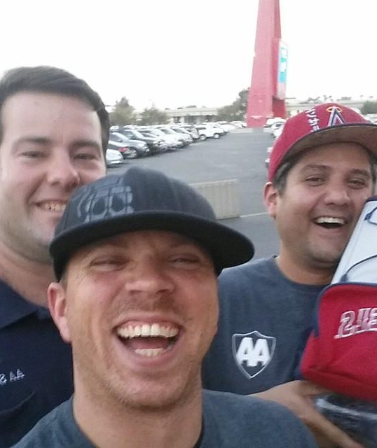
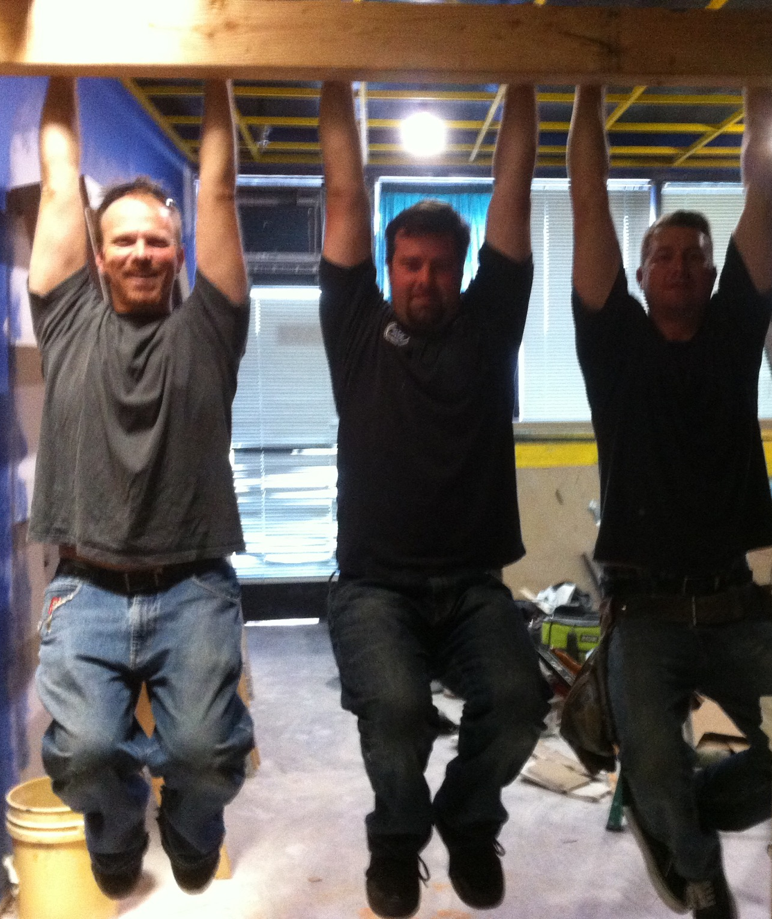
Accomplishments
Found God, Family and Home
Small Business Consultant
3 Successful Business Startups
2 Years College for Self Improvement
California Bounty Hunter (requires Police and Bail Bonds certifications)
Volunteer Work
World Traveller

Slide 11
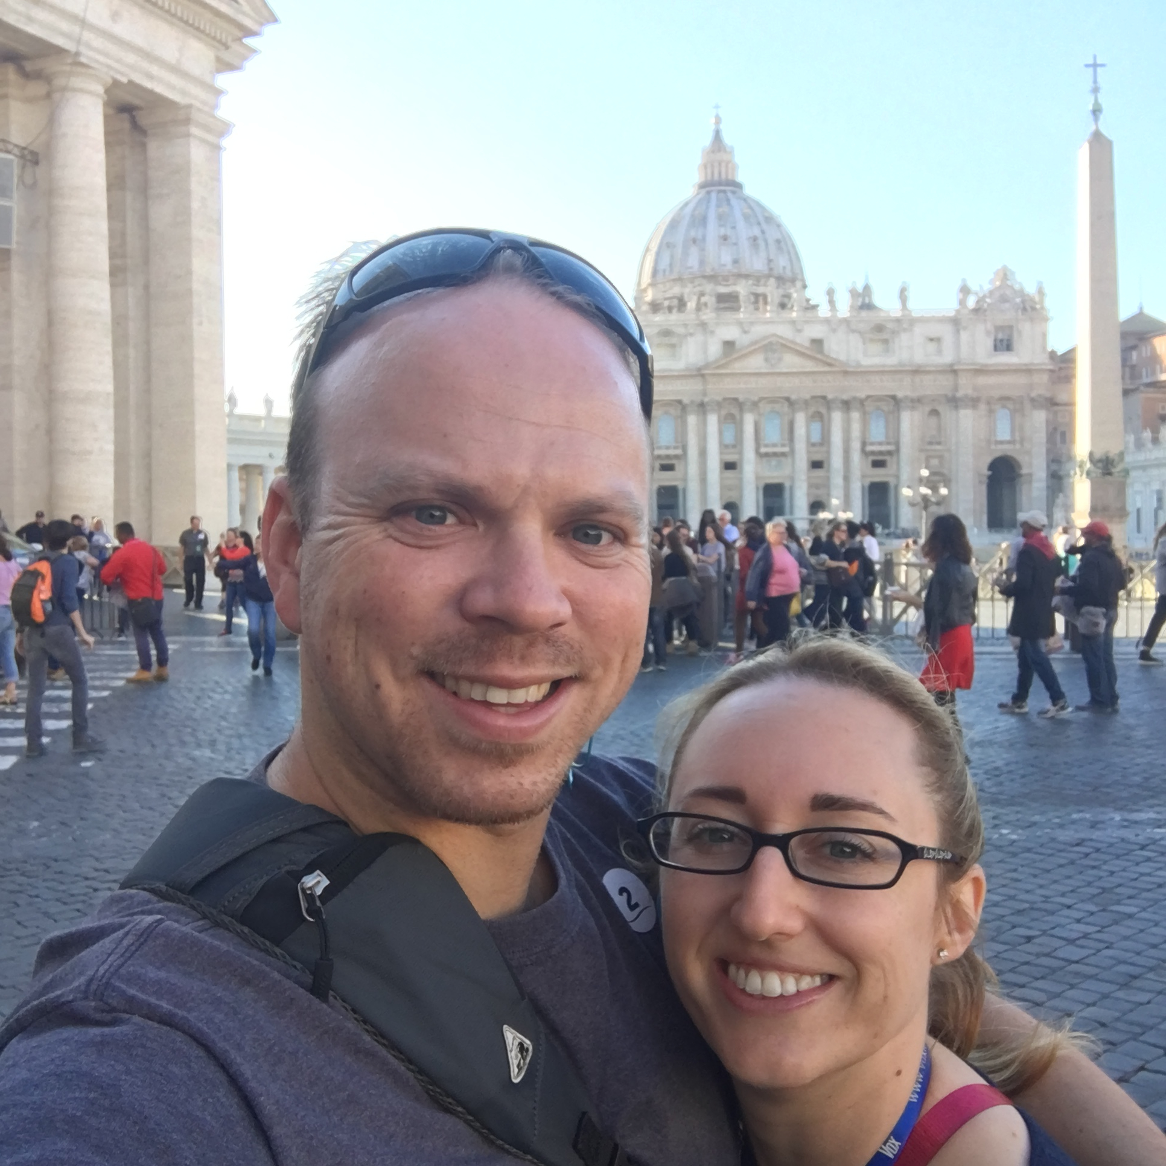
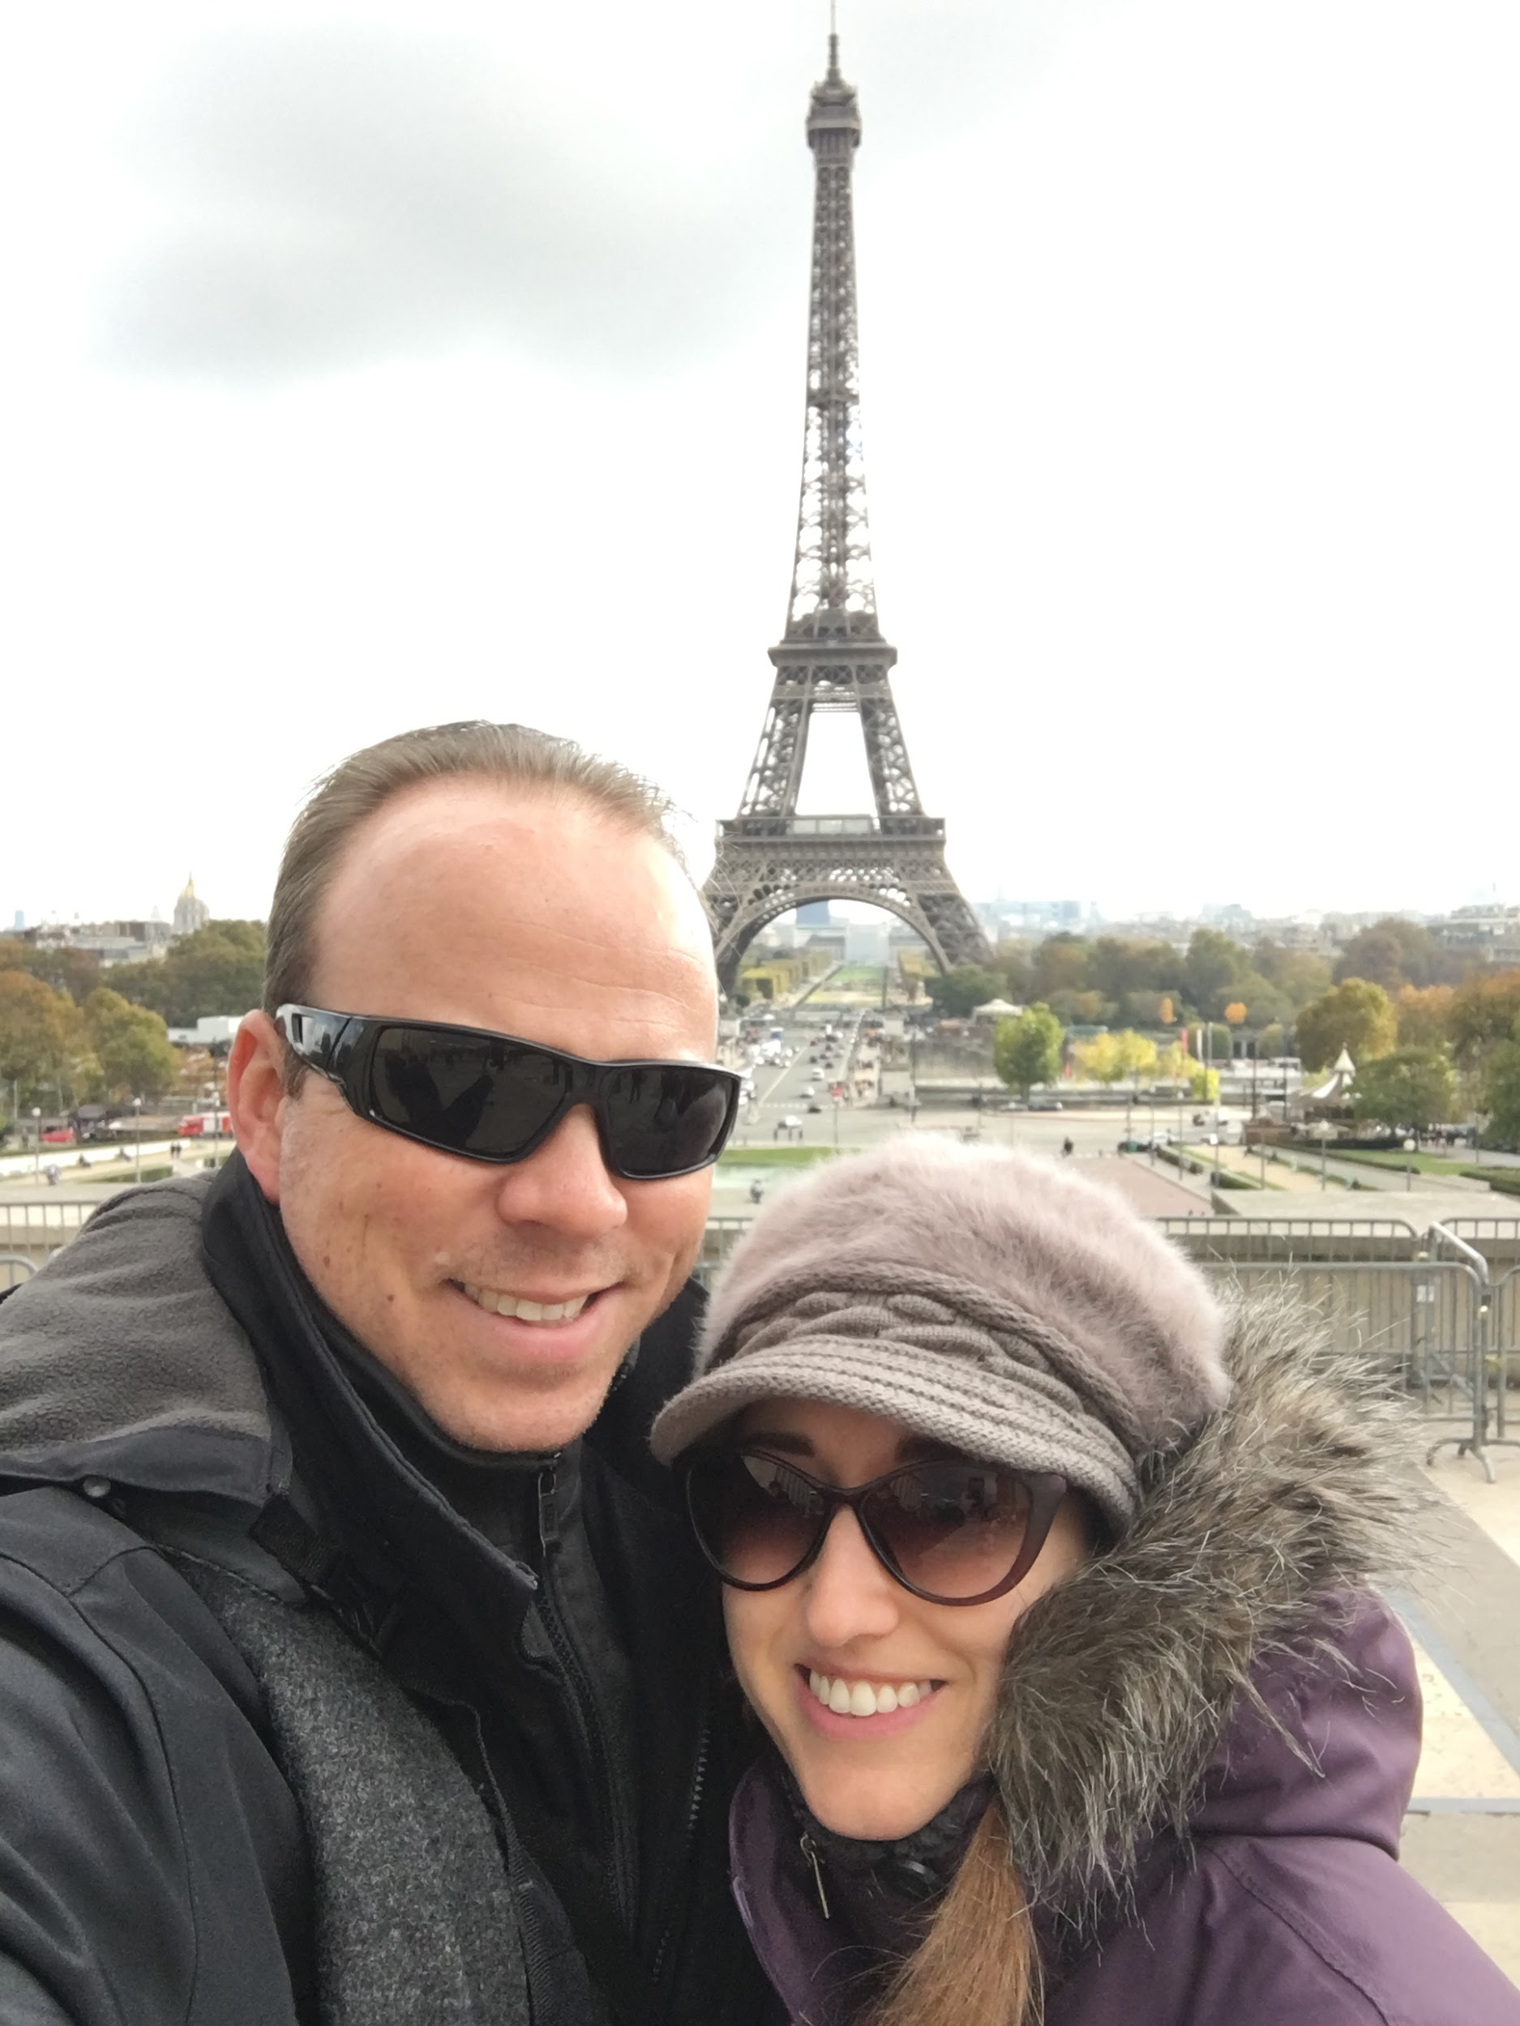
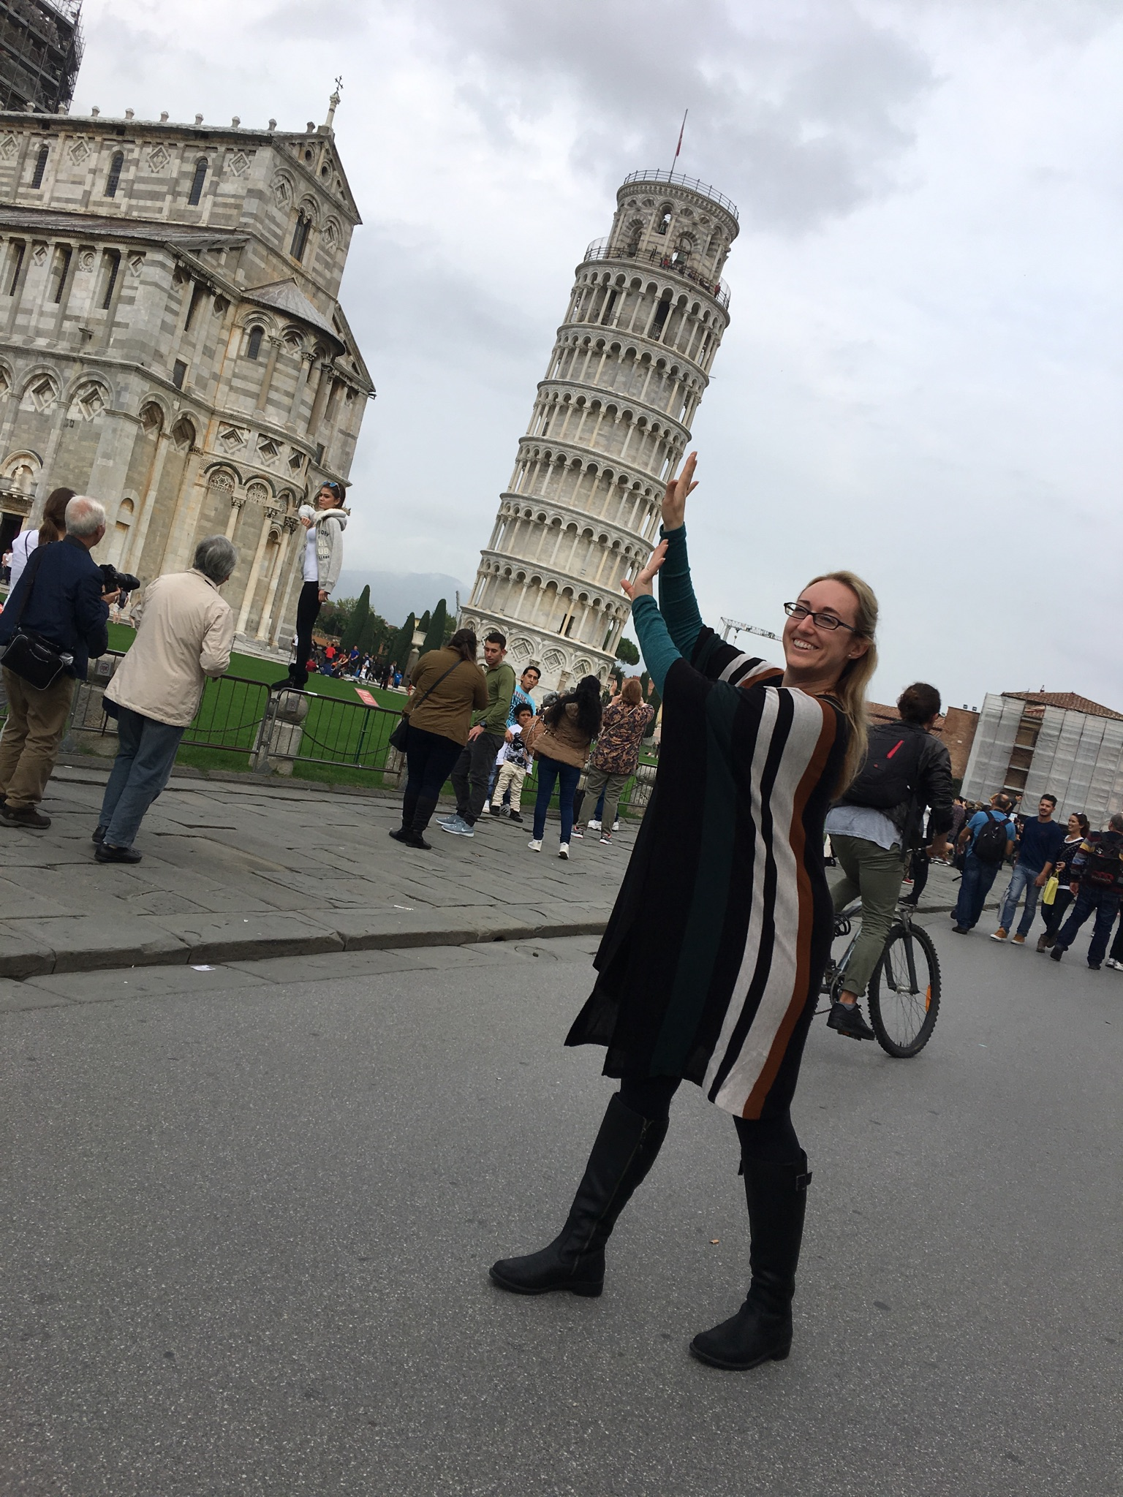
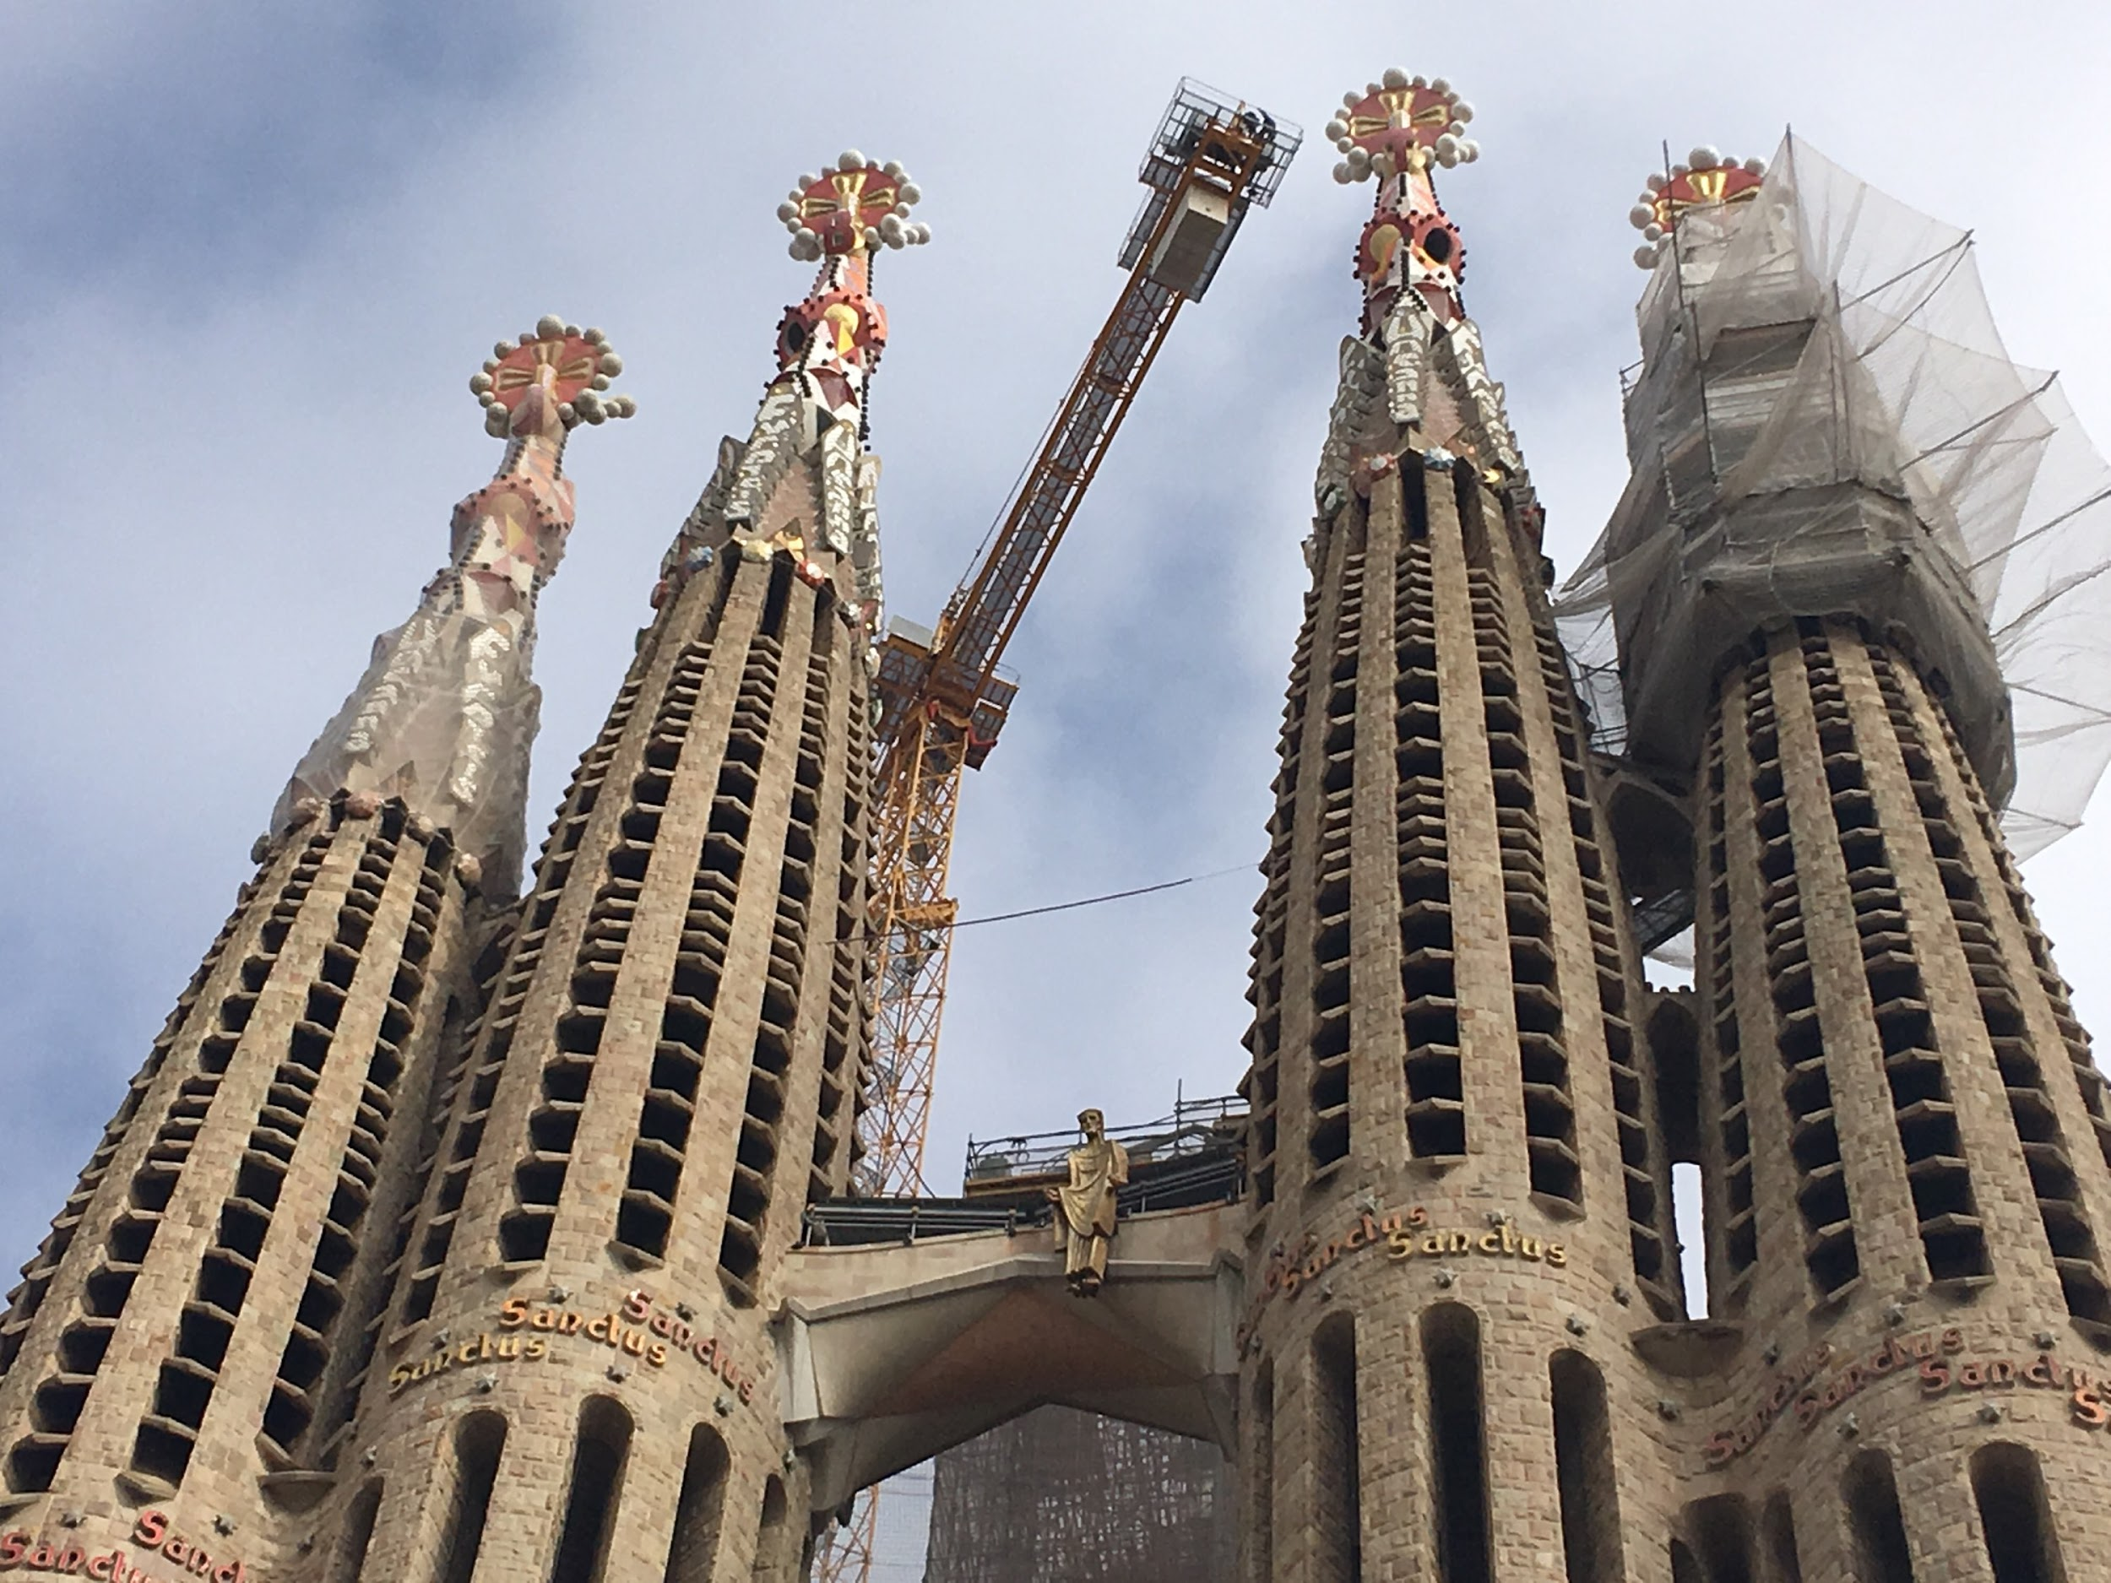

Slide 12
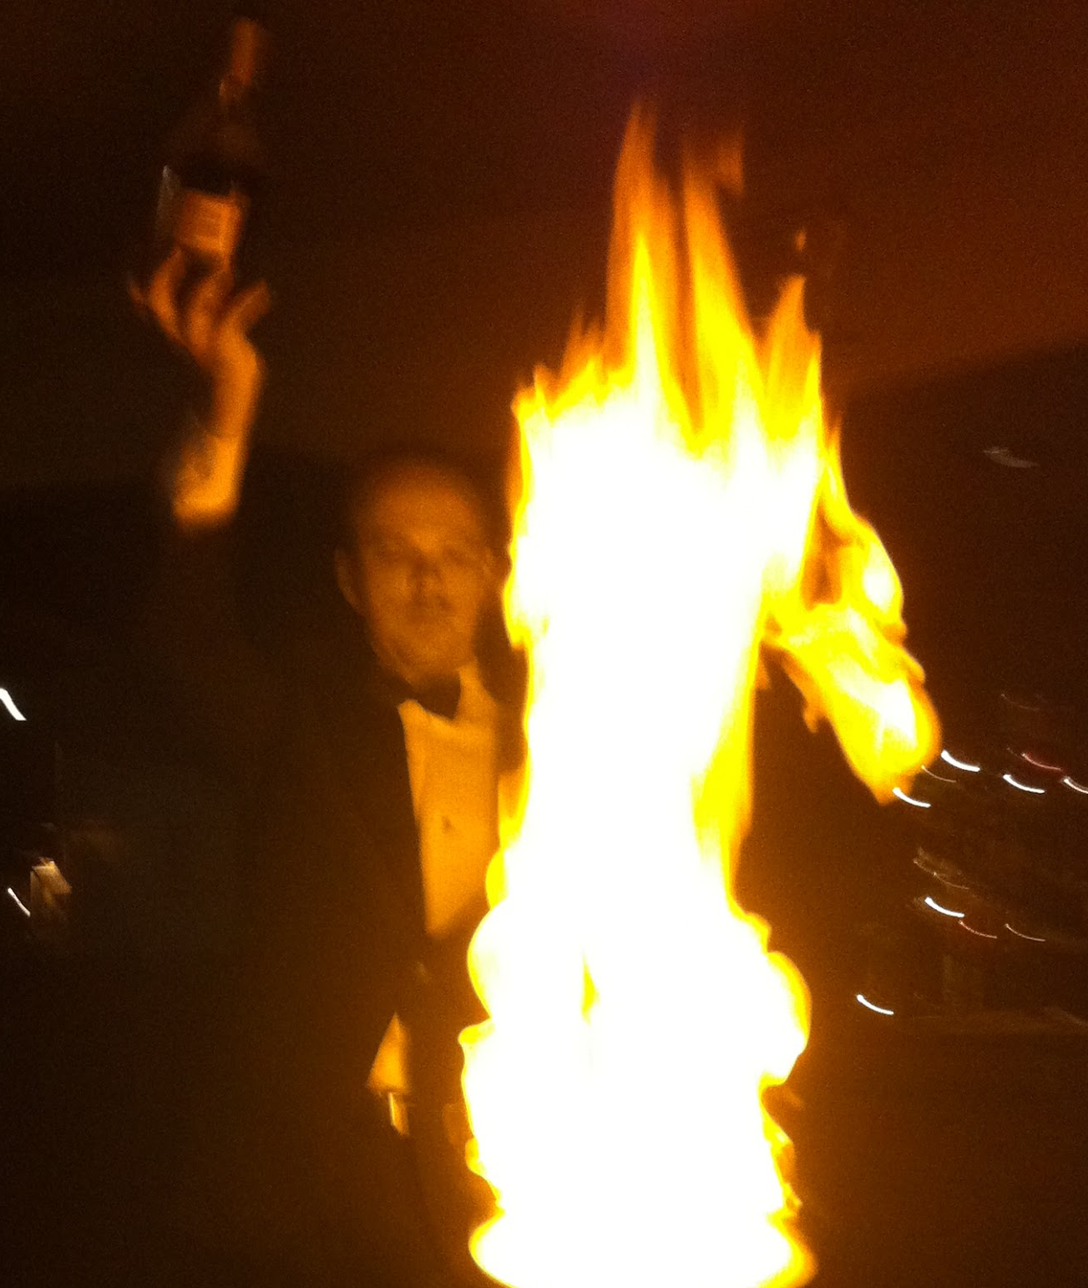
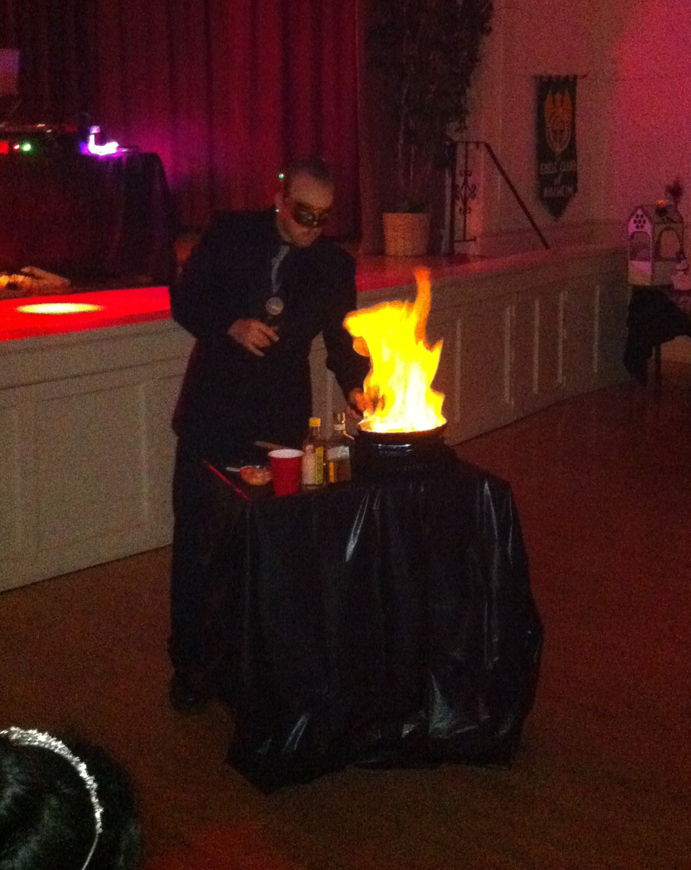
How I Picked Myself Up
Stay Busy, Get a Job, Go to School
Started working at KFC until finding a job in fine dining as busser, then promoted to server, bartender, and finally supervisor
Went to El Camino College and studied business, accounting, criminal justice, and other classes to better myself
When presented with the opportunity to start a small business, leapt at the chance!

Slide 14
AA Security Systems

Slide 15
About AA
The Team
Headquartered in Long Beach
Security Systems
Integration & Wholesale
Client Base: 80% Commercial
Notable Clients:
IRS, Homeland Security, Adopt-A-Highway, Petco, Joseph McClendon III
Managing Member/CEO: Me
Installation Manager: Aaron
Project Manager: Jonny
Accounting Manager: Michelle
Lead Technician: Patrick

Slide 16
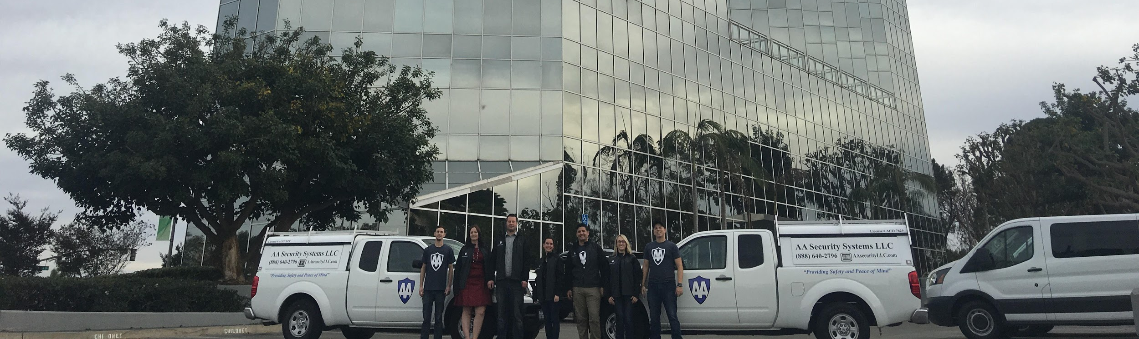
What is AA Security Systems LLC
Who we are: We a small local business specializing in the latest advancements in the integration of security, networking, and communication technologies.

Slide 17

What is AA Security Systems LLC
What we do: Install, monitor, and repair electronic security systems primarily for commercial clients. We also wholesale security systems to other integrators, as well as help them with tech support, installation, and even marketing services.

Slide 18
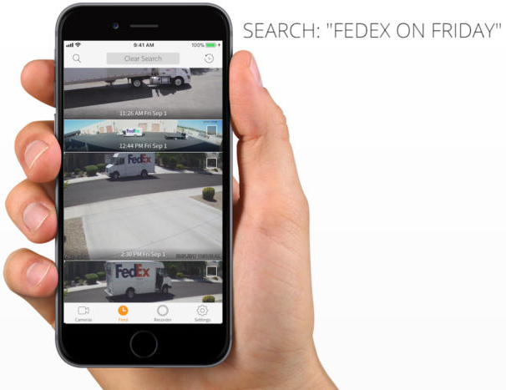


What is AA Security Systems LLC
How we are changing: Moving towards consultation, distribution, and ecommerce and away from physical installations. With the disruptions from AI, blockchain, and IoT technology combined with rising labor costs and jobsite unpredictability we are trying to stay ahead of the curve.

Slide 19
Humble Beginnings
Started with 2 Guys and a Truck
Aaron and I worked for ourselves and ADT (largest alarm company in USA)
I went full time at the end of 2011, and my partner joined me full time by end of 2013
First employees were my half brother Patrick in 2012 and then in 2013 yet another friend from high school Jonny

Slide 20
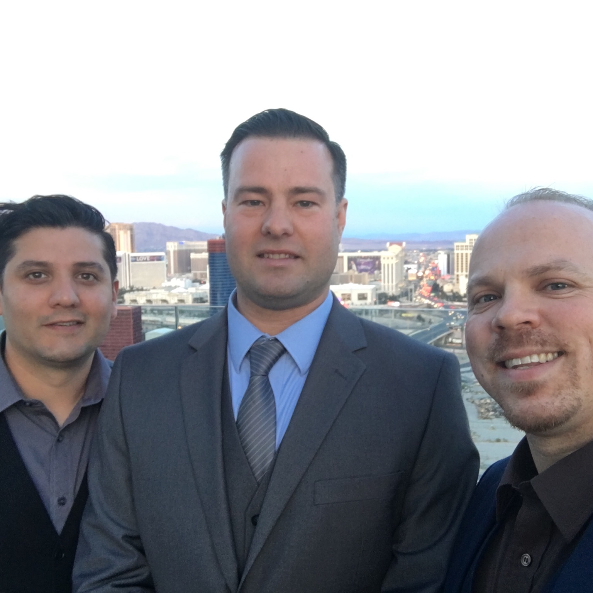
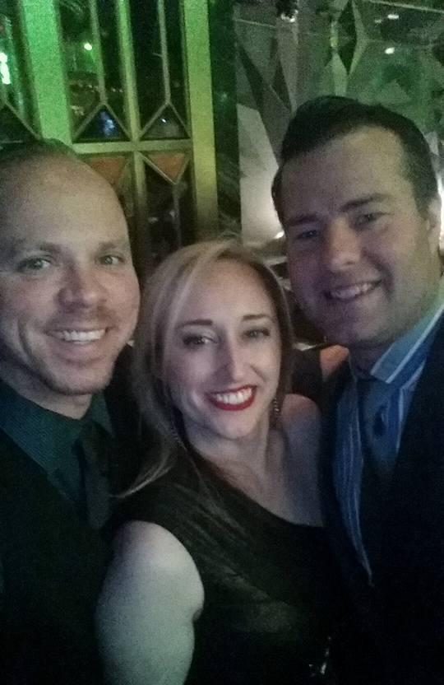
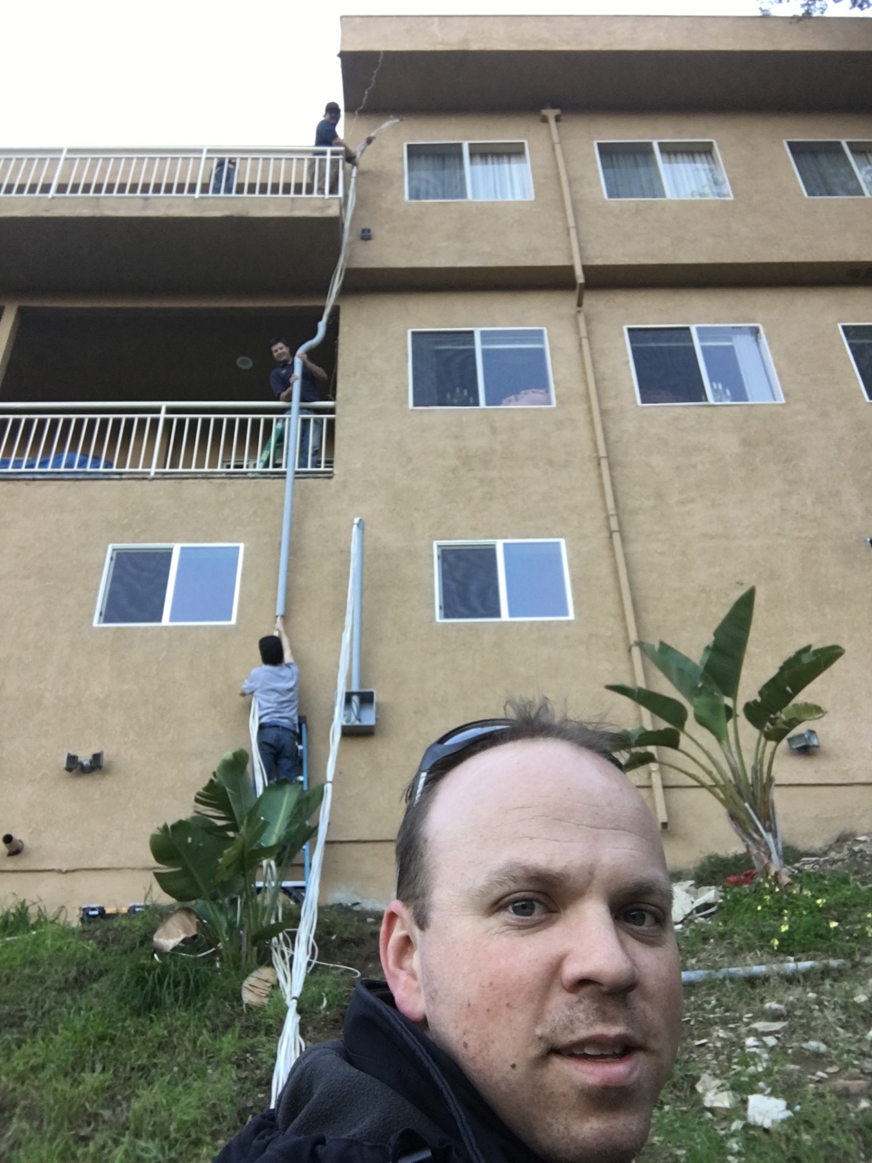
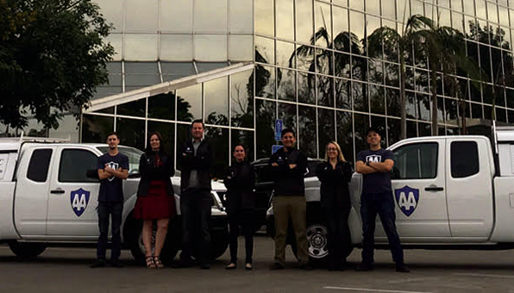

Slide 21
My Roles Within AA Security
ME
MANAGEMENT
ENTRY LEVEL
ME
ENTRY LEVEL

Slide 22
C-Suite
($60K)
Management
($50K)
Supervisor
($35K)
Entry Level
($20K)

Slide 23
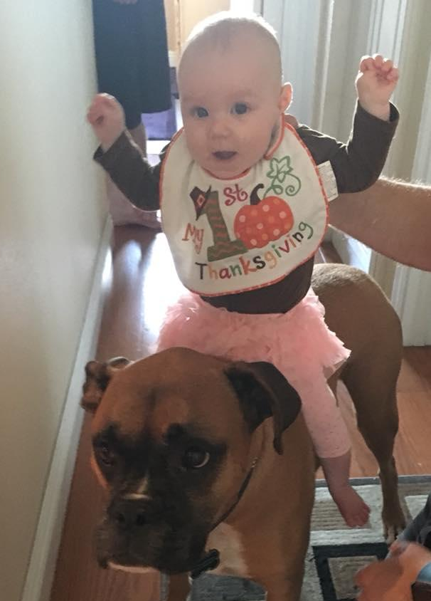
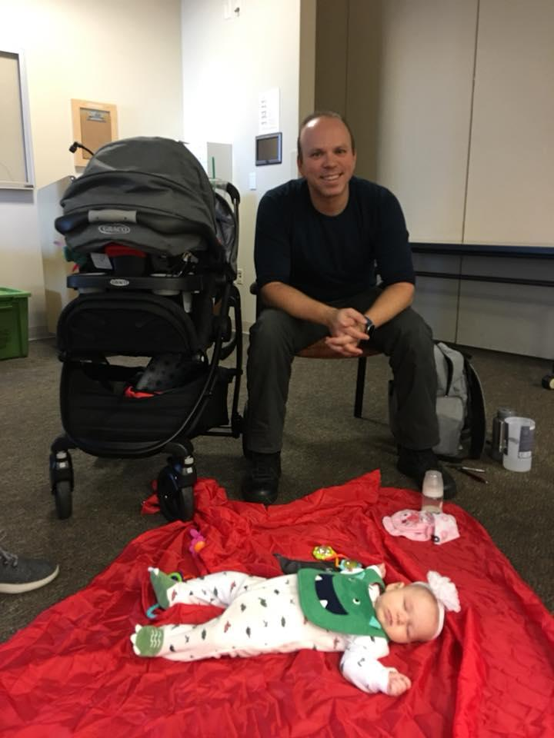

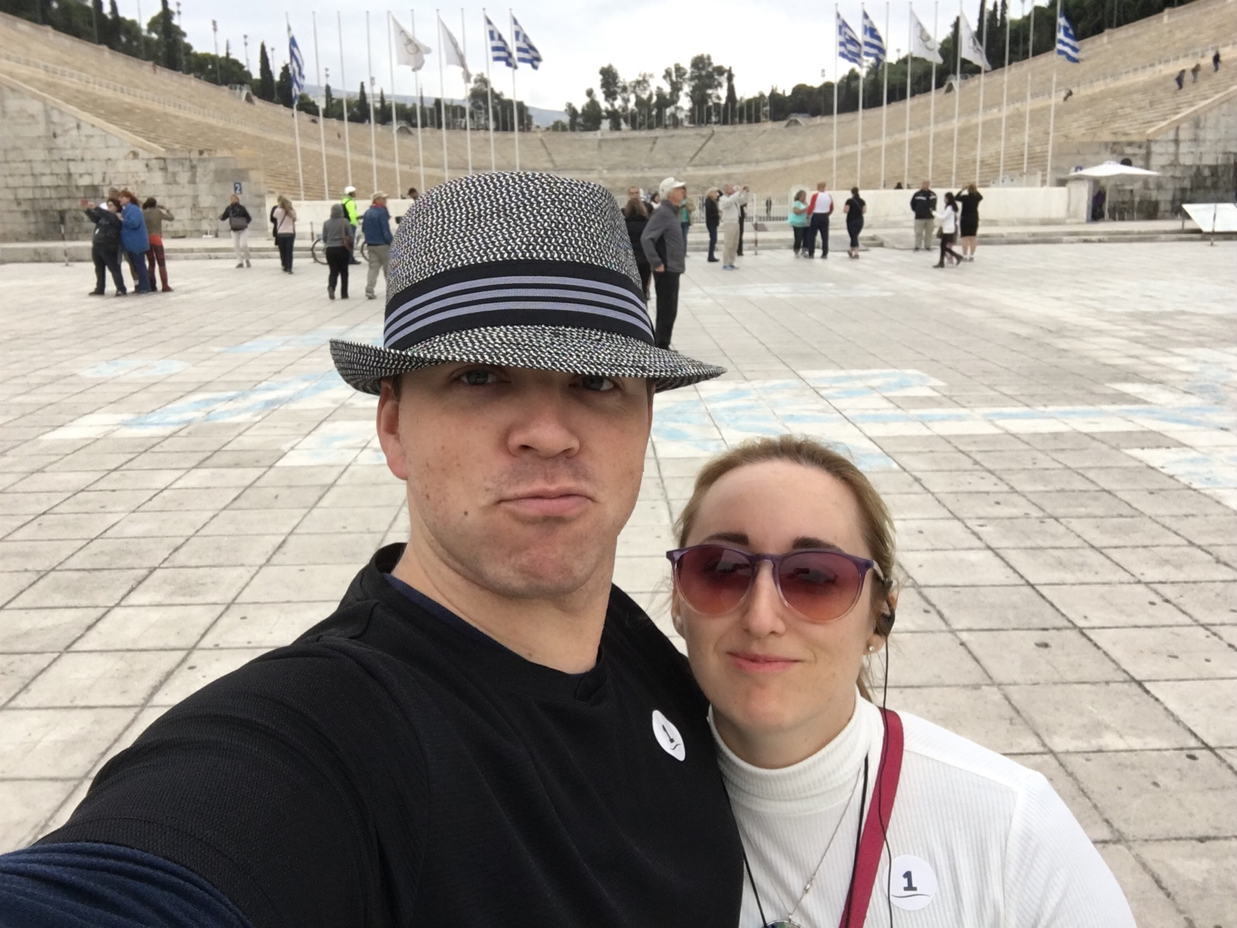
More Than Just Work...
When I am not working I like to be:
Spending time with my family
Boxing, Hiking, Sports, etc
Traveling (Next up: China)
Leisure Reading & Creative Writing
Volunteering (Church, Daddy Boot Camp, YBA, LinkedinLocal)
Boardgames, Console, and D&D

Slide 24
If I could go back in time and offer my high school self a few pieces of advice what would they be?

Slide 25
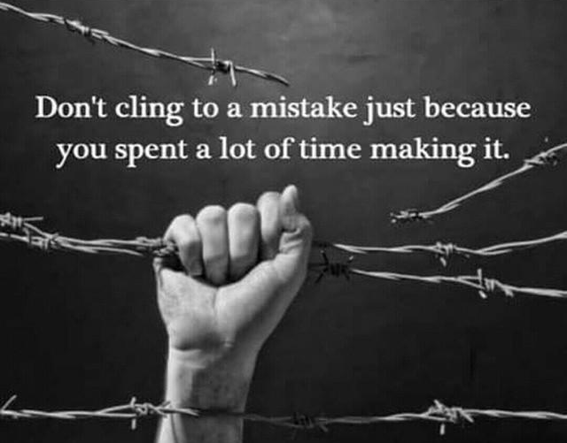

Slide 26


Slide 27
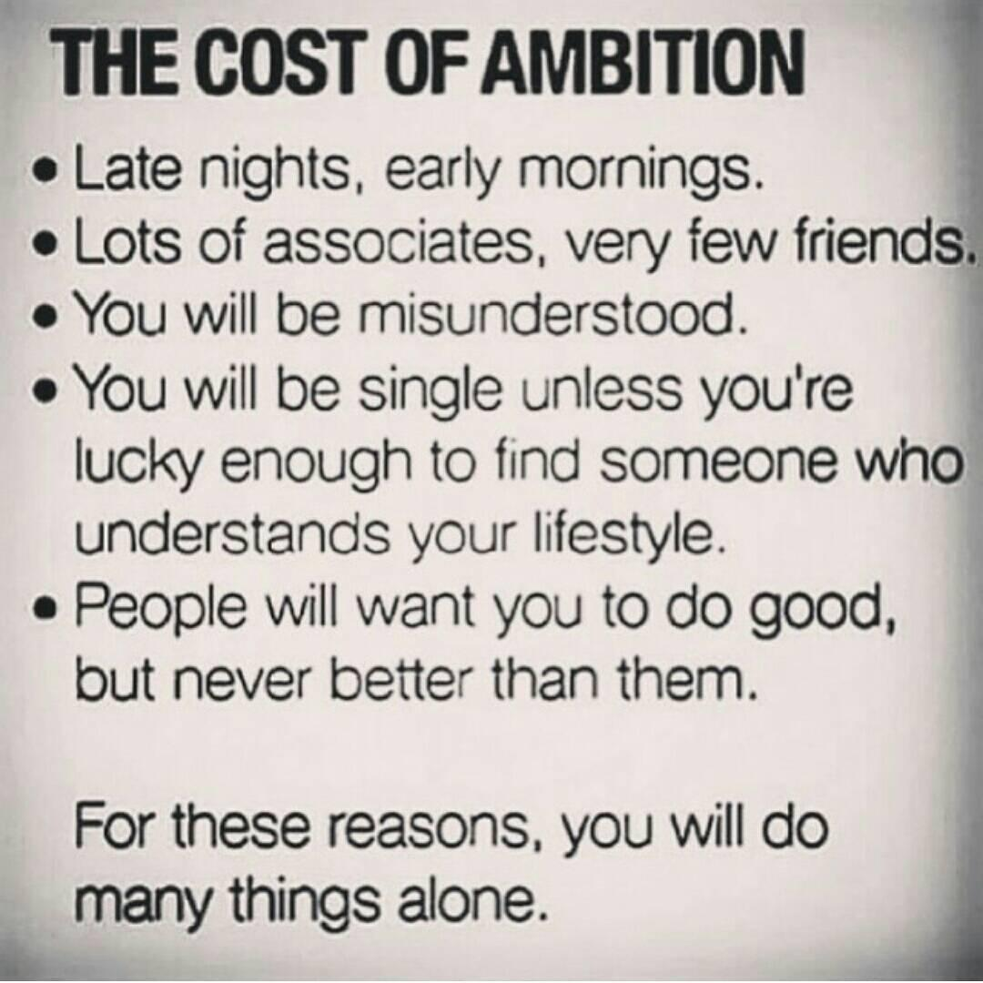

Slide 28
What is the difference between a business and a hobby?

Slide 29
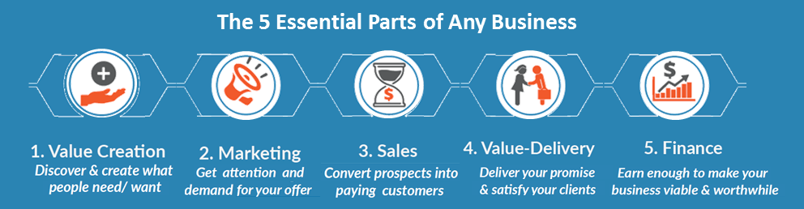
A venture that doesn’t create value is a hobby
A venture that doesn’t attract attention is a flop
A venture that doesn’t sell its value is a non-profit
A venture that doesn’t deliver value is a scam
A venture that doesn’t bring in enough money to keep operating will inevitably close

Slide 30
Questions & Answers

