Slide 1
INTRODUCTION
My name is Jennifer Somer and I am 42 years old.
I work for Junk Food Clothing Company
Junk Food is an apparel company that designs and manufactures clothing under various different brands for retailers ranging from Target to Saks Fifth Avenue.
My role at Junk Food is President.
I had several other jobs in the retail industry prior to Junk Food – I love building brands and developing products.
I started my career after college in the finance industry.

Slide 2
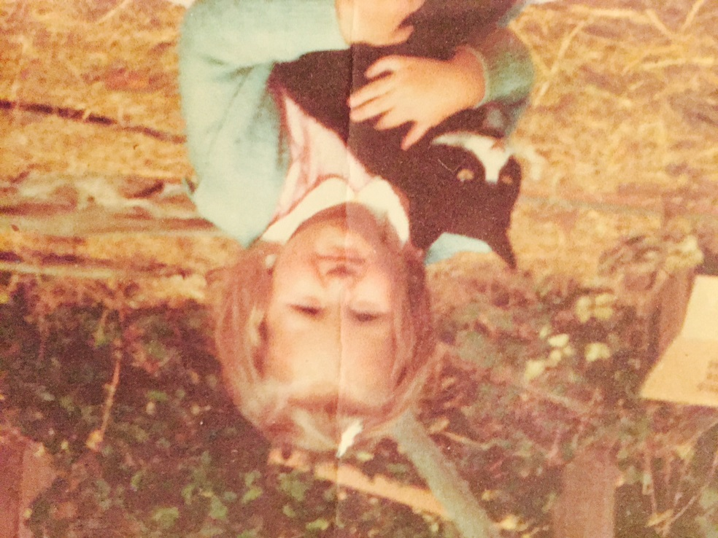
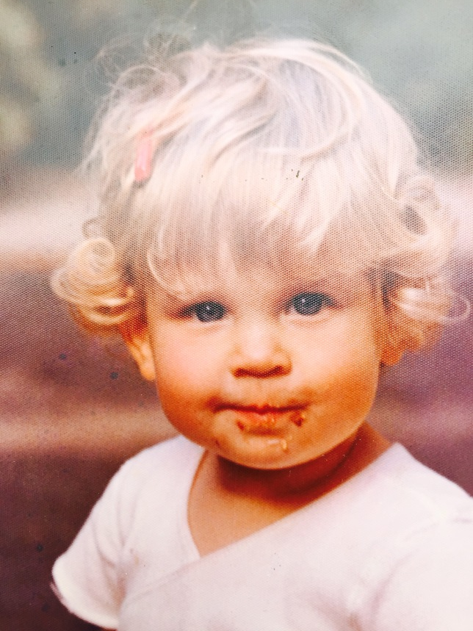
The Early Years…
I was born in Buenos Aires, Argentina and raised in New York, California, Connecticut and Brazil (I moved a lot as a kid!)
This is a picture of me when I was 2 years.
This is a picture of me when I was 4 years old with my cat sweet pea.

Slide 3
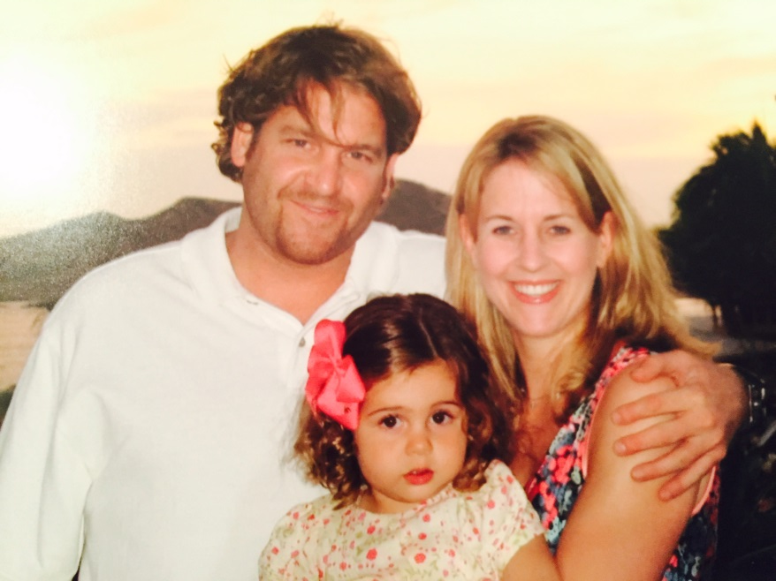
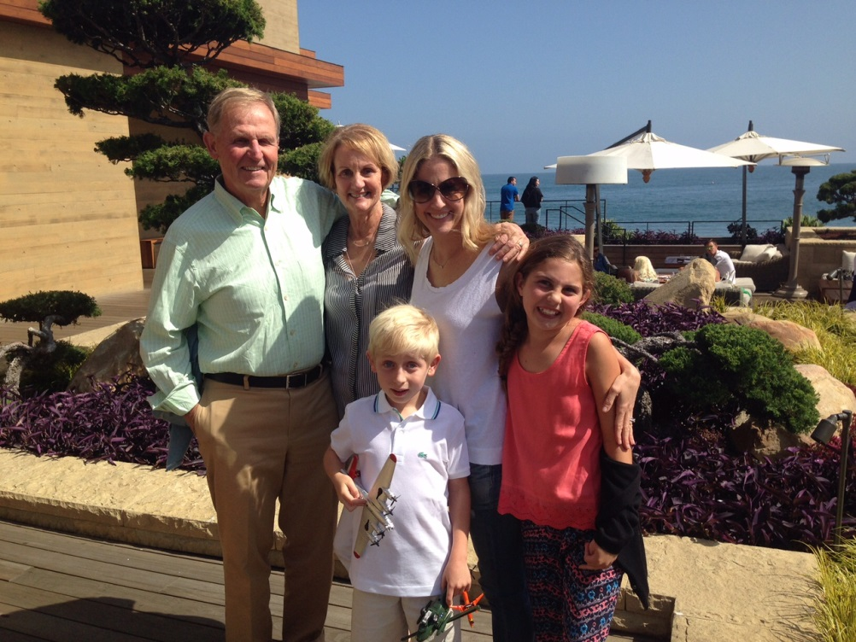
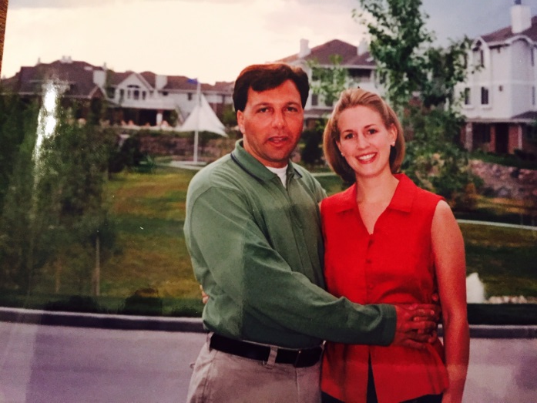
My Family…
My parents and my kids (Alessa and Ethan). I have one brother named Andrew.
My husband Jason and I when we were first married

Slide 4
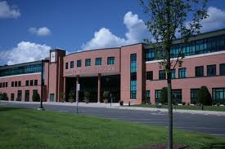

HIGH SCHOOL
I attended Staples HS in Westport, CT
\

Slide 5
HIGH SCHOOL
As a HS student I was involved in track (ran in fall and spring all 4 years), riding, volunteer work.
I moved to Westport from California my freshman year of high school.
This was a tough transition as it was a large school (2,000 kids) and hard to make friends.
I ended up making friends with the “smart kids” – I was very nerdy in high school.
Probably best thing that could have happened to me, pushed me to be a good student and work hard.
\

Slide 6
HIGH SCHOOL
Things I enjoyed in HS
Things I did not enjoy in HS
Academics
  Math and science, english, history
  I loved learning new things
Sports
  Track
  Riding
Music
  Played the violin
Cliques – I was not a “cool kid”. As it turns out, a lot of them are now losers, it all works out……
Senior year english teacher

Slide 7
HIGH SCHOOL
Fondest memories from HS
Obstacles/Adversity you had to overcome in HS
Seeing hard work pay off – both in academics, athletics, and earning money with the different jobs I had (I was always very busy):
  Babysitting
  Camp counselor
  Clerk at local store
Having fun with friends
I had a big mouth and I got in trouble frequently for talking back – expressing yourself and being assertive is a good thing, learning how and when to do it is key.

Slide 8
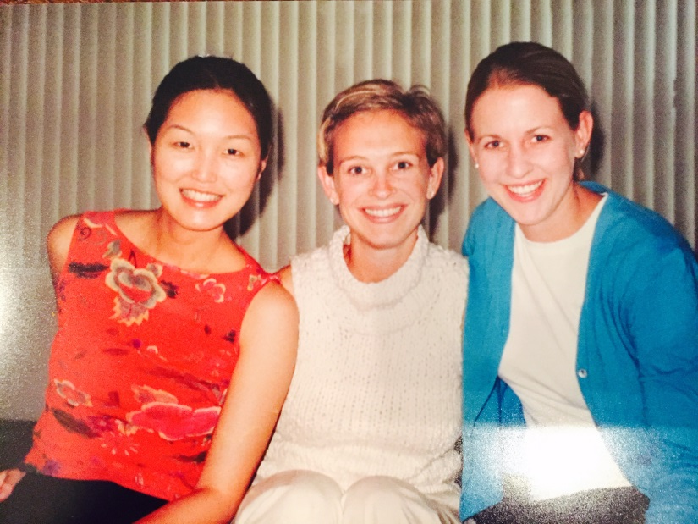
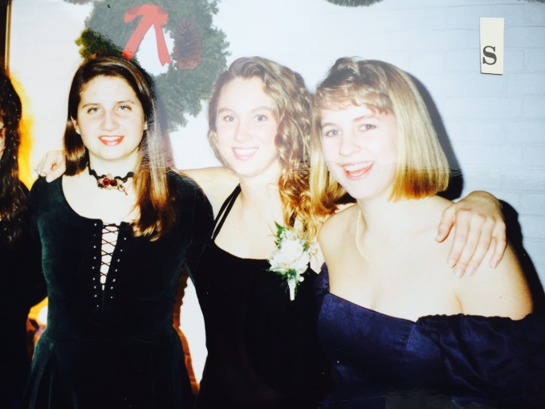
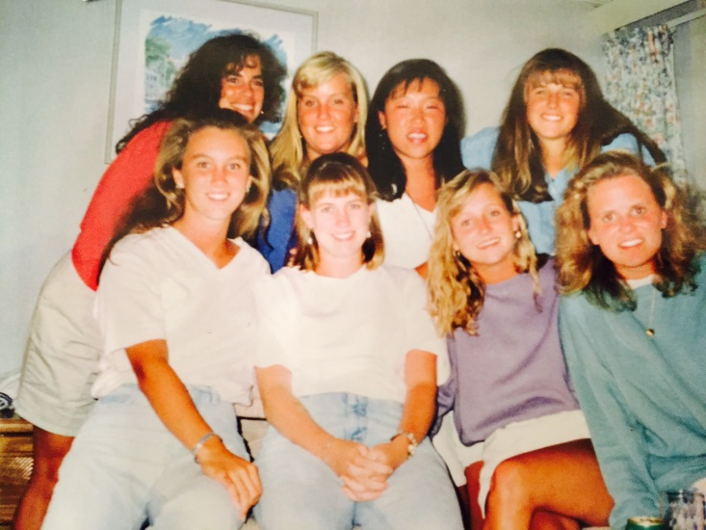
College and
Graduate School
I attended Colby College in Waterville, ME and business school at Columbia University in NY, NY
Business School
College – nice bangs!

Slide 9
Path from College to Graduate School
First job out of college was as a paralegal – learned I did not want to be a lawyer.
Second job was with Fidelity Investments in the retirement account call center (boring, but paid the bills).
Moved to NYC and found a job as a associate with a large financial services company
  Stayed 4 years – excellent experience learning about companies, and understanding financial statements, but I was not passionate about my job……
Decided to go to graduate school to transition into a job with more creative elements.

Slide 10
Career Path
Entry level positions in legal and finance fields
Started own apparel company after business school. Went on to hold various roles at different home and apparel retailers
I was hired at Junk Food Clothing after the founders left. I am now the President.
Notes:
You may use this chart to describe your journey to the current career

Slide 11
Career
Some challenges I had to overcome in my career
It was a journey to find out what I was truly passionate about. Sometimes finding out what you DON’T want to do is as valuable as what you DO want to do.
I have worked hard, and have moved several times for job opportunities.

Slide 12
CURRENT ROLE
History
Junk Food Clothing was founded in Los Angeles in 1998
Size
$80 million in annual sales
We design and manufacture over 10 million garments every year
Location
Headquarter offices in Culver City, CA and showrooms in downtown LA and New York City
Retail store on Abbot Kinney in Venice, CA
Products
Customers
Original “vintage graphic” tee and fleece company – it all started with a Twister tee
Tees, Fleece, Knit bottoms, loungewear, accessories, footwear
Junk Food brand is sold at retailers such as Bloomingdales, Nordstrom, Saks Fifth Avenue, Boutiques, and Urban Outfitters
We design and manufacture proprietary brands for retailers such as Old Navy, American Eagle, Abercrombie & Fitch, and Target
NFL, NBA, DC Comics (batman, superman), Disney, Star Wars, Rock Bands
Notes:
Use this graph to give more description of your current company (history, size, location, products and services, etc.)

Slide 13
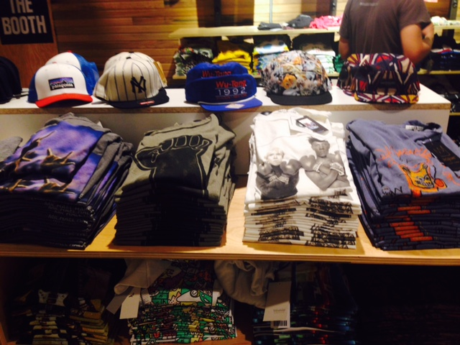
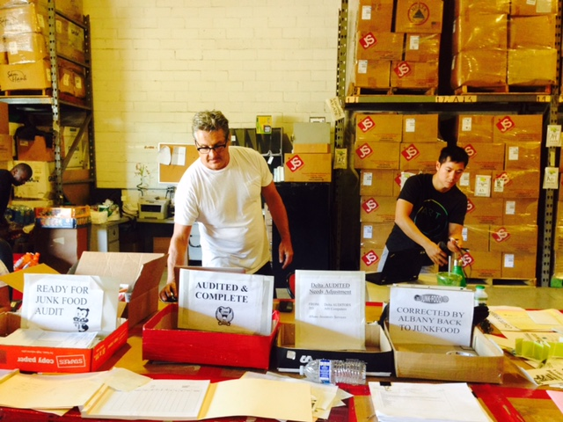
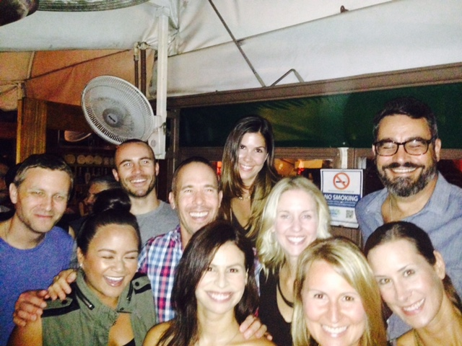
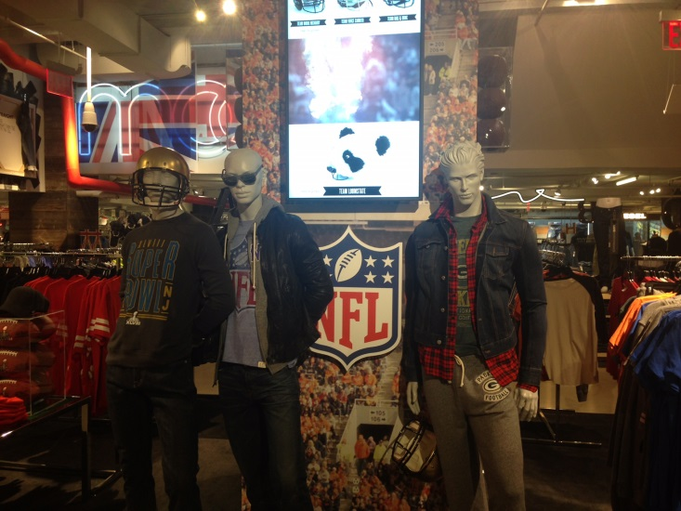
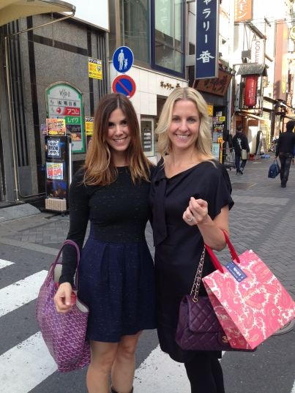
Junk Food
Physical Inventory
Urban Outfitters
NFL Product at Bloomingdales
Junk Food Team
Japan

Slide 14
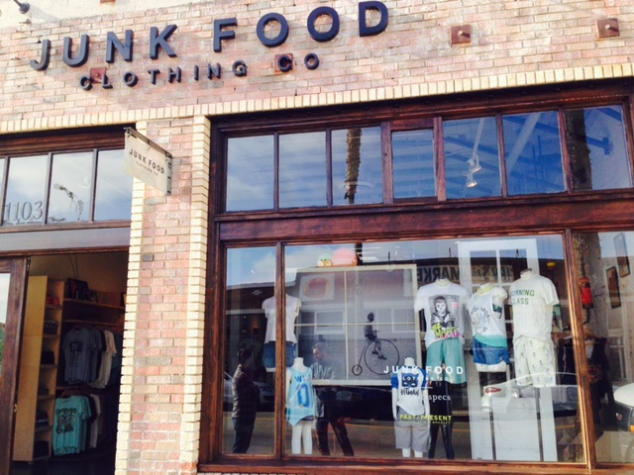
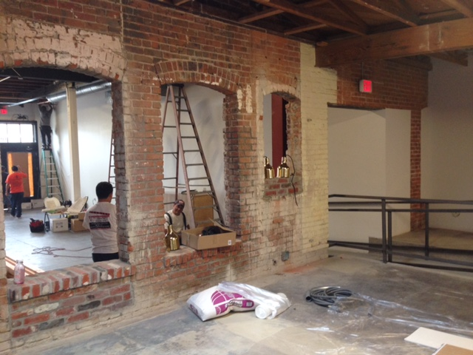
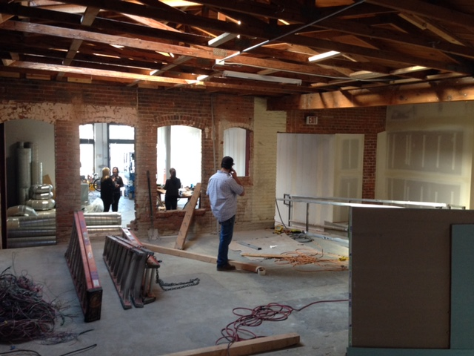
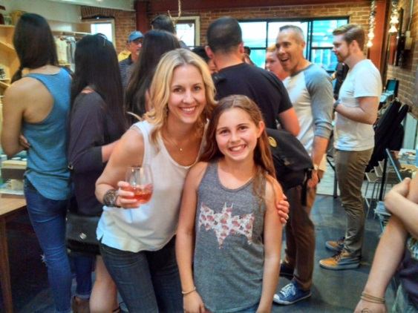
Junk Food
Store Construction
Opening…………..
6 months later

Slide 15

QUESTION AND ANSWER

