Slide 1
XPRIZE

Slide 2
Our prize competitions drive innovations that make the world a better place.

Slide 3
WHAT WE’VE
BEEN DOING

Slide 4
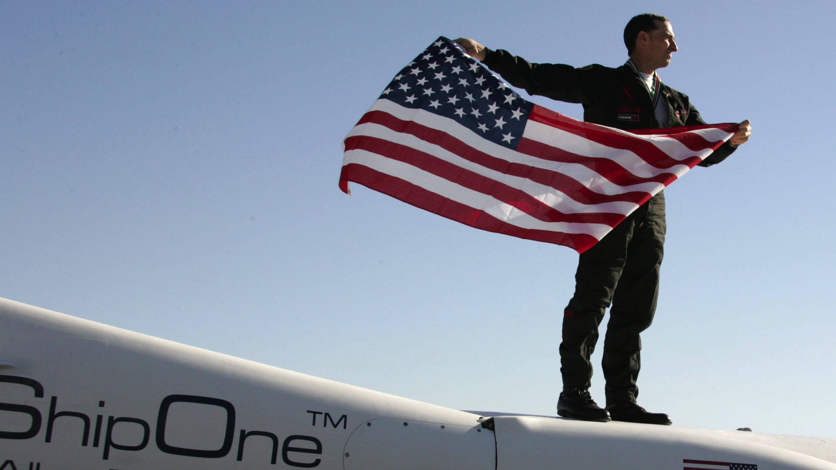
GRAND CHALLENGE
Spaceflight was expensive, exclusive and out of reach of private citizens.
RESULTS
A 3 billion dollar private sector space industry, creating new opportunities for aerospace and aeronautics professionals.

Slide 5
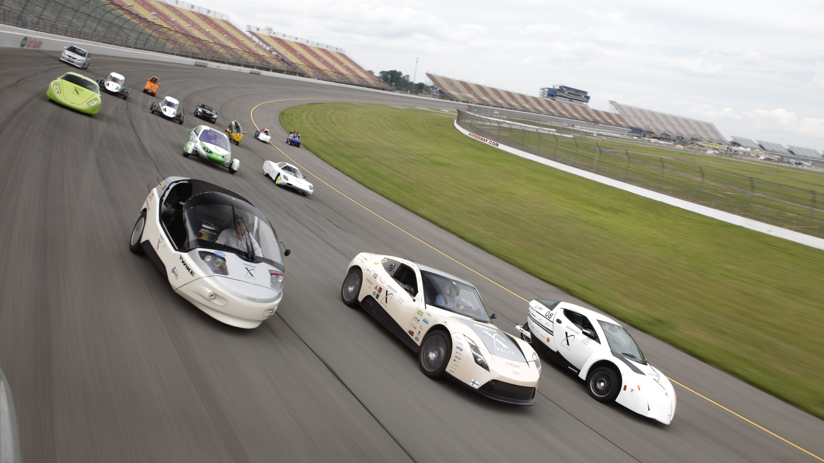
GRAND CHALLENGE
Create an energy efficient vehicle capable of 100 MPGe.
RESULTS
An energy efficient vehicle capable of 135 MPGe and a new energy standard.
Notes:
DASH PLUS – DOE & DEPT. OF ED.

Slide 6

GRAND CHALLENGE
Oil recovery technology hadn’t improved in 40 years and the Gulf BP crisis loomed large.
RESULTS
Oil recovery technology that quadruped the industry standard.

Slide 7
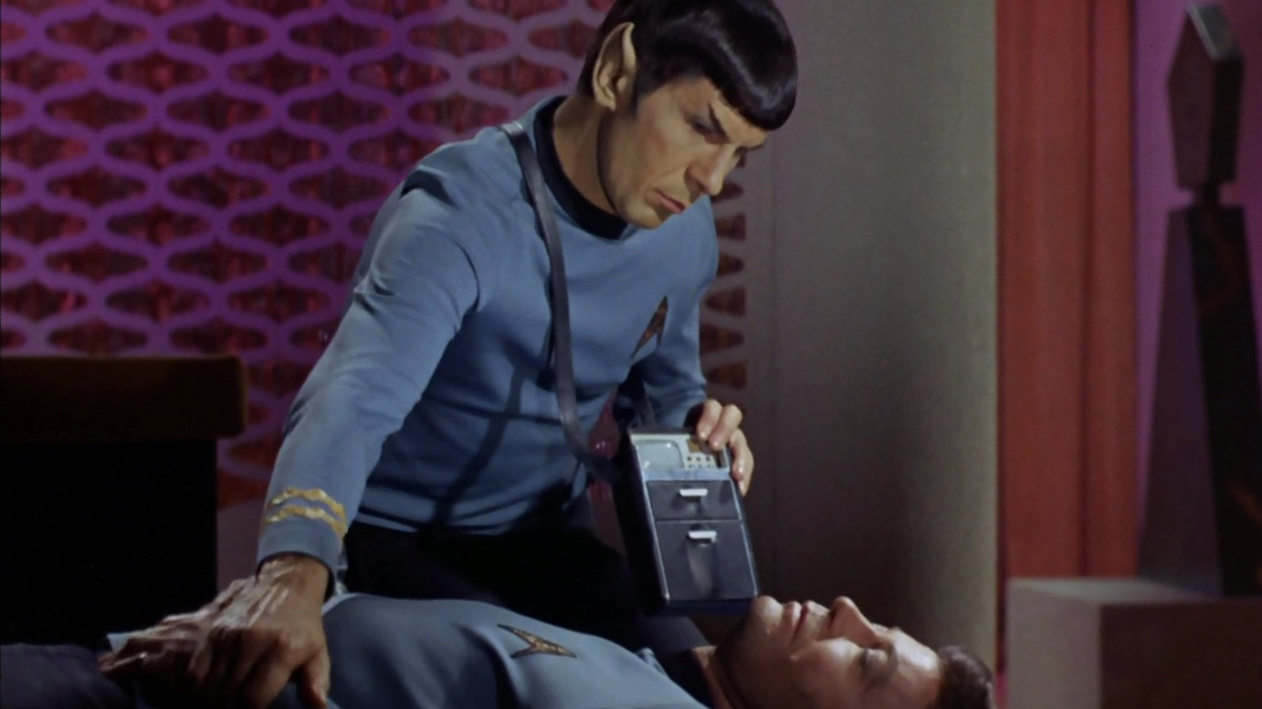

GRAND CHALLENGE
The need for patients to have more control over their healthcare.
COMPETITION
Turning science fiction into science reality by creating a Star Trek-inspired medical device that puts healthcare in the palm of patients’ hands.

Slide 8
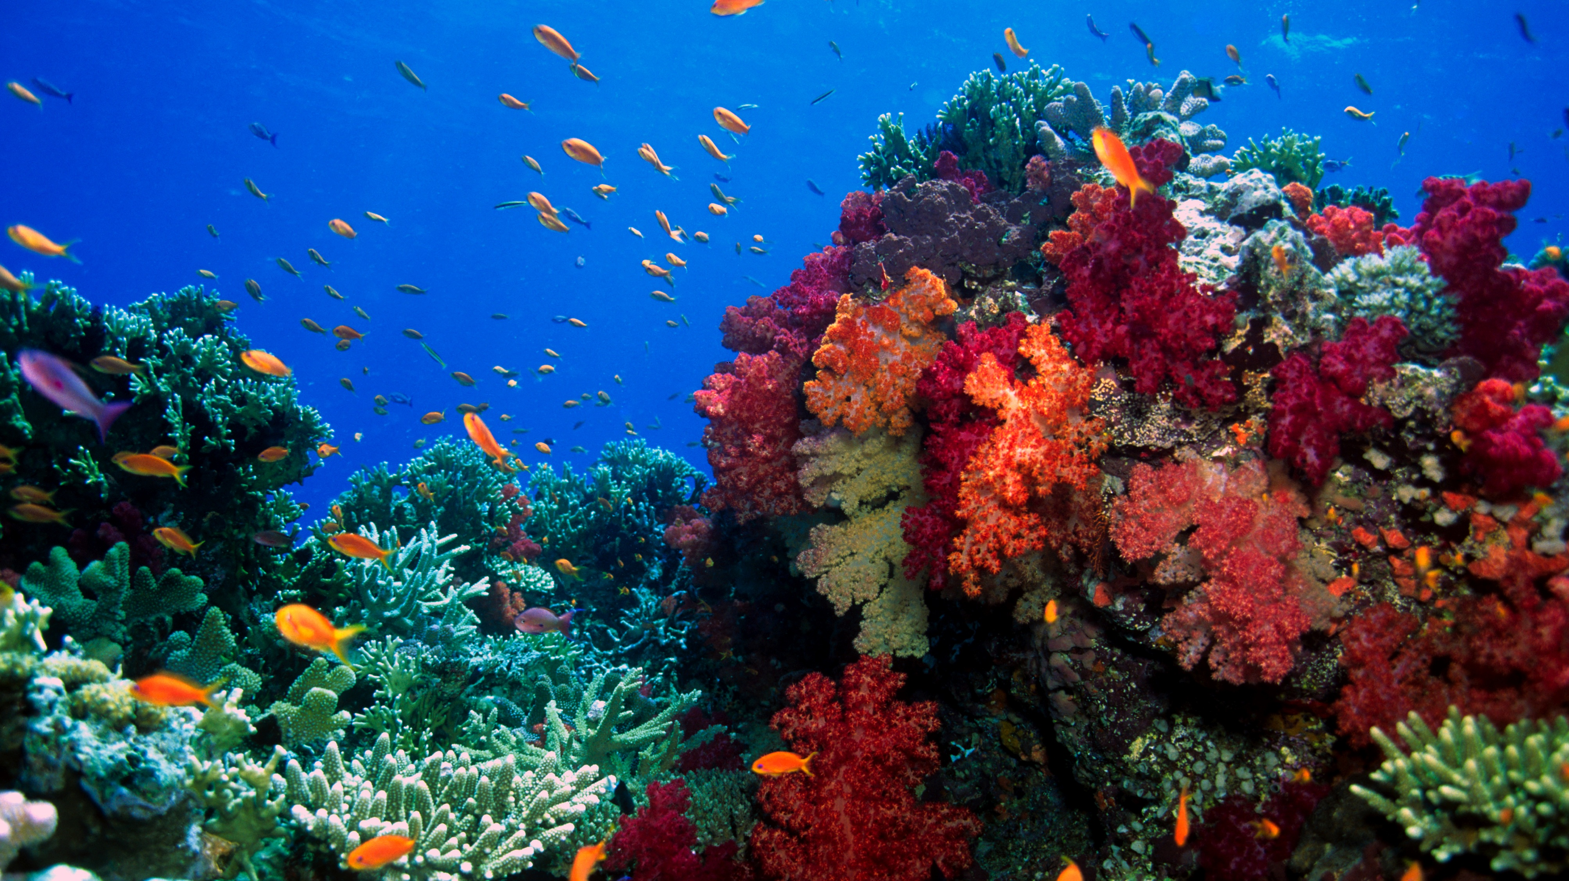

GRAND CHALLENGE
The need for patients to have more control over their healthcare.
COMPETITION
Turning science fiction into science fact by creating a Star Trek-inspired medical device that puts healthcare in the palm of patients’ hands.
GRAND CHALLENGE
Rising levels of man-made atmospheric carbon dioxide are causing the ocean to become more acidic. The potential biological, ecological, biogeochemical and societal implications are staggering.
COMPETITION
Incentivize the development of accurate, affordable, and robust pH sensors to improve our understanding of ocean acidification.

Slide 9
Who we are.
501(c)(3) Educational non-profit focused on s.t.e.a.m. education

Slide 10
Futurists and thought leaders
Elon Musk
Arianna Huffington
Ray Kurzweil
Larry Page
Jennifer Granholm
Wendy Schmidt
J. Craig Ventor
Will Wright
Lori Garver
Dean Kamen

Slide 11
NASA, SpaceX, Virgin Galactic, UCLA, MIT, CalTech, Scripps Oceanography, GoogleX, 3D Systems, Ubounded Robotics, Ekso Bionics, Intuitive Surgical, Qualcomm, Popular Mechanics, TED, etc.
s.t.e.a.m. network

Slide 12
First lego league
6K distribution, 20K teams across 70 countries maker-faire
165K attendees, 300K readership MAKE magazine boys & girls club of america
4M+ members science beyond boundaries
81M+ annual visitors science center network
244 centers around the world
Reaching Millions of children
Notes:
California Science Center, Museum of Flight, AZ Science Center, COSI, Museum of Discovery & Science, Pacific Science Center

Slide 13
REACHING XM KIDS EVERY YEAR

Slide 14
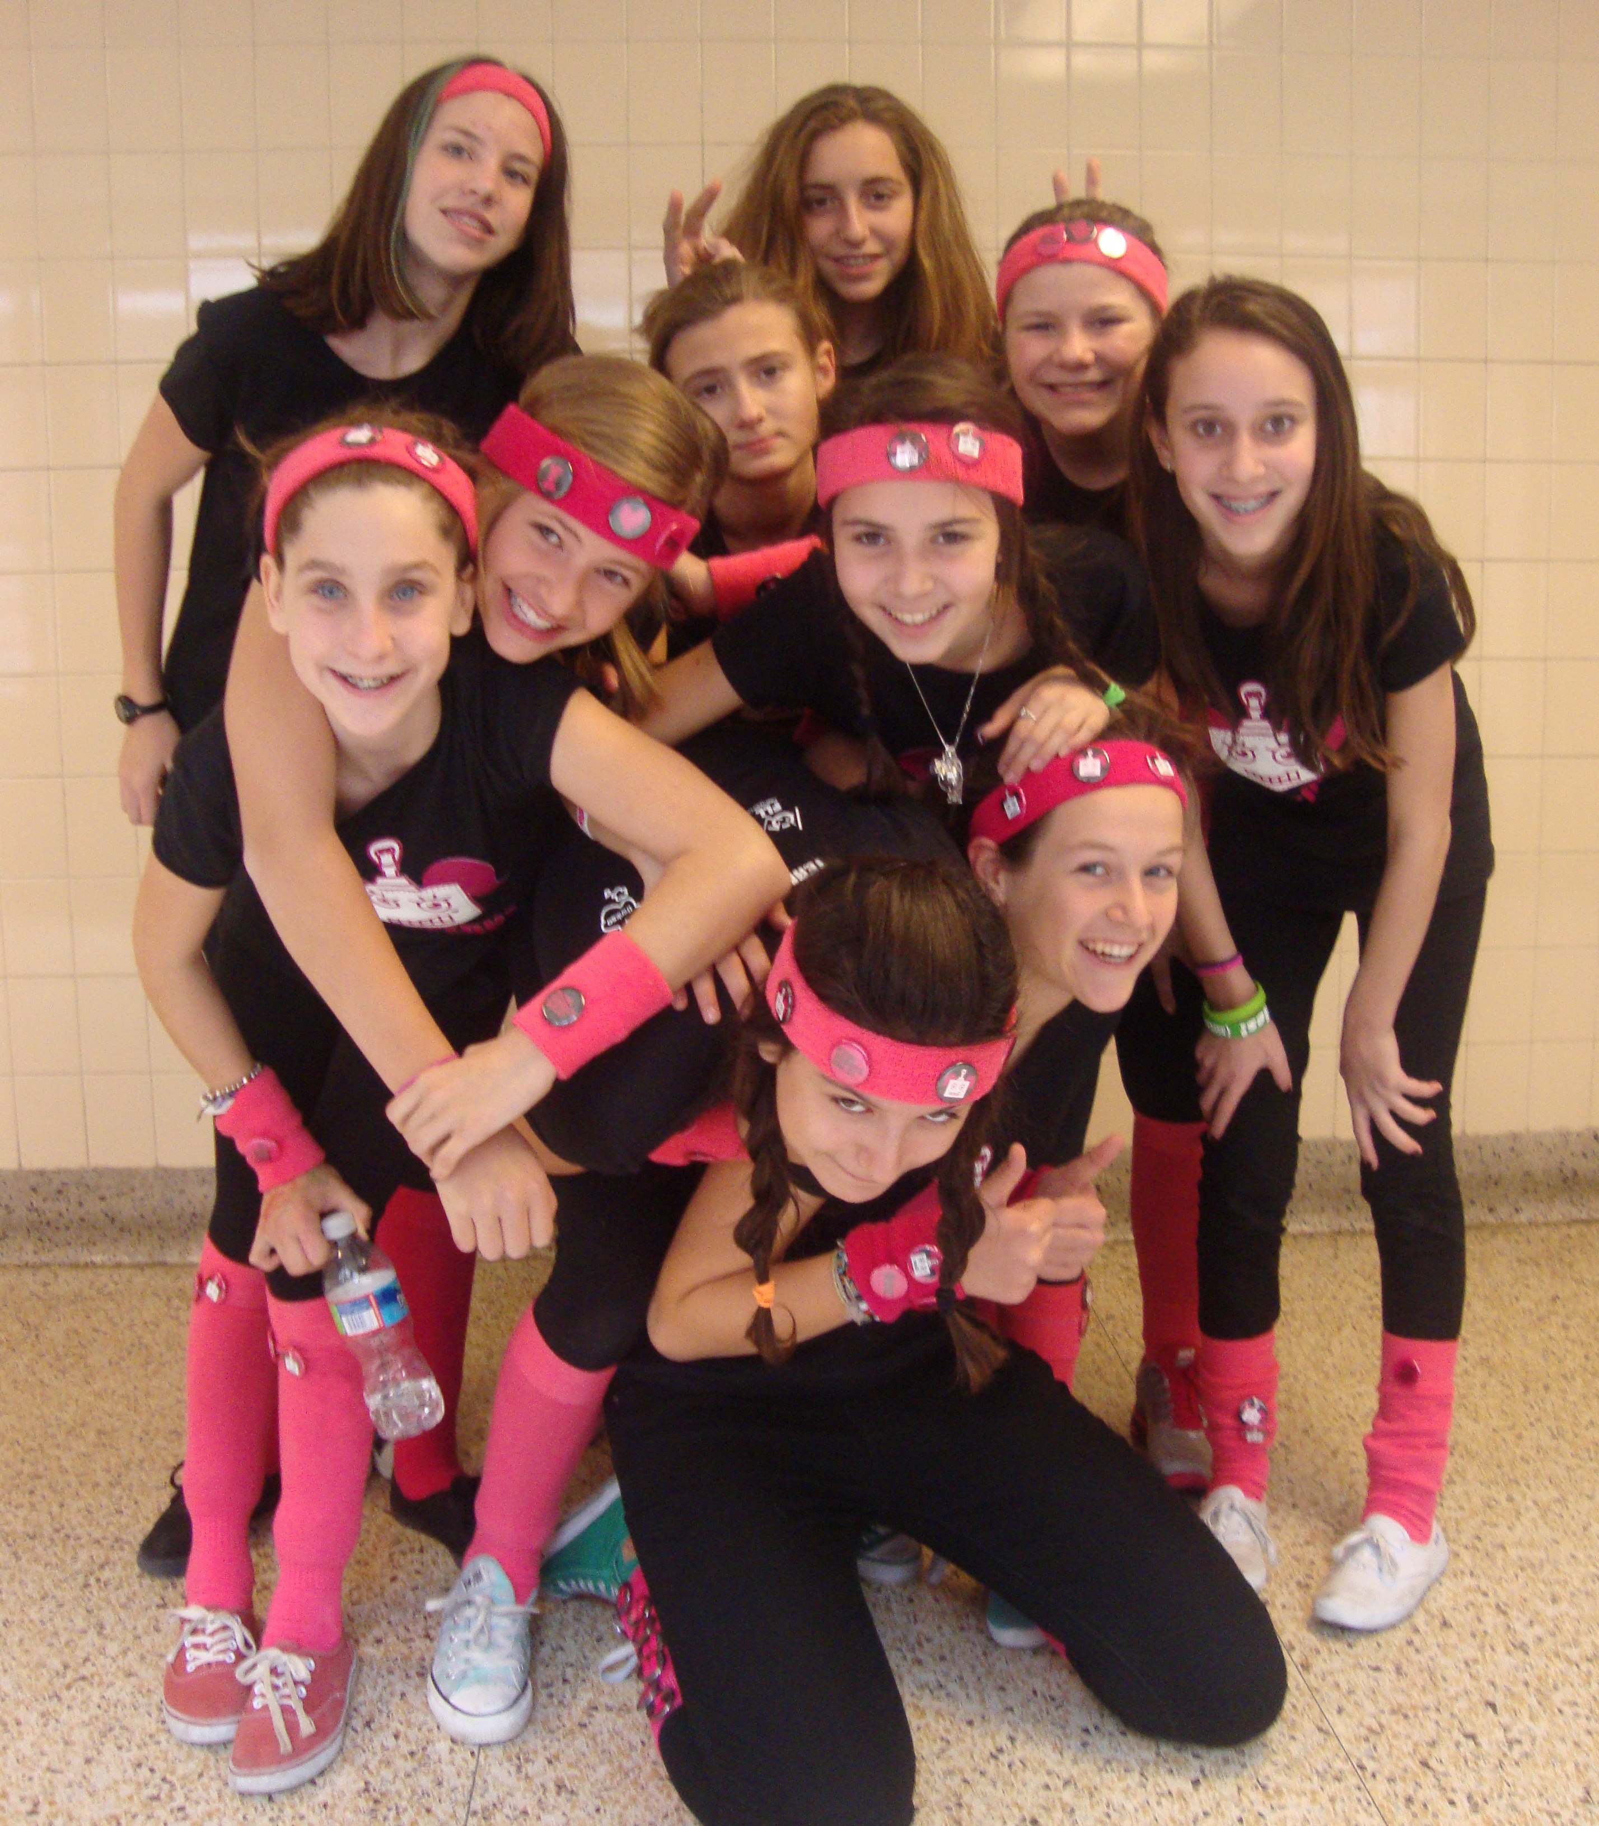
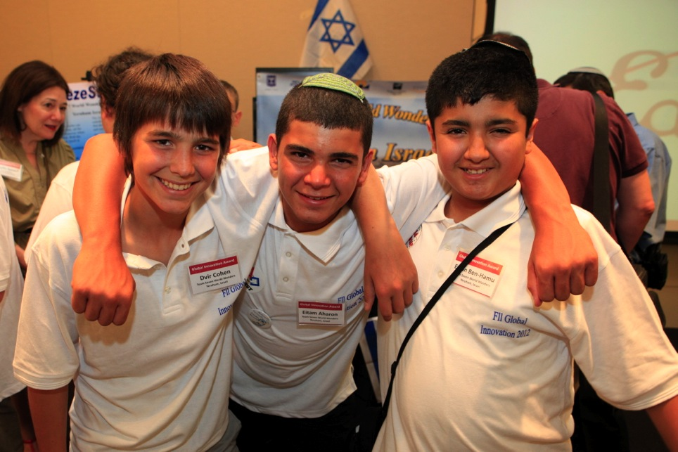
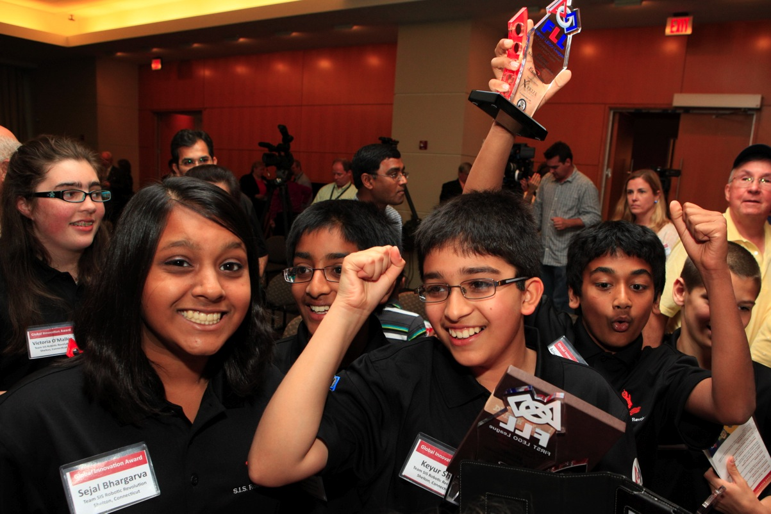
FIRST LEGO LEAGUE
A robotics program for 9 to 16 year olds designed to get children excited about science and technology, and teach them valuable employment and life skills. Every April, the FLL World Festival hosts 85 teams and over 10,000 students in St. Louis, MO.
Over 6K kids compete annually
20K teams across 70 countries

Slide 15
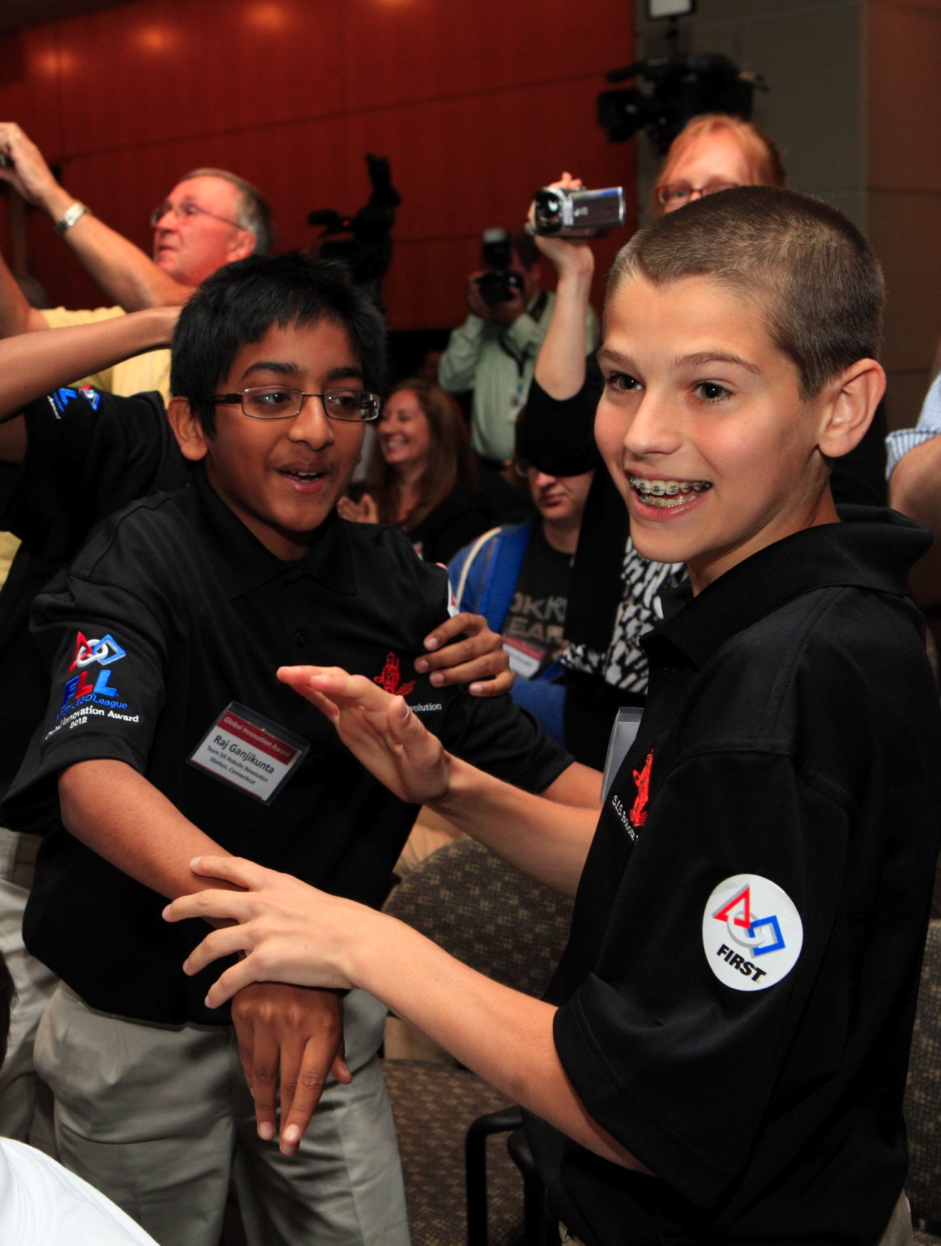
FLL & XPRIZE GLOBAL INNOVATION AWARD
Recognizing young inventors who apply outstanding innovation and creativity in solving a challenge such as prosthetics, senior solutions, food safety and biomedical systems. XPRIZE provides financing to the winning team’s patent, and is proud to be the Presenting Sponsor and Founding Partner.
Over 6K kids compete annually
20K teams across 70 countries

Slide 16
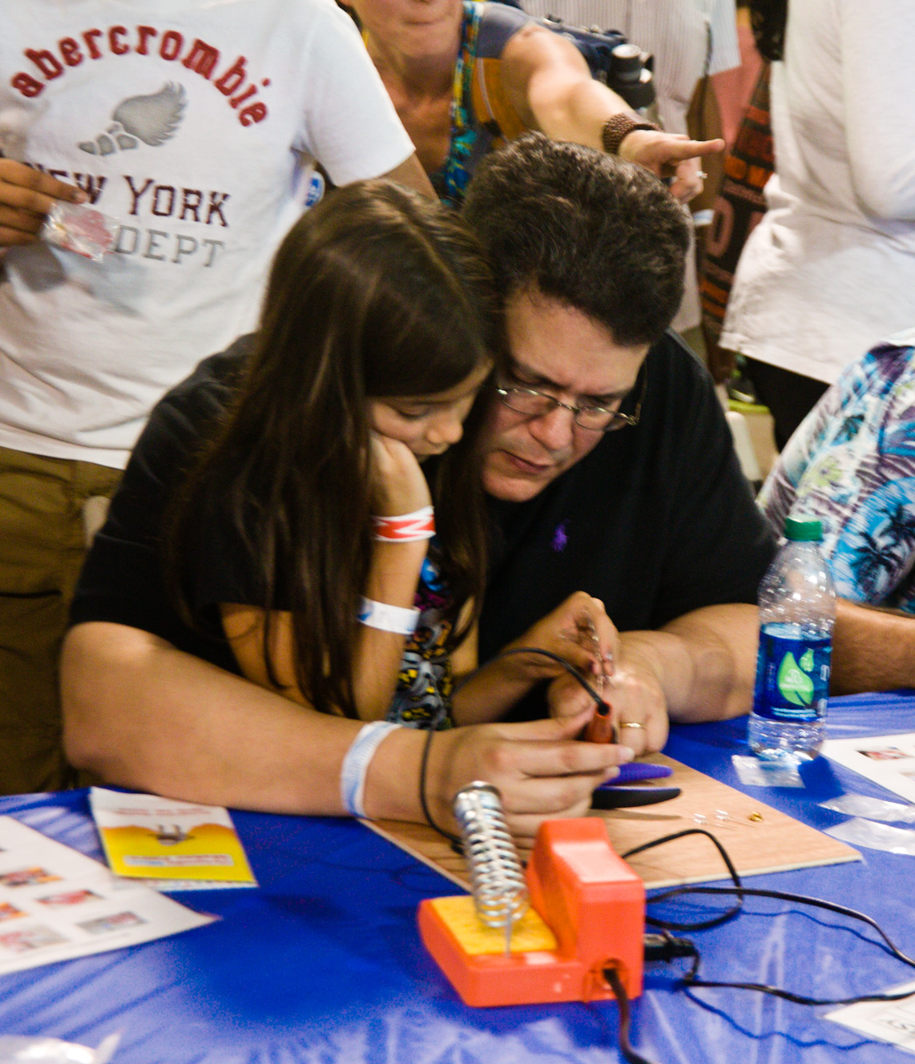
Maker faire
Part science fair, part county fair, and part DIY audience, XPRIZE participates each year in Maker Faire with family activities such as MoonBots and our Eggs Prize, challenging them to design and build a ‘lunar lander’ capable of safely landing an egg from a drop off a balcony.
165k attendees
300K readership Make Magazine

Slide 17
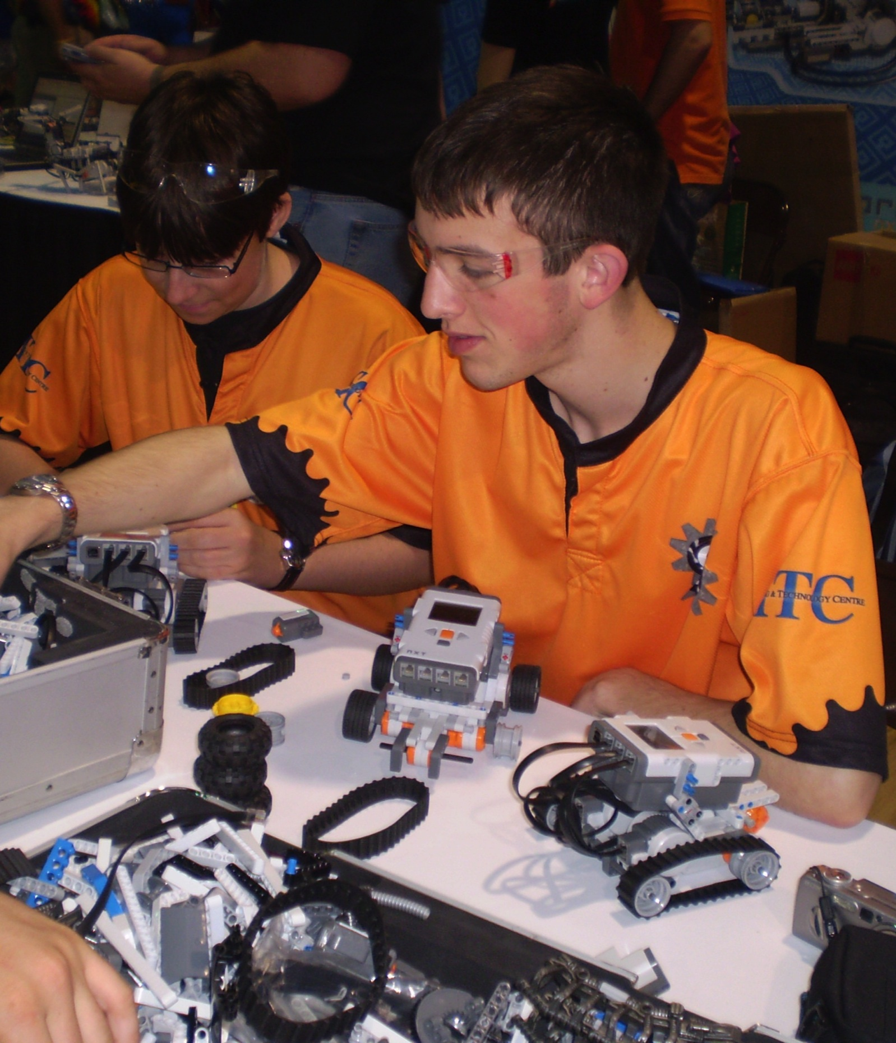
MOONBOTS
An annual competition challenging teams of students ages 9 to 17 to design, program and build robots that simulate lunar missions, similar to those required to win the $30M Google Lunar XPRIZE.
Over 10K kids compete annually
150K teams across 22 countries

Slide 18
Boys club
An annual competition challenging teams of students ages 9 to 17 to design, program and build robots that simulate lunar missions, similar to those required to win the $30M Google Lunar XPRIZE.
Over 10K kids compete annually
150K teams across 22 countries

Slide 19
Girl scouts
An annual competition challenging teams of students ages 9 to 17 to design, program and build robots that simulate lunar missions, similar to those required to win the $30M Google Lunar XPRIZE.
Over 10K kids compete annually
150K teams across 22 countries

Slide 20
Science center network
An annual competition challenging teams of students ages 9 to 17 to design, program and build robots that simulate lunar missions, similar to those required to win the $30M Google Lunar XPRIZE.
Over 10K kids compete annually
150K teams across 22 countries

Slide 21
At xprize, We specialize in two things.

Slide 22
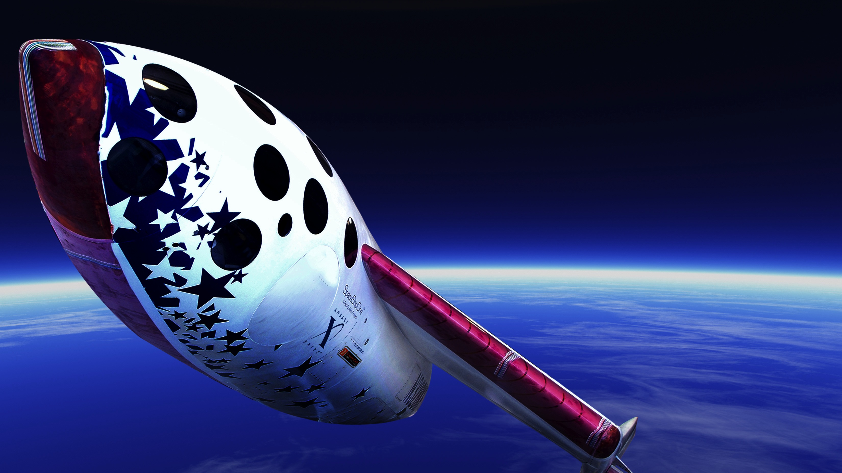
Innovation

Slide 23
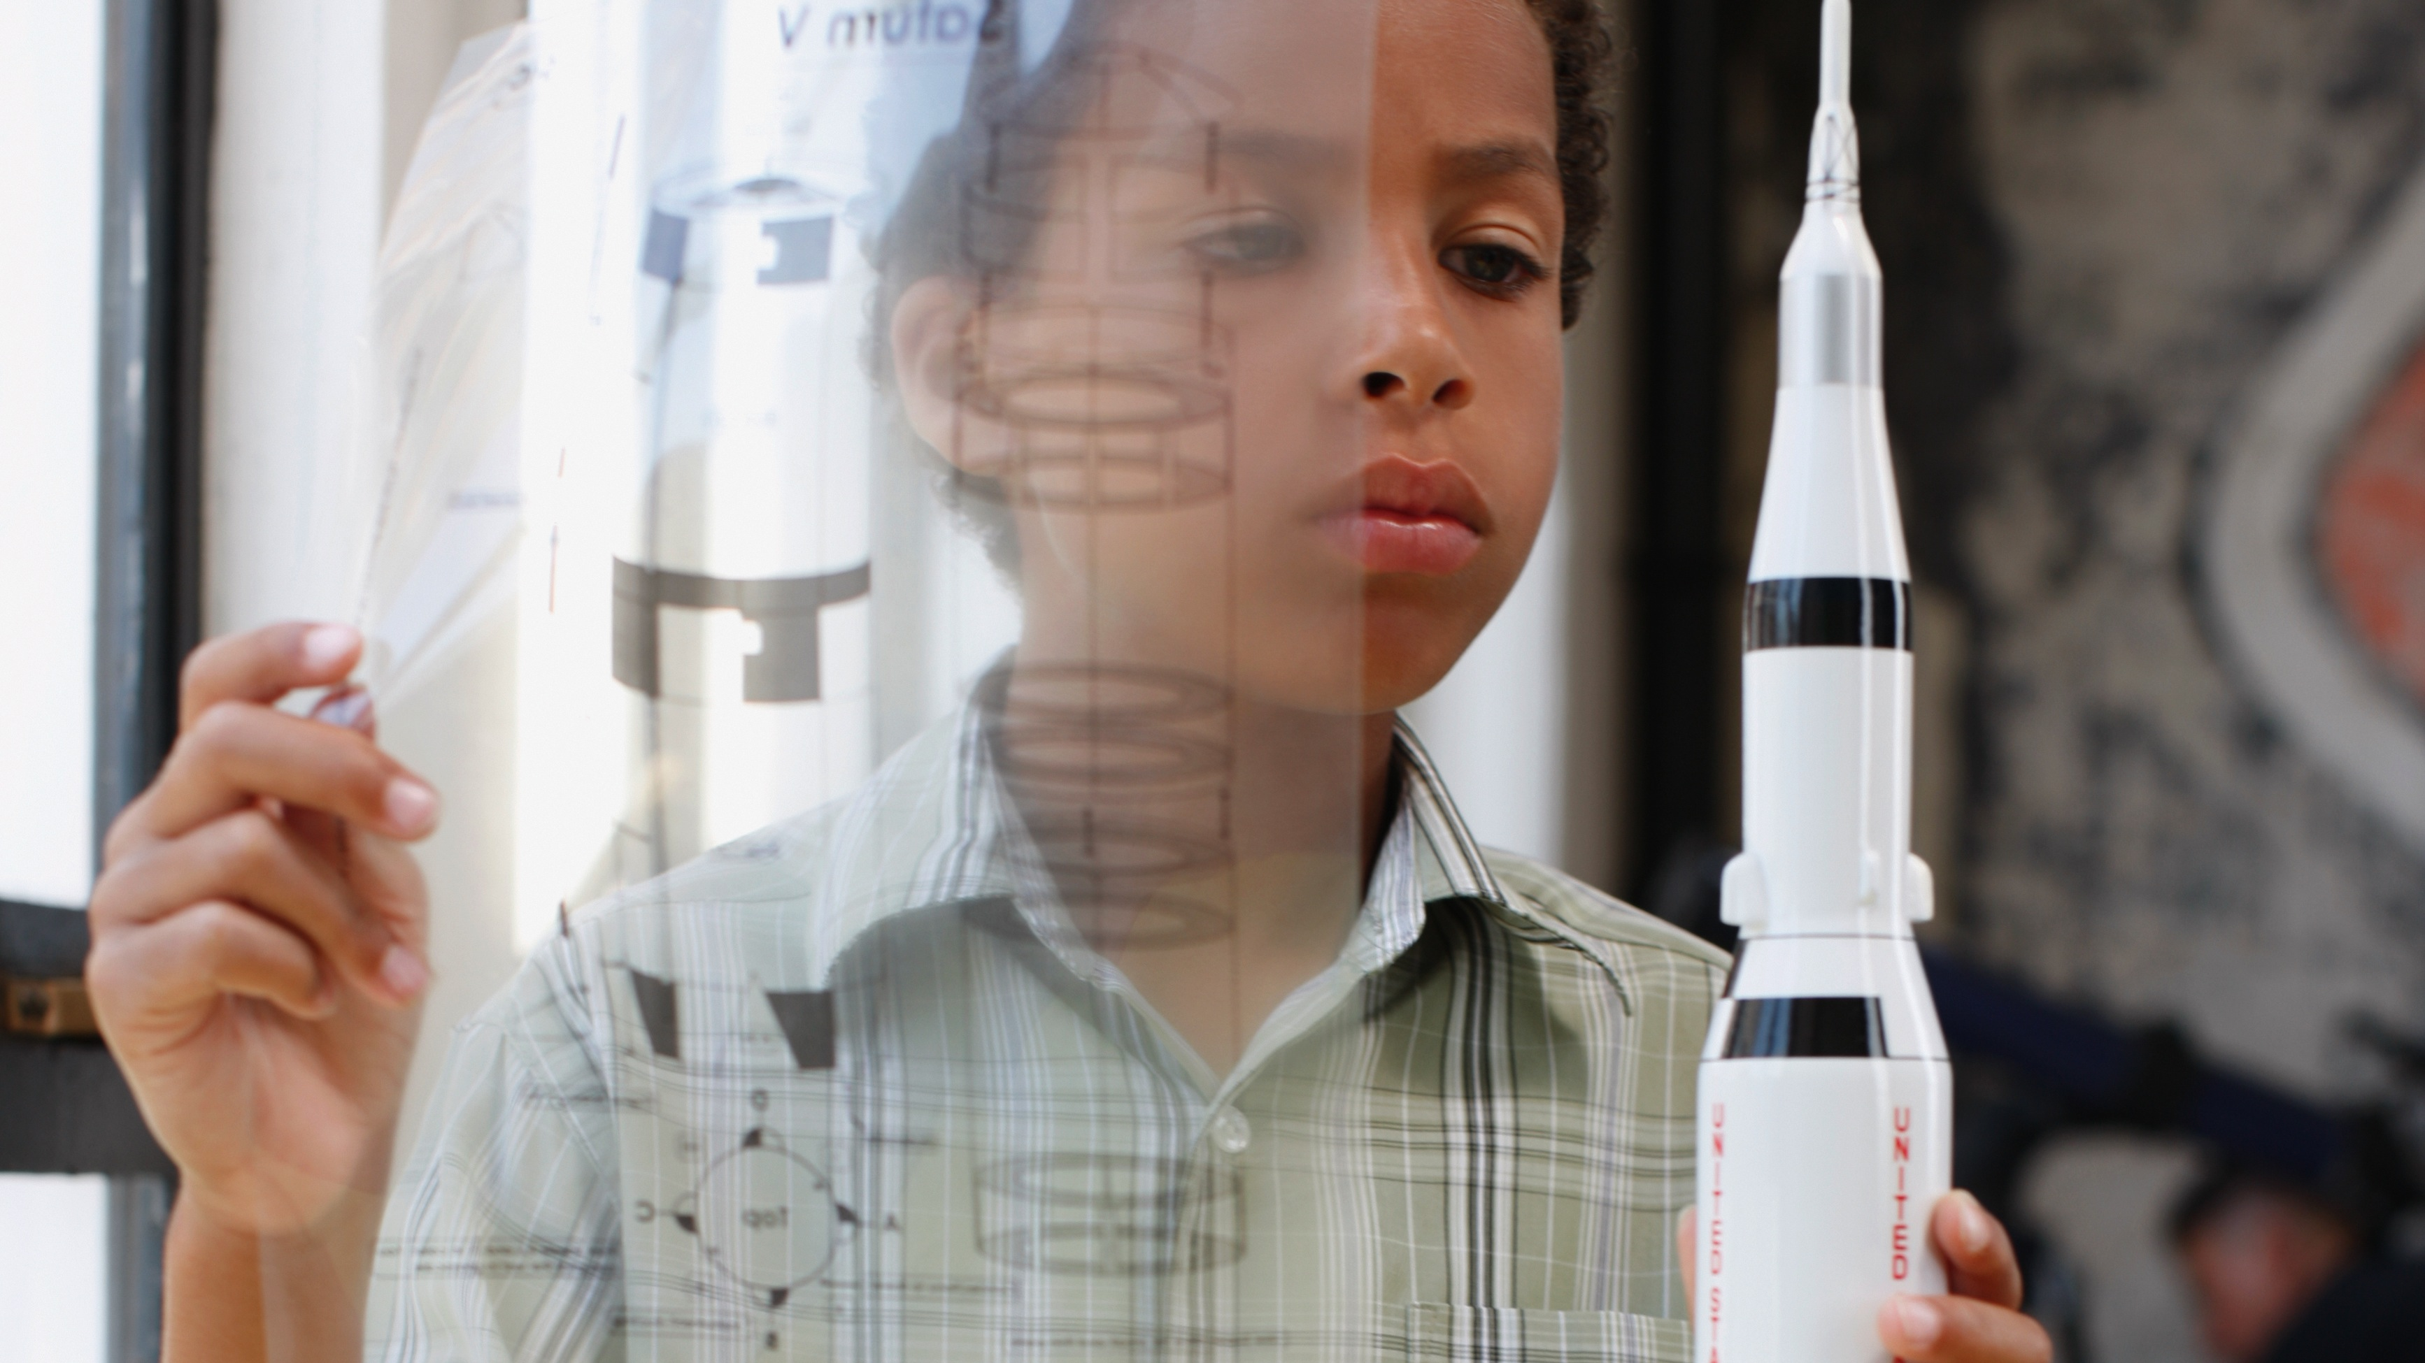
inspiration

Slide 24










xprize S.T.E.A.M. LOOP

