Slide 1
Youth Business Alliance @ Animo Inglewood High School
March 20, 2018

Slide 2
INTRODUCTION
My name is Nicole Webb and I am 33 years old
I work for MatchCraft in Santa Monica, CA
MatchCraft is a digital marketing platform
My role at MatchCraft is the Head of People & Culture

Slide 3
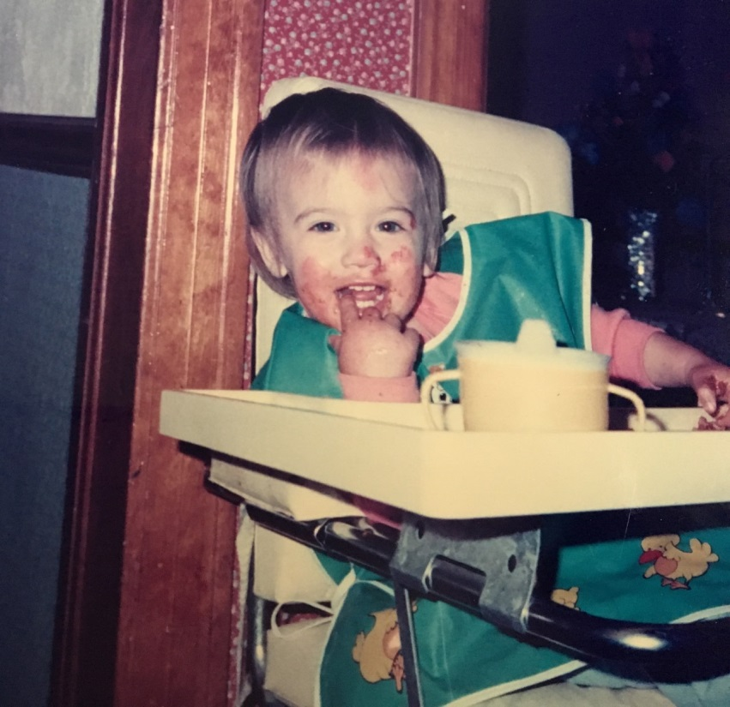
My childhood
I was born in San Jose, CA and raised in Sacramento, CA
“Jump into the middle of things, get your hands dirty, fall flat on your face, and then reach for the stars.” – Ben Stein

Slide 4
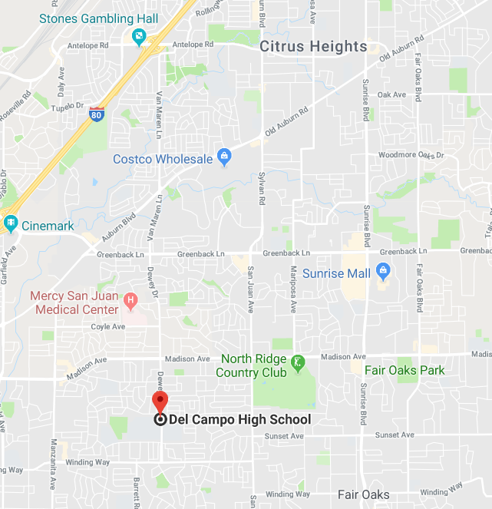
MY HIGH SCHOOL
I attended Del Campo High School in Fair Oaks, CA

Slide 5
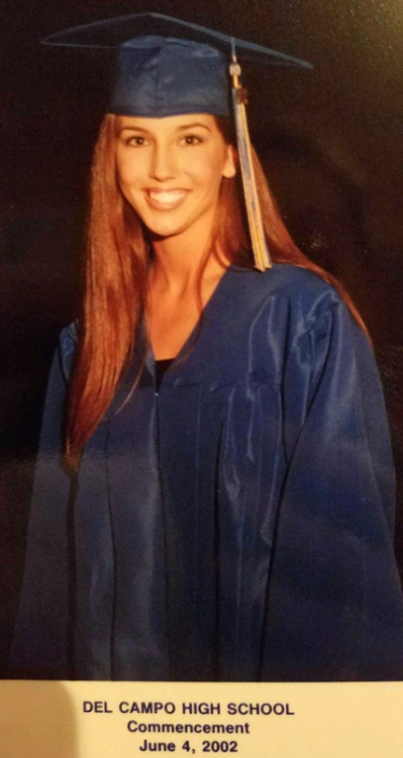
High School
In High School I was:
Outgoing
Moderately Academic
Social
An Observer

Slide 6
High School
:
Things I enjoyed in High School:
Challenges in High School:
Classes:
Sociology and History classes
Art Classes
Activities:
School sporting events
Social events and dances
Dance
Challenging classes:
Algebra
Challenging experiences:
Bullying and Harassment as a Freshman

Slide 7
Getting in to College
A few things I encourage you to do to ensure you get into college:
Make sure you meet with your counselors
Ensure your choosing transferable courses
Take the PSAT and SATs
Research Applicable Grants & Funding
Ask for Help

Slide 8
College
B.A. Psychology
Phi Kappa Phi Honor Society
Master Certificate in Human Resources
School of Industrial & Labor Relations

Slide 9
College
Things I enjoyed in College:
Challenges in College:
Autonomy
Getting to explore education
Being a Professors Assistant
Earning my degree
Favorite Classes:
Multicultural Psychology
Psychopharmacology
History of Rock N Roll
Religion in Film
Working 15-20 hours a week and taking a full-load+
Finding out my last semester of college that I was missing 1 unit
Most Challenging Classes:
Advanced Research Methods
Cognitive Psychology

Slide 10
College
Working while getting my Education:
High School
College
Post-undergraduate

Slide 11
Getting a job after College
The top few things I did to ensure I got a good job after college were:
Graduated College with Honors
Professor Assistant in College
Going Above and Beyond at my Part-time Jobs
Networking
Resume Creation

Slide 12
My Career
The first job I had after college was:
Anthem Venture Partners
Executive Assistant and Office Management
The worst job I have ever had was:
Working in a Tanning Salon

Slide 13
My Career
Challenges I have had to overcome throughout my career are:
Graduating college right before the “Crash of 2008”
Economic downturn
Becoming too invested in someone else’s company

Slide 14
My Career Path
E.A. + Office Manager
Office Manager + Supply Chain & Fulfillment Operations
Community Manager
Head of People + Culture
Director of Operations + Human Resources
Notes:
You may use this chart to describe your journey to the current career

Slide 15
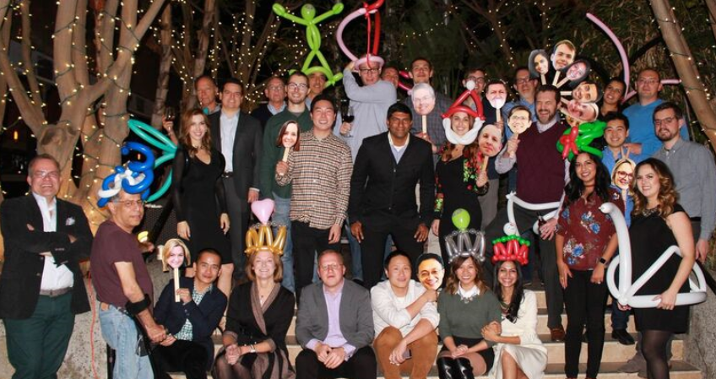
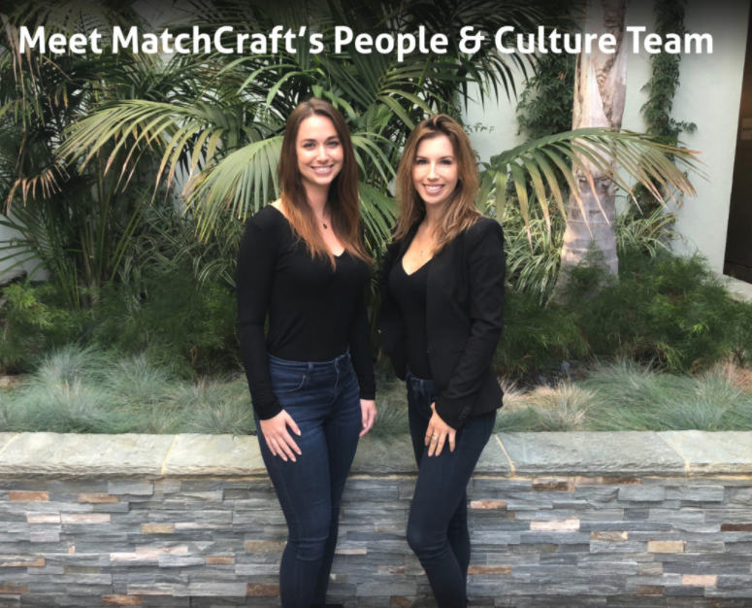
This is My Company
Santa Monica, CA | Leiden, Netherlands | Sao Paulo, Brazil
https://www.instagram.com/matchcraftllc/?hl=en

Slide 16
Organizational Structure
CEO
Head of People + Culture
People + Culture Generalist
Notes:
Use this graph to give more description of your role specifically (responsibilities, typical work week, direct reports, etc.)

Slide 17
Compensation at my company
C-Suite
($200k-400K)
Director +
V.P. Level
($120-$190K)
Middle Manager
($75-$110K)
Entry Level
($50,000)
Notes:
Use this graph to show general compensation ranges for people in various roles in your company

Slide 18
People & Culture Functions
Benefits and Employee Welfare
Performance Review Management
Compensation Analysis and Market trends
Compliance and Employment Law Trends
Employee Relations
Career Pathing
Recruiting and Talent Acquisition

Slide 19
A hands-on lesson
The Importance of an Interview
“Never wear a backward baseball cap to an interview unless applying for the
job of umpire”– Dan Zevin

Slide 20
Hiring manager Pet-Peeves
Tardiness—Don’t be late to an interview
Not knowing what company you’re interviewing for or what service the company provides
When resumes don’t match an application

Slide 21
Favorite Interview Questions
How do you define work-life balance?
What benefits are most valuable to you when considering employment at a company?
Describe an accomplishment you are most proud of and why
Describe some adversity or challenge that you have had to overcome and how you dealt with it?

Slide 22
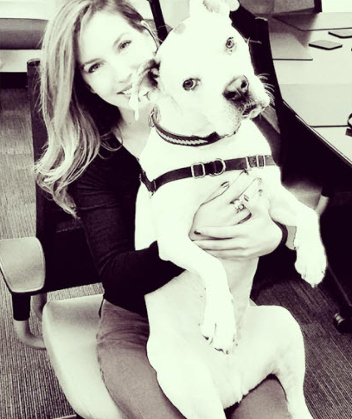
More than just work
Make Art
Dance
Pilates
Travel
Community Outreach and Philanthropy
Spend time with family, friends, & my beloved rescue dog, Oliver!

Slide 23
Do it all over again?
If I could talk to my high school self, what would I say?
Don’t place so much value on what others are doing or saying
Having a social life in high school is great; however, when you’re in college and taking 22 units in one semester, you’ll wish you would have stayed home to focus on studying a little more often

Slide 24
QUESTION AND ANSWER

