Slide 1
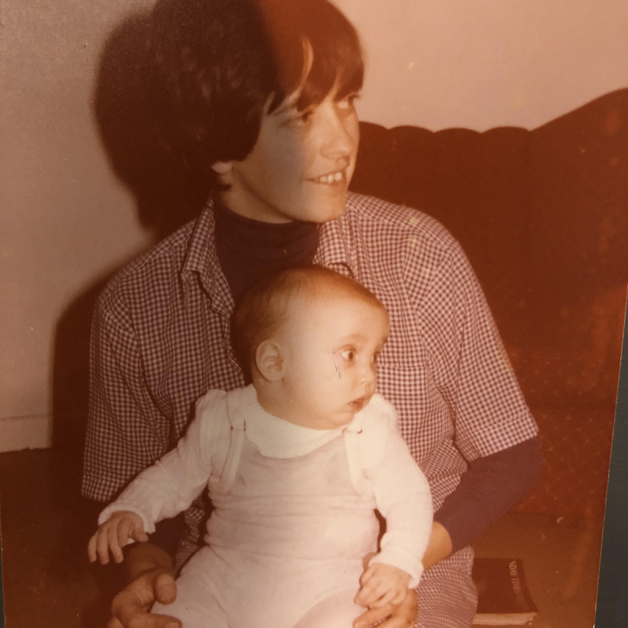
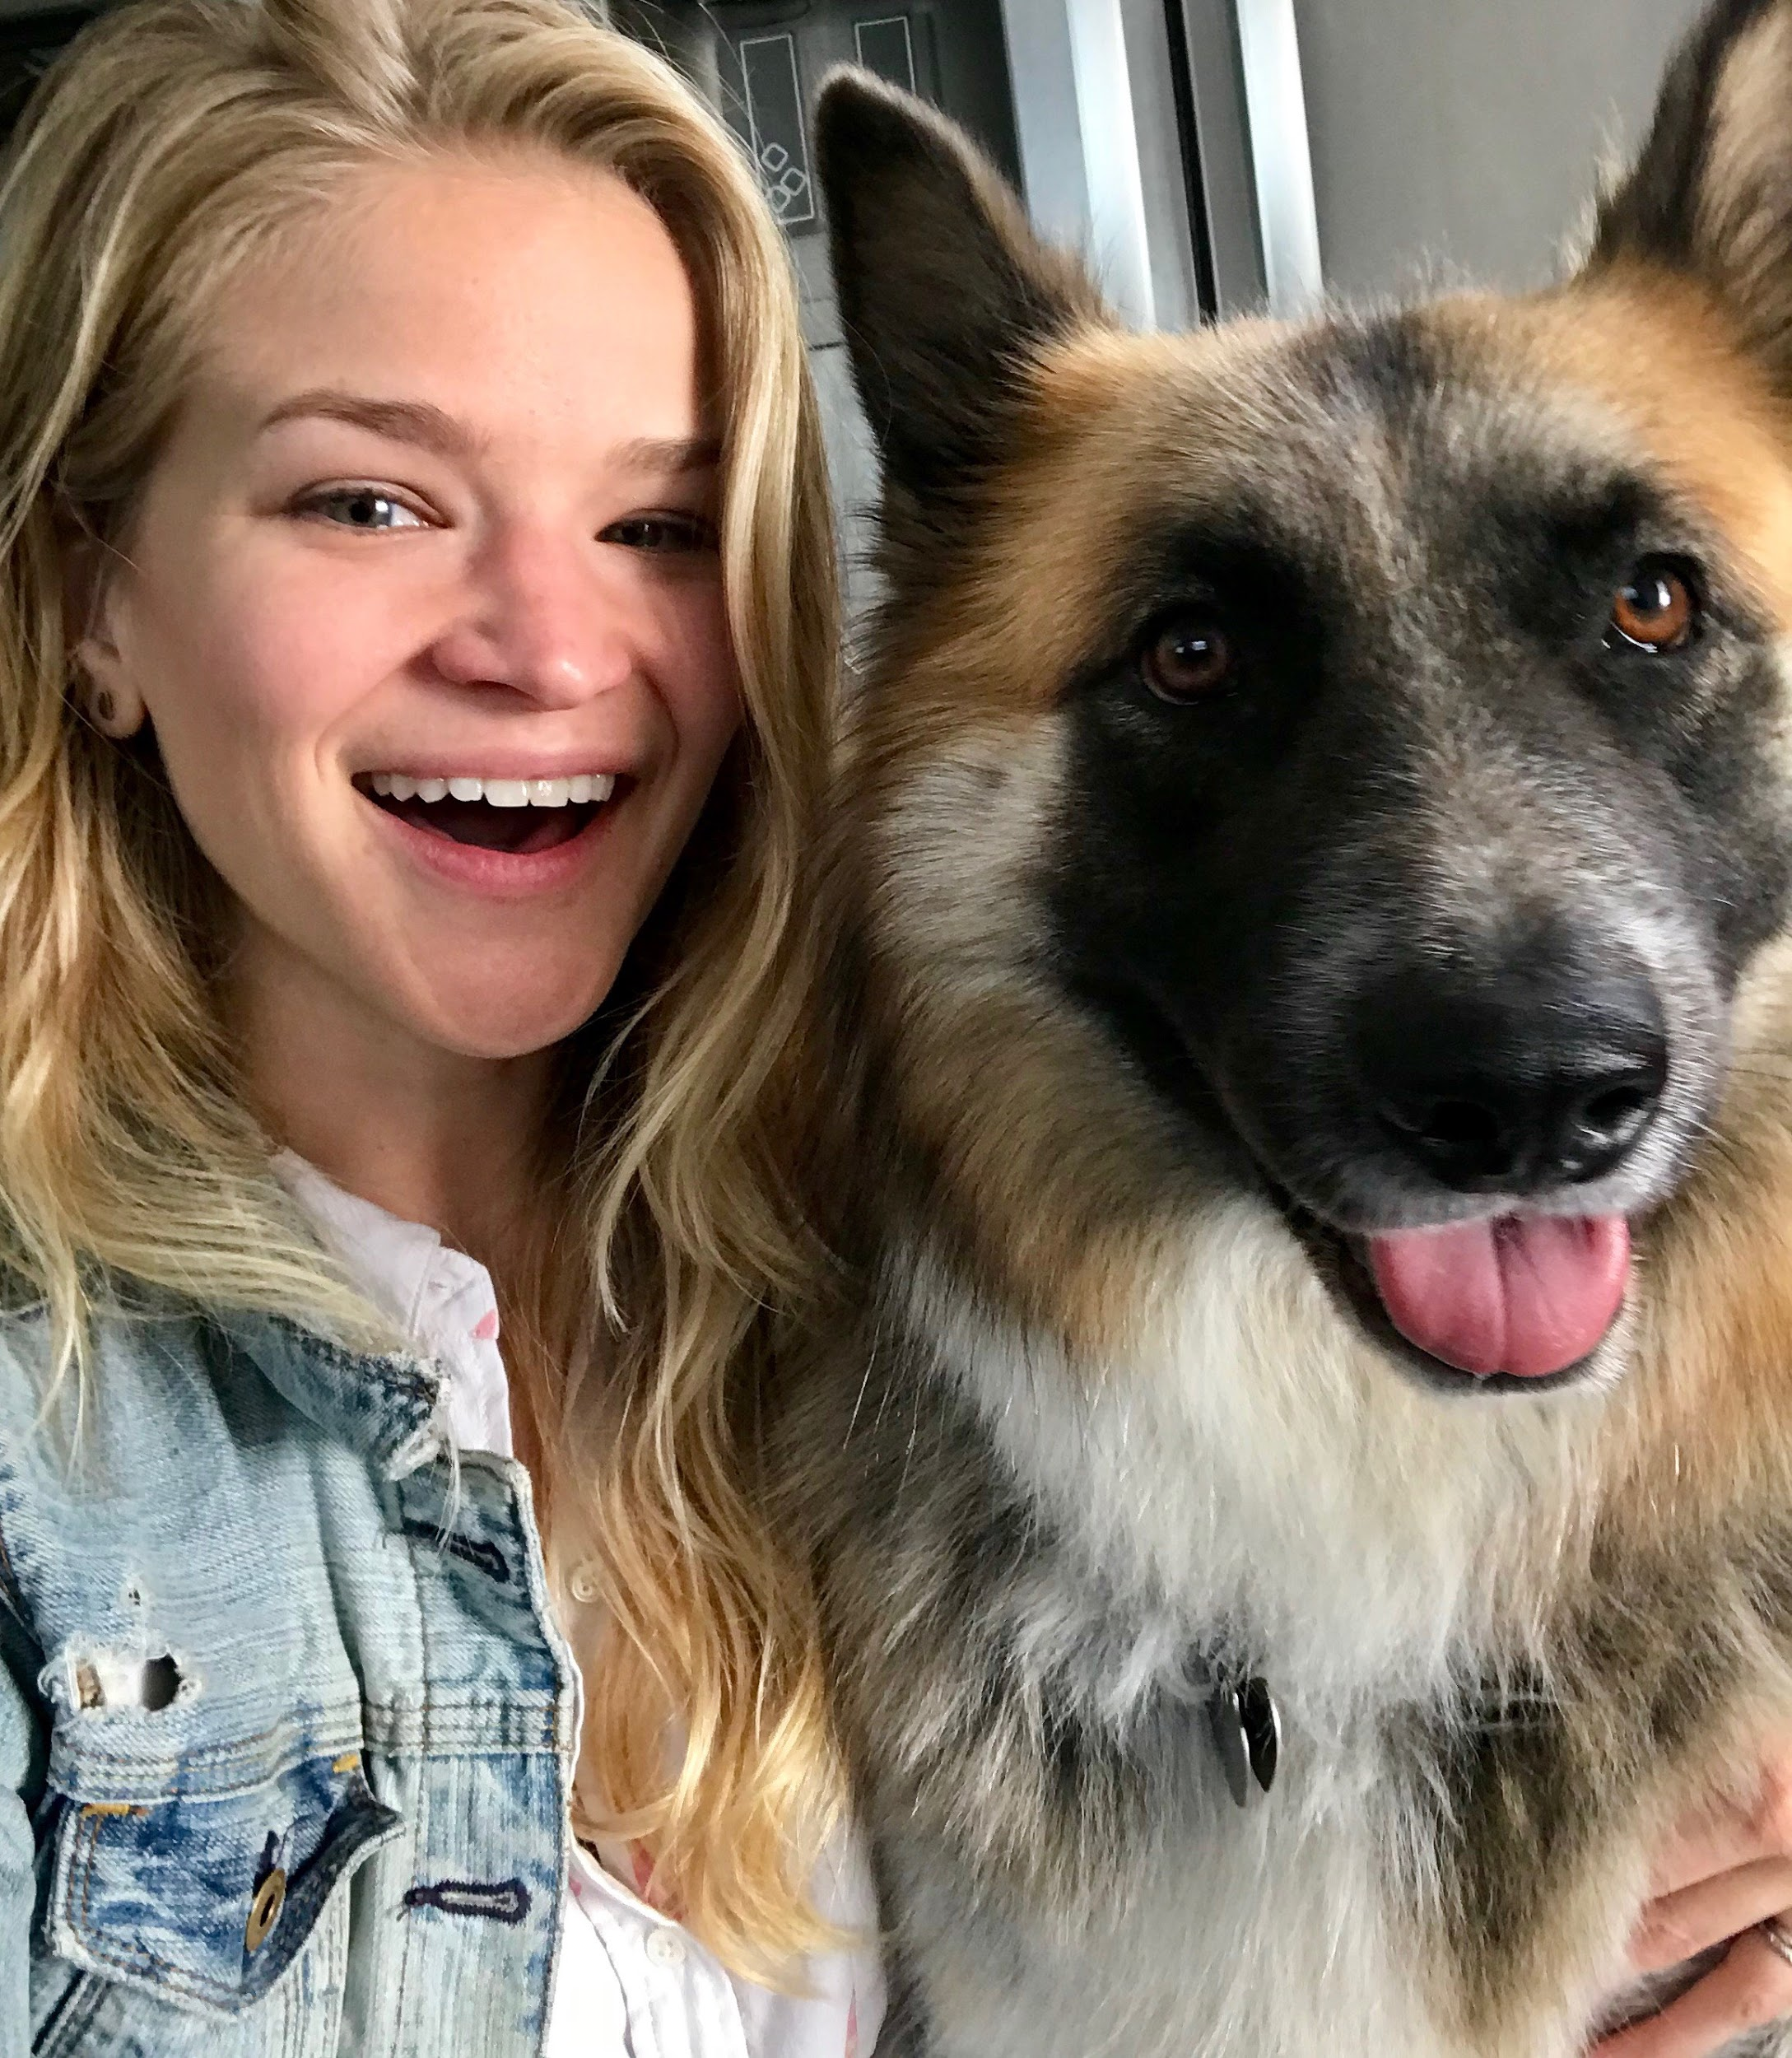
Hi, I’m Henry
Born in Southampton, England.
Moved to Victoria, Canada at 2 years old.
What did I get up to? sports, chess, writing & annoying my younger sister.
Went to University @ Simon Fraser in Vancouver.
Didn’t know what I wanted to do, eventually decided to major in business.
Met life-long friends at College
Post-college: London.
Wanted an adventure. Challenging at first but settled in (for 8 years!)
Moved to New York City to set up a hospitality business.
Met my wife & got to experience an amazingly diverse city.
And then to LA.
Lived here 3 years now.
Interests outside of work: Soccer, running, food, reading.
Notes:
Born in Southampton, England
Moved to Victoria, Canada @ 2 years old
(just above Seattle and just as rainy, and yes a lot of Canadian stereotypes are valid)
Proceeded to play sports, chess, write and annoy my younger sister for a good 16 years.
Went to University @ Simon Fraser in Vancouver. Didn’t know what I wanted to do, eventually decided to major in business.
Met some of my best friends there.
Some personal challenges
Post - college. Ended up in London, wanted an adventure.
Challenging at first, loneliness, muggings.
Got much better, stayed 8 years before moving back to the States. Largely career is what kept me there.
Moved to New York City to set up a hospitality business.
Also allowed me to be closer to my family
Met my wife there and a great group of friends.
And then to LA, been here the last 3 years.
Interests outside of work: Soccer, running, food, reading.

Slide 2
Some Lessons Learned / Discussion
Lessons learned.
Exposure to different viewpoints and cultures helped me become more empathetic and a better leader.
Be social, try new things, get out of your comfort zone.
Keep going when things are hard. Such is life, difficulties pass and are opportunities for learning.
What experiences have you had, that have put you out of your comfort zone?
Exposed you to different view points and opinions?
Have you found those experiences helpful in growing?

Slide 3
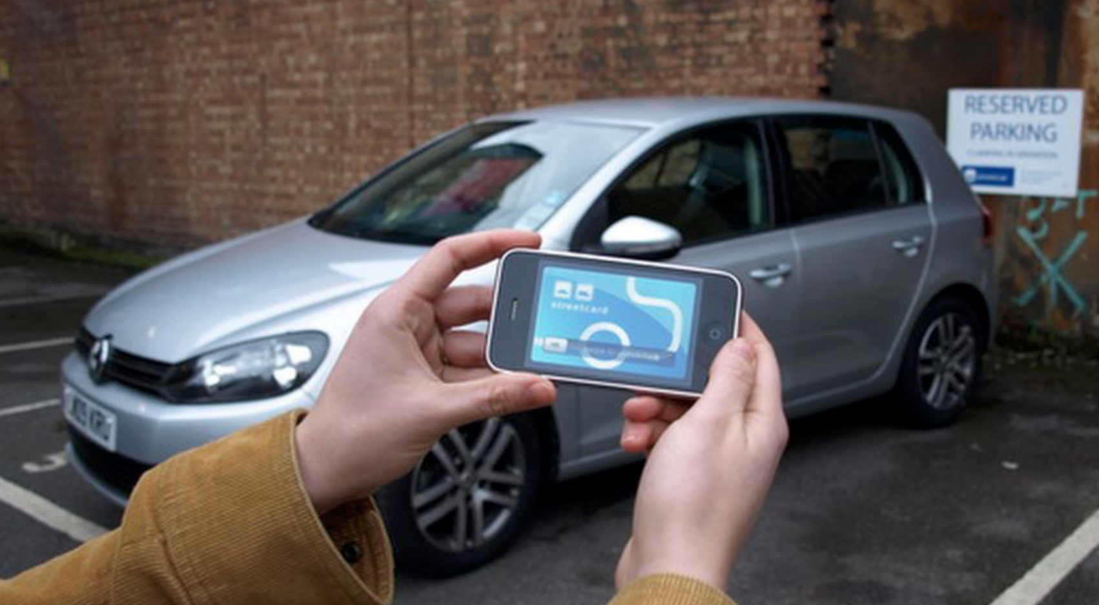
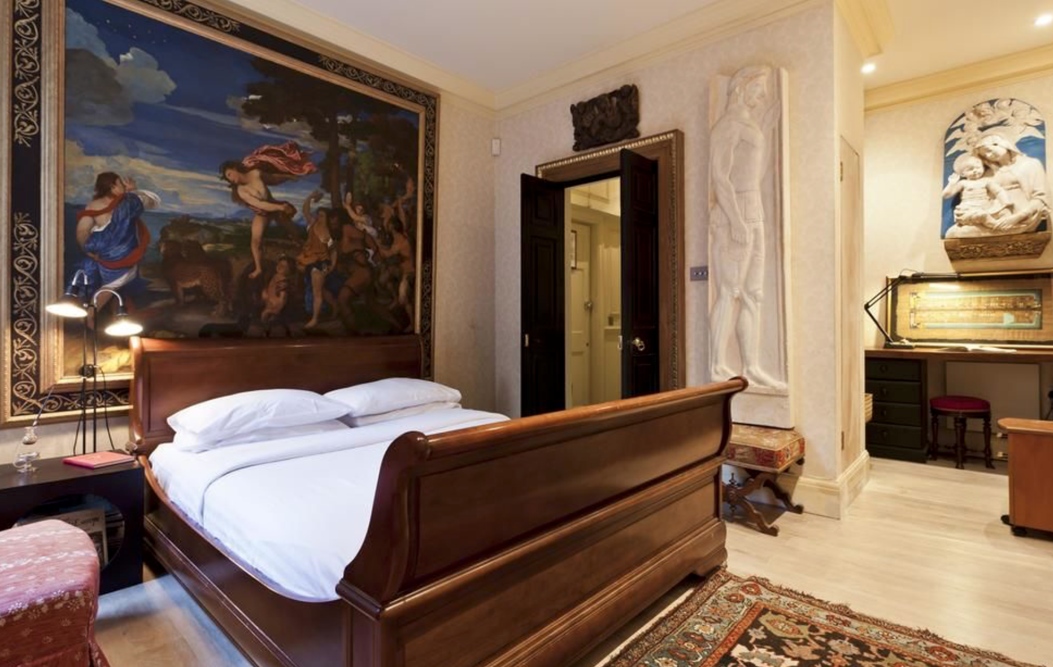
CAREER STUFF
No idea what I wanted to do or be after college.
Who knows what they want to do?
Applied to MANY jobs.
Streetcar years:
First employee, 50 members → 250 employees, 150,000 members
Had a great Mentor
Role & Challenges
Zipcar acquisition
Onefinestay years:
Like Airbnb
Co-founded US business in New York
General Manager Role
Challenges and wins
A theme emerged…
Early stage company, taking on incumbent players
General management type-role
Leading people
Tech enabled, but not a pure tech business
Notes:
No idea what I wanted to do or be out of College. (Me along with most ppl). Who knows what they want to do?
Applied to many, many jobs. Considered following my friend and roommate and going into trading. Random luck connected with two entrepreneurs who had just started a car sharing club
Streetcar years -
First employee, 50 members. Grew company to 250 employees, 150,000 members. Learnt a lot along the way (great mentor)
Role and how it evolved // examples of challenges.
Zipcar bought us, integrating the companies and time for a new challenge
Onefinestay years -
Like a high end airbnb
Co-founded US business in New York. Was General Manager for US business.
Really hard business to run but a great product
A theme emerged. Early stage company, general management role, leadership based. Tech enabled, but not a pure tech business.

Slide 5
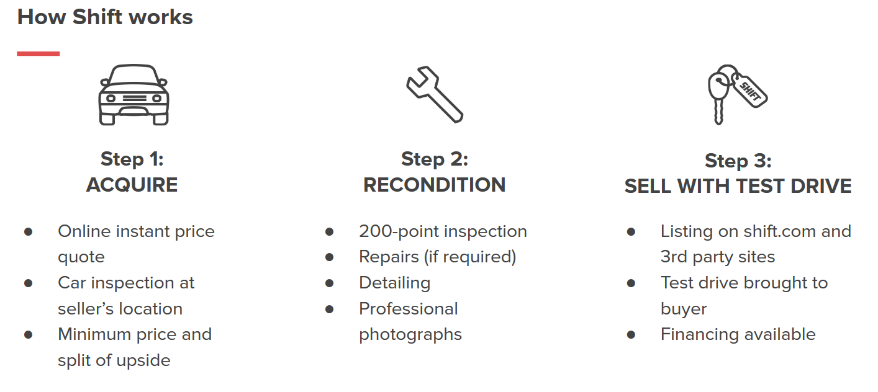

Slide 6
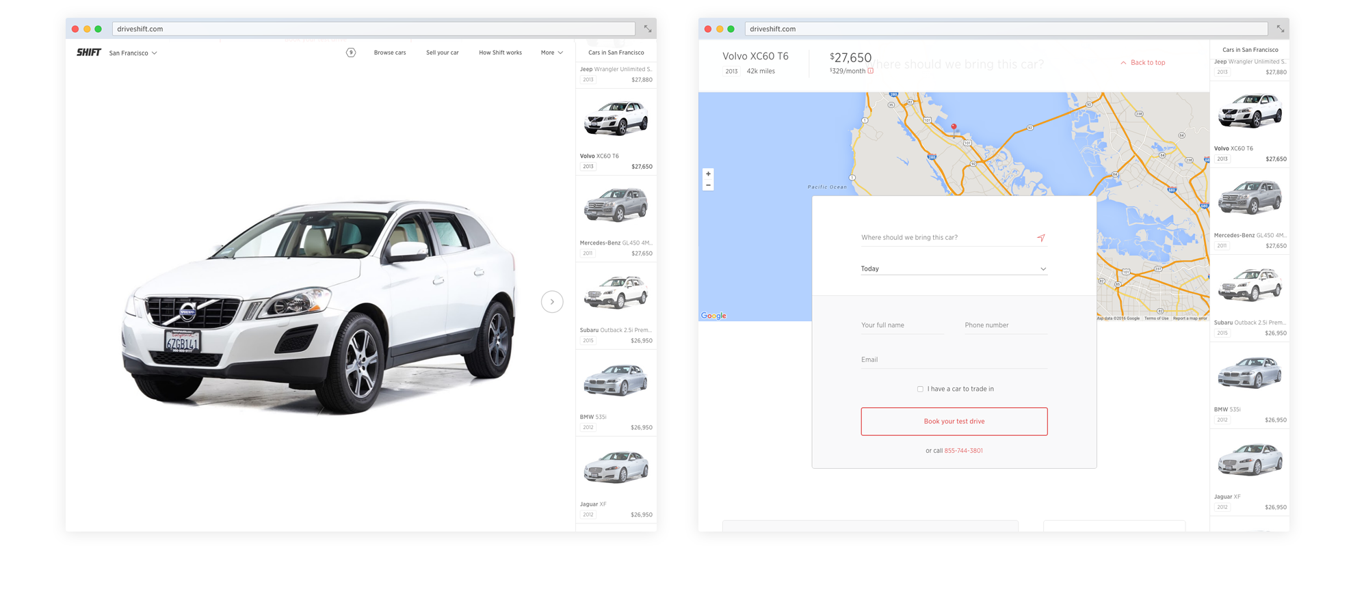
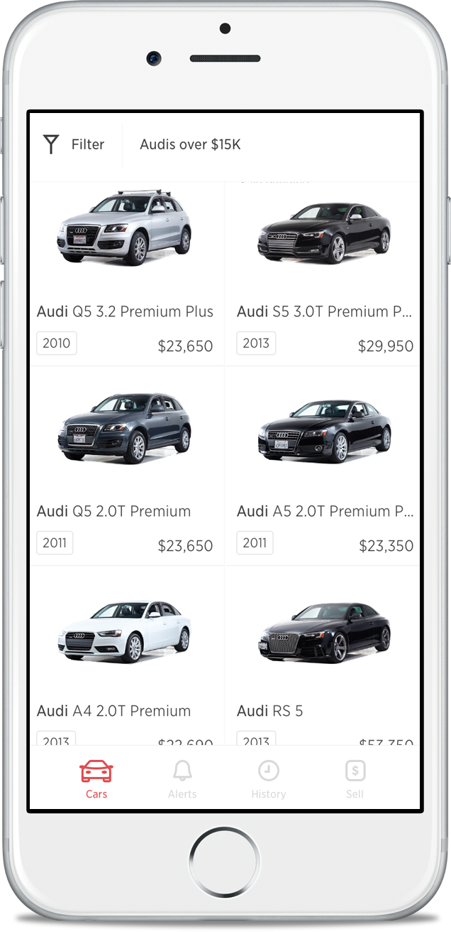
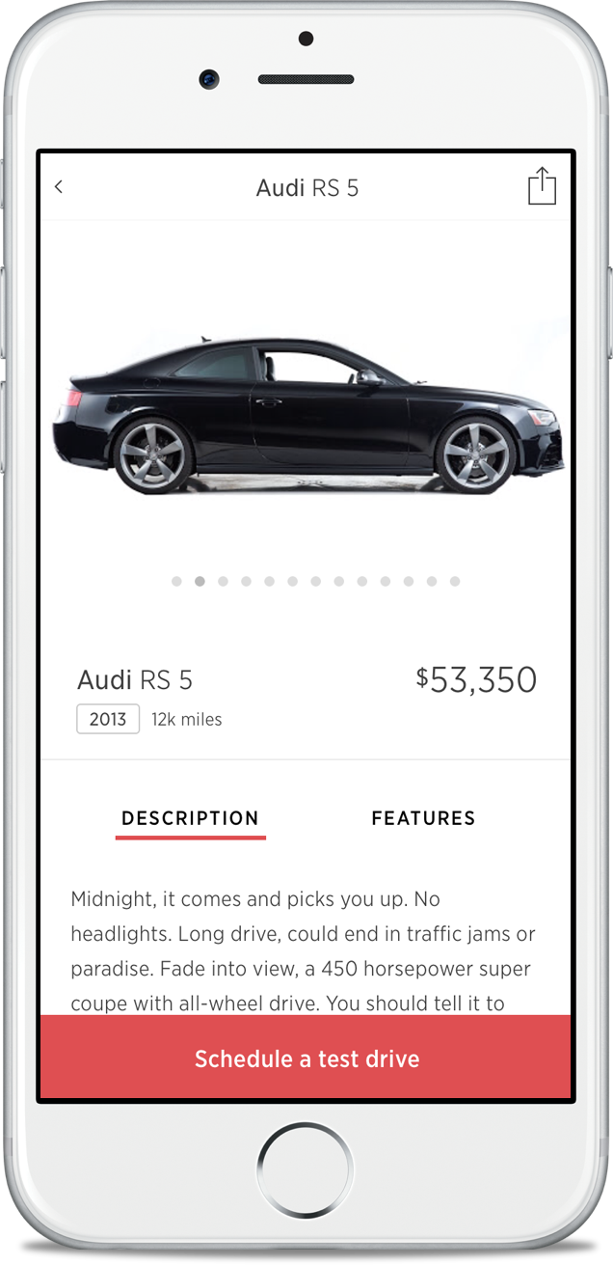
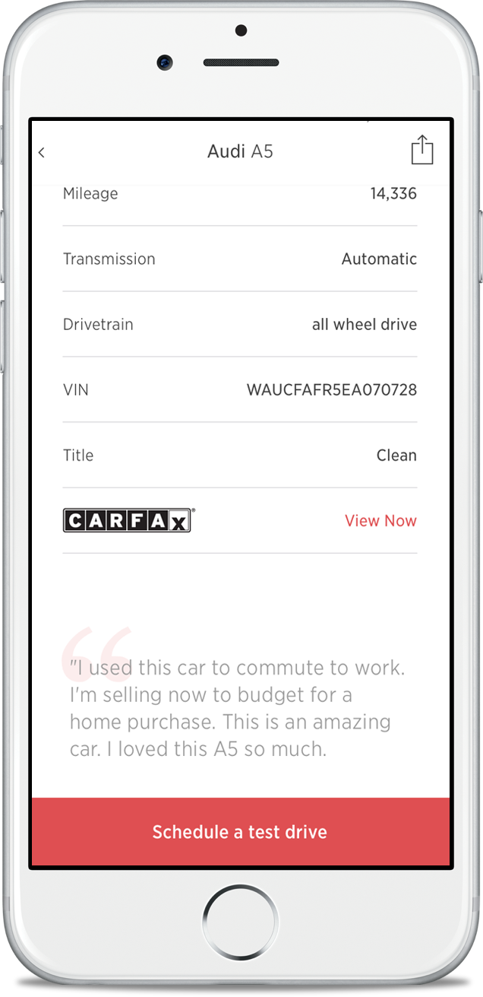
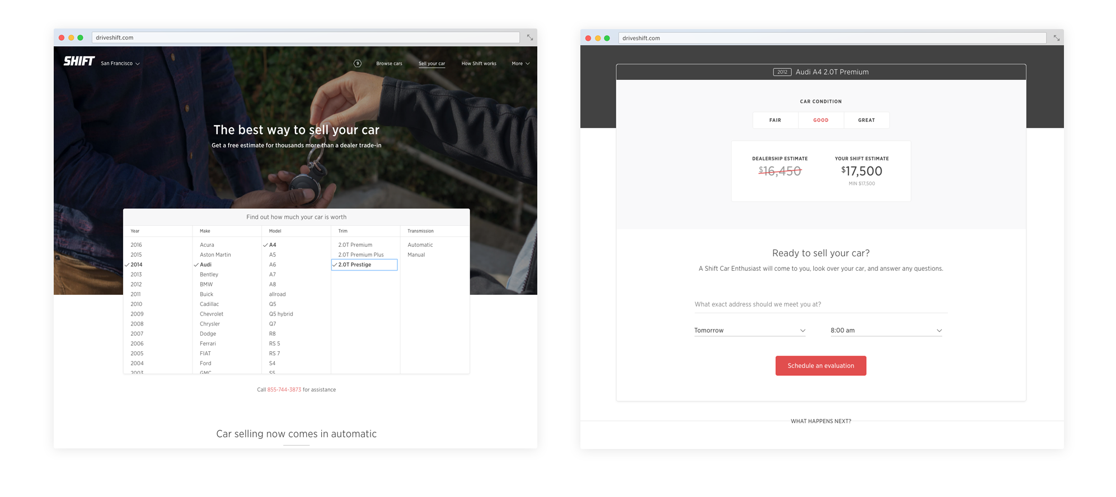
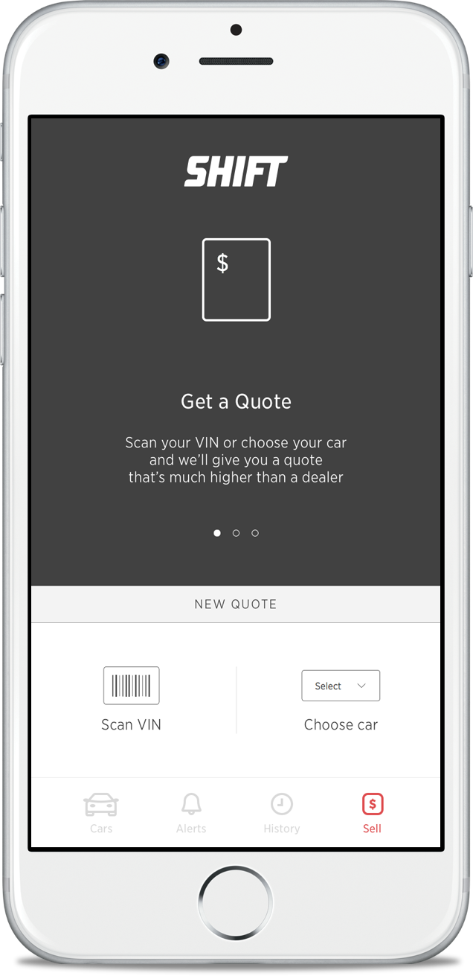
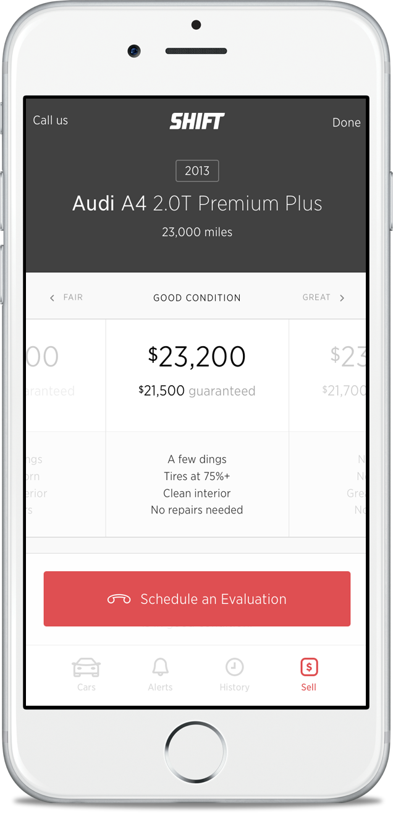
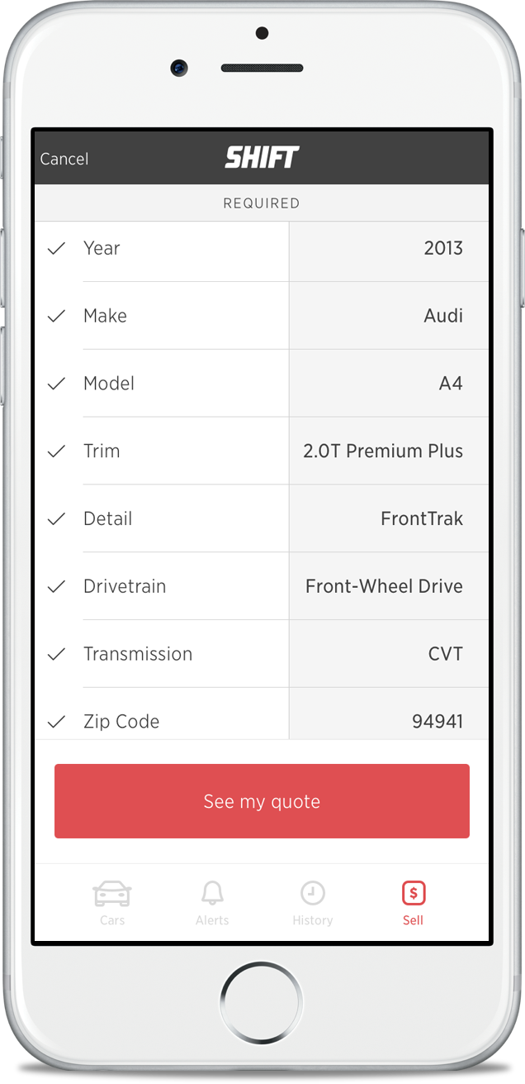
Modern Web And Mobile Customer Experience
Shift.com
Shift Mobile App

Slide 7
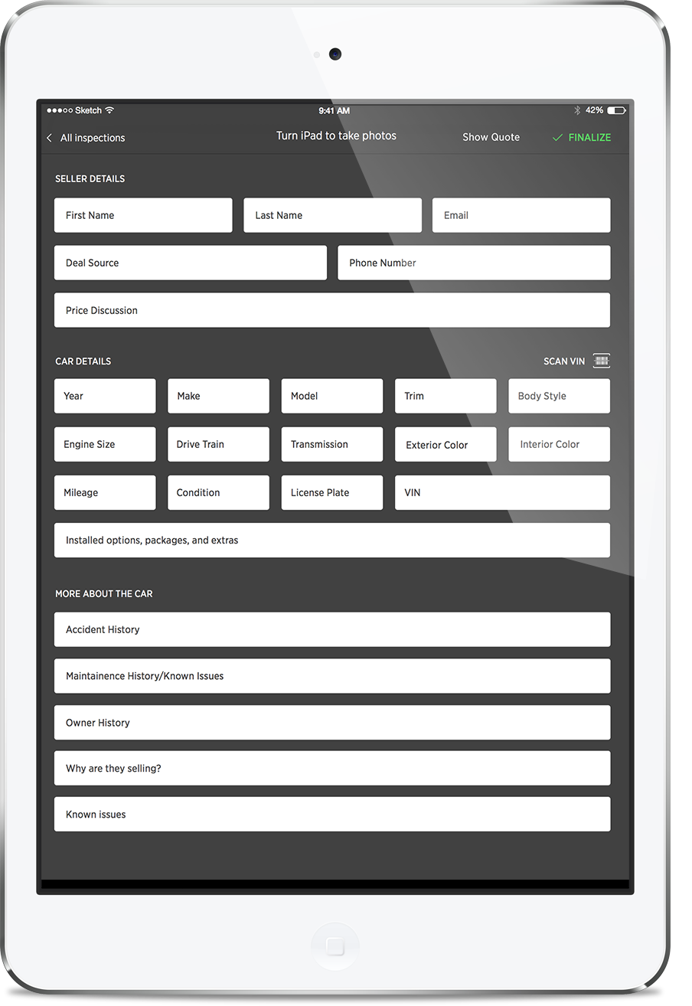
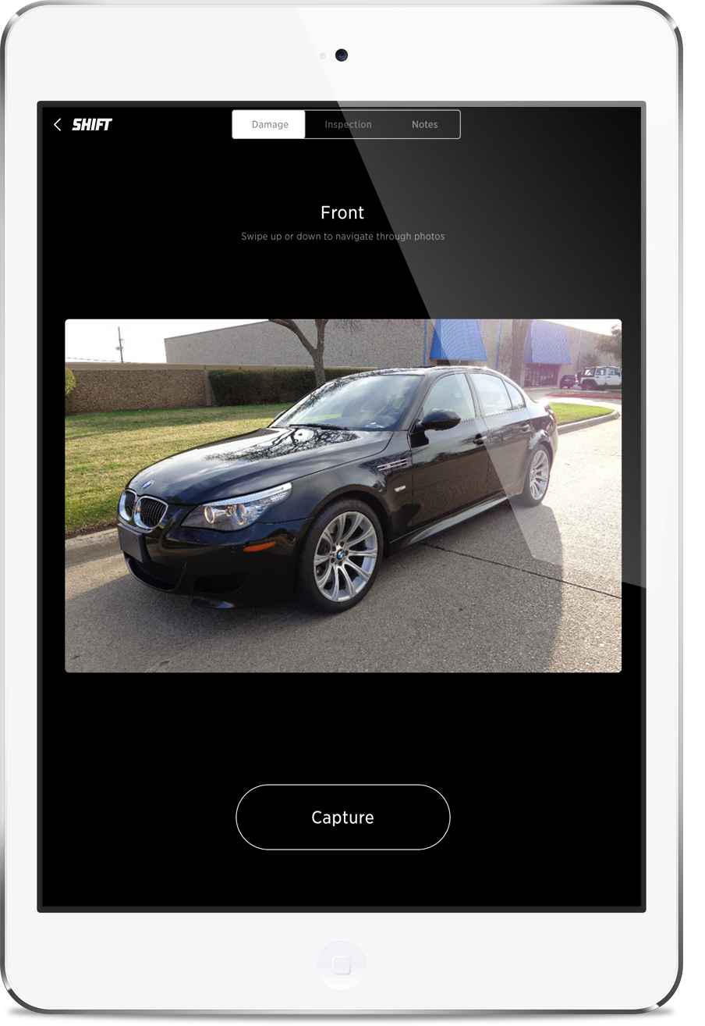
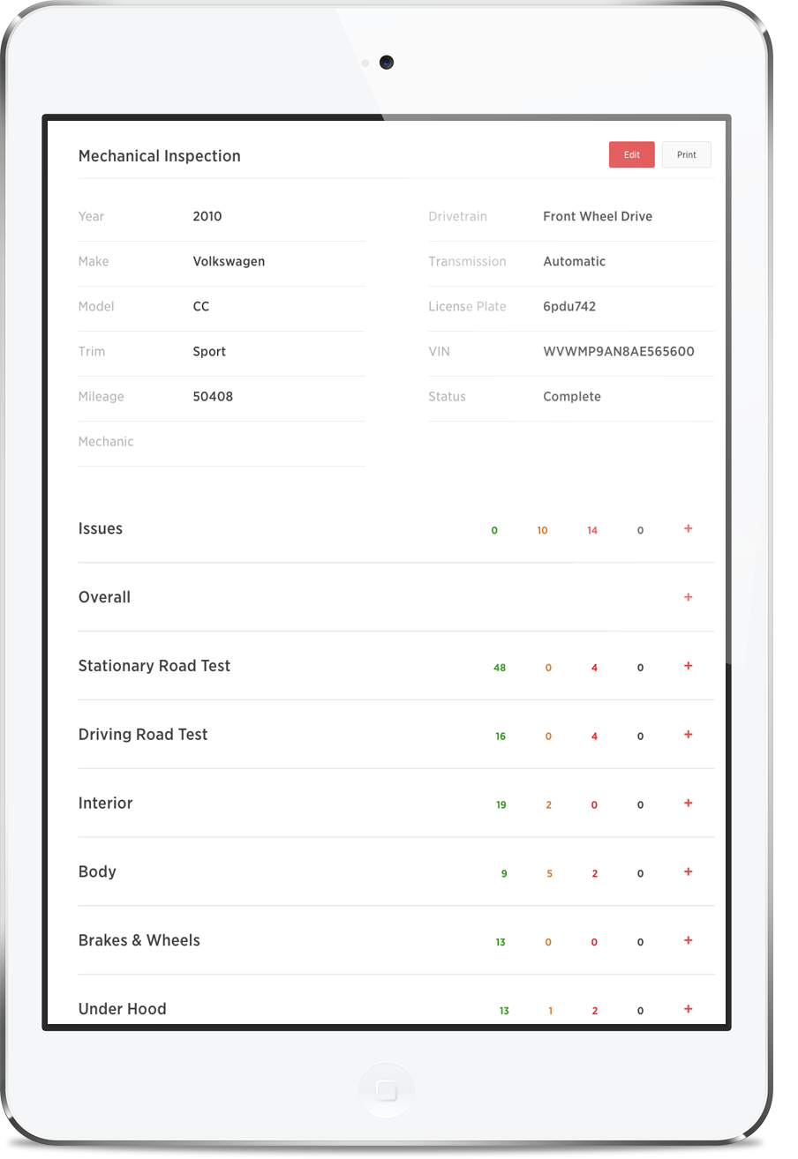
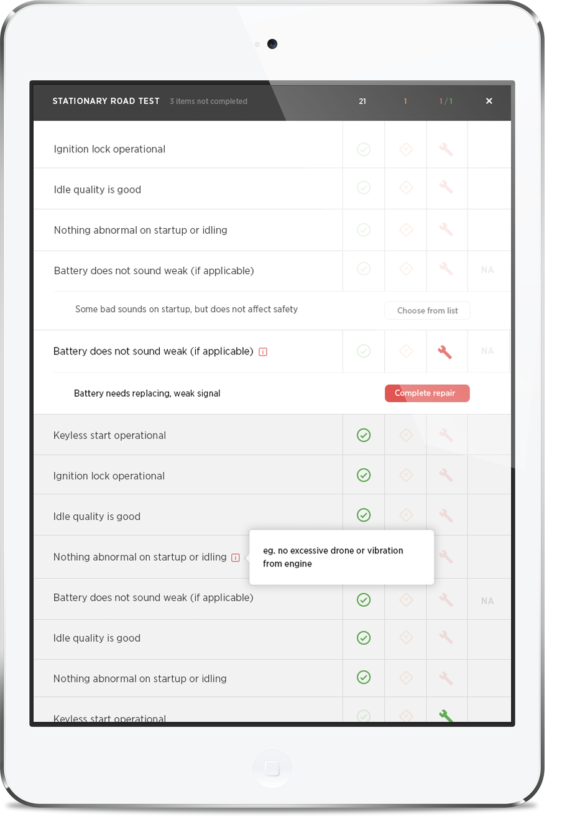
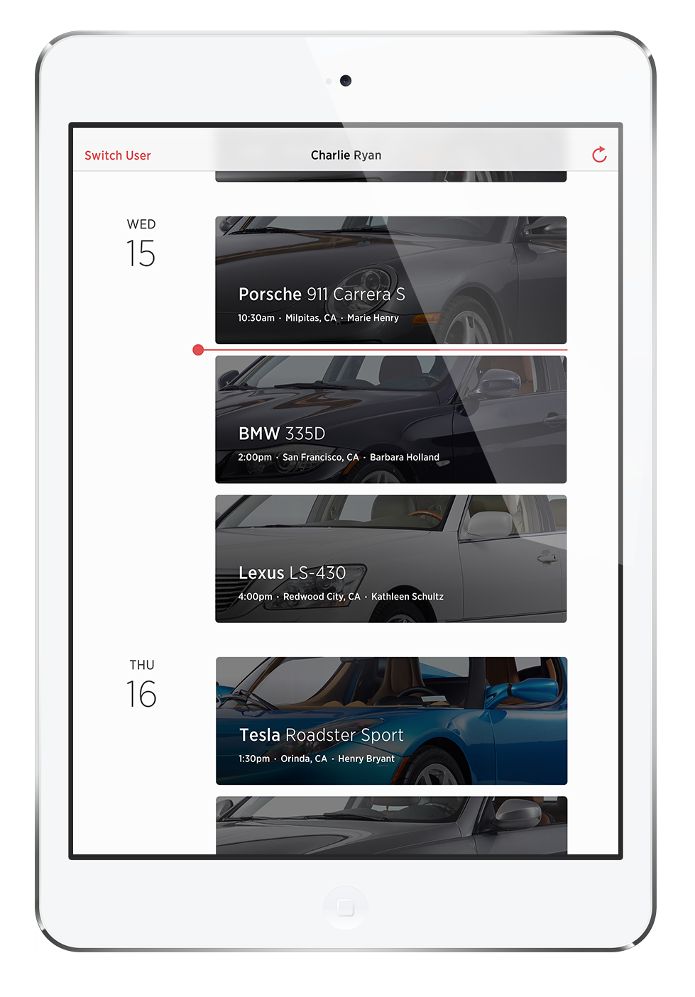
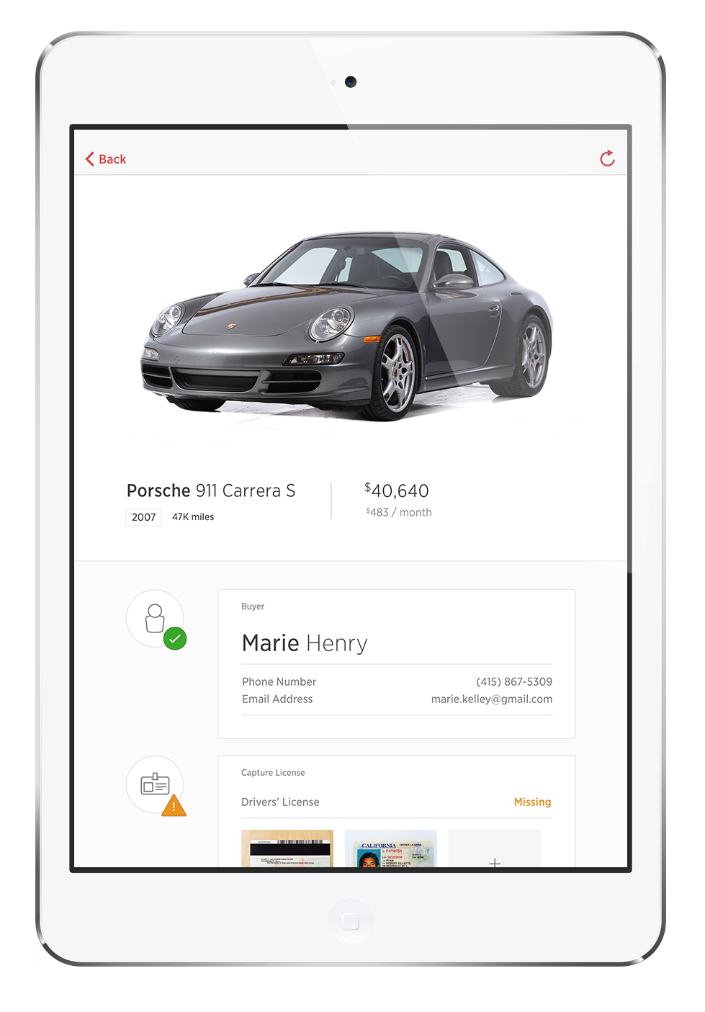
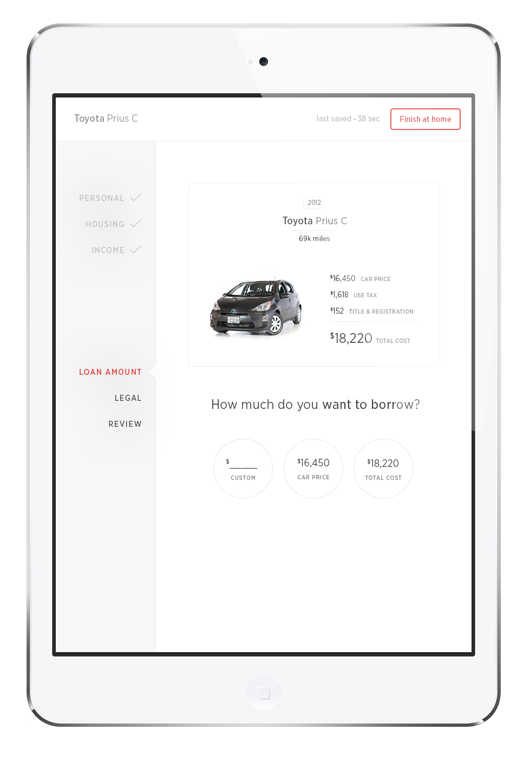
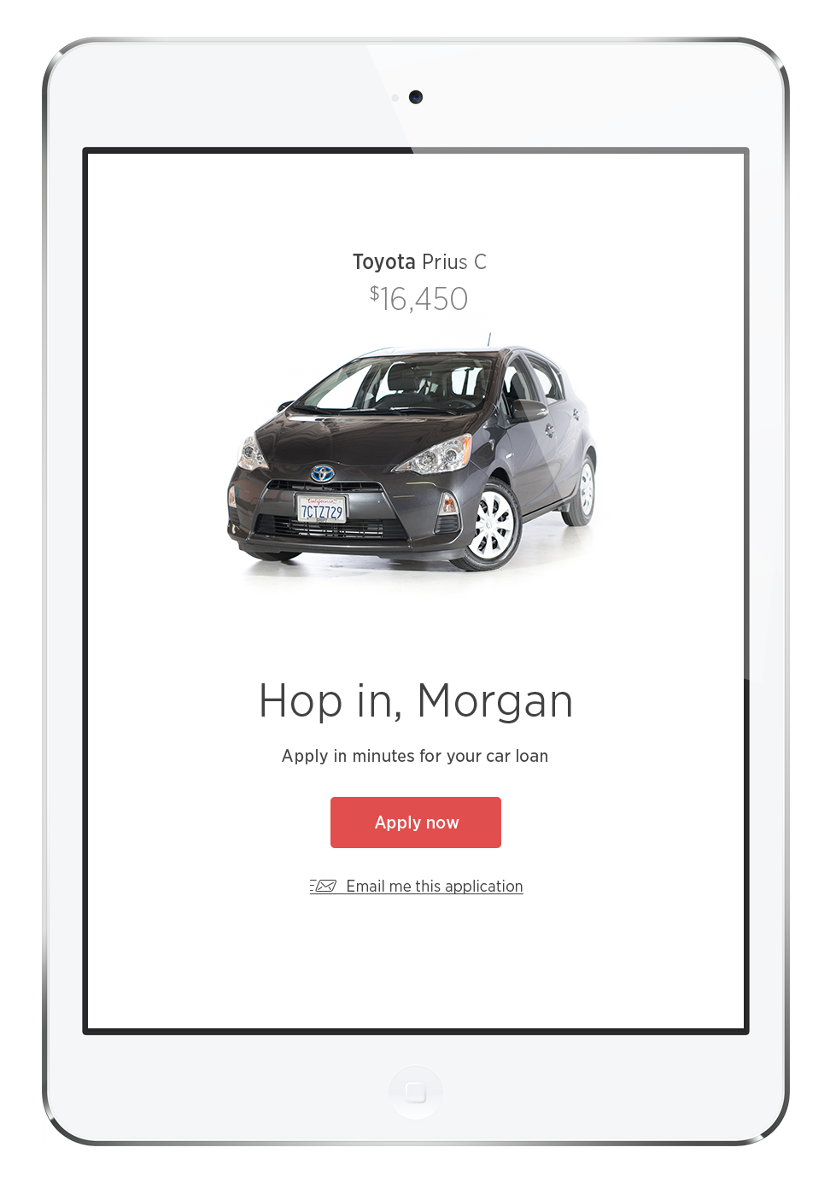
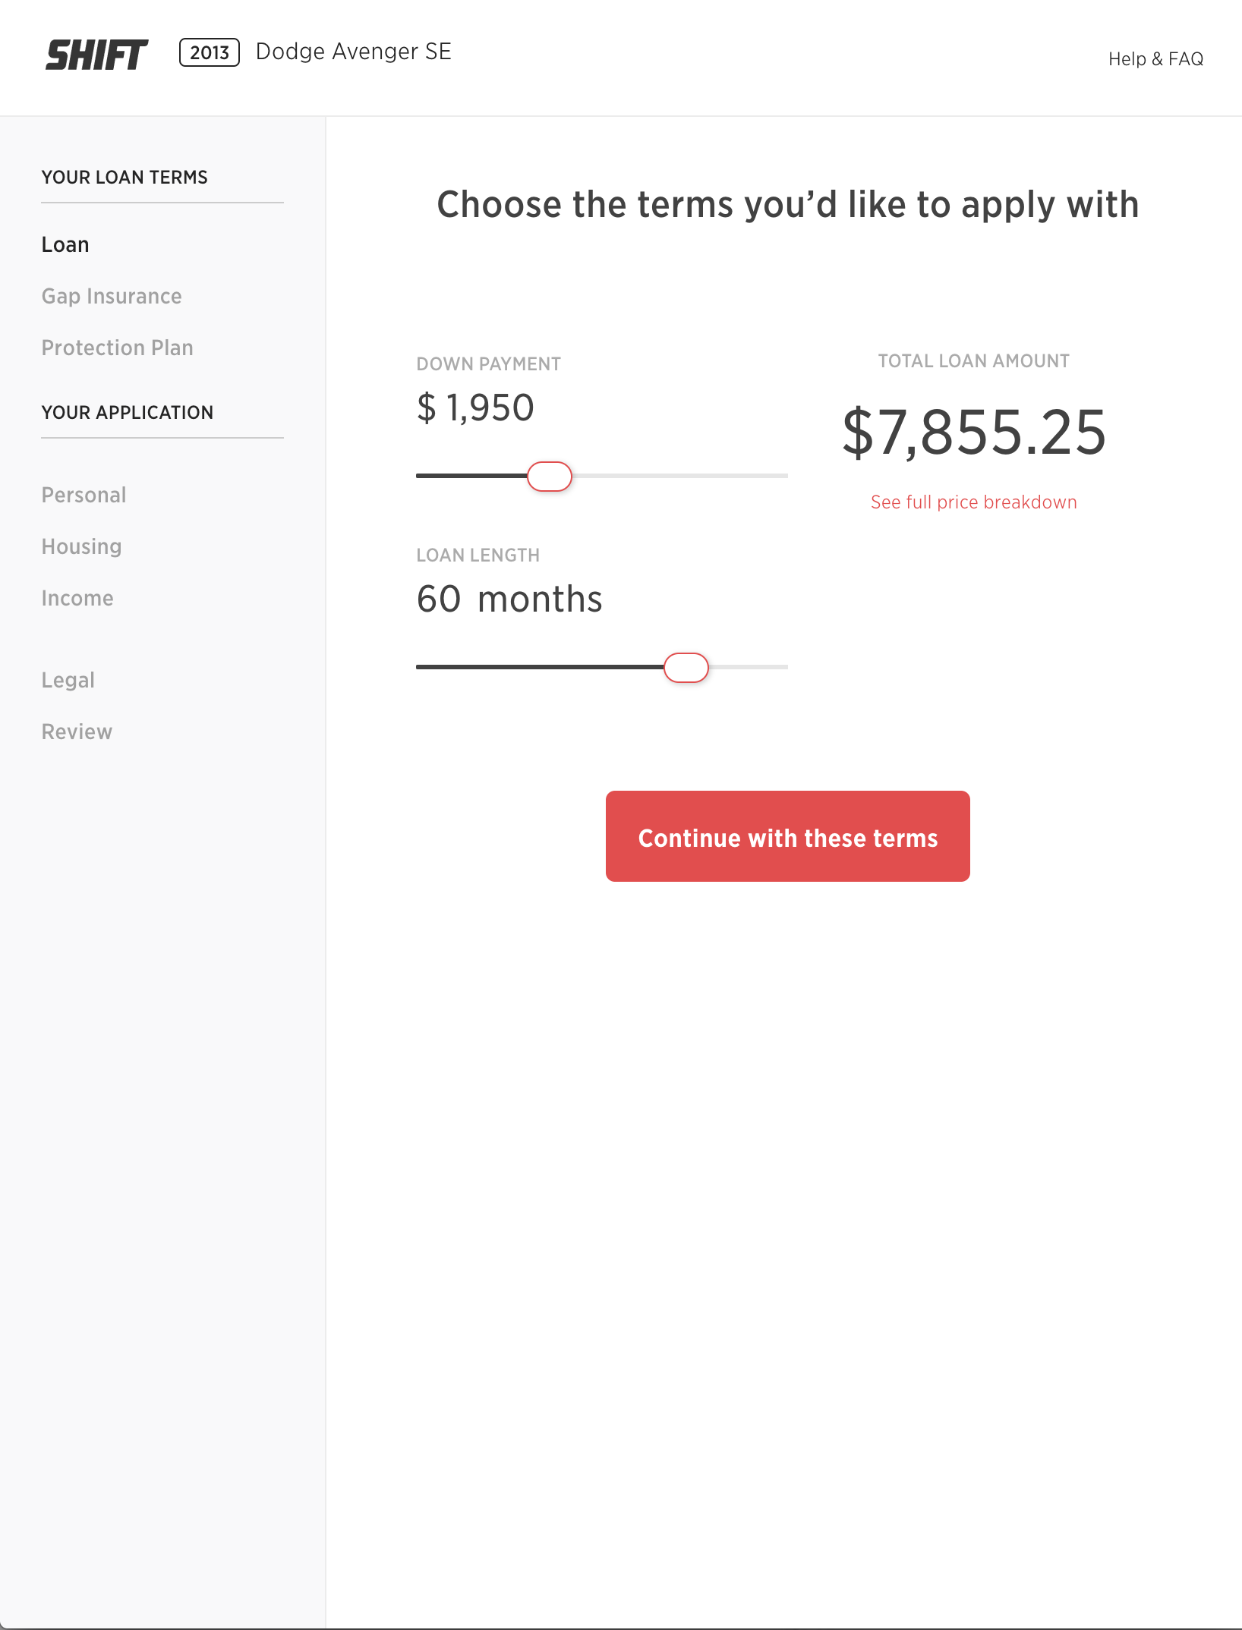
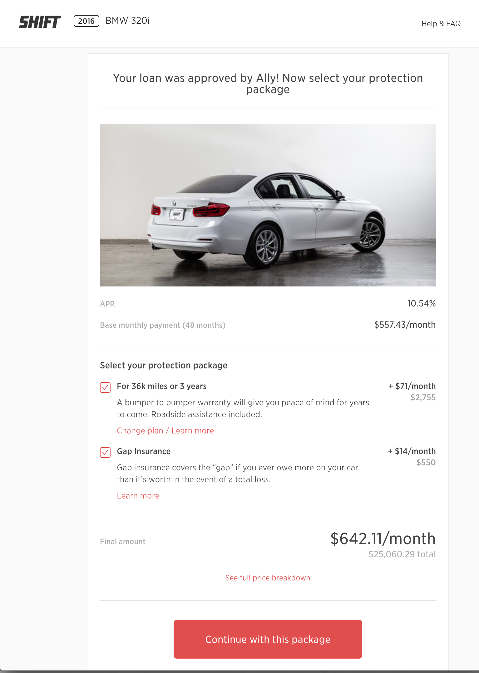
Shift’s Operations Are Powered By Technology At Every Step
Evaluations App
- Verifies vehicle price + condition
- Onboards seller
Mechanical Inspection App
- Produces repair cost estimates
- Generates inspection report for customer transparency
Test Drive App
- Schedule/logistics management
- Payments/transaction mgmt
Financing Platform App
- Finance + insurance application and purchase flow

Slide 8
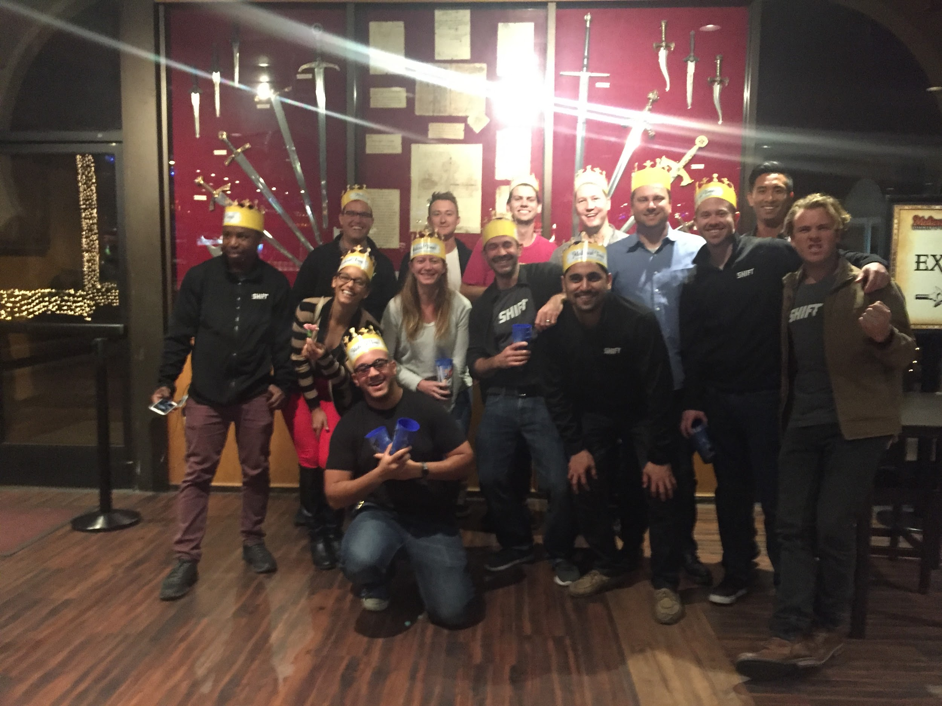
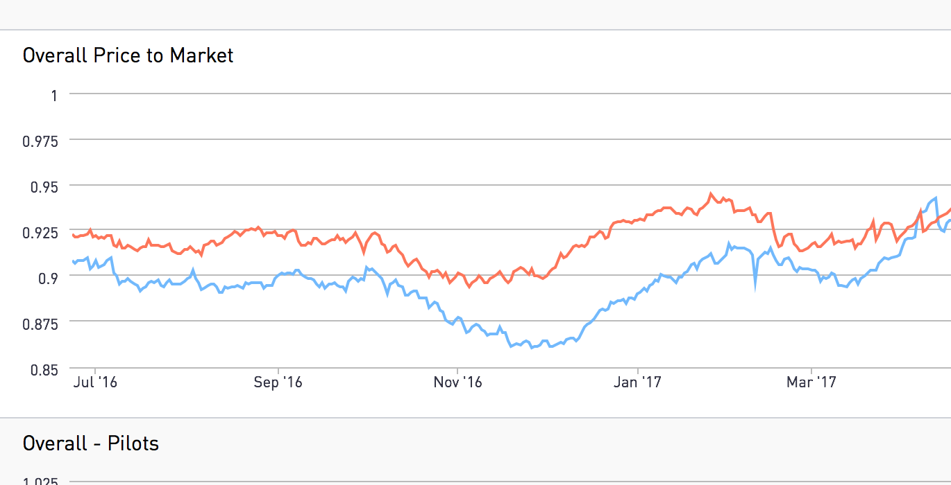
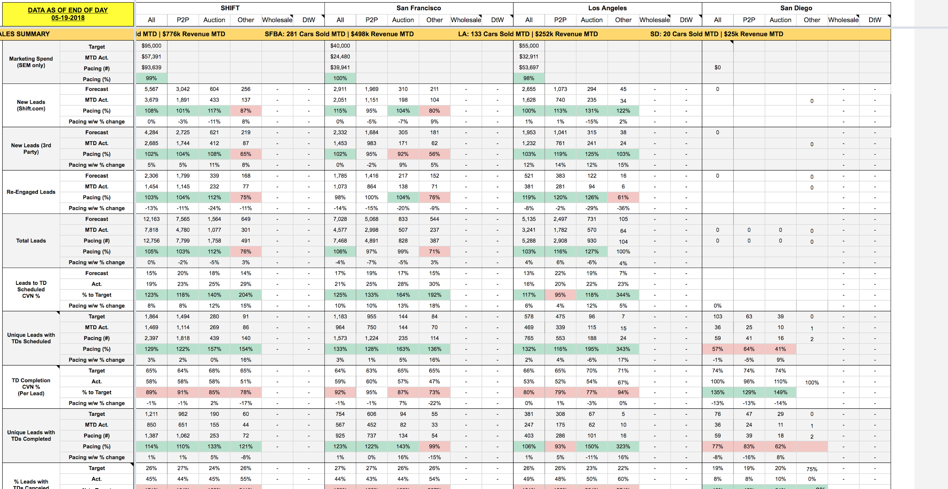
So, what do you actually do?
Get to see some pretty awesome cars.
Run Sales and Operations.
Day to day business mgmt
Split time between SF+LA
No real typical office hrs
People Management.
Expansion & Growth.
Build the right technology.
Challenges and good parts.
Lessons Learned:
Ask questions, be curious.
Learn by doing
Hard work & interpersonal skills key
In my industry, comfort with ambiguity a must
Notes:
Get to see some pretty awesome cars.
Run Sales and Operations.
Day to day business management
Setting targets across the organization
Managing the business toward those targets, using key performance indicators. Use a lot of data.
People Management:
Around 150 ppl in my organization, have 10 direct reports.
Need to keep the team aligned, motivated, and hire the right talent
Expansion
How do we grow the business mature markets, or new?
Build the right technology to enable scalability. Work closely with product and the ladies and gents who write code. Make sure they’re building the right stuff.
Some thoughts on career lessons learned.
Ask questions, be curious.
Learn by doing
Hard work, interpersonal skills key
In my industry comfort with ambiguity a must

Slide 9
Exercise
Take a look at these 2 companies.
Dragons Den style, who would you invest in and why?

Slide 10
Q&A

Slide 11
Thanks for listening to me!
henry.imber@gmail.com if you want to get in touch!

