Slide 1
YBA GUEST Jackie Kibler
You are what you believe you can achieve

Slide 2
INTRODUCTION
My name is Jackie Kibler and I am 51 years old.
I work for ProVisors.
My company does:
Professional Networking Organization for Senior Level Trusted Advisors
My role at ProVisors is the Vice President of Membership Sales & Service
I oversee the activity and results for three client (member) facing teams for their life with ProVisors

Slide 3
My childhood
I was born and raised in Syracuse NY
This is a picture of me at 4 months of age

Slide 4
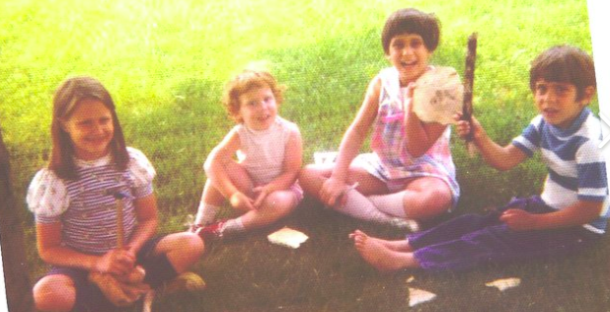
My family
A little about my family: Traditional family – father worked and mother stayed at home. Three children
This is a picture of me and my family: Al, Billie, Cathy, Steve and friend Marita

Slide 5
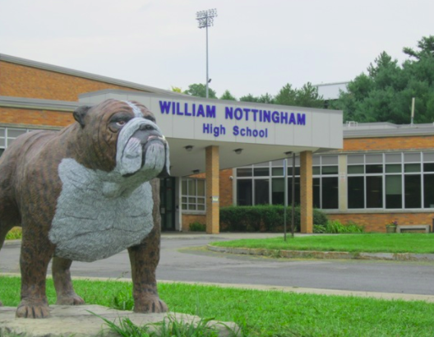
MY HIGH SCHOOL
I attended Nottingham High School in Syracuse, NY

Slide 6
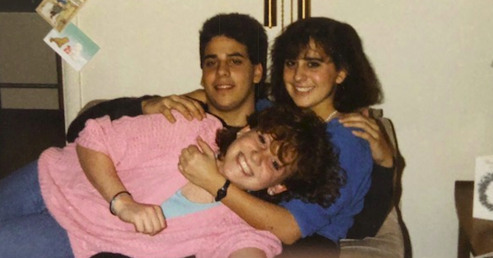
High School
As a HS student I was an average student. I didn’t apply myself. I worked at least one job at all times and was fairly popular.
Here is a picture of me in HS

Slide 7
High School
Things that I really liked in High School were:
I really enjoyed singing in chorus. It allowed me to express myself
Classes I enjoyed were around language. English and Spanish. I felt through words, I could share my thoughts and feelings
I liked to work and make money. My father was a teacher and my mother stayed home. If I wanted anything outside of necessities, I had to buy it myself
Hanging out with friends was always my weekend night plans.

Slide 8
High School
Things that felt difficult or challenging for me while I was in High School were:
I always found math to be challenging in high school and probably should have had a tutor to help me through bumps in the road.
I had a strong personality and didn’t know how to use it properly. Some teachers found it challenging. In time, I found my pace which has leant itself to become an asset

Slide 9
High School
Jobs I worked while I was in High School were:
Various retailers in Shoppingtown Mall (clothing, yogurt, shoes)
Volunteer with the Autistic class
Fitness instructor at Kelly-Lynn
Friendly’s waitress

Slide 10
Getting in to College
The top few things I did to ensure I got into college were:
In my Senior year of high school, I focused on my grades and did very well. However, because my grades were overall average: For my first college – State University of New York, College at New Paltz – I made an appointment with a counselor and interviewed to get into the school. At the interview, I committed to studying and got in. I lived with my grandparents for that first year.
I achieved a GPA of 3.5 which gave me the opportunity to apply to other colleges the following year. In my sophomore year, I was able to attend Oswego State University

Slide 11
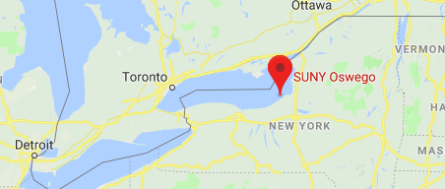
College
I attended college in Oswego, NY

Slide 12
College
Things I enjoyed in College
Things I didn’t enjoy in College
I loved my studies of Psychology and Art History
I was a hotline counselor and trained people to be on the hotline
I was a resident assistant
I worked with the developmentally disabled and also in inpatient rehab
I made some of my closest friends
Best memories and learned about myself
I was on the great lake of Lake Ontario…. I froze

Slide 13
College
Favorite classes
Least favorite classes
All Psychology Classes
All Fine Arts Classes
All Art History Classes
Film Studies
Womens Studies
Algebra

Slide 14
College
Jobs I worked while I was in College were:
Inpatient Dual Diagnosis Rehab Counselor (paid)
Crew Supervisor with the Developmentally Disabled (paid)
Hotline Suicide Counselor (volunteer)
Hotline Suicide Trainer (volunteer)
Resident Assistant (room & board)
Friendly’s waitress (paid)

Slide 15
College
Things that felt difficult or challenging for me while I was in College were:
Several deaths in the family (AID’s, Cancer)
I was attacked physically and the same person stalked me for about 9-10 months
I was able to work through these through my support system
If it were to happen now – I would get counseling/therapy

Slide 16
Getting a job after College
The top few things I did to ensure I got a good job after college were:
In my Senior year of college, I made the decision that I wanted to go into business vs. getting my Masters. I immediately sought out advertising agencies that I could intern at during my last year. I was able to the an internship at Eric Mower & Associates in Syracuse.
I interviewed with Kemper Insurance upon graduation and got a job as a Boiler & Machinery Claims adjuster (2 years). A friend helped me get an interview with Dun & Bradstreet – and that is where my career began

Slide 17
This is My Company
Every day at my company:
Over our 60-year history, Vistage has solidified our reputation as the world’s most trusted executive coaching organization. Our core formula of peer groups of executives from non-competing industries, backed by one-to-one coaching, has driven our members to outperform their competition through boom markets and recession.

Slide 18
My Career Path
I moved to Corporate Executive Board in Washington DC where I ran a team of 120 front line lead generators - globally
I started my career updating D&B reports & selling D&B data. I was promoted every 12-18 months and became a manager within 5 years
I now am the Regional Executive of Vistage where I have 60 “Chairs” and 1300 members across Southern California
I also host a TV show in the San Gabriel Valley where I interview CEO’s on their journey
I sing in a band that plays for the developmentally disabled and Sr Citizens
Notes:
You may use this chart to describe your journey to the current career

Slide 19
My Career
The first job I had after college was:
I was a Boiler and Machinery Claims adjuster for Kemper Insurance. The only female in the country
The market in Syracuse was not “employment rich” – I interviewed many times with Kemper and finally was offered the job
The worst job I have ever had was:
For three weeks, I was an assistant manager with a restaurant called “Rib-Inns” – I had to clean out the fryer (and everything that goes into that). I burned myself with grease – everyday.
The food was GROSS

Slide 20
My Career
Challenges I have had to overcome throughout my career are:
As a woman in my age group – I was usually in a very male dominated space.
I was the primary bread winner for many years and we moved every 12-18 months for a long time
Double Standard for both my husband and myself
Leaving Family & Guilt associated with that
Be confident in who you are – ask for feedback from the right people

Slide 21
My role within organization
CEO
MANAGEMENT
ENTRY LEVEL
ME
ENTRY LEVEL
Notes:
Use this graph to give more description of your role specifically (responsibilities, typical work week, direct reports, etc.)

Slide 22
Compensation at my company
C-Suite
($350K)
Management
($150-200K)
Middle Manager
($75K)
Entry Level
($20K)
Notes:
Use this graph to show general compensation ranges for people in various roles in your company

Slide 23
More than just work
When I am not at work I like to:
Cooking, Entertaining, Wine
Hiking or walking with the dogs
Spending time with family
Singing with the band
Exercising (SPIN, Pilates, Yoga, Trainer)
Traveling (both local and outside of CA/USA)

Slide 24
Do it all over again?
If I could talk to my high school self, what would I say?
You don’t have to “Be Cool”
Listen more – talk less
Enjoy more of what you love
Be okay with who you are
Ask for feedback
Don’t be defensive
Don’t worry about being right
Study

Slide 25
QUESTION AND ANSWER

