Slide 1
My Career Journey
Connie Goshgarian
VP Systems Engineering & Architecture
AT&T Entertainment Group

Slide 2
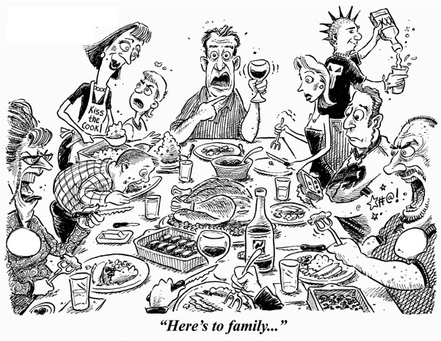
My Background
Notes:
I am the youngest of a large family of 10 that didn’t have much money. We were extremely competitive, but only one brother and one sister had gone to school past high school.
My dad left us when I was sixteen and then we had no money so everything I earned went to the family expenses.
Luckily, Caltech ensured anyone who got in could attend. I majored in ChE but got involved freshman year in the Student Space Organization.
I learned so many skills in that (organization, presentation, technical program management, machining, marketing, networking, architecture and design) and got the university president as a mentor. I got to meet Isaac Asimov, Chuck Yeager, Frank Borman, Steven Spielberg, and many aerospace/manufacturing CEOs and executives.
Once I graduated, I didn’t really want to do ChE (went on a plant trip and got scared) so I went to graduate school at UW. I had a full fellowship for a PhD and did research in controls which translated to aerospace. After a year and a half, I went back to Caltech to help out with fund raising for the space org and executives at Hughes convinced me a PhD was not needed for what I wanted to do. I stopped with a Masters and joined Hughes as a systems engineer. I had to interview for my first job there and joined system test for a year to learn all about satellites. I then started working systems engineering in attitude control for the new HS601 3 axis satellite. About a year in, a golden parachute program resulted in my being in charge of ACS. I ended up in Australia with the first customer for a year and a half and learned an awful lot.

Slide 3
No Right or Wrong Choices
Major
Company
Position
Project
Opportunity
Change
Notes:
You will not make the exactly perfect choice each time. Some choices may be better than others but just move forward. Examples for me: major, PhD
Point is that you will learn from almost anything and you adapt as you go.
If you pick the wrong major, company, position, etc. – either help to change it from within or switch
Never turn down an opportunity to do more if you can possibly help it
Keep taking paths that are out of your comfort mode

Slide 4
Find Your Passion
Technical Problems
Big Picture
Space
Satellite Systems Engineering
Notes:
Think about the things you really enjoy doing and focus your career in that direction
Don’t confuse comfort with passion – keep stretching yourself
Going to work should be fun and something you look forward to.
If you’re having fun, you will advance and get even more cool things to work on.

Slide 5
Be the Best
Always Improve
I am a great believer in luck, and I find the harder I work, the more I have of it.
Keep current in technology. Read and experiment. What worked today probably won’t tomorrow.
Learn how to communicate effectively. It is EXTREMELY important. To lead and influence, you must be understood
Notes:
You have to put in the work to be really good
You have to keep improving your skills. Change is at an incredible pace.
Communication skills are the key to success.

Slide 6
It’s all about the PEOPLE
Associate Yourself with the Best
Talented leaders always work/create the best projects
Find a Mentor
If you’re good, people want to help you
Find someone senior/good to get guidance from
Be Someone to Count On
Build relationships inside and outside your org
Deliver on time and above expectations
Do everything you can to get on teams led by them
Notes:
Working with the best people will always be to your advantage. It is key to make them want you. They will always be innovating and pushing technology, process, etc.
Mentors are key. No one knows everything they need to as they proceed through a career. Have one or more people that help you with by giving advice and acting as a sounding board.
Build all the relationships you can – this is where opportunities come from.
Build a reputation as someone that can be counted upon.

Slide 7
Desirable Characteristics
Technical
Superior thinker
Ability to see big picture
Communication
Good written and verbal skills
Ability to explain complex concepts so anyone can understand
Attitude
Enthusiasm
Leadership
Basic skills any technical person would have
Team Player
Deals with failure
Excellent skills in areas of interest
Able to multitask
Notes:
Technical
Not worried about skills with particular tools and areas unless really targeting missing expertise. Rather have a good person who learns than a mediocre person who knows.
Important to see where things are going, not just what you are working to avoid dead ends.
Communication
- Can clearly communicate accomplishments to date, resume clear and concise. Upon questioning, able to explain in layman's terms without all jargon
Attitude
A go-getter who likes to problem solve
Someone who is both good working with groups and can also lead a group or task
Has encountered failure and used it to come up with a better way forward
Watch Outs:
It’s all about me
Lots of job changing without real reasons
Claiming you did/led something but you can’t answer questions about it
People didn’t recognize my value

