Slide 1
Youth Business Alliance Guest Speaker Series
Kate Hirsh
Associate Vice President, Development
CIM Group

Slide 2
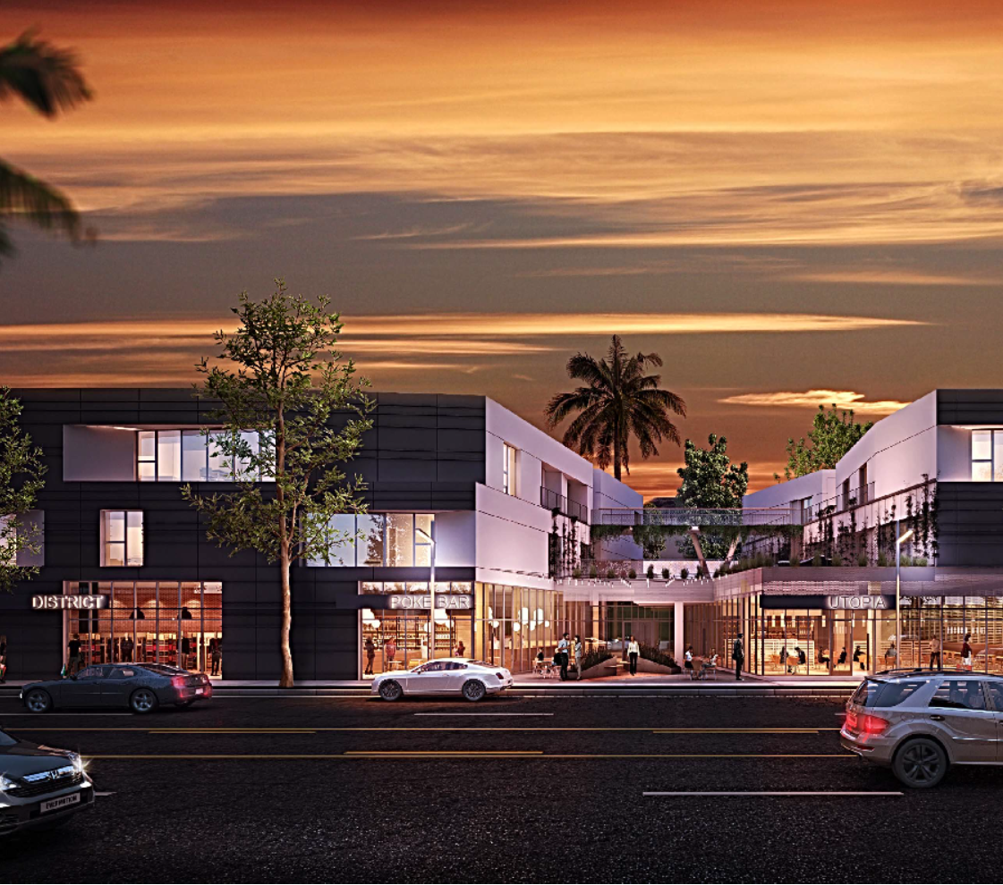
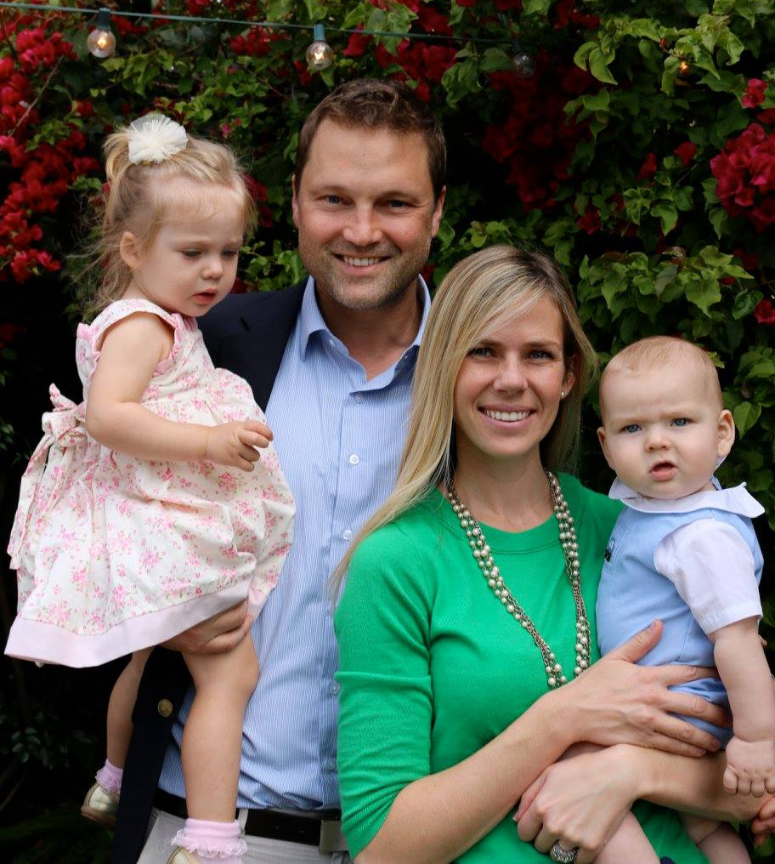
Who I am….
Real estate developer
Mom & wife
Volunteer
Sister, daughter, friend, peer

Slide 3
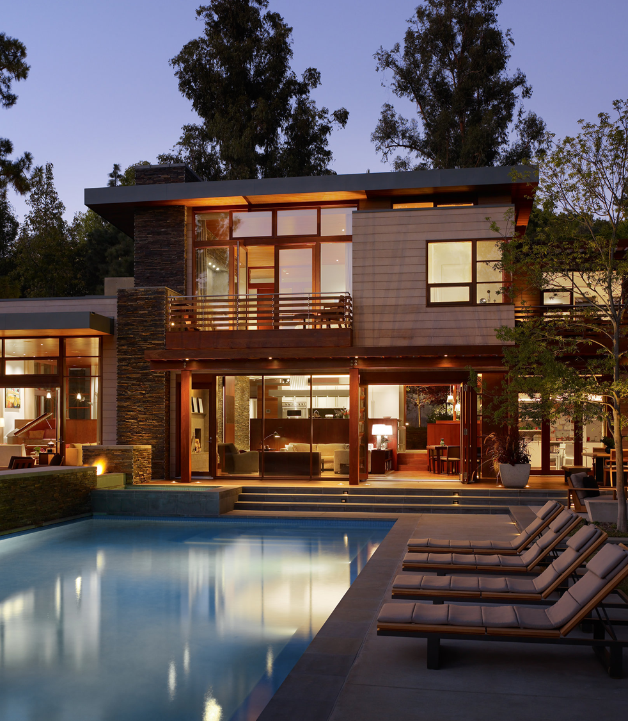
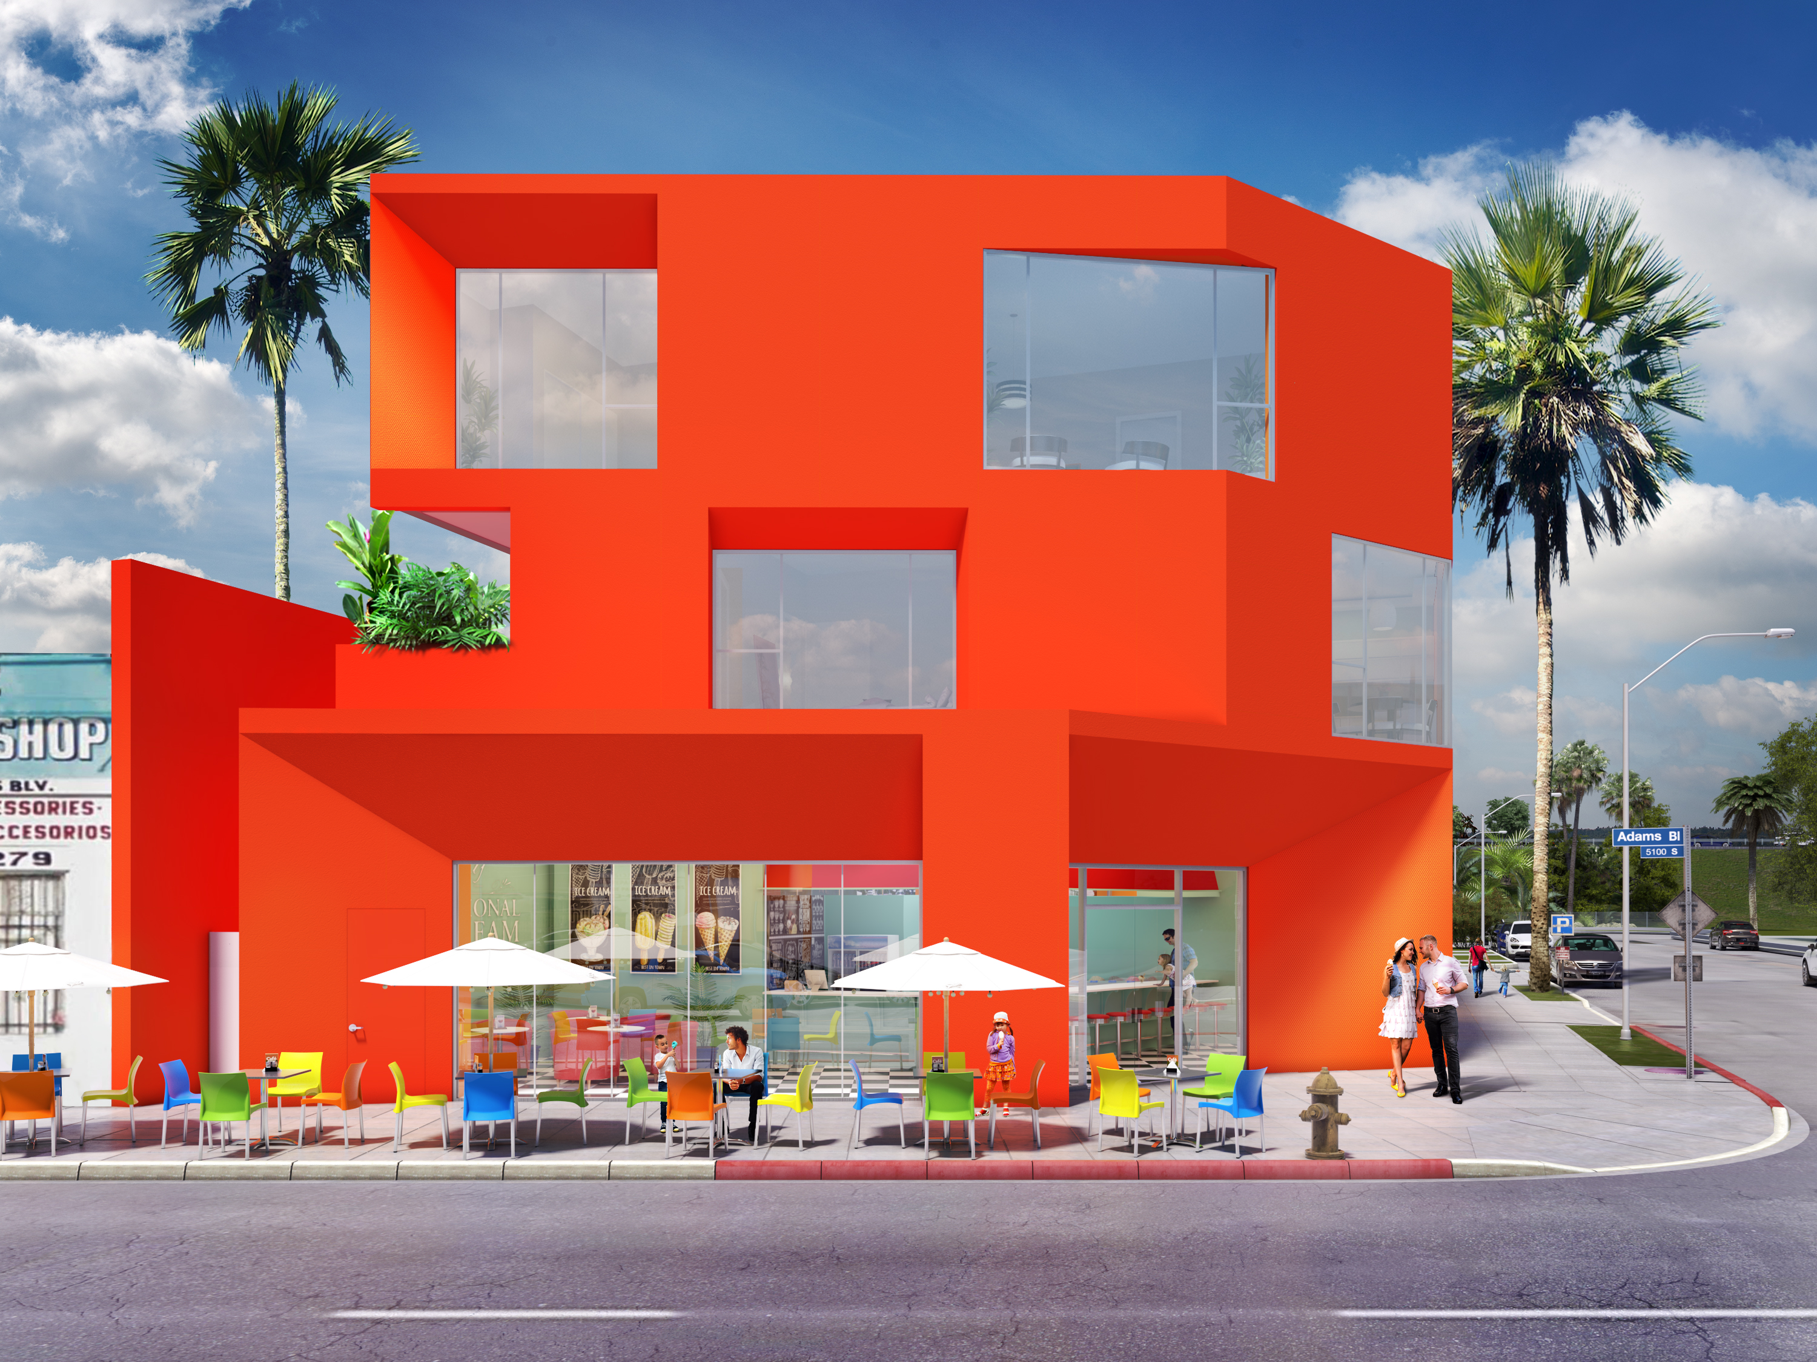
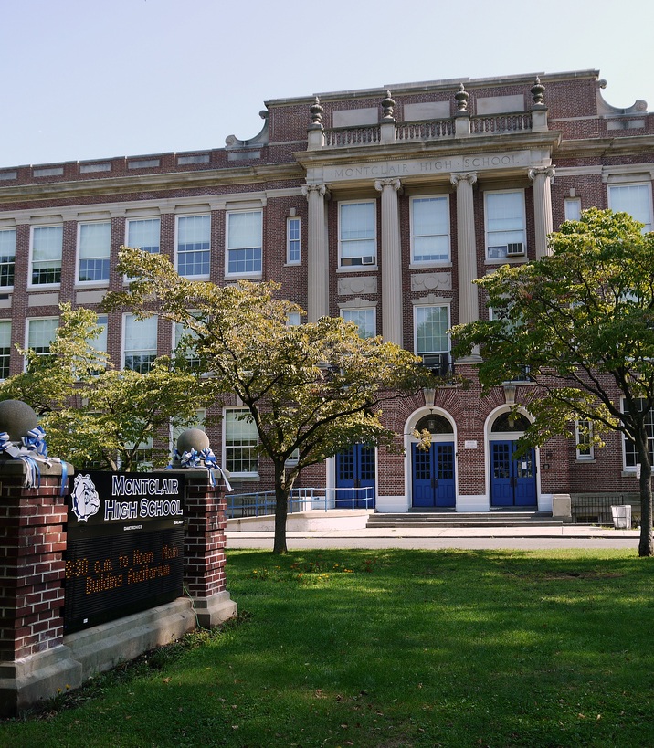
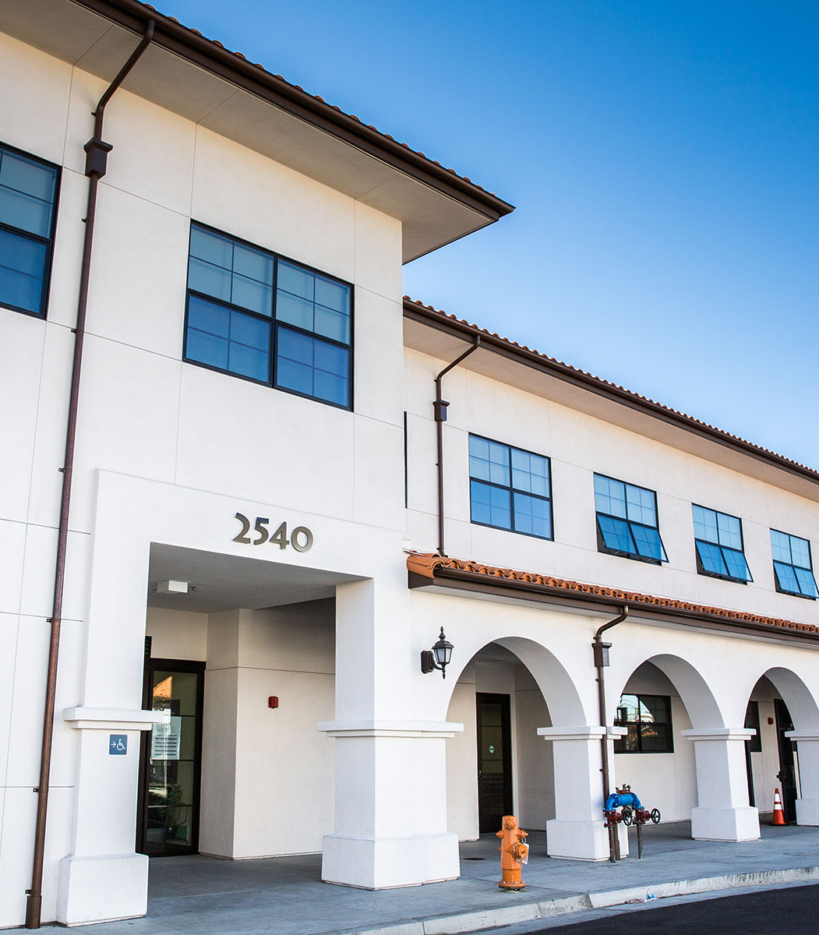
How I got here….
High school
University of Michigan
Rockefeller Partners Architects
UCLA- Anderson
Pacific Charter School Dev
CIM Group

Slide 5
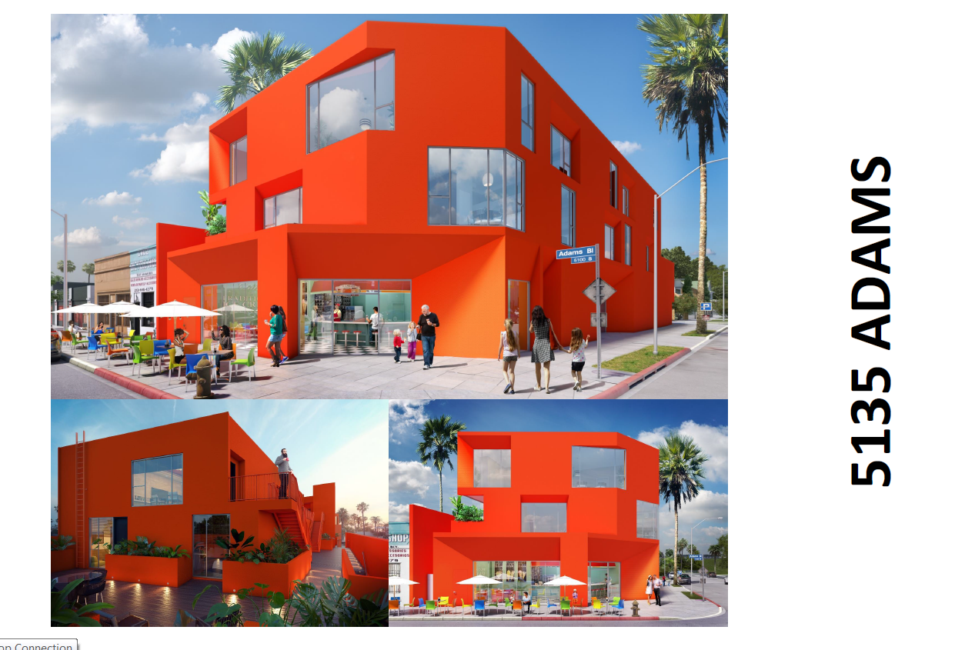

Slide 6
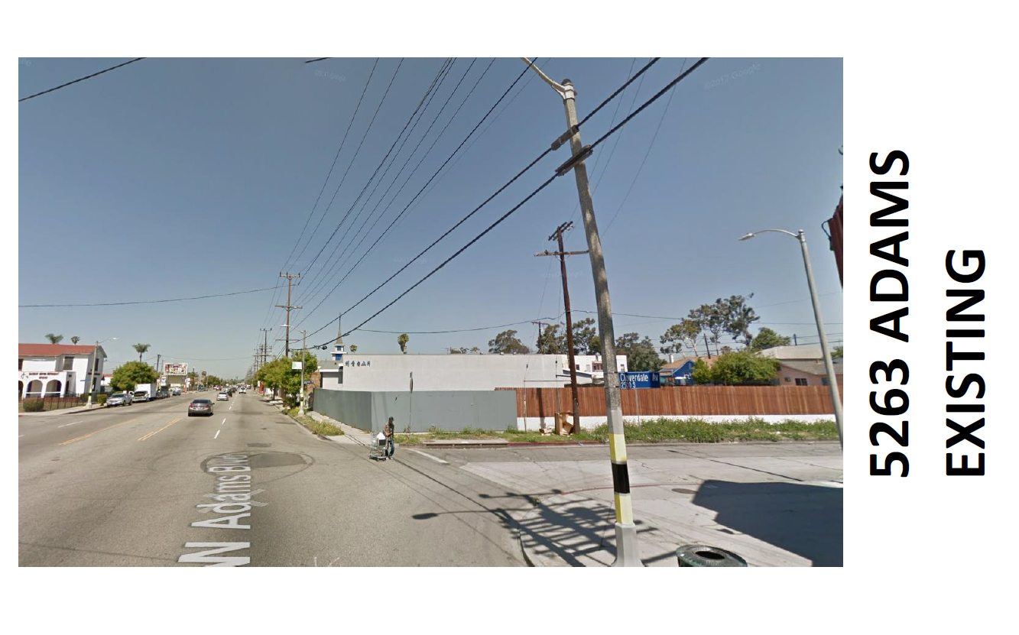

Slide 7
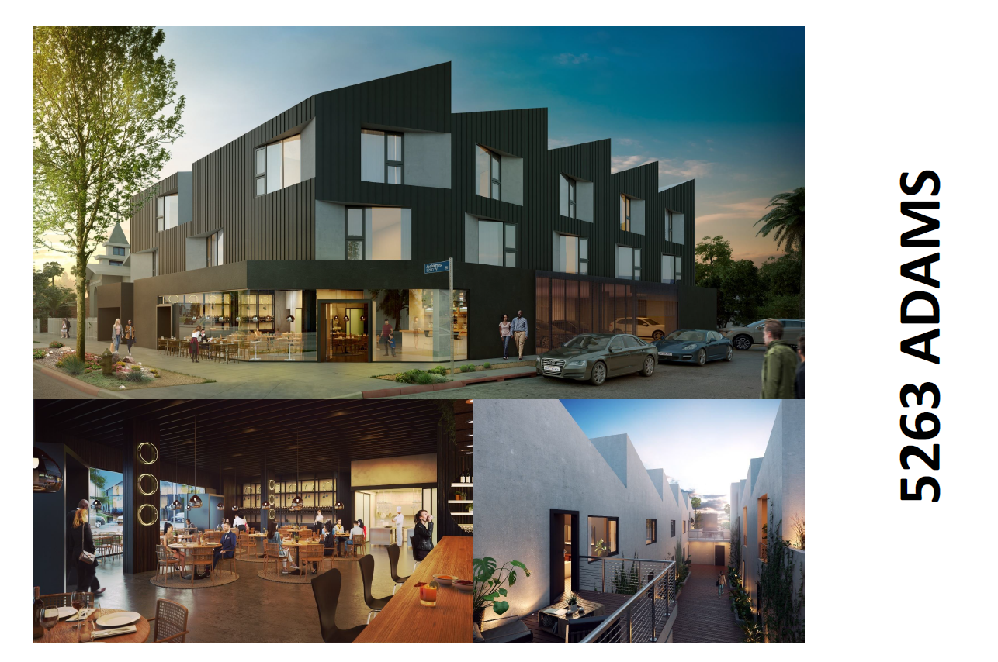

Slide 8
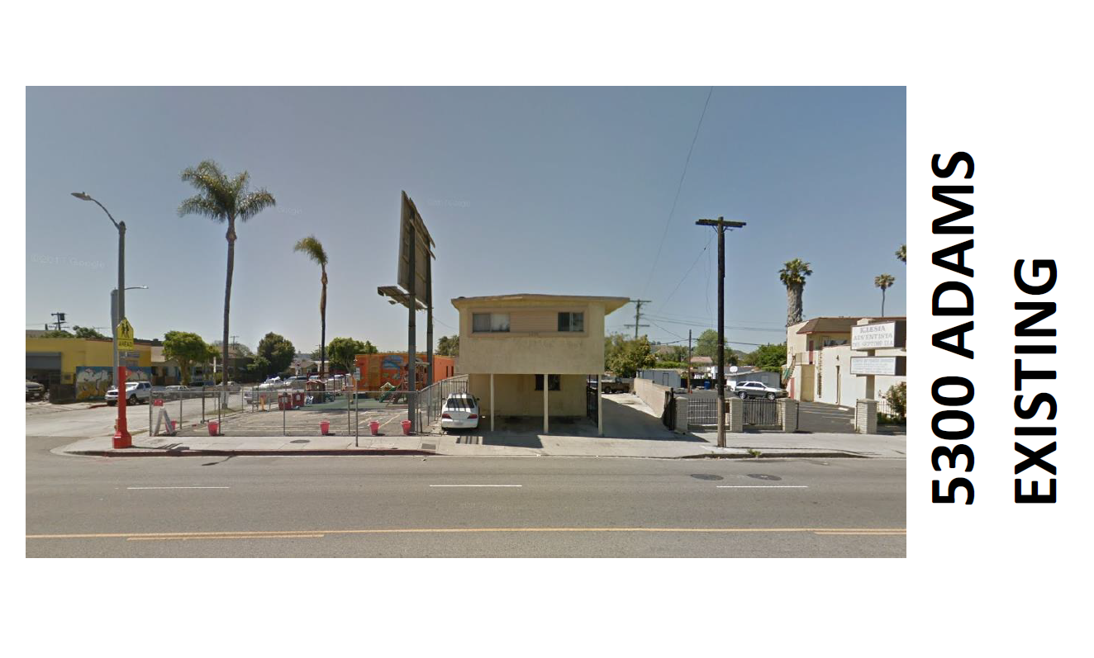

Slide 9
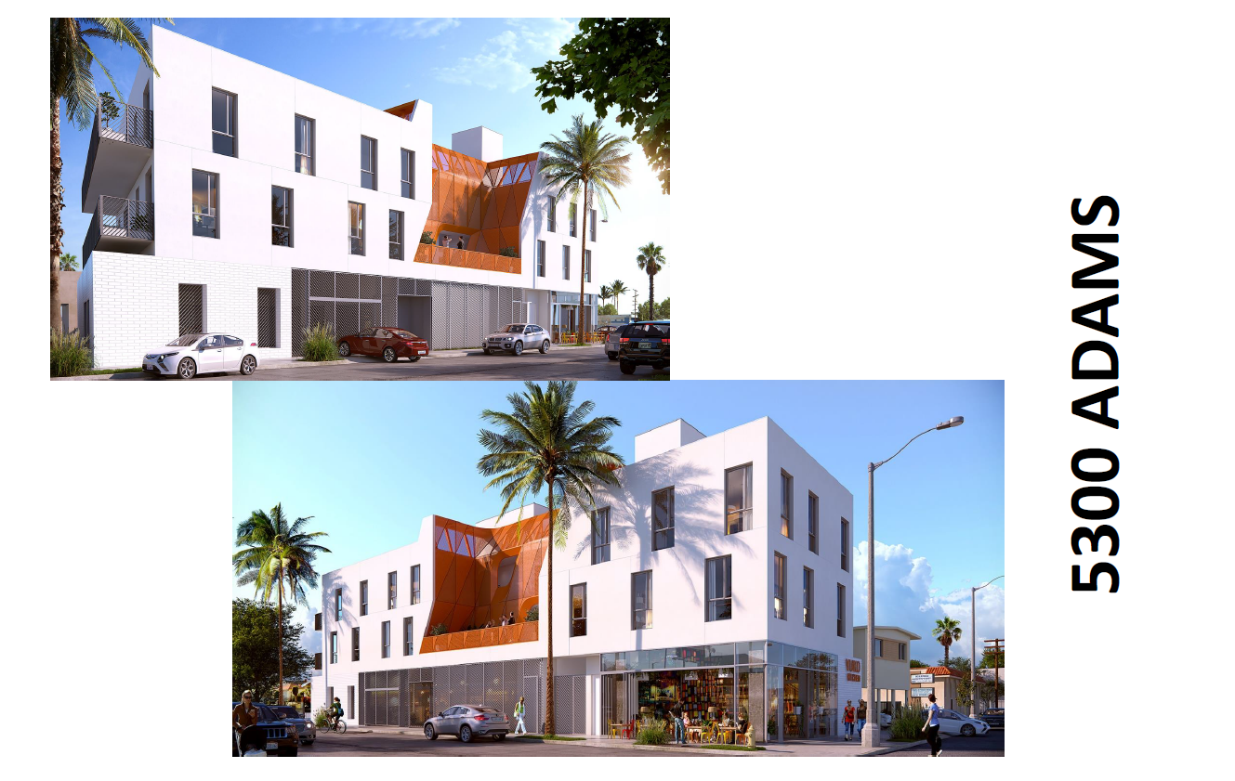

Slide 10
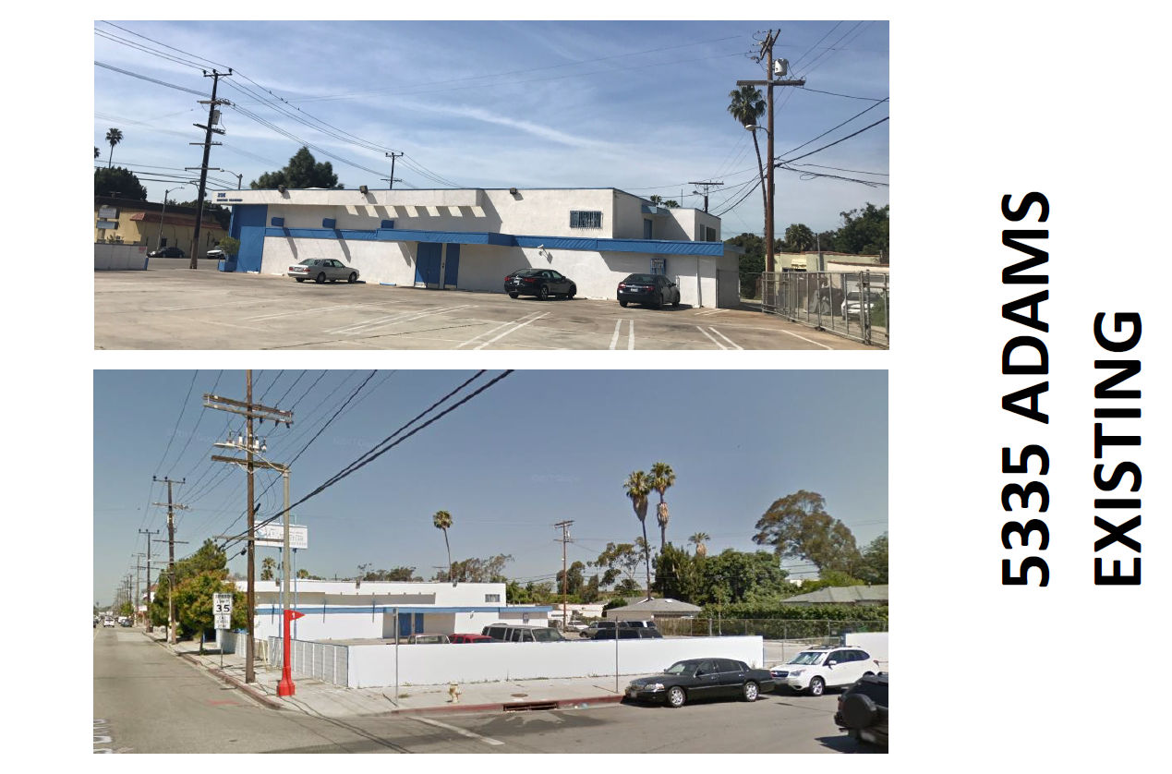

Slide 11
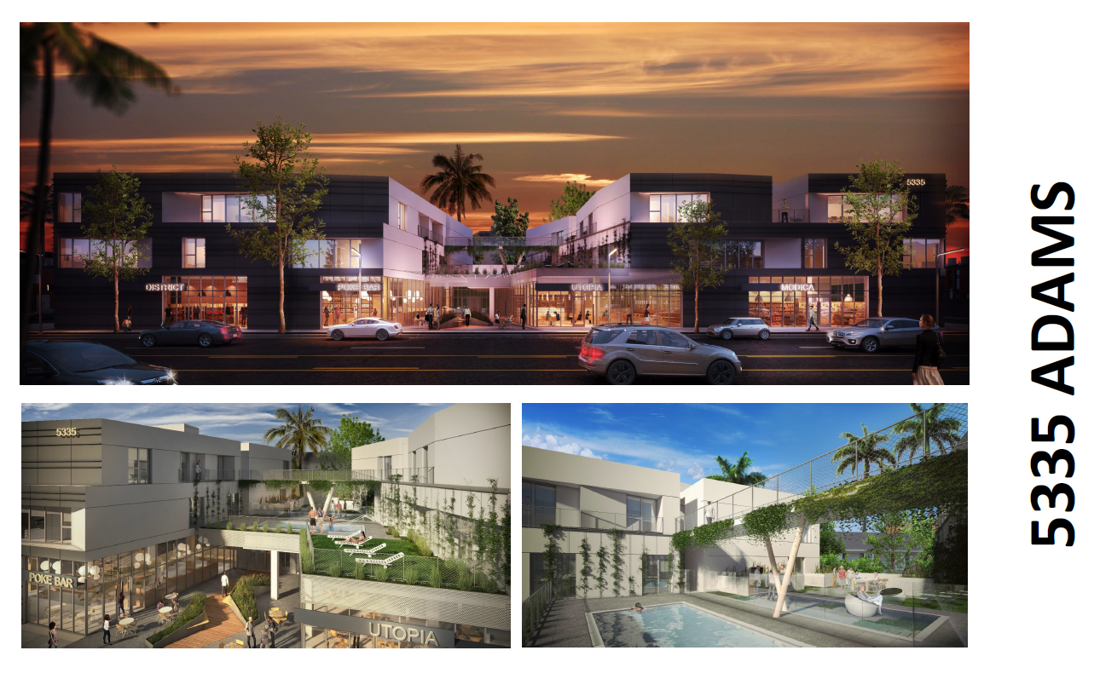

Slide 12
Development overview
Site selection
Identify need
Permitting
Environmental
Secure property
Design
Affordability analysis
Hire professional team
Establish program
Zoning
Constructability
Construction
Hire subcontractors
Oversight & closeout

Slide 13
Case study
Aspire Pacific Academy, Huntington Park

Slide 14
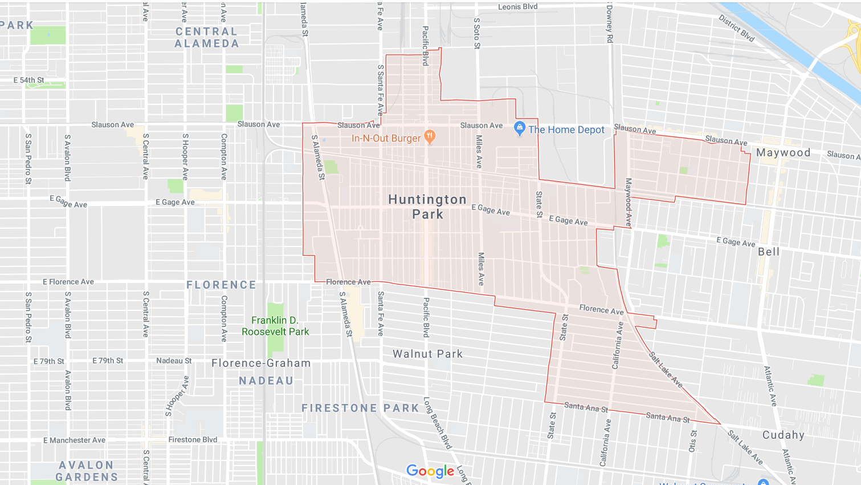
Site Search
Client need
Location
Size

Slide 15
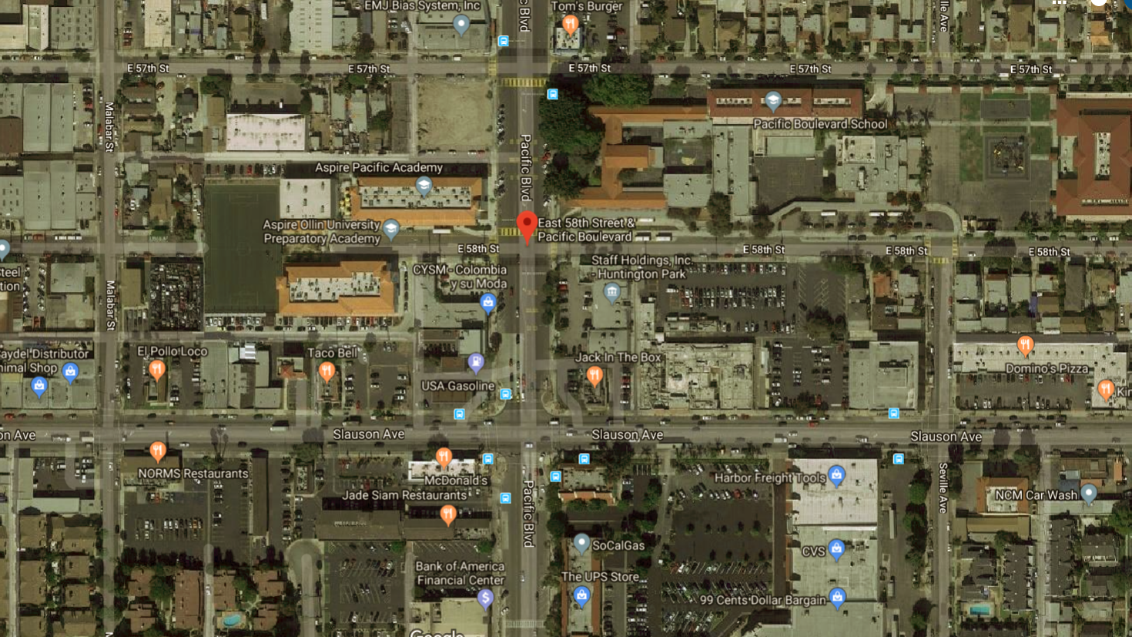
Site Selection
Zoning
Entitlements
Political Support
Environmental Factors

Slide 16
Affordability metrics
Income:
$24,000 per student
980 students
Expense:
$2MM acquisition price
$300/ SF construction costs
20% soft costs
Need:
60SF bldg. per student
Max available project costs:
$24,000 * 980 = $23,520,000
Building size:
60 * 980 = 58,800 SF
Project cost:
58,800 * 300 = $17,640,000
$17,640,000 * (1+ 20%) = $21,168,000
$21,168,000 + $2,000,000 = $23,168,000

Slide 17
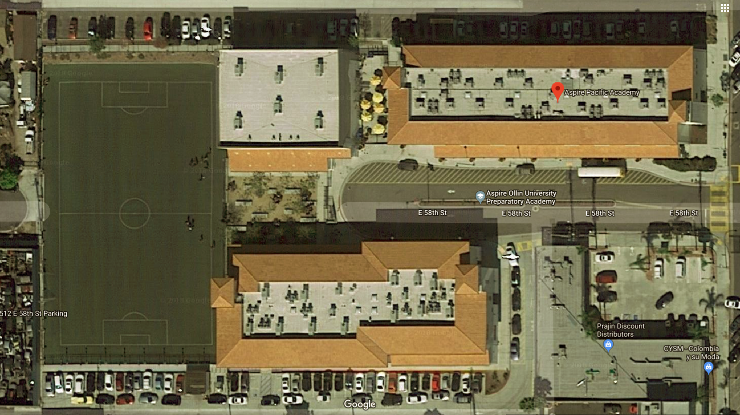
Design
Site size: 2.4 acres (105k SF)
Buildable FAR: 1.5:1
Building height: 45’
Bldg need: 60SF x 980 seats
Soccer Field: 80 x 50 yds
Site plan efficiency: 70%

Slide 18
Class Exercise
Evaluate sites and determine the one best suited for a new 500 seat charter high school.
Assumptions:
Affordability: $24,000 per student
Bldg size based on 60SF per student
New construction @ $300 PSF
TI @ $150 PSF
Soft costs @ 20% of construction costs
FAR: 1.5:1
Max buildable height: 45’

Slide 19
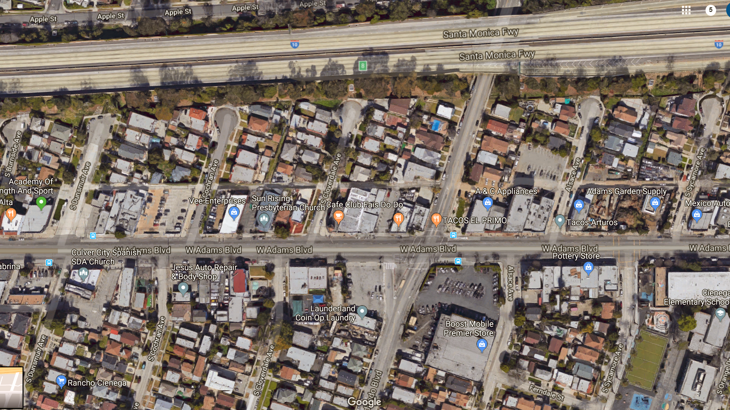
5335 ADAMS: $2.5MM
LAND SIZE: 33,000SF
BLDG SIZE: 13,000SF
5200 ADAMS: $7.5MM
LAND SIZE: 67,000SF
BLDG SIZE: 25,000SF

Slide 20
Q&A

