Slide 1
Youth business alliance
K.C. Newton

Slide 2
INTRODUCTION
My name is K.C. and I am OLD.
I am the founder of OMNI Consulting Solutions, L.L.C.
My company does:
Help the military buy things to help the US warfighter
My role at OMNI is Chief Executive Officer
Every day I “make friends”. I recruit potential employees; I meet with customers about their needs; I discuss partnering with other companies to win work

Slide 3
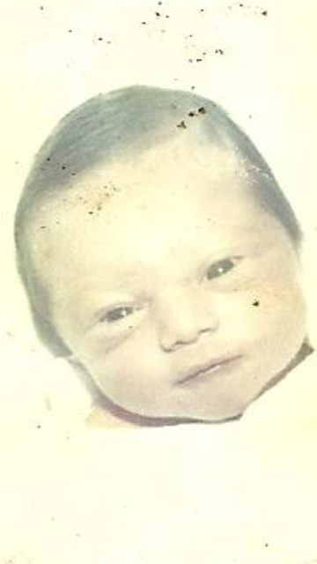
My childhood
I was born in Inglewood and raised in Victorville
This is a picture of me just months old

Slide 4
My family
A little about my family
I am from a divorced family where both sides were poor. I lived with my father and visited my mother every other weekend and summers. Alcohol and drugs were everywhere. You could say I raised myself.
I couldn’t find a picture of my family growing up

Slide 5
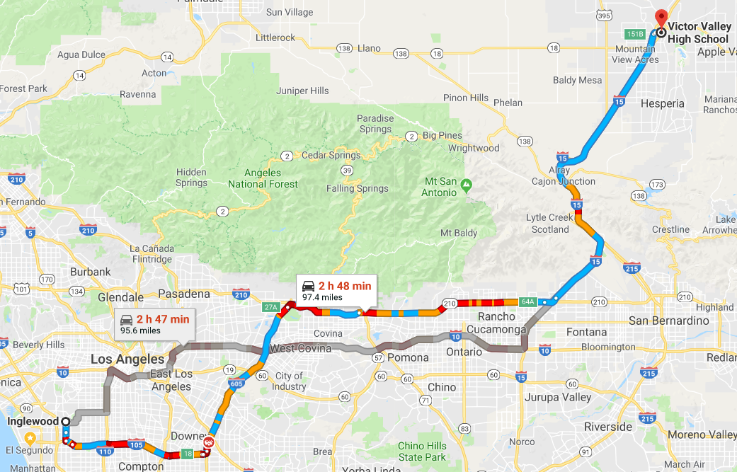
MY HIGH SCHOOL
I attended Victor Valley HS in Victorville, CA

Slide 6
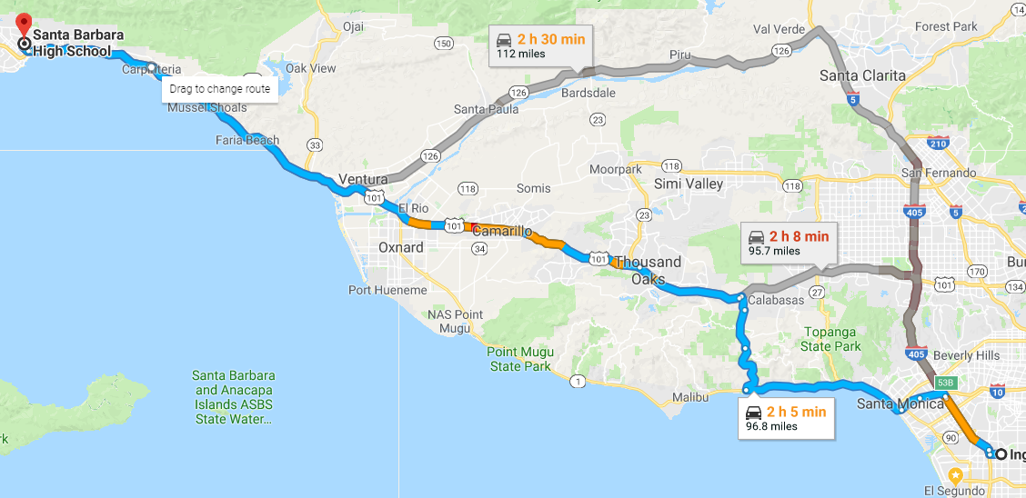
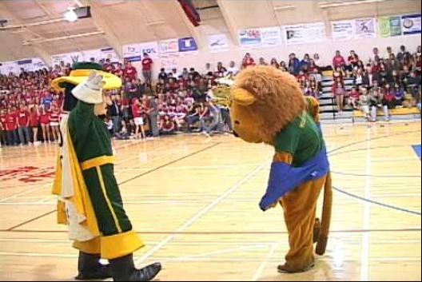
MY other HIGH SCHOOL
I attended Santa Barbara HS in Santa Barbara, CA my junior and senior year

Slide 7
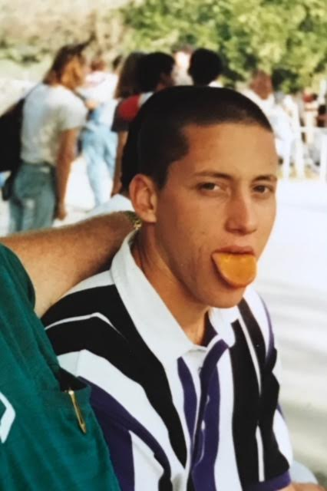
High School
As a HS student I was painfully shy but I was athletic and I thought I could get a baseball scholarship.
Here is a picture of me in HS

Slide 8
High School
Things that I really liked in High School were:
Baseball
Learning

Slide 9
High School
Things that felt difficult or challenging for me while I was in High School were:
Feeling like I didn’t belong
Biology and Spanish
I overcame it through perseverance
I knew that I could control the amount of effort that I put into something – “No one could out hustle me”.

Slide 10
High School
Jobs I worked while I was in High School were:
I got my first job when I was 15 ½ as a servers assistant; I had so much money and it was an awesome feeling.

Slide 11
Getting in to College
The top few things I did to ensure I got into college were:
Grades; retaking classes if I needed to raise my grade
Sports, extra-studying, charity work, SAT prep and SAT tests
Persistence-persistence-persistence

Slide 12
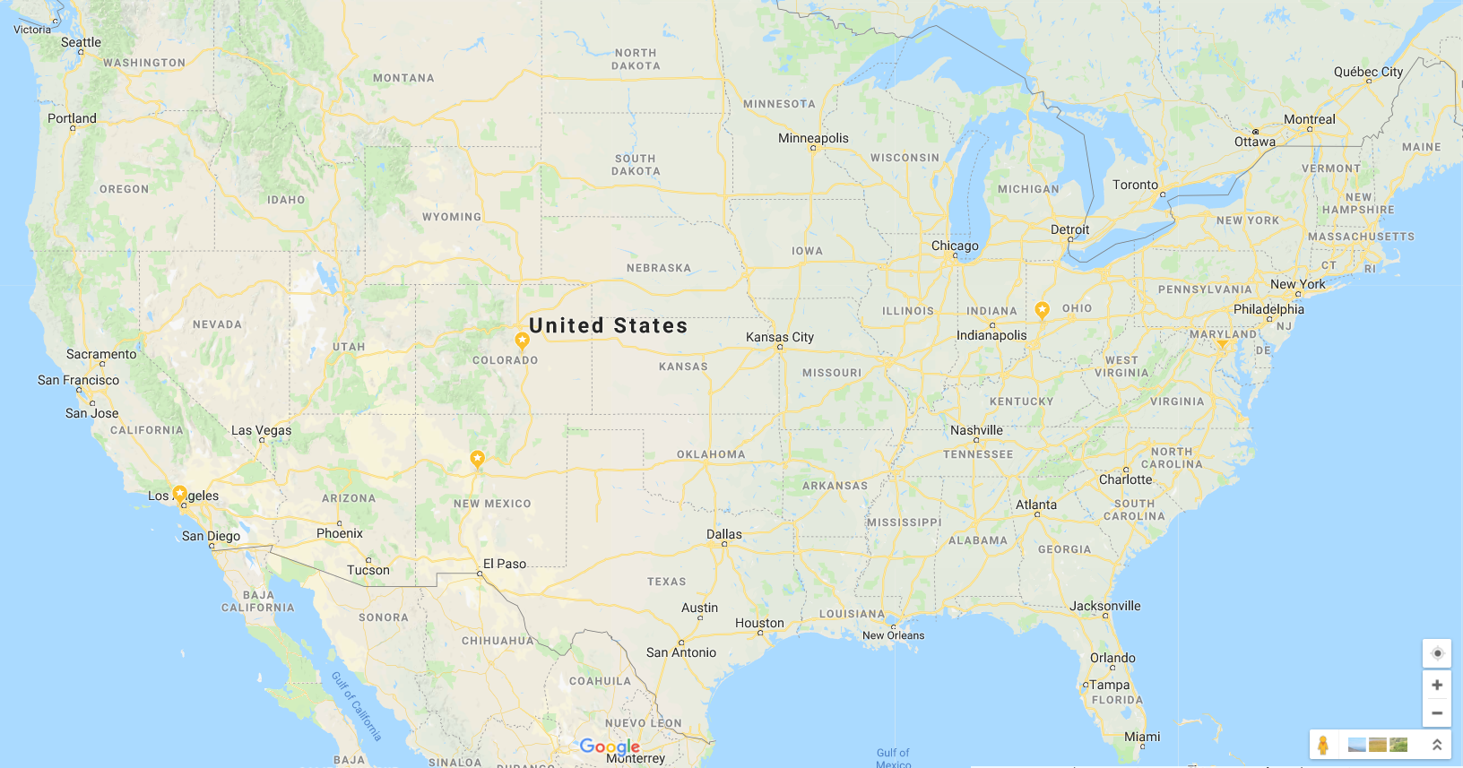
College
I graduated from the United States Air Force Academy in Colorado Springs, CO and University of Maryland in University Park, Maryland
Insert map shot here

Slide 13
College
Things I enjoyed in College
Things I didn’t enjoy in College
Proving that I belonged
Friends
Girls
Learning
Flying planes
Summer internship in Guam and Okinawa
All nighters
Computer Science
Saturday morning inspections

Slide 14
College
Favorite classes
Least favorite classes
All my business classes
Mechanical engineering
Summer programs
Thermodynamics
Electrical Engineering
Biology

Slide 15
College
Jobs I worked while I was in College were:
Grocery stocker
Forklift driver
Truck washer
Shipping and receiving clerk
Dock loader
Valet parker
Auto salesperson

Slide 16
College
Things that felt difficult or challenging for me while I was in College were:
Catching up to my peers scholastically
Working full-time and going to school full-time; night shift….
“Learning” military discipline

Slide 17
Getting a job after College
The top few things I did to ensure I got a good job after college were:
Follow-orders
Self-starter; self-motivated
Believe in yourself

Slide 18
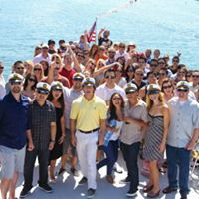
This is My Company
Every day at my company:
I solve new challenges everyday, inspire others to believe in themselves and achieve more than they think is possible. We started in 2012 with just two people and now we are nationwide with 40. I provide military leaders with knowledge and information so they can buy the most advanced systems on the Earth in support of the US military warfighter.

Slide 19
My Career Path
I got a job as a military analyst with a company similar to OMNI where I learned about the business of supporting the military
I learned about the business of the military while serving in the military
I am now the CEO of OMNI….
Notes:
You may use this chart to describe your journey to the current career

Slide 20
My Career
The first job I had after college was:
Contracting officer in the Air Force
The worst job I have ever had was:
Wrapping cellophane around cardboard software boxes; I knew that I had to continue grinding my way through college

Slide 21
My Career
Challenges I have had to overcome throughout my career are:
Overcoming obstacles of all kinds – my background, education, age, personal set backs (divorce, Dan, Katelyn, children)

Slide 22
My role within organization
CEO
Functional Leads
Functional Leads
Functional Leads
Functional Leads
Project Manager
Project Manager
Project Manager
Project-Matrixed Employees
Notes:
Use this graph to give more description of your role specifically (responsibilities, typical work week, direct reports, etc.)

Slide 23
Compensation at my company
C-Suite
($300K)
Management
($140K)
Middle Manager
($95K)
Entry Level
($50K)
Notes:
Use this graph to show general compensation ranges for people in various roles in your company

Slide 24
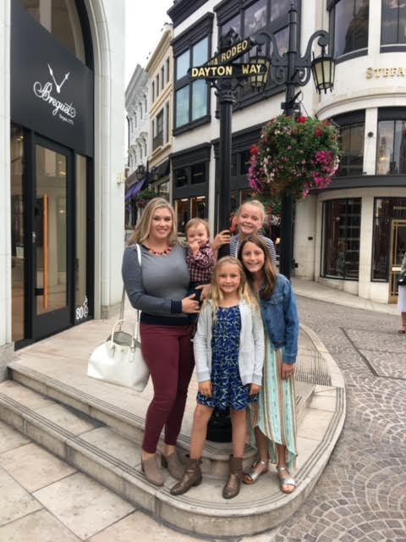
More than just work
When I am not at work I like to:
Travel, read, learn new things, bike, work on my house, watch football with friends

Slide 25
Do it all over again?
If I could talk to my high school self, what would I say?
Don’t listen to “the negative”
You will persevere
Do what is right even when no one is watching - INTEGRITY

Slide 26
QUESTION AND ANSWER

