Slide 1
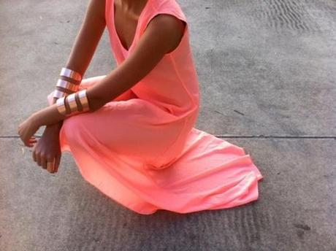
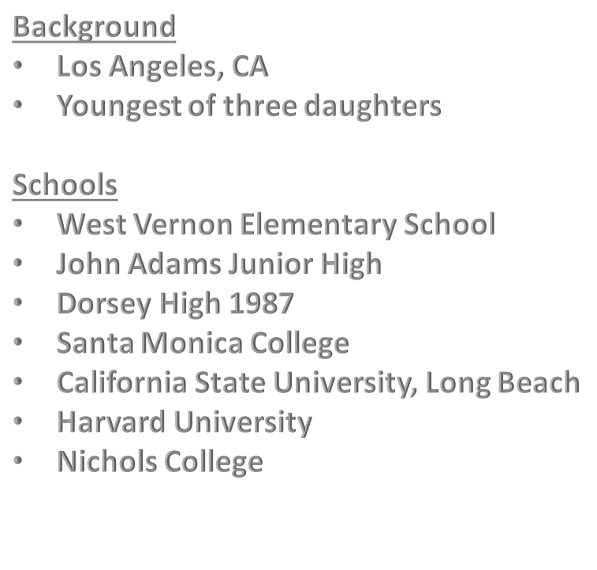
Carolyn Mathis
Assoc. Vice President, Human Resources
Pacific Oaks College & Children’s School
Youth Business Alliance
Manual Arts High School
March 15, 2018

Slide 2
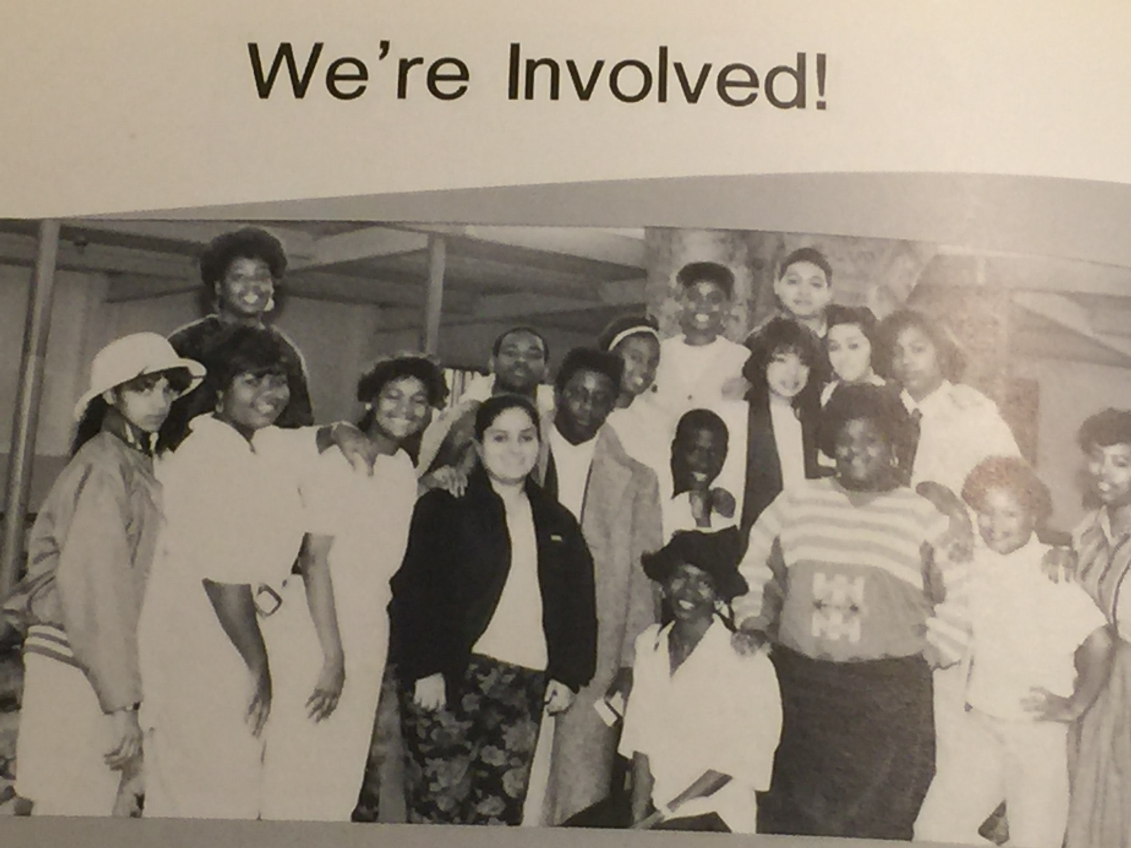
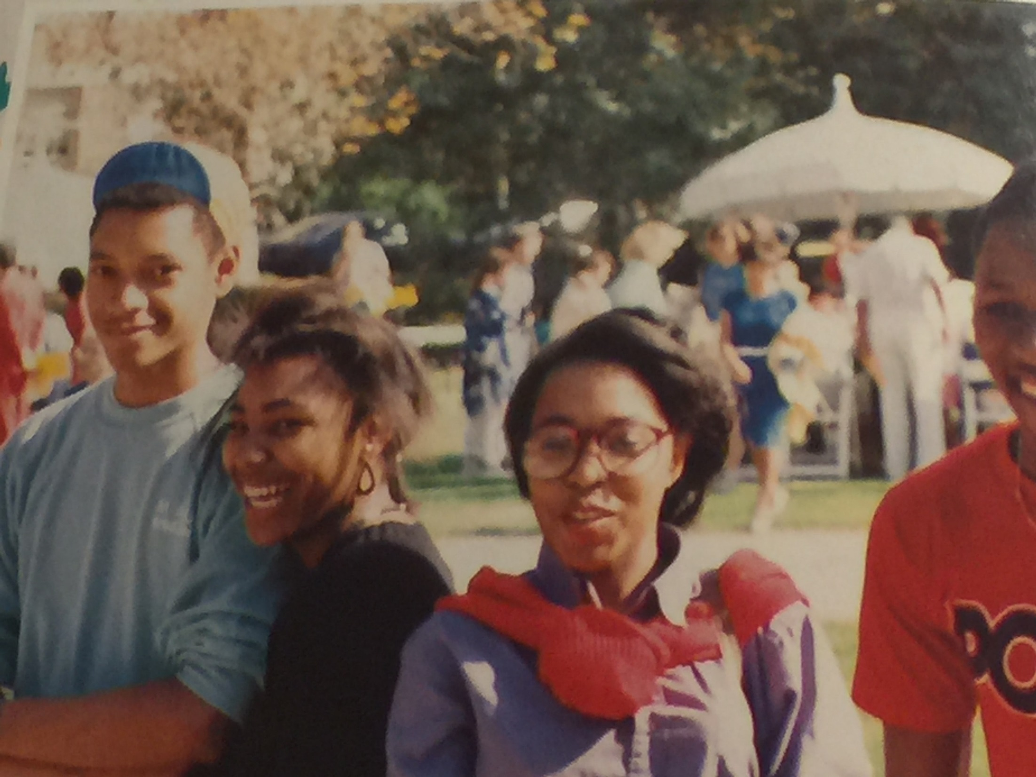
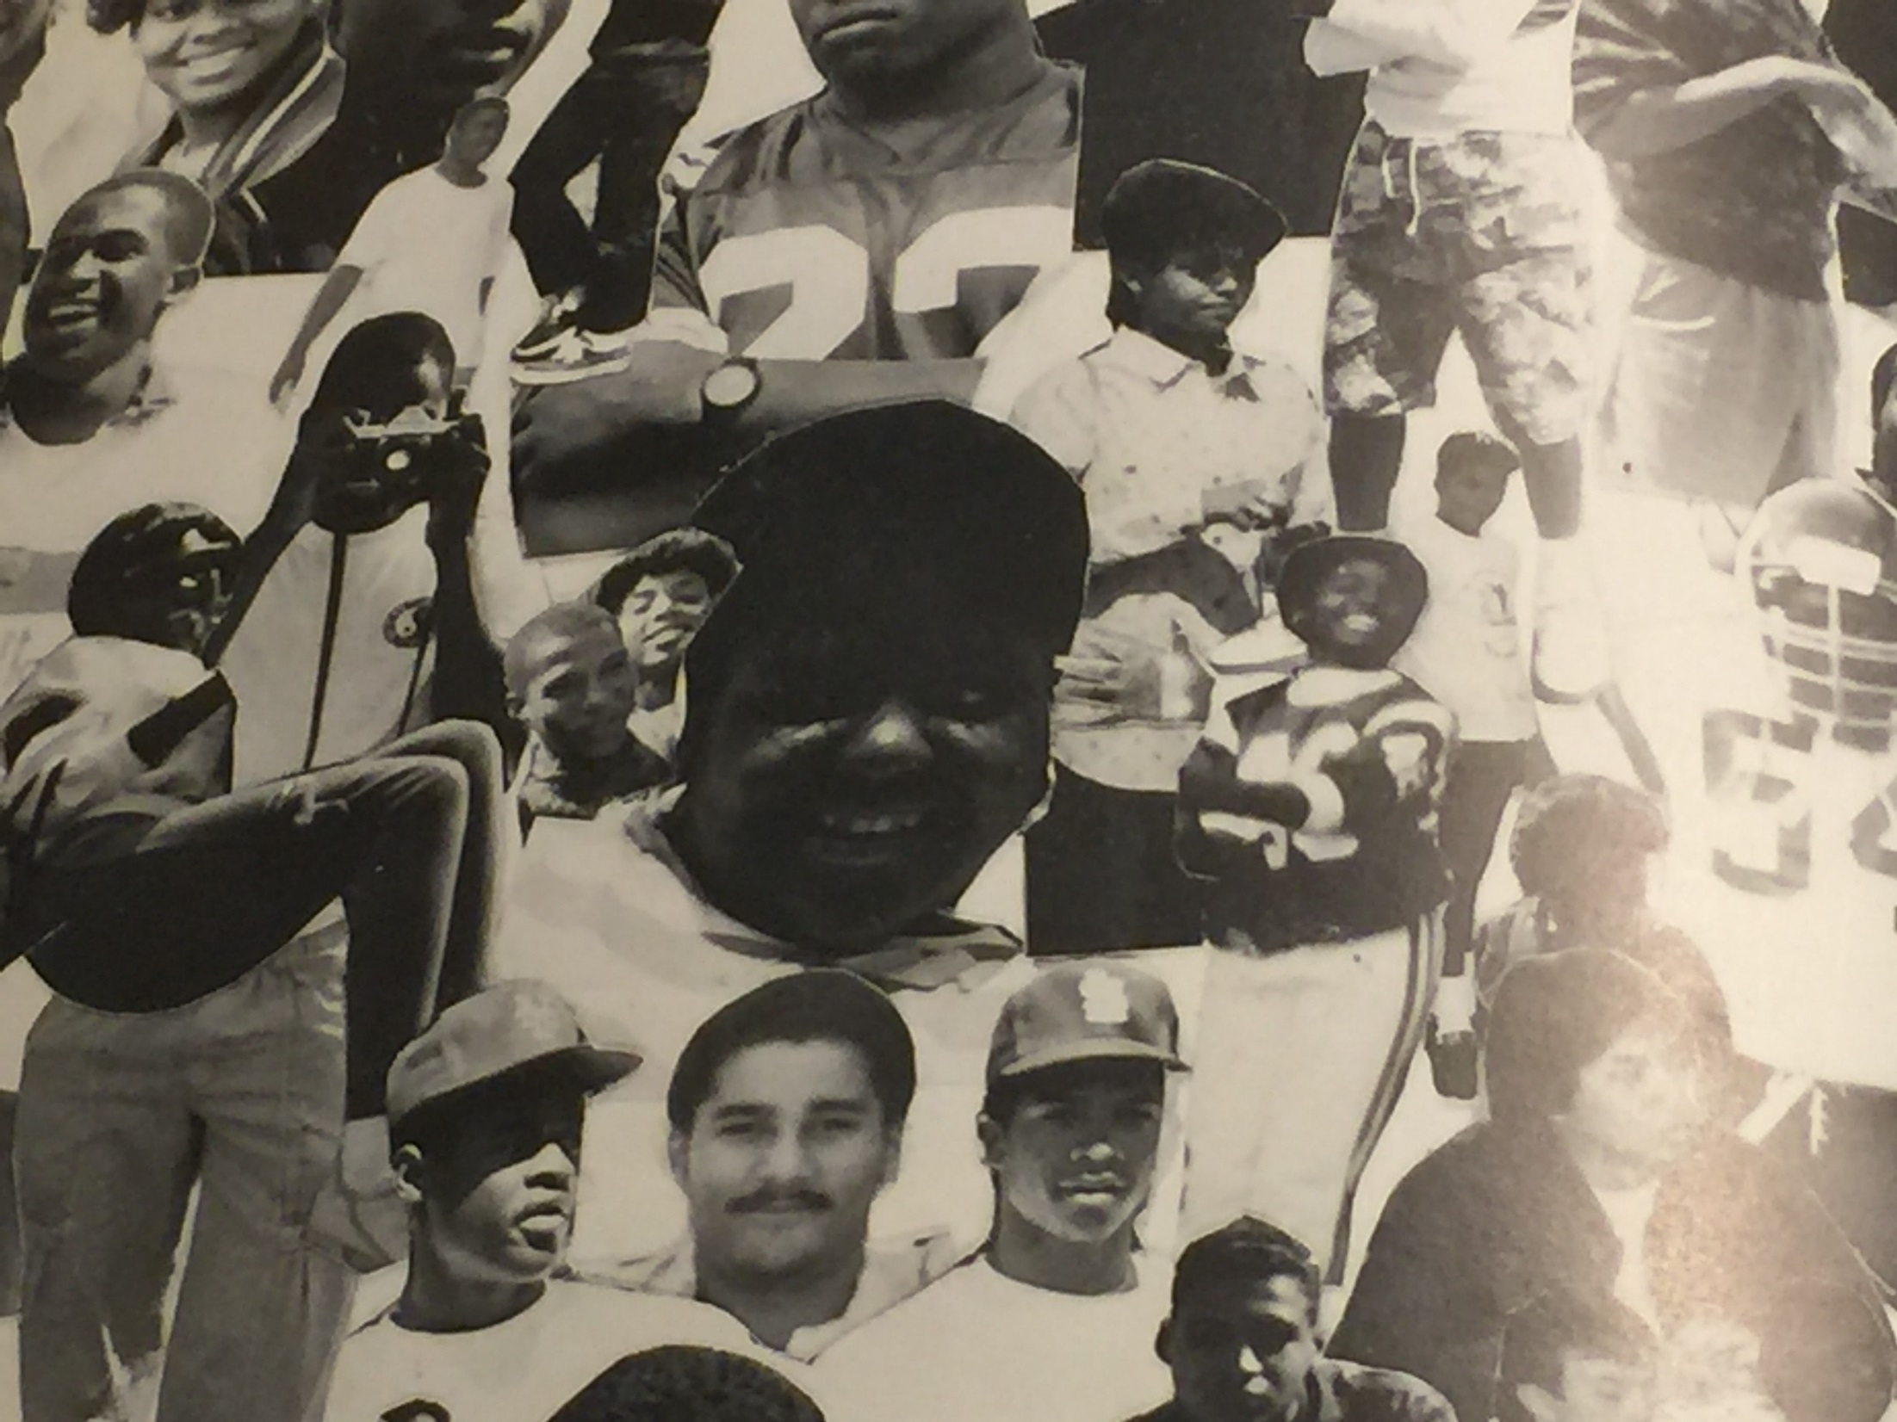
Create Your Story

Slide 3
Bank Teller
Writer
Salesperson
Receptionist
Fashion show dresser
Campaign Rep

Slide 4
Human Resources

Slide 5
Human Resources
Recruit and hire new employees
Training and development
Compensation
Employee Relations & Employment Laws
Rewards and recognition
Benefits
Safety
Project Management

Slide 6
Recruitment: Dressing for an interview
Using a few basic pieces, it's easy to put together an outfit that is stylish, professional, and tasteful.
Your suit should be comfortable and fit you well so that you look and act your best.
Avoid loud colors and flashy ties.
Interview suits should be simple and dark in color.
Keep your jewelry and hair accessories to a minimum, and stick to those that are not flashy, distracting, or shiny.
Shoes should be conservative and fairly low-heeled. While interviews at startup companies or for non-professional jobs signify a more casual look, if you're interviewing for a professional position, it's important that you stick with a formal look.
A pair of classic black slacks is an essential part of a woman's interview wardrobe. It's worth it to invest in a pair of quality black dress pants that fit well and will hold up after many wears.
A tasteful dress in an interesting color, such as a muted turquoise or deep red, is a good addition to your interview wardrobe.
Notes:
Dress in a manner that is professionally appropriate to the position for which you are applying.
Before you say a single word to the interviewer, you have already made an impression based on how you’re dressed.
The guidelines given here are commonly accepted as appropriate for interviewing. Every company has a different dress code; how you dress at the job may have very little to do with how you dress for an interview.

Slide 7
Recruitment: Interview Questions
Tell me about yourself.
Where do you see yourself in five years?
Why should we hire you?
Why do you want to work here?
What do you know about us?
How do people describe you?
What is your greatest strength/ greatest weakness?
How did you find this job?
Why do you want this job?
Why do you want to leave your current job?

Slide 8
Kahoot

Slide 9
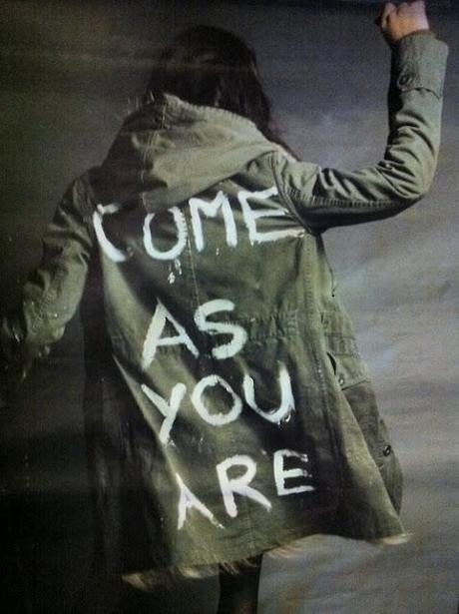
Sometimes you don’t choose your career,
sometimes your career chooses you...

