Slide 1
YBA GUEST RESOURCE TEMPLATE

Slide 2
INTRODUCTION
My name is Ben Smith and I am 35 years old.
I work for Athletic Greens
My company does: Inspires fulfilling lives, starting with a focus on health, by providing 75 whole-food sourced vitamins, minerals, pre and probiotics.
My role at Athletic Greens, is Chief Operating Officer (COO)
Every day I am ensuring our product is being manufactured and distributed to our ~20,000 monthly subscribers around the world.
I am responsible for our customer experience and overall business operations.

Slide 3
My childhood
I was born and raised in Sydney, Australia
This is a picture of me as a kid, I guess thinking I was going to be a pirate.

Slide 4
My family
A little about my family
I have an older sister
My father is an electrician and my mother mostly worked in customer service
We grew up in a semi rural town on 5 acres without a lot of money
My parents separated when I was 10, my sister went to live with my mother and I stayed with my father. This was a challenging time for our family but one thing that my parents did was put their differences aside so that the separation had as little impact on my sister and I as possible. I learnt a lot of leadership lessons in this experience.

Slide 5
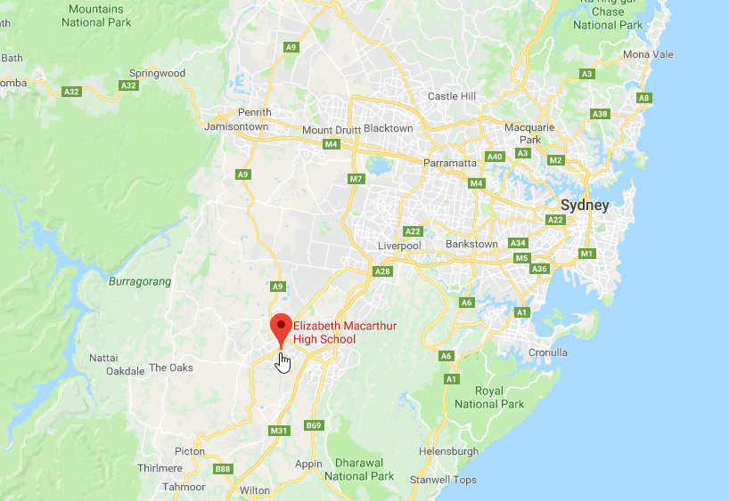
MY HIGH SCHOOL
I attended Elizabeth Macarthur HS in Narellan, NSW, Australia

Slide 6
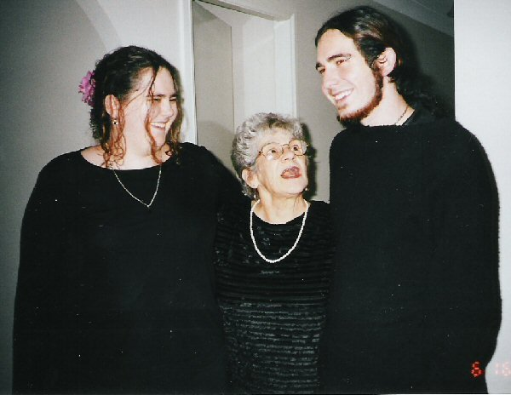
High School
As a HS student I was a bit of a goth, into alternative music, heavy metal and wearing a lot of black!
Here is a picture of me in HS, with my sister and grandmother

Slide 7
High School
Things that I really liked in High School were:
Making friends
Playing sport
Music class

Slide 8
High School
Things that felt difficult or challenging for me while I was in High School were:
Being a bit of an outcast in terms of styles and tastes
Staying focused at times during subjects that were less interesting to me at the time
I was a little bit shy. I liked the girls, but didn’t have the guts to ask them out!

Slide 9
High School
Jobs I worked while I was in High School were:
I did a work experience stint in a guitar store, it was not as exciting as I had hoped!
I worked for my father occasionally
I was actually knocked back for a job at KFC, I guess they didn’t want a metal head scaring of their customers!

Slide 10
Getting in to College
The top few things I did to ensure I got into college were:
I did things a little differently and went to college in my later years. I did not know what I wanted to do when I left school and didn’t want to get a college degree in something I wouldn’t use.
When the time came around to enroll I made sure my application was perfect and asked for help to improve what I had done.

Slide 11
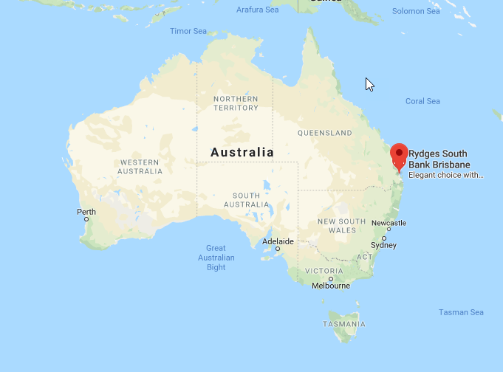
College
I attended college (and) grad school in Brisbane, QLD, Australia

Slide 12
College
Favorite classes
Least favorite classes
Supply Chain
Project Management
Economics
Analysis
Technology
Marketing
Finance

Slide 13
College
Jobs I worked while I was in College were:
I worked full time and studied part time, I was working for a Logistics Company when I was at college.

Slide 14
College
Things that felt difficult or challenging for me while I was in College were:
Balancing work/college/life balance
Not having peer support (I was doing this online)

Slide 15
Getting a job after College
The top few things I did to ensure I got a good job after college were:
Had several people help build my resume
Offer to help some business on weekends or after hours so I could add them to my resume

Slide 16
This is My Company
Every day at my company:
Athletic Greens have innovated on our product 51 times to ensure it is the best it can be.
We continue to grow at a rapid rate so one of my areas of focus is to ensure we can continue to scale, without impacting customer experience

Slide 17
My Career Path
Worked in a steel factory
Started working for my dad!
Was promoted to the logistics office
Held several mid-senior level roles in Australia, UK and China over the next 10 years
I am now the COO for Athletic Greens, previously COO for Sugarfina and Fame & Partners
Notes:
You may use this chart to describe your journey to the current career

Slide 18
My Career
The first job I had after college was:
Working for my father who was an electrician. I was knocked back for a job at KFC…
The worst job I have ever had was:
Working at a glass factory unloading containers of very heavy glass sheets, I dropped and shattered several!

Slide 19
My Career
Challenges I have had to overcome throughout my career are:
Being a young manager was challenging, I had to learn how to deal with many different personalities and learn that mutual respect is incredibly important
Asking for help when I really needed it

Slide 20
My role within organization
CEO
COO (ME)
Head of Finance
VP Marketing
VP of Strategic Partnerships
Head of Product Safety & Development
VP of China
Head of Supply Chain
Head of Fulfillment & Distribution
Head of Technology
Head of Customer Happiness
Notes:
Use this graph to give more description of your role specifically (responsibilities, typical work week, direct reports, etc.)

Slide 21
Compensation at my company
C-Suite
($250K)+
Management
($120K)
Middle Manager
(75$)
Entry Level
($30K)
Notes:
Use this graph to show general compensation ranges for people in various roles in your company

Slide 22
More than just work
When I am not at work I like to:
Travel – I love the USA, it’s a beautiful country with so much to see
Listening to Podcasts
Watching movies
Playing guitar, listening to music

Slide 23
Do it all over again?
If I could talk to my high school self, what would I say?
It isn’t that hard to focus and learn if you put your mind to it
Learn now so it’s easier in college/work
Ask for help with subjects I didn’t like. Typically I didn’t like what I didn’t understand – learning about this has changed my approach today.
Be a little nicer to the teachers, they’re doing their job they really want to help make a difference in your life.
You might not know exactly what you want to do and that’s OK but having some tertiary education will help you determine what you do and don’t like

Slide 24
Questions?

