Slide 1
YBA GUEST VICKY SCHIFF Managing Partner, Oro Capital Advisors
Real Estate and Investing

Slide 2
INTRODUCTION
My name is Vicky Schiff and I am 49 (don’t tell anyone!) years old.
I live with my husband and son in Pacific Palisades, CA
My husband restores vintage Ford Broncos (cool!)
I am a partner at Oro Capital Advisors and in my career history, I have founded 4 companies in real estate investment and advisory businesses.
Oro Capital buys apartments, industrial properties and grocery anchored retail centers across the US.
I am the Founder and Co-Managing Partner of the firm and am active in management of the firm, sourcing transactions and developing new opportunities both inside and outside the firm.

Slide 3
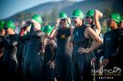
INTRODUCTION
I’m a mom of a 6 year old boy and love doing triathlons for fun (really, it is fun!)

Slide 4
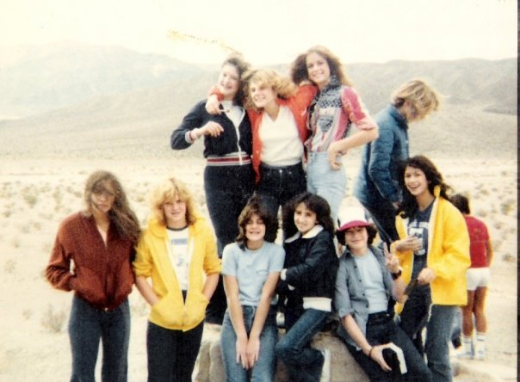
The Early Years…
I was born and raised in Las Vegas, Nevada
This is a picture of me at 3 years old at the construction of Circus Circus!
This is a picture of me at 14 on a field trip with my best girl friends.

Slide 5
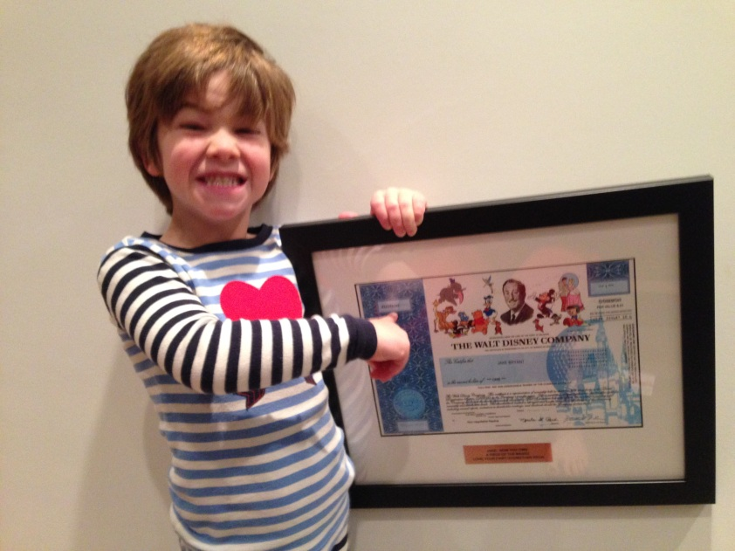
My FAMILY…
A little more about me and my family…
This is a picture of my vision board
This is a picture of my son Jake with his first share of dividend paying stock! (More about that later)

Slide 6
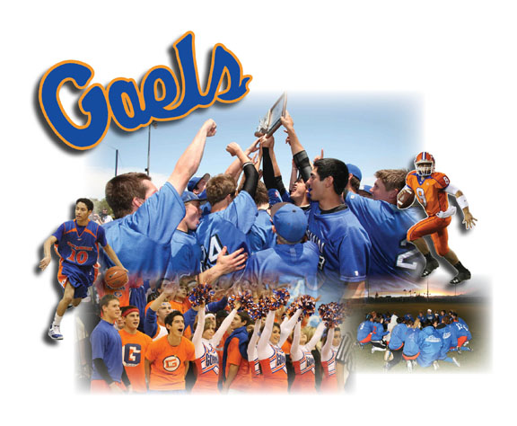
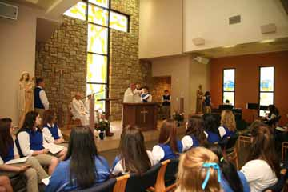
HIGH SCHOOL
I attended Bishop Gorman High School in Las Vegas
\

Slide 7
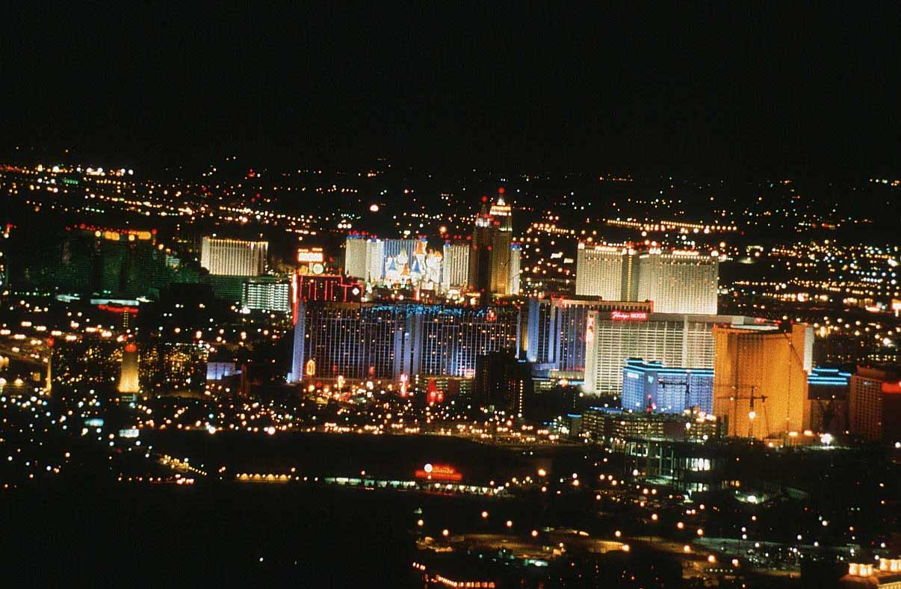
HIGH SCHOOL
As a HS student I was involved in yearbook but mostly I didn’t take school seriously overall. Being naturally smart was a handicap for me because at the time I didn’t realize I should have worked twice as hard.
As a HS student I was always trying to be cool and hung out with a diverse group of people but sometimes didn’t feel like I fit in. Las Vegas was also an interesting environment…I’ll explain.

Slide 8
HIGH SCHOOL
Things I enjoyed in HS
Things I did not enjoy in HS
Being in a smaller school.
Hanging out with my friends.
Theology Class….had a very interesting priest as a teacher.
Football games.
Writing.
Math.
I liked the routine and wearing a uniform (less to think about in the morning!)
Being in a small school.
German class! I’m not great at languages.
Some of the social games that went on with girls.

Slide 9
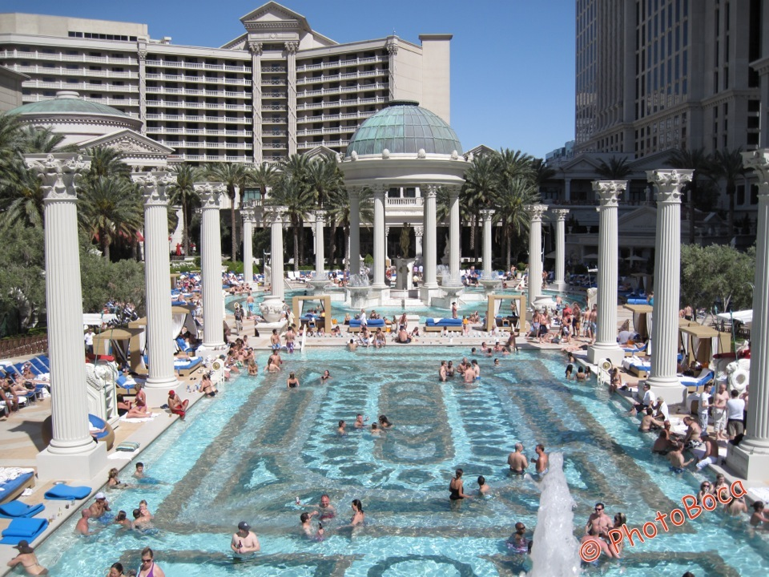
HIGH SCHOOL
Jobs I worked while in HS
I was a lifeguard at Caesars Palace Hotel Pool. YEA!!!
I worked at the front desk of a hotel (family business).

Slide 10
HIGH SCHOOL
Fondest memories from HS
Obstacles/Adversity I had to overcome in HS
Spending time with my father at his office and working.
Traveling with my family.
Listening to music on a record player (have you ever seen one of those?)
Driving around in my car with my friends.
Being shy.
Not trying hard enough and getting to graduation. (I didn’t realize then that discipline is FREEDOM).
Social conflicts.
Disappointing my father with some of my bad behavior.

Slide 11
College or Graduate School
I attended college/grad school in Los Angeles, CA
Undergrad at USC
Exercise Science Major
Graduate School/MBA at UCLA
MBA Finance
\

Slide 12
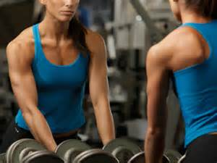
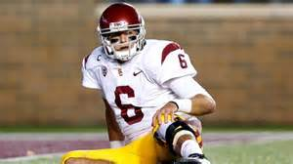
College
Activities in College
Jobs I worked while in College
Joined a Sorority
Worked with football team wrapping knees.
Worked in the sports medicine lab.
Started competitive bodybuilding.
Worked at a few restaurants.
Worked at a gym as a trainer.

Slide 13
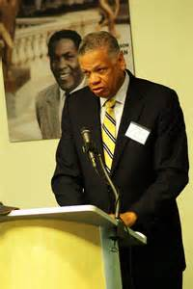
College and Graduate School
Favorite classes
College
Creative writing
Biomechanics
Graduate School
Operations
Critical thinking!! THE BEST CLASS EVER. How to think backwards which is one of the most valuable things I have ever learned.
Entrepreneurship. Wonderful because the professor was engaged and excited and taught us to create our own destiny.
Economics…the science of finance and behavior.
My favorite Professor
UCLA Graduate School of Management
Al Osborne Jr.

Slide 14
College and Graduate School
Fondest memories
Obstacles or adversity that I had to overcome
Getting to know the athletes at USC and how they thought..what drove them.
The social life at USC and UCLA.
The responsibility.
Being around smart and motivated people. Surrounding myself with excellence made me better.
Study groups and working together to create presentations.
The field study….we created a business plan for the largest company in Australia and presented in person at their offices for our MBA class.
My father died during the summer of my freshman year in college…that was the biggest one.
Realization 1 …… I am only here for a little while and if I’m afraid to do something or take a positive risk in life or business, I should do it. (regret what you don’t try)
Realization 2…..I was the only one who could be responsible for my destiny.
Drinking too much in college
I quit completely when I was 22

Slide 15
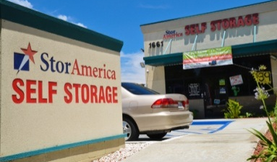
Career Path
I started as a commercial real estate broker cold calling so I learned to take rejection and keep going no matter what.
EMPLOYEE
I left after starting business school to work at an investment firm that was VERY entrepreneurial and did a LOT of acquisitions/buying of large properties…I started as an analyst and was soon working on closing the deals.
EMPLOYEE
I left after 3 years to start my own real estate investment and development company after I recognized an opportunity in the Self-Storage industry. I was backed by a wealthy family. I built the company to 22 properties and 120 employees and sold it. FOUNDED FIRM
Through our fundraising activity, recognized the need for an “emerging managers” real estate fund to finance smaller companies in the real estate sector with some emphasis on women and minority businesses. CO-FOUNDED FIRM
Through a business relationship, I started another company raising capital for real estate and private equity firm.
CO-FOUNDED FIRM
WCG
Integration of Capital and Opportunity
In 2010, after crisis in real estate, believed a good opportunity existed to buy real estate at deep discounts.
FOUNDED FIRM
45
40
35
31
27
21
Notes:
You may use this chart to describe your journey to the current career

Slide 16
Career Compensation
Real Estate Investment
You eat what you kill! Need to make good decisions and invest SOME of your own money. Can be $0, can be $x,000,000+
Investment banking
$1M-$3M per year depending on business activity
President of a StorAmerica
$250k PLUS share in profits
Had to also invest my own money.
Analyst
$60k (in 1993)
Notes:
Use this graph to show general compensation ranges for people in various roles in your company

Slide 17
Career
Some challenges I had to overcome in my career
Things that have helped me in my career
People having different points of view or motivations.
Markets.
Power struggles within organizations/politics.
Starting over after a business crisis.
Helping other people.
Being able to write and communicate.
Being good at simple math.
Studying how money works.
Being female.
Believing in myself.
The ability to move forward no matter what and change direction if necessary.
Listening to a lot of peoples points of view/data points and then coming up with my own best answer.
Being disciplined physically…gives me a reference point when things in life get difficult and also gives me time to think.
Starting over after a business crisis.

Slide 18
LESSONS LEARNED- ADVICE
Schedule a meeting with at least 3 people each year that motivate/inspire you and ask questions…get mentor(s).
Give back to people in your family, community, etc. Give what you can when you can.
Write letters…real ones in an envelope and mail them as follow up to meetings OR as a Thank you to friends and family for nice things people do or who they are.
Subscribe to 1 business publication and read it.
Harvard Business Review
Wall Street Journal
Forbes
Entrepreneur,
Etc.
Pay attention to patterns in history and around you.
Example: Go to a Starbucks and notice what kind of customers come in, when and how many. What do you think drives their behavior.
Go to a business that always seems to be empty and talk to the owner. Get their perception.
Read biographies.
Keep going no matter what. If something doesn’t work, get creative, think of another way…if that doesn’t work, do it again.
On the wealth creation front, Save at least 10% of EVERYTHING YOU MAKE NO MATTER WHAT.
Do it early in your life.
Research investments that pay a dividend/return and keep adding to them over time.

Slide 19
RECOMMENDED READING NOW – I READ THIS WHEN I WAS 16

Slide 20
ACADEMIC EXERCISE
We will now spend several minutes discussing the day’s academic module and how it is relevant in the ‘real world’

Slide 21
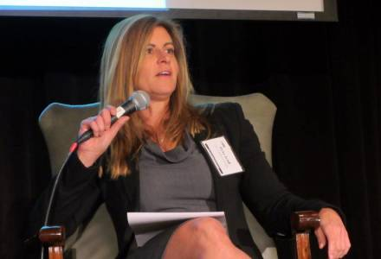
QUESTION AND ANSWER

