Slide 1
Youth business alliance + Britt mCcoll
February 2018

Slide 2
Introduction
My name is Britt McColl, and I am 43 years old.
I work at ad agency RPA.
My company is a full-service ad agency, which means we create and produce commercials, digital ads, and social content, as well as handle web development and media planning and buying.
My role at RPA is VP, Director of PR.
Everyday I interact with reporters to get attention for our client campaigns, and oversee the RPA brand as well. This entails getting our senior leaders known for their expertise (e.g., pitching and securing speaking engagements for them at major conferences like SXSW).

Slide 3
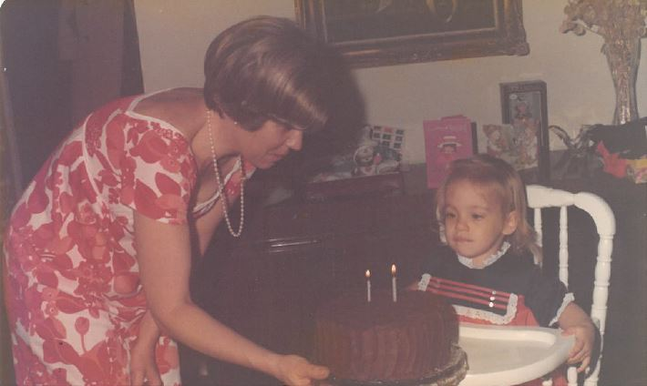
My childhood
I was born and raised in Northridge.

Slide 4
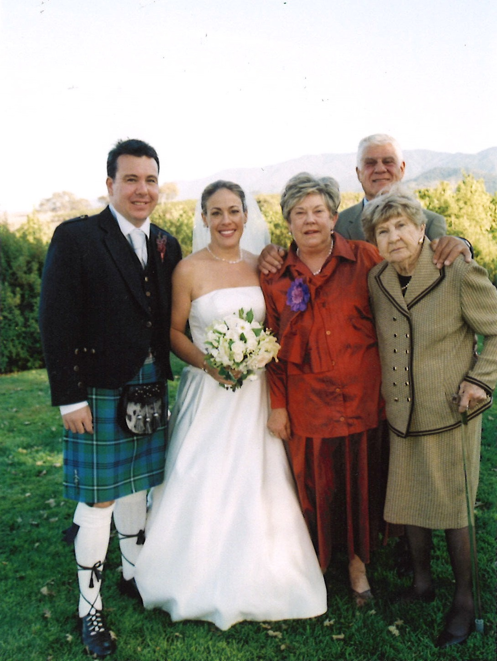
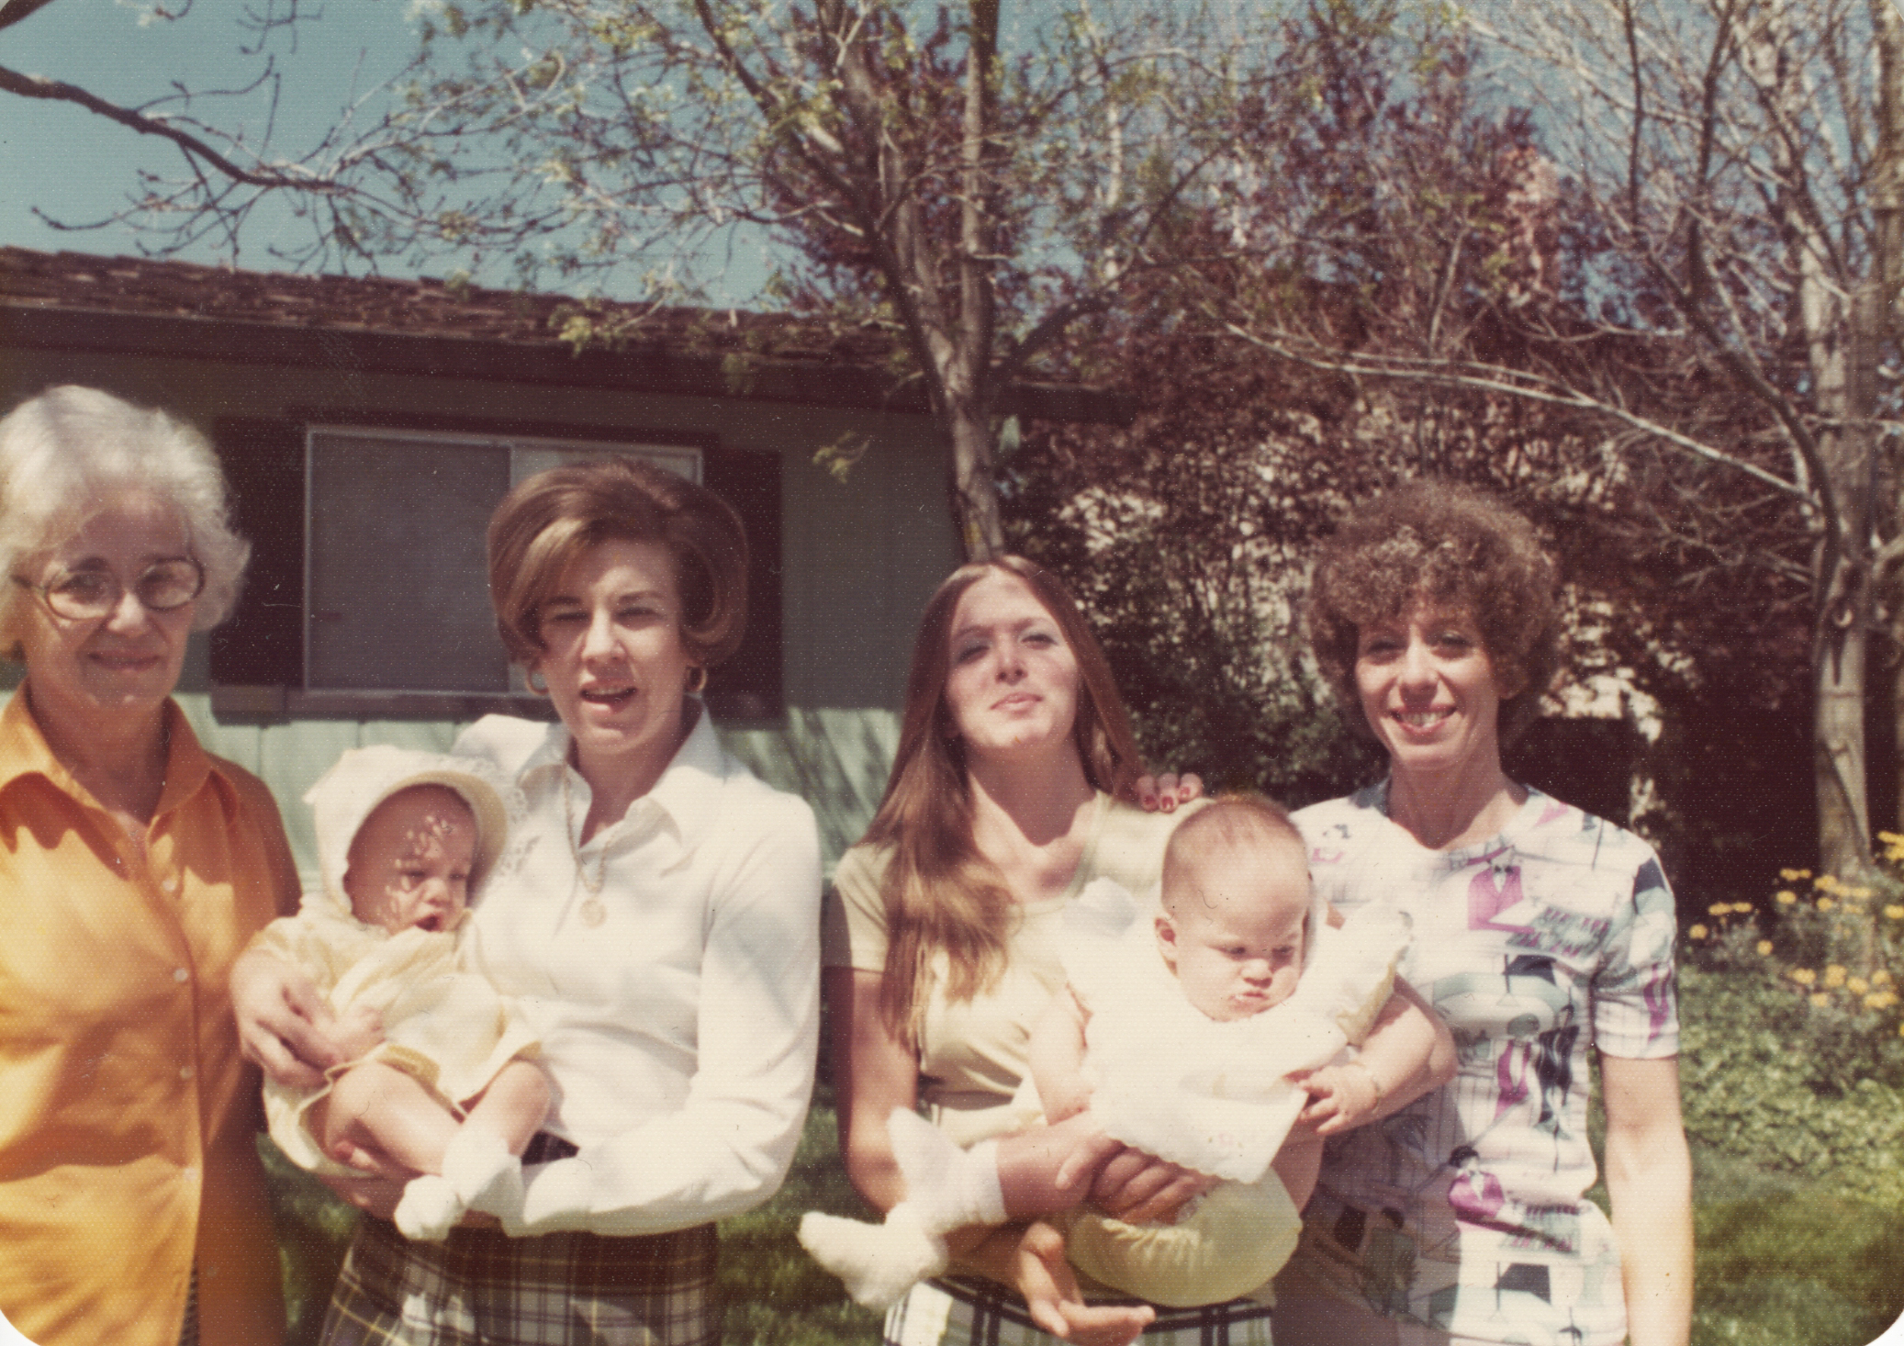
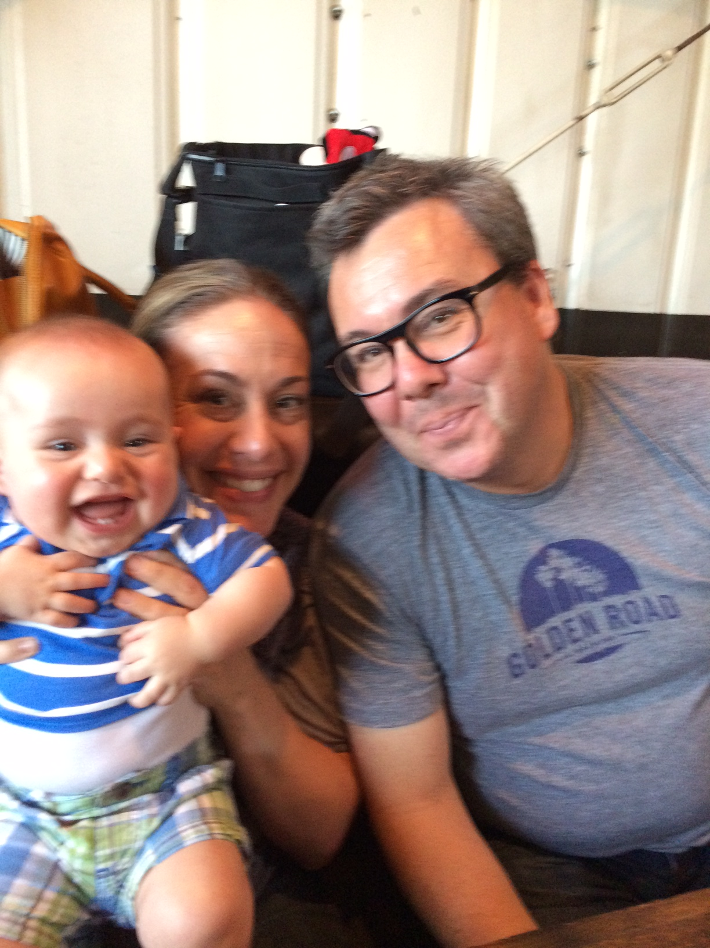
My family
I am an only child. While growing up, my mom worked full-time at a bank and my dad owned a small business during most of my childhood. My grandmother (Momo) was a big part of our life – she came on family vacations and helped my mom with school dropoffs and pickups.

Slide 5
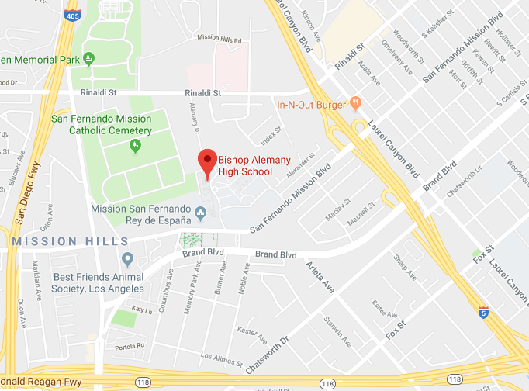
My High school
I attended Alemany High School in Mission Hills.

Slide 6
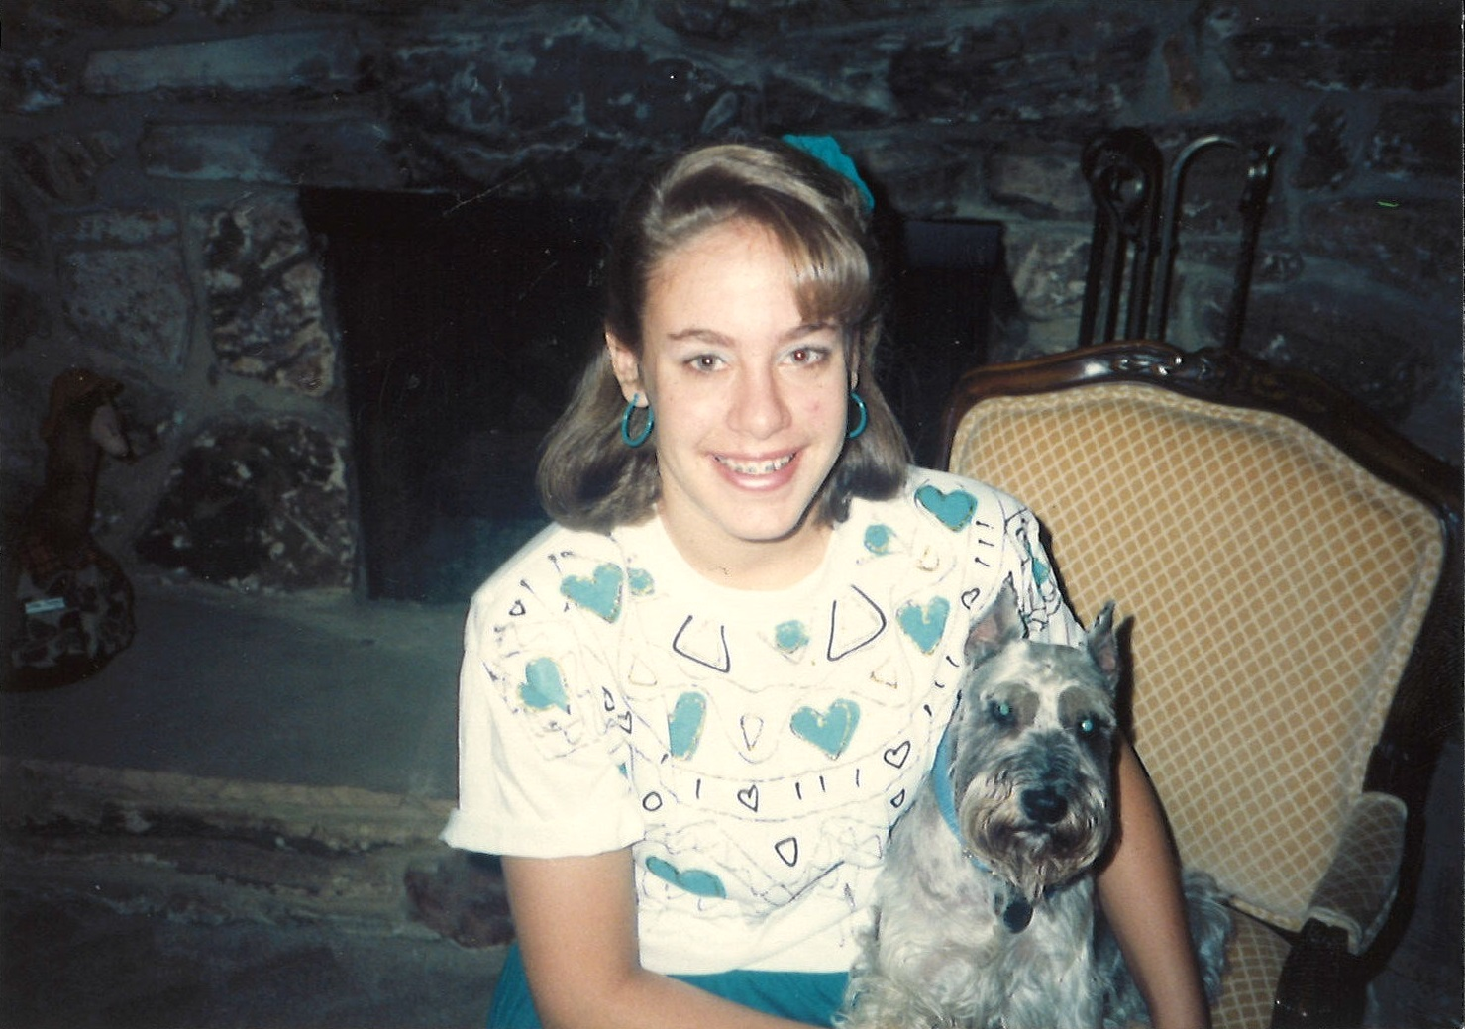
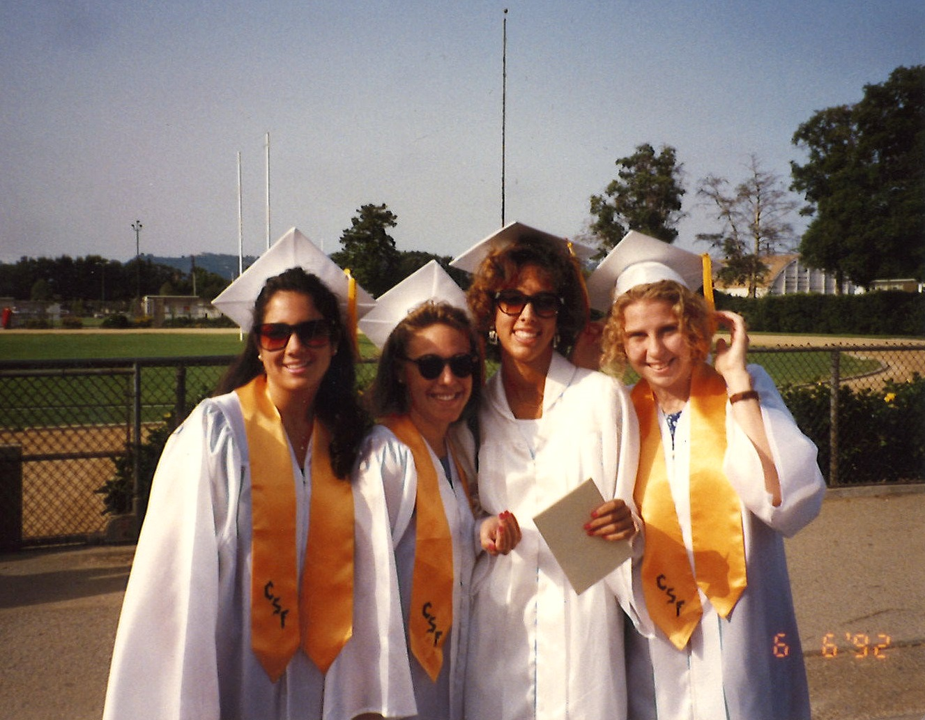
High school
As a high school student, I felt overlooked – not popular, athletic or smart.

Slide 7
High school
Things that I really liked in high school were English/literature class, Friday-night football games and spending time with my friends.
Things that felt difficult or challenging for me while I was in high school were algebra and geometry. I tested into remedial math before starting high school and always felt behind my classmates. To catch up, I look geometry at Pierce College one summer – thanks to lots of tutoring, I passed.
Jobs I worked while in high school included babysitting on the weekends. I got my first part-time job at 15½ as a holiday gift wrapper. Earning money gave me more funds for fun (e.g., going out to dinner) and saving for my first car.
The top few things I did to ensure I got into college were to keep my GPA as high as I could and to graduate with California Scholarship Federation recognition. I took a SAT prep class too since I didn’t do well on standardized tests.

Slide 8
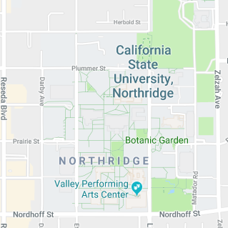
college
I attended college at Cal State University, Northridge.

Slide 9
college
Things I enjoyed in college:
Things I didn’t enjoy in college:
Sorority
Journalism classes
Weekend trips with friends
Fighting to get classes & graduate
Parking
The earthquake & clean-up

Slide 10
college
Favorite classes:
Least favorite classes:
Writing & Reporting
Editing
Writing for PR
Media Law
Public Policy Process
Statistics
Microeconomics
Psychology

Slide 11
college
Jobs I worked while I was in college were part-time employment at Gap Kids, summer camp counselor (every summer!) and internships (3 total).
Things that felt difficult or challenging for me while I was in college included navigating a giant, public university and finding my niche as a freshman.

Slide 12
Getting a job after college
The top few things I did to ensure I got a good job after college were – internships! It made all the difference to have practical experience in the field where I wanted to work after graduation.

Slide 13
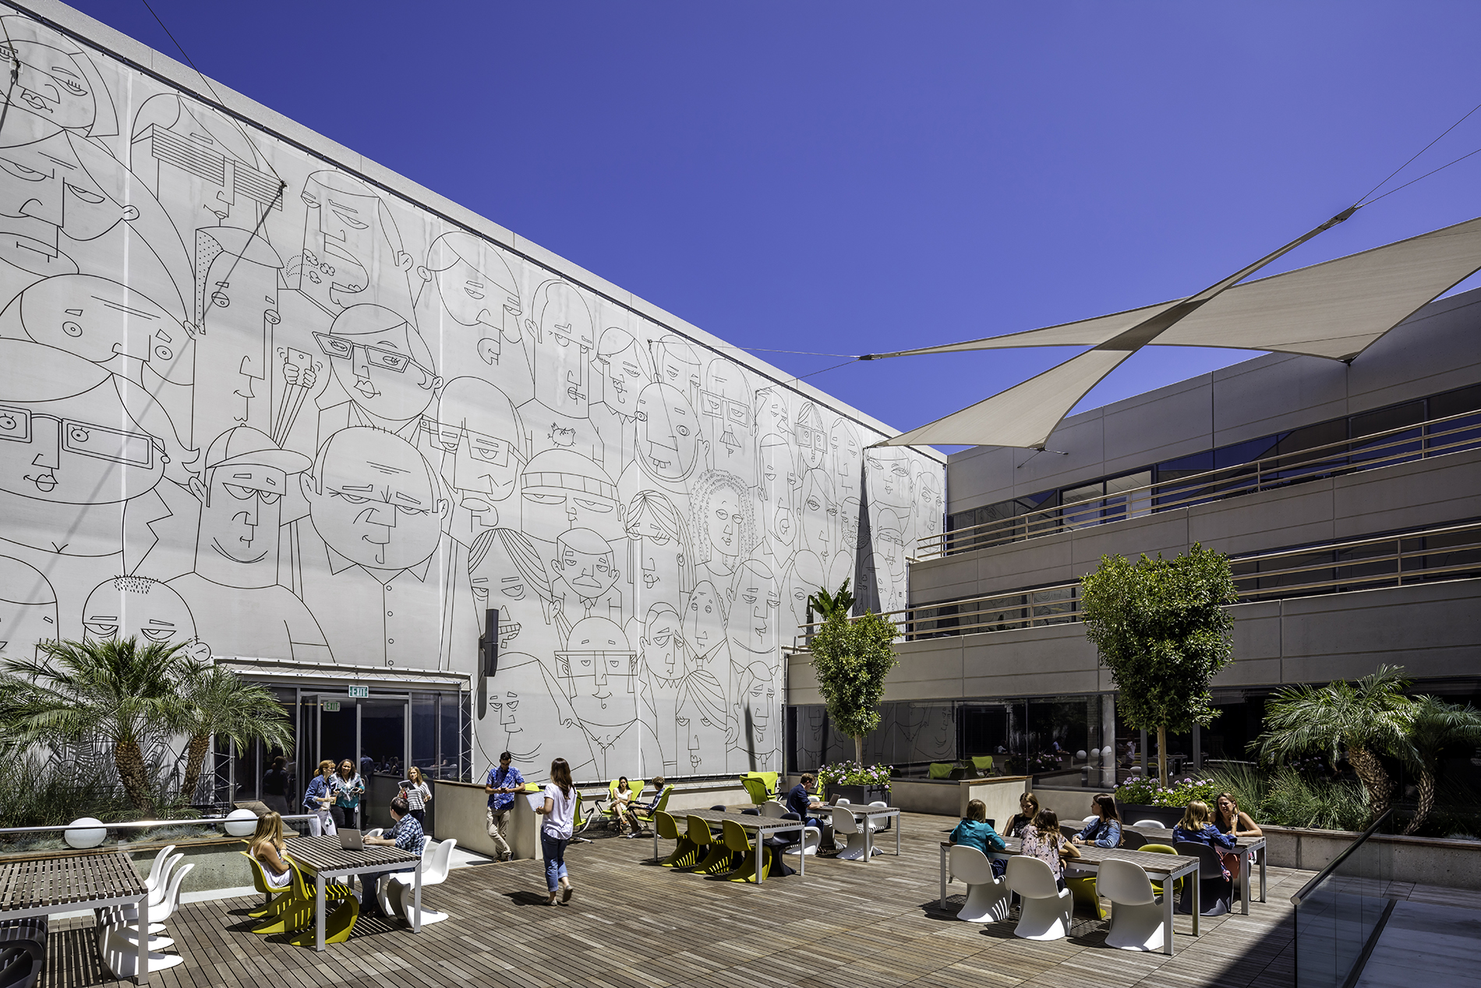
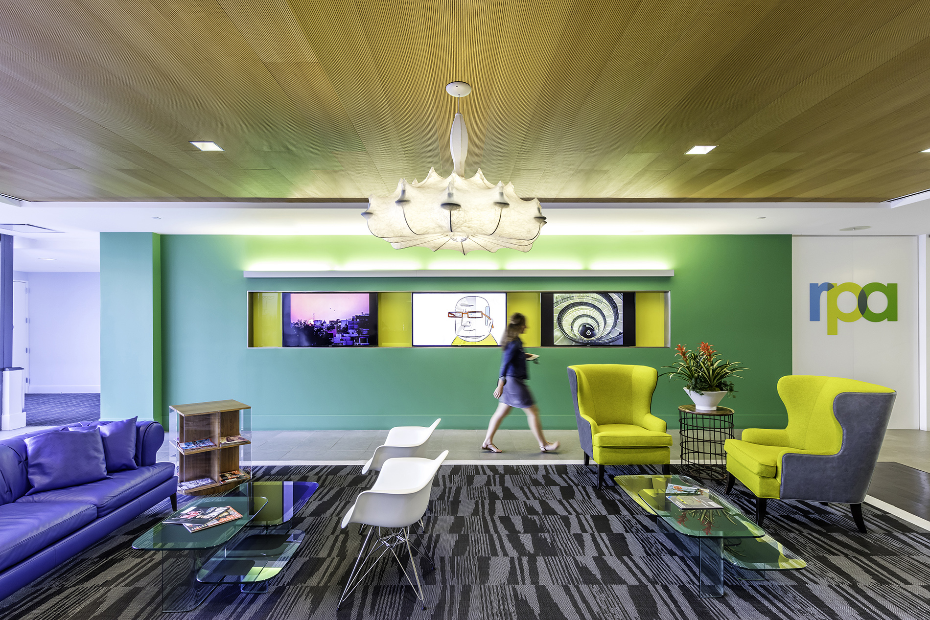
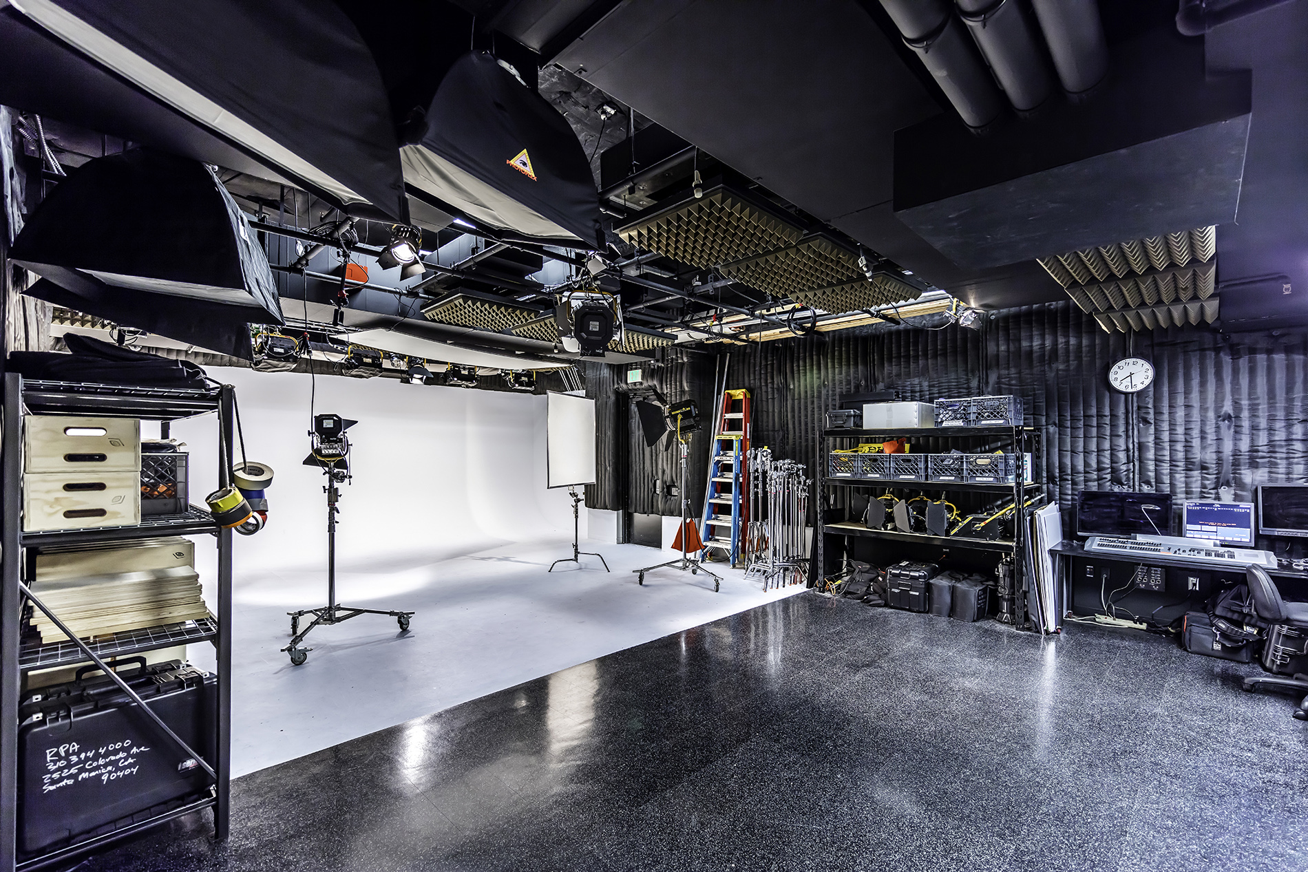
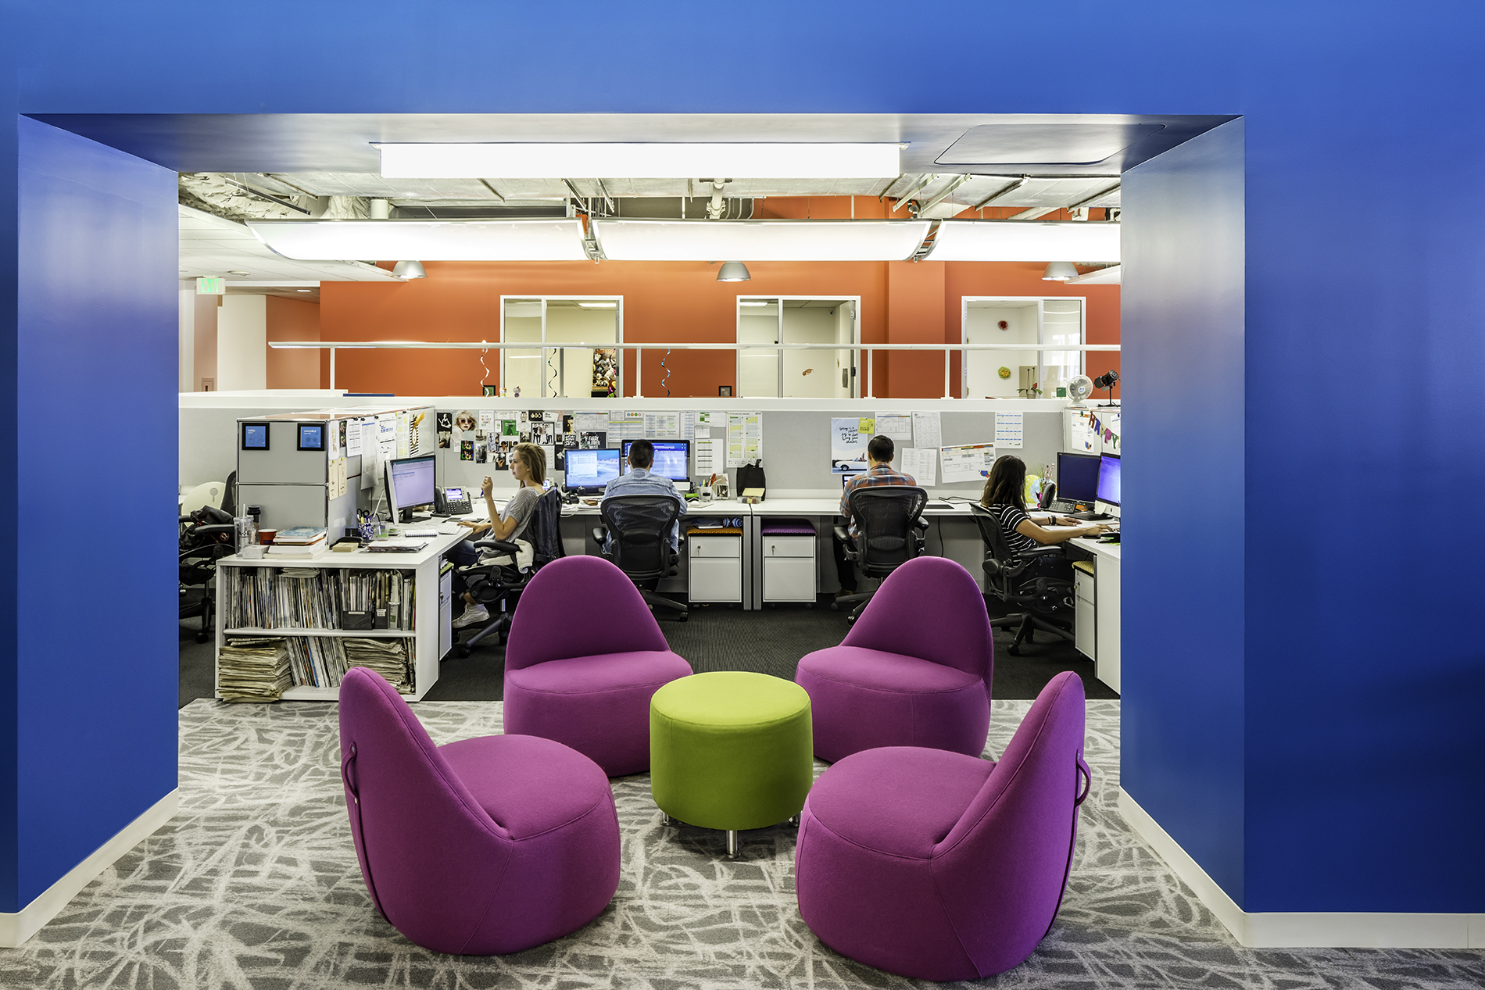
This is my company

Slide 14
What happens at RPA?
Account Management
Admin
HR, Finance, IT, Office Services
Content Production
Creative
Social Media, Digital / Design, User Experience
Digital Strategy
Media (Planning & Buying)
Branded Content, Search
New Business / Marketing / PR
Project Management
Wed Development
Strategic Planning

Slide 15
My career path
Entry-level (account coordinator, intern) (2 yrs): PR agencies
Mid-level manager (account exec, supervisor) (4 yrs): PR agency + academia
Director, VP (14 yrs): academia + ad agency

Slide 16
My career
The first job I had after college was being hired as an account coordinator at Porter Novelli to work on McDonald’s.
The worst job I have ever had was working for small PR agencies.
Challenges I have had to overcome throughout my career are keeping my bluntness in check and finding ways to motivate myself since I never really had a mentor.

Slide 17
My role within rpa
Co-founders, CEO, COO, CFO
Executive Committee (EVPs, SVPs)
Management Committee (VPs) (me)
Managers
Entry-level

Slide 18
Compensation at my company
Founders, CEO, COO
Executive Committee (250K+)
Management Committee (100K+)
Managers (>100k)
Entry-level (35K)
Interns

Slide 19
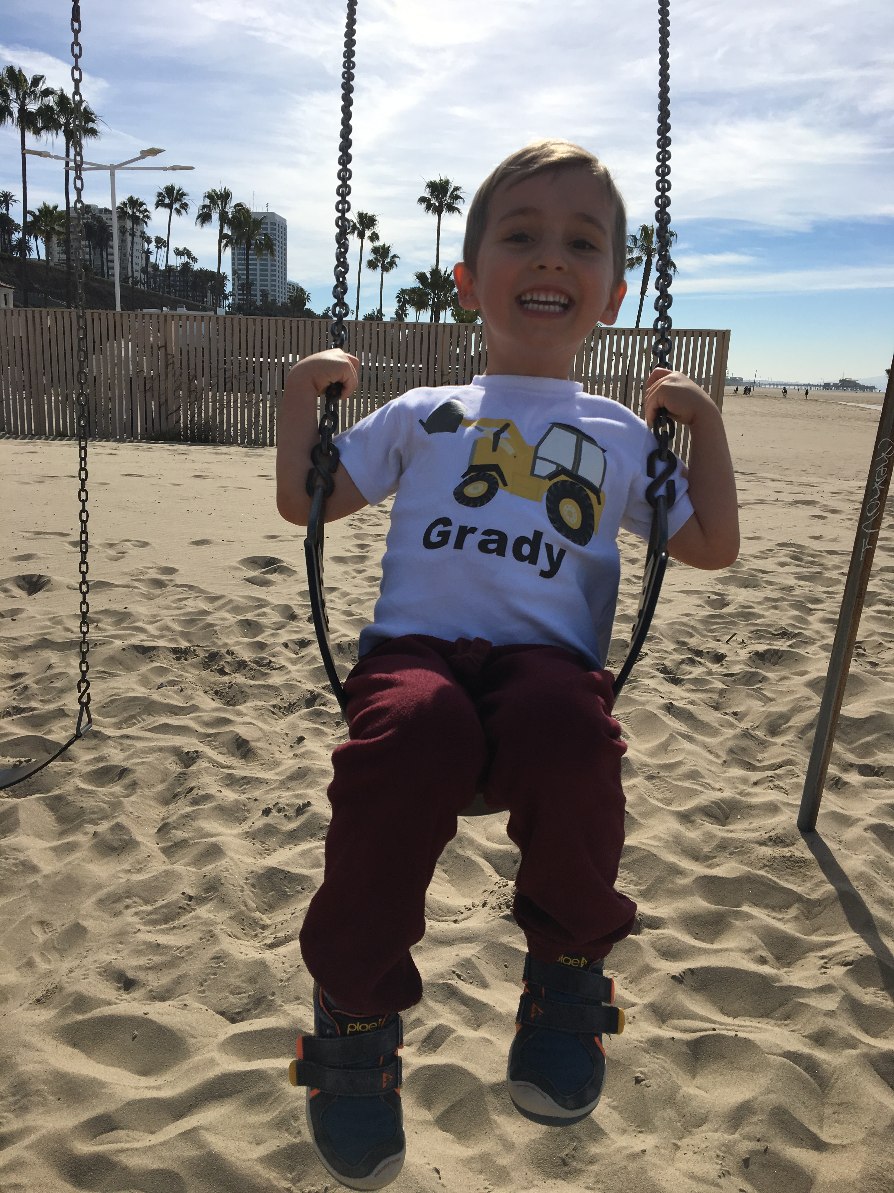
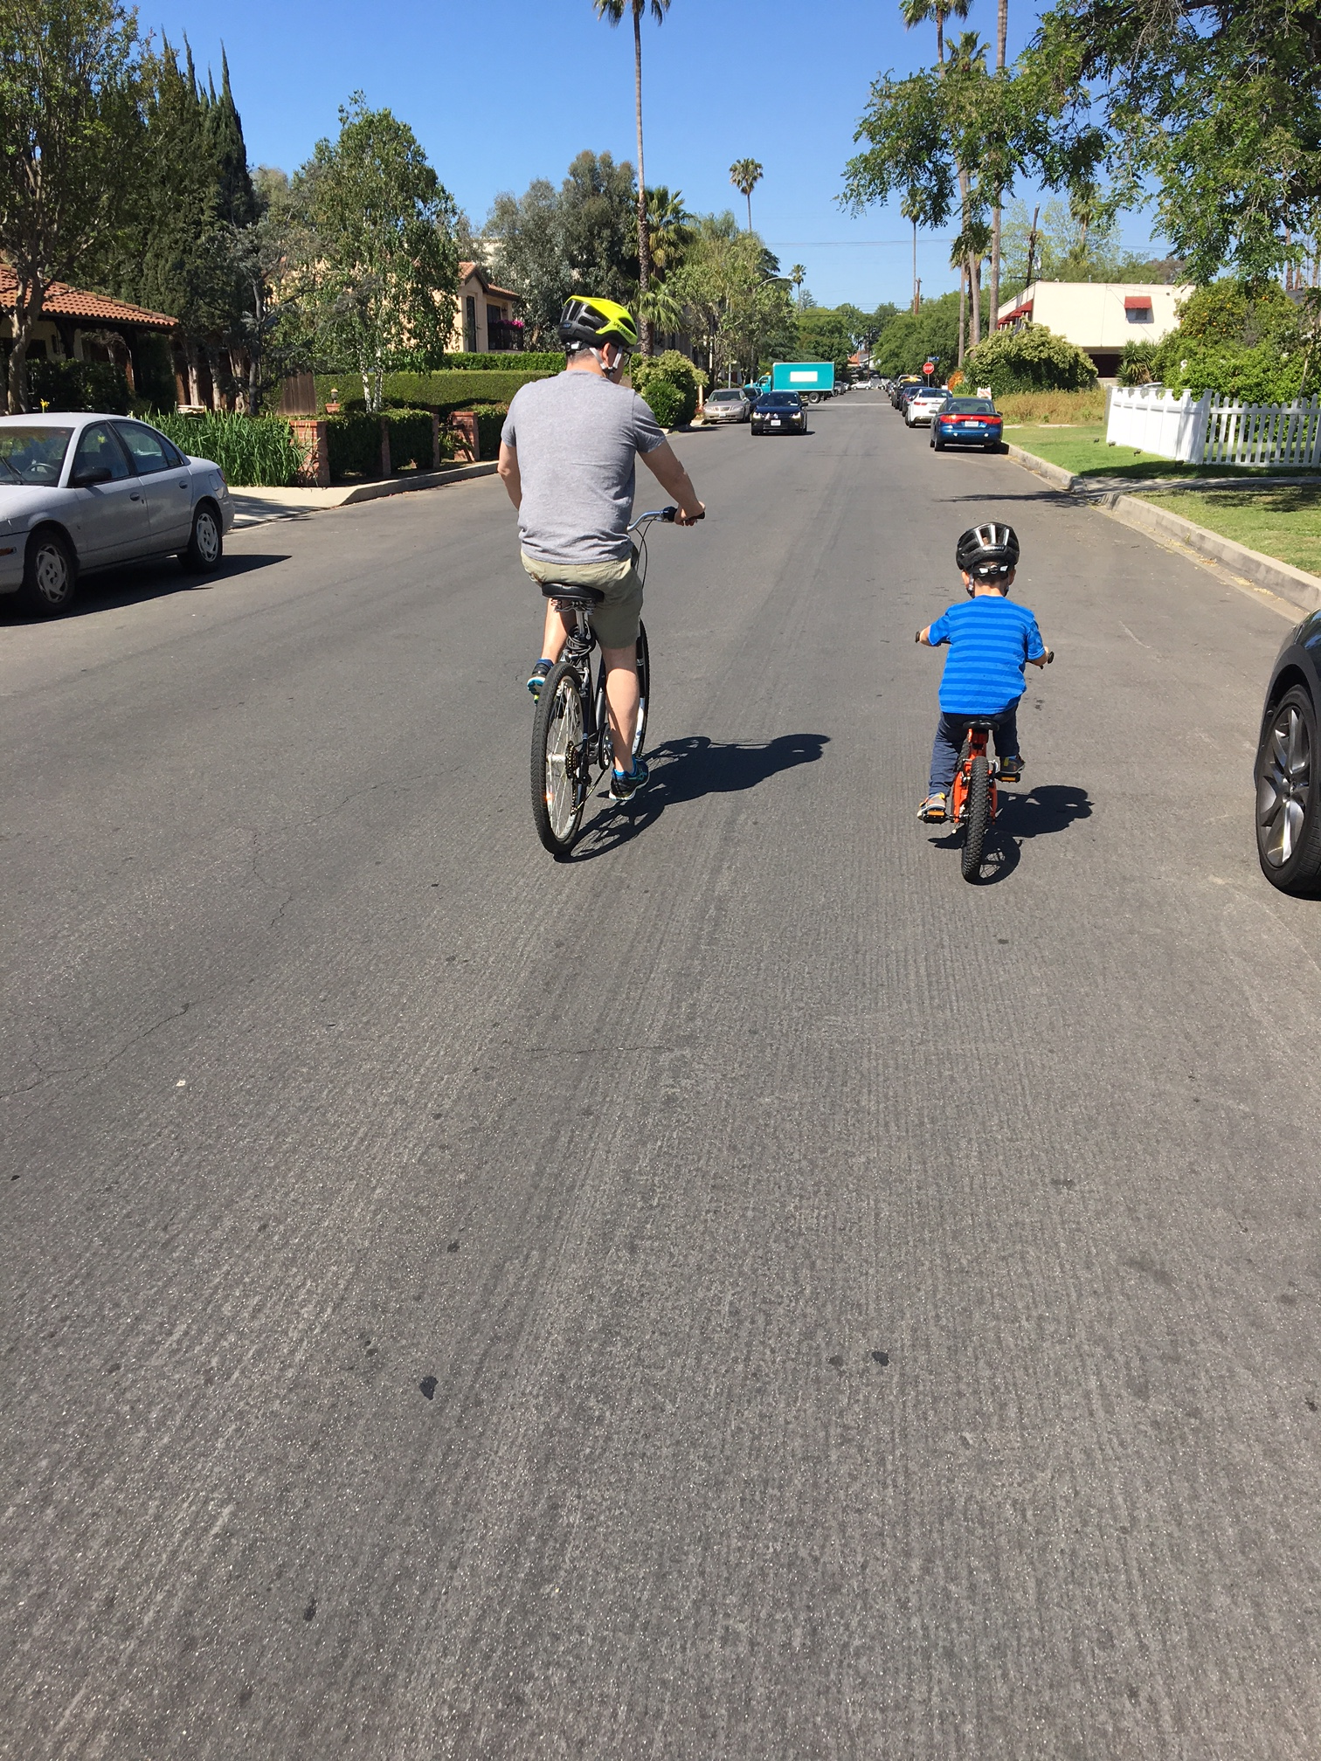
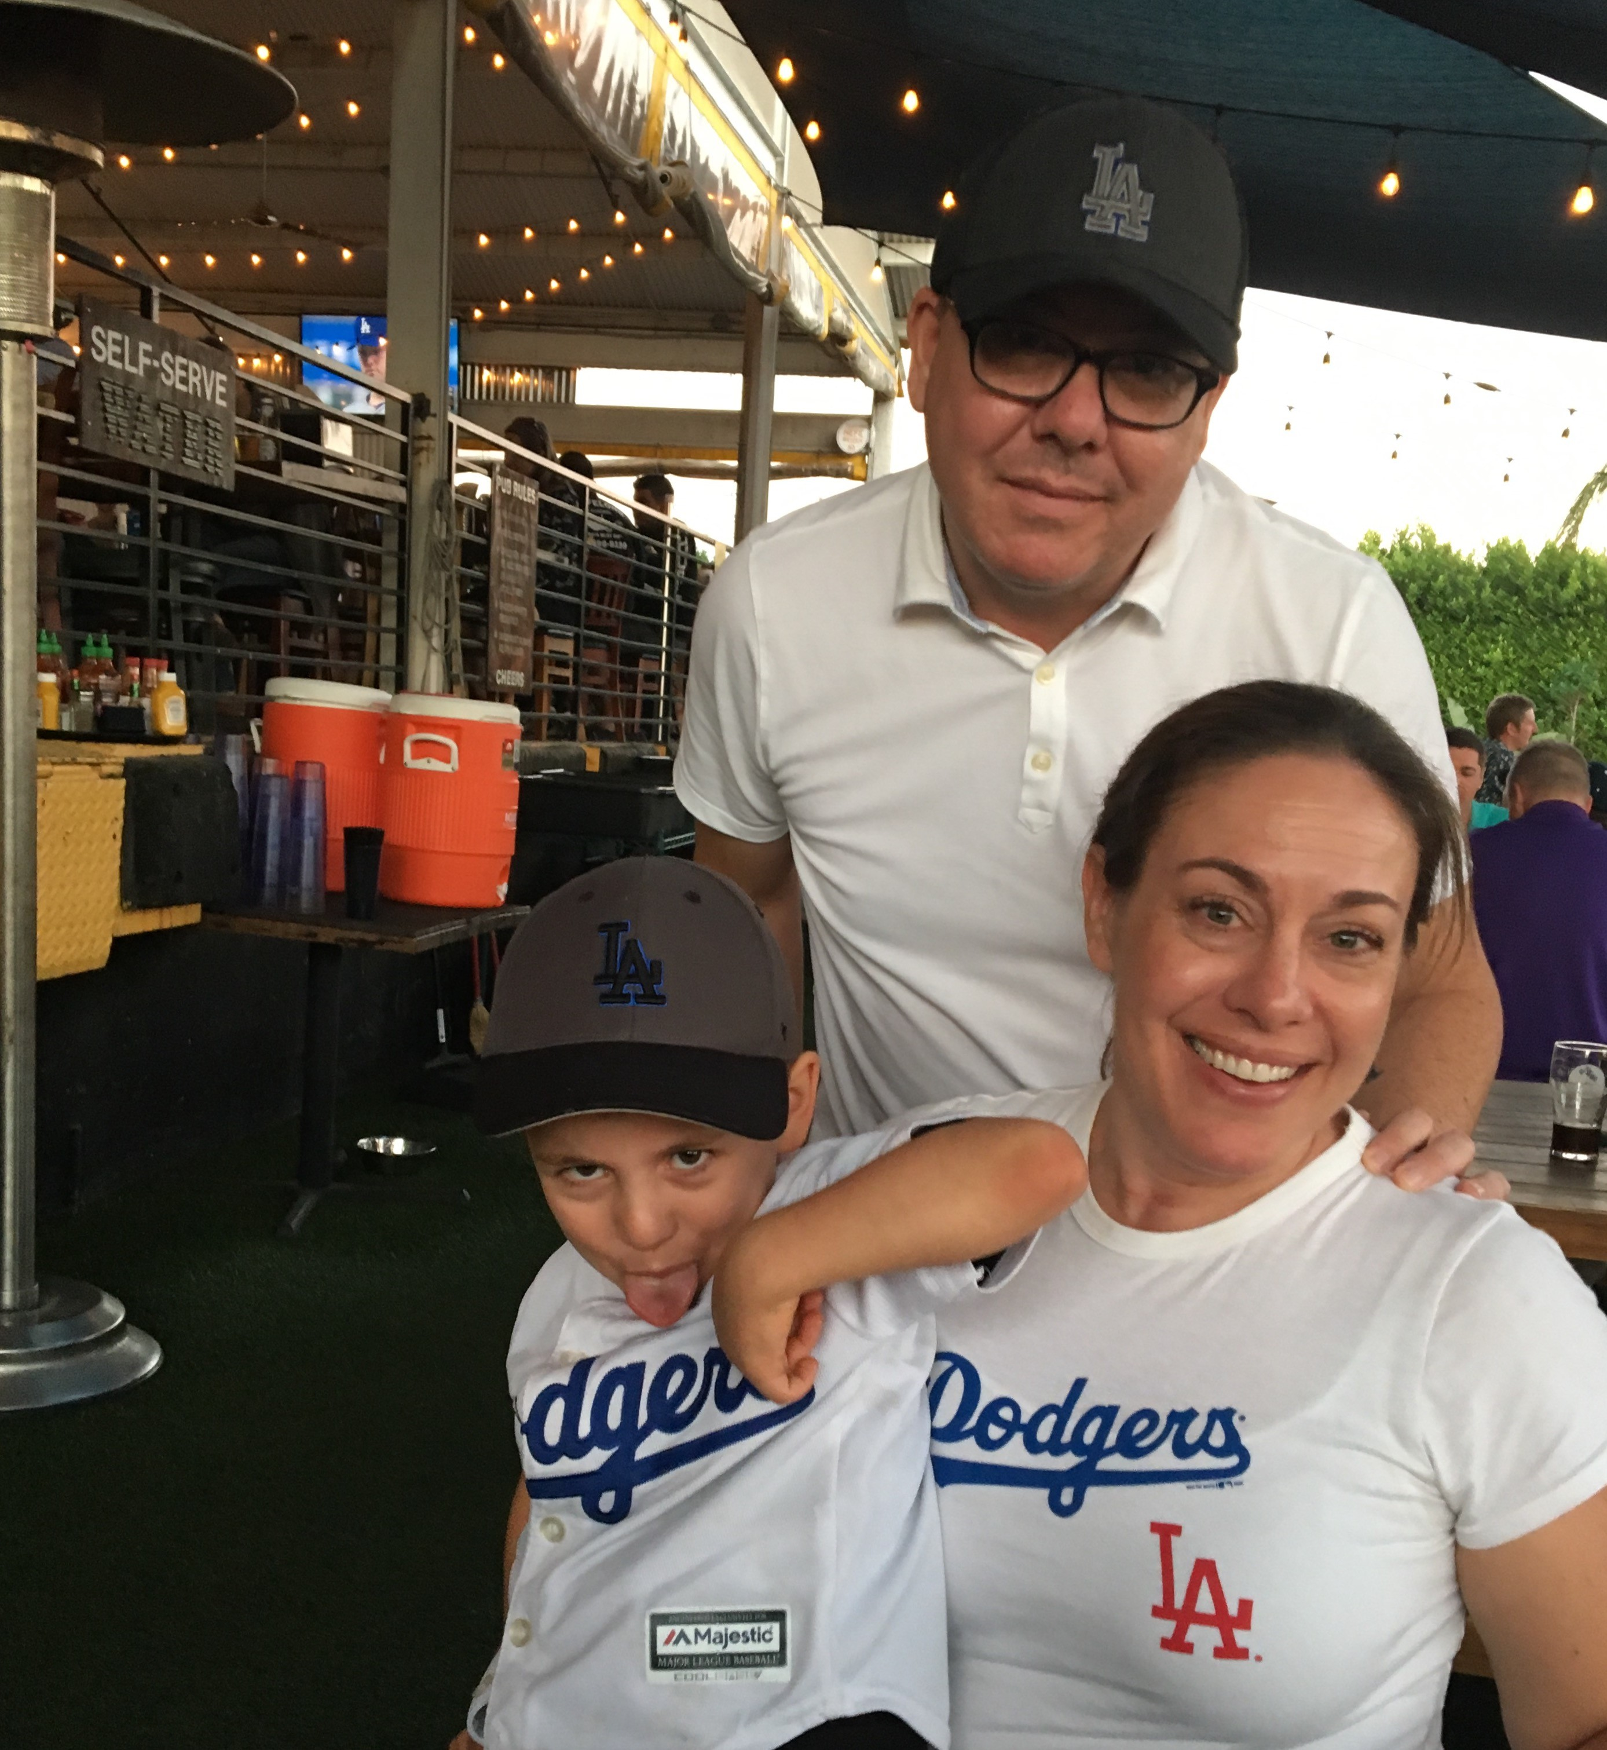
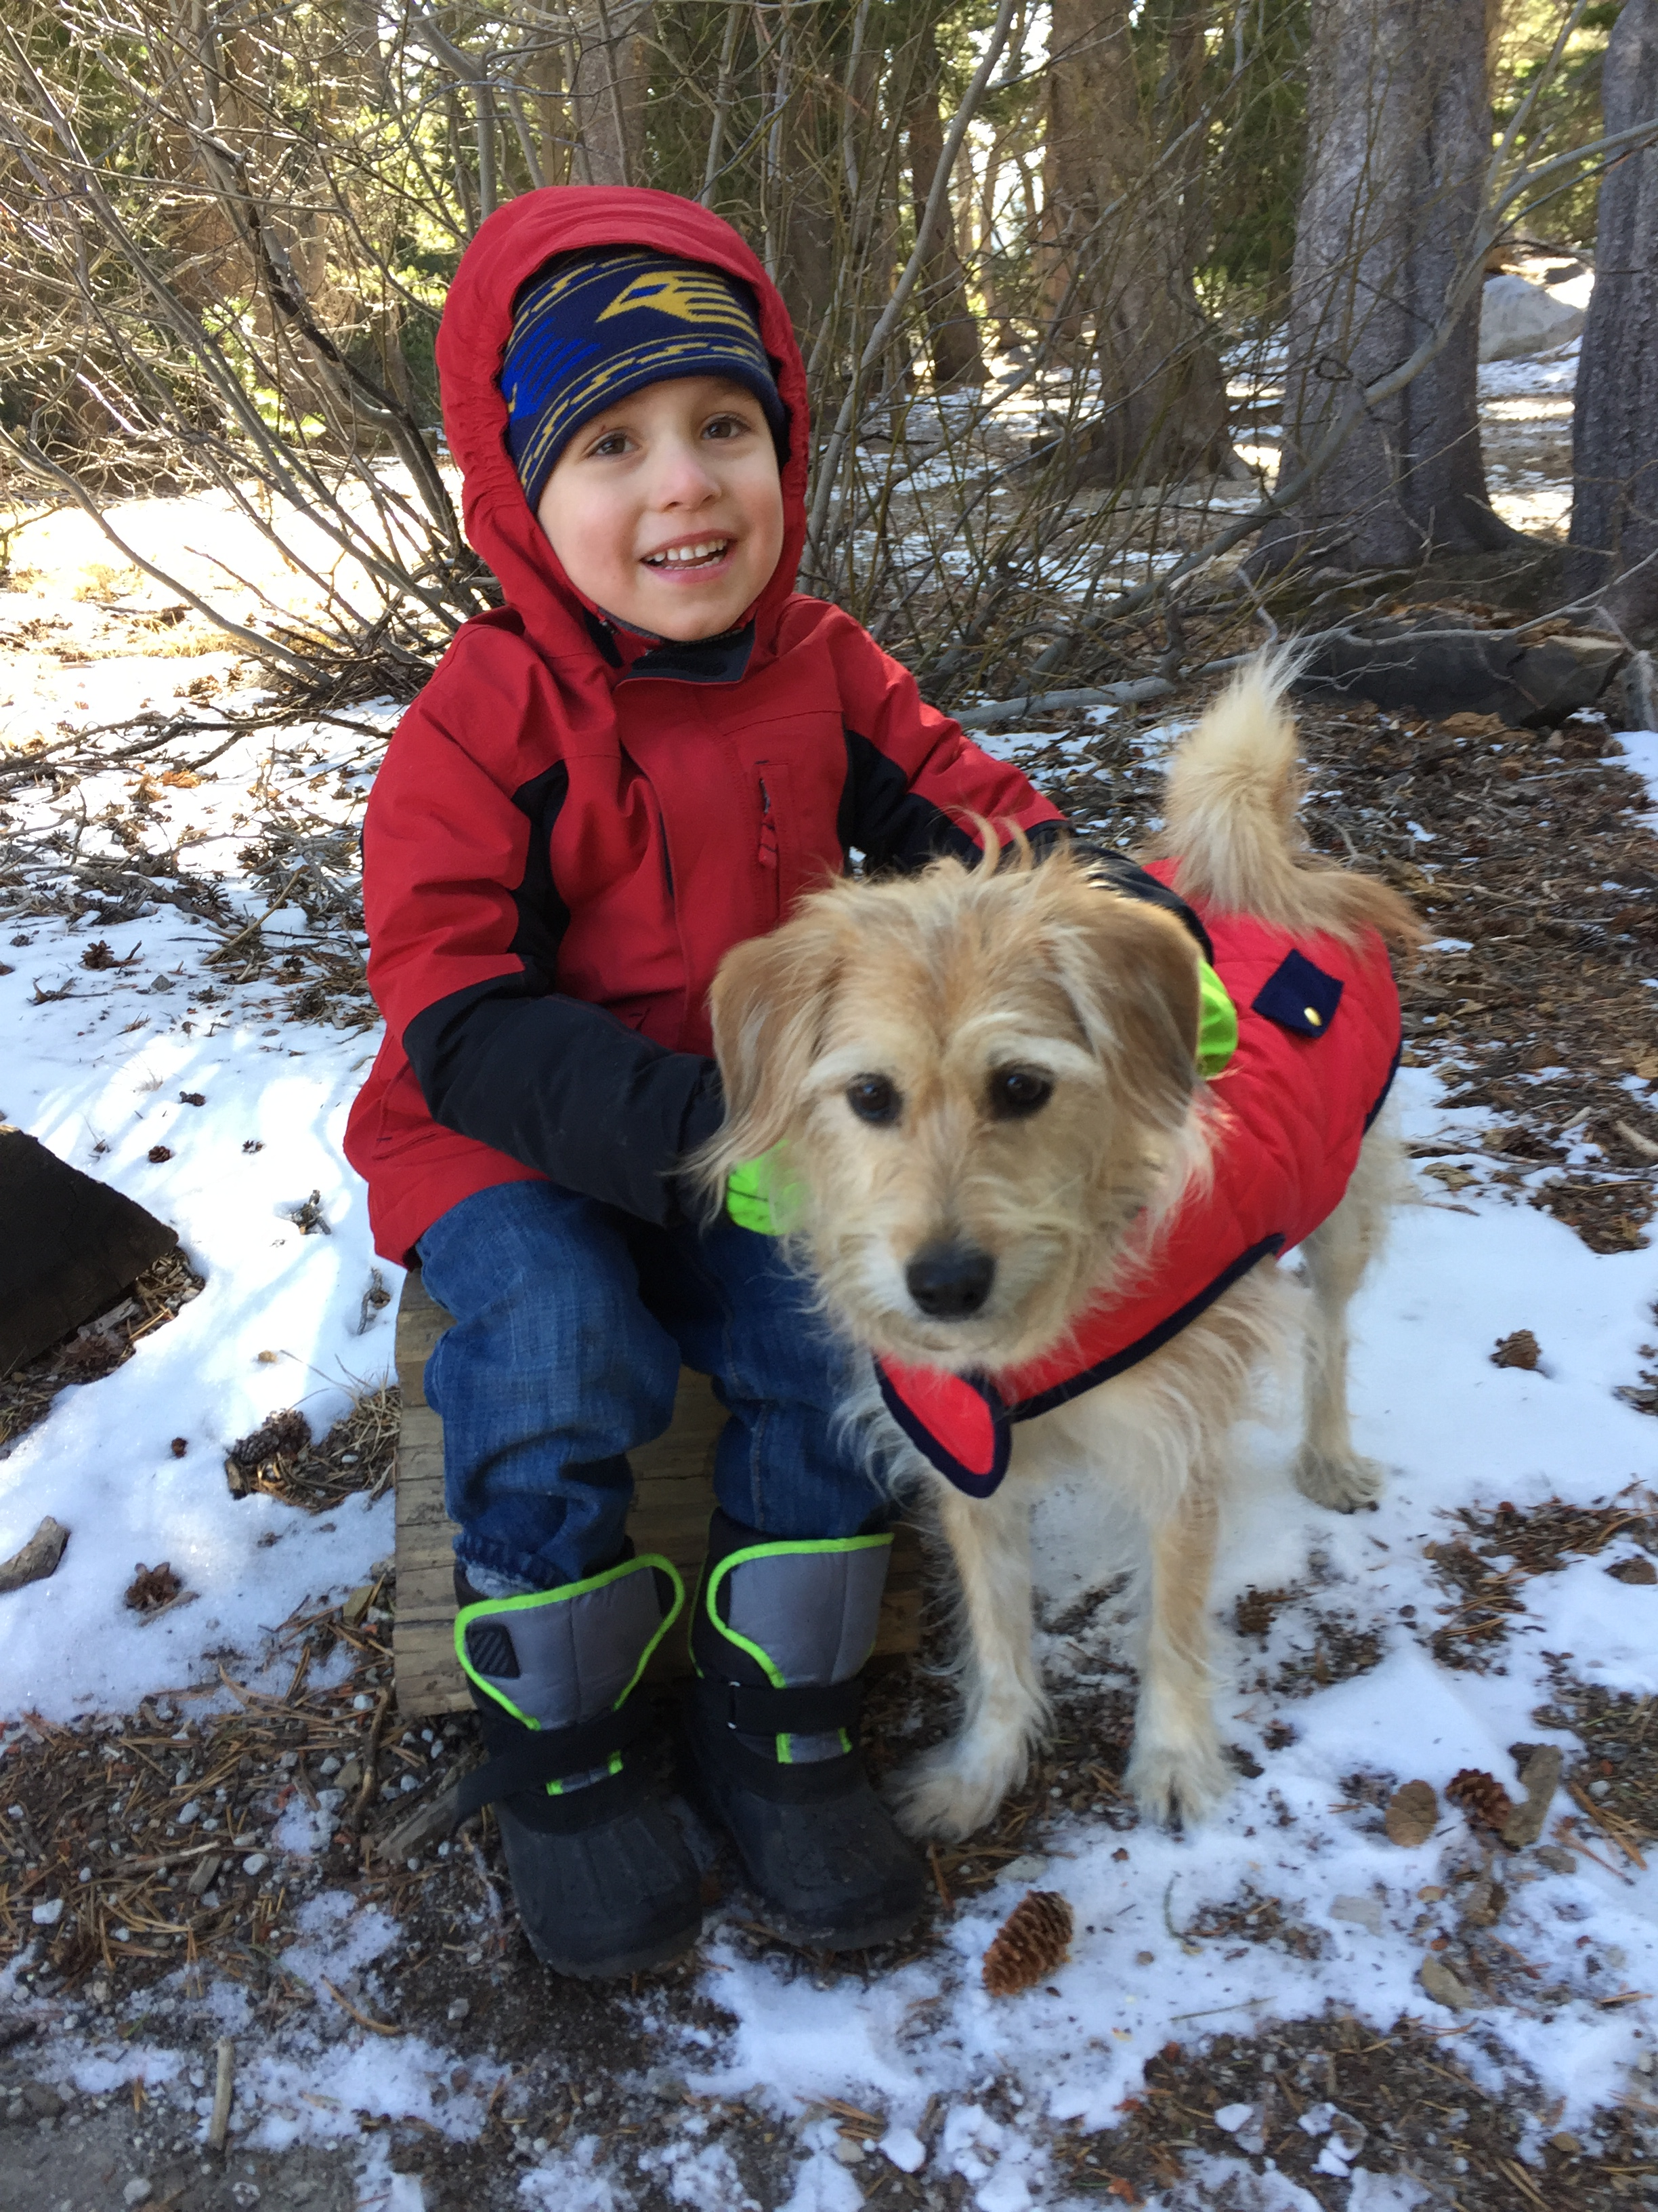
More than just work
When I am not at work, it’s all about family time.

Slide 20
Do it all over again?
If I could talk to my high school self, what would I say?
Talk to people about their jobs, why they like it, what they don’t and how they found their way there.
Take different, untraditional classes that may spark a lifelong interest.
Volunteer for causes or groups that mean something to you. You never know who you will meet.
Don’t think you have to have all the answers – you never do.

Slide 21
Questions & answer

Slide 22
activity
Problem: Honda needs to make a big splash for a little car.
Target Audience: 18 to 35, sensible and fun, value experiences
Insight: Honda believes in creating vehicles that are useful and fun to drive. The latest Fit is a perfect example of this.
Goal: To appeal emotionally to potential buyers and demonstrate value and tech. Maximize personality of the Fit.
Voice: Cheeky, eternal optimist, innovative
Media buy: Digital and social
Assignment: What could the Fit advertising campaign look like? How does Honda attract the attention of those 18 to 35? What would the press headline look like?

Slide 23
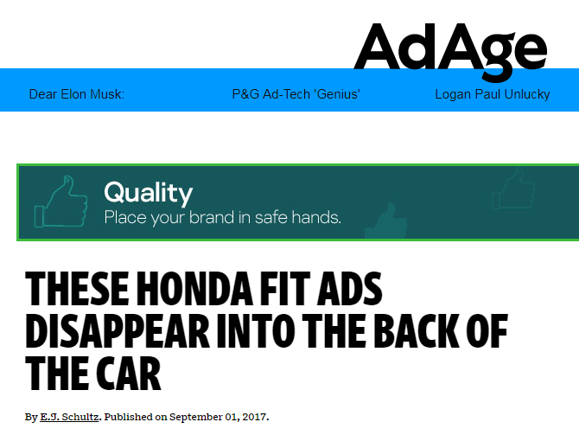
activity
General market TV spot: https://www.youtube.com/watch?v=xKR5rksTc_o&feature=youtu.be
Hispanic Spot: https://www.youtube.com/watch?v=VbSF-ILa_gE&feature=youtu.be
Hulu pre-roll:

