Slide 1
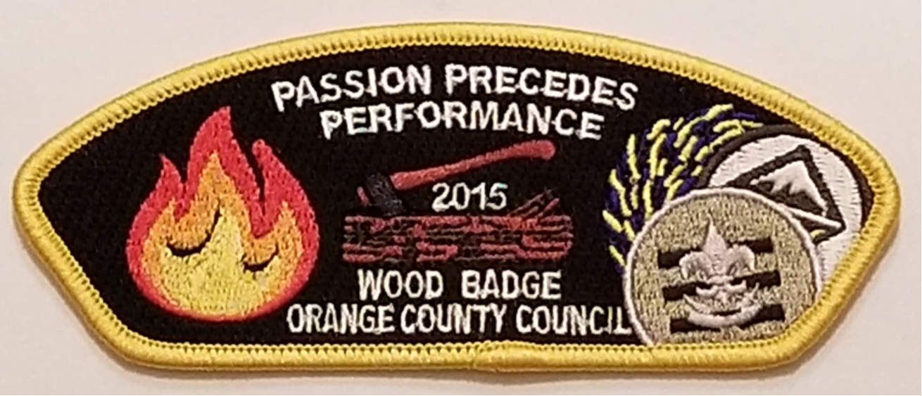
Passion precedes performance
by Tom Miller Persuasive Business Plans

Slide 2

You will remember the stories . . .
Notes:
Story is key – I believe that we are HARD WIRED to respond to STORY - PERSONAL HISTORY AND THOUGHT PROCESS

Slide 3

I was born in the us but not in a state
Notes:
Washington DC

Slide 4
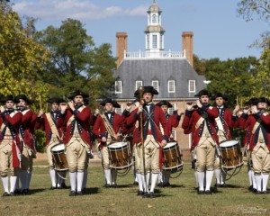
WHO is Tom?
US History!
Notes:
Jamestown
Colonial Williamsburg
Uncle who had Pharmacy in Yorktown

Slide 5
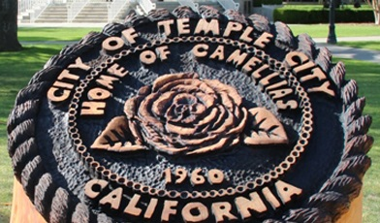
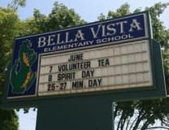
WHO is Tom?
California here I come!
Notes:
3rd Grade – Temple City
4th Grade – Monterey Park
5th Grade to 8th Grade - Whittier

Slide 6
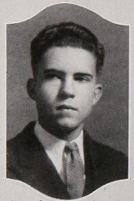

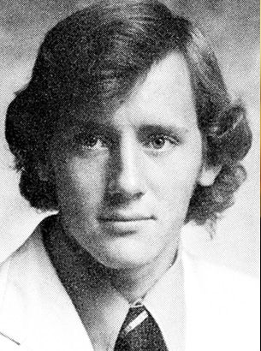
WHO is Tom?
Cardinal!
Notes:
Richard Nixon
held same ASB office - Treasurer
John Lasseter
Story of his Passion

Slide 7

WHO is Tom?
Anteater!
Notes:
Chose UCI because of Computer Science
Not Electrical Engineering
Not Math
5 year program – not for me – added Econ in Jr. Yr.

Slide 8
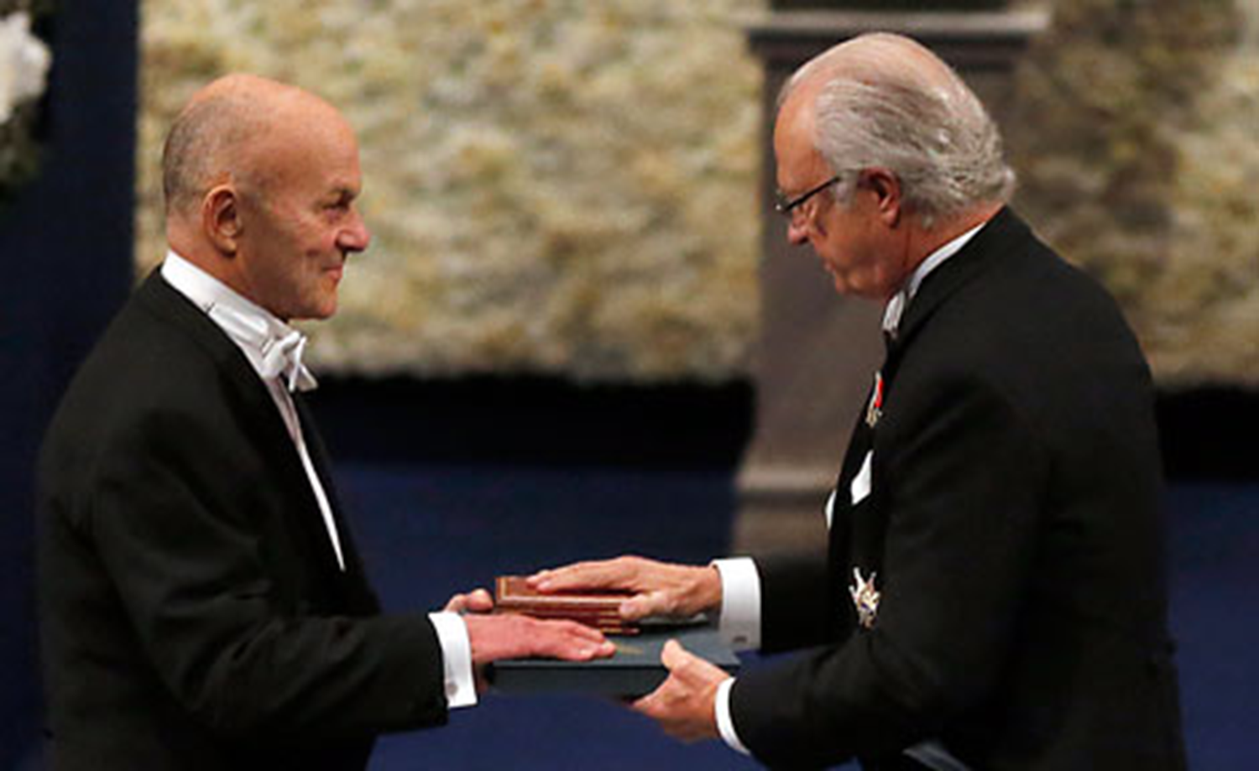

WHO is Tom?
Maroon!
Notes:
MBA in Finance – this is my finance professor receiving his Nobel Prize

Slide 9
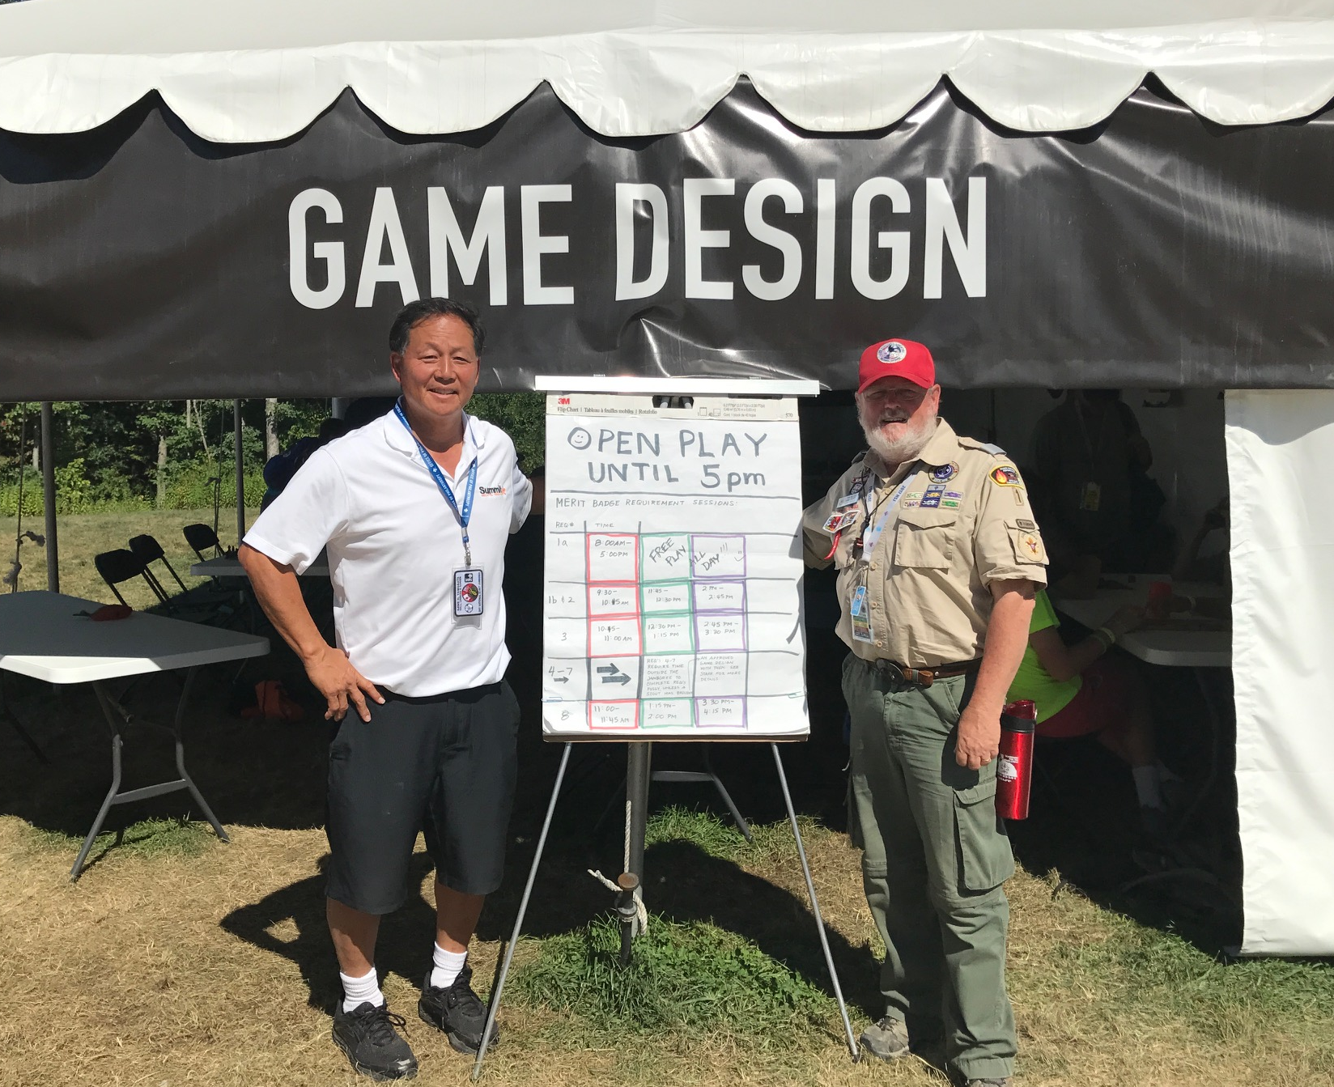
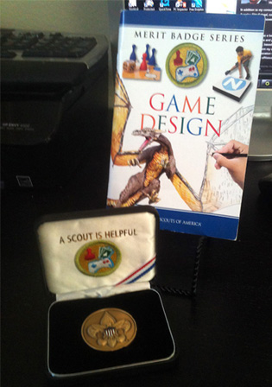
Who is tom?
Scout
Notes:
Gamer forever; Helped Scouts develop a Merit Badge in Game Design, spend 10 days in West Virginia in 2013 and 2017; likes to play electronic games

Slide 10
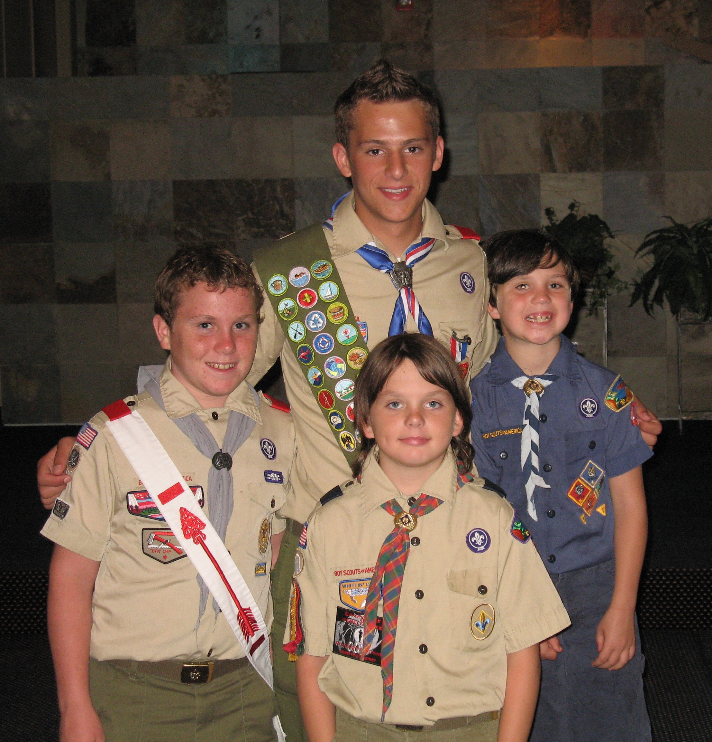

WHO is Tom?
Family!
Notes:
Nephew and his 3 cousins, my sons David, Jon, and Sam
A bit older now – Sam, the one in blue, just started his second year at Bob Cole Conservatory at CSULB
Jon, the one with long hair is at Golden West and David is at Concordia (Which is why I need referrals)
All 3 are now Eagle Scouts
Wife doesn’t like her picture taken, but this is her artwork

Slide 11
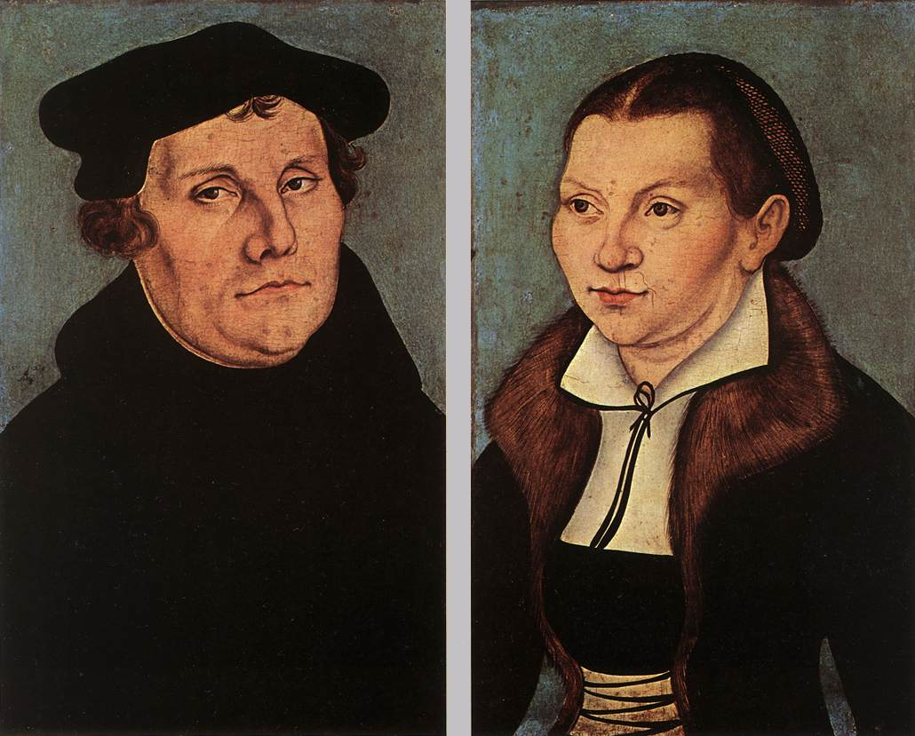
Who is tom?
Faith!
Notes:
Martin and Kitty Luther – Married Karen, who was introduced to me a blind date because she was smart and Lutheran

Slide 12

Who is tom?
FUN
Notes:
These are a few of my favorite things – and if I was as musically talented as the rest of my family, I would sing a few bars but I’m not so I’ll spare you the experience.
Sailing – Gaming – Cooking – Reading

Slide 13




Who is tom?
Fraternal
Notes:
Connector and Promotors before I learned those teams in Referral Mindset. . . .
As a consultant, I don’t need to have all the answers, but to know who the person who does . . ..

Slide 14

First failure
Hedging Of Interest Rate Risk with Interest Rate
Futures
Notes:
ABD PhD in Finance – Greg – understood math; I understood the technology
Small banks couldn’t afford it
Big banks were already doing it
Mid size banks were a target, but we had to get real jobs. . . .

Slide 15


Not a (Great) fit
Notes:
Don’t play politics well enough to succeed in a fortune 500 firms.
Internal Consulting for Typesetting Division
Business Manager for R & D Center
Project Manager

Slide 16
Legacy
Notes:
US Patents
5054984 – Binding Line Book Tracking System and Method (Oct 8, 1991)
5122179 – Binding Line Book Tracking System and Method (May 12, 1992)

Slide 17
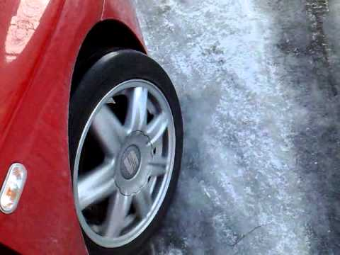
Worked myself out of a job!
Notes:
AEP Story
Embezzlement
Systems, Policies, Procedures,
Two issues – Lifestyle vs Wealth Building Entrepreneur
Reactive vs proactive management styles.

Slide 18

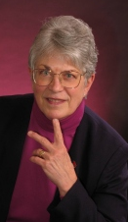

Career Counseling
It’s not Who you know, but who knows YOU
Notes:
Kathleen Jennings – now in Washington
Like Variety
Like Project Work – things that have a beginning and an end.

Slide 19




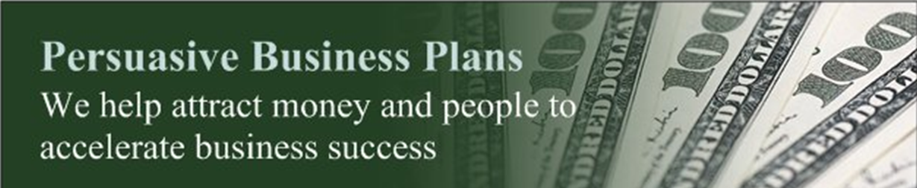
Consulting!

Slide 20

Second failure
Is there a better way to do Private Armed Security?
Notes:
Partner was unsuitable
Owner (me) not involved in the business on day to day basis
Dishonest and/or lazy Employees

Slide 21
Five basic Services
Transition into Business Ownership
Obtaining Key Human and/or Financial Capital
Business Remodeling
Fractional CFO
Profit Doctor

Slide 22
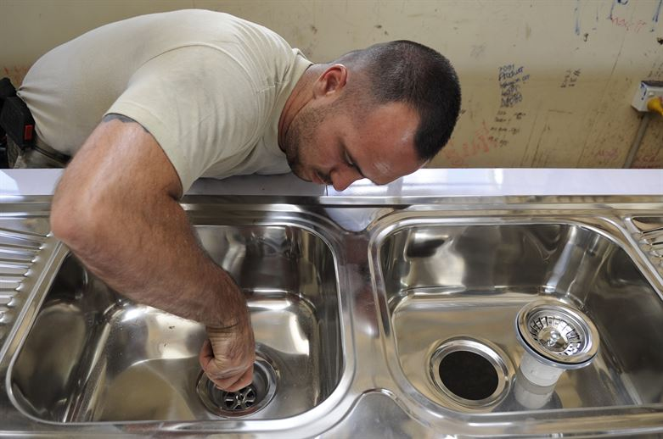
The Transition
#1
FROM THIS . . .
Notes:
Typical Client #1 – Help people understand the being a plumber is really different than running a plumbing business

Slide 23
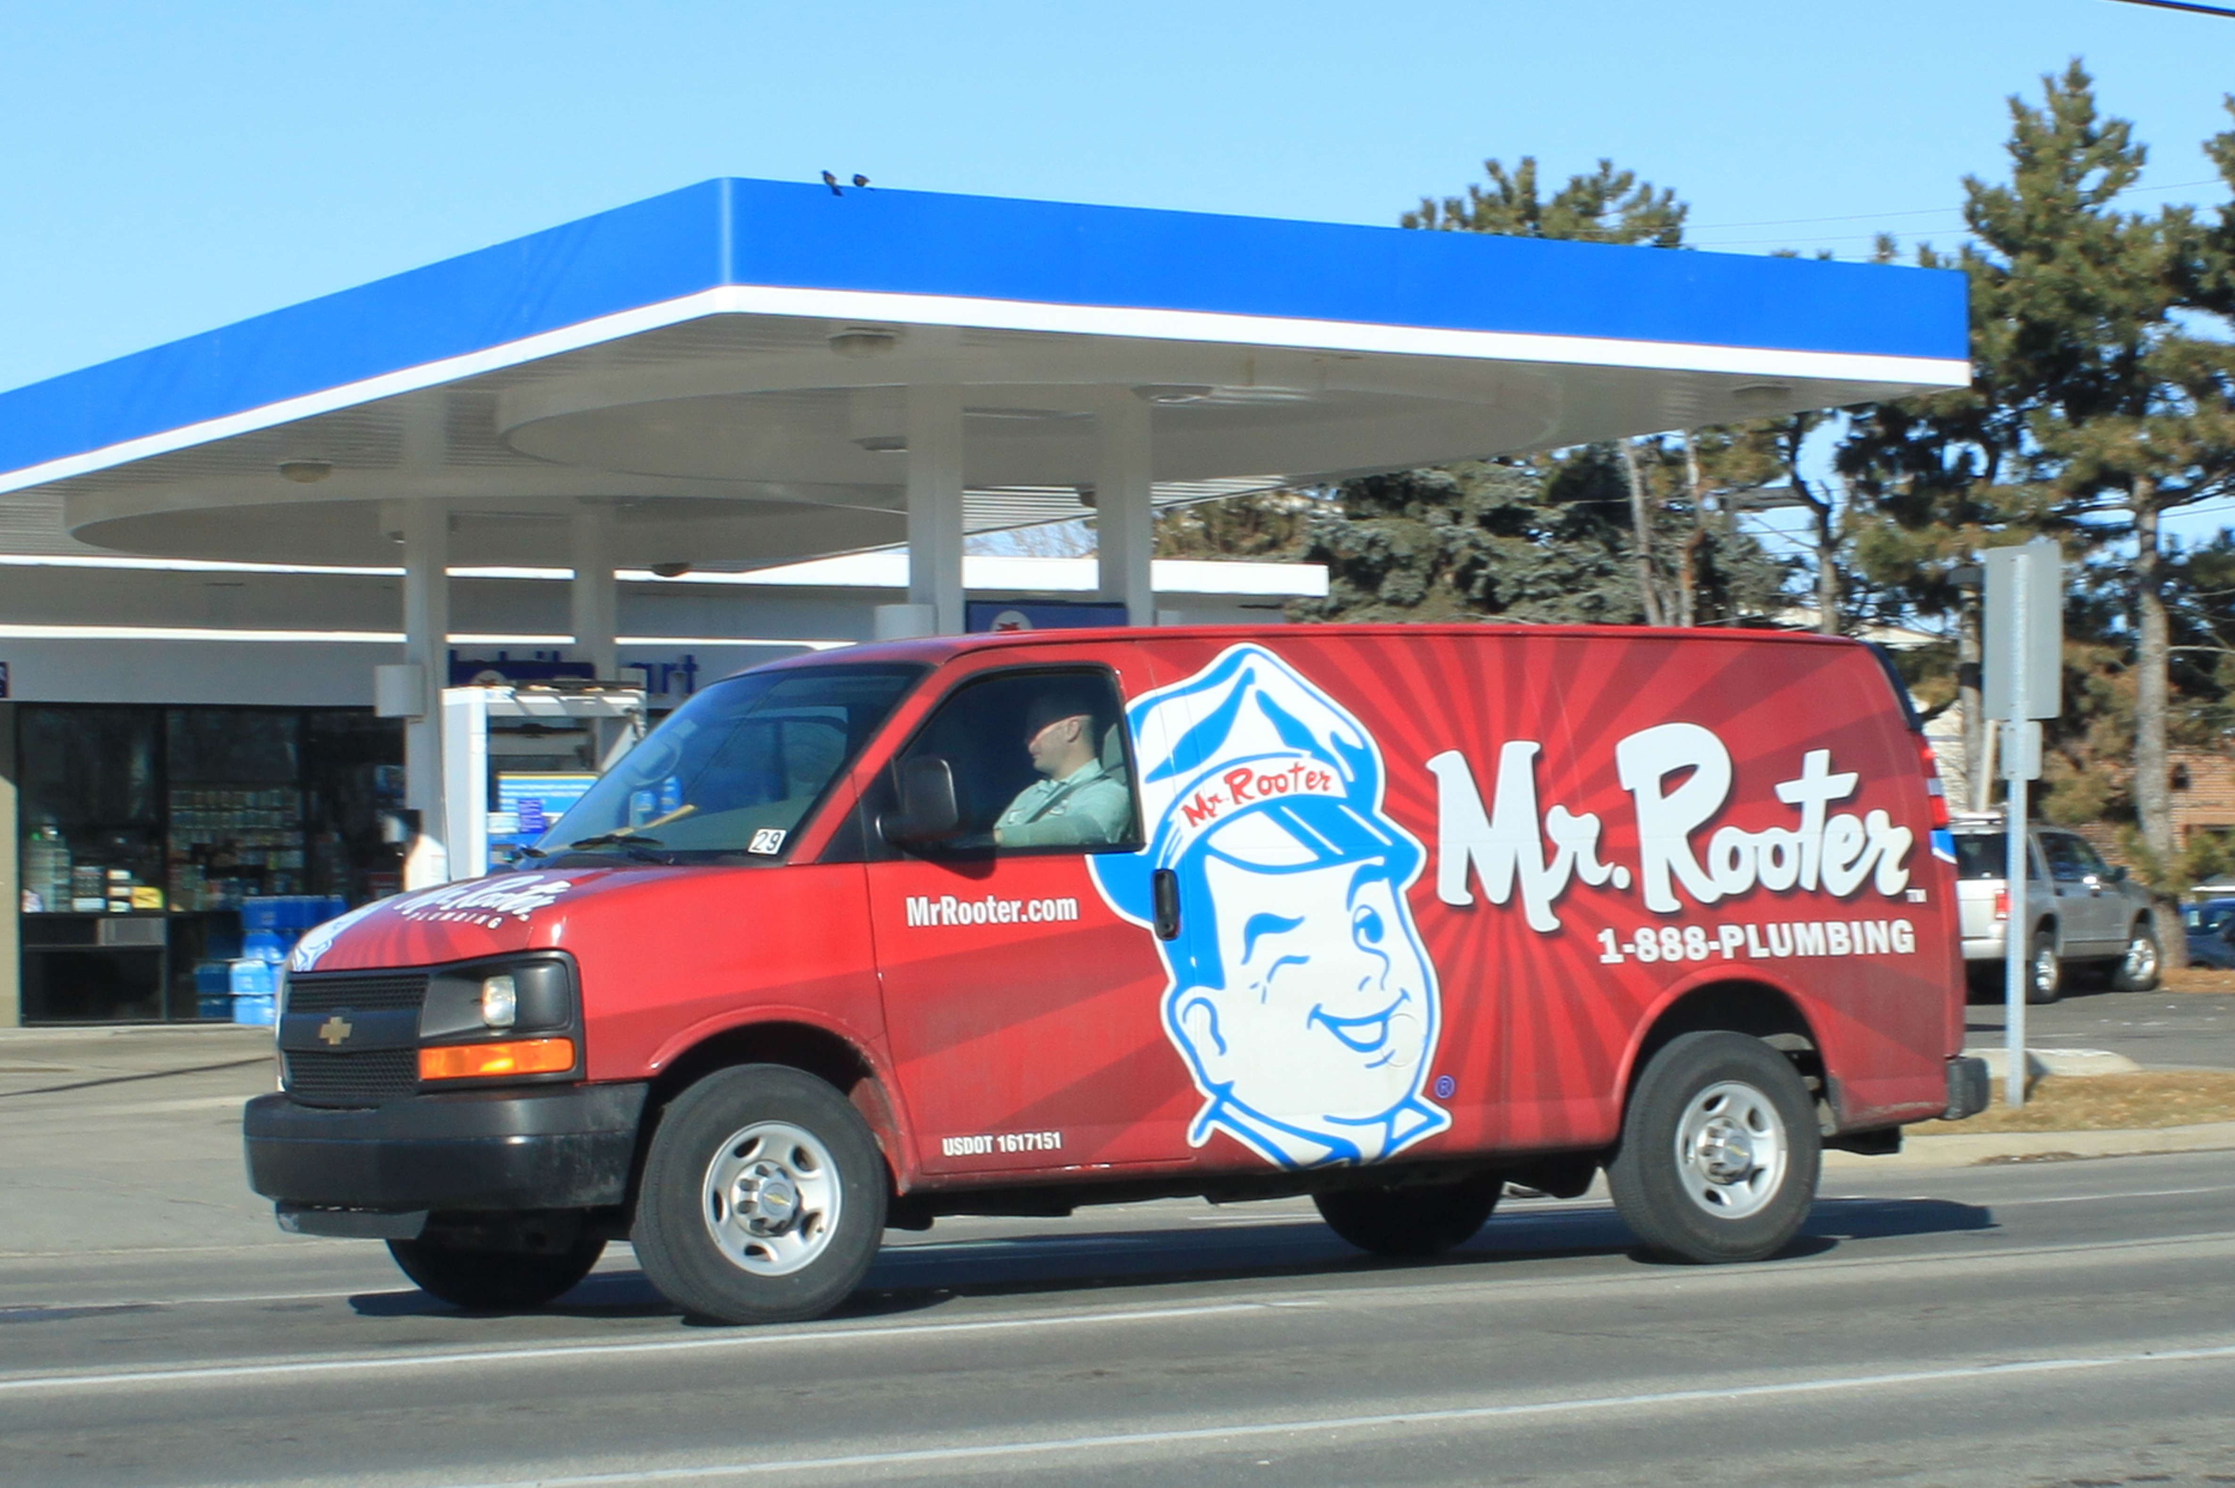
The Transition
#1
TO THIS !
Notes:
How many of you have made the transition from Employee to Owner?
Was it harder than you though?
Let’s look at why that may be. . .

Slide 24
Human and/or financial capital
#2
Notes:
Typical Client #2 - Need to find key executive (Human Capital) or raise in excess of $500,000 (Financial Capital)

Slide 25
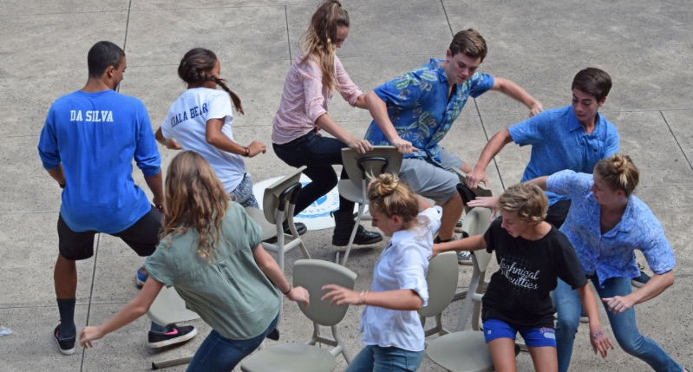
Business remodeling
#3
Notes:
Typical Client #2 - Need to find key executive (Human Capital) or raise in excess of $500,000 (Financial Capital)

Slide 26
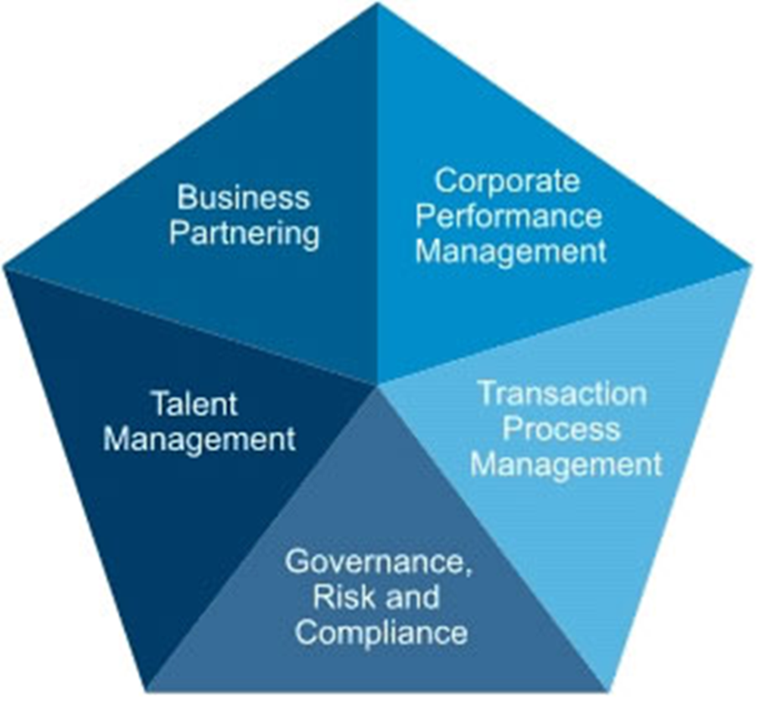
Fractional (P/T) CFO
#4
Notes:
Typical Client #4 – Has a bookkeeper or data entry person, may have a CPA, but not invested in administration or using technology / numbers to help manage their business.

Slide 27
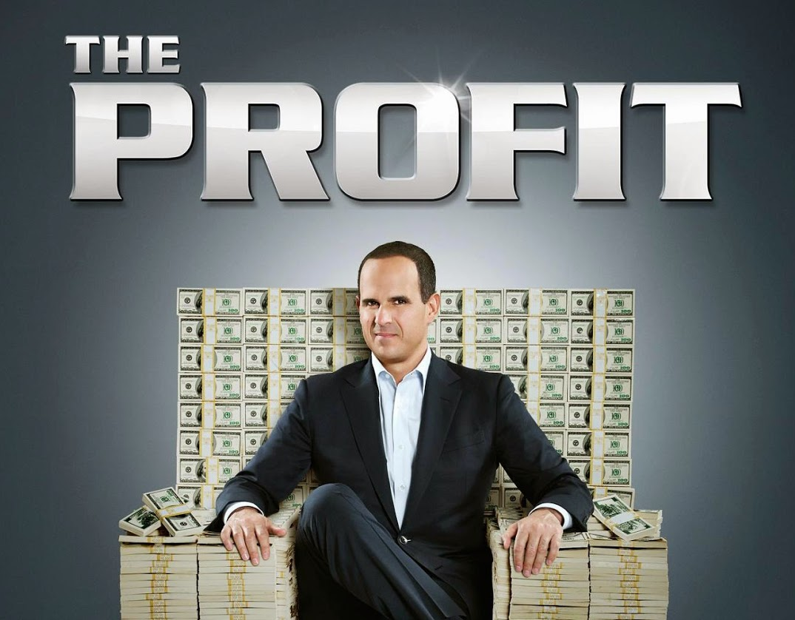
Fix sick businesses
#5
Notes:
Typical Client #5 – Sick Businesses – know symptoms but need a doctor to diagnose and prescribe

Slide 28







FOR WHOM DOES A CONSULTANT WORK?
Notes:
These are just a few of the client I’ve helped over the past couple of years.

Slide 29



Teaching!
Notes:
Graduate MBA Program @ Concordia
Undergraduate Entrepreneurship @ Chapman & Fullerton

Slide 30
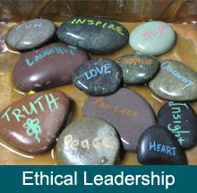

WHAT ARE YOUR CORE VALUES?
Notes:
This is an exercise that I do with my College Seniors because culture and values in an organization are evident.

Slide 31

THANKS!
Notes:
If you have questions, let’s set up a one-to-one

