Slide 1
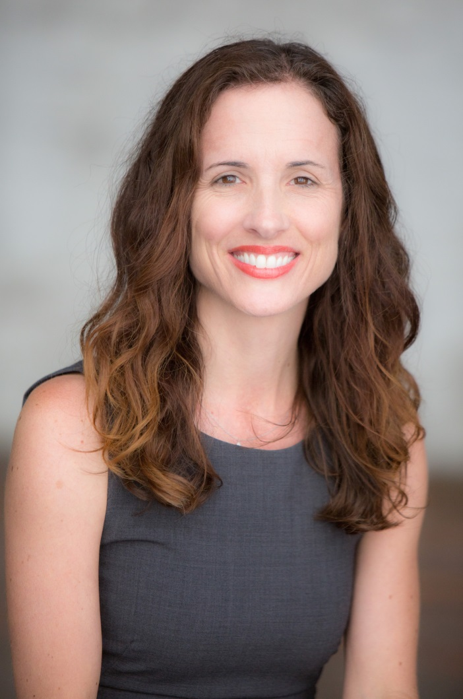
Staci Armao
Director of Operations
The Gabriella Foundation

Slide 2
INTRODUCTION
My name is STACI ARMAO and I am 47 years old.
I work for THE GABRIELLA FOUNDATION.
  The Mission of The Gabriella Foundation is to transform the lives of underserved youth in Los Angeles through high quality dance instruction.
My role at THE GABRIELLA FOUNDATION is
DIRECTOR OF OPERATIONS
  I am in charge of facilities, finances, and human resources

Slide 3
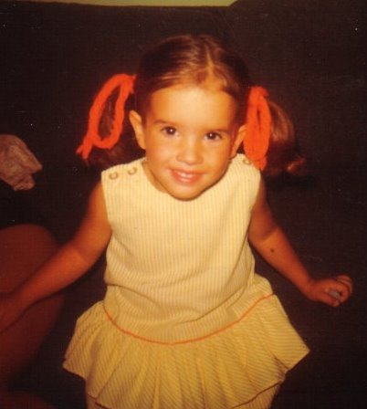
My childhood
I was born in WASHINGTON, D.C. and raised in BOWIE, MARYLAND and ORANGE COUNTY, CALIFORNIA
This is a picture of me at age 3

Slide 4
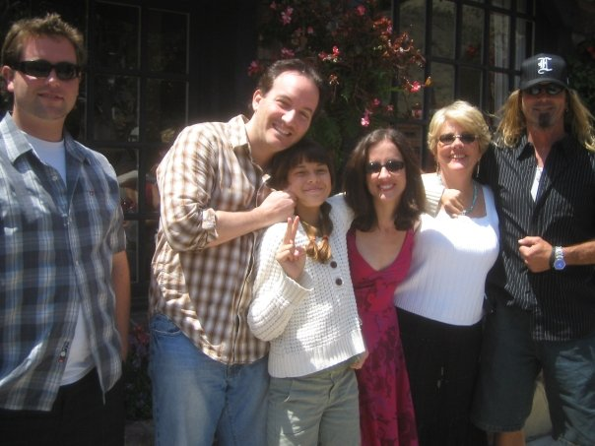
My family
My parents divorced when I was 9. My mom re-married within a year and we moved to California. My father re-married when I was in college. I kind of have three families:

Slide 5
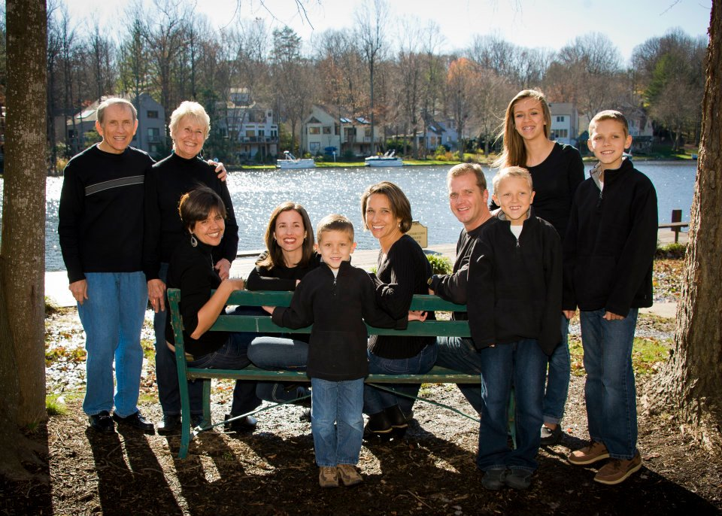
My family

Slide 6
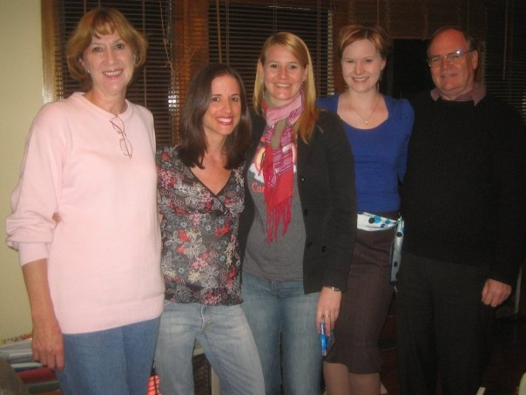
My family

Slide 7
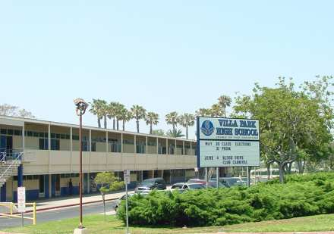

MY HIGH SCHOOL
I attended VILLA PARK HIGH SCHOOL in
VILLA PARK, CA

Slide 8
High School
As a high school student I was a little shy, a good student, and very independent.
Things that I really liked in high school were:
  Spanish
  Drama
  English
  Ballet Classes
  Reading

Slide 9
High School
Things that felt difficult or challenging for me while I was in high school were:
Feeling like people didn’t really know me and thought of me as just quiet and smart
Experiencing people making fun of other students
Watching kids try to fit in by getting drunk
I didn’t really like high school. I felt a little lost and a little bored.

Slide 10
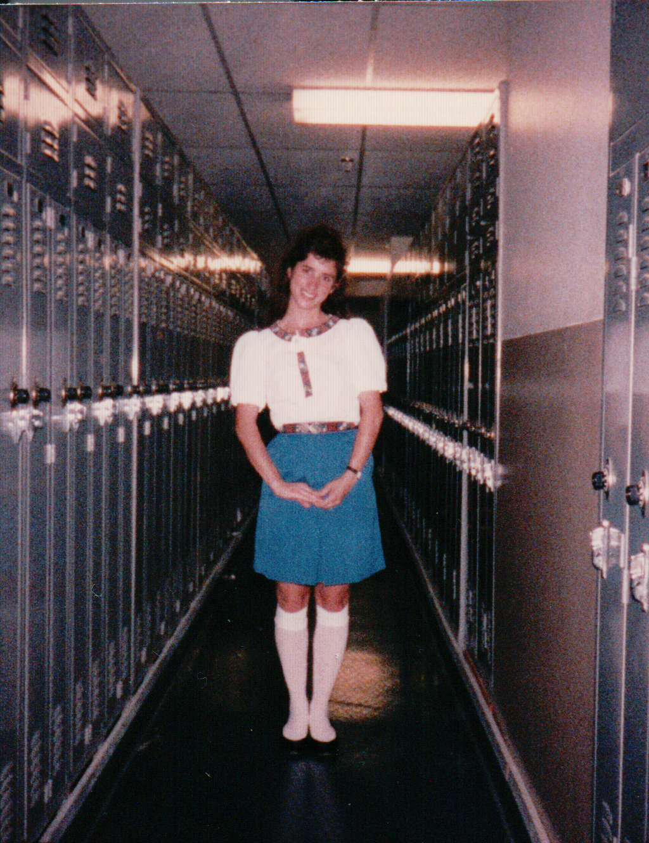
High School
Jobs I worked while I was in high school were:
  Book store
  Making sandwiches at a deli
  Babysitting
  Disneyland

Slide 11
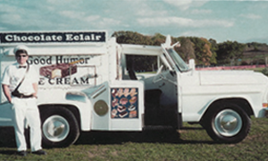
Career Path
Notes:
You may use this chart to describe your journey to the current career

Slide 12
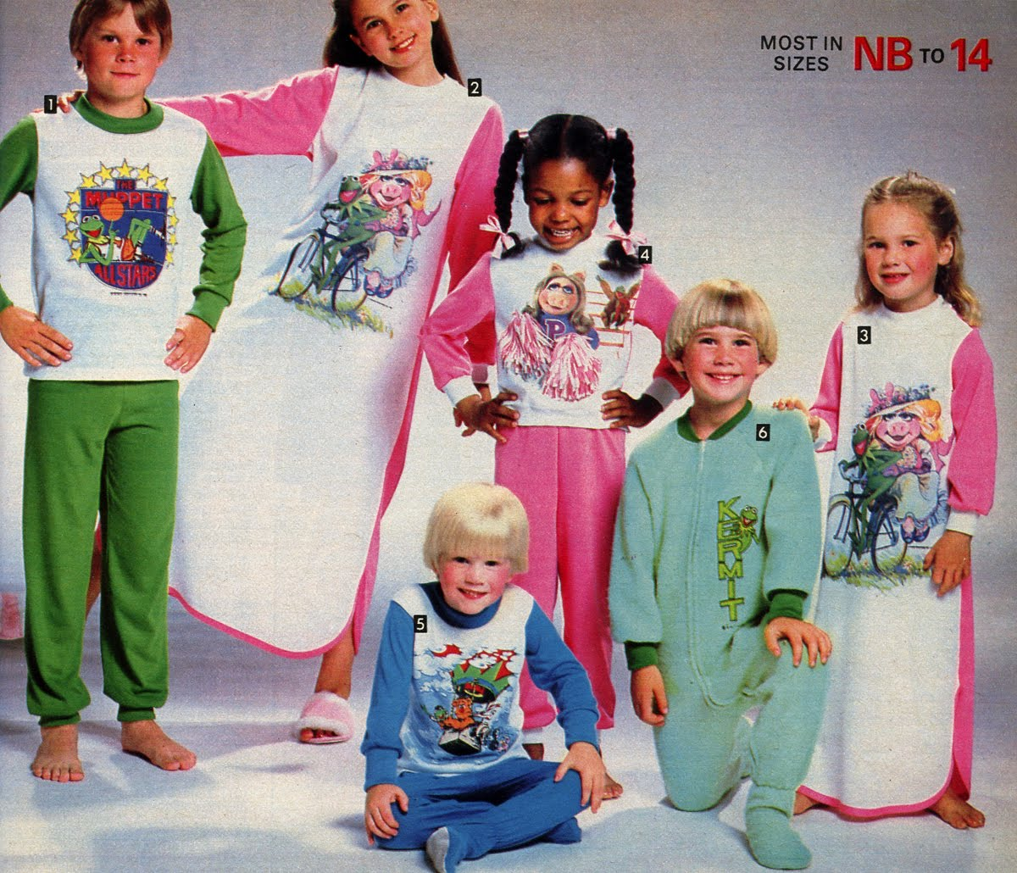
Career PATH

Slide 13
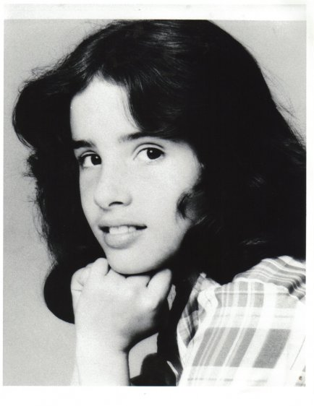
Career path

Slide 14
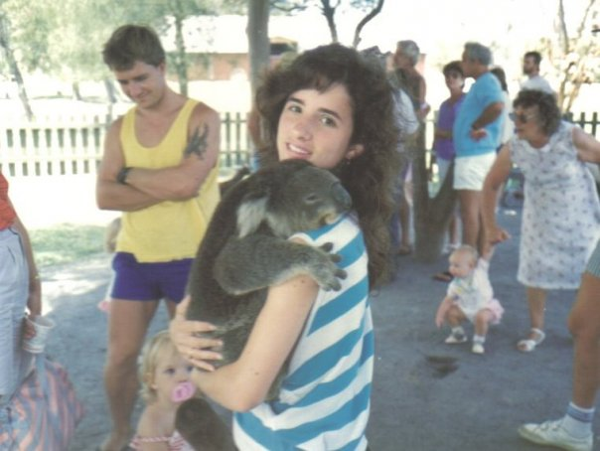
EXCHANGE STUDENT

Slide 15
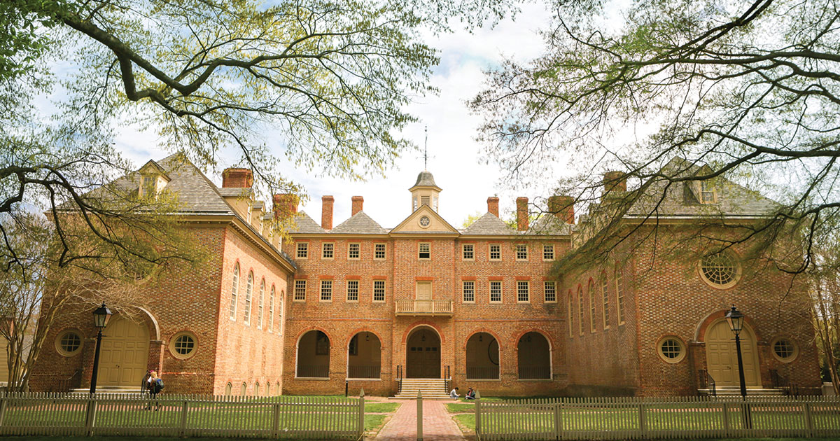
College
I attended THE COLLEGE OF WILLIAM & MARY
in WILLIAMSBURG, VIRGINIA

Slide 16
College
Things I enjoyed in College
Things I didn’t enjoy in College
Living in the Spanish House and the German House Junior and Senior years
Being in the college dance company
I was able to design my own major
Loved the quaint town and campus
I can’t think of anything. College was one of the best experiences!

Slide 17
College
Favorite classes
Least favorite classes
Spanish
Dance
Theater
Sociology
Ancient Spanish Literature

Slide 18
College
Jobs I worked while I was in college were:
  I did one TV commercial that paid for all of my books and the car I bought when I graduated. All I had to do was ride rides at an amusement park for a day while they filmed us and every time they played the commercial, they had to pay me.

Slide 19
College
Things that felt difficult or challenging for me while I was in college were:
  Most people didn’t have their own computers back then, so we would have to go to a computer lab, which was inconvenient
  Being across the country from my boyfriend

Slide 20
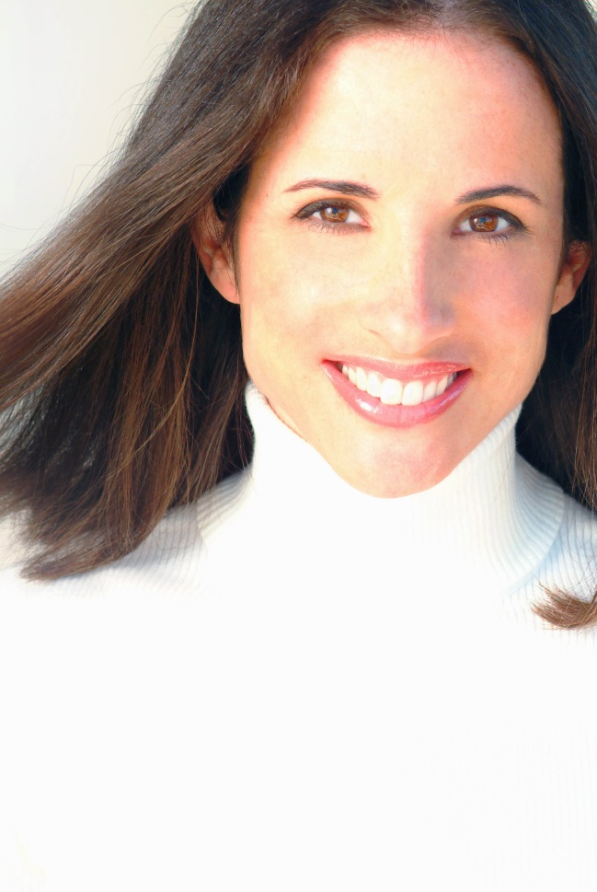
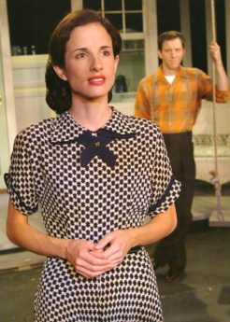
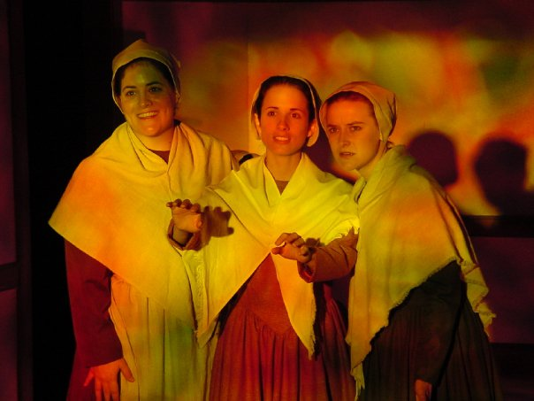
AFTER COLLEGE
I was an actress and a professional dancer

Slide 21
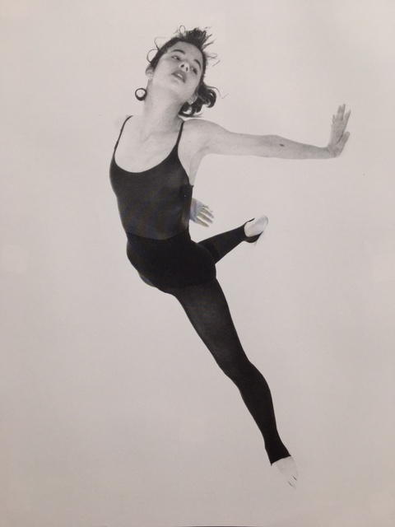
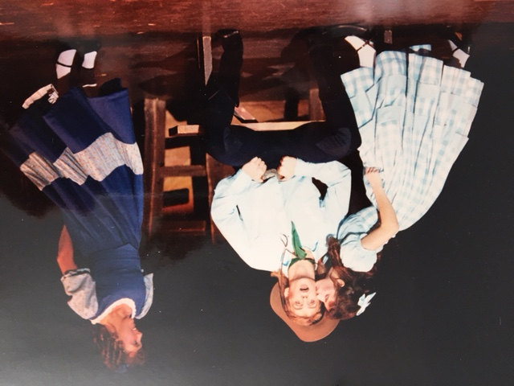
AFTER COLLEGE
I was an actress and a professional dancer

Slide 22
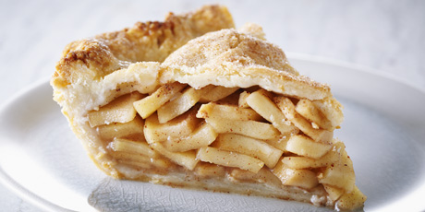

Slide 23
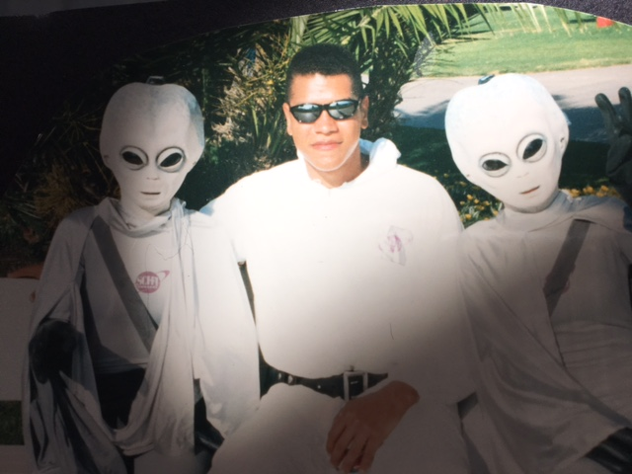

Slide 24
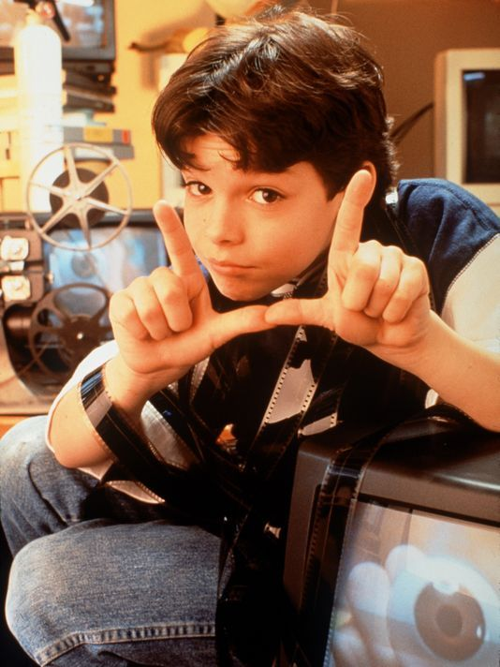

Slide 25
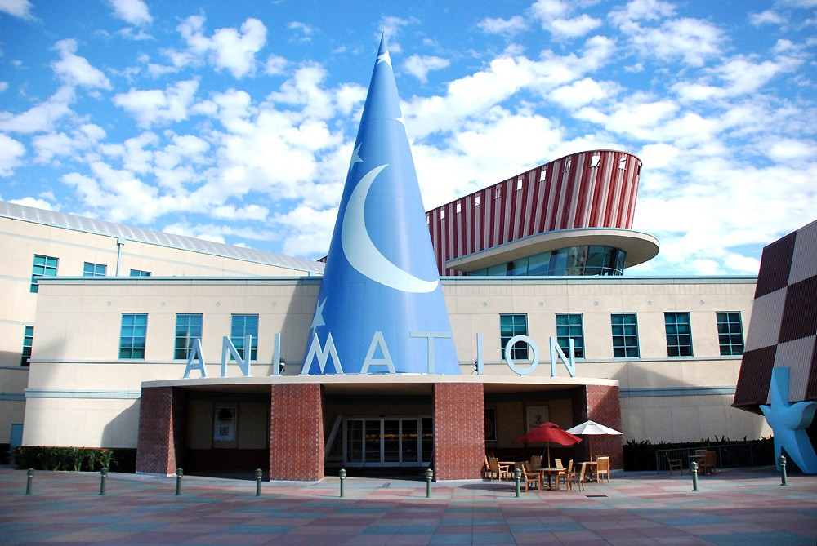

Slide 26
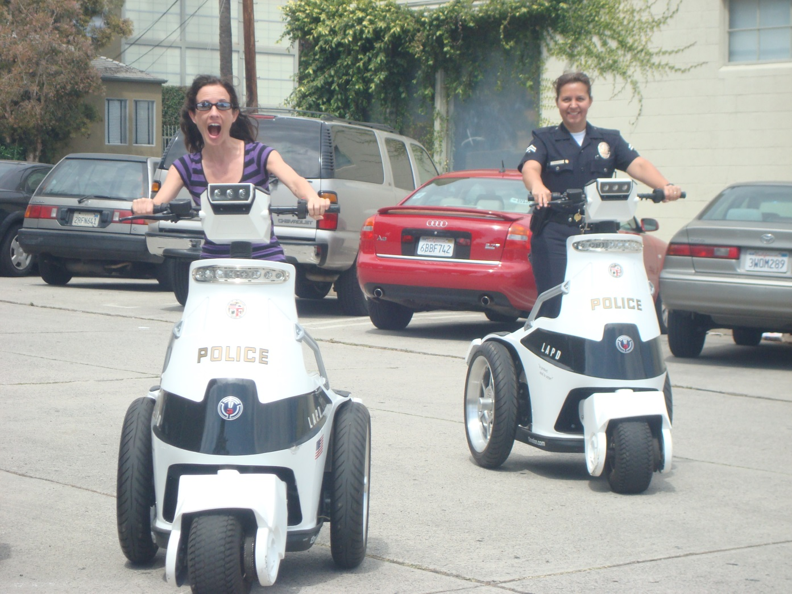

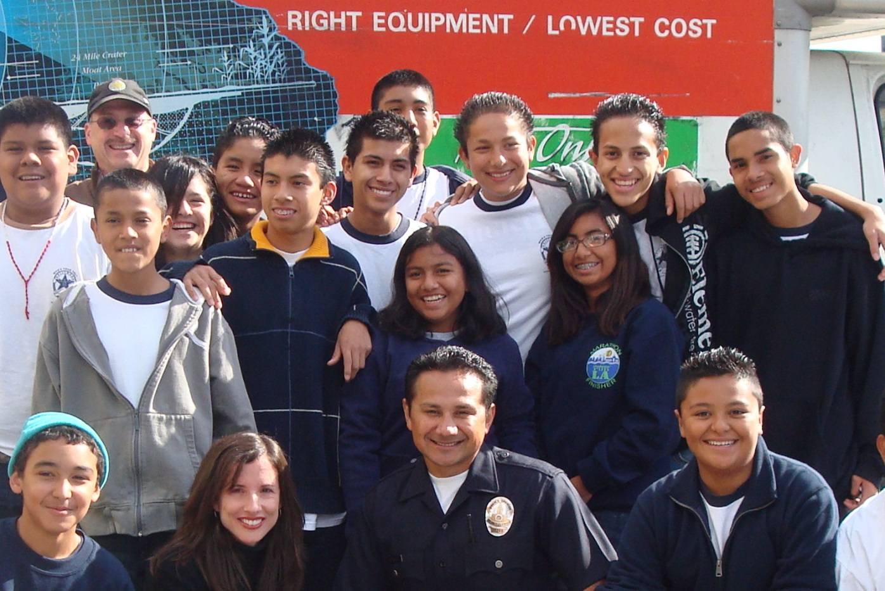

Slide 27
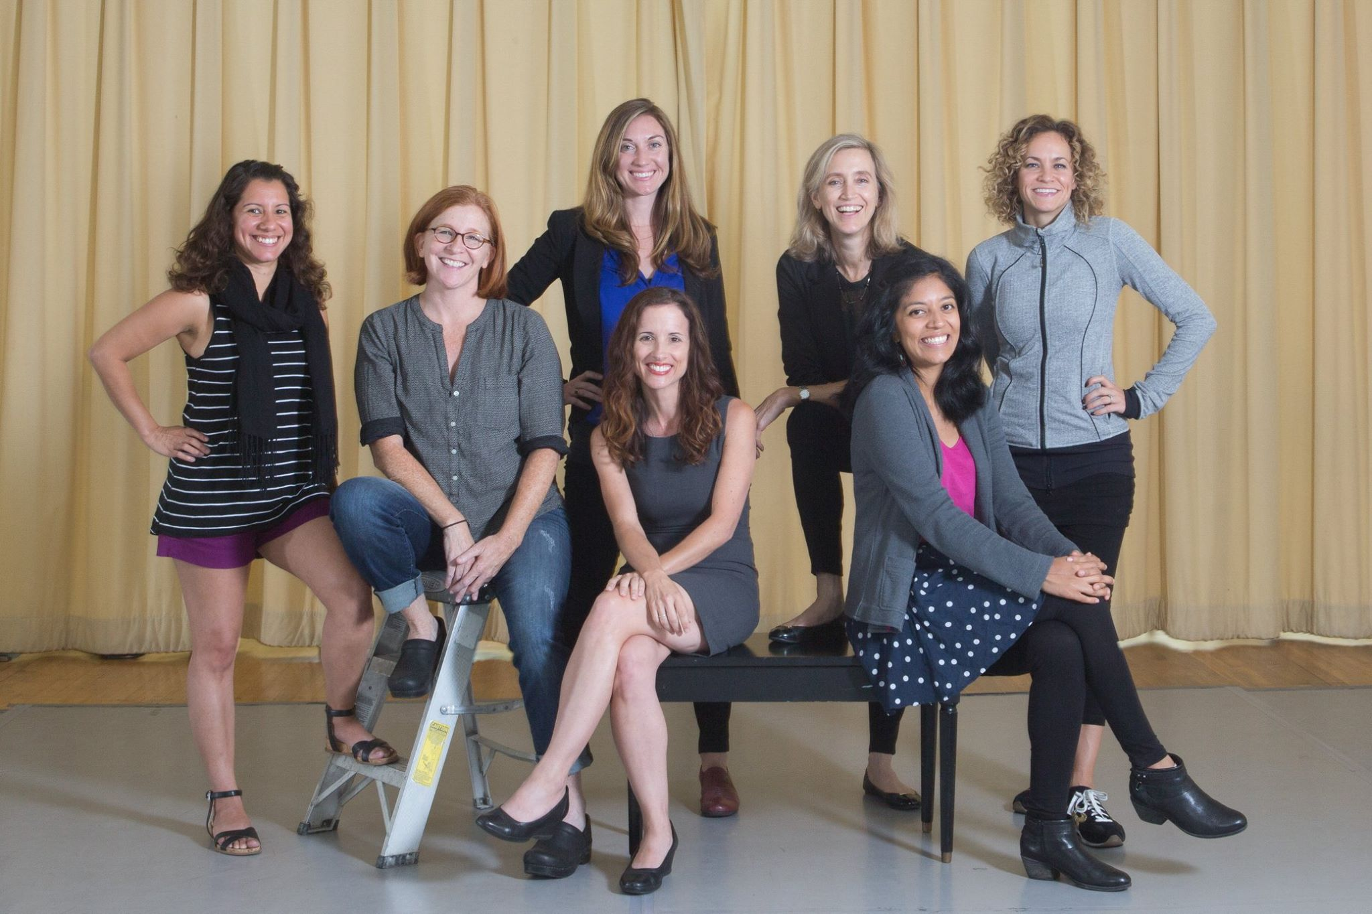
This is My Company
THE GABRIELLA FOUNDATION
Insert company picture

Slide 28

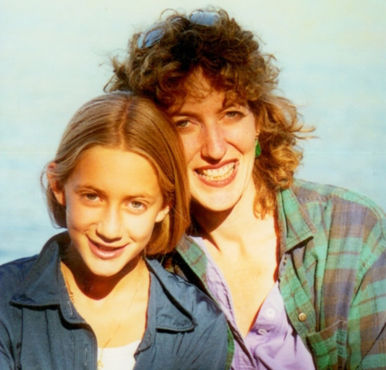
The Gabriella Foundation’s program everybody dance! was started by Liza Bercovici, a lawyer whose 13-year-old daughter passed away. Gabriella loved to dance.

Slide 29

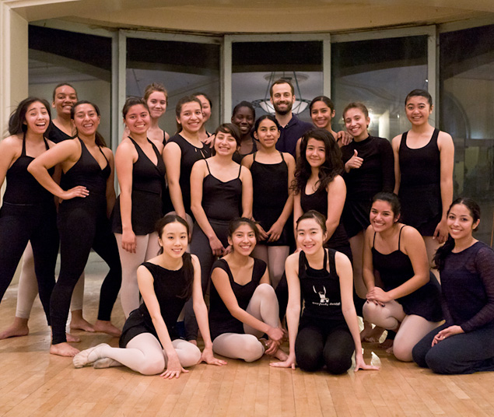
In 2017-18, The Gabriella Foundation’s everybody dance! program will provide high-quality, in/after-school dance education to 3,500 underserved children and youth at 18 sites around Los Angeles. On average, students stay with our program for 7+ years
Insert company picture

Slide 30

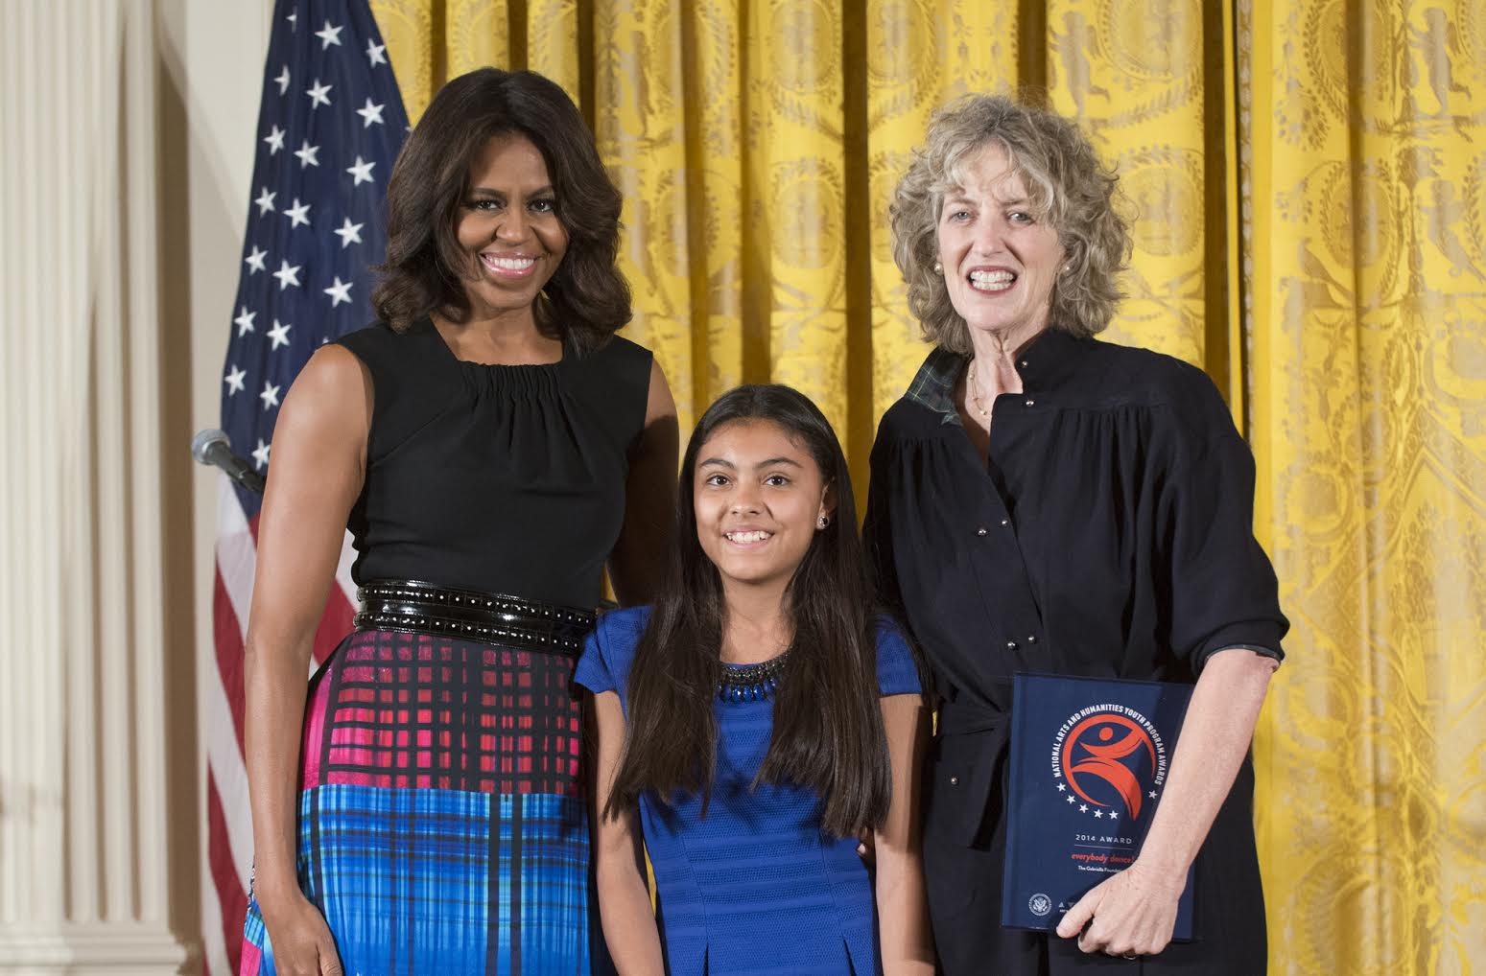
In 2014, Michelle Obama presented our program a National Arts and Humanities Youth Program Award
Insert company picture

Slide 31
Notes:
Use this graph to give more description of your role specifically (responsibilities, typical work week, direct reports, etc.)

Slide 32
Compensation at my company
C-Suite
($95-140k)
Management
($75-95K)
Middle Manager
($55k-75K)
Entry Level
($37K-42k)
Notes:
Use this graph to show general compensation ranges for people in various roles in your company

Slide 33
Career CHALLENGES
Challenges I have had to overcome throughout my career are:
  Looking younger than I am
  Being a woman and experiencing harassment
  Working in unhealthy work cultures
  Learning how to have difficult conversation with people

Slide 34
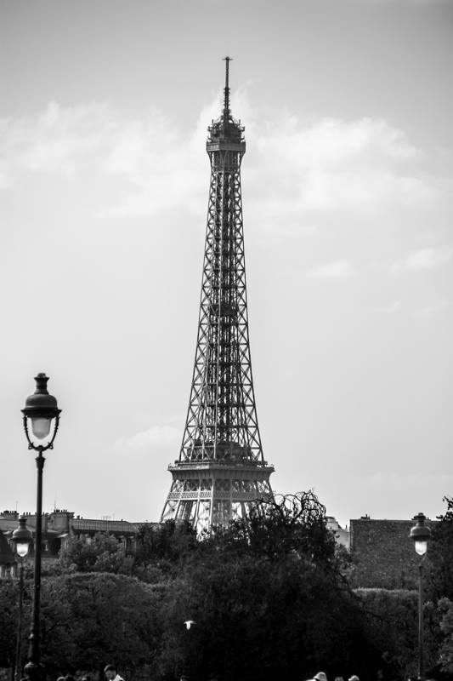
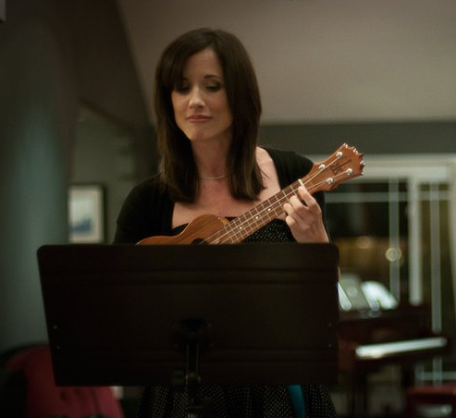
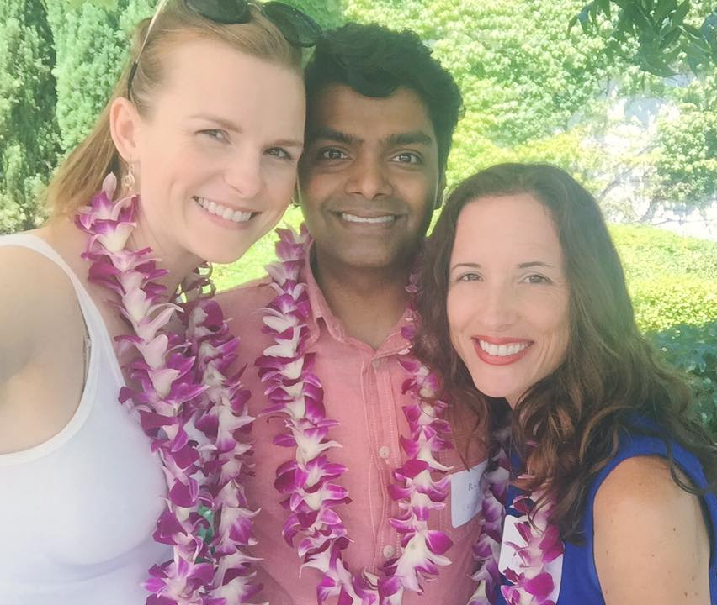
More than just work
When I am not at work I like to:
  Travel, photography, play ukulele and write comedic ukulele songs, write, do storytelling, hike, watch documentaries, spend time with friends, go to the Hollywood Bowl, see plays, etc.

Slide 35
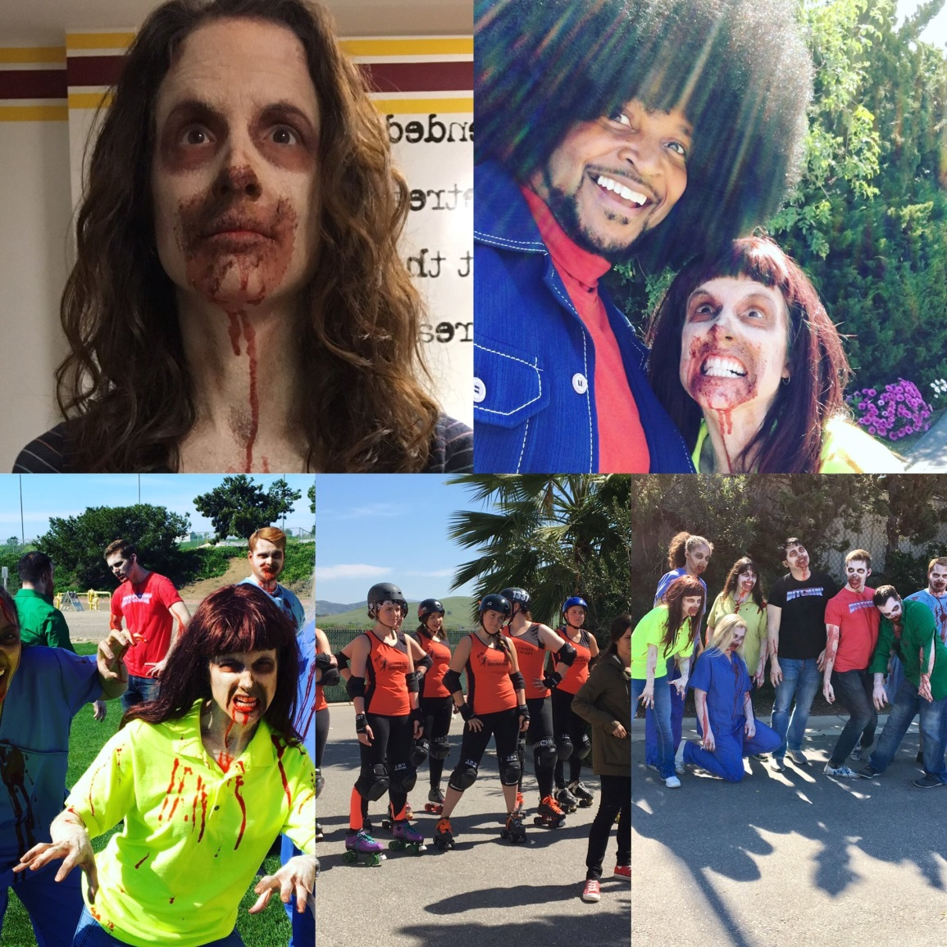
More than just work
Occasionally I still act for fun:
Me as a zombie in the comedy movie Bloodsucka Jones vs. the Creeping Death

Slide 36
Do it all over again?
If I could talk to my high school self, what would I say?
  Try more things and be open to new experiences
  Be friends with everyone and try to understand people who are different from you
  Don’t be afraid to go to parties even if you’re not a drinker
  Don’t assume you know what people think
  Save money and open an IRA as soon as you get a job!!!
  IT’S OKAY TO MAKE MISTAKES…..IN FACT, IT’S YOUR RIGHT!

Slide 37
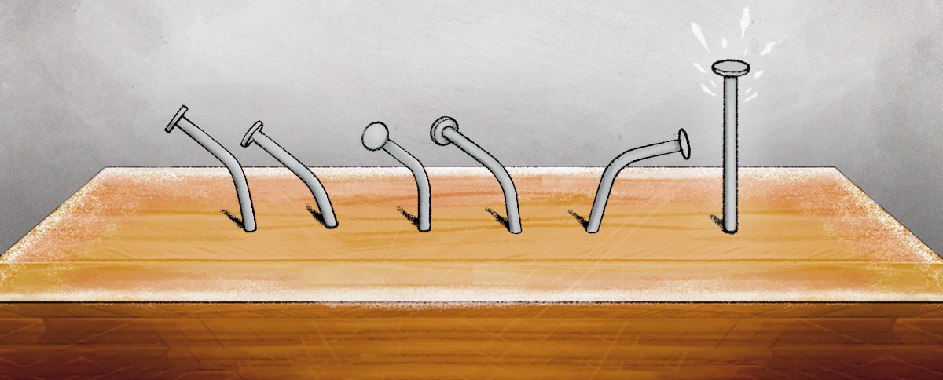
EXERCISE
MISTAKES – THE BEST WAY TO LEARN

Slide 38
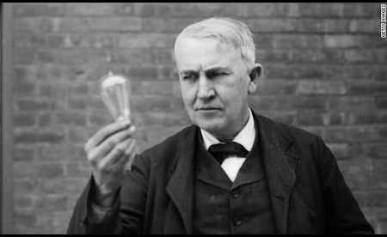
EXERCISE
"I have not failed 1,000 times. I have successfully discovered 1,000 ways to NOT make a light bulb.”
~ Thomas Edison

Slide 39
EXERCISE
Write down five events in your life when you made a mistake and what you learned from it:
Event What I Learned
1.
2.
3.
4.
5.

Slide 40

QUESTION AND ANSWER

