Slide 1
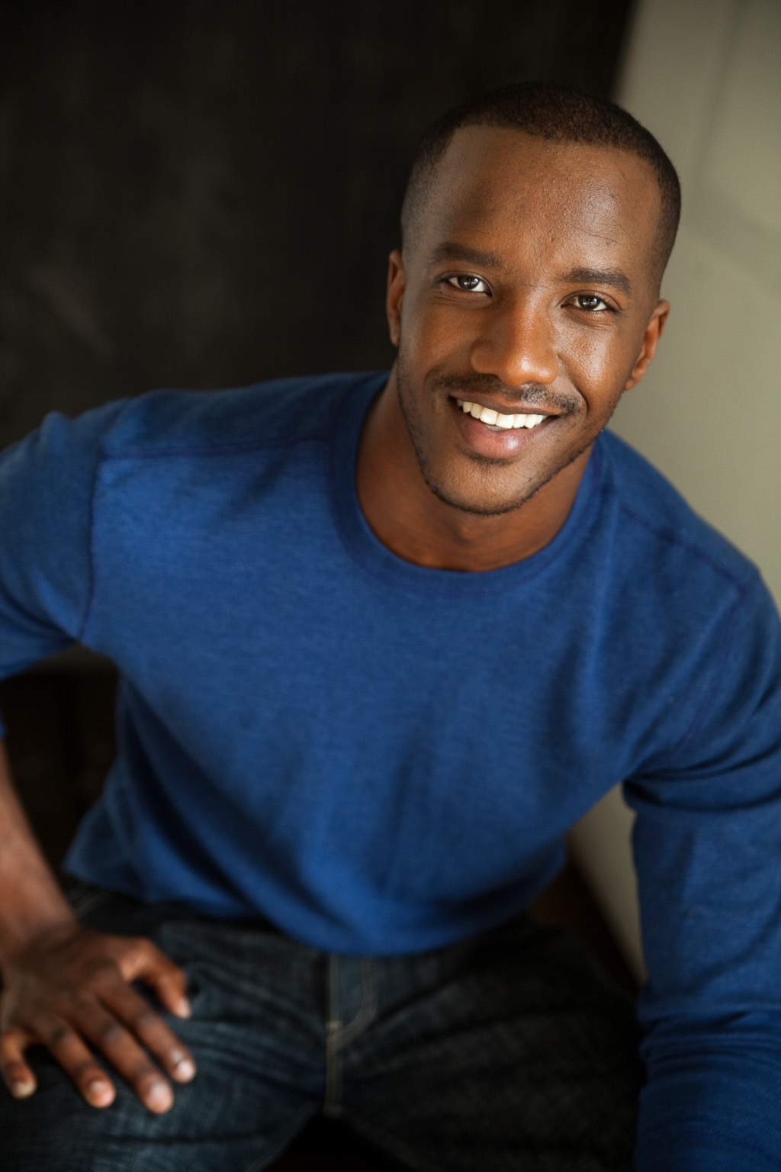
Brian Isom
February, 9 1982
Age: 36

Slide 2
Introduction
How I grew up
What I was like as a teenager
What my high school/college experience was like
What my career path did I take

Slide 3
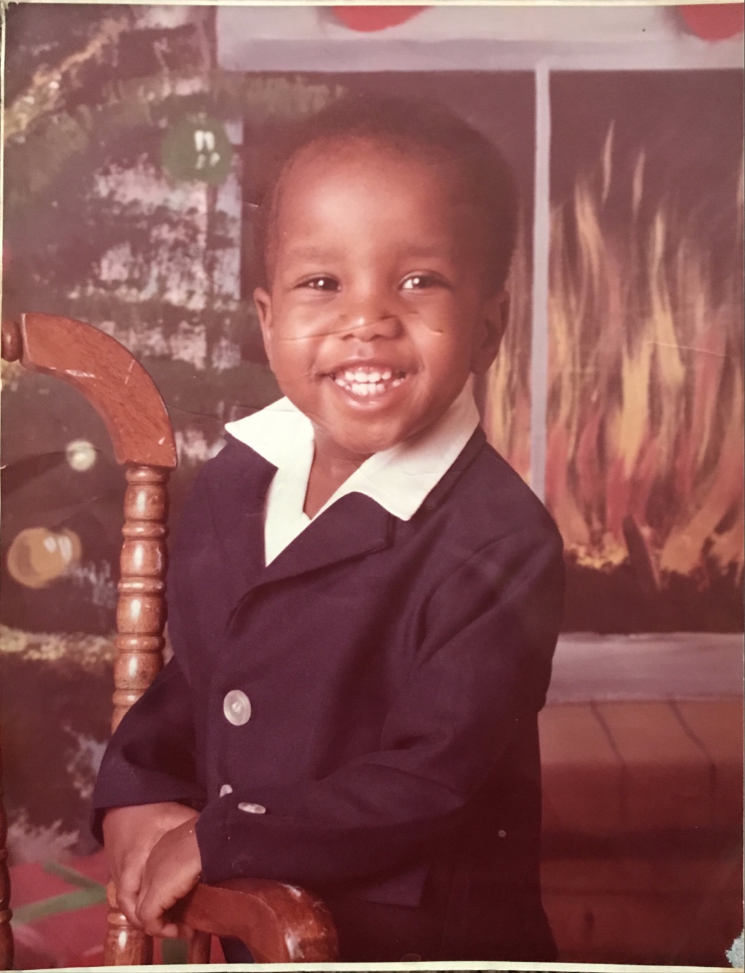
How I grew up
I grew up in Gadsden, Alabama and raised by a single mother (middle class home)
I have 5 siblings, 3 brothers and two sisters
I grew up super-religious with restricted thinking
I had a stuttering problem as a kid
I had low self-esteem, crooked teeth and acne

Slide 4
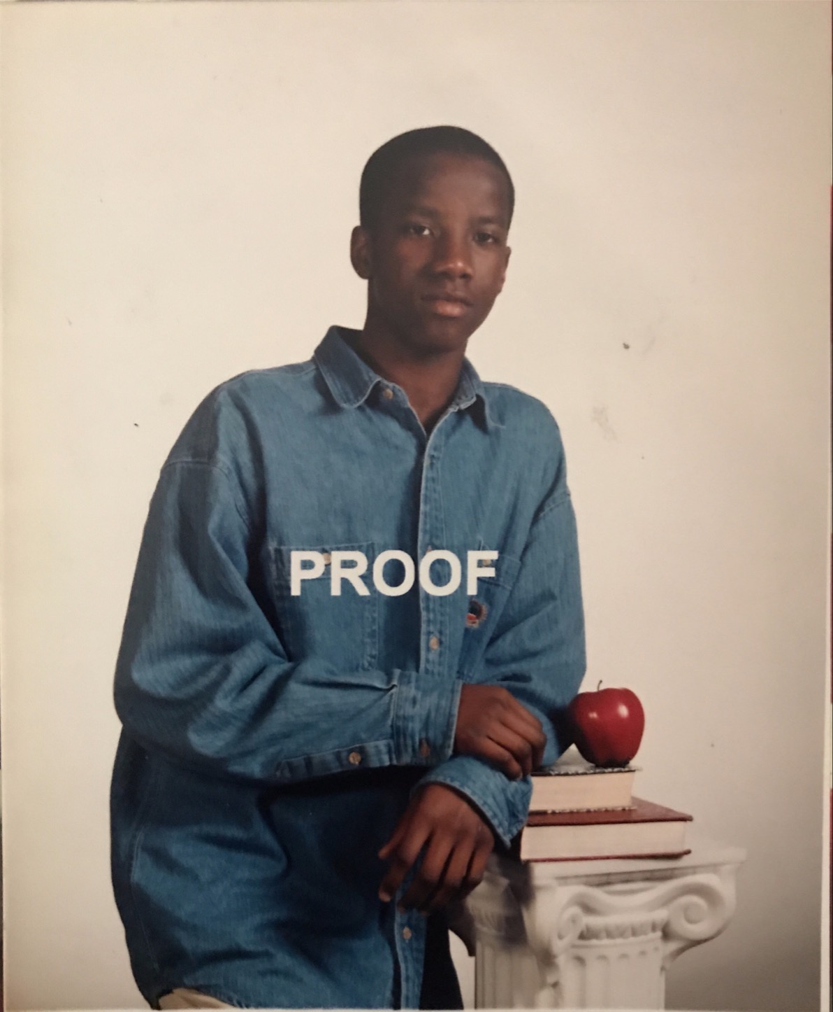
Teenage Years
Struggles with identity (The man I wanted to become?)
Overcoming bullying
Building up my confidence
Forcing myself to dream

Slide 5
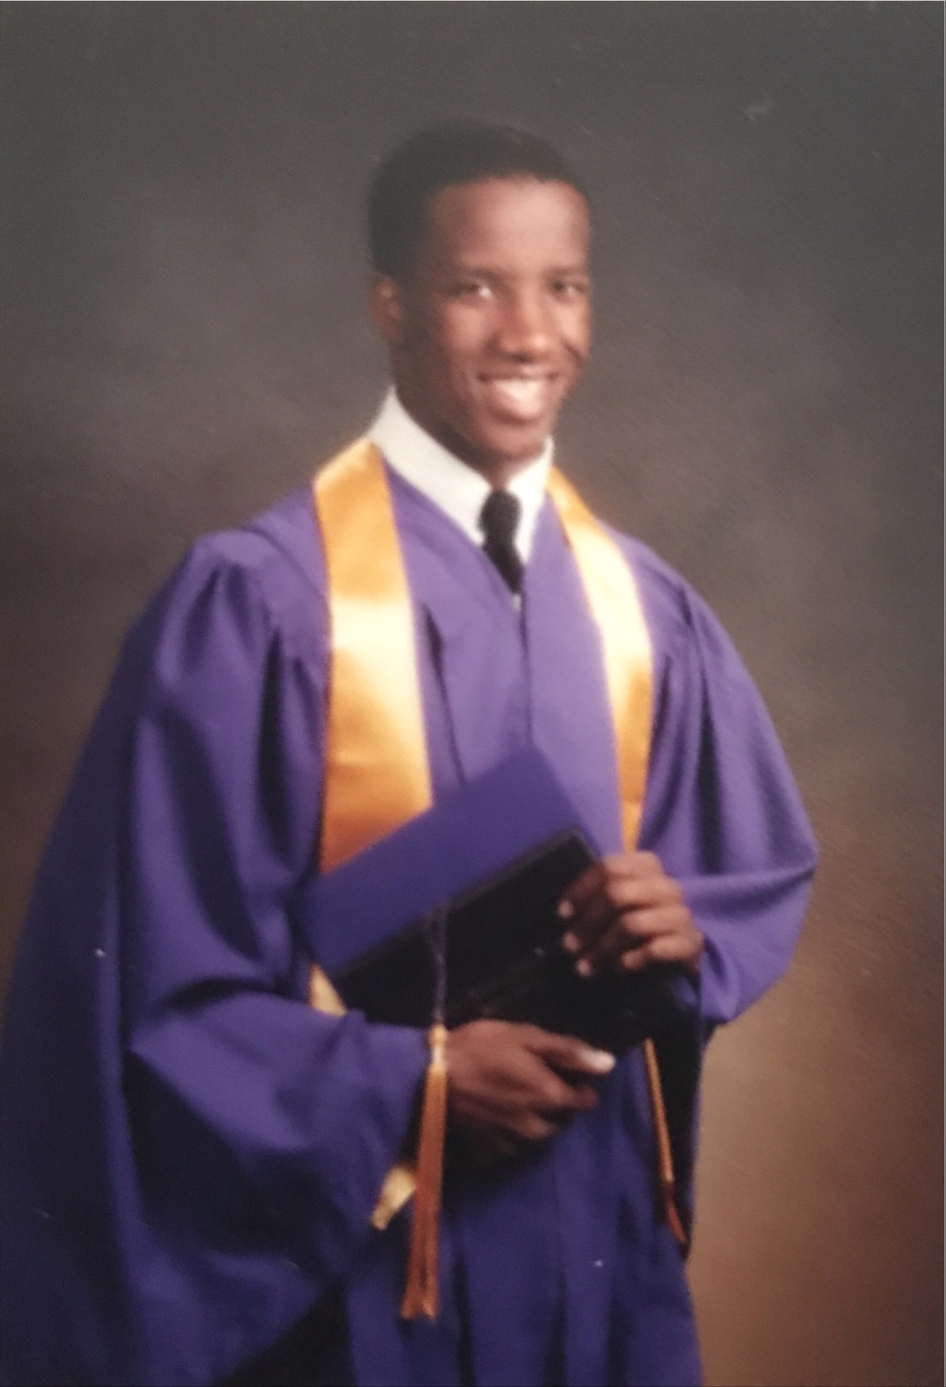
Post High School Career Path
2001 – I started Community College
Worked several jobs:
Mental Health Provider
FedEx
AT&T
Fast food
Car Manufacturing Maintenance worker

Slide 6
Career Path
I joined the Military at 19
A typical day
exercising
leadership training
on-the-job training
What I like about being in the Army
The structure and discipline that helped me grow as a man.
I developed skills that allowed me lead people

Slide 7
Pictures
My Basic Training picture and as you can see, I was very excited!

Slide 8
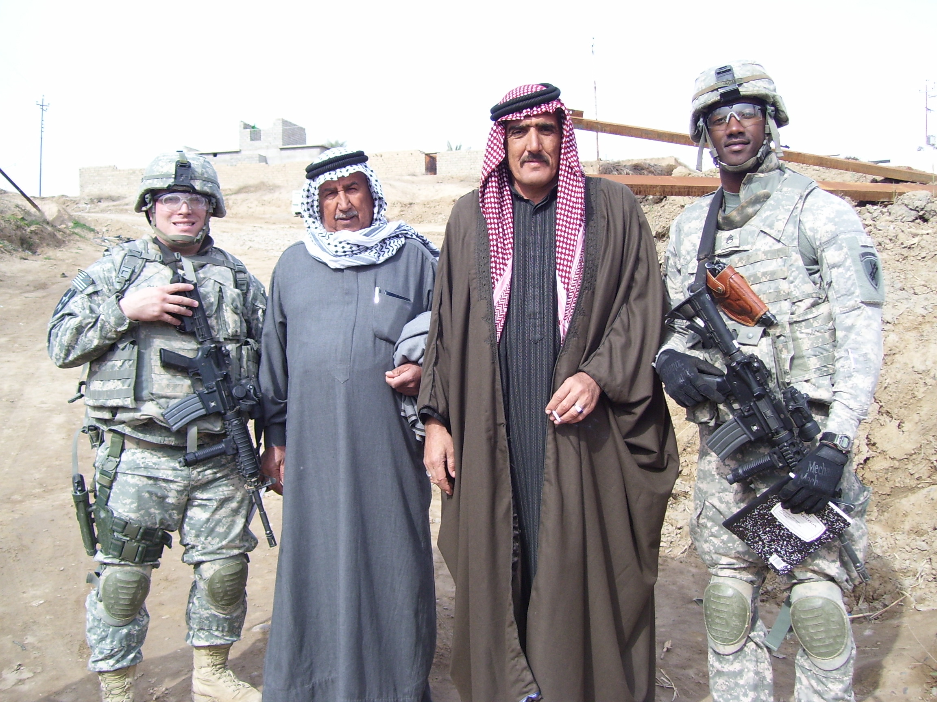
Pictures
In 2009, I went to Iraq to help rebuild the infrastructure of the country.
What is infrastructure?
The basic physical and organizational structures and facilities (e.g., buildings, roads, and power supplies) needed for the operation of a society or enterprise.

Slide 9
Pictures
Taking pictures for a group of middle schoolers that sent me gifts.

Slide 10
Pictures
One of the last pictures I took before leaving Iraq.

Slide 11
Pictures
After coming home, I moved to LA and my first job was playing a Bailiff on a court tv show.

Slide 12
Knowing your passion
Everyone needs to focus and discover what they are passionate about. A lot of times people are not taught to follow their gut or seek their own happiness, no matter what it is.
We sometimes are taught to follow our parents’ guidelines on how they perceive our lives to be.
Find what excites you at every moment – believe it and trust in yourself and your ability to create the life you truly want.

Slide 13
Drop Expectations
Don’t expect people to help you. If they do help that’s great, but motivate yourself.
No one owes you anything.
Apply yourself in everything you do.
Don’t seek validation from people, places and things.

Slide 14
Healthy Mind set
Food nutrition helps you to focus
Being aware of what you put into your body can affect your judgement
Hydrating with H20
Sleep

Slide 15
Exercise
What are you passionate about?

Slide 16
Questions
What did you learn?

