Slide 1
MY NAME IS CARLOS JIMENEZ SALGADO
I AM A PRODUCTION COORDINATOR AT FOX SPORTS MARKETING.

Slide 2
HOW DID I GET TO WHERE I AM AT?

Slide 3
HARD WORK

Slide 4
FAILING…. A LOT

Slide 5
FINDING A WAY TO GET BACK UP

Slide 6
OVERCOMING MY SHYNESS

Slide 7
AND A LITTLE BIT OF LUCK

Slide 8
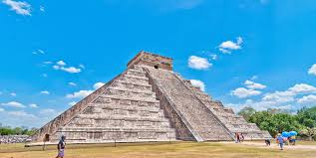
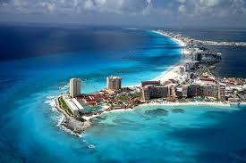
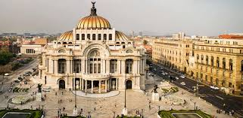
WHERE AM I ORINGINALLY FROM?

Slide 9
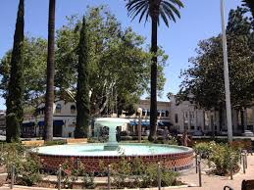
I GREW UP IN THE CITY OF ORANGE IN ORANGE COUNTY

Slide 10
High School
Loved to play Basketball
Met the most important teacher in my life. Nancee Hoertz
Helped me get prepared for the business world

Slide 11
First Life Challenge
Adversity
I found out that I didn’t qualify for any finical aid, because of my immigration status.

Slide 12
What did I end up doing?

Slide 13
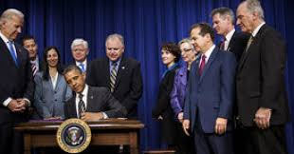
Remember about luck?
When it was time to transfer, Dream act was approved by Obama

Slide 14
I was able to go to a 4 year University!
Went to Cal-State Northridge
Decided to Study TV Production
Was burned out all the time in college

Slide 15
Remember about Hard Work?
I worked 3 jobs and school on top of it
All I did was eat sleep, work and study
I still managed to find time to hangout with friends

Slide 16
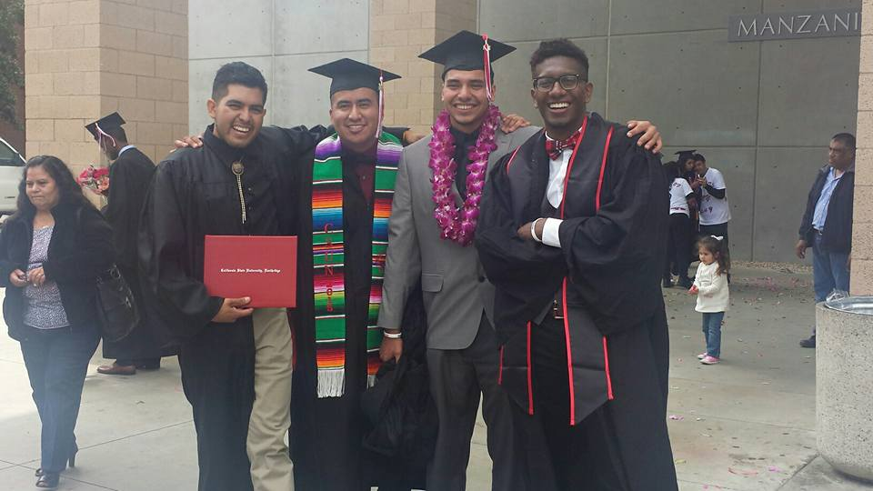
Graduation
Graduated in 2015

Slide 17
Career
Landed a job with Fox Sports as a Production Assistant

Slide 18
Remember about Failing?
Didn't’t do great at my job

Slide 19
Getting back up
I got another opportunity with the marketing team

Slide 20
Working my way up
Learned from every mistake
Communicated with my boss everyday
Went above any beyond

Slide 21
What does my day at FOX Sports look like?

Slide 22
FOX Sports

Slide 23
Promos
Our goal is to get people excited and to tune in to our events

Slide 24
What did I learn from working at FOX?
Don’t give up.
Get to know your co-workers.
Throw out new ideas.

Slide 25
KEYS TO OBTAINING THE CAREER OF YOUR CHOICE
GPA
SCORES ON ENTRANCE EXAMS
PREPARE FOR INTERVIEWS
RESEARCH
RESUME
BE PROACTIVE
SET GOALS
WORK HARD/TAKE PRIDE
FACE YOUR FEARS
BELIEVE IN YOURSELF
BE A GOOD PERSON

Slide 26
Activity

Slide 27
World Cup Teaser

Slide 28
Questions?

