Slide 1

David Brownlee
Founder/ CEO

Slide 2
INTRODUCTION
My name is David Brownlee and I am 43 years old.
I work for David Brownlee & Associates.
We help business owners and entrepreneurs grow their companies, increase revenues and achieve their goals though consulting, coaching and training.
My role at David Brownlee & Associates is Founder/ CEO.
As CEO, I am responsible for the ultimate vision of the company, creating content and operating the business.

Slide 3
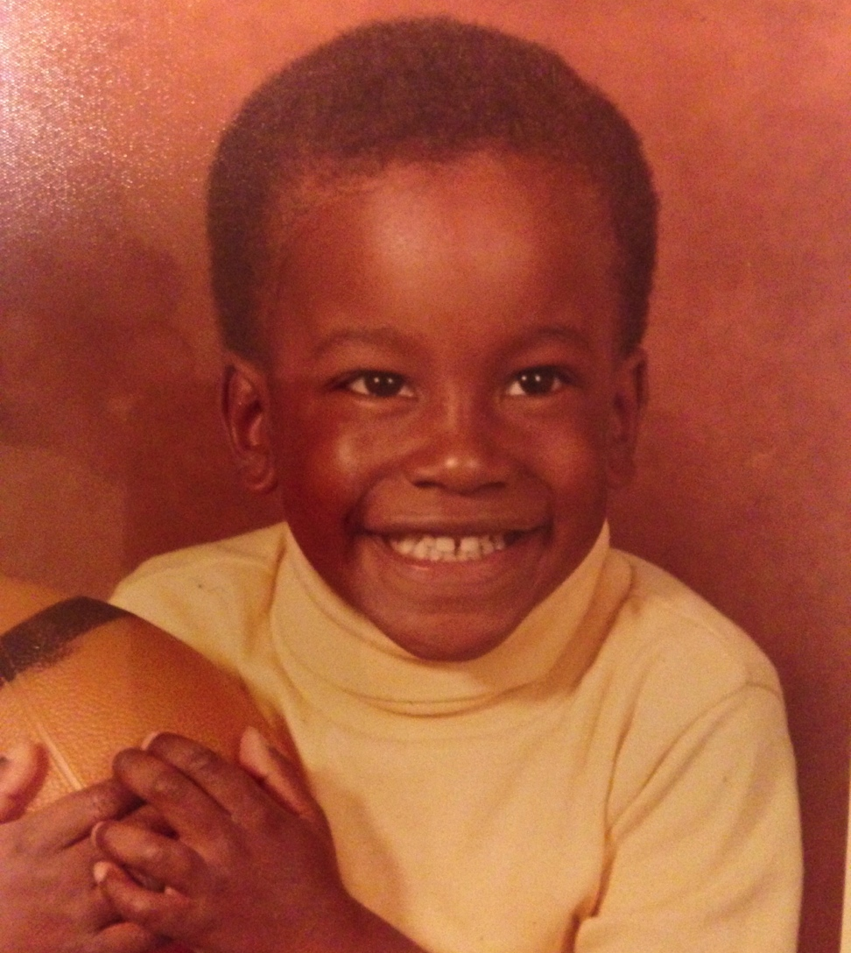
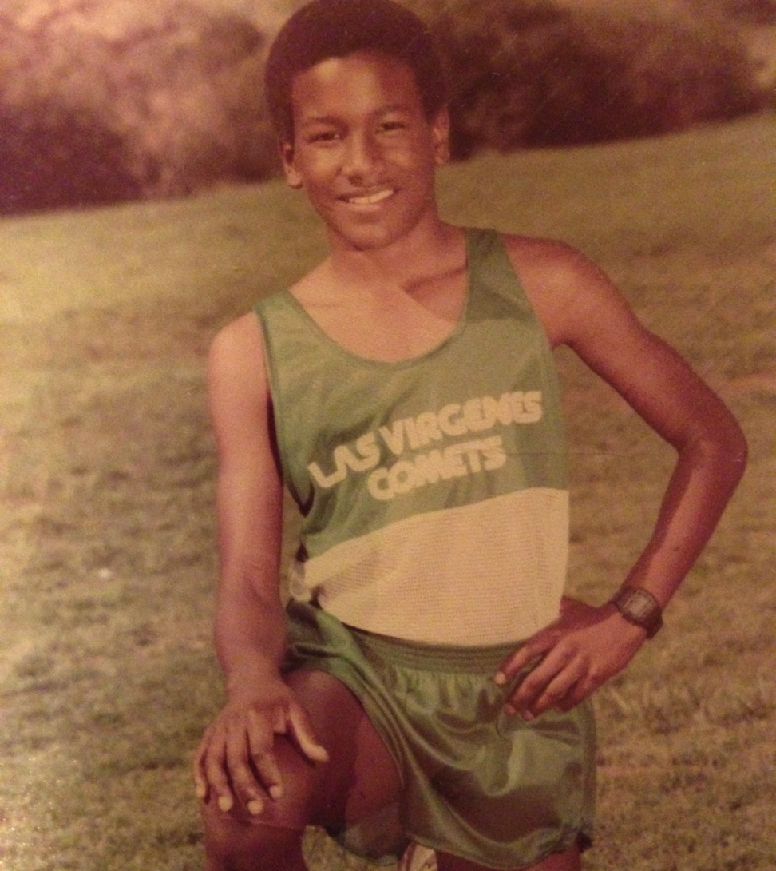
The Early Years…
I was born and raised in Westlake Village, CA.
This is a picture of me at 4 age.
This is a picture of me at age 12.

Slide 4
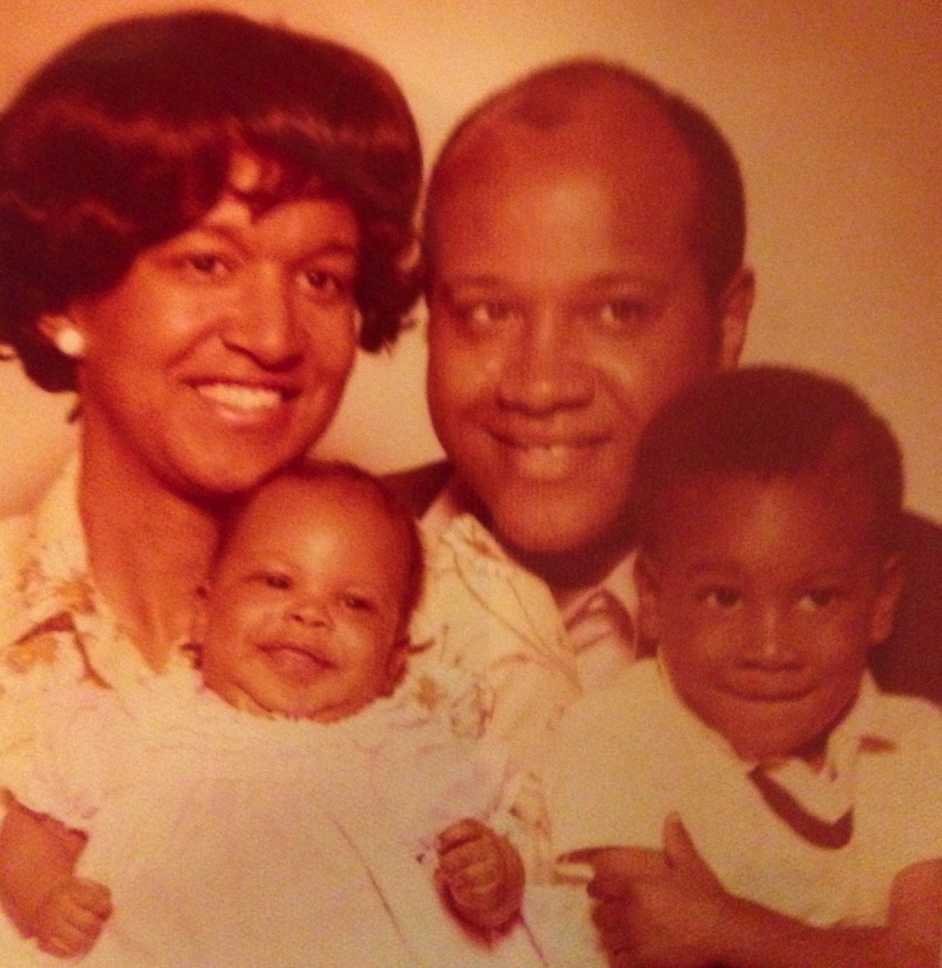
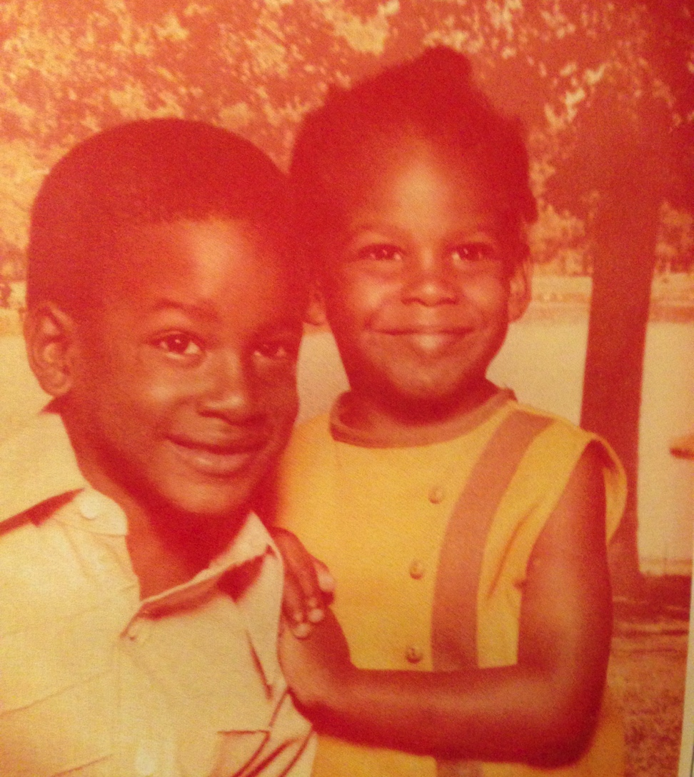
More Early Years…
A little about my family…
This is a picture of me and my younger sister Crystal. (3.5yrs younger)
This is a picture of Crystal, my parents and me.

Slide 5
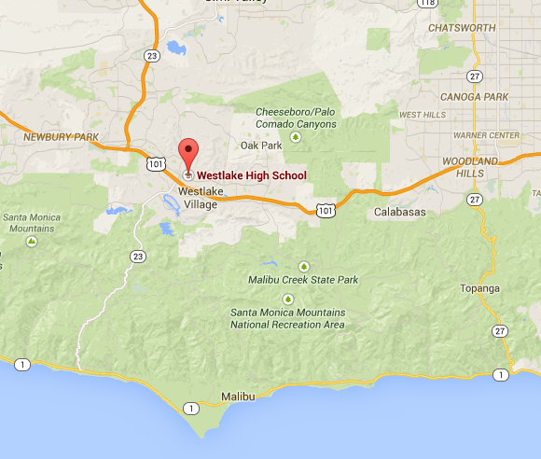
HIGH SCHOOL
I attended Westlake HS in Westlake Village, CA
\

Slide 6
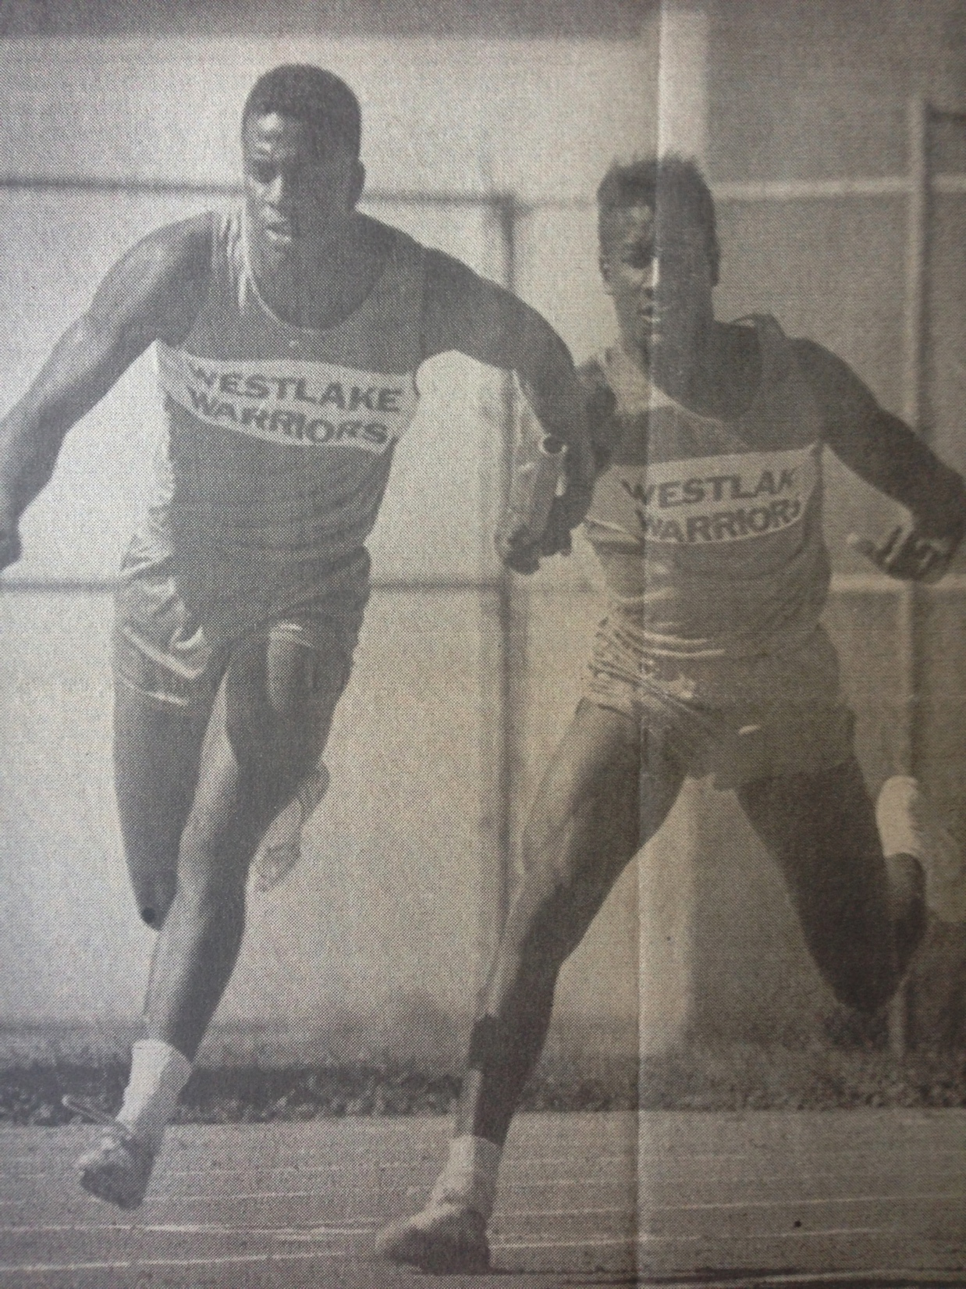
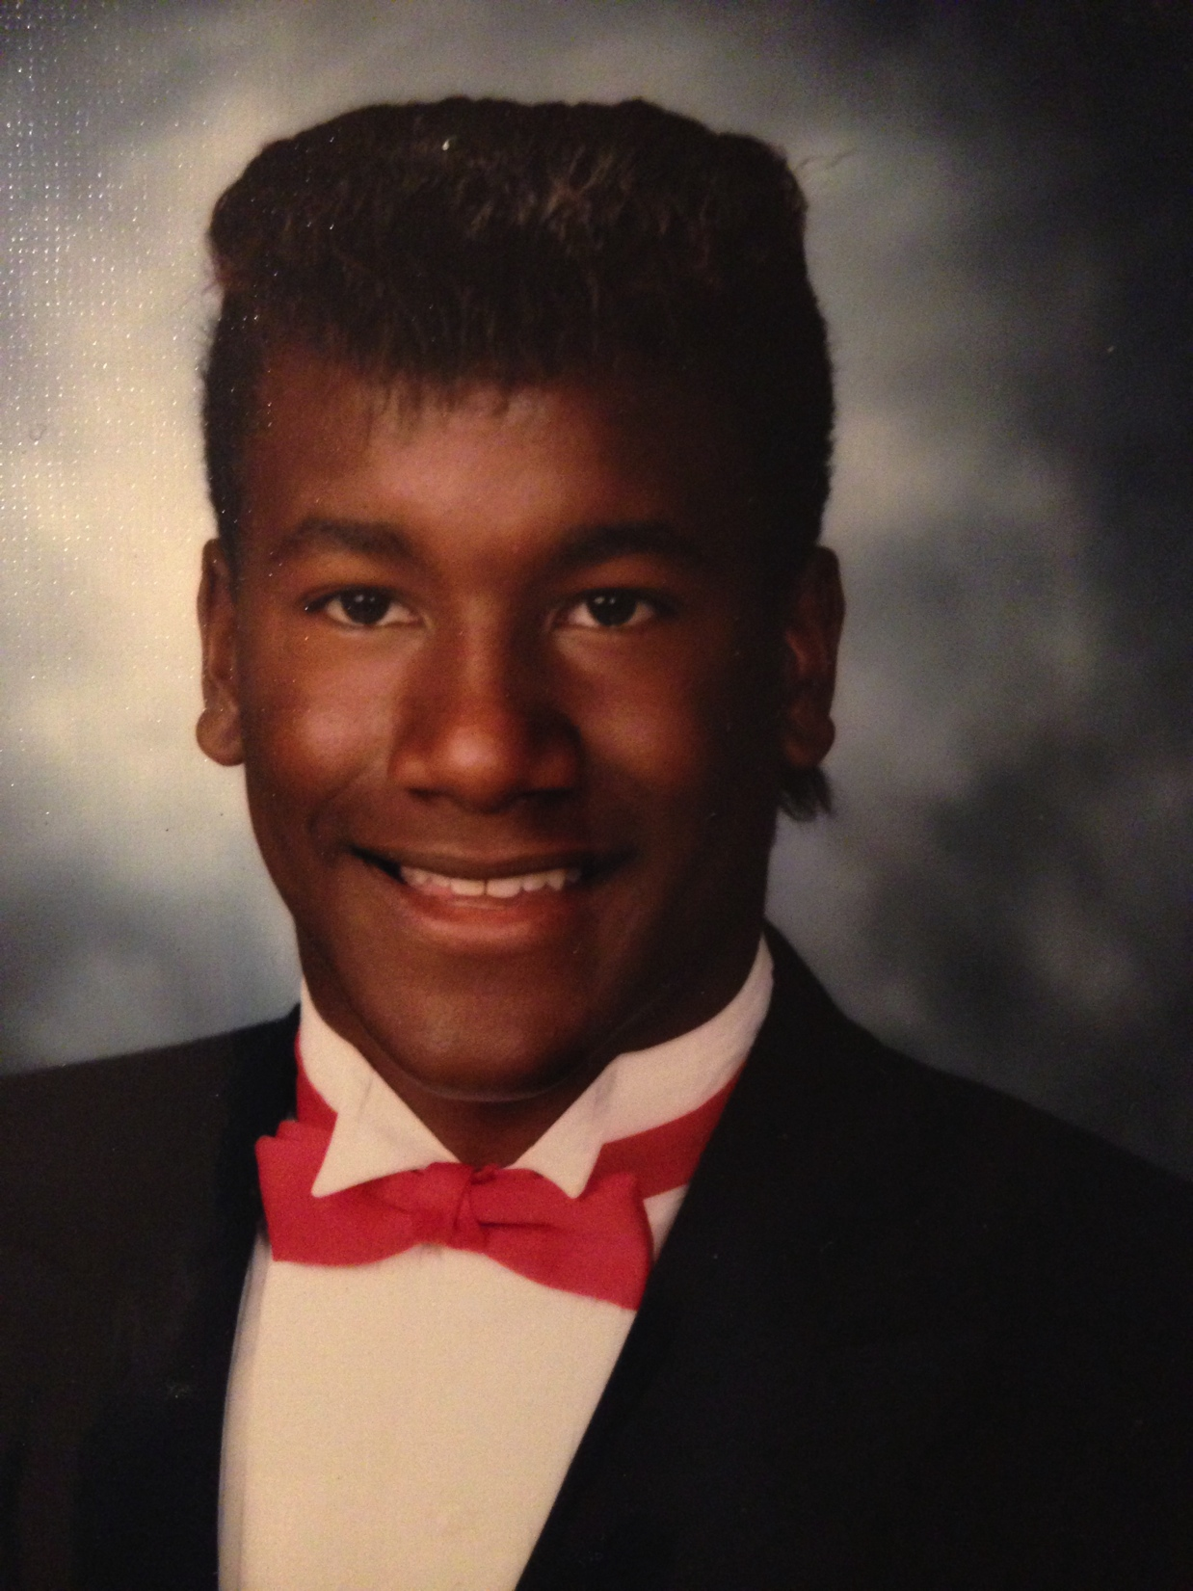
HIGH SCHOOL
As a HS student I was on the track team.
As a HS student I was athletic and pretty popular. Had friends from all different groups and kinds of kids.
Here is a shot of me in HS
Handing off the baton in the 400M Relay

Slide 7
HIGH SCHOOL
Things I enjoyed in HS
Things I did not enjoy in HS
Hanging out with friends
Going to the beach
Skiing
Camping
Motorcycle riding
Guitar and music
Math
Spanish
Saturday clean up

Slide 8
HIGH SCHOOL
Activities/Athletics in HS
Jobs I worked while in HS
Track and Filed
Football
Dishwasher at Lupes Mexican Restaurant
Silk screened T-Shirts
Pizza delivery

Slide 9
HIGH SCHOOL
Fondest memories from HS
Obstacles/Adversity you had to overcome in HS
Riding my scooter to the beach with friends
Flying with my buddies
Senior cruise
Not many other Black students
Parents separating
Grades dropping
Hip and back injuries
Fouling out of track meet

Slide 10
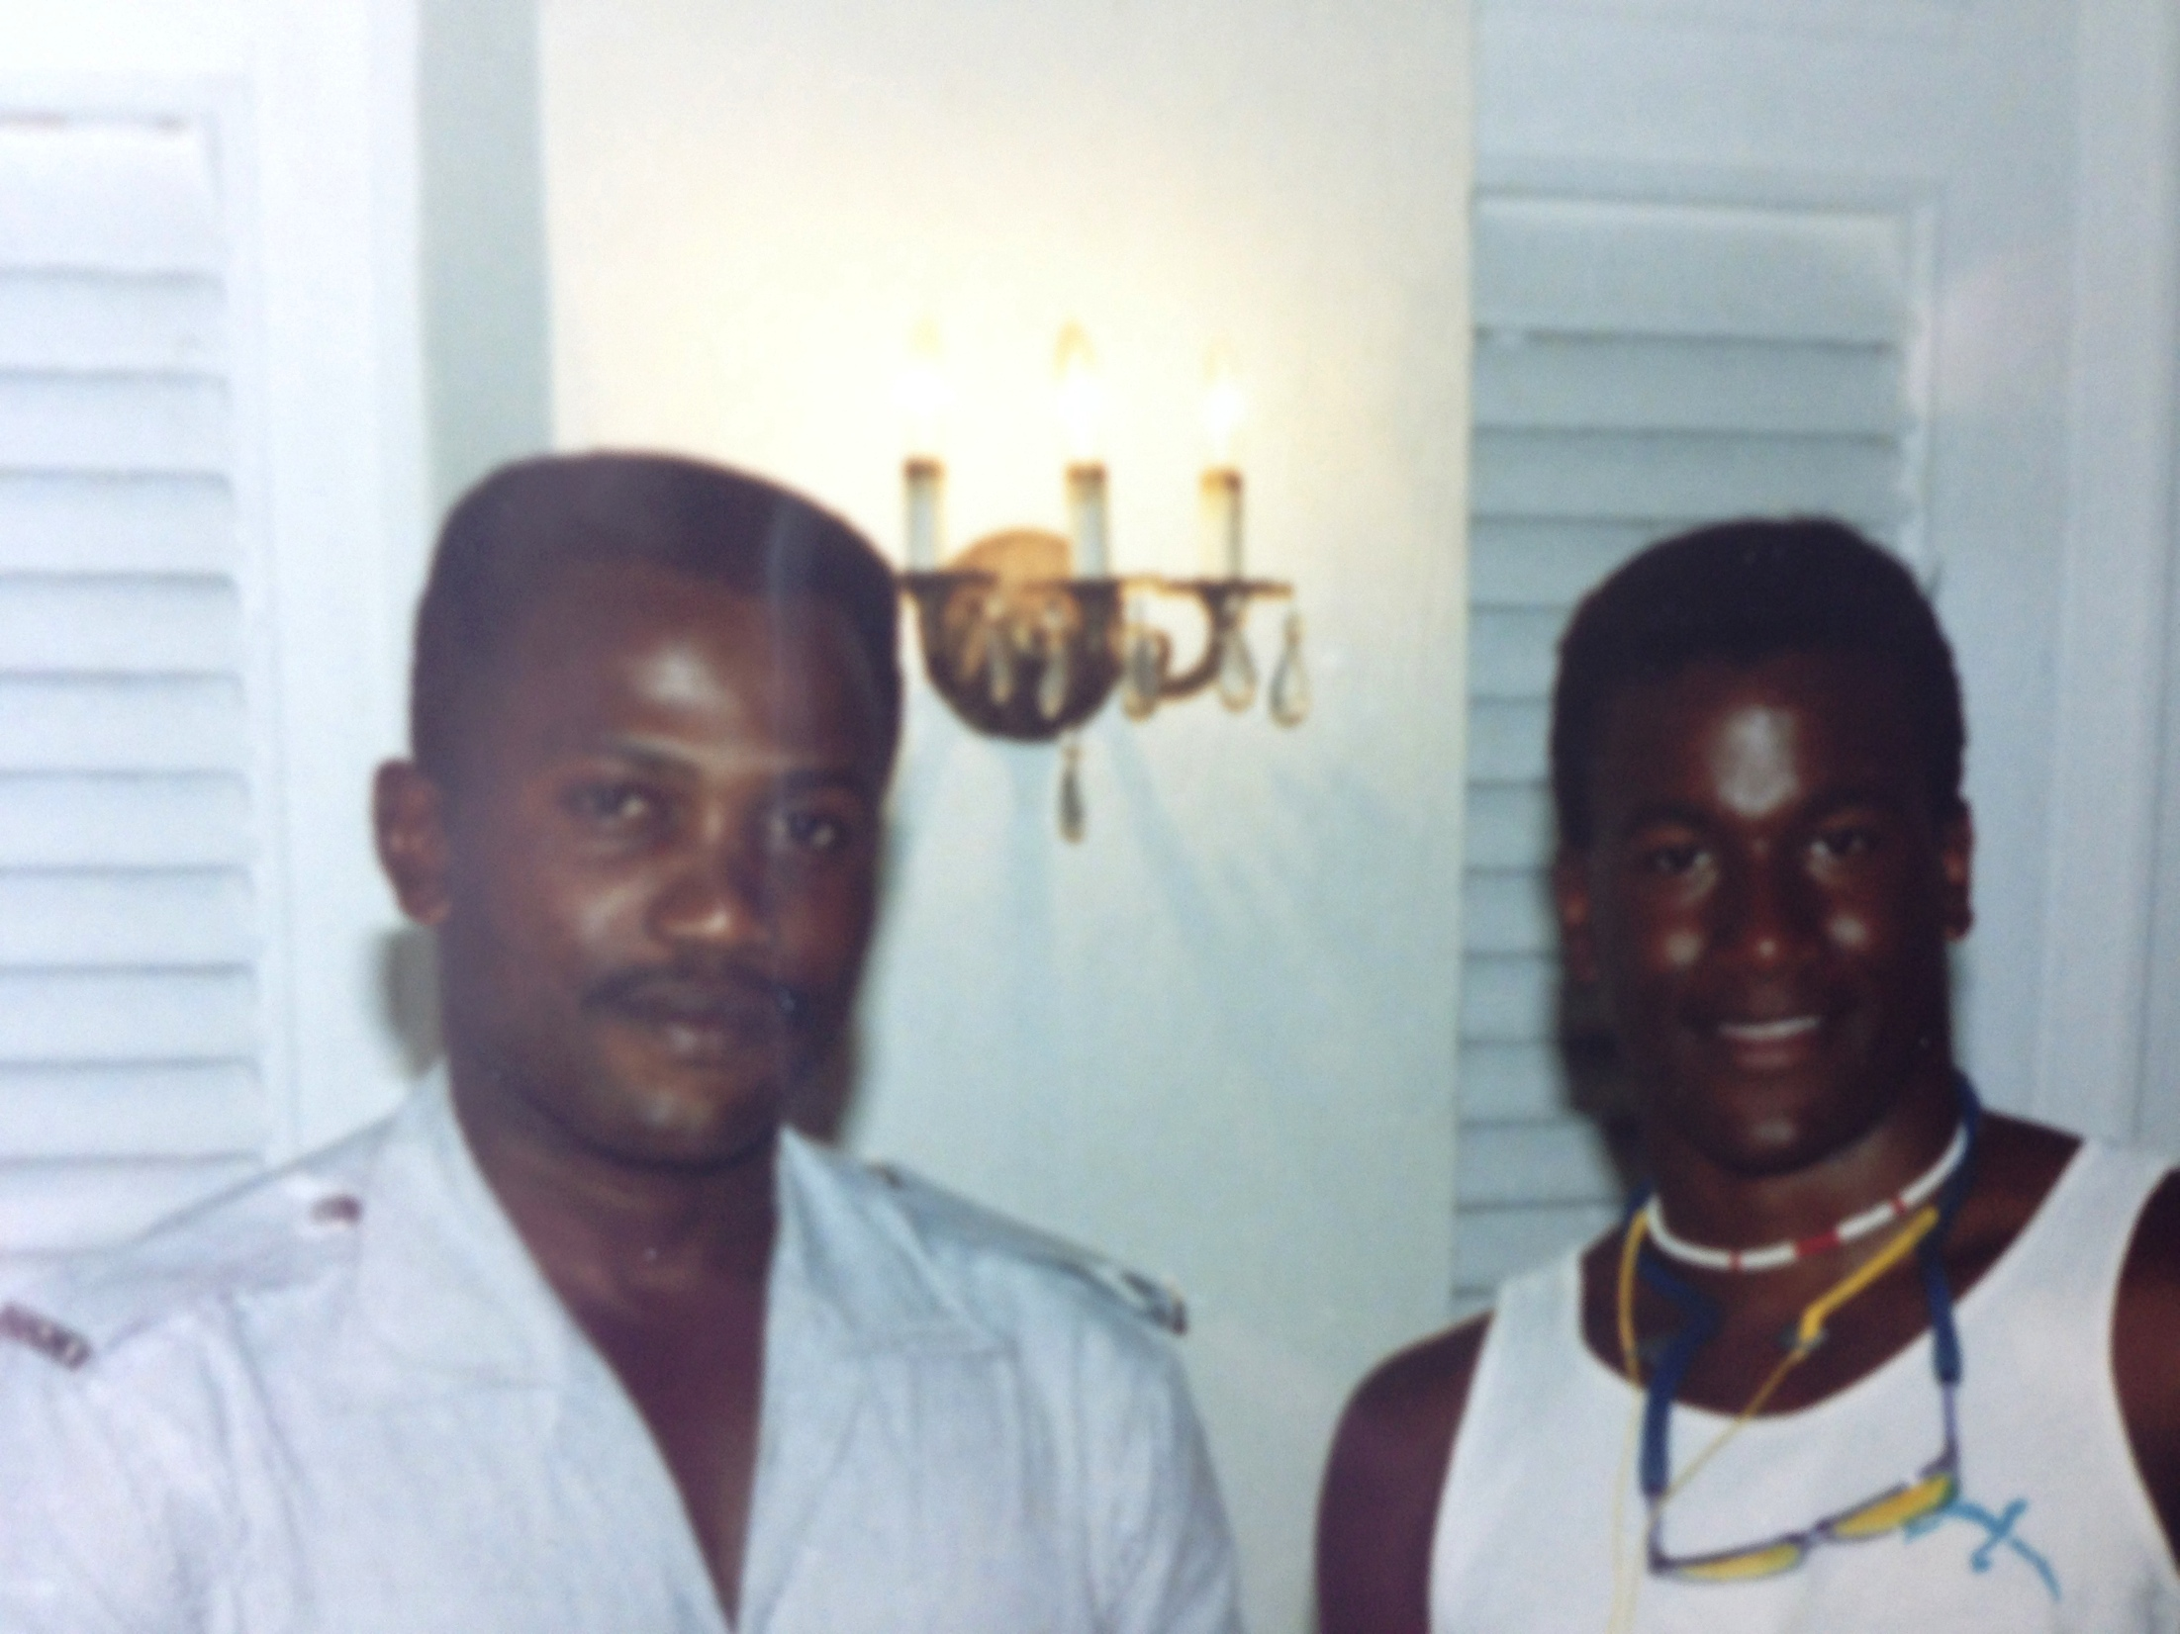
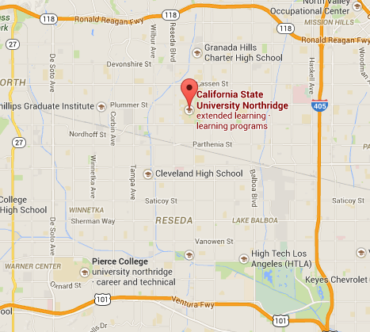
College
I attended college at California State Univ. Northridge, CA
My 2nd year of college

Slide 11
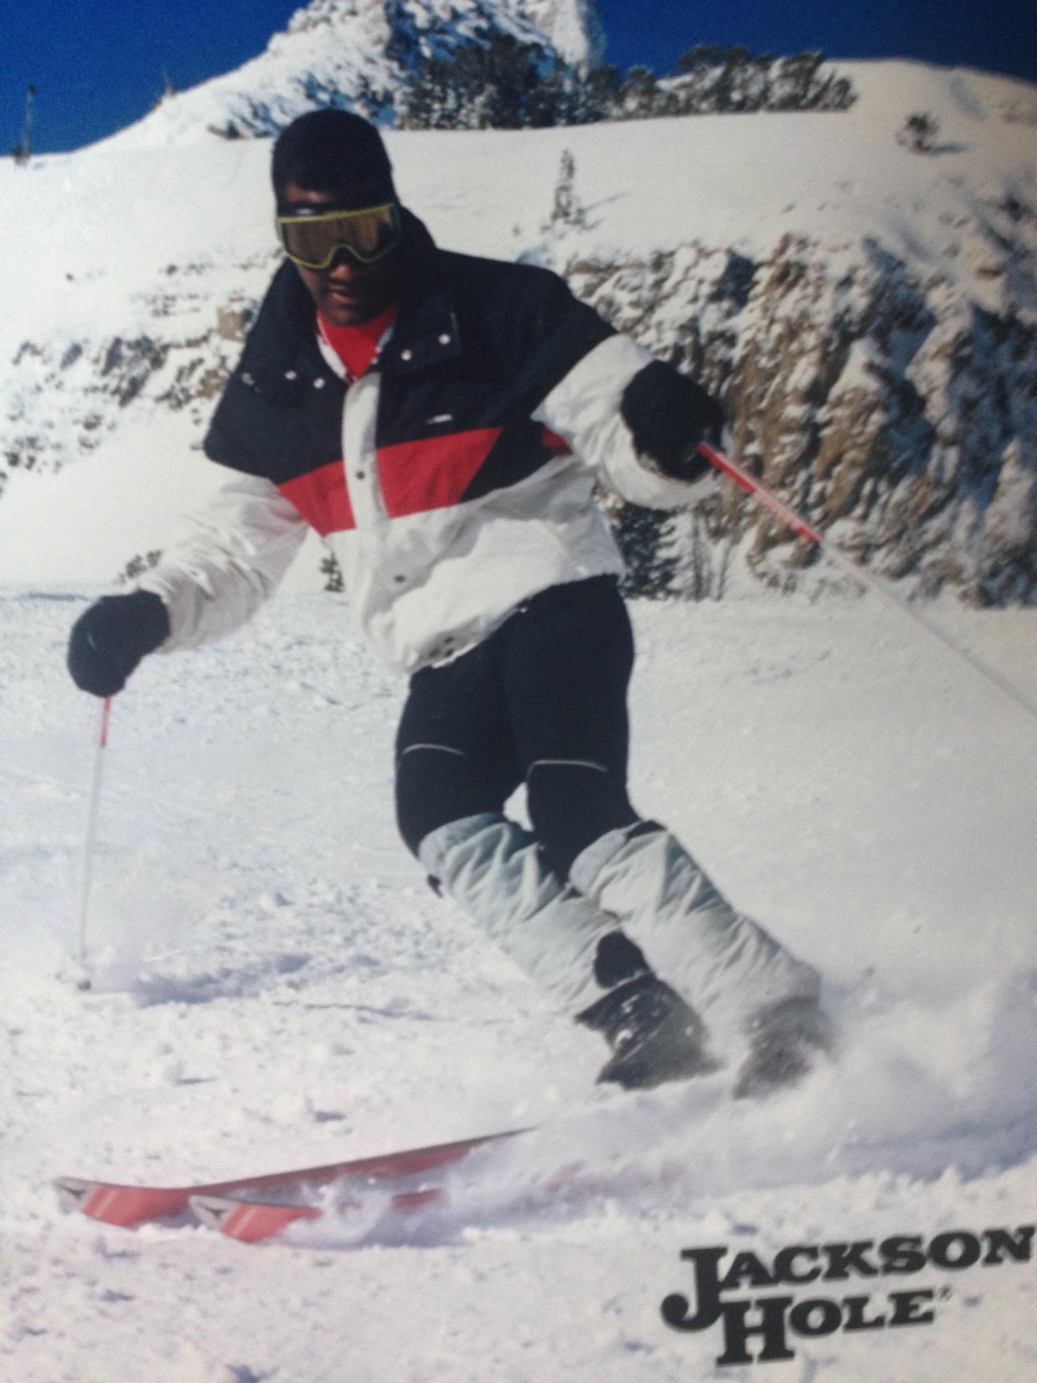
College
Activities/Athletics in College
Jobs I worked while in College
Pi Kappa Alpha Fraternity
Intramural sports
Community Service Chairman
Skiing
Made sandwiches and coffee at the campus coffee shop
Sold tuxes at Gary’s Tux Shop
Waiter at Chili’s
DJ
Band with Ruthless Records
Actor

Slide 12
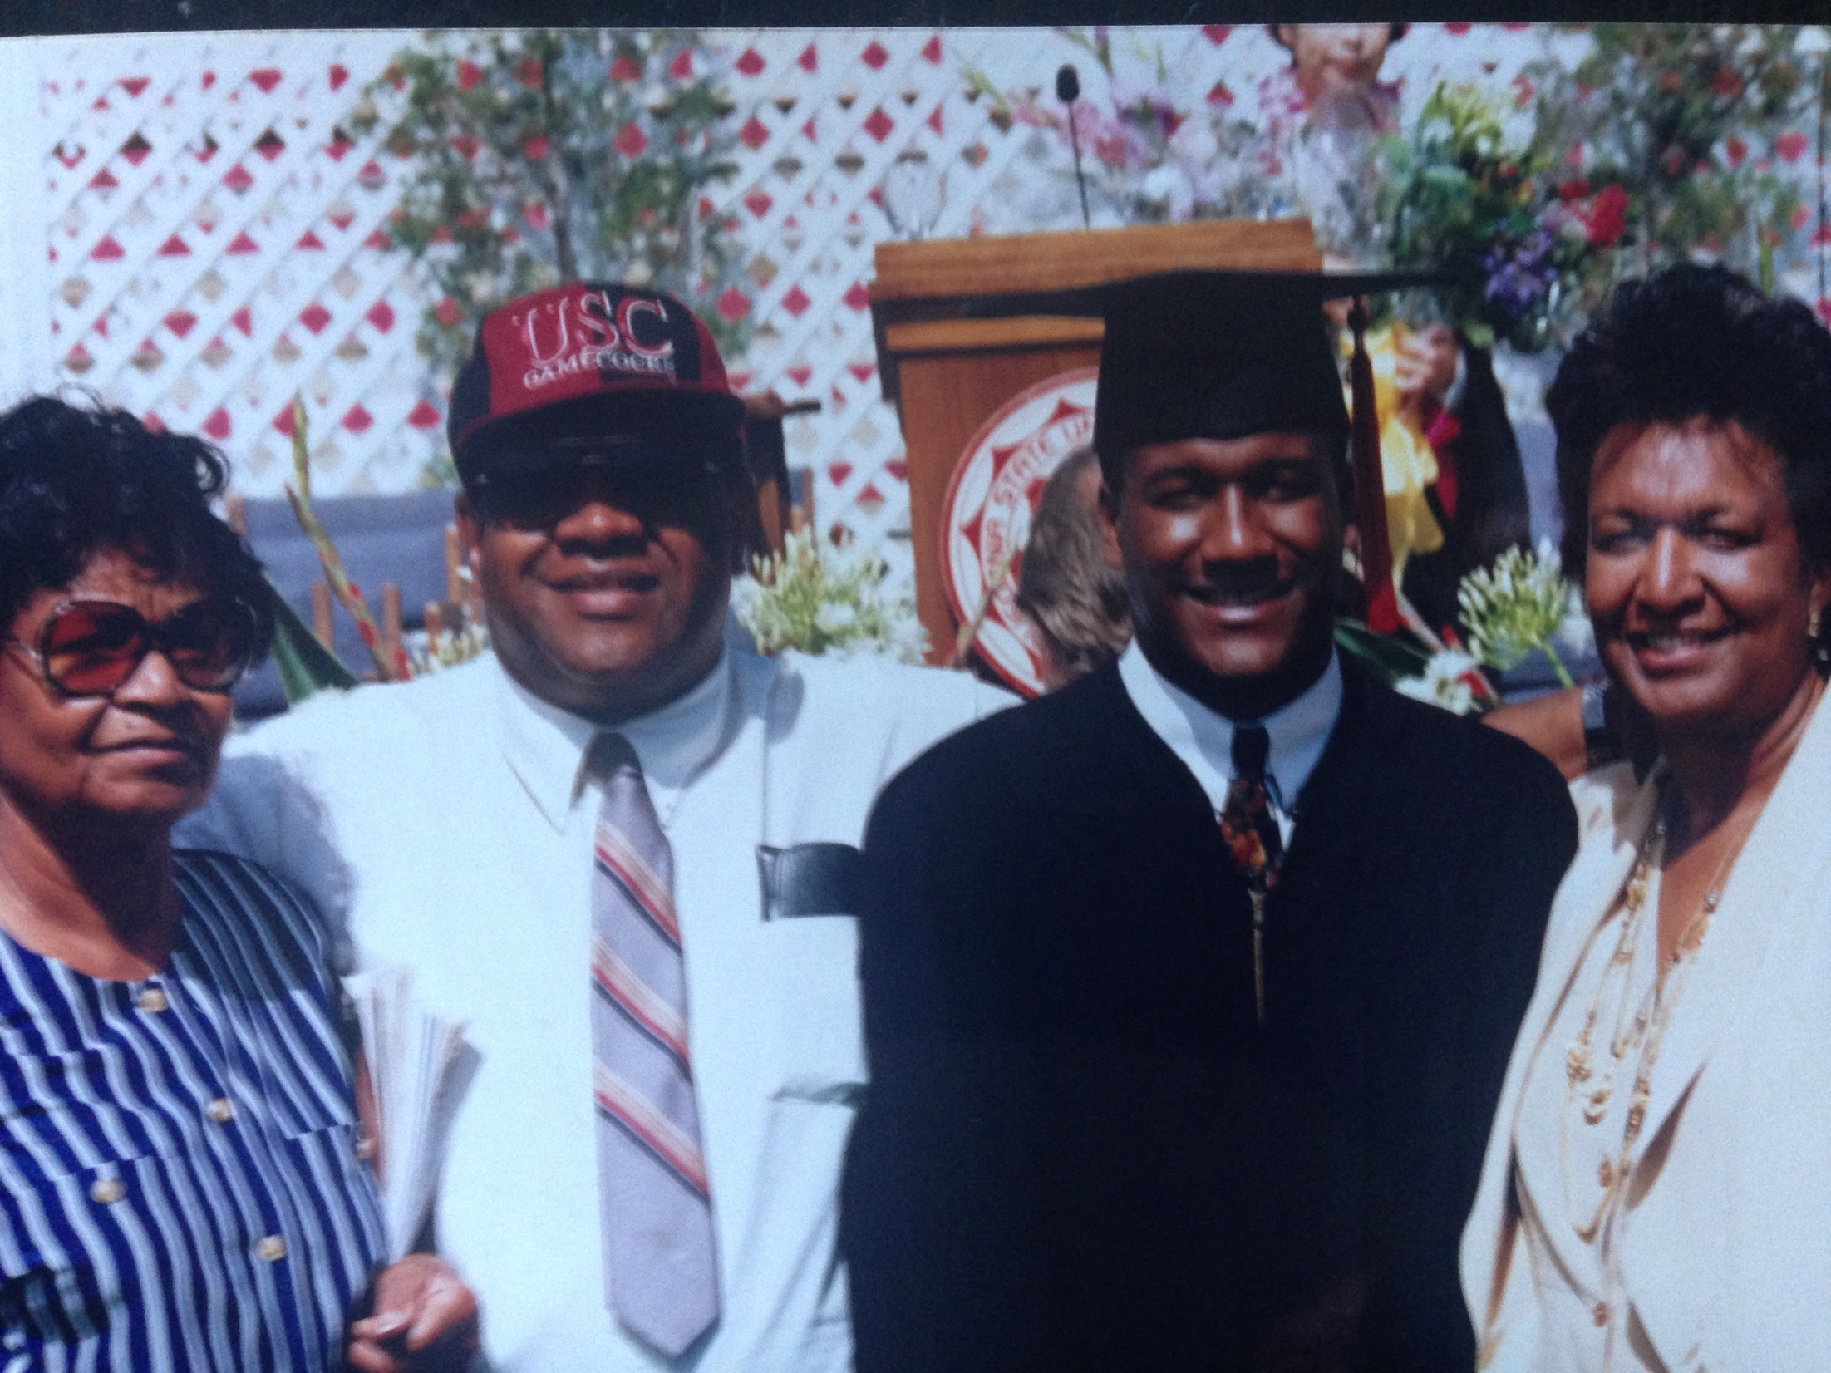
College
Favorite classes
Least favorite classes
Psychology
Speech
Screen Writing
Math
Humanities
Golf
Grandma, dad, mom and me at college graduation

Slide 13
College
Fondest memories
Obstacles or adversity that you had to overcome
Fraternity parties
My girlfriend
Sports
Ski trips
Being pulled over by police while dong nothing wrong
Passing math class
Academic probation

Slide 14
Career Path
Sales and marketing for large companies
Started my first company – entertainment and special events
I am now the CEO of David Brownlee & Associates
Notes:
You may use this chart to describe your journey to the current career

Slide 15
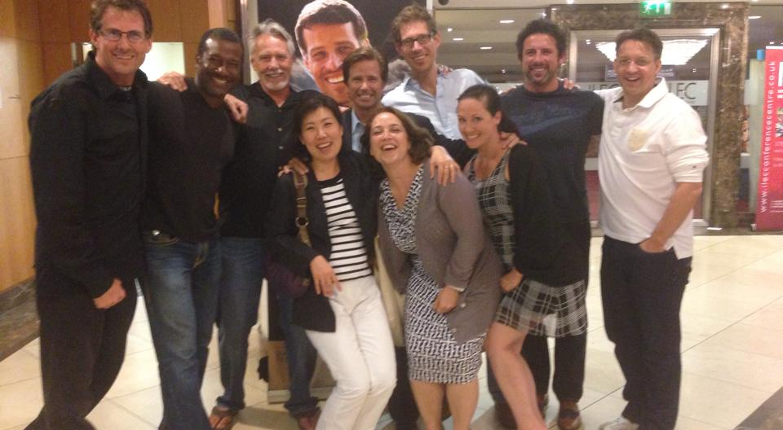
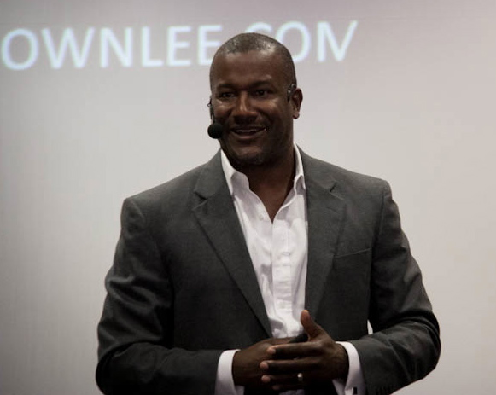
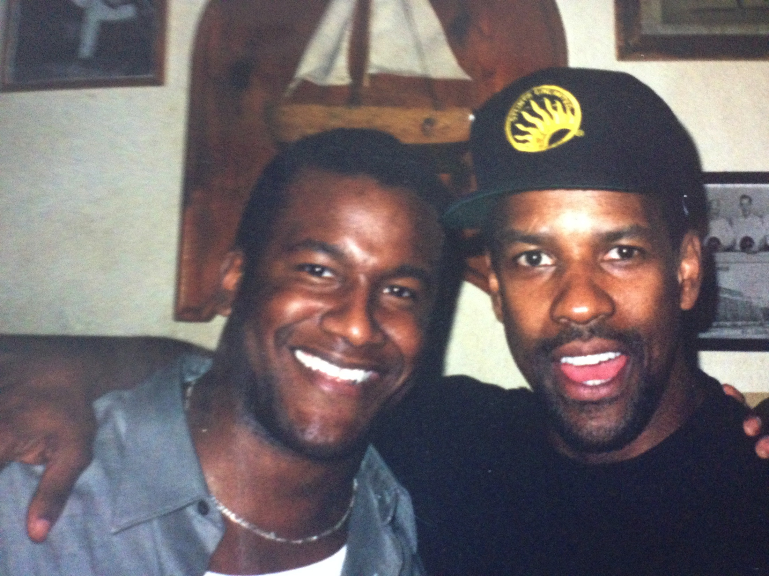
Career
Tony Robbins Business Mastery Coaching Team
Speaking to business owners
Putting on an event for Denzel Washington

Slide 16
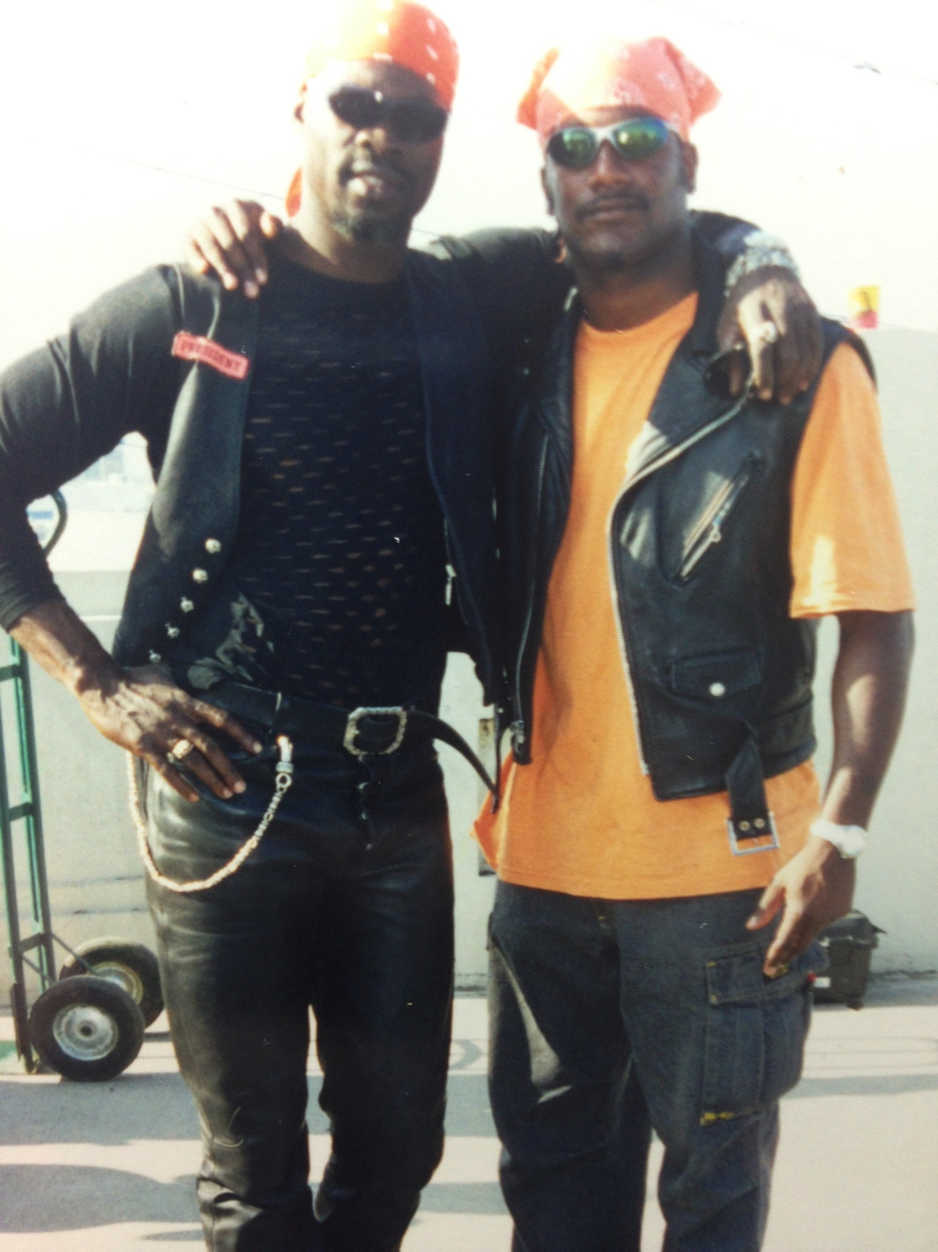
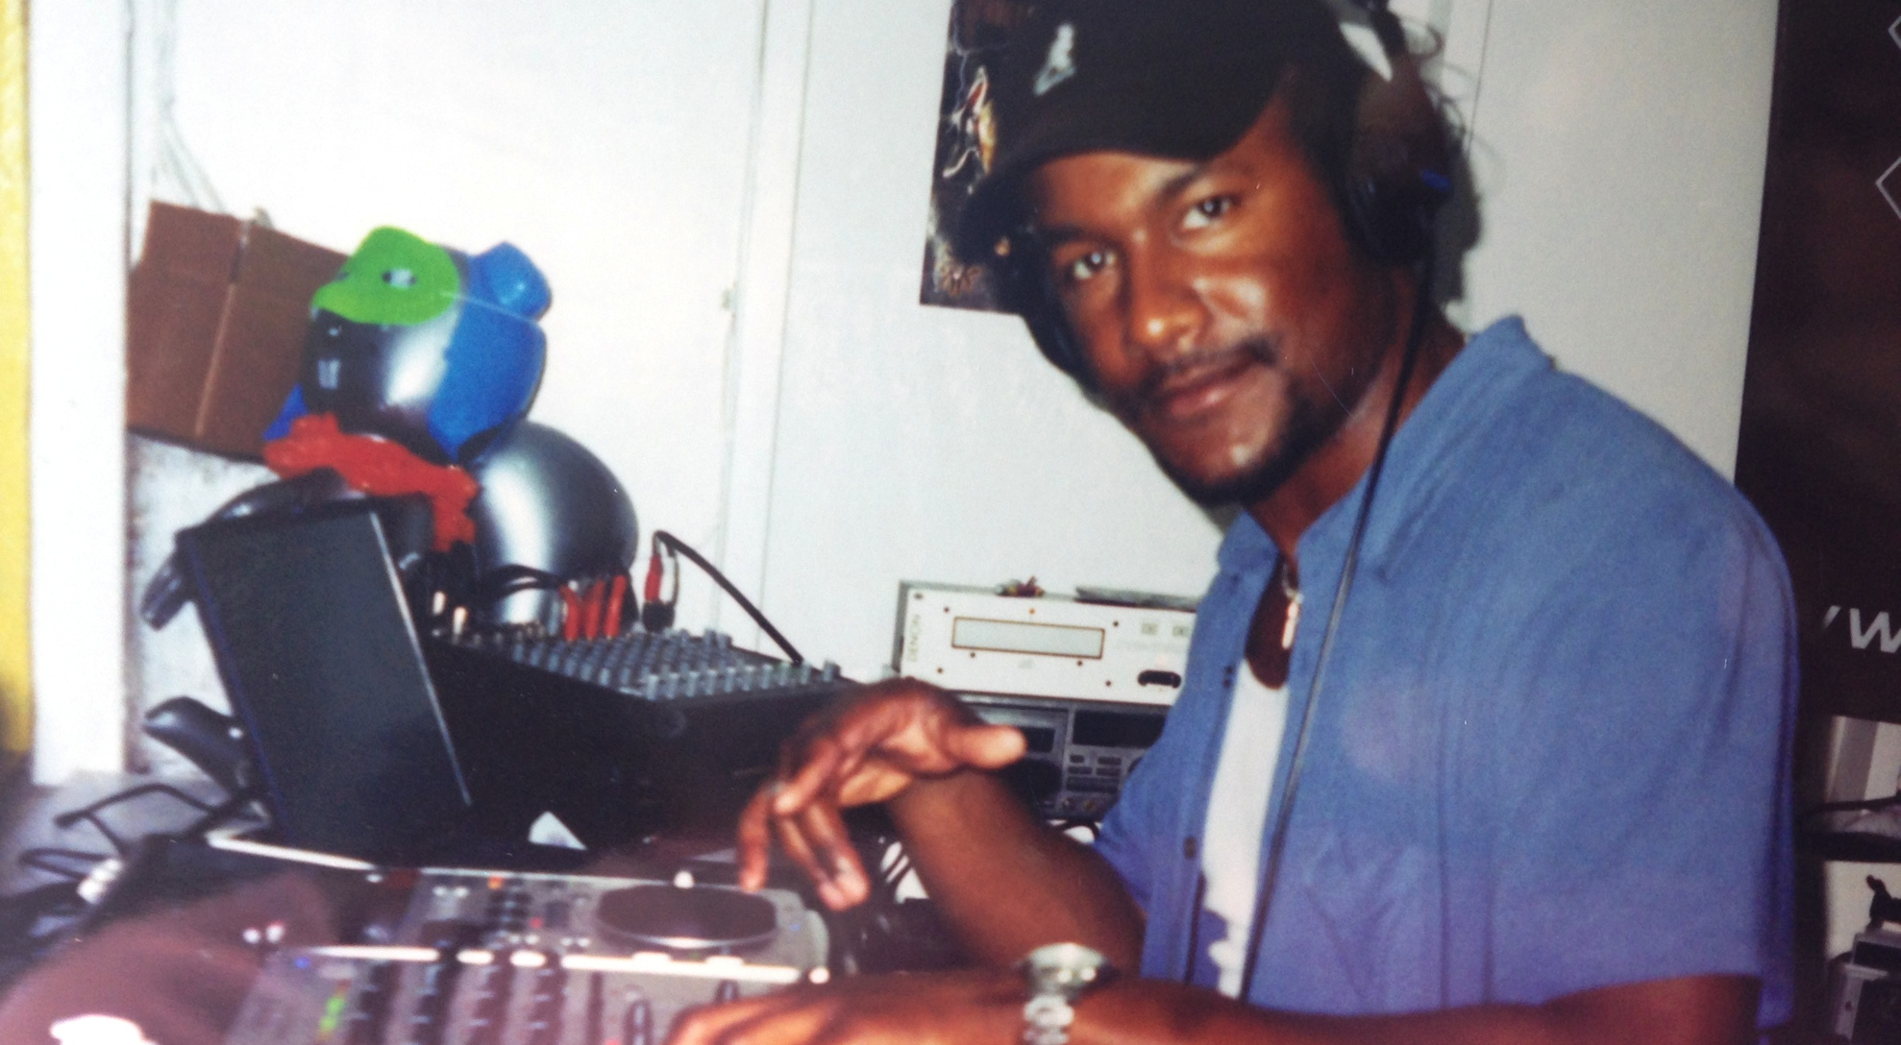
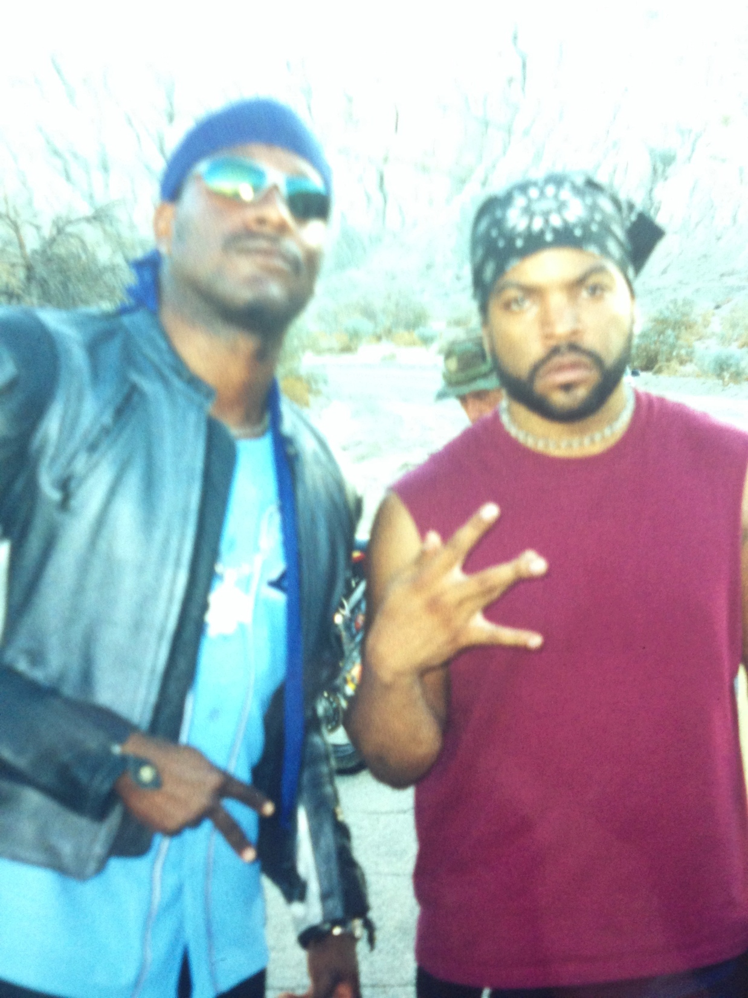
Career
DJing MTV Spring Break, Negril, Jamaica
Hanging out on the set of Biker Boyz
with Djimon Hounsou (Blood Diamond,
Amistad)
In between takes as a stunt double on the set
of Torque with Ice Cube.

Slide 17
Career
My first Job
My worst Job
Baby sitting
Washing dishes at Lupe’s Mexican Restaurant

Slide 18
Career
Some challenges I had to overcome in my career
Deciding what to do!
Keeping a positive mindset
Investment capital
Lack of business knowledge and skills
Accounting
Getting outside my comfort zone and pushing myself
Be Consistent!

Slide 19
CURRENT ROLE
History
David Brownlee & Associates - Started 2012
Size
10 employees
Location
Downtown San Diego
Products
Services
Rock Star Customer Service Training Program Online
Rock Star Customer Service Training program, 6 Steps To Excellent Customer Service, (The E-Book on Amazon)
Business coaching
Business consulting
Sales, Customer Service and Marketing Training
Notes:
Use this graph to give more description of your current company (history, size, location, products and services, etc.)

Slide 20
Current Role
CEO
Marketing
Sales
Customer Service
Operations
Notes:
Use this graph to give more description of your role specifically (responsibilities, typical work week, direct reports, etc.)

Slide 21
Career Compensation
Sales
($60k - $120K)
Facilitating
($48k - $90K)
Coaching
($36k – 75k)
Assistant
$24k-$36k
Notes:
Use this graph to show general compensation ranges for people in various roles in your company

Slide 22
ACADEMIC EXERCISE
We will now spend several minutes discussing the day’s academic module and how it is relevant in the ‘real world’

Slide 23

QUESTION AND ANSWER

