Slide 1
YBA GUEST
RESOURCE TEMPLATE
Saara Vakil
Nov 17th, 2014

Slide 2
INTRODUCTION
My name is Saara and I am 35 years old.
I work for EY.
EY is a multinational professional services company providing advisory, audit, accounting and tax services to its clients.
My role at EY is performance improvement consultant under the advisory arm.
I help businesses to develop and improve strategies related to their customers. For example how to improve customer experience or utilize digital channels to engage and interact with customers.

Slide 3
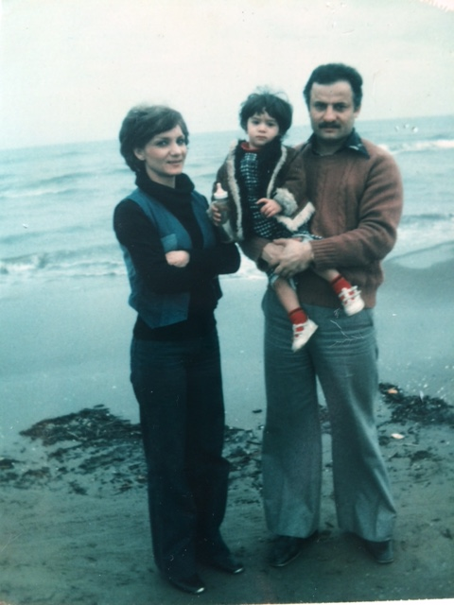
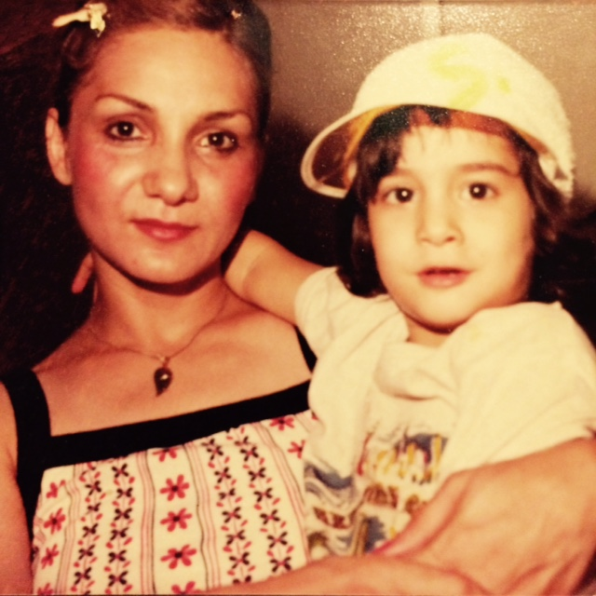
More Early Years…
A little about my family…
This is a picture of my mom, dad and I.
This is a picture of my mom and I. I was a tomboy until HS. I only played with boys and didn’t like dolls or anything girly.

Slide 4
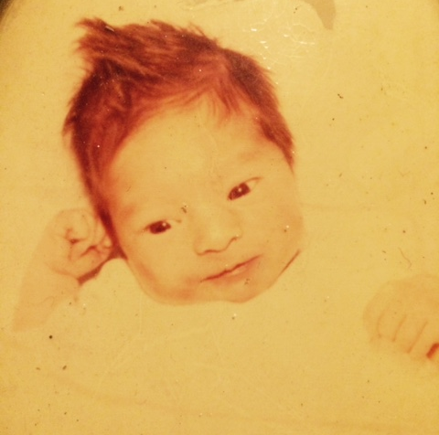
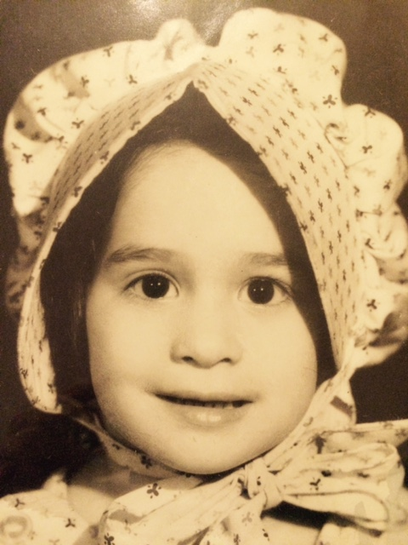
The Early Years…
I was born in Pittsburg and raised in Tehran until I was 16.

Slide 5
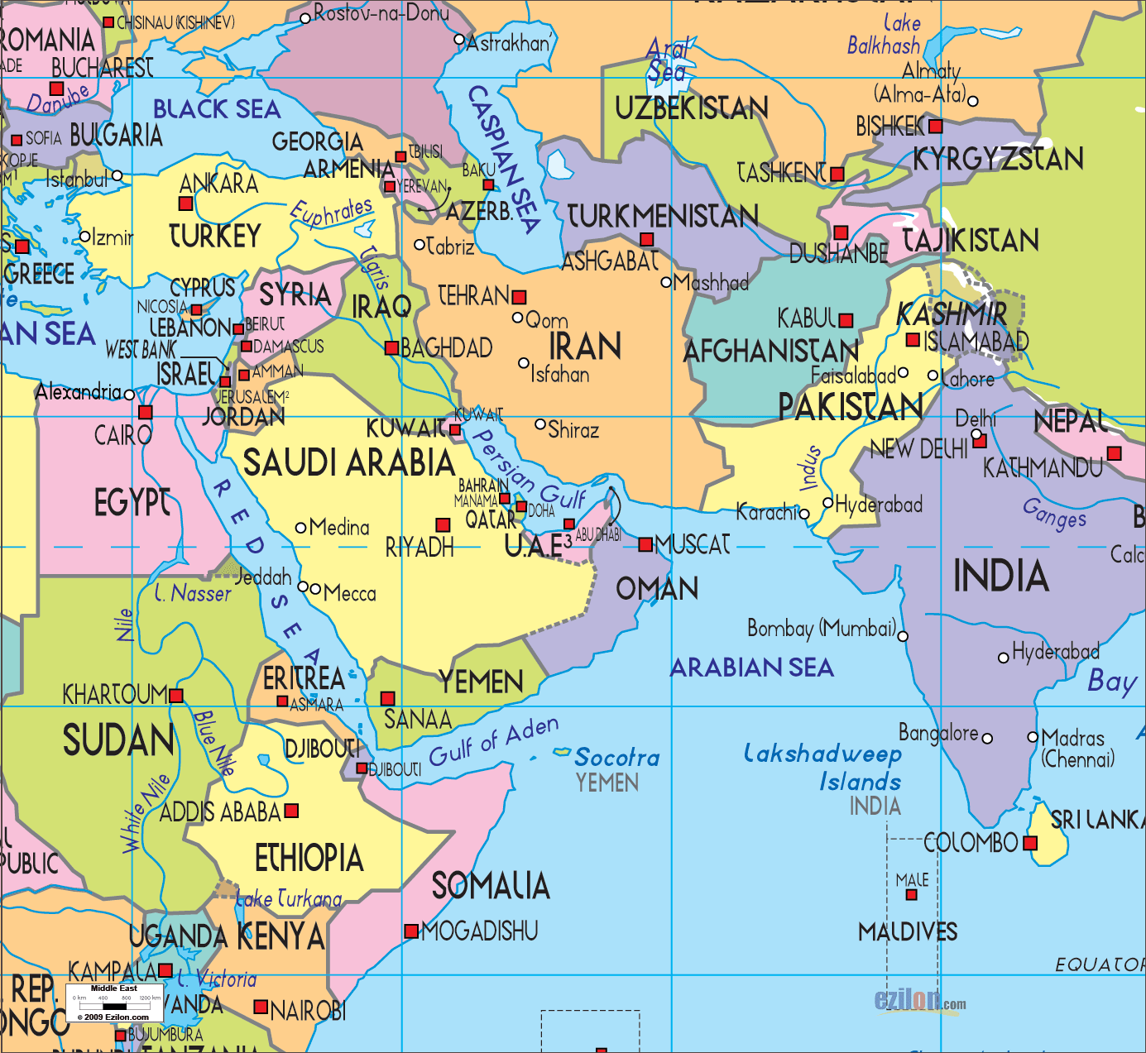
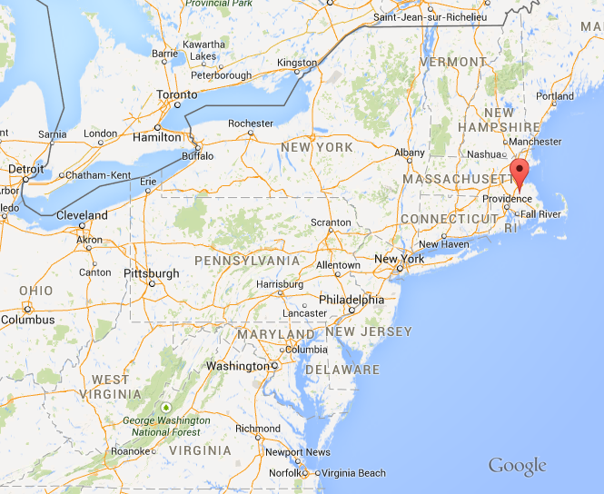
HIGH SCHOOL
I attended 2 years of HS in Tehran, Iran and my senior year at Oliver Ames in N. Easton, Massachusetts.
\

Slide 6
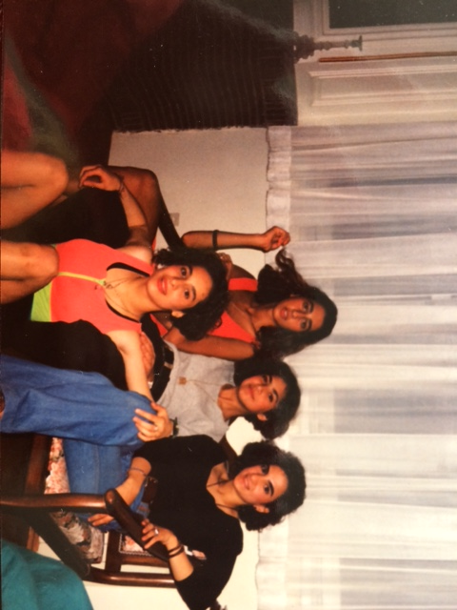
HIGH SCHOOL
As a HS student I was involved in swimming, horseback riding and skiing. I also won an award for drafting in New England.
As a HS student I was athletic, outgoing and popular.
When I moved to the US at 16 I didn’t speak any English. I was very outgoing so I made a lot of friends and that’s how I learned how to speak English.
10th grade with 3 of my good friends.
\

Slide 7
HIGH SCHOOL
Things I enjoyed in HS
Things I did not enjoy in HS
Calculus
Statistics
Drafting
Arts
Anything athletic
History
Philosophy
Geography
Biology
English (because I had to learn a whole new language)

Slide 8
HIGH SCHOOL
Activities/Athletics in HS
Jobs I worked while in HS
Skiing
Horseback riding
Swimming
Karate
Drafting
Lifeguard
Swimming instructor

Slide 9
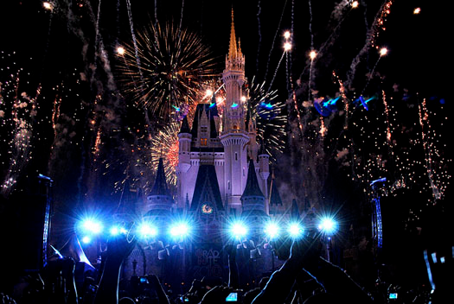
HIGH SCHOOL
Fondest memories from HS
Obstacles/Adversity you had to overcome in HS
Friends
Ski trips
Grad Nite at Disney World
Leaving my friends and family and coming to the US
Learning a new language and culture

Slide 10


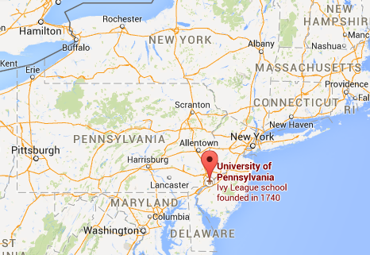
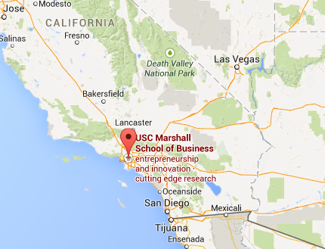
College or
Graduate School
I attended University of Pennsylvania for my undergraduate and USC’s Marshall School of Business for my graduate degree.

Slide 11
College or
Graduate School
Activities/Athletics in College
Jobs I worked while in College
College
Sorority (Kappa Alpha Theta)
  Social chair
  Risk manager
Wharton Retail Club
Graduate School
President of Consulting Club
VP of Social
VP of Professional Development
College
Lifeguard
Swimming instructor
Gym manager
Graduate School
Just Perfect Event Planning (company I founded in 2007)

Slide 12
College or
Graduate School
Favorite classes
Least favorite classes
Chemistry
Statistics
Marketing/ Branding
Management and Leadership
Macro Economics
English
Physics
Biology

Slide 13
College or
Graduate School
Fondest memories
Obstacles or adversity that you had to overcome
Sorority mixers
Trips with friends
  Sr. year college Acapulco trip
  Grad school ski trips
  Grad school abroad trips
Leadership roles in grad school (made some major changes in the program)
Graduation
First year at UPenn was very difficult for me. I was still learning English while trying to keep up with some of the smartest students in the country.

Slide 14
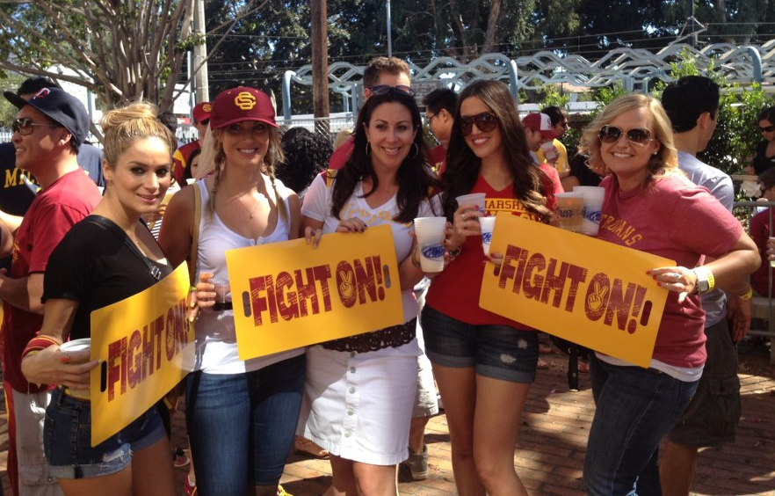
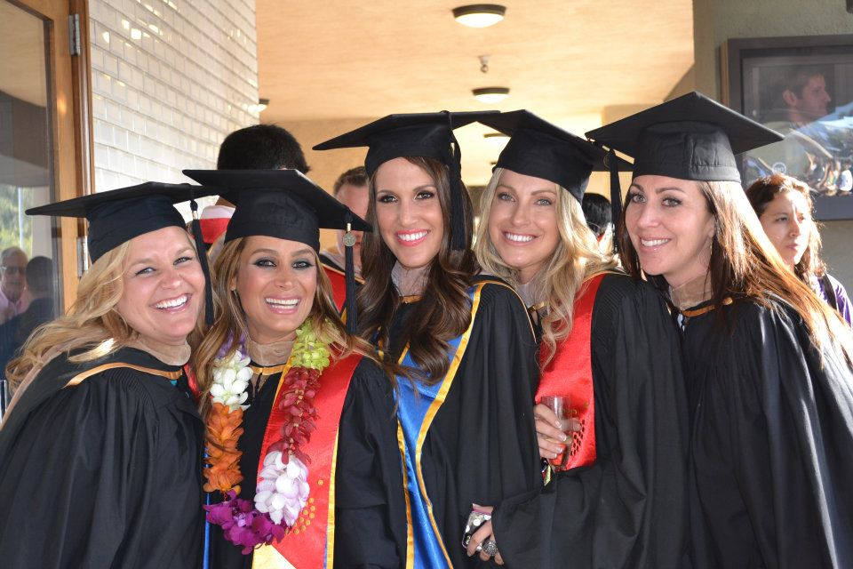
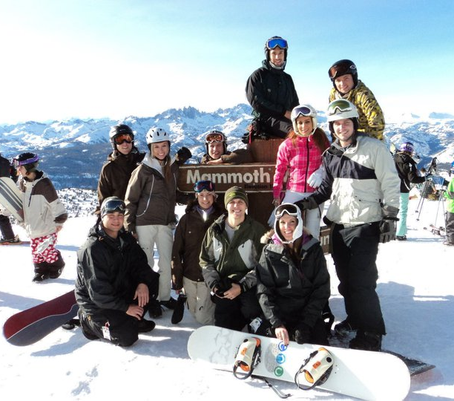
College or
Graduate School

Slide 15
Career Path
Until Jr. year in college I thought I wanted to be a doctor because both my parents are doctors and I didn’t know anything besides that.
After college I worked as a trader for Nasdaq on Wall Street in New York City.
After moving to LA I worked in the business side of the entertainment industry.
Few years later, I started an event planning and experiential marketing company.
After business school I sold my business and went to work at EY as a management consultant.
Notes:
You may use this chart to describe your journey to the current career

Slide 16
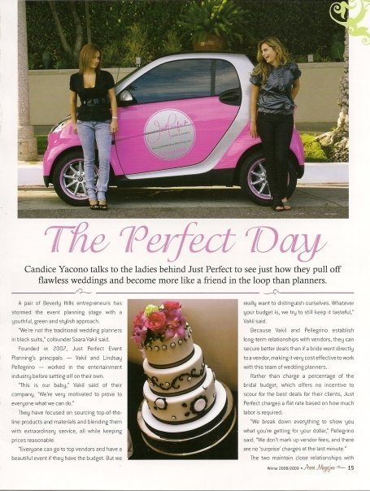
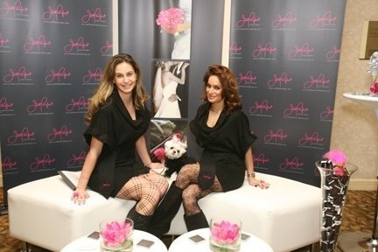
Career

Slide 17
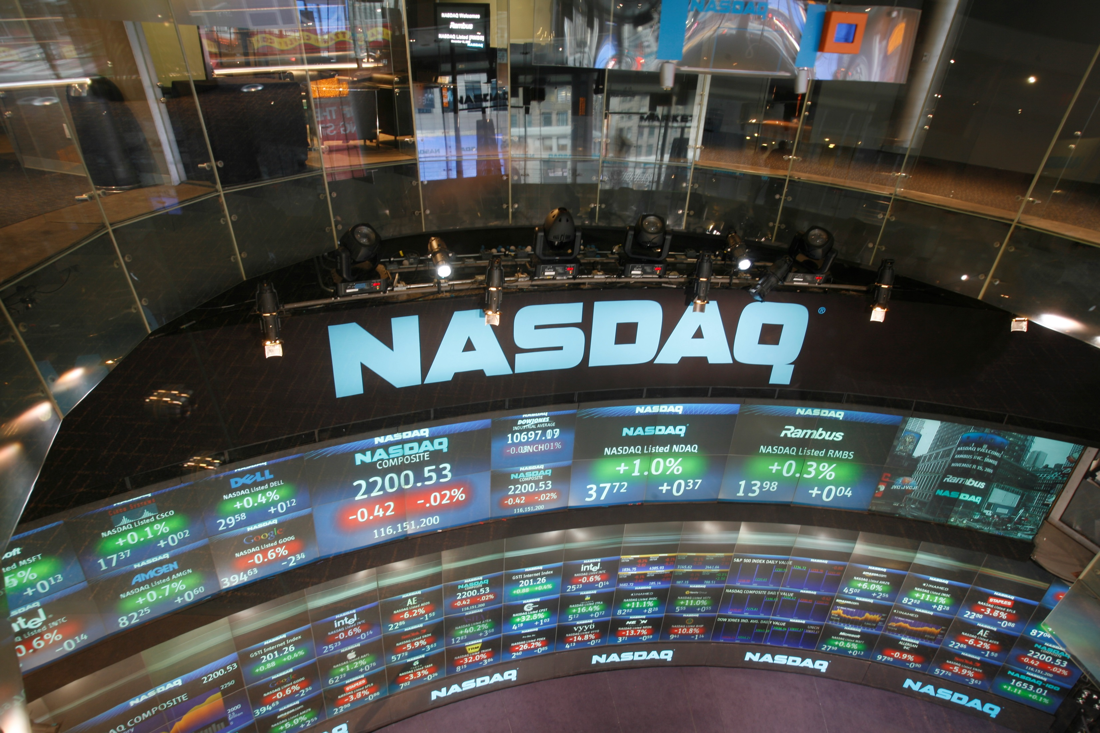
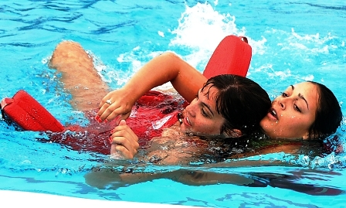
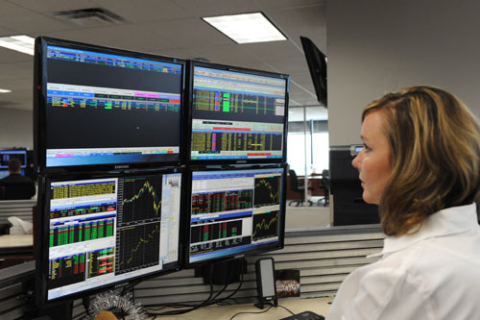
Career
My first Job
My worst Job
Lifeguard and swimming instructor
My first job out of college as a trader because it was lacking creativity.

Slide 18
Career
Some challenges I had to overcome in my career
I grew up in a culture that made me believe that I had to follow my parents foot steps and become a doctor.
It was later in life (Jr. yr. in college) that I figured that’s not what I wanted to do.
It took me a few different jobs to finally find out what I like to do.
I am glad I never settled for the jobs I didn’t like and kept trying different things to find what I really want in a career.

Slide 19
CURRENT ROLE
History
Founded 1989 through the merger of Ernst & Whinney and Arthur Young & Co.
The 3rd largest professional services firm in the world by aggregated revenue in 2012 and is one of the "Big Four" audit firms.
Size
700 offices in over 150 countries
190,000 employees worldwide
Location
Global
Services
Headquarter in London
Audit
Tax
Transactions
Advisory
Notes:
Use this graph to give more description of your current company (history, size, location, products and services, etc.)

Slide 20
Current Role
Consultant
Analysis
Strategy dev.
Implemen-tation
Business dev.
Notes:
Use this graph to give more description of your role specifically (responsibilities, typical work week, direct reports, etc.)

Slide 21
Career Compensation
Partner
~350- +1M
Sr. Manager
~150-250K
Sr. Consultant
/Manager
~ 90-180K
Consultant
~$60-80k
*Ranges vary depending on years of experience.
Notes:
Use this graph to show general compensation ranges for people in various roles in your company

Slide 22
ACADEMIC EXERCISE
We will now spend several minutes discussing the day’s academic module and how it is relevant in the ‘real world’

Slide 23

QUESTION AND ANSWER

Slide 24
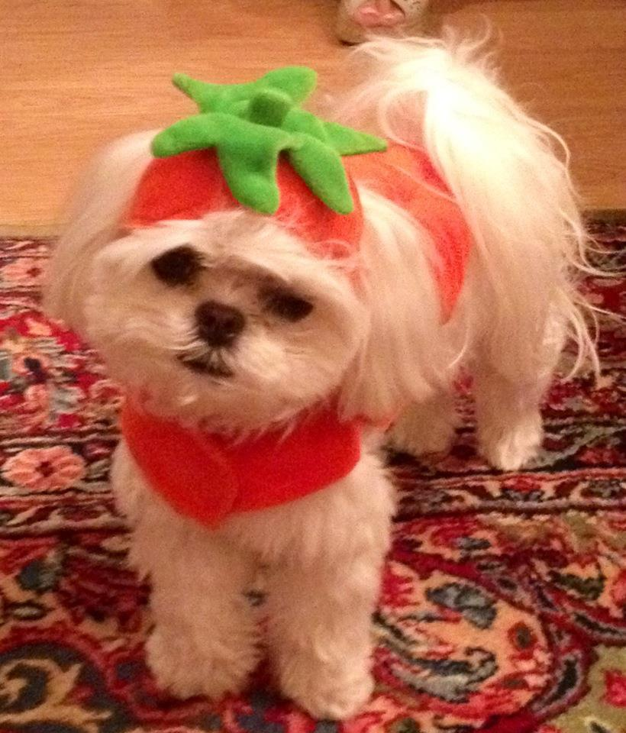
Have an awesome week!

