Slide 1
LILIANA ARISTIZABAL
VICE PRESIDENT OF SALES

Slide 2
INTRODUCTION
I have been working in the Broadcast/Digital Media and Advertising Industry for over 20 years.
Sell Advertising to Media Agencies and Brands.
For example, the commercials you see anywhere and everywhere when you watch your favorite program or show.
My focus has been the Hispanic Media Market
What is my Role?
Drive Sales to the company.
Manage a sales team and support staff.
Set the priorities, goals and sale focus for the team.
Keep team engaged and motivated.
Sell to clients and internal stakeholders.
Make sure our customers are happy.
Make sure we are creative and sell out of the box ideas not just spots n dots.

Slide 3
My Childhood
I was born in Cali, Colombia.
I was raised in Queens, New York.
I am the 3rd out of 4 siblings.

Slide 4
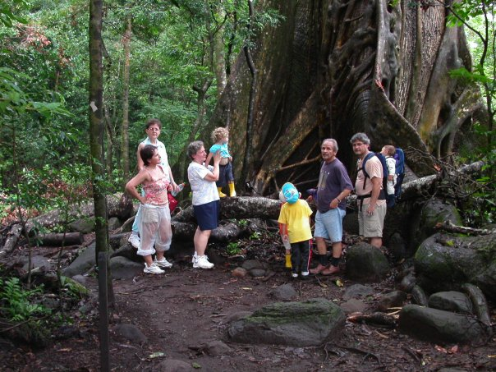
A Little @ My Family…
My parents worked very hard and sacrificed a lot to make sure Orlando, Elizabeth, Edward, and I had the opportunity of an education and a career.
My parents are enjoying their retirement.
Orlando is a Physicists,
Elizabeth is a Nuclear Technologists, Acupuncturists and Oriental Medicine Practitioner
Edward manages a dry cleaners.
Costa Rica Trip

Slide 5
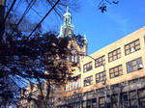
MY HIGH SCHOOL
I attended Newtown High School in Queens, New York

Slide 6
High School
Favorite Courses: Accounting, Math, Astronomy
Things that felt difficult or challenging for me while I was in High School were:
English was difficult specially writing – I attended after school classes.
Math was also very difficult specially algebra and trigonometry. School provided tutoring classes and my brother Orlando helped with some tutoring as well.
Gym was not one of my favorite classes. I did not like physical activity much because I was a bit heavy for my age. So I did not participate in too many sports.

Slide 7
High School
Jobs I worked while I was in high school were:
Worked at a Factory with my Mother
Receptionist for a Real Estate office
Sold Avon and Jafra
Worked at KFC
Retail salesperson at Sears, Alexander’s and Electrolux

Slide 8
Getting in to College
The top few things I did to ensure I got into college were:
My parents could not afford to pay for all of our tuition’s so I worked hard and saved money.
I was not an “A” student in H.S., but I knew that I needed to go to College to achieve success.
I attended a Community college -2 year associates program applied for student loans and worked in the afternoons.
Internship at Citibank
Graduated from BERNARD M. BARUCH COLLEGE - BBA in International Marketing and Management

Slide 9
COLLEGE
Jobs I worked while I was in College were:
John Blair Communications
WABC-TV

Slide 10
COLLEGE
Things that felt difficult or challenging for me while I was in College were:
Having a Network of Friends
Engaging in events off Campus – always working
Commuting
Paying for Tuition

Slide 11
Getting a job after College
The top few things I did to ensure I got a good job after college were:
At Queensborough Community College I attended a job fair.
Met the HR Director for John Blair.
First real job, and where I learned the Broadcast and Media side of the business.

Slide 12
NBC Universal-Telemundo
When I started my career at Telemundo it was owned by Sony.
Frist station launched in Puerto Rico and later in New York.
Sold to Investors, General Electric, NBCU than Comcast bought NBC and Telemundo
We sell advertising time to agencies and brands – Network, Station Group, Digital, Major Events, Programming.
Corporate office for Comcast is in Philadelphia, NBC in NYC Rockefeller Center and Telemundo in Miami.
Company has over 10,000 employees throughout the U.S.

Slide 13
My Career Path…How I started out?
JOHN BLAIR / 2.5 YRS
WABC / 7+ YEARS
SALES ASSISTANT
SALES ASSISTANT
SUPERVISOR TO S.A.
SUPERVISE TO S.A.
ASSISTANT TO LSM
ASSISTANT – LEGAL DEPT.
HR COORDINATOR
SUPERVISOR FOR ACCOUNTS PAYABLE
ATTENDED SCHOOL AT NIGHT @ BARUCH COLLEGE.
THIS EXPERIENCE HELPED ME BETTER DEFINE WHAT I WANTED TO DO NEXT.
Notes:
You may use this chart to describe your journey to the current career

Slide 14
My career path…My first chapter in Sales
XEROX / 2.5 YEARS
TELEMUNDO / 16+ YEARS
SALESPERSON
NATIONAL ACCOUNT EXECUTIVE
NATIONAL SALES MANAGER –NYC
LOCAL SALES MANAGER- MIAMI
VP OF SALES – NYC
DIRECTOR OF SALES* (ZGS COMM.)
Notes:
You may use this chart to describe your journey to the current career

Slide 15
My career path…Chapter 2-New beginnings
LBI MEDIA – LESS THAN 1 YEAR
VP/GENERAL SALES MANAGER
Chapter 2
Notes:
You may use this chart to describe your journey to the current career

Slide 16
My Career
The first job I had after college was:
Sales assistant at John Blair
The worst job I have ever had was:
Assistant at the legal department at ABC/Disney
Spent my entire day making copies and stapling
I found it boring and not challenging.
This experience taught me what I did not want to become and helped me define what I wanted out of my career.

Slide 17
My Career
Challenges I have had to overcome throughout my career are:
As my career grew managing company politics was challenging for me.
The more responsibilities and the further you grow in your career finding work life balance is challenging.
Managing stress.

Slide 18
My role within organization
PRESIDENT
CEO
SVP OF SALES
VP OF SALES
VP OF SALES
VP OF SALES
Notes:
Use this graph to give more description of your role specifically (responsibilities, typical work week, direct reports, etc.)

Slide 19
More than just work
When I am not at work I like to:
Spending time with my husband and family
Exercising
Traveling
Foodie – love eating.
Reading
Spending time at home.

Slide 20
Do it all over again?
If I could talk to my high school self, what would I say?
Never stop learning.
Never stop aiming for your goals
Get your MBA early
Have a strong group of people that you trust and value along your career.
Have a mentor that is your go to person in your life/career.
Embrace your failures and mistakes because they are part of life. Every experience good and bad will allow you to succeed, grow, and evolve to the person that you want to become.

