Slide 1
YBA GUEST SPEAKER
Duane Stullich

Slide 2
INTRODUCTION
My name is Duane Stullich and I am 45 years old
I co-founded FocalPoint Partners
FocalPoint is an investment bank with offices in Los Angeles and Chicago that:
  Links companies in need of capital with investors
  Advises owners of companies on their liquidity options and advises them in M&A transactions
  Advises companies that are either in, or close to, Chapter 11
FocalPoint has advised on over $4 billion in transactions since being founded in 2002

Slide 3
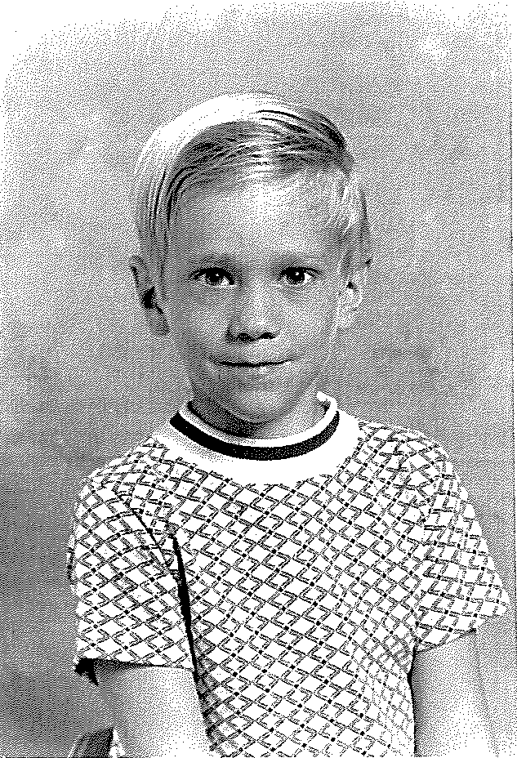

The Early Years…
I was born in Indiana and raised in Lancaster, CA
This is a picture of me at age 2
At age 5

Slide 4
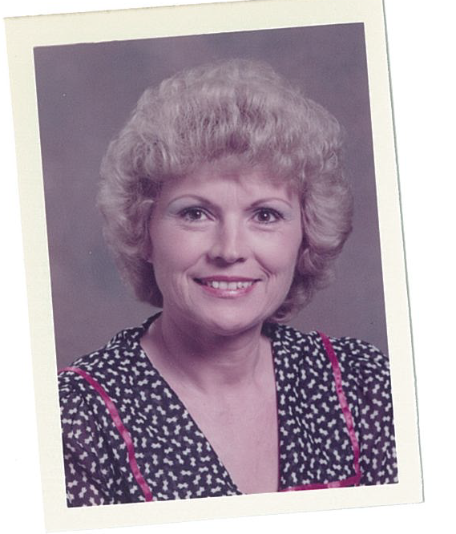
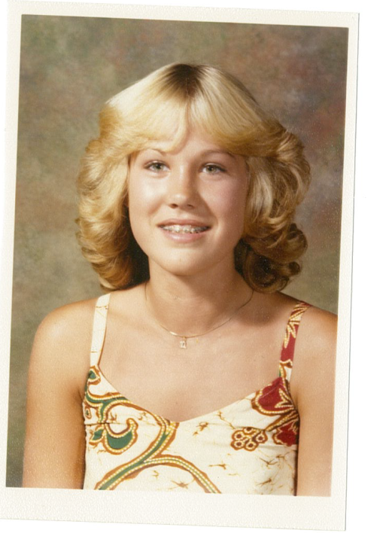
More Early Years…
My parents divorced when I was a baby and I was raised by my mother (who was also a teacher at my school)
My Mother, Genel
My sister, Denise

Slide 5
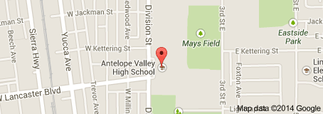
HIGH SCHOOL
I attended Antelope Valley HS in Lancaster, CA
\

Slide 6
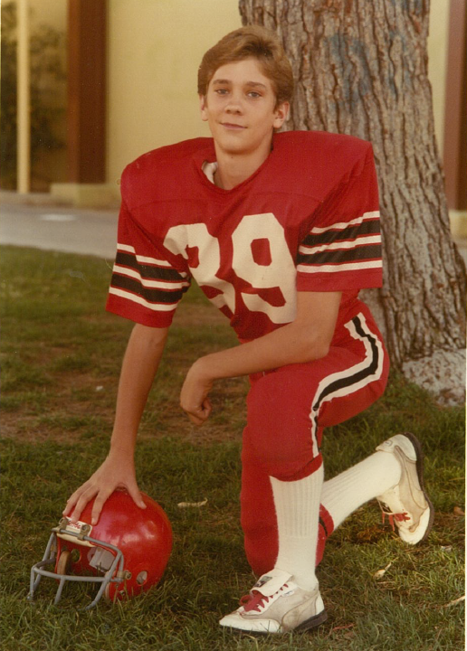

HIGH SCHOOL
Activities/Athletics in HS
Jobs I worked while in HS
Der Weinerschnitzel
Sandy’s Pool Supplies

Slide 7
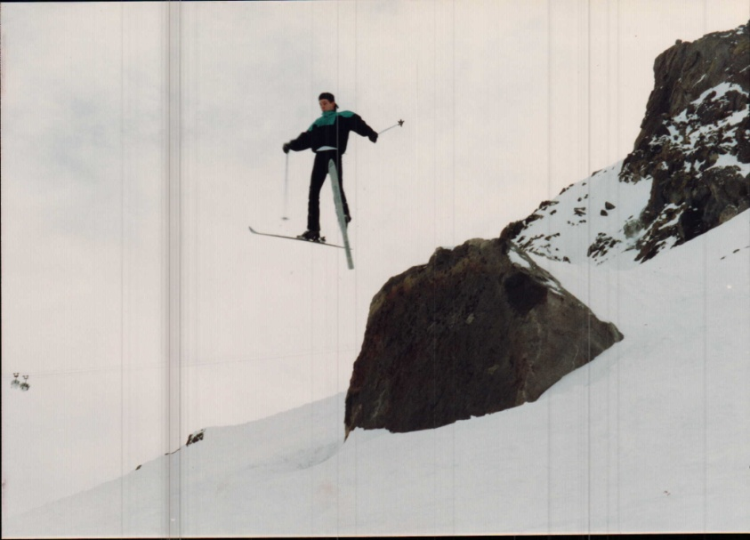
HIGH SCHOOL
I was a bit of an adrenaline junkie (and yes, I stuck that landing!)
I was studious my freshman and sophomore years, then got a little, well, let’s say, “side tracked” my junior and senior years
\

Slide 8

The Epiphany

Slide 9
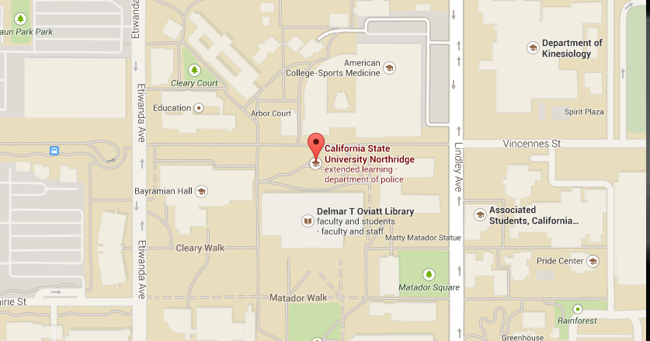
College
I attended junior college for two years before transferring to California State University Northridge where I earned a degree in Accounting.
\

Slide 10
College
Activities/Athletics in College
Jobs I worked in College
Accounting Association
Beta Alpha Psi
Marie Callendar’s
A Royal Suite
KPMG (this is where I discovered that I didn’t want to become an accountant)

Slide 11
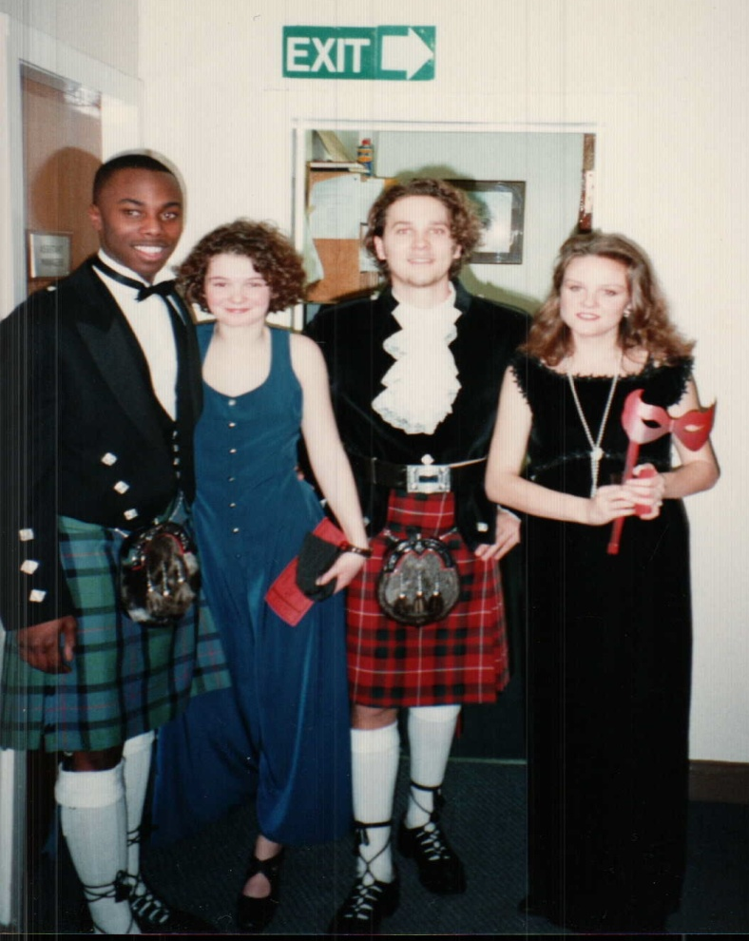

Rotary Scholarship
Me in a Kilt
University of Glasgow

Slide 12

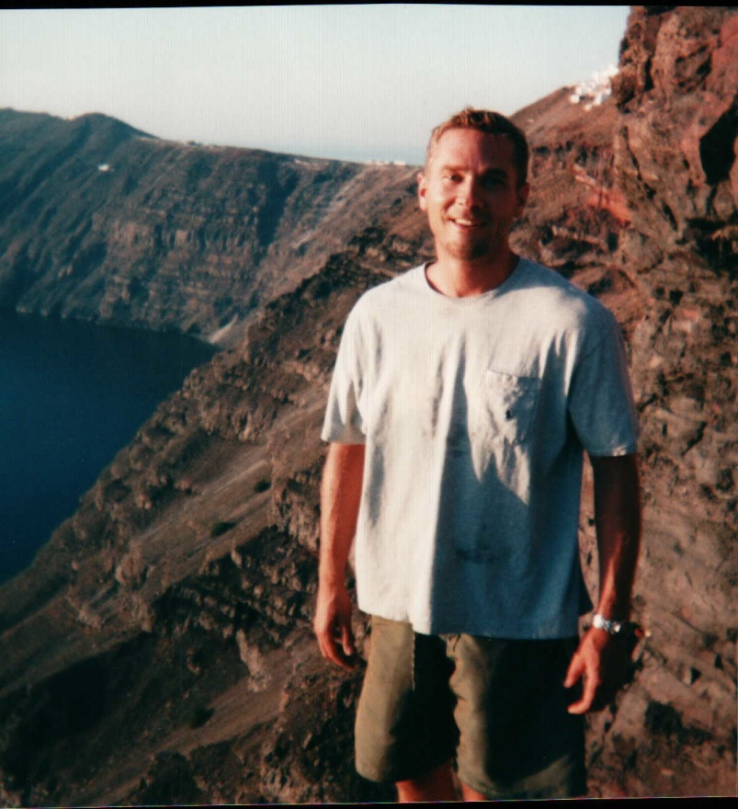
Rotary Scholarship
A Traveler’s Education

Slide 13
Career Path
I started as an Analyst at Houlihan Lokey…
I was promoted to Vice President after 5 years…
When that start-up fizzed out, I co-founded FocalPoint Partners
I left Houlihan Lokey after 5.5 for a start-up

Slide 14
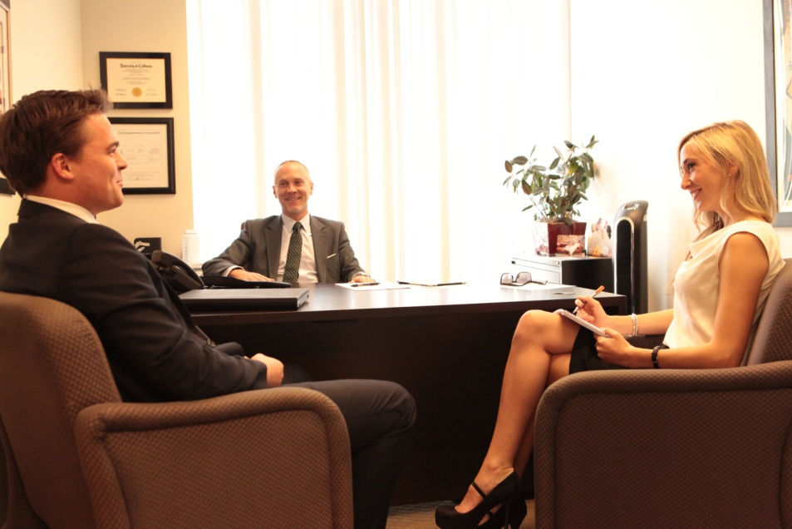
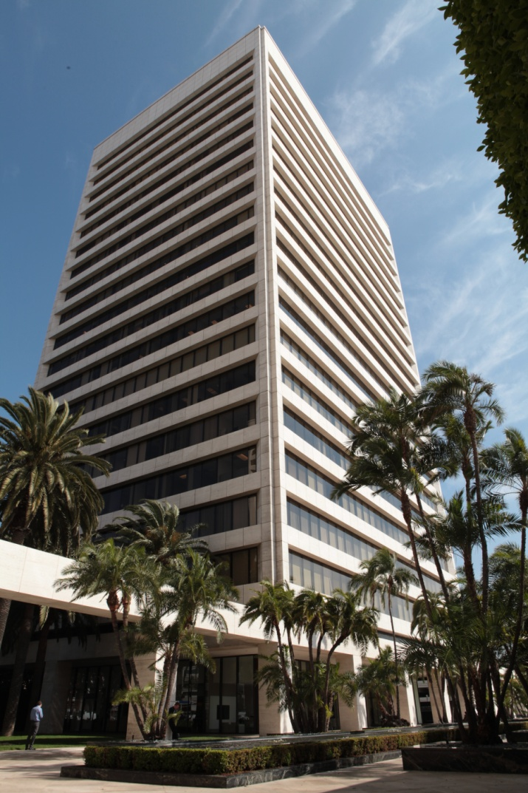
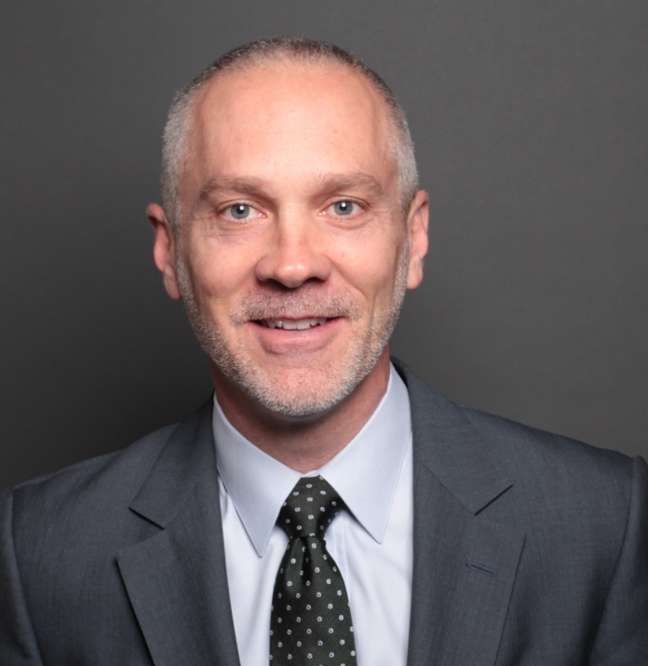
Career
Company pic #2
Where I Work

Slide 15
Current Role
Managing Director
Companies Need Capital
Accountants
Prospective Buyers and Investors
Attorneys
Notes:
Use this graph to give more description of your role specifically (responsibilities, typical work week, direct reports, etc.)

Slide 16
Career Challenges
Getting my foot in the door out of CSUN
Crazy work hours the first several years (100+ hours per week)
Starting a business from nothing….twice
Getting sued by my former partner (from the start-up)

Slide 17
Career Compensation
Managing Directors: $500K+
Associates/VP’s: $150 to $400K
Analysts: $80 to 120K
Interns
(Unpaid)
Notes:
Use this graph to show general compensation ranges for people in various roles in your company

Slide 18
It’s Possible
Coming from a guy who never even took the SAT test, my journey has feels a bit surreal when I stop to think about it
I’ve often felt like I am playing with the house’s money
But you have to believe in yourself and follow your “true north”
It’s not where you start, but rather how you finish

Slide 19

QUESTION AND ANSWER

