Slide 1

The Power in Coloring Outside the Lines
Stacyann P. Russell

Slide 2
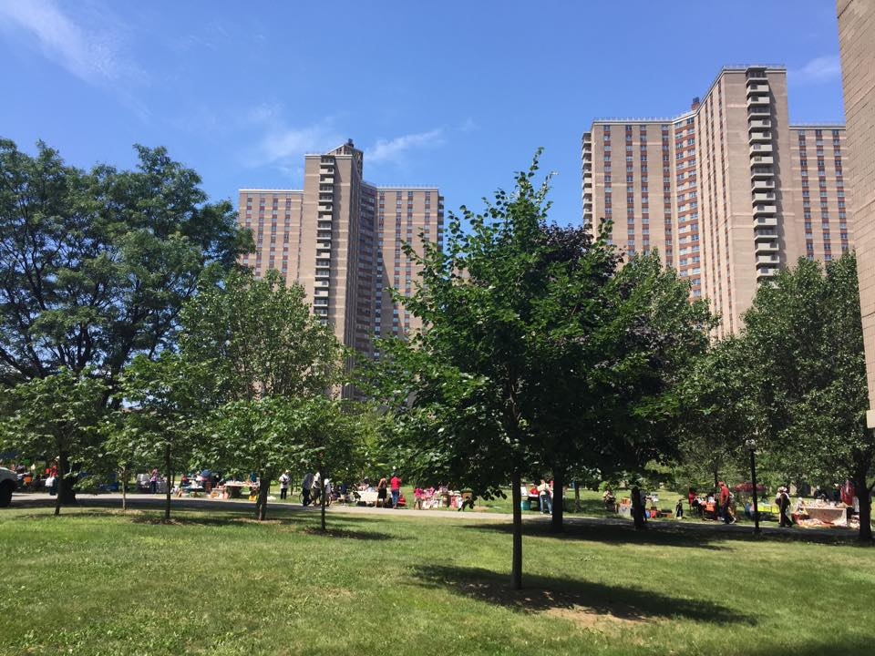
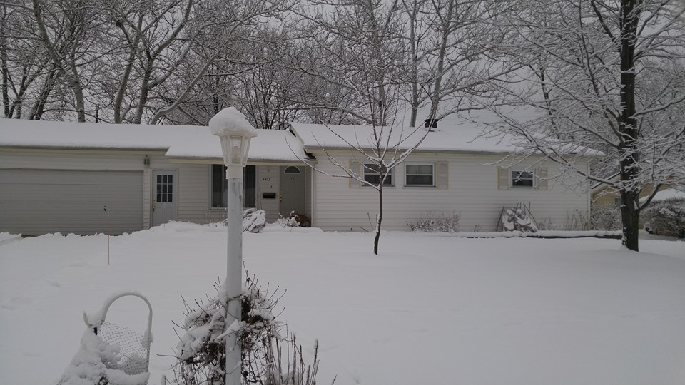



About Me
Jamaica
The Bronx, NY
Cleveland, OH

Slide 3



The Master Plan…
Teacher
Violinist
Engineer

Slide 4



Getting Educated…
Bachelor of Science Industrial & Systems Engineering
Masters of Science in
Engineering Management
Masters of Business Administration

Slide 5
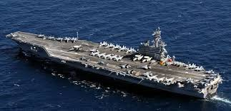


Getting Experience…
Modeling & Simulation Engineer
Nuclear Engineer
Industrial Engineer

Slide 6
Supply Chain Management Consulting

Slide 7
Supply Chain Management
“Give the customer what they want, when they want it, how they want it, where they want it, and at a reasonable price. All while making a profit.”
Plan
Source
Make
Deliver
Return
Source: APICS

Slide 8






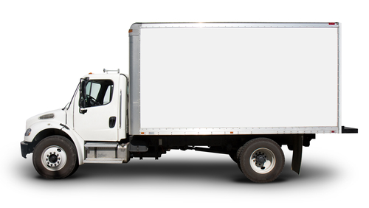



Supply Chain Example
SOURCE
MAKE
RECYCLE
DELIVER
REUSE

Slide 9
Supply Chain Management
Plan | Determining the requirements necessary to forecast, meet, and communicate the demand and supply for a product or service
Source | Managing inventory, suppliers, supplier agreements, supplier performance, payments, receiving, quality control, and transfer to the production team
Make | Executing production orders, manufacturing, packaging, staging, and releasing the product for delivery
Deliver | Facilitating order management, warehousing, and transportation of products
Return | Handling the return of containers, packaging, or defective products

Slide 10
Supply Chain Game

Slide 11

Cell Phone Retail Game
Chips are cell phones
For this game all color phones are the same
We will buy cell phones from suppliers and sell them in our retail store
Retail price = $5 per phone
=

Slide 12
Key Terms
Unit – Each phone you buy or sell
Revenue – Amount of money ($$) you make when you sell phones
Inventory – Phones you have bought from suppliers
Supplier – A maker of cell phones
Demand – Number of phones that can be sold to customers
Lead Time – The amount of time that elapses between when a process starts (order is placed) and when it is completed (delivered to customer)

Slide 13





Game Set Up
Roles:
Game Rules:
  Each team starts with a budget of $100 and 5 phones in inventory
  Teams must fill out game score sheets completely
  Demand Each Round – Determined by deck of cards (Ace – 10) at retail store
  Penalty Each Round – 3 scenarios
    Cost of Excess Inventory – If your team has excess inventory at the end of a round, you will be charged a penalty of $1/unit
    Cost of Unmet Demand – If your team has unmet demand at the end of a round, you will draw a missed demand card and be charged a penalty for each unit of missed demand (Jack - $1, Queen - $2, King - $3, Joker - $4)
    No Penalty – If your team successfully fulfills the order with no excess inventory
Retail Store Manager
Suppliers (3)
Accountant
Purchasing
Sales
Teams of 3

Slide 14
Cell Phone Suppliers
Supplier A
Insource
Capacity = 10 units/week
Price = $4/unit
Lead Time = 0 weeks
No Min Quantity
Supplier B
Gotham City
Capacity = 15 units/week
Price = $3/unit
Lead Time = 1 week
No Min Quantity
Supplier C
China
Capacity = 30 units/week
Price = $1/unit
Lead Time = 2 weeks
Min Quantity = 10

Slide 15
Cell Phone Retail Store
Each team picks a weekly demand card (Ace – 10)
Each team sells phones based on number of units of current week’s demand. Store pays team $5 for each sale
Each team pays weekly penalty
  Excess Inventory: $1 per phone
  Unmet demand: Draw card for per unit penalty (Jack = $1, Queen = $2, King = $3, Joker = $4)
  $0: Fill perfect order

Slide 16
Game Flow
Beginning
Accounting
Get
Demand
Source Phones
Compute Sales and Inventory
Compute Profit or Loss
End
Accounting
Sell Phones & Pay Penalty
PLEASE DO NOT MOVE AHEAD.
TEAMS WILL STAY ON THE SAME WEEK UNTIL THE INSTRUCTOR SAYS TO MOVE TO THE NEXT WEEK!

Slide 17
Week 1 Practice Round
We go through 1 practice round and fill out the score sheet together:
All teams with works with Supplier B for the practice round
Assume Supplier B has unlimited capacity for practice round
Teams pick up demand cards (Ace – 10) from the Retail Store at the beginning of every week
If unmet demand, teams pick up random penalty cards (Jack, Queen, King, Joker) from the Retail Store at the end of the round
All teams share same demand and penalty for practice rounds

Slide 18
Team Scorecard (Week 1 Practice)
Step |  | Description | Calculation Hint | Week 1 | Week 2
Start Accounting | 1 | Starting Cash Balance | Line 19 from previous week | $100 | $
Get Demand | 2 | Weekly Demand | Pick Card (Ace - 10) from retail store | units | units
Source Phones | 3 | Choose Supplier | Team Chooses A, B or C
 | 4 | Week supply becomes available | Current week, or +1 week or +2 weeks
 | 5 | Cost per Unit of Supply | $4, $3 or $1 based on team supplier choice | $ | $
 | 6 | Phones you choose to Order | Team chooses | units | units
 | 7 | Total Order Cost | Line 5 x Line 6 | $ | $
Compute Inventory and Sales | 8 | Beginning Inventory | Line 12 from previous week | 5 units | units
 | 9 | Units Delivered this week | From Line 4 and Line 6 | units | units
 | 10 | Inventory Available for Sale | Line 8 + Line 9 | units | units
 | 11 | Number of Sales | Max (Line 2, if sufficient inventory or < Line 2 insufficient inventory) | units | units
 | 12 | Ending Inventory on hand | Line 10 - Line 11 | units | units
 | 13 | Units of Missed Demand | Max (Line 2 - Line 10 or 0) | units | units
Compute Penalty Costs | 14 | Missed Demand Penalty | Pick Card (Jack = $1, Queen = $2, King = $3, Joker = $4) Per Unit | $ | $
 | 15 | Cost of Missed Demand | Line 14 x Line 13 | $ | $
 | 16 | Inventory Holding Cost | $1 x Line 12 | $ | $
Compute Profit or Loss | 17 | Revenue from Phone Sales | $5 x line 11 | $ | $
 | 18 | Total Penalty Cost | Line 15 + Line 16 | $ | $
End Accounting | 19 | Ending Cash Balance | Line 1 - Line 7 + Line 17 - Line 18 | $ | $
Start with $100
Start with 5 units

Slide 19
Team Scorecard (Week 1 Practice)
Step |  | Description | Calculation Hint | Week 1 | Week 2
Start Accounting | 1 | Starting Cash Balance | Line 19 from previous week | $100 | $
Get Demand | 2 | Weekly Demand | Pick Card (Ace - 10) from retail store | 7 units | units
Source Phones | 3 | Choose Supplier | Team Chooses A, B or C
 | 4 | Week supply becomes available | Current week, or +1 week or +2 weeks
 | 5 | Cost per Unit of Supply | $4, $3 or $1 based on team supplier choice | $ | $
 | 6 | Phones you choose to Order | Team chooses | units | units
 | 7 | Total Order Cost | Line 5 x Line 6 | $ | $
Compute Inventory and Sales | 8 | Beginning Inventory | Line 12 from previous week | 5 units | units
 | 9 | Units Delivered this week | From Line 4 and Line 6 | units | units
 | 10 | Inventory Available for Sale | Line 8 + Line 9 | units | units
 | 11 | Number of Sales | Max (Line 2, if sufficient inventory or < Line 2 insufficient inventory) | units | units
 | 12 | Ending Inventory on hand | Line 10 - Line 11 | units | units
 | 13 | Units of Missed Demand | Max (Line 2 - Line 10 or 0) | units | units
Compute Penalty Costs | 14 | Missed Demand Penalty | Pick Card (Jack = $1, Queen = $2, King = $3, Joker = $4) Per Unit | $ | $
 | 15 | Cost of Missed Demand | Line 14 x Line 13 | $ | $
 | 16 | Inventory Holding Cost | $1 x Line 12 | $ | $
Compute Profit or Loss | 17 | Revenue from Phone Sales | $5 x line 11 | $ | $
 | 18 | Total Penalty Cost | Line 15 + Line 16 | $ | $
End Accounting | 19 | Ending Cash Balance | Line 1 - Line 7 + Line 17 - Line 18 | $ | $
Pick demand card

Slide 20
Team Scorecard (Week 1 Practice)
Step |  | Description | Calculation Hint | Week 1 | Week 2
Start Accounting | 1 | Starting Cash Balance | Line 19 from previous week | $100 | $
Get Demand | 2 | Weekly Demand | Pick Card (Ace - 10) from retail store | 7 units | units
Source Phones | 3 | Choose Supplier | Team Chooses A, B or C | B
 | 4 | Week supply becomes available | Current week, or +1 week or +2 weeks | 2
 | 5 | Cost per Unit of Supply | $4, $3 or $1 based on team supplier choice | $ | $
 | 6 | Phones you choose to Order | Team chooses | units | units
 | 7 | Total Order Cost | Line 5 x Line 6 | $ | $
Compute Inventory and Sales | 8 | Beginning Inventory | Line 12 from previous week | 5 units | units
 | 9 | Units Delivered this week | From Line 4 and Line 6 | units | units
 | 10 | Inventory Available for Sale | Line 8 + Line 9 | units | units
 | 11 | Number of Sales | Max (Line 2, if sufficient inventory or < Line 2 insufficient inventory) | units | units
 | 12 | Ending Inventory on hand | Line 10 - Line 11 | units | units
 | 13 | Units of Missed Demand | Max (Line 2 - Line 10 or 0) | units | units
Compute Penalty Costs | 14 | Missed Demand Penalty | Pick Card (Jack = $1, Queen = $2, King = $3, Joker = $4) Per Unit | $ | $
 | 15 | Cost of Missed Demand | Line 14 x Line 13 | $ | $
 | 16 | Inventory Holding Cost | $1 x Line 12 | $ | $
Compute Profit or Loss | 17 | Revenue from Phone Sales | $5 x line 11 | $ | $
 | 18 | Total Penalty Cost | Line 15 + Line 16 | $ | $
End Accounting | 19 | Ending Cash Balance | Line 1 - Line 7 + Line 17 - Line 18 | $ | $
Supplier B
Available week 2

Slide 21
Team Scorecard (Week 1 Practice)
Step |  | Description | Calculation Hint | Week 1 | Week 2
Start Accounting | 1 | Starting Cash Balance | Line 19 from previous week | $100 | $
Get Demand | 2 | Weekly Demand | Pick Card (Ace - 10) from retail store | 7 units | units
Source Phones | 3 | Choose Supplier | Team Chooses A, B or C | B
 | 4 | Week supply becomes available | Current week, or +1 week or +2 weeks | 2
 | 5 | Cost per Unit of Supply | $4, $3 or $1 based on team supplier choice | $3 | $
 | 6 | Phones you choose to Order | Team chooses | units | units
 | 7 | Total Order Cost | Line 5 x Line 6 | $ | $
Compute Inventory and Sales | 8 | Beginning Inventory | Line 12 from previous week | 5 units | units
 | 9 | Units Delivered this week | From Line 4 and Line 6 | units | units
 | 10 | Inventory Available for Sale | Line 8 + Line 9 | units | units
 | 11 | Number of Sales | Max (Line 2, if sufficient inventory or < Line 2 insufficient inventory) | units | units
 | 12 | Ending Inventory on hand | Line 10 - Line 11 | units | units
 | 13 | Units of Missed Demand | Max (Line 2 - Line 10 or 0) | units | units
Compute Penalty Costs | 14 | Missed Demand Penalty | Pick Card (Jack = $1, Queen = $2, King = $3, Joker = $4) Per Unit | $ | $
 | 15 | Cost of Missed Demand | Line 14 x Line 13 | $ | $
 | 16 | Inventory Holding Cost | $1 x Line 12 | $ | $
Compute Profit or Loss | 17 | Revenue from Phone Sales | $5 x line 11 | $ | $
 | 18 | Total Penalty Cost | Line 15 + Line 16 | $ | $
End Accounting | 19 | Ending Cash Balance | Line 1 - Line 7 + Line 17 - Line 18 | $ | $
Cost per unit is $3
Supplier B

Slide 22
Team Scorecard (Week 1 Practice)
Step |  | Description | Calculation Hint | Week 1 | Week 2
Start Accounting | 1 | Starting Cash Balance | Line 19 from previous week | $100 | $
Get Demand | 2 | Weekly Demand | Pick Card (Ace - 10) from retail store | 7 units | units
Source Phones | 3 | Choose Supplier | Team Chooses A, B or C | B
 | 4 | Week supply becomes available | Current week, or +1 week or +2 weeks | 2
 | 5 | Cost per Unit of Supply | $4, $3 or $1 based on team supplier choice | $3 | $
 | 6 | Phones you choose to Order | Team chooses | 5 units | units
 | 7 | Total Order Cost | Line 5 x Line 6 | $ | $
Compute Inventory and Sales | 8 | Beginning Inventory | Line 12 from previous week | 5 units | units
 | 9 | Units Delivered this week | From Line 4 and Line 6 | units | units
 | 10 | Inventory Available for Sale | Line 8 + Line 9 | units | units
 | 11 | Number of Sales | Max (Line 2, if sufficient inventory or < Line 2 insufficient inventory) | units | units
 | 12 | Ending Inventory on hand | Line 10 - Line 11 | units | units
 | 13 | Units of Missed Demand | Max (Line 2 - Line 10 or 0) | units | units
Compute Penalty Costs | 14 | Missed Demand Penalty | Pick Card (Jack = $1, Queen = $2, King = $3, Joker = $4) Per Unit | $ | $
 | 15 | Cost of Missed Demand | Line 14 x Line 13 | $ | $
 | 16 | Inventory Holding Cost | $1 x Line 12 | $ | $
Compute Profit or Loss | 17 | Revenue from Phone Sales | $5 x line 11 | $ | $
 | 18 | Total Penalty Cost | Line 15 + Line 16 | $ | $
End Accounting | 19 | Ending Cash Balance | Line 1 - Line 7 + Line 17 - Line 18 | $ | $
Choose 5 phones

Slide 23
Team Scorecard (Week 1 Practice)
Step |  | Description | Calculation Hint | Week 1 | Week 2
Start Accounting | 1 | Starting Cash Balance | Line 19 from previous week | $100 | $
Get Demand | 2 | Weekly Demand | Pick Card (Ace - 10) from retail store | 7 units | units
Source Phones | 3 | Choose Supplier | Team Chooses A, B or C | B
 | 4 | Week supply becomes available | Current week, or +1 week or +2 weeks | 2
 | 5 | Cost per Unit of Supply | $4, $3 or $1 based on team supplier choice | $3 | $
 | 6 | Phones you choose to Order | Team chooses | 5 units | units
 | 7 | Total Order Cost | Line 5 x Line 6 | $15 | $
Compute Inventory and Sales | 8 | Beginning Inventory | Line 12 from previous week | 5 units | units
 | 9 | Units Delivered this week | From Line 4 and Line 6 | units | units
 | 10 | Inventory Available for Sale | Line 8 + Line 9 | units | units
 | 11 | Number of Sales | Max (Line 2, if sufficient inventory or < Line 2 insufficient inventory) | units | units
 | 12 | Ending Inventory on hand | Line 10 - Line 11 | units | units
 | 13 | Units of Missed Demand | Max (Line 2 - Line 10 or 0) | units | units
Compute Penalty Costs | 14 | Missed Demand Penalty | Pick Card (Jack = $1, Queen = $2, King = $3, Joker = $4) Per Unit | $ | $
 | 15 | Cost of Missed Demand | Line 14 x Line 13 | $ | $
 | 16 | Inventory Holding Cost | $1 x Line 12 | $ | $
Compute Profit or Loss | 17 | Revenue from Phone Sales | $5 x line 11 | $ | $
 | 18 | Total Penalty Cost | Line 15 + Line 16 | $ | $
End Accounting | 19 | Ending Cash Balance | Line 1 - Line 7 + Line 17 - Line 18 | $ | $
Total Order Cost is
5 x $3 = $15

Slide 24
Team Scorecard (Week 1 Practice)
Step |  | Description | Calculation Hint | Week 1 | Week 2
Start Accounting | 1 | Starting Cash Balance | Line 19 from previous week | $100 | $
Get Demand | 2 | Weekly Demand | Pick Card (Ace - 10) from retail store | 7 units | units
Source Phones | 3 | Choose Supplier | Team Chooses A, B or C | B
 | 4 | Week supply becomes available | Current week, or +1 week or +2 weeks | 2
 | 5 | Cost per Unit of Supply | $4, $3 or $1 based on team supplier choice | $3 | $
 | 6 | Phones you choose to Order | Team chooses | 5 units | units
 | 7 | Total Order Cost | Line 5 x Line 6 | $15 | $
Compute Inventory and Sales | 8 | Beginning Inventory | Line 12 from previous week | 5 units | units
 | 9 | Units Delivered this week | From Line 4 and Line 6 | 0 units | units
 | 10 | Inventory Available for Sale | Line 8 + Line 9 | units | units
 | 11 | Number of Sales | Max (Line 2, if sufficient inventory or < Line 2 insufficient inventory) | units | units
 | 12 | Ending Inventory on hand | Line 10 - Line 11 | units | units
 | 13 | Units of Missed Demand | Max (Line 2 - Line 10 or 0) | units | units
Compute Penalty Costs | 14 | Missed Demand Penalty | Pick Card (Jack = $1, Queen = $2, King = $3, Joker = $4) Per Unit | $ | $
 | 15 | Cost of Missed Demand | Line 14 x Line 13 | $ | $
 | 16 | Inventory Holding Cost | $1 x Line 12 | $ | $
Compute Profit or Loss | 17 | Revenue from Phone Sales | $5 x line 11 | $ | $
 | 18 | Total Penalty Cost | Line 15 + Line 16 | $ | $
End Accounting | 19 | Ending Cash Balance | Line 1 - Line 7 + Line 17 - Line 18 | $ | $
No supply arrives in week 1

Slide 25
Team Scorecard (Week 1 Practice)
Step |  | Description | Calculation Hint | Week 1 | Week 2
Start Accounting | 1 | Starting Cash Balance | Line 19 from previous week | $100 | $
Get Demand | 2 | Weekly Demand | Pick Card (Ace - 10) from retail store | 7 units | units
Source Phones | 3 | Choose Supplier | Team Chooses A, B or C | B
 | 4 | Week supply becomes available | Current week, or +1 week or +2 weeks | 2
 | 5 | Cost per Unit of Supply | $4, $3 or $1 based on team supplier choice | $3 | $
 | 6 | Phones you choose to Order | Team chooses | 5 units | units
 | 7 | Total Order Cost | Line 5 x Line 6 | $15 | $
Compute Inventory and Sales | 8 | Beginning Inventory | Line 12 from previous week | 5 units | units
 | 9 | Units Delivered this week | From Line 4 and Line 6 | 0 units | units
 | 10 | Inventory Available for Sale | Line 8 + Line 9 | 5 units | units
 | 11 | Number of Sales | Max (Line 2, if sufficient inventory or < Line 2 insufficient inventory) | units | units
 | 12 | Ending Inventory on hand | Line 10 - Line 11 | units | units
 | 13 | Units of Missed Demand | Max (Line 2 - Line 10 or 0) | units | units
Compute Penalty Costs | 14 | Missed Demand Penalty | Pick Card (Jack = $1, Queen = $2, King = $3, Joker = $4) Per Unit | $ | $
 | 15 | Cost of Missed Demand | Line 14 x Line 13 | $ | $
 | 16 | Inventory Holding Cost | $1 x Line 12 | $ | $
Compute Profit or Loss | 17 | Revenue from Phone Sales | $5 x line 11 | $ | $
 | 18 | Total Penalty Cost | Line 15 + Line 16 | $ | $
End Accounting | 19 | Ending Cash Balance | Line 1 - Line 7 + Line 17 - Line 18 | $ | $
5 units available
for sale

Slide 26
Team Scorecard (Week 1 Practice)
Step |  | Description | Calculation Hint | Week 1 | Week 2
Start Accounting | 1 | Starting Cash Balance | Line 19 from previous week | $100 | $
Get Demand | 2 | Weekly Demand | Pick Card (Ace - 10) from retail store | 7 units | units
Source Phones | 3 | Choose Supplier | Team Chooses A, B or C | B
 | 4 | Week supply becomes available | Current week, or +1 week or +2 weeks | 2
 | 5 | Cost per Unit of Supply | $4, $3 or $1 based on team supplier choice | $3 | $
 | 6 | Phones you choose to Order | Team chooses | 5 units | units
 | 7 | Total Order Cost | Line 5 x Line 6 | $15 | $
Compute Inventory and Sales | 8 | Beginning Inventory | Line 12 from previous week | 5 units | units
 | 9 | Units Delivered this week | From Line 4 and Line 6 | 0 units | units
 | 10 | Inventory Available for Sale | Line 8 + Line 9 | 5 units | units
 | 11 | Number of Sales | Max (Line 2, if sufficient inventory or < Line 2 insufficient inventory) | 5 units | units
 | 12 | Ending Inventory on hand | Line 10 - Line 11 | units | units
 | 13 | Units of Missed Demand | Max (Line 2 - Line 10 or 0) | units | units
Compute Penalty Costs | 14 | Missed Demand Penalty | Pick Card (Jack = $1, Queen = $2, King = $3, Joker = $4) Per Unit | $ | $
 | 15 | Cost of Missed Demand | Line 14 x Line 13 | $ | $
 | 16 | Inventory Holding Cost | $1 x Line 12 | $ | $
Compute Profit or Loss | 17 | Revenue from Phone Sales | $5 x line 11 | $ | $
 | 18 | Total Penalty Cost | Line 15 + Line 16 | $ | $
End Accounting | 19 | Ending Cash Balance | Line 1 - Line 7 + Line 17 - Line 18 | $ | $
Sold all 5 units available for sale

Slide 27
Team Scorecard (Week 1 Practice)
Step |  | Description | Calculation Hint | Week 1 | Week 2
Start Accounting | 1 | Starting Cash Balance | Line 19 from previous week | $100 | $
Get Demand | 2 | Weekly Demand | Pick Card (Ace - 10) from retail store | 7 units | units
Source Phones | 3 | Choose Supplier | Team Chooses A, B or C | B
 | 4 | Week supply becomes available | Current week, or +1 week or +2 weeks | 2
 | 5 | Cost per Unit of Supply | $4, $3 or $1 based on team supplier choice | $3 | $
 | 6 | Phones you choose to Order | Team chooses | 5 units | units
 | 7 | Total Order Cost | Line 5 x Line 6 | $15 | $
Compute Inventory and Sales | 8 | Beginning Inventory | Line 12 from previous week | 5 units | units
 | 9 | Units Delivered this week | From Line 4 and Line 6 | 0 units | units
 | 10 | Inventory Available for Sale | Line 8 + Line 9 | 5 units | units
 | 11 | Number of Sales | Max (Line 2, if sufficient inventory or < Line 2 insufficient inventory) | 5 units | units
 | 12 | Ending Inventory on hand | Line 10 - Line 11 | 0 units | units
 | 13 | Units of Missed Demand | Max (Line 2 - Line 10 or 0) | units | units
Compute Penalty Costs | 14 | Missed Demand Penalty | Pick Card (Jack = $1, Queen = $2, King = $3, Joker = $4) Per Unit | $ | $
 | 15 | Cost of Missed Demand | Line 14 x Line 13 | $ | $
 | 16 | Inventory Holding Cost | $1 x Line 12 | $ | $
Compute Profit or Loss | 17 | Revenue from Phone Sales | $5 x line 11 | $ | $
 | 18 | Total Penalty Cost | Line 15 + Line 16 | $ | $
End Accounting | 19 | Ending Cash Balance | Line 1 - Line 7 + Line 17 - Line 18 | $ | $
0 units left over

Slide 28
Team Scorecard (Week 1 Practice)
Step |  | Description | Calculation Hint | Week 1 | Week 2
Start Accounting | 1 | Starting Cash Balance | Line 19 from previous week | $100 | $
Get Demand | 2 | Weekly Demand | Pick Card (Ace - 10) from retail store | 7 units | units
Source Phones | 3 | Choose Supplier | Team Chooses A, B or C | B
 | 4 | Week supply becomes available | Current week, or +1 week or +2 weeks | 2
 | 5 | Cost per Unit of Supply | $4, $3 or $1 based on team supplier choice | $3 | $
 | 6 | Phones you choose to Order | Team chooses | 5 units | units
 | 7 | Total Order Cost | Line 5 x Line 6 | $15 | $
Compute Inventory and Sales | 8 | Beginning Inventory | Line 12 from previous week | 5 units | units
 | 9 | Units Delivered this week | From Line 4 and Line 6 | 0 units | units
 | 10 | Inventory Available for Sale | Line 8 + Line 9 | 5 units | units
 | 11 | Number of Sales | Max (Line 2, if sufficient inventory or < Line 2 insufficient inventory) | 5 units | units
 | 12 | Ending Inventory on hand | Line 10 - Line 11 | 0 units | units
 | 13 | Units of Missed Demand | Max (Line 2 - Line 10 or 0) | 2 units | units
Compute Penalty Costs | 14 | Missed Demand Penalty | Pick Card (Jack = $1, Queen = $2, King = $3, Joker = $4) Per Unit | $ | $
 | 15 | Cost of Missed Demand | Line 14 x Line 13 | $ | $
 | 16 | Inventory Holding Cost | $1 x Line 12 | $ | $
Compute Profit or Loss | 17 | Revenue from Phone Sales | $5 x line 11 | $ | $
 | 18 | Total Penalty Cost | Line 15 + Line 16 | $ | $
End Accounting | 19 | Ending Cash Balance | Line 1 - Line 7 + Line 17 - Line 18 | $ | $
2 units of
missed demand

Slide 29
Team Scorecard (Week 1 Practice)
Step |  | Description | Calculation Hint | Week 1 | Week 2
Start Accounting | 1 | Starting Cash Balance | Line 19 from previous week | $100 | $
Get Demand | 2 | Weekly Demand | Pick Card (Ace - 10) from retail store | 7 units | units
Source Phones | 3 | Choose Supplier | Team Chooses A, B or C | B
 | 4 | Week supply becomes available | Current week, or +1 week or +2 weeks | 2
 | 5 | Cost per Unit of Supply | $4, $3 or $1 based on team supplier choice | $3 | $
 | 6 | Phones you choose to Order | Team chooses | 5 units | units
 | 7 | Total Order Cost | Line 5 x Line 6 | $15 | $
Compute Inventory and Sales | 8 | Beginning Inventory | Line 12 from previous week | 5 units | units
 | 9 | Units Delivered this week | From Line 4 and Line 6 | 0 units | units
 | 10 | Inventory Available for Sale | Line 8 + Line 9 | 5 units | units
 | 11 | Number of Sales | Max (Line 2, if sufficient inventory or < Line 2 insufficient inventory) | 5 units | units
 | 12 | Ending Inventory on hand | Line 10 - Line 11 | 0 units | units
 | 13 | Units of Missed Demand | Max (Line 2 - Line 10 or 0) | 2 units | units
Compute Penalty Costs | 14 | Missed Demand Penalty | Pick Card (Jack = $1, Queen = $2, King = $3, Joker = $4) Per Unit | $2 | $
 | 15 | Cost of Missed Demand | Line 14 x Line 13 | $ | $
 | 16 | Inventory Holding Cost | $1 x Line 12 | $ | $
Compute Profit or Loss | 17 | Revenue from Phone Sales | $5 x line 11 | $ | $
 | 18 | Total Penalty Cost | Line 15 + Line 16 | $ | $
End Accounting | 19 | Ending Cash Balance | Line 1 - Line 7 + Line 17 - Line 18 | $ | $
Q = $2 penalty for each missed unit

Slide 30
Team Scorecard (Week 1 Practice)
Step |  | Description | Calculation Hint | Week 1 | Week 2
Start Accounting | 1 | Starting Cash Balance | Line 19 from previous week | $100 | $
Get Demand | 2 | Weekly Demand | Pick Card (Ace - 10) from retail store | 7 units | units
Source Phones | 3 | Choose Supplier | Team Chooses A, B or C | B
 | 4 | Week supply becomes available | Current week, or +1 week or +2 weeks | 2
 | 5 | Cost per Unit of Supply | $4, $3 or $1 based on team supplier choice | $3 | $
 | 6 | Phones you choose to Order | Team chooses | 5 units | units
 | 7 | Total Order Cost | Line 5 x Line 6 | $15 | $
Compute Inventory and Sales | 8 | Beginning Inventory | Line 12 from previous week | 5 units | units
 | 9 | Units Delivered this week | From Line 4 and Line 6 | 0 units | units
 | 10 | Inventory Available for Sale | Line 8 + Line 9 | 5 units | units
 | 11 | Number of Sales | Max (Line 2, if sufficient inventory or < Line 2 insufficient inventory) | 5 units | units
 | 12 | Ending Inventory on hand | Line 10 - Line 11 | 0 units | units
 | 13 | Units of Missed Demand | Max (Line 2 - Line 10 or 0) | 2 units | units
Compute Penalty Costs | 14 | Missed Demand Penalty | Pick Card (Jack = $1, Queen = $2, King = $3, Joker = $4) Per Unit | $2 | $
 | 15 | Cost of Missed Demand | Line 14 x Line 13 | $4 | $
 | 16 | Inventory Holding Cost | $1 x Line 12 | $ | $
Compute Profit or Loss | 17 | Revenue from Phone Sales | $5 x line 11 | $ | $
 | 18 | Total Penalty Cost | Line 15 + Line 16 | $ | $
End Accounting | 19 | Ending Cash Balance | Line 1 - Line 7 + Line 17 - Line 18 | $ | $
$4 cost of
missed demand

Slide 31
Team Scorecard (Week 1 Practice)
Step |  | Description | Calculation Hint | Week 1 | Week 2
Start Accounting | 1 | Starting Cash Balance | Line 19 from previous week | $100 | $
Get Demand | 2 | Weekly Demand | Pick Card (Ace - 10) from retail store | 7 units | units
Source Phones | 3 | Choose Supplier | Team Chooses A, B or C | B
 | 4 | Week supply becomes available | Current week, or +1 week or +2 weeks | 2
 | 5 | Cost per Unit of Supply | $4, $3 or $1 based on team supplier choice | $3 | $
 | 6 | Phones you choose to Order | Team chooses | 5 units | units
 | 7 | Total Order Cost | Line 5 x Line 6 | $15 | $
Compute Inventory and Sales | 8 | Beginning Inventory | Line 12 from previous week | 5 units | units
 | 9 | Units Delivered this week | From Line 4 and Line 6 | 0 units | units
 | 10 | Inventory Available for Sale | Line 8 + Line 9 | 5 units | units
 | 11 | Number of Sales | Max (Line 2, if sufficient inventory or < Line 2 insufficient inventory) | 5 units | units
 | 12 | Ending Inventory on hand | Line 10 - Line 11 | 0 units | units
 | 13 | Units of Missed Demand | Max (Line 2 - Line 10 or 0) | 2 units | units
Compute Penalty Costs | 14 | Missed Demand Penalty | Pick Card (Jack = $1, Queen = $2, King = $3, Joker = $4) Per Unit | $2 | $
 | 15 | Cost of Missed Demand | Line 14 x Line 13 | $4 | $
 | 16 | Inventory Holding Cost | $1 x Line 12 | $0 | $
Compute Profit or Loss | 17 | Revenue from Phone Sales | $5 x line 11 | $ | $
 | 18 | Total Penalty Cost | Line 15 + Line 16 | $ | $
End Accounting | 19 | Ending Cash Balance | Line 1 - Line 7 + Line 17 - Line 18 | $ | $
0 units left over

Slide 32
Team Scorecard (Week 1 Practice)
Step |  | Description | Calculation Hint | Week 1 | Week 2
Start Accounting | 1 | Starting Cash Balance | Line 19 from previous week | $100 | $
Get Demand | 2 | Weekly Demand | Pick Card (Ace - 10) from retail store | 7 units | units
Source Phones | 3 | Choose Supplier | Team Chooses A, B or C | B
 | 4 | Week supply becomes available | Current week, or +1 week or +2 weeks | 2
 | 5 | Cost per Unit of Supply | $4, $3 or $1 based on team supplier choice | $3 | $
 | 6 | Phones you choose to Order | Team chooses | 5 units | units
 | 7 | Total Order Cost | Line 5 x Line 6 | $15 | $
Compute Inventory and Sales | 8 | Beginning Inventory | Line 12 from previous week | 5 units | units
 | 9 | Units Delivered this week | From Line 4 and Line 6 | 0 units | units
 | 10 | Inventory Available for Sale | Line 8 + Line 9 | 5 units | units
 | 11 | Number of Sales | Max (Line 2, if sufficient inventory or < Line 2 insufficient inventory) | 5 units | units
 | 12 | Ending Inventory on hand | Line 10 - Line 11 | 0 units | units
 | 13 | Units of Missed Demand | Max (Line 2 - Line 10 or 0) | 2 units | units
Compute Penalty Costs | 14 | Missed Demand Penalty | Pick Card (Jack = $1, Queen = $2, King = $3, Joker = $4) Per Unit | $2 | $
 | 15 | Cost of Missed Demand | Line 14 x Line 13 | $4 | $
 | 16 | Inventory Holding Cost | $1 x Line 12 | $0 | $
Compute Profit or Loss | 17 | Revenue from Phone Sales | $5 x line 11 | $25 | $
 | 18 | Total Penalty Cost | Line 15 + Line 16 | $ | $
End Accounting | 19 | Ending Cash Balance | Line 1 - Line 7 + Line 17 - Line 18 | $ | $
$5 x 5 phones sold

Slide 33
Team Scorecard (Week 1 Practice)
Step |  | Description | Calculation Hint | Week 1 | Week 2
Start Accounting | 1 | Starting Cash Balance | Line 19 from previous week | $100 | $
Get Demand | 2 | Weekly Demand | Pick Card (Ace - 10) from retail store | 7 units | units
Source Phones | 3 | Choose Supplier | Team Chooses A, B or C | B
 | 4 | Week supply becomes available | Current week, or +1 week or +2 weeks | 2
 | 5 | Cost per Unit of Supply | $4, $3 or $1 based on team supplier choice | $3 | $
 | 6 | Phones you choose to Order | Team chooses | 5 units | units
 | 7 | Total Order Cost | Line 5 x Line 6 | $15 | $
Compute Inventory and Sales | 8 | Beginning Inventory | Line 12 from previous week | 5 units | units
 | 9 | Units Delivered this week | From Line 4 and Line 6 | 0 units | units
 | 10 | Inventory Available for Sale | Line 8 + Line 9 | 5 units | units
 | 11 | Number of Sales | Max (Line 2, if sufficient inventory or < Line 2 insufficient inventory) | 5 units | units
 | 12 | Ending Inventory on hand | Line 10 - Line 11 | 0 units | units
 | 13 | Units of Missed Demand | Max (Line 2 - Line 10 or 0) | 2 units | units
Compute Penalty Costs | 14 | Missed Demand Penalty | Pick Card (Jack = $1, Queen = $2, King = $3, Joker = $4) Per Unit | $2 | $
 | 15 | Cost of Missed Demand | Line 14 x Line 13 | $4 | $
 | 16 | Inventory Holding Cost | $1 x Line 12 | $0 | $
Compute Profit or Loss | 17 | Revenue from Phone Sales | $5 x line 11 | $25 | $
 | 18 | Total Penalty Cost | Line 15 + Line 16 | $4 | $
End Accounting | 19 | Ending Cash Balance | Line 1 - Line 7 + Line 17 - Line 18 | $ | $
$4 in total
penalty costs

Slide 34
Team Scorecard (Week 1 Practice)
Step |  | Description | Calculation Hint | Week 1 | Week 2
Start Accounting | 1 | Starting Cash Balance | Line 19 from previous week | $100 | $
Get Demand | 2 | Weekly Demand | Pick Card (Ace - 10) from retail store | 7 units | units
Source Phones | 3 | Choose Supplier | Team Chooses A, B or C | B
 | 4 | Week supply becomes available | Current week, or +1 week or +2 weeks | 2
 | 5 | Cost per Unit of Supply | $4, $3 or $1 based on team supplier choice | $3 | $
 | 6 | Phones you choose to Order | Team chooses | 5 units | units
 | 7 | Total Order Cost | Line 5 x Line 6 | $15 | $
Compute Inventory and Sales | 8 | Beginning Inventory | Line 12 from previous week | 5 units | units
 | 9 | Units Delivered this week | From Line 4 and Line 6 | 0 units | units
 | 10 | Inventory Available for Sale | Line 8 + Line 9 | 5 units | units
 | 11 | Number of Sales | Max (Line 2, if sufficient inventory or < Line 2 insufficient inventory) | 5 units | units
 | 12 | Ending Inventory on hand | Line 10 - Line 11 | 0 units | units
 | 13 | Units of Missed Demand | Max (Line 2 - Line 10 or 0) | 2 units | units
Compute Penalty Costs | 14 | Missed Demand Penalty | Pick Card (Jack = $1, Queen = $2, King = $3, Joker = $4) Per Unit | $2 | $
 | 15 | Cost of Missed Demand | Line 14 x Line 13 | $4 | $
 | 16 | Inventory Holding Cost | $1 x Line 12 | $0 | $
Compute Profit or Loss | 17 | Revenue from Phone Sales | $5 x line 11 | $25 | $
 | 18 | Total Penalty Cost | Line 15 + Line 16 | $4 | $
End Accounting | 19 | Ending Cash Balance | Line 1 - Line 7 + Line 17 - Line 18 | $106 | $
$100 + $25 - $15 - $4 penalty

Slide 35
Team Scorecard (Week 1 Practice)
Step |  | Description | Calculation Hint | Week 1 | Week 2
Start Accounting | 1 | Starting Cash Balance | Line 19 from previous week | $100 | $106
Get Demand | 2 | Weekly Demand | Pick Card (Ace - 10) from retail store | 7 units | units
Source Phones | 3 | Choose Supplier | Team Chooses A, B or C | B
 | 4 | Week supply becomes available | Current week, or +1 week or +2 weeks | 2
 | 5 | Cost per Unit of Supply | $4, $3 or $1 based on team supplier choice | $3 | $
 | 6 | Phones you choose to Order | Team chooses | 5 units | units
 | 7 | Total Order Cost | Line 5 x Line 6 | $15 | $
Compute Inventory and Sales | 8 | Beginning Inventory | Line 12 from previous week | 5 units | units
 | 9 | Units Delivered this week | From Line 4 and Line 6 | 0 units | units
 | 10 | Inventory Available for Sale | Line 8 + Line 9 | 5 units | units
 | 11 | Number of Sales | Max (Line 2, if sufficient inventory or < Line 2 insufficient inventory) | 5 units | units
 | 12 | Ending Inventory on hand | Line 10 - Line 11 | 0 units | units
 | 13 | Units of Missed Demand | Max (Line 2 - Line 10 or 0) | 2 units | units
Compute Penalty Costs | 14 | Missed Demand Penalty | Pick Card (Jack = $1, Queen = $2, King = $3, Joker = $4) Per Unit | $2 | $
 | 15 | Cost of Missed Demand | Line 14 x Line 13 | $4 | $
 | 16 | Inventory Holding Cost | $1 x Line 12 | $0 | $
Compute Profit or Loss | 17 | Revenue from Phone Sales | $5 x line 11 | $25 | $
 | 18 | Total Penalty Cost | Line 15 + Line 16 | $4 | $
End Accounting | 19 | Ending Cash Balance | Line 1 - Line 7 + Line 17 - Line 18 | $106 | $
Start week 2

Slide 36
Repeat step for each Week
Start Accounting
Get Demand
Source Phones
Compute Sale and Inventory
Sell Phones & Pay Penalty
Compute Profit or Loss
End Accounting
PLEASE DO NOT MOVE AHEAD. TEAMS WILL STAY ON THE SAME STEP UNTIL THE INSTRUCTOR SAYS TO MOVE TO THE NEXT!
AFTER EACH WEEK WE WILL RECORD OUR TEAMS SCORES!

Slide 37
Let the Game Begin

Slide 38

Q & A

Slide 39
Just Remember….
Tried to get exposed to as much as possible
Build a team
Color outside the lines

Slide 40

Stay in contact
stacyann@stacyannpatrice.com
@stacyannpatrice

