Slide 1
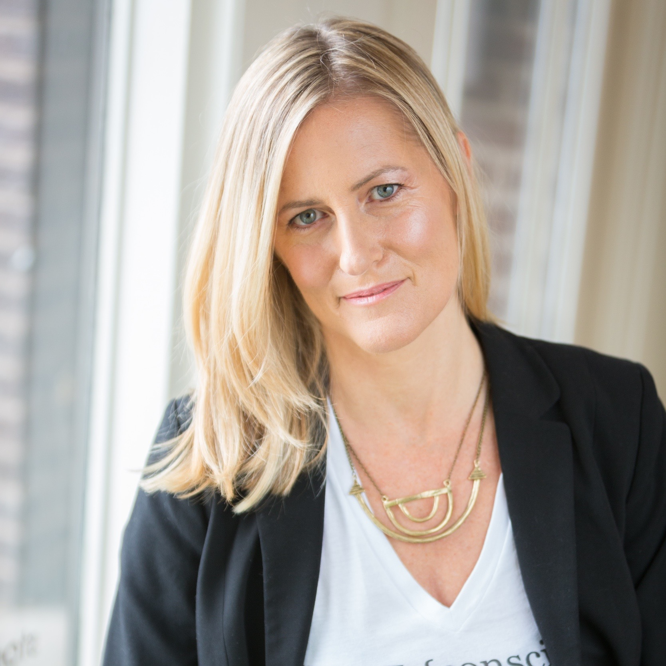
Justine Lassoff Cofounder/CEO Love Goodly Cofounder TuesdayNights

Slide 2
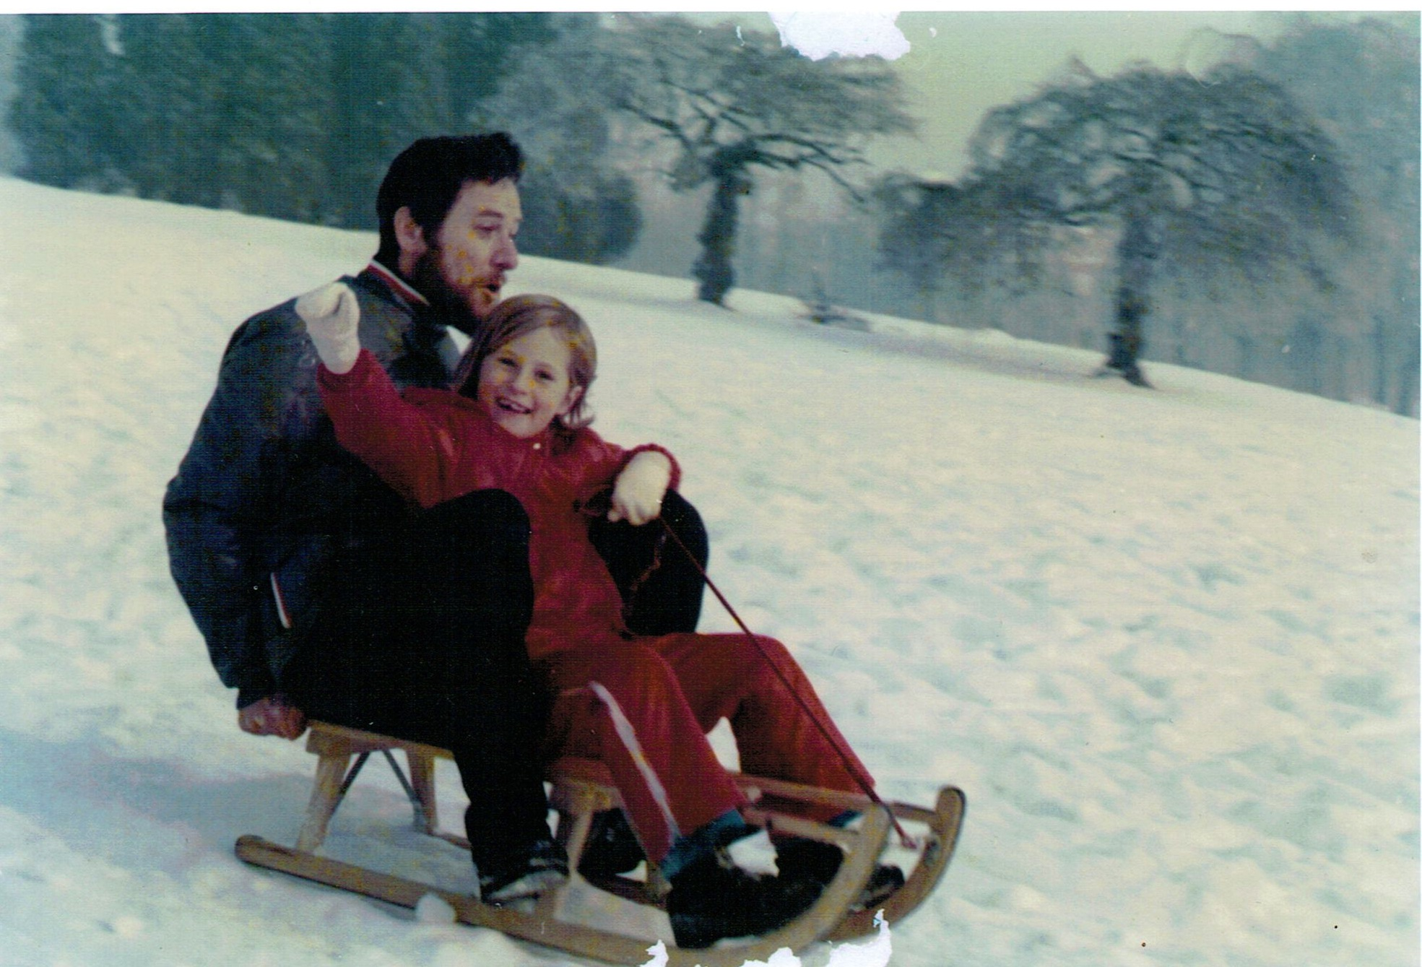
Born in Orange, California Grew up in Europe age 1-10 (England, Italy, Belgium) Mom was a teacher and dad engineer

Slide 3
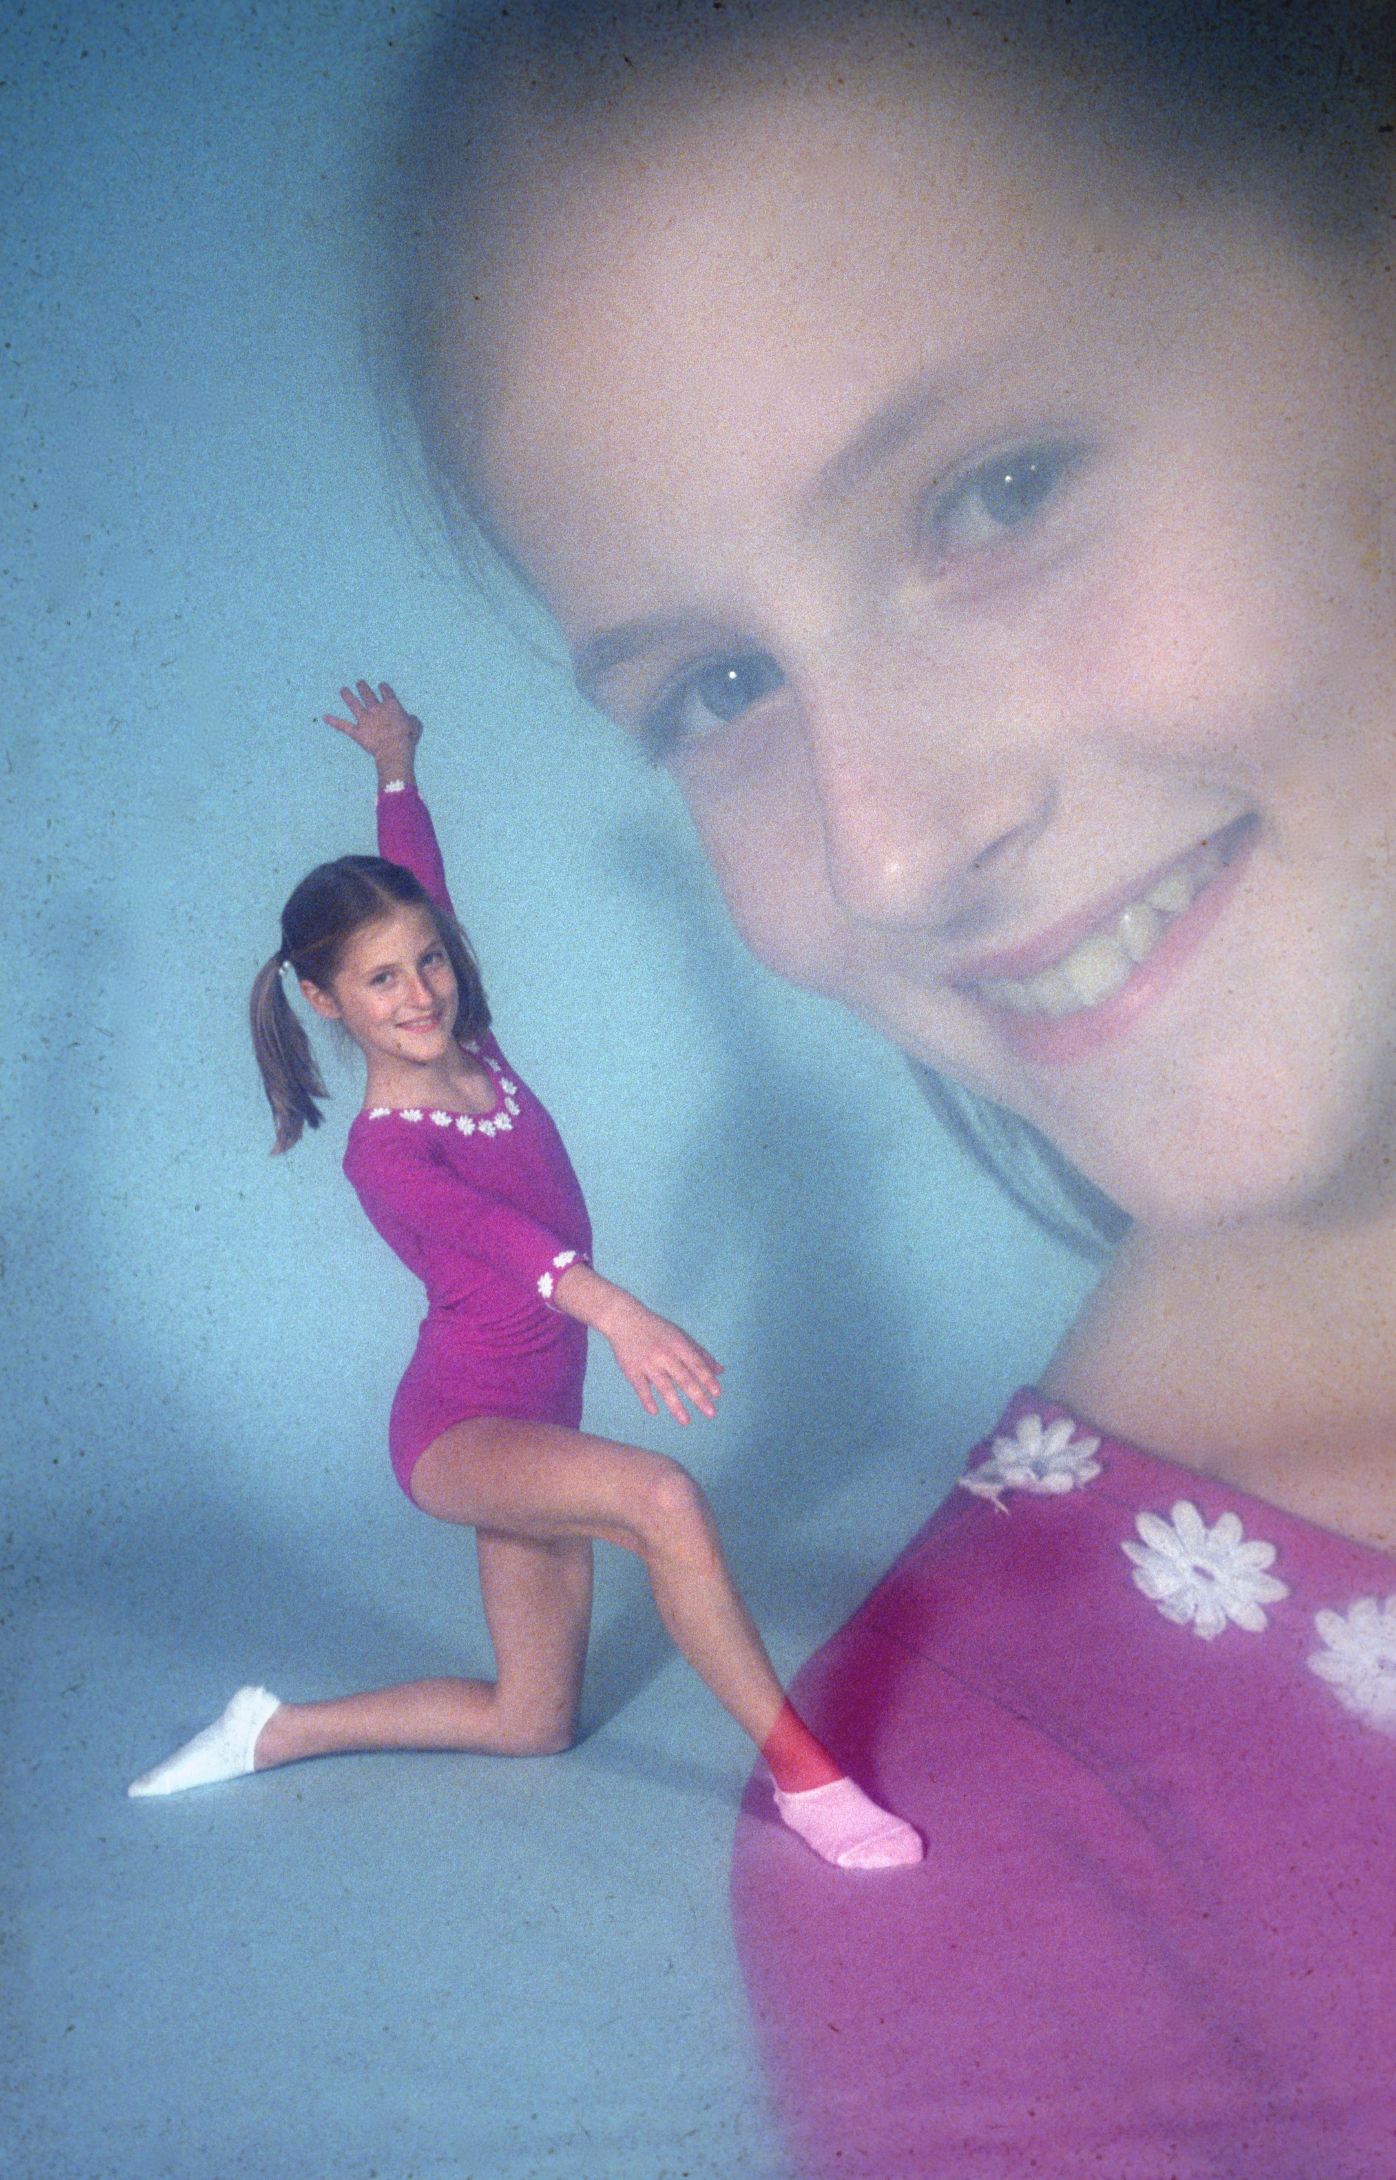
Competed gymnastics for 9 years (ages 7-16) Played violin for 11 years

Slide 4
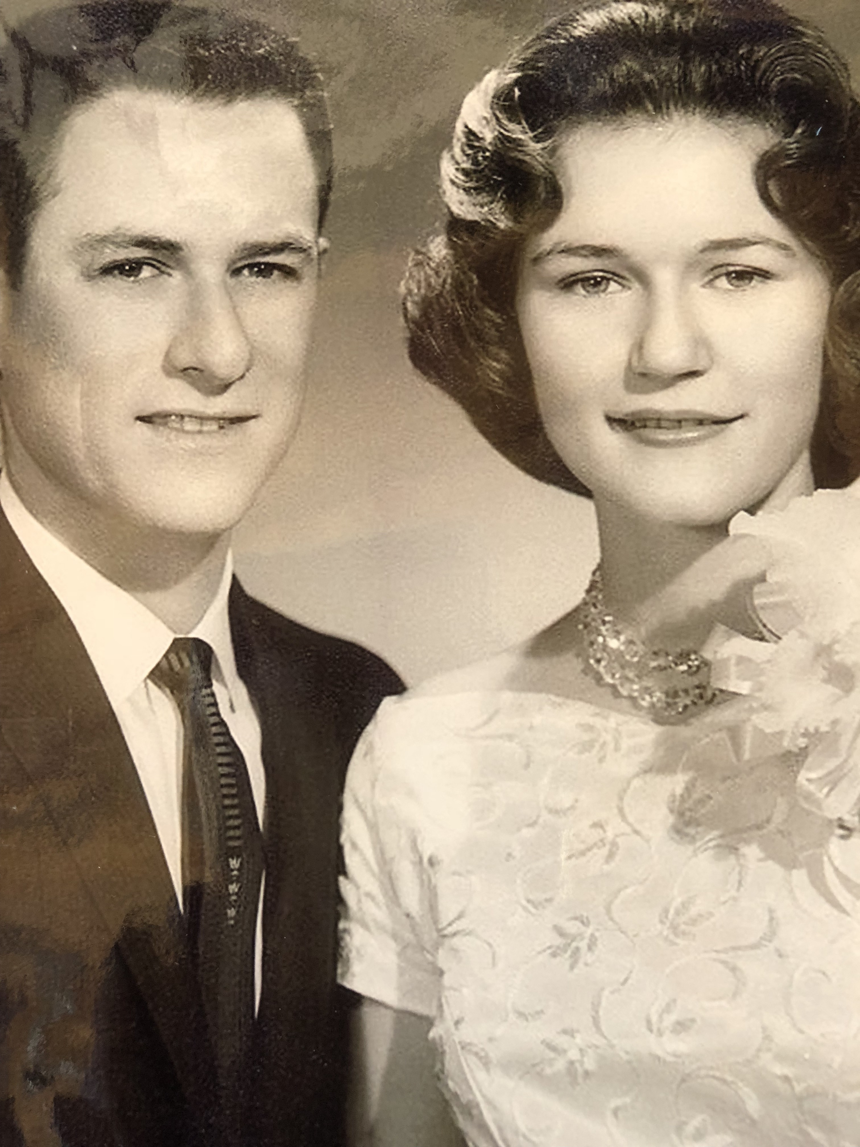
My parents valued education – UCLA, USC, UC Berkeley

Slide 5
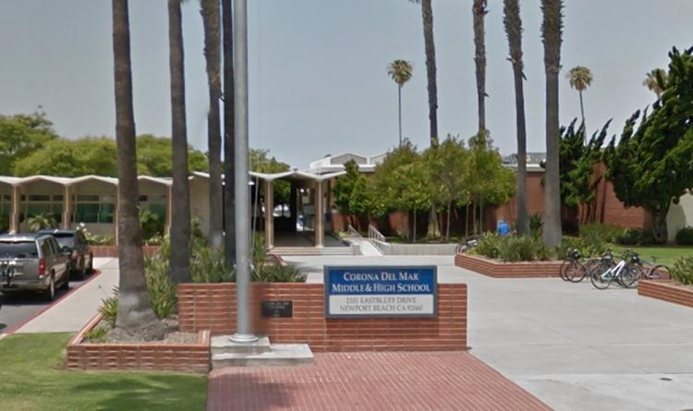
High school - Corona del Mar

Slide 6
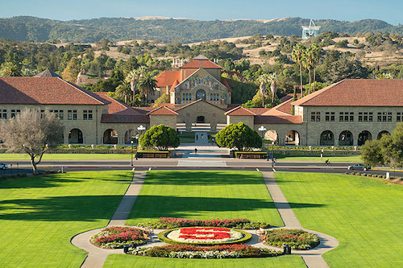
Stanford University Studied International Relations & Economics

Slide 7
After college

Slide 9
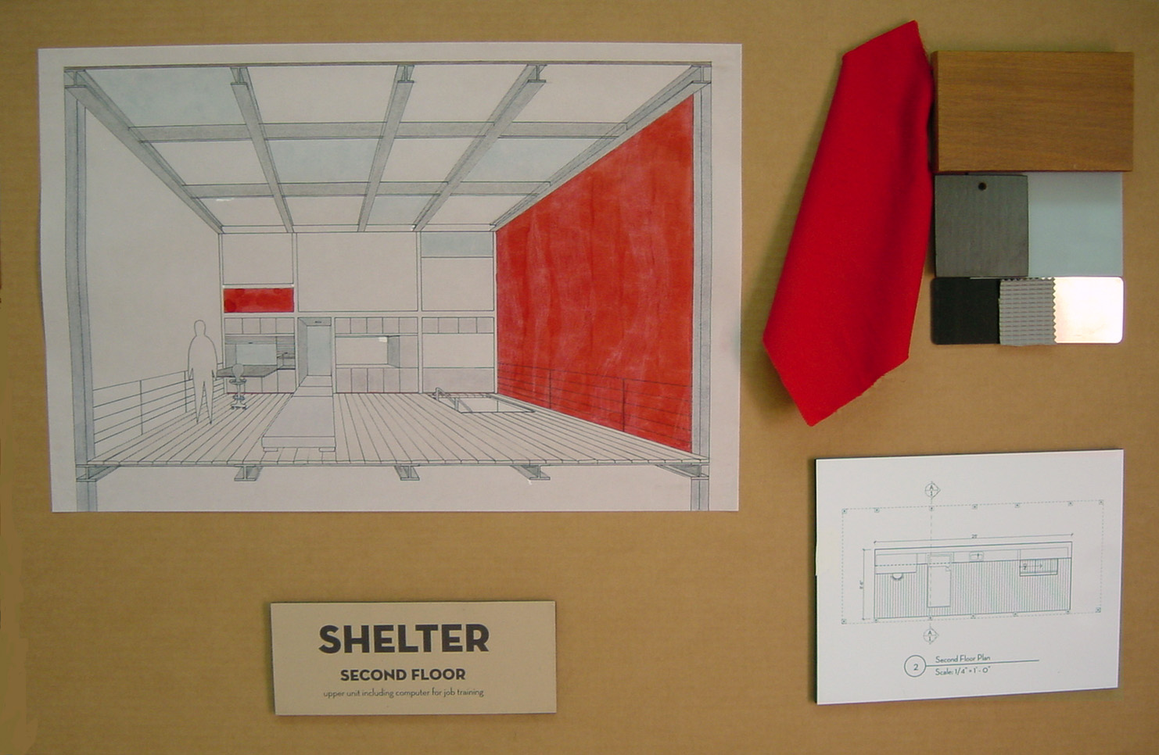
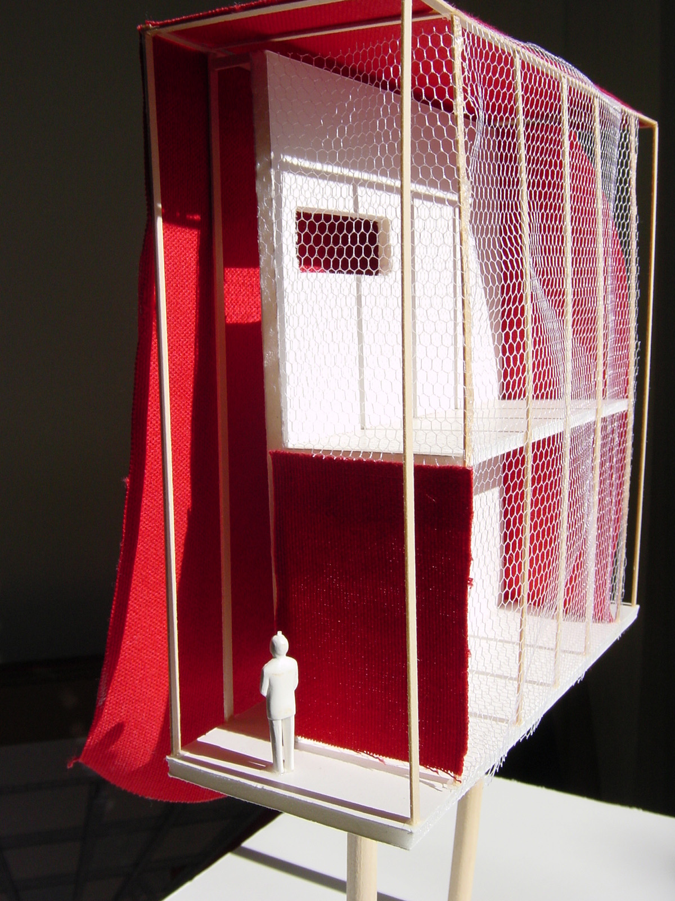
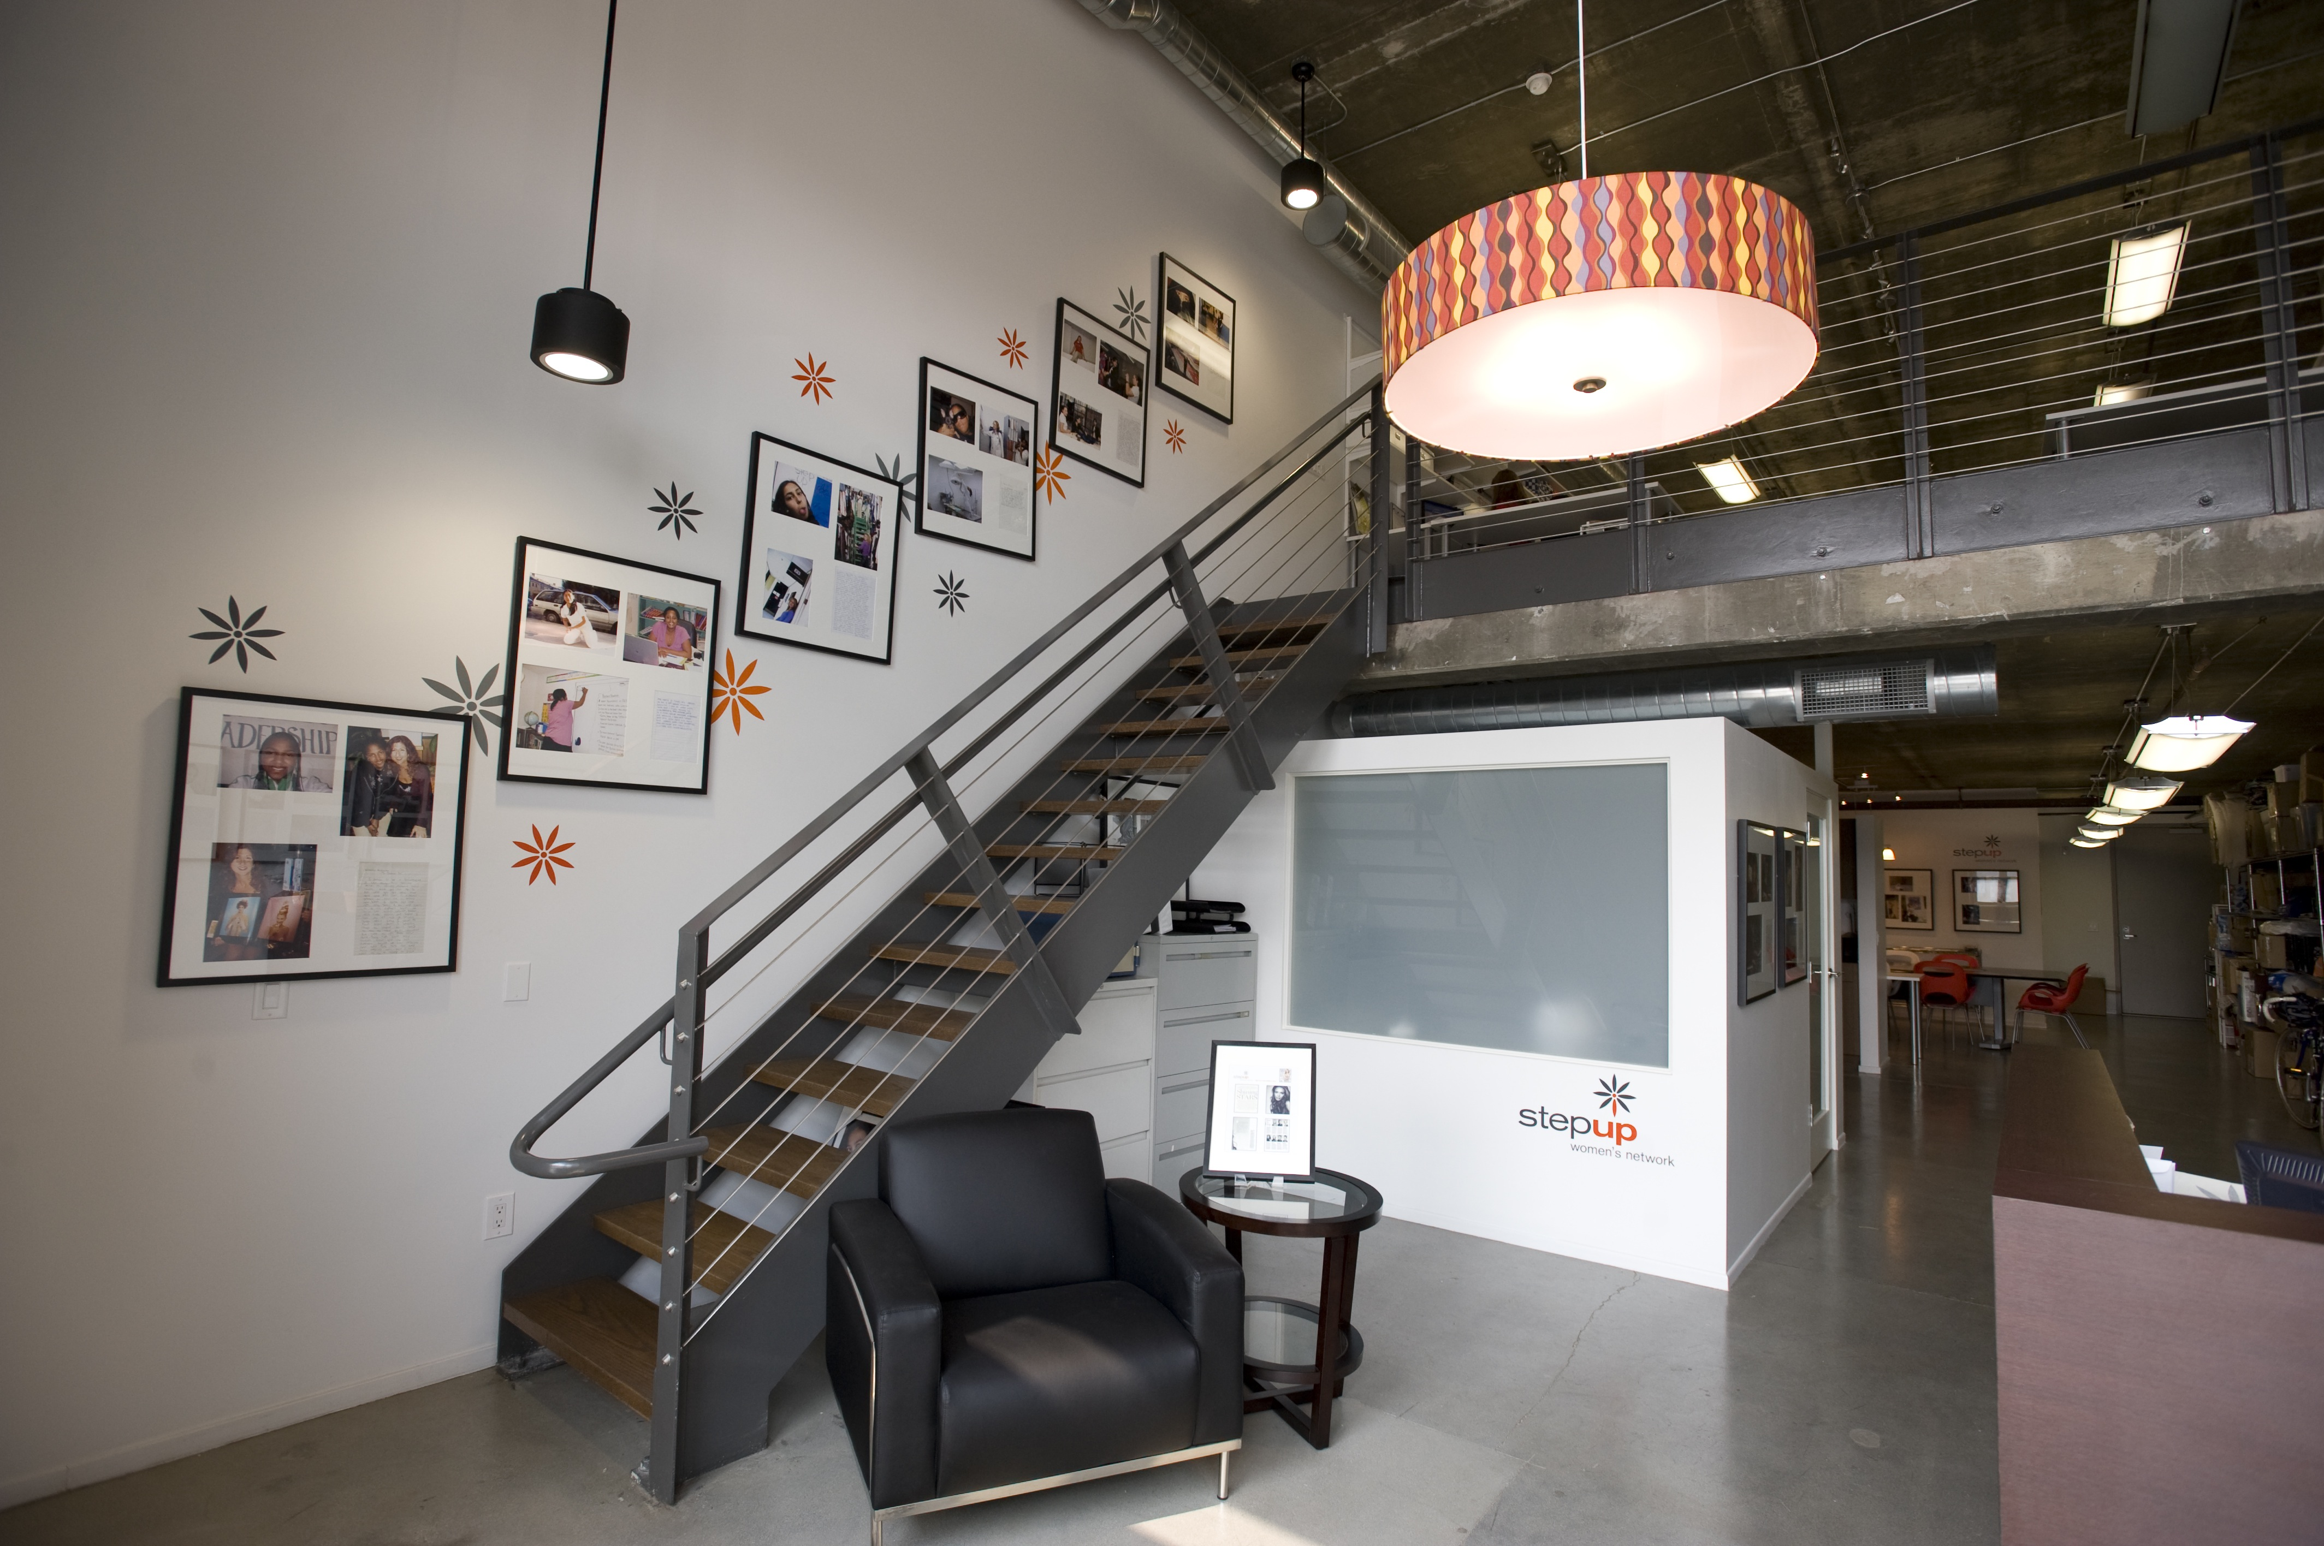
Interior Design Nonprofit’s offices; Shelter won scholarship; UCLA Extension Interior Design & Architecture

Slide 10
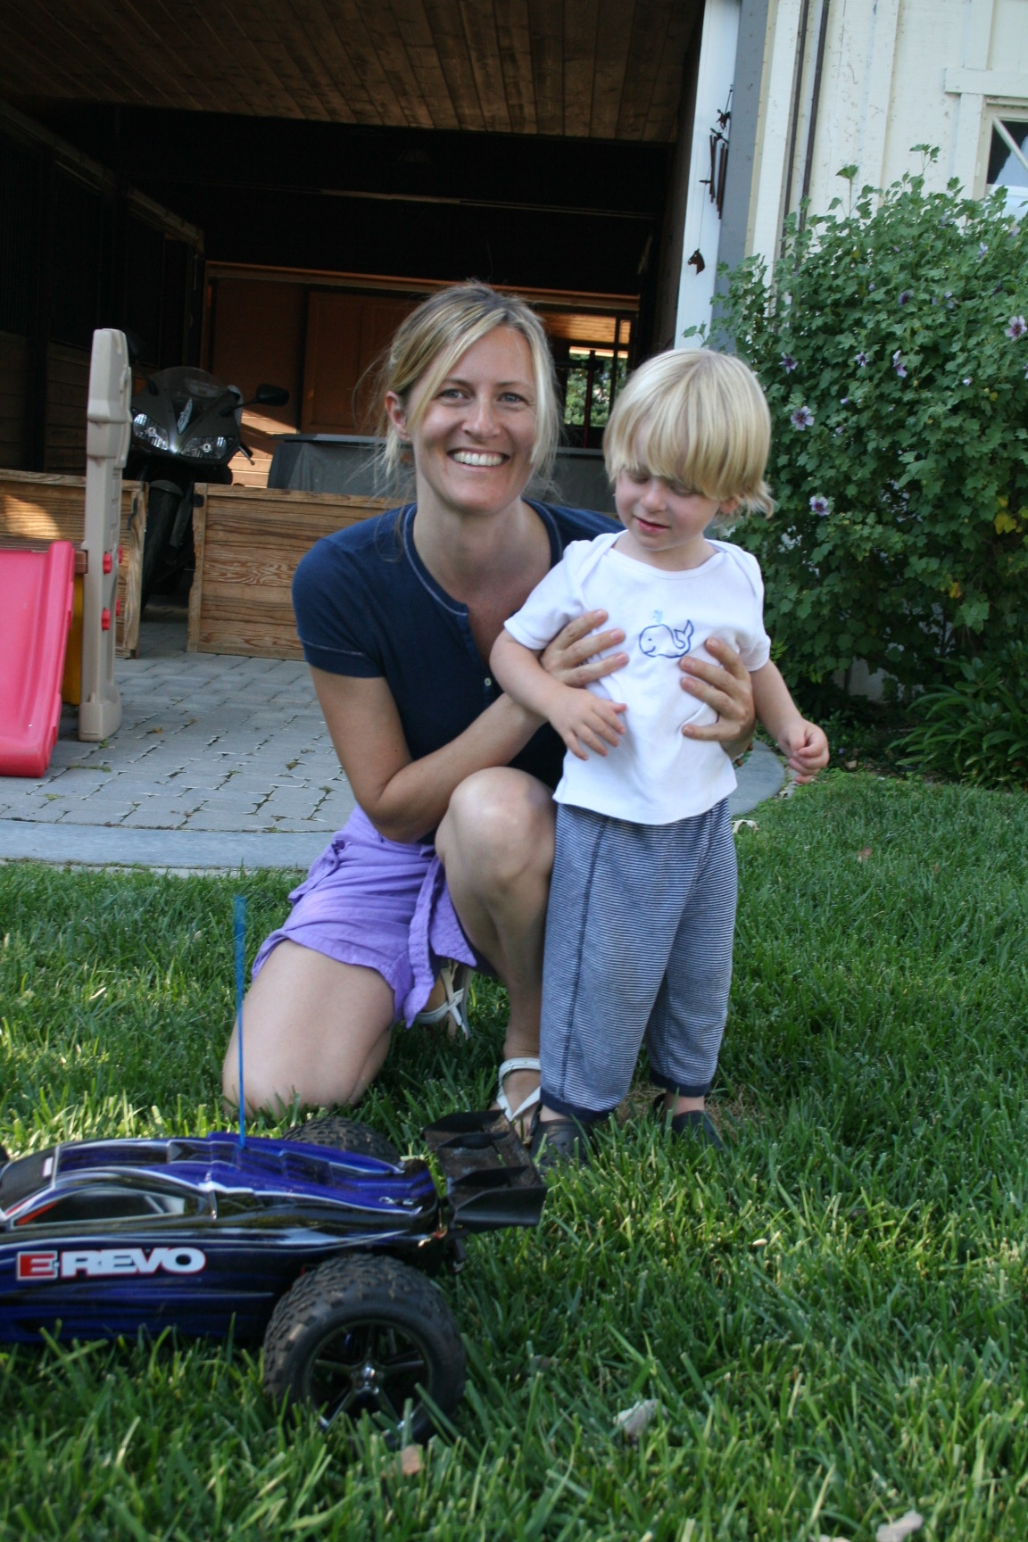
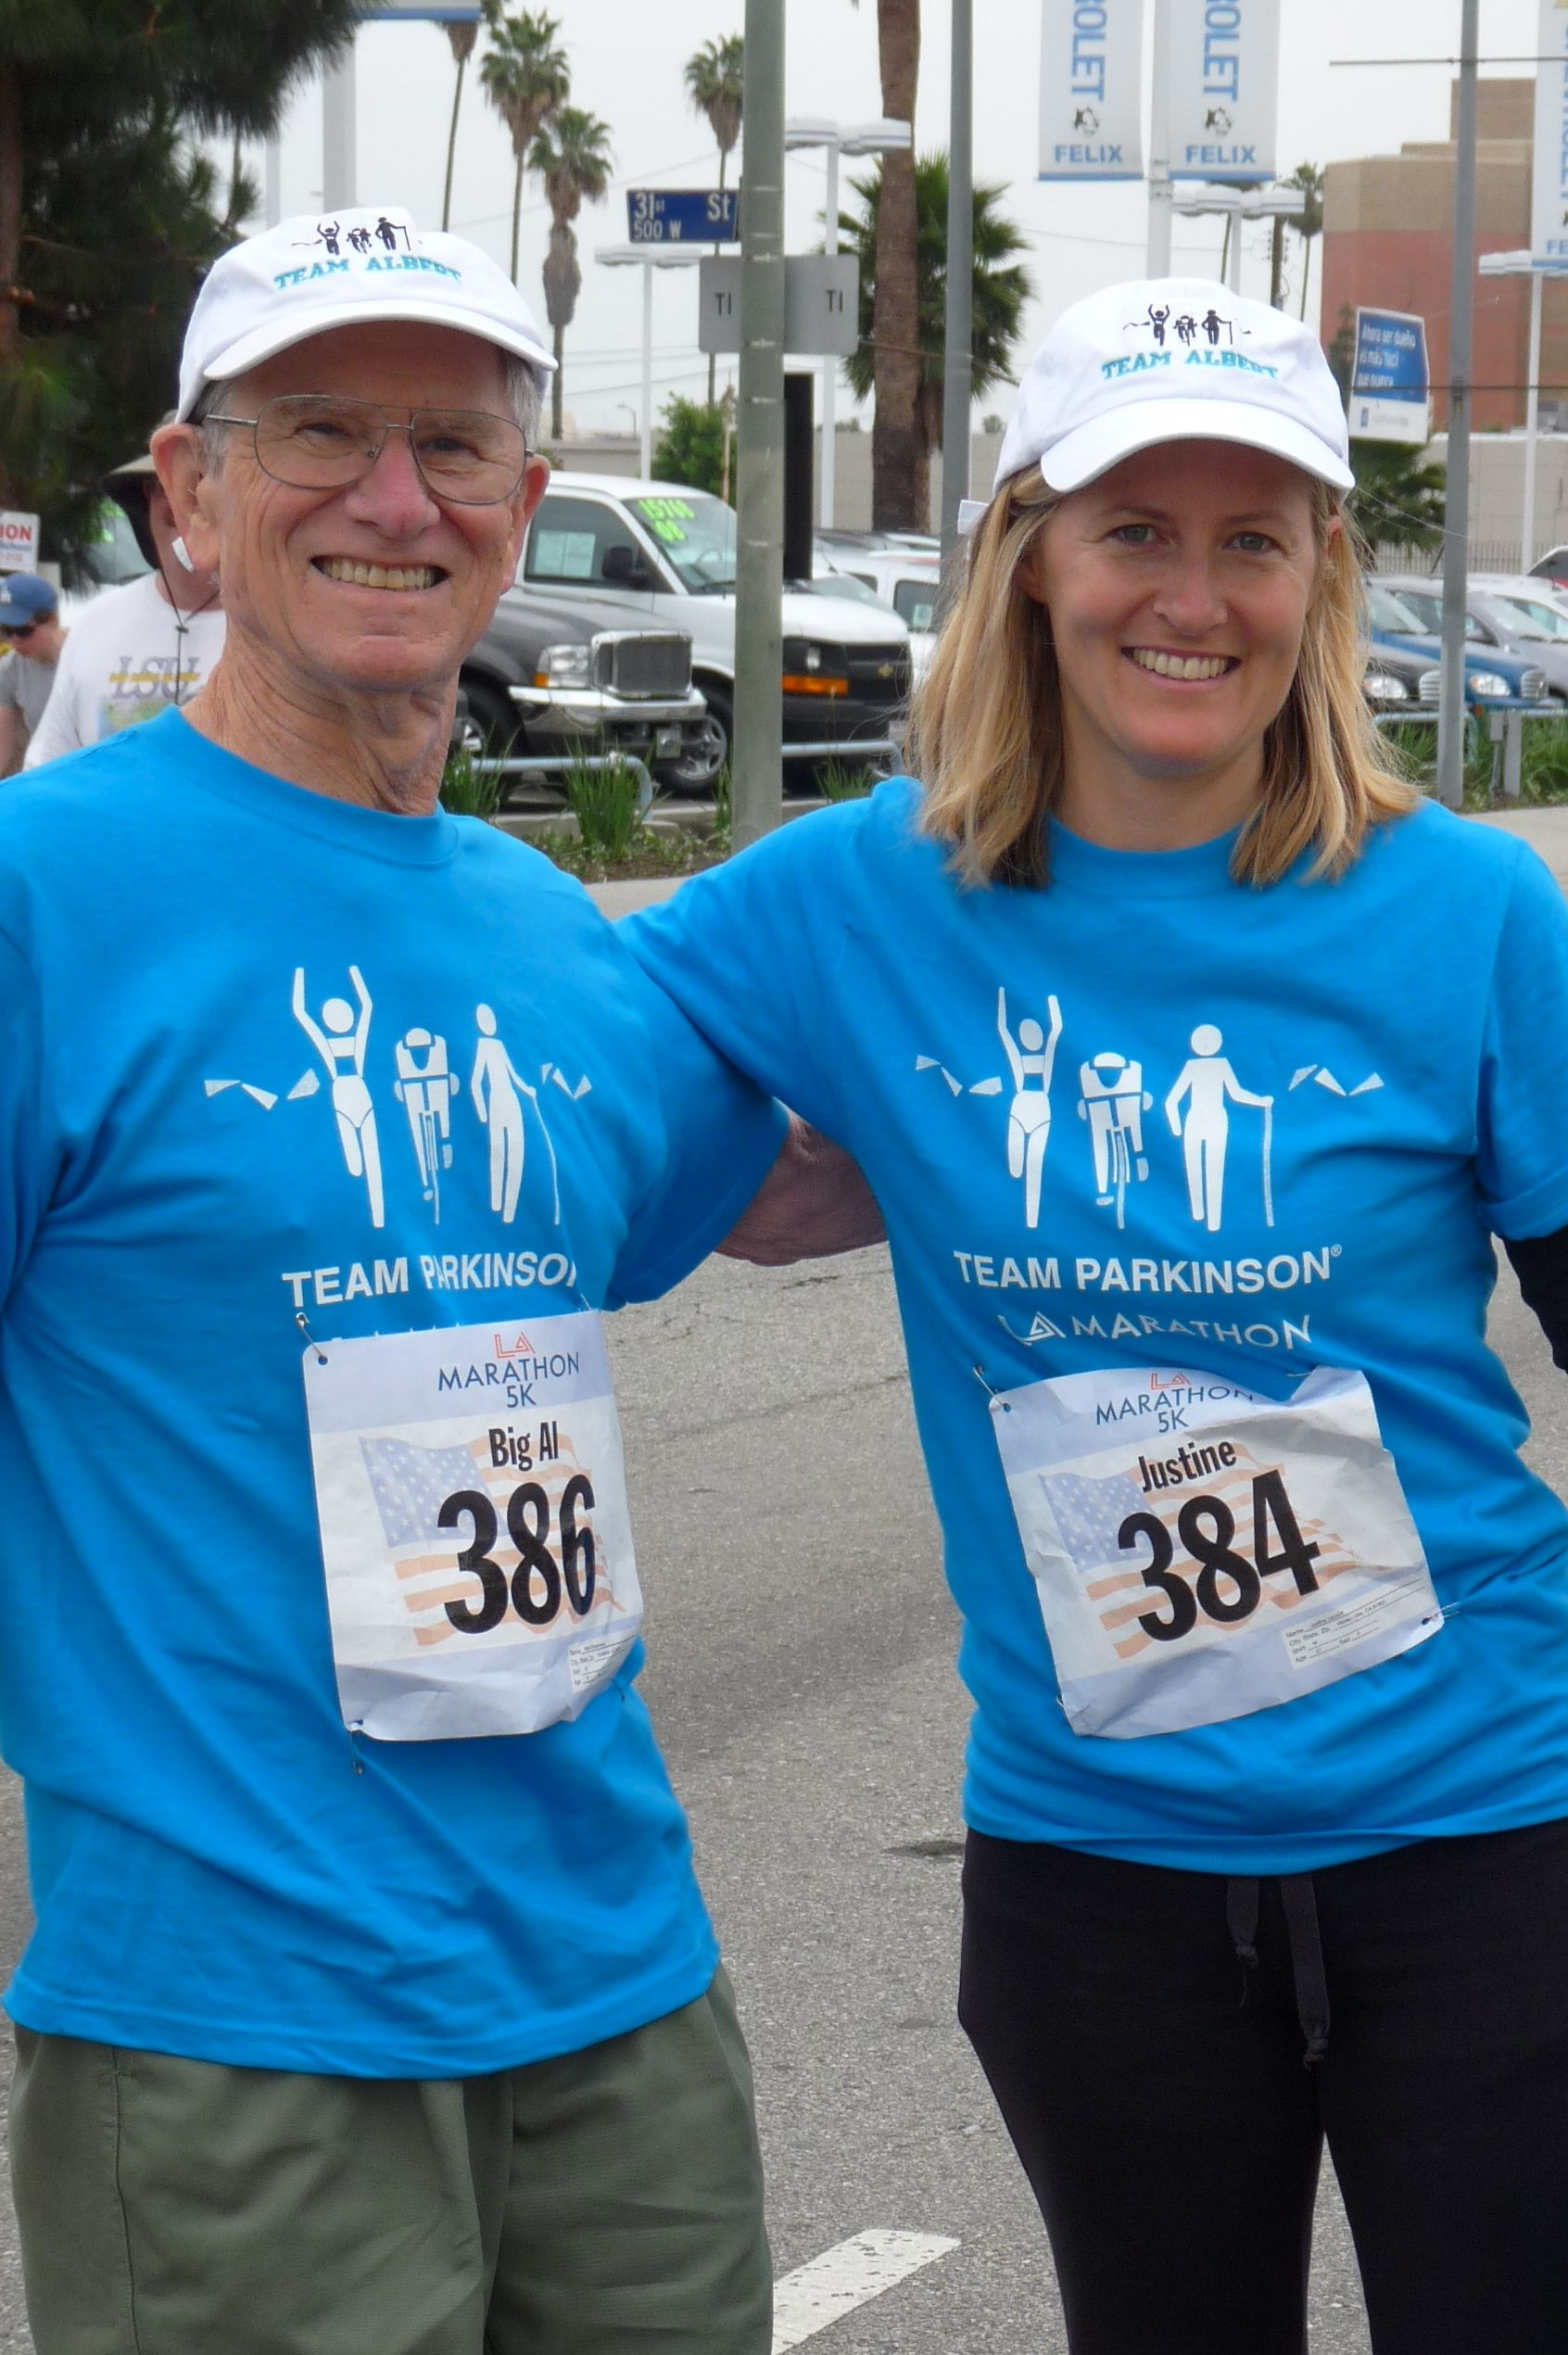
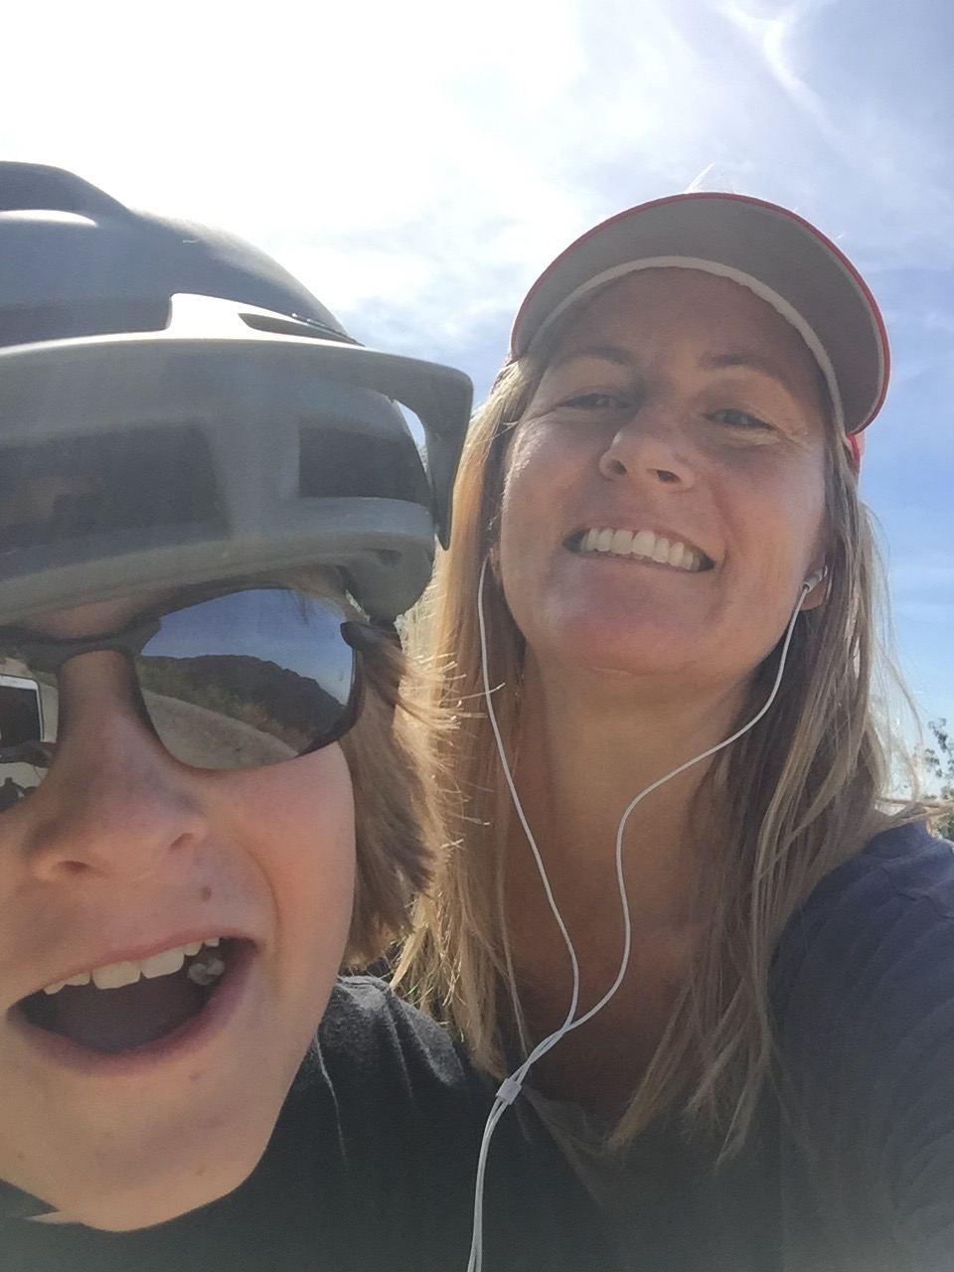
Had my son, dad got sick, survived cancer

Slide 11
Giving Back

Slide 12
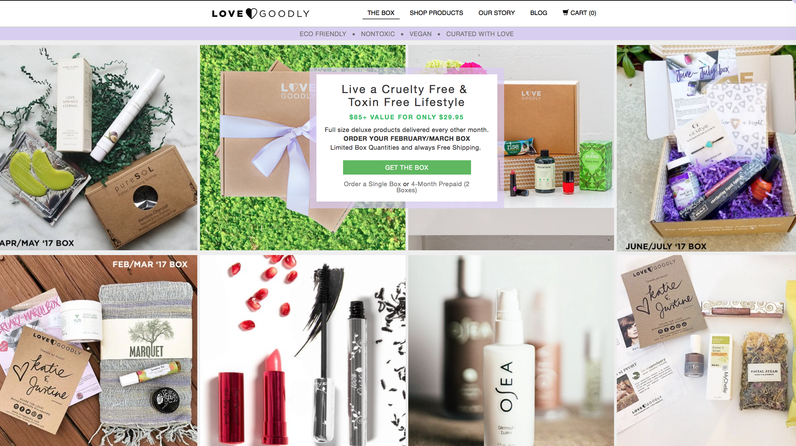
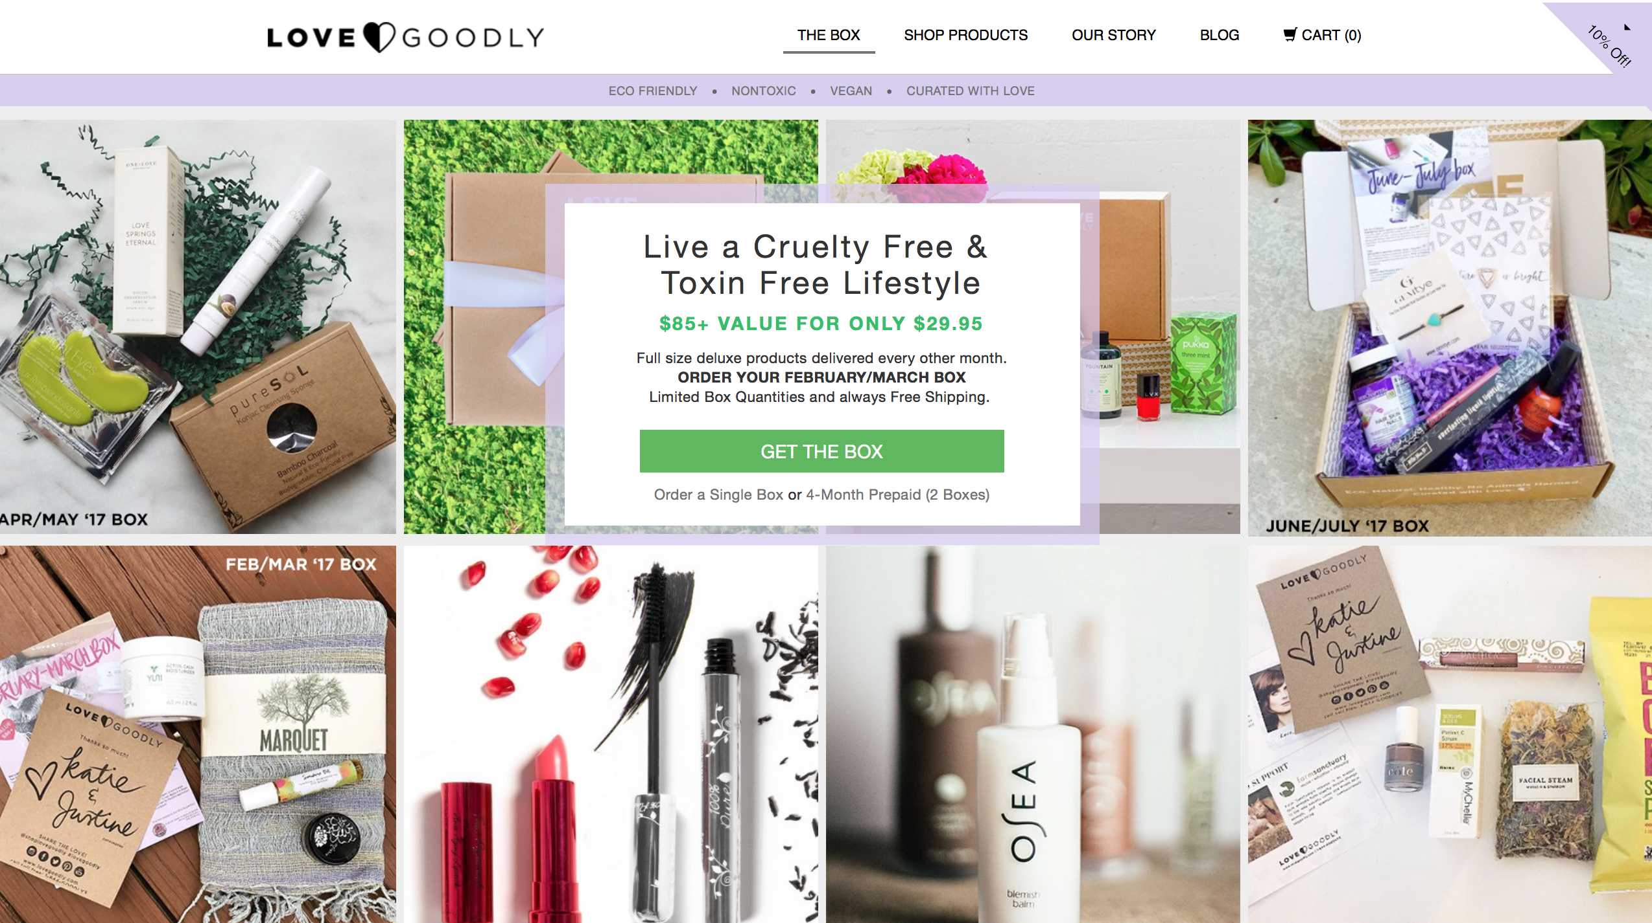

Slide 13
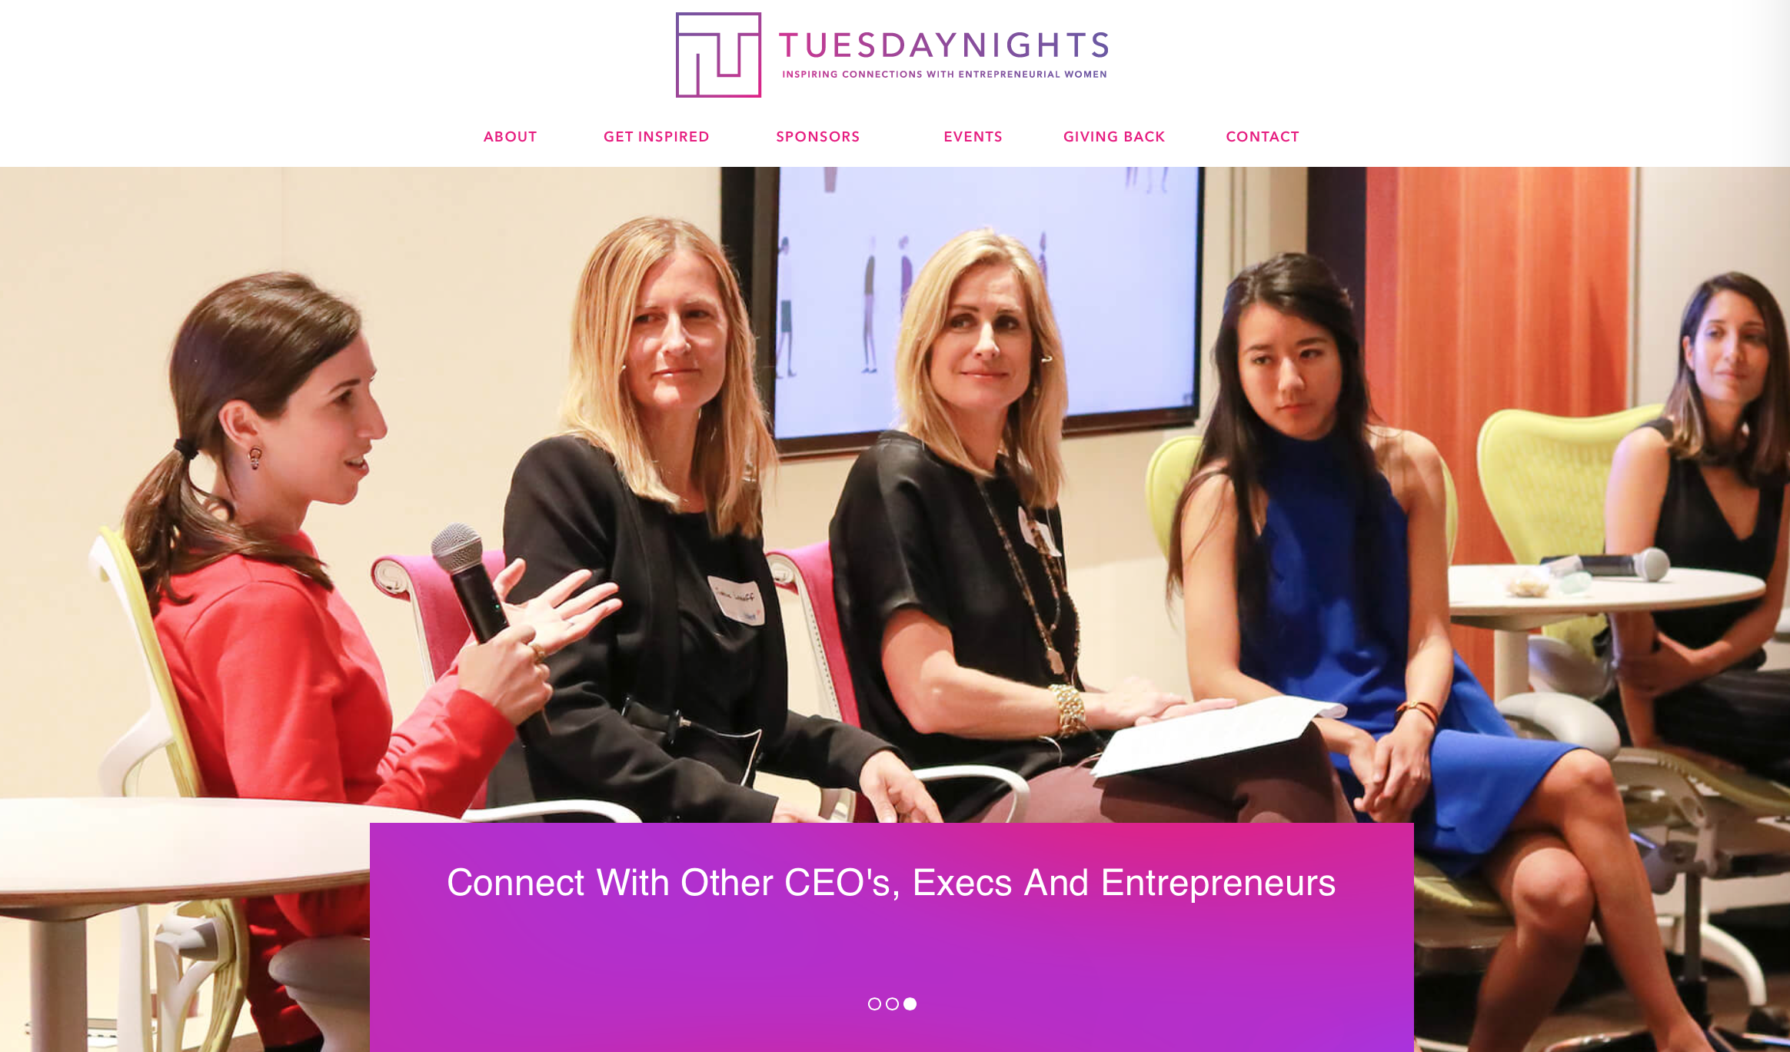

Slide 14
My advice for you: Develop your passion now Follow your passion Reach for the stars Find mentors Ask people for help Join organizations Do your homework / studies Believe in yourself Do not get distracted Be kind Help others Give back

Slide 15
Activity – Start a Social Good Enterprise

Slide 16
1. Come up with a for profit social enterprise 2. Give your company a name 3. How does it make money? 4. One sentence on what it does and why (elevator pitch) 5. Sketch a quick logo 6. Present to the class
Activity – Start a Social Good Enterprise

Slide 17
Justine Lassoff https://www.linkedin.com/in/justinelassoff/ julassoff@gmail.com

