Slide 1
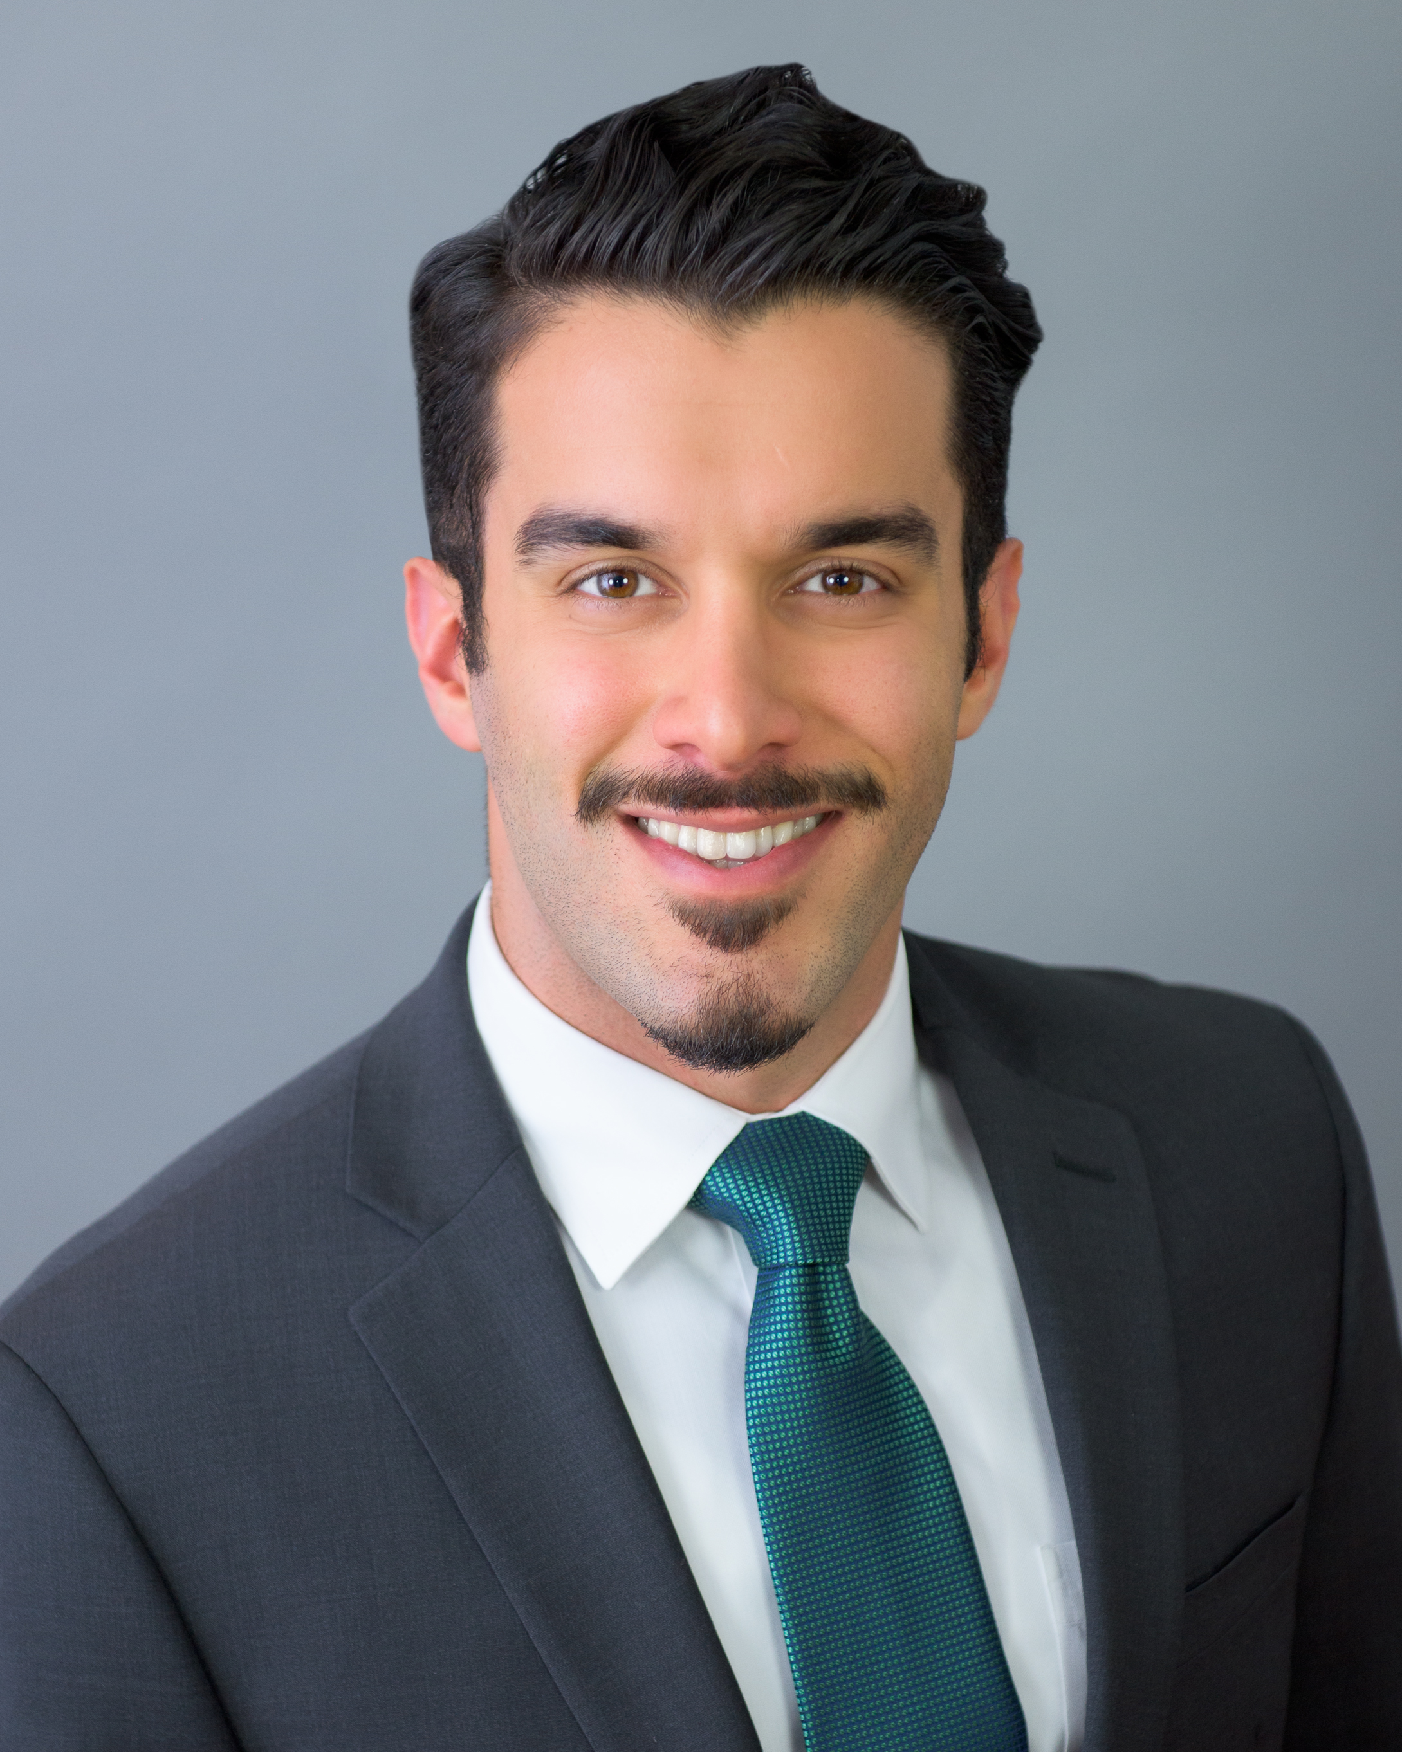

Amirali Ghasemipour:
My Life & Career
Downtown Magnets high school
February 5th, 2018

Slide 2
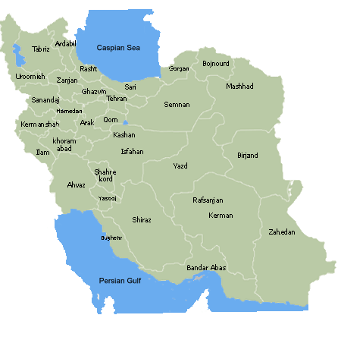
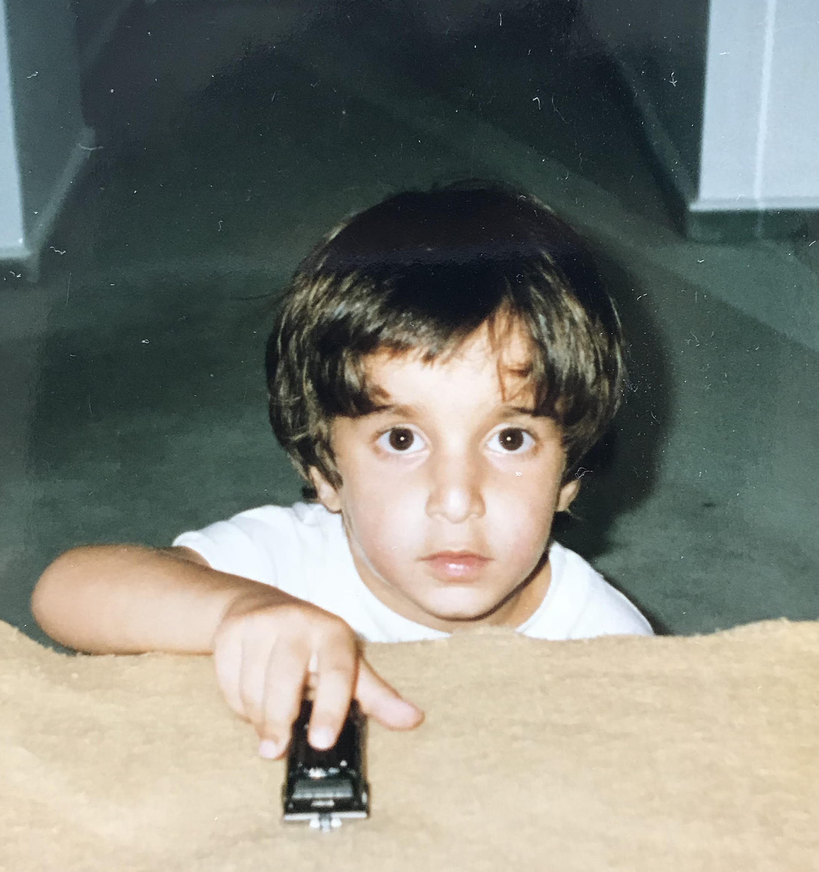

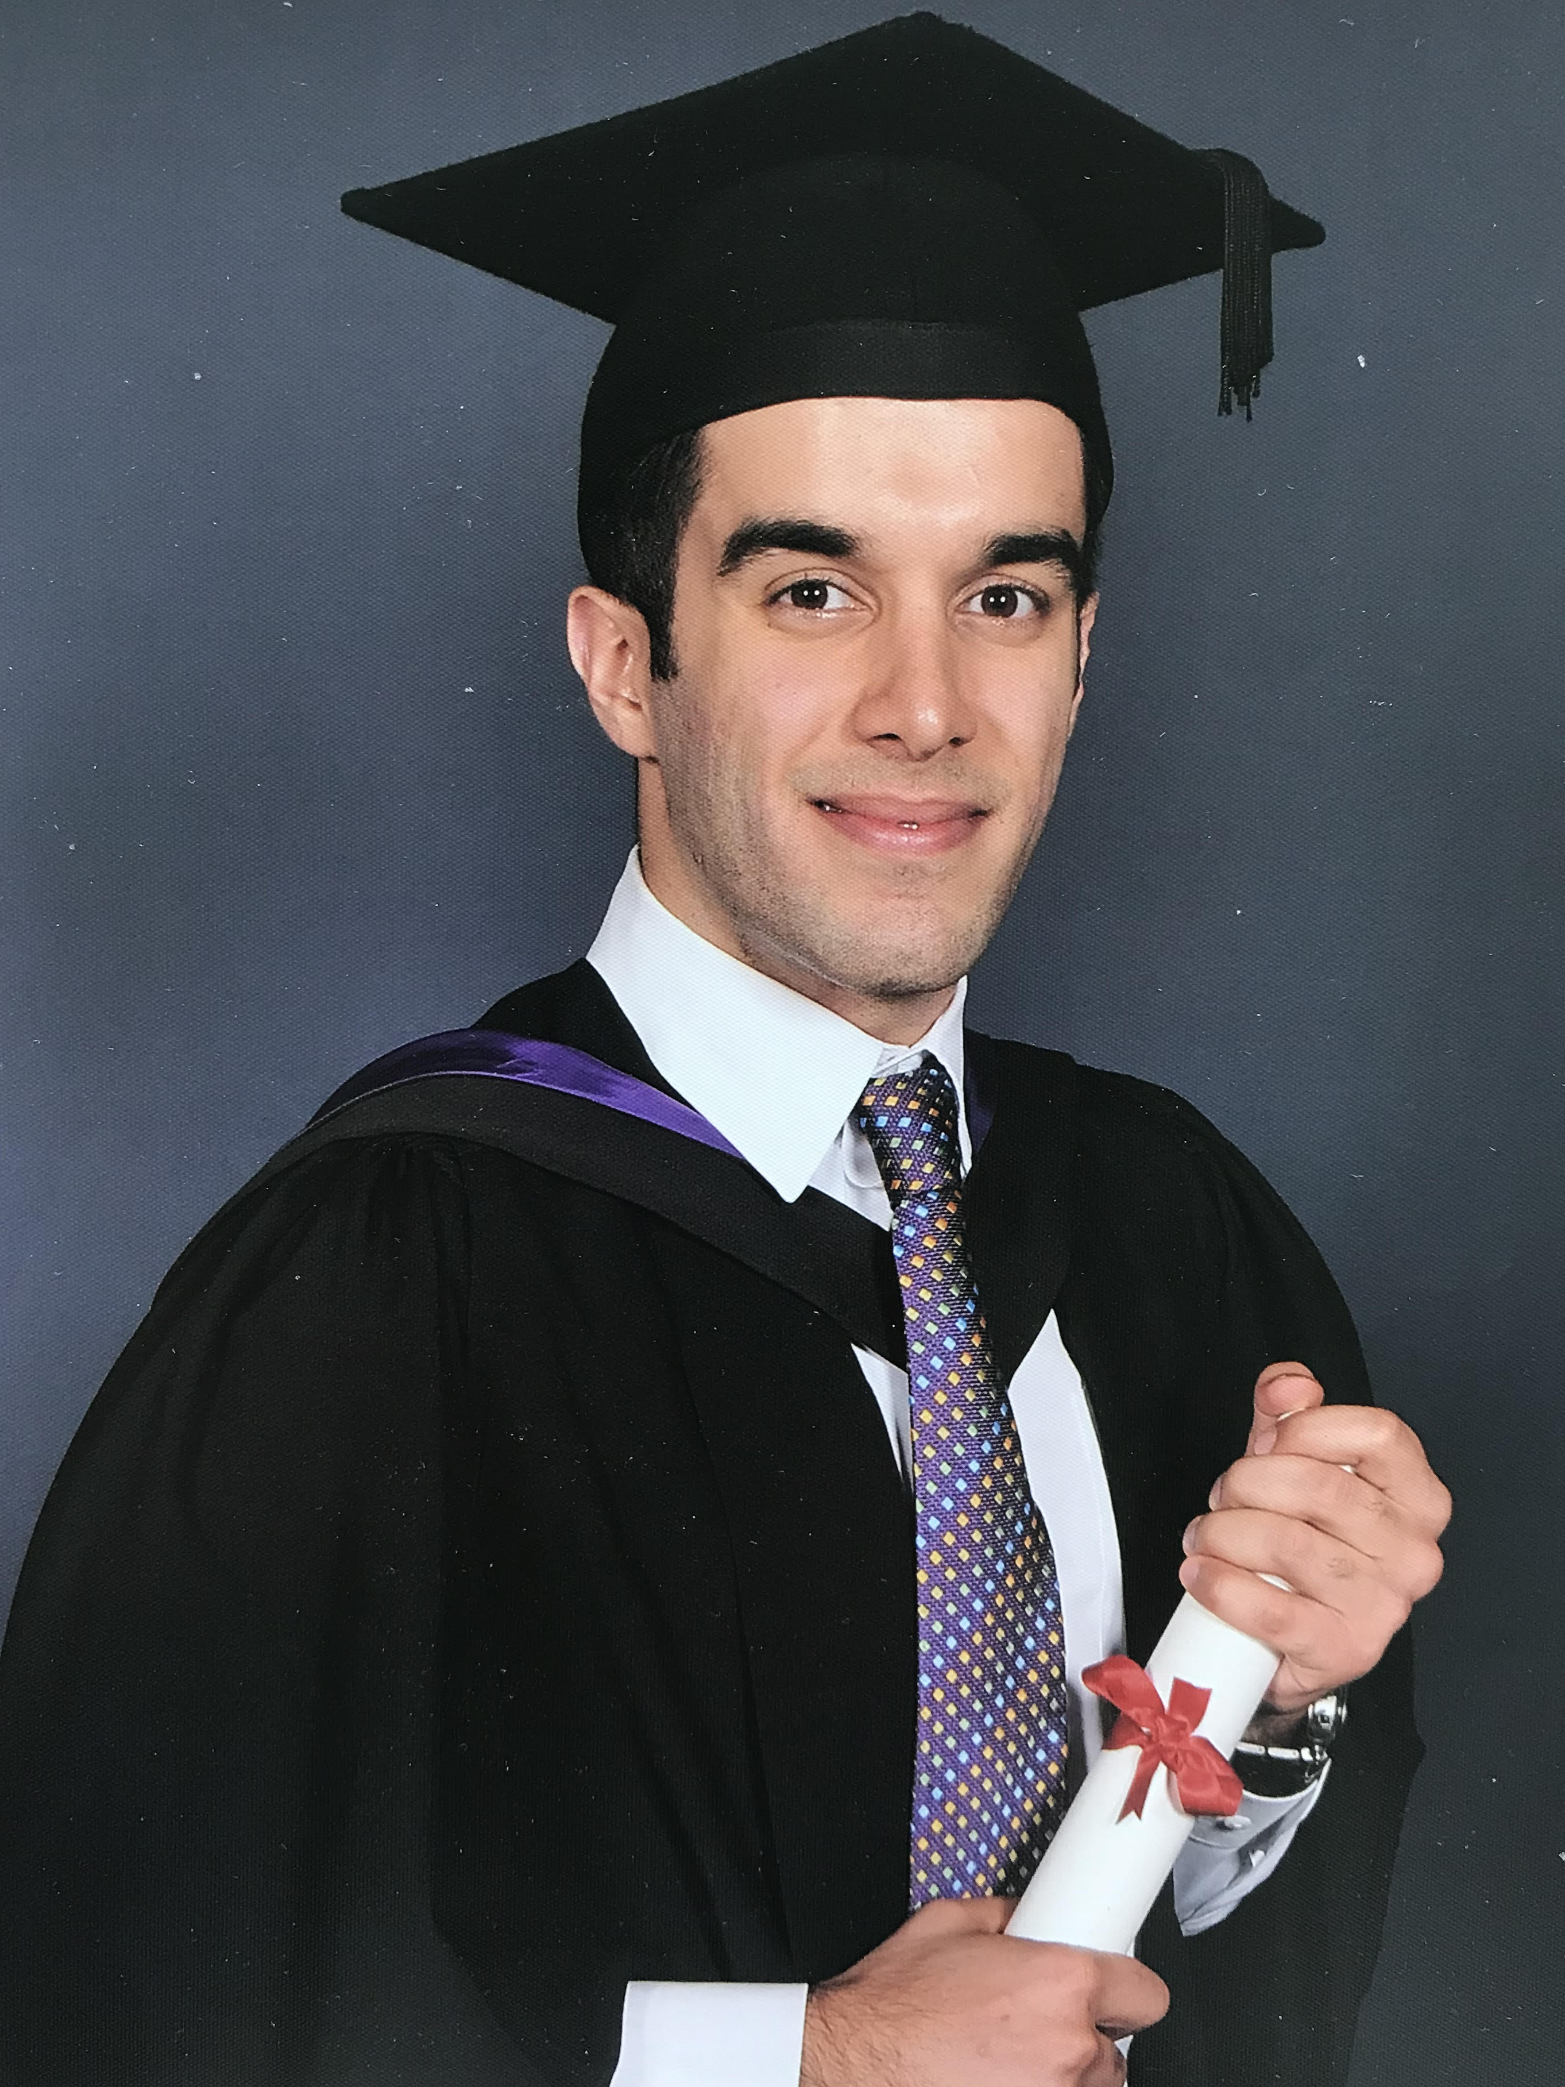
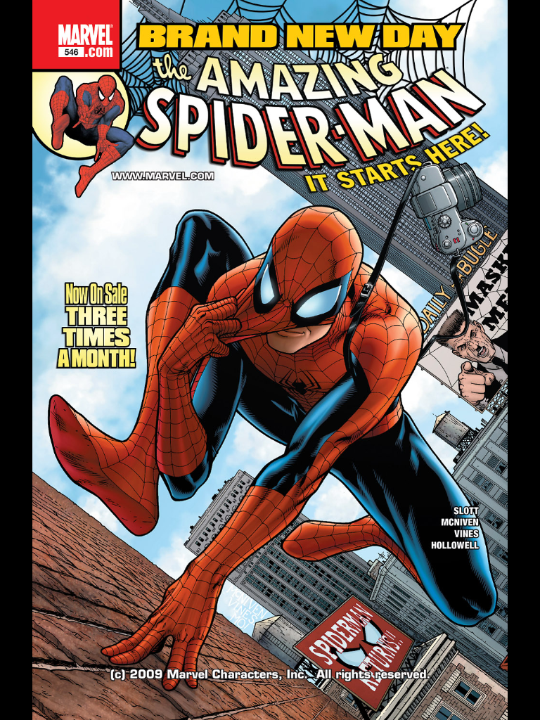
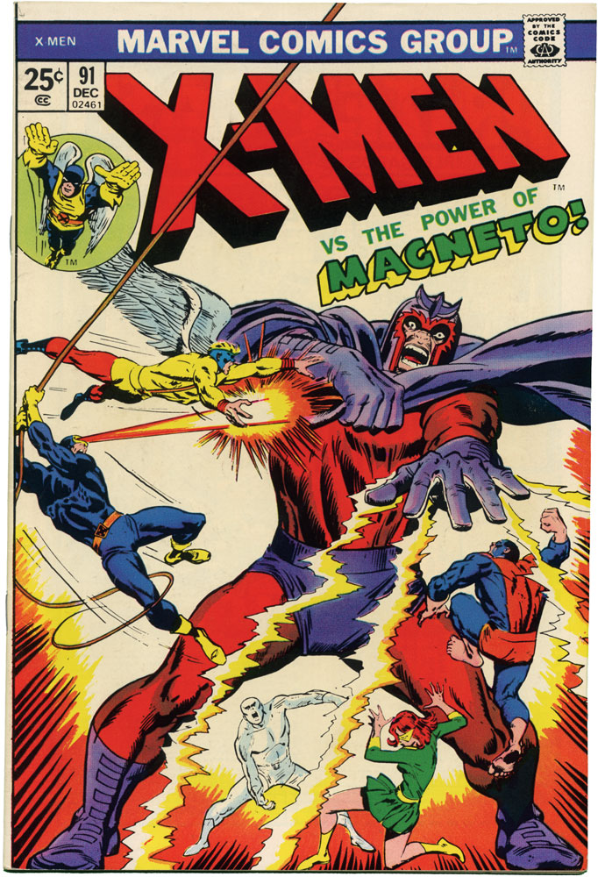
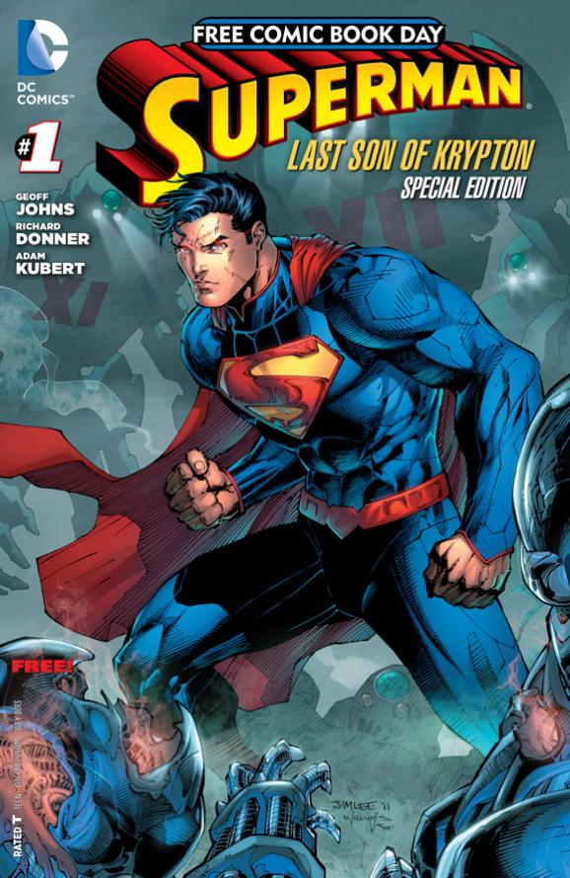

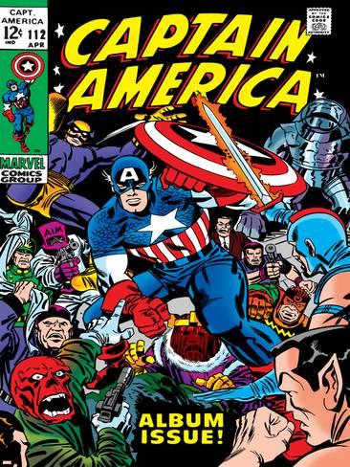



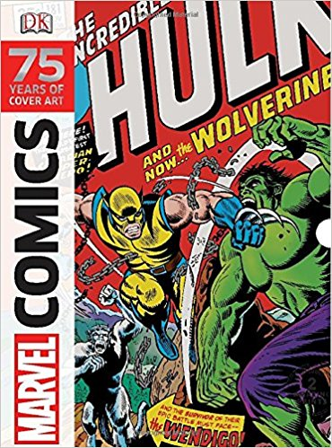
About Me
Born in Tehran, Iran
Moved to London, UK
Bachelor’s in Chemical Engineering
Passionate about Music Production
Passionate about cooking
Passionate about the nature & environment
Love movies & comic books

Slide 3

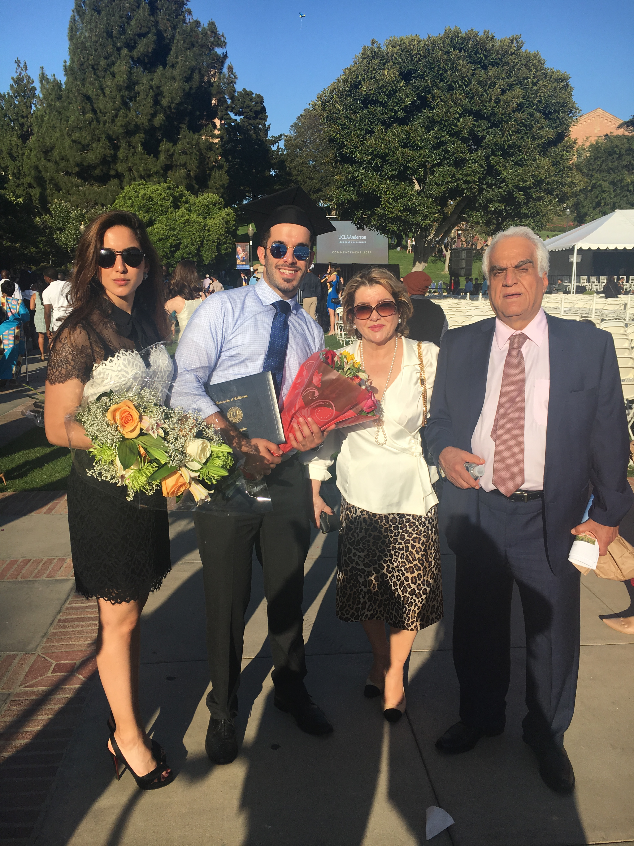
My Family
I am 28 (almost 29!) years old.
I moved to L.A. 6 years ago and now I live in Hollywood, about 15 minutes from Downtown L.A.
My parents live in a different country.
I have one sister who lives in Boston and two step siblings.

Slide 4



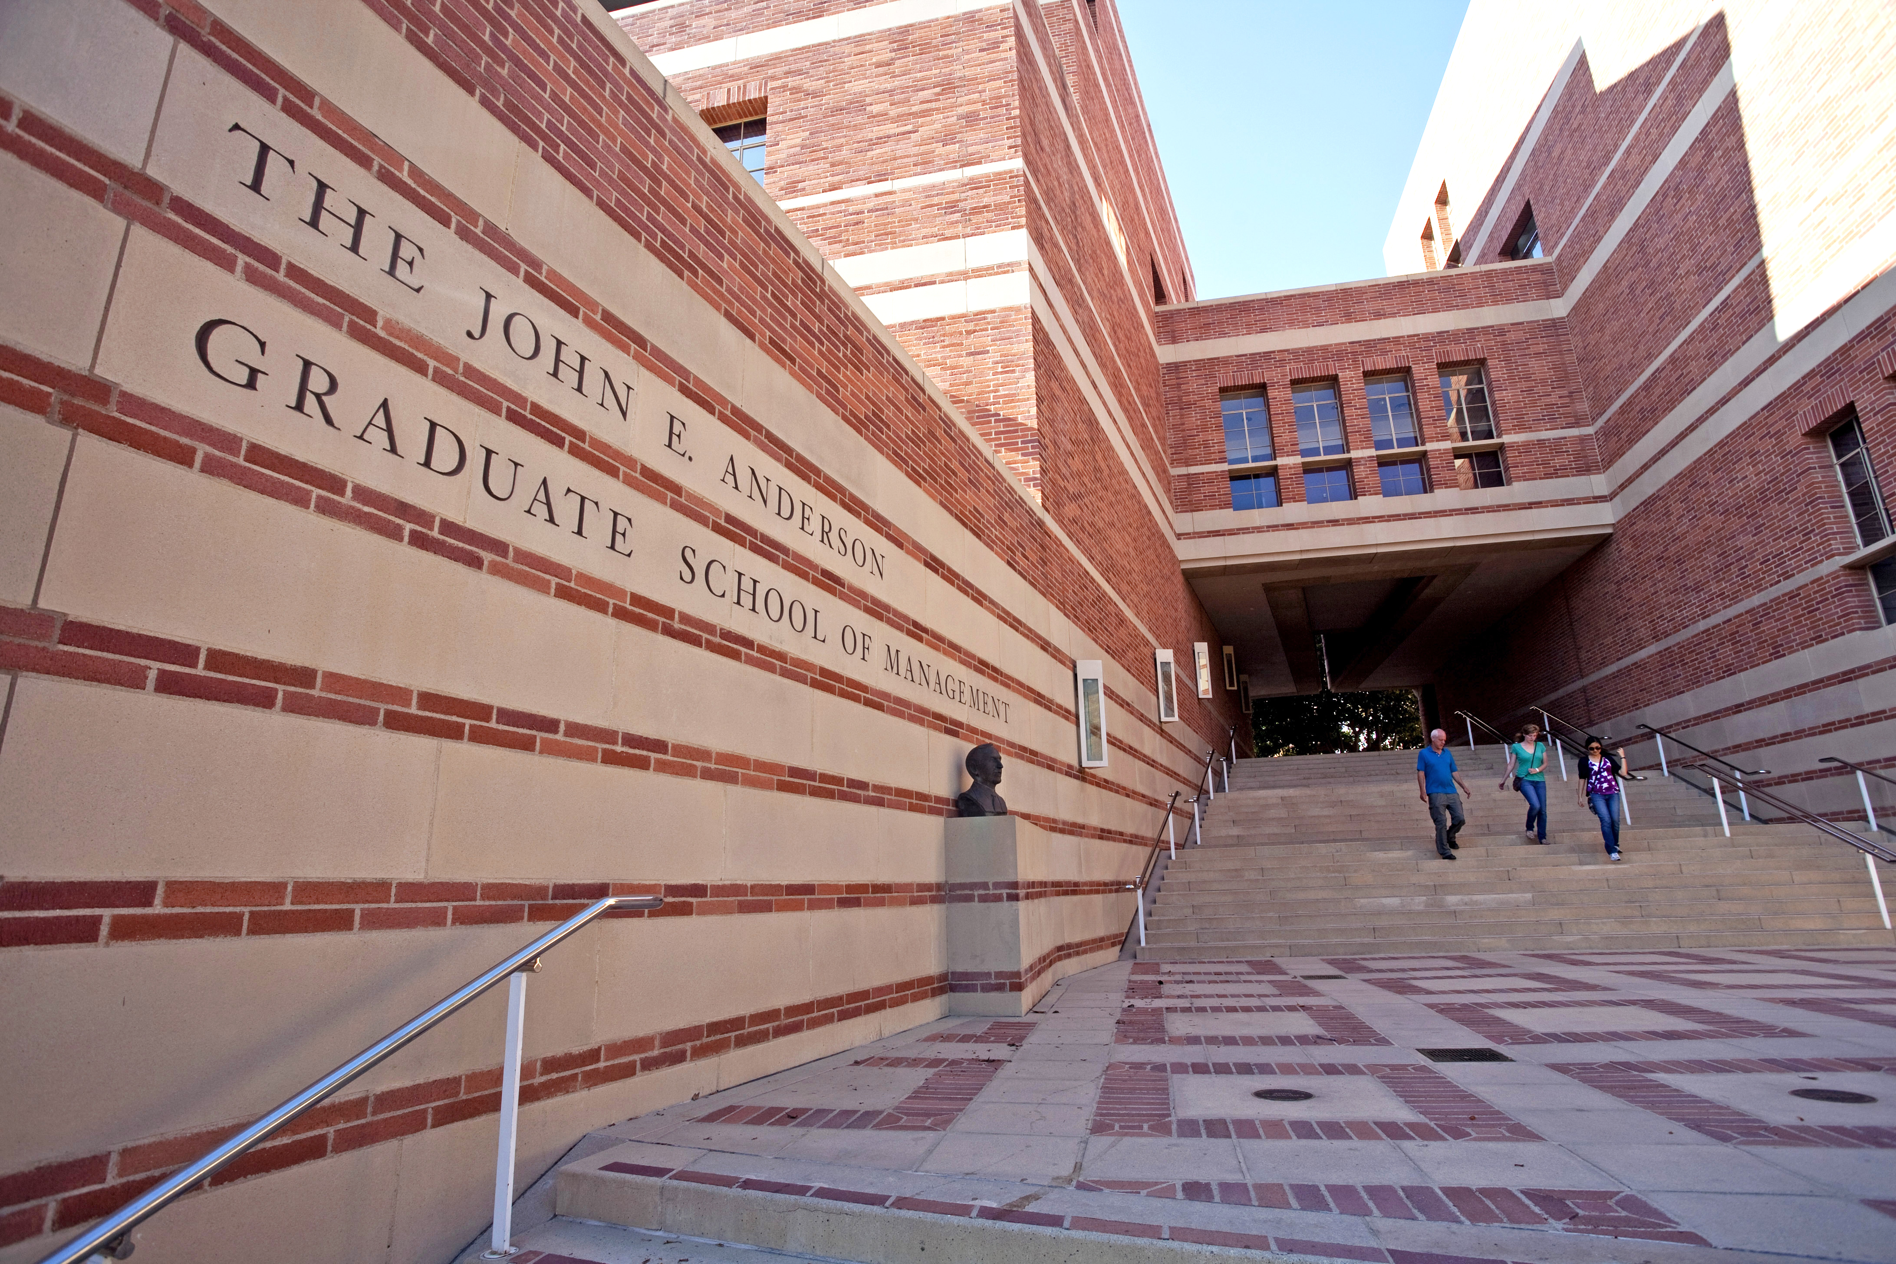
What I do…
Moved to Los Angeles, CA
Got accepted to UCLA Anderson School of Management
Joined Alvarez & Marsal and began a career in
Management Consulting…

Slide 5

What is Management Consulting?
So…

Slide 6


Slide 7


Management Consultants…
What……
How……
Provide a service
Work with leaders of a company
Help find, diagnose, solve problems
Learn about the business
Apply knowledge and experience
Deliver positive change

Slide 8
Now… Let’s put our consulting hats on!

Slide 9
So here is the problem…
Maria's donut shop is located in Burbank and sells three varieties of donut.
  Double Chocolate
  Strawberry Jelly
  Vanilla Cream
  Each donut is $1
  Last year Maria’s shop made $30,000
Uncle Bob’s donut shop B is located in Beverly Hills and sells three varieties of donut.
  Double Chocolate
  Strawberry Jelly
  Salted Caramel
  Each donut is $3
  Last year Uncle Bob’s shop made $18,000
Why?

Slide 10
Questions to ask…
Which flavors are the most popular?
What do customers say about the shop and the customer service?
What is the population of Burbank and Beverly Hills?
Are there other donut shops in Beverly Hills?
How much does it cost to make one donut in Burbank and in Beverly Hills?
Turns out….
Maria’s neighborhood has a higher population → Higher number of customer visits
Vanilla Cream is the most popular flavor in all of LA
People in Beverly Hills like more healthier options, like... gluten-free vegan kale cookies
Maria’s donut shop can make donuts for less money than Uncle Bob’s

Slide 11
Keys to success in Management Consulting…
“Talent wins games, but teamwork wins championships.” – Andrew Carnegie
“We have two ears and one mouth so that we can listen twice as much as we speak.” – Epictetus
“The single biggest problem in communication is the illusion that it has taken place.”– George Bernard Shaw

Slide 12
Keys to success in Management Consulting…
Teamwork
Fresh Thinking
Communication
Love collaborating
Make compromise
Set aside your ego
Don’t take anything personally
Don’t be afraid to ask for help
Be a good listener
Think outside the box
Don’t overcomplicate the problem
Always stay up-to-date
Be smart with your short-cuts
Know your audience
Don’t assume…
Be organized and concise
Be persuasive
Be a “People’s Person”
Practice… ALWAYS!

Slide 13
Remember…
Don’t EVER underestimate yourself
Think big
Never stop learning

Slide 14

Questions?

